Slide 1
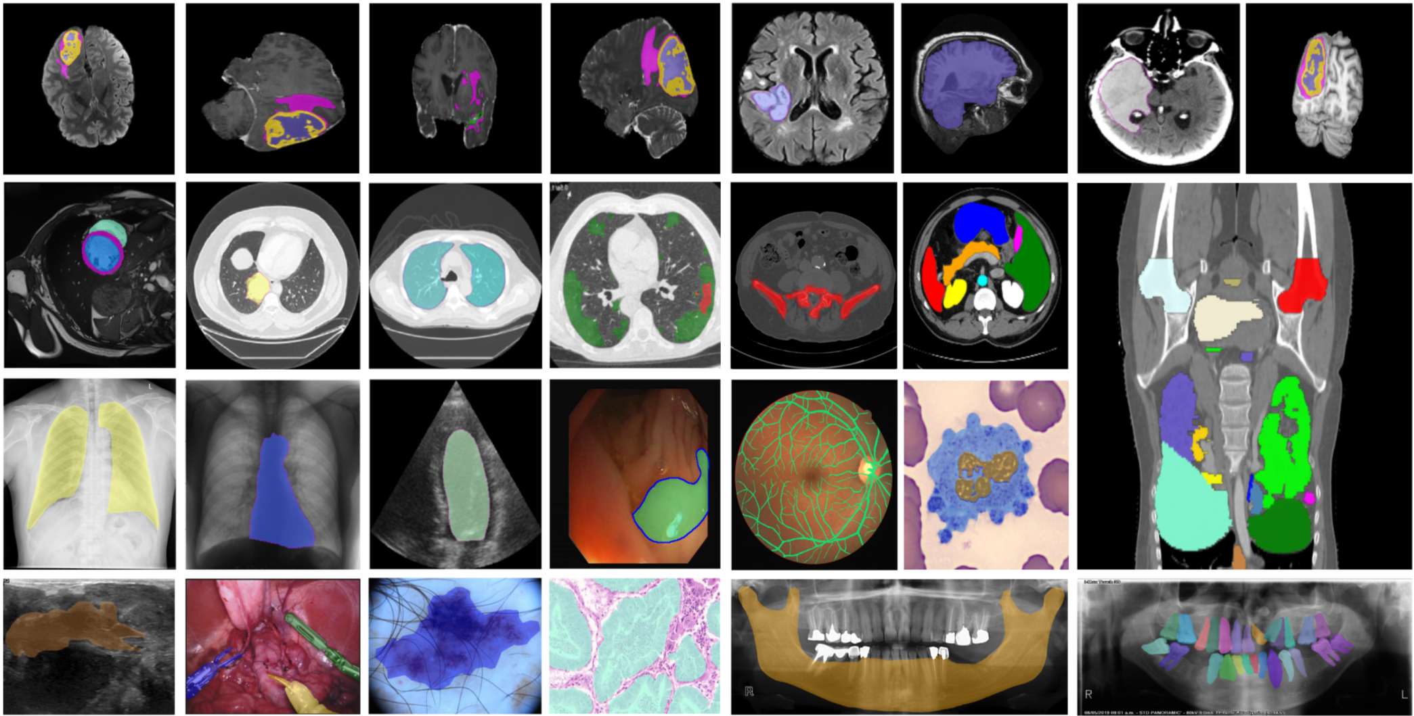
Διπλωματική Εργασία
Placenta Segmentation in MRI with Deep Learning Techniques
Επιβλέπων: Γεώργιος Ματσόπουλος, Καθηγητής, ΕΜΠ
School of Electrical and Computer Engineering, NTUA
Γρηγόριος Τσένος| ΕΜΠ | 2026

Slide 2
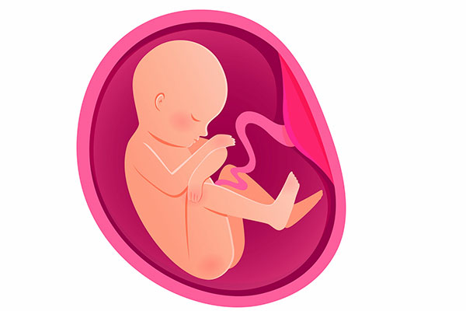
Presentation Outline
01
Introduction & Clinical Motivation
Theoretical Background (MRI, Placenta, Metrics
Deep Learning Architectures (CNN, Transformers, Mamba)
Experimental Protocol (Data, Preprocessing, Training)
Results (Quantitative, Qualitative, Timing)
Conclusions & Future Work

Slide 3
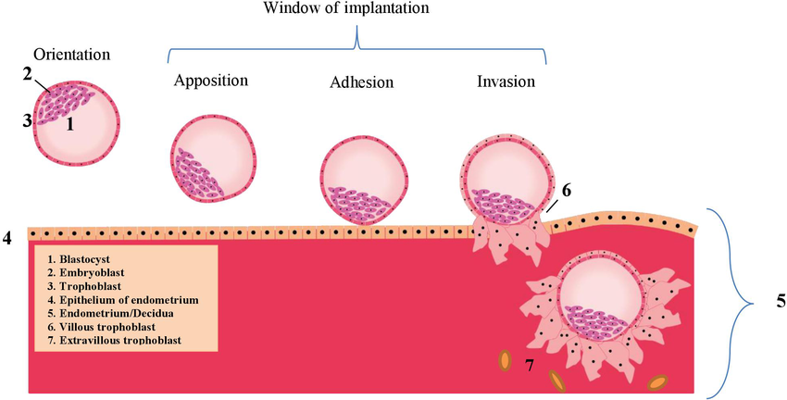
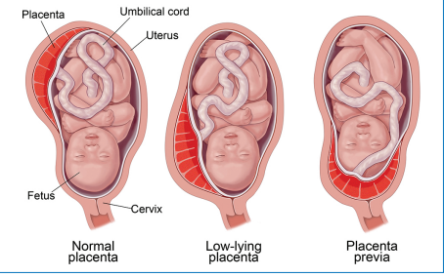
The Placenta and Clinical Significance
02
Development: from trophoblast of blastocyst (~7-12 days post-fertilization)
Critical organ of pregnancy (maternal-fetal interface)
Functions: Gas exchange, nutrients, endocrine role
Dysfunction linked to complications (preeclampsia, abnormal implantation, miscarriage)
Quantitative assessment (volume, shape) requires accurate segmentation
Manual segmentation: time-consuming, observer-dependent, not scalable

Slide 4
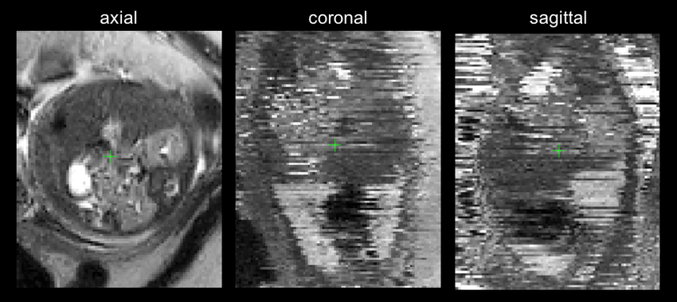
MRI Challenges for Placenta Imaging
03
Advantages: superior soft-tissue contrast, 3D volumetric data, no ionizing radiation
Challenges specific to placental MRI:
Motion artifacts (fetal/maternal movement) -> blurring distortions
Intensity inhomogeneity (bias field) -> same tissue appears with varying intensities
Low boundary contrast between placenta and myometrium
Class imbalance: placenta occupies small foreground volume
Necessitates robust preprocessing and architecture design

Slide 5
Research Objectives & Methodology
04
Primary objective: Systematic comparative evaluation of modern deep learning architectures for 3D placenta segmentation
Key methodological principles:
Unified pipeline (MONAI/PyTorch) for preprocessing, training, inference
Strict standardization of hyperparameters, augmentation, sampling strategy
Fair comparison isolating architectural differences from implementation artifacts
Secondary objective: Identify architectural strengths/weaknesses for placenta-specific challenges
BLACKBOX EXPERIMENTAL FRAMEWORK
Placenta Mask
MRI Images + Masks
Segmentation model
Volume/Morphology Metrics

Slide 6
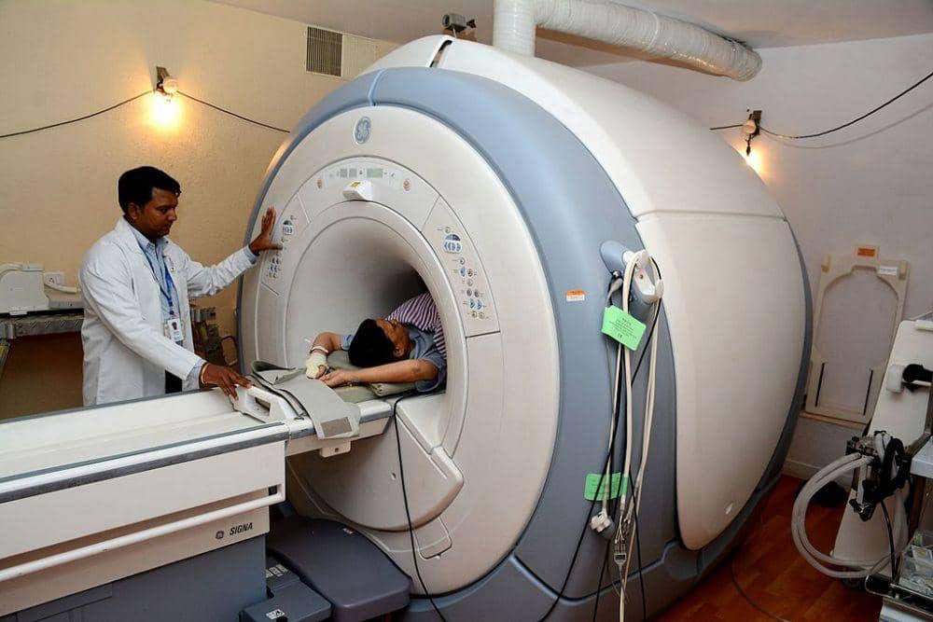
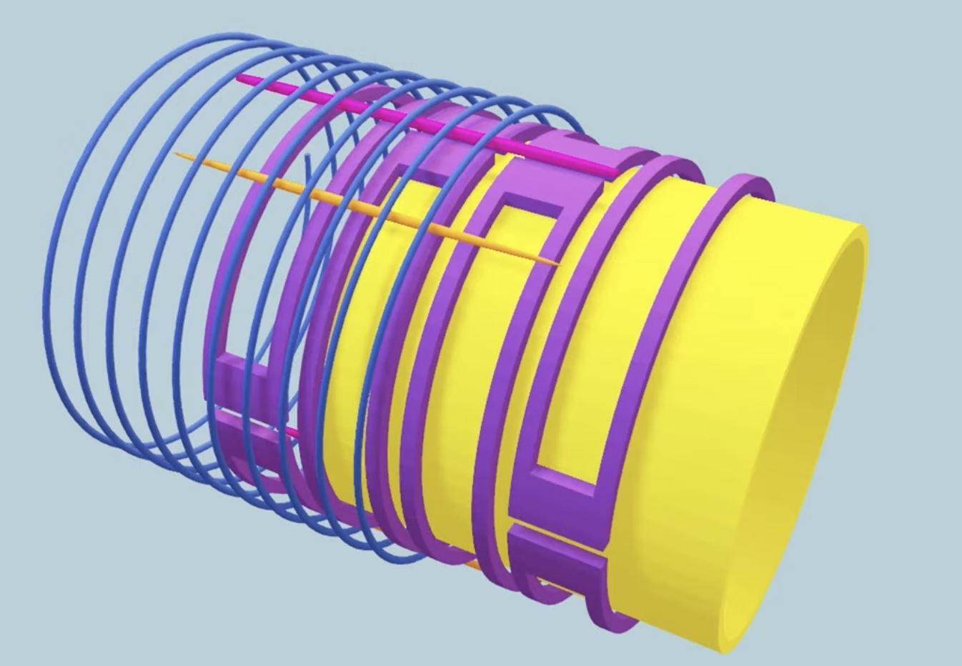
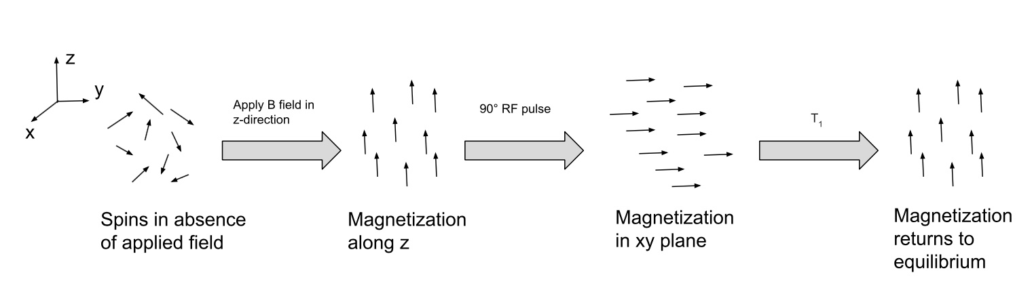

Magnetic Resonance Imaging (MRI)
05
Imaging technique based on nuclear magnetic resonance
Gradient coils causes position dependent magnetic field and each position has a different Larmor Frequency: $ω\left(z\right)=γB(z)$
Advantages: High soft tissue contrast, 3D information, no ionizing radiation
Preprocessing: Bias field correction (N4ITK), intensity normalization
Requires precise ROI definition for quantification

Slide 7
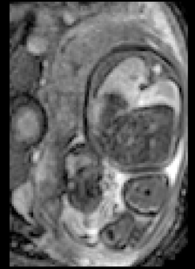
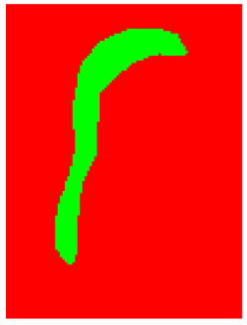
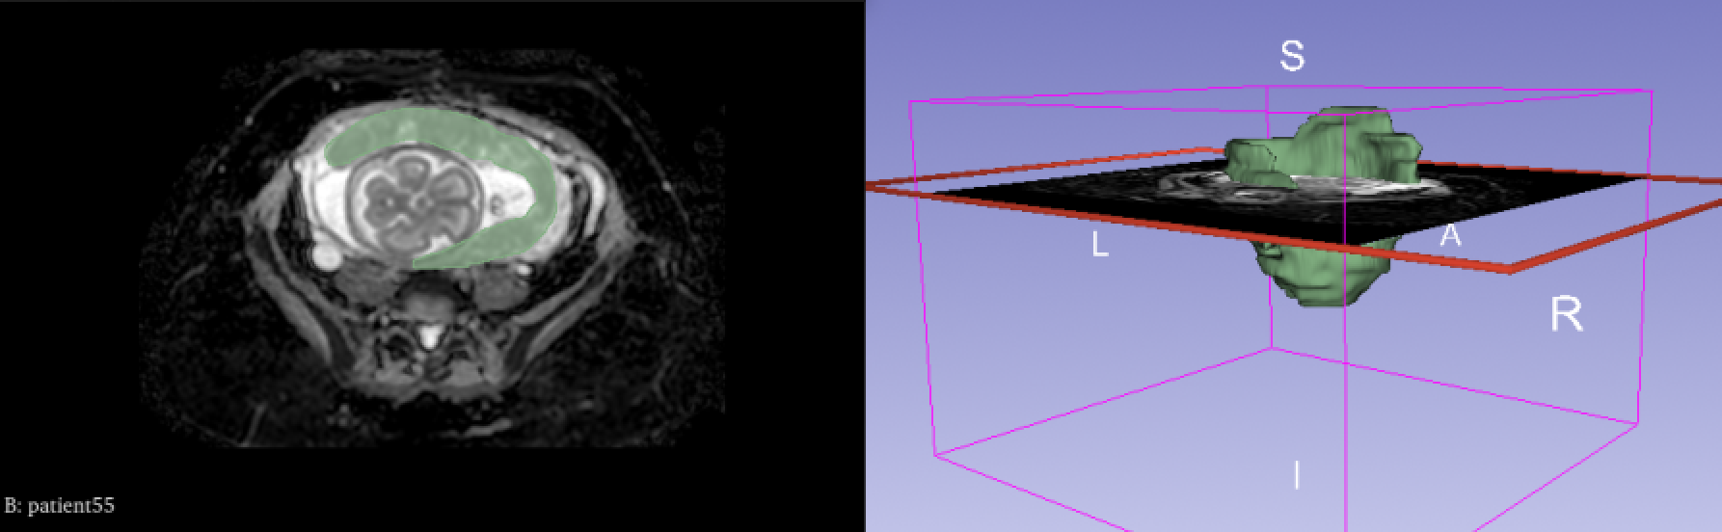

Medical Image Segmentation: Formal Definition
06
Input: 3D MRI volume $X∈ℝ^{H×W×D}$
Output: Binary mask $Y∈{\left\{0,1\right\}}^{H×W×D}$indicating placenta voxels
Learning formulation: Supervised learning with pairs $(X_{i},Y_{i})$
Goal: Learn $f_{θ}$such that $f_{θ}\left(x\right)≈Y$
Key distinction from classification: Dense prediction (per-voxel) vs image-level label
3D challenge: High computational/memory demands → patch-based training, sliding-window inference

Slide 8
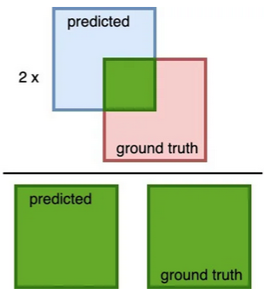
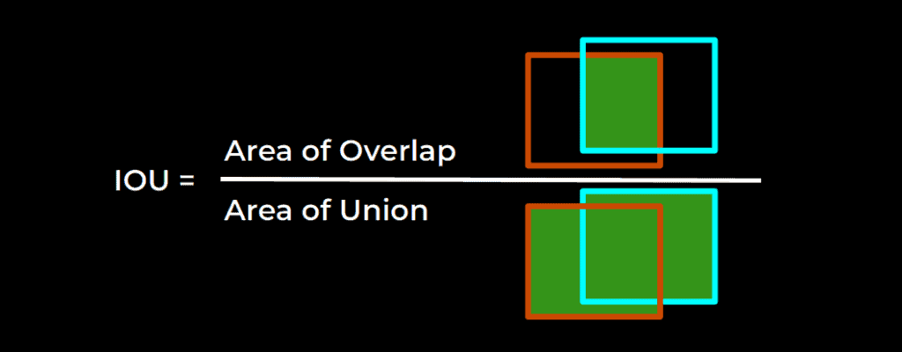


Performance Metrics
07
Dice Coefficient (DSC) (Figure on the right)
$DSC=\frac{2\left|P∩G\right|}{\left|P\right|+\left|G\right|}$
Values [0,1], 1 = perfect overlap.
Intersection over Union (IoU/Jaccard)
$IoU=\frac{|P∩G|}{|P∪G|}$
Suitable for severe class imbalance (especially DSC).
Additional monitoring: Training/validation loss (DiceCELoss)
Qualitative assessment: Visual inspection of boundary quality, false positives/negatives

Slide 9
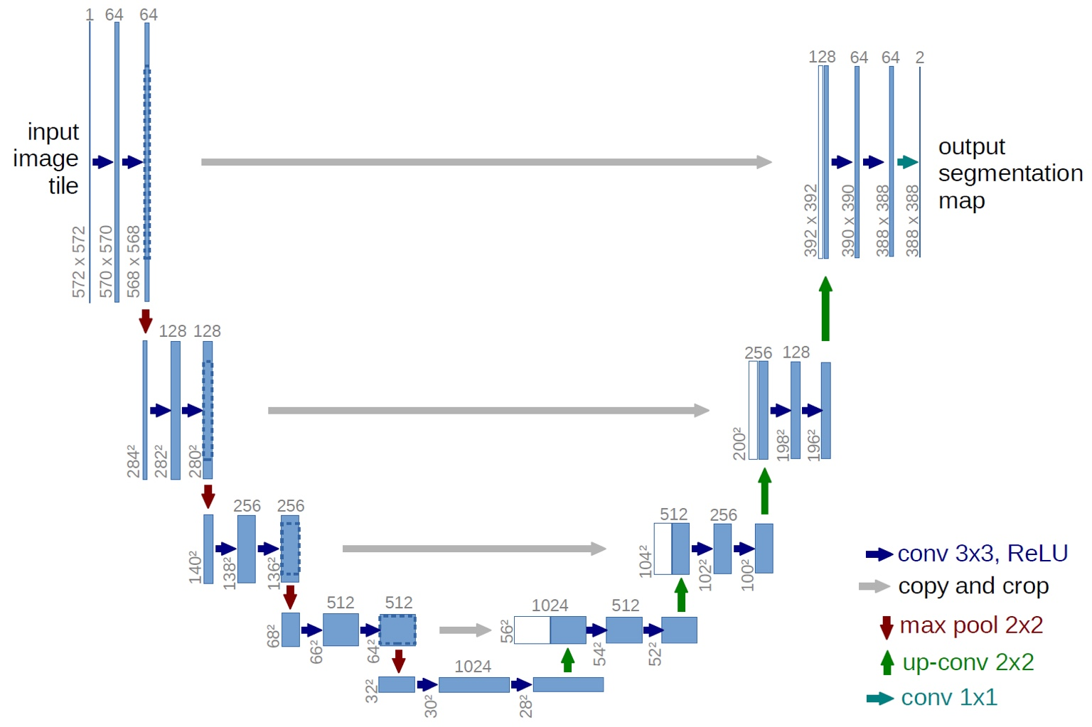
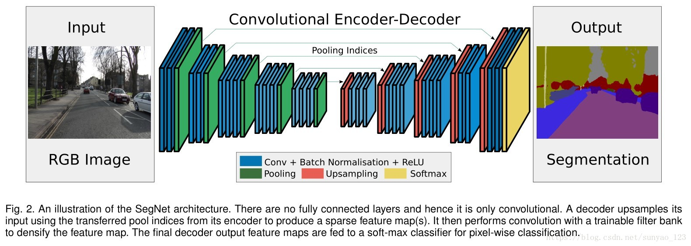
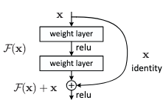
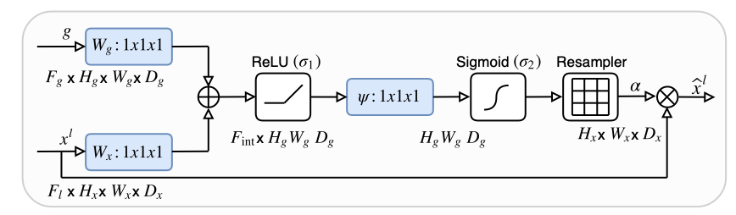
Convolutional Networks (CNNs) & U-Net
08
Dominant family of models for medical segmentation.
U-Net: Symmetric encoder-decoder architecture with skip connections.
Advantages: Efficiency, emphasis on local morphological features.
Variants: DynUNet (dynamic adaptation), SegResNet (residual blocks), Attention U-Net.

Slide 10
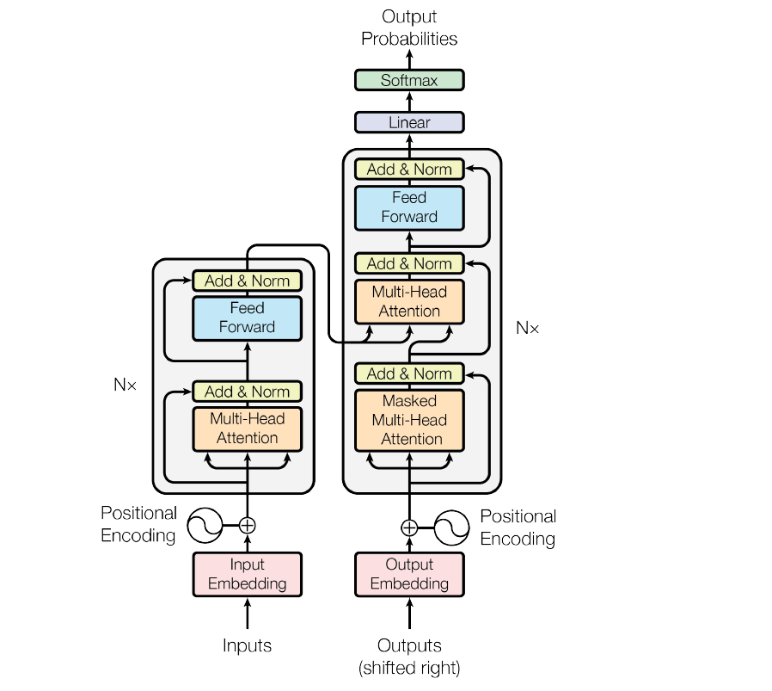
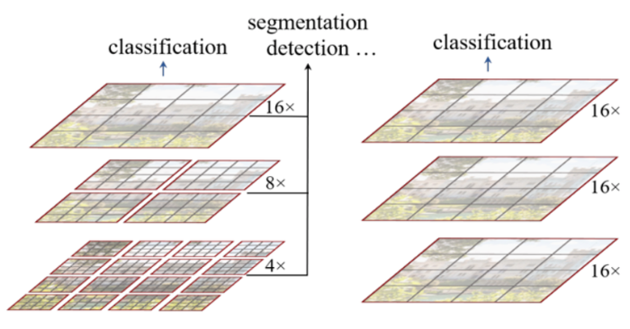
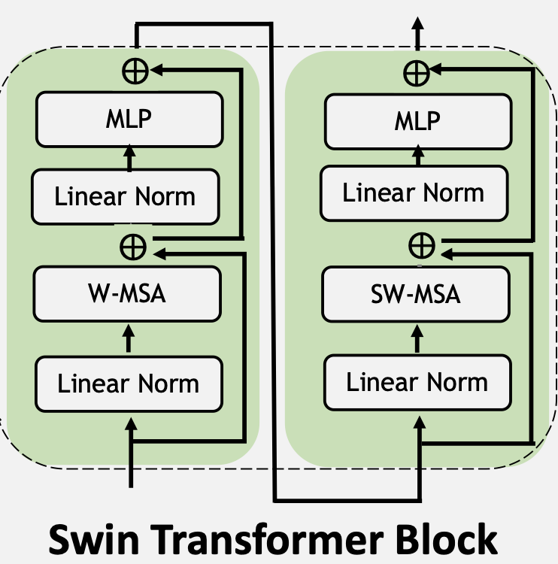
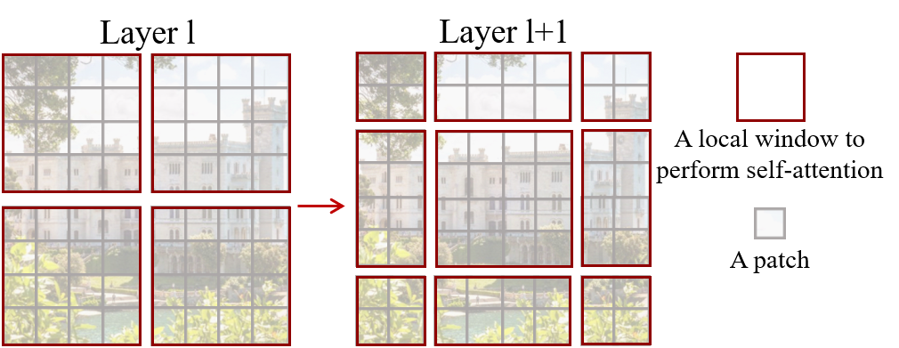

Attention Models & Transformers
09
Self-Attention mechanism for modeling long-range dependencies (global context).
Challenge: Quadratic cost $O\left(n^{2}\right)$ for high-resolution 3D data.
Solutions: Hierarchy, local windows (Window Attention).
Models: UNETR (ViT encoder), SwinUNETR (Swin Transformer encoder).

Slide 11
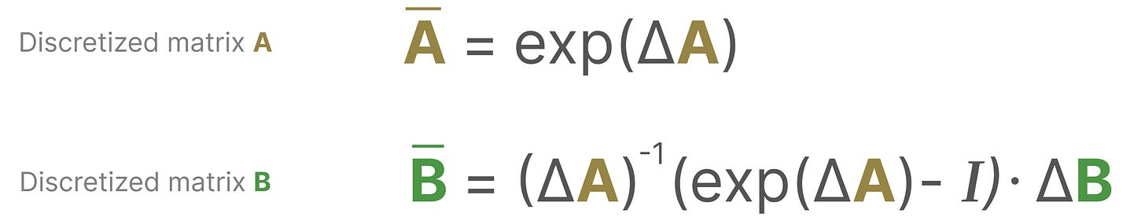
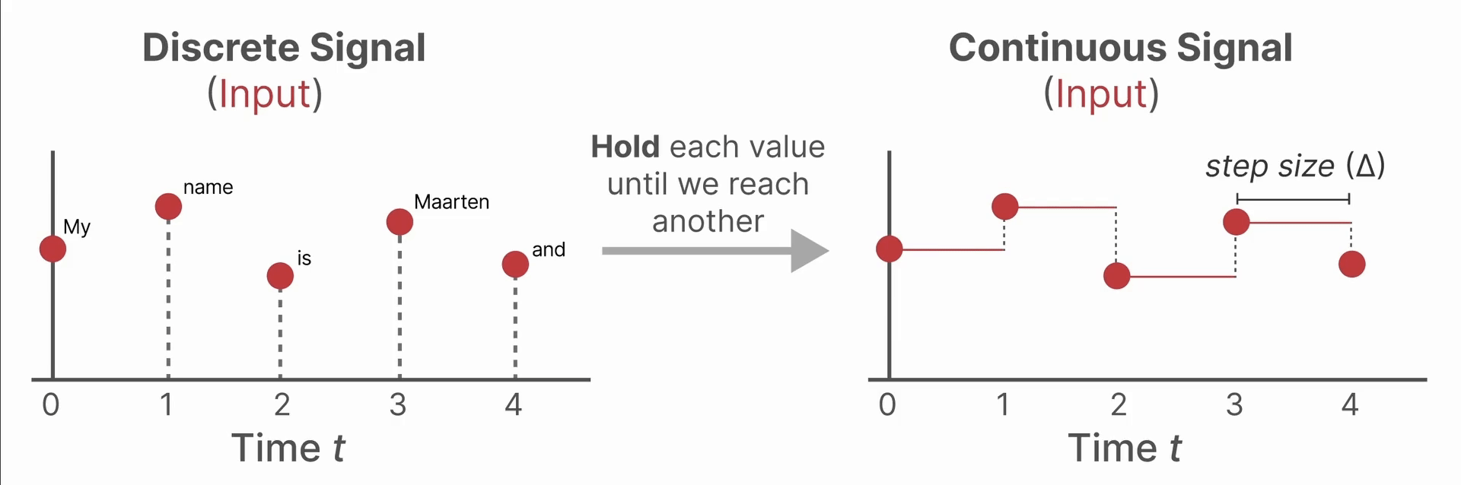
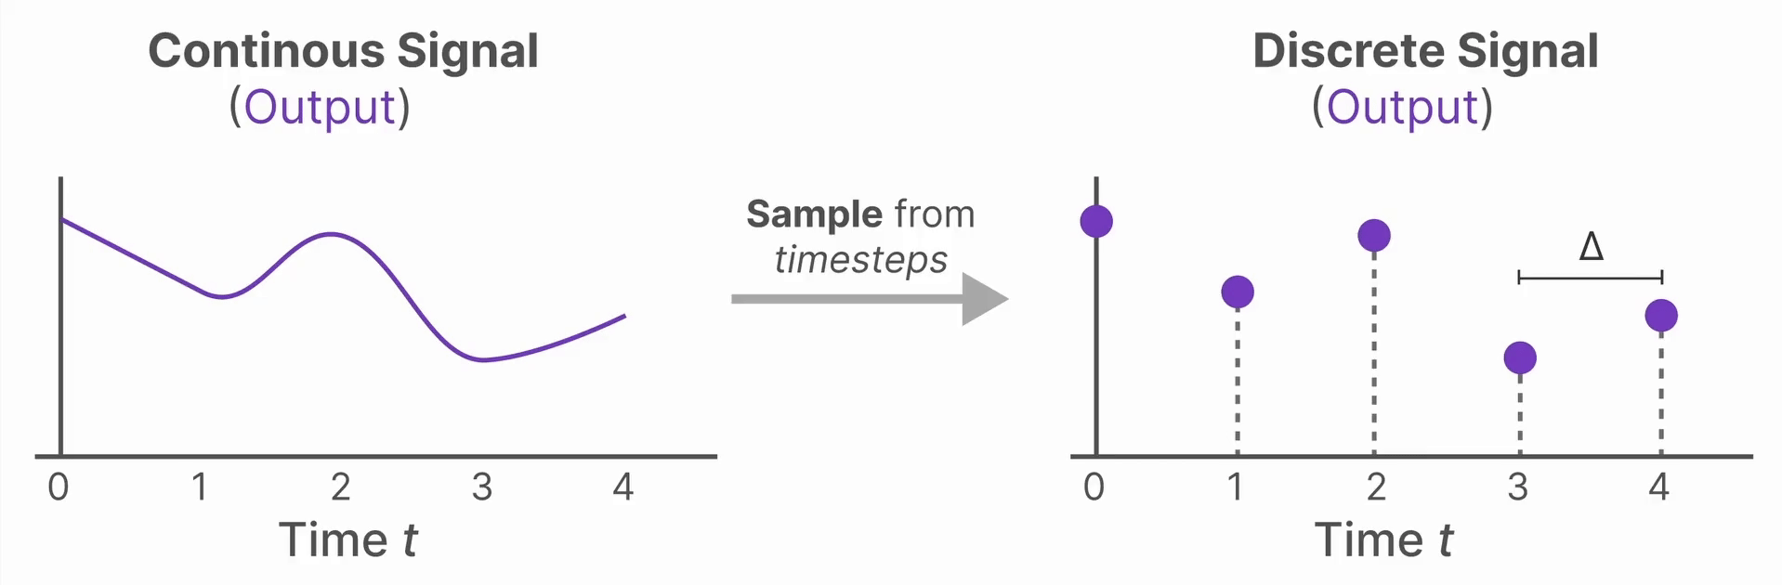
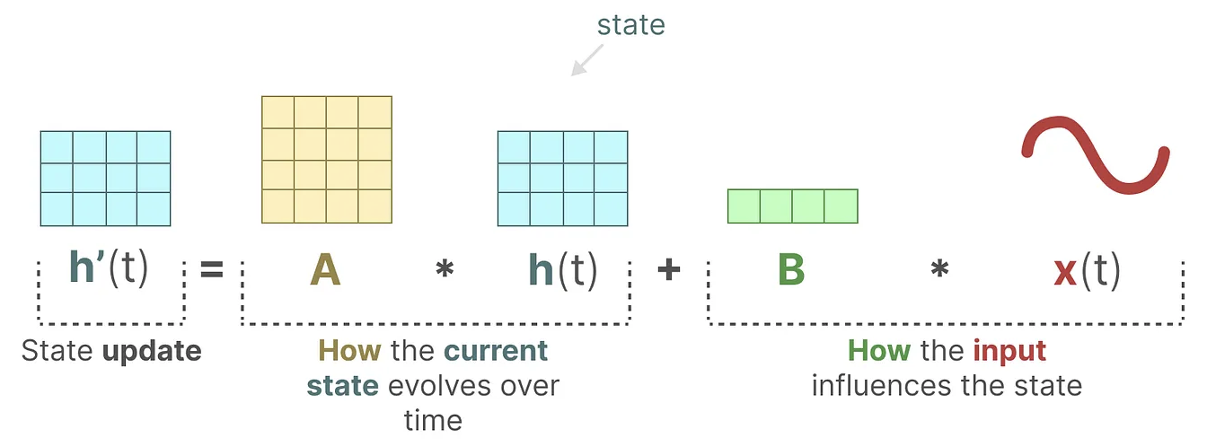
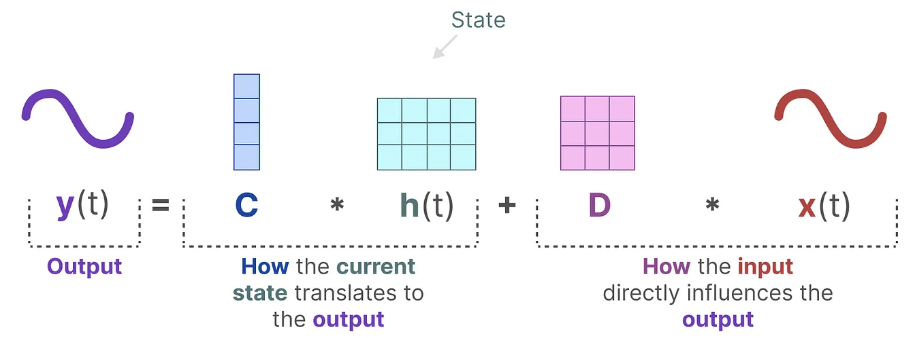
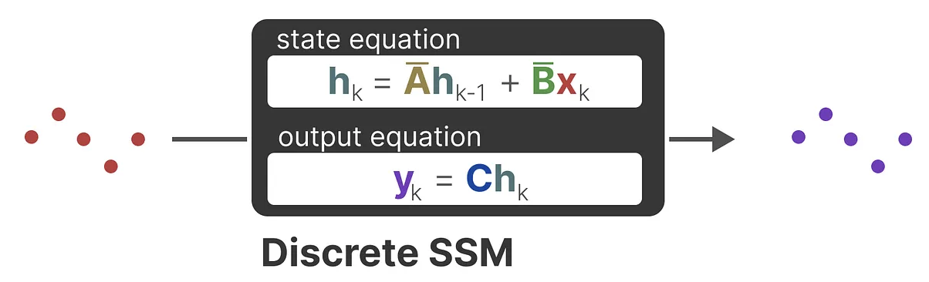

Emerging Approach: State Space Models (SSMs)
10
RNNs: “Great memory… until sequence gets long and they forget (and training gets slow).”
Transformers: “Great context… until attention decides $O(n^{2})$ is a perfectly normal lifestyle.”
SSMs(S6): “Same long-range vibe, but linear-time-like attention, but on a budget.”
Long-range dependencies + linear scaling.
Mamba: Selective State Space Models, ability to filter irrelevant data.
Content-dependent parameterization (content-based selection).
SegMamba: Mamba blocks in U-shape design for 3D segmentation.

Slide 12
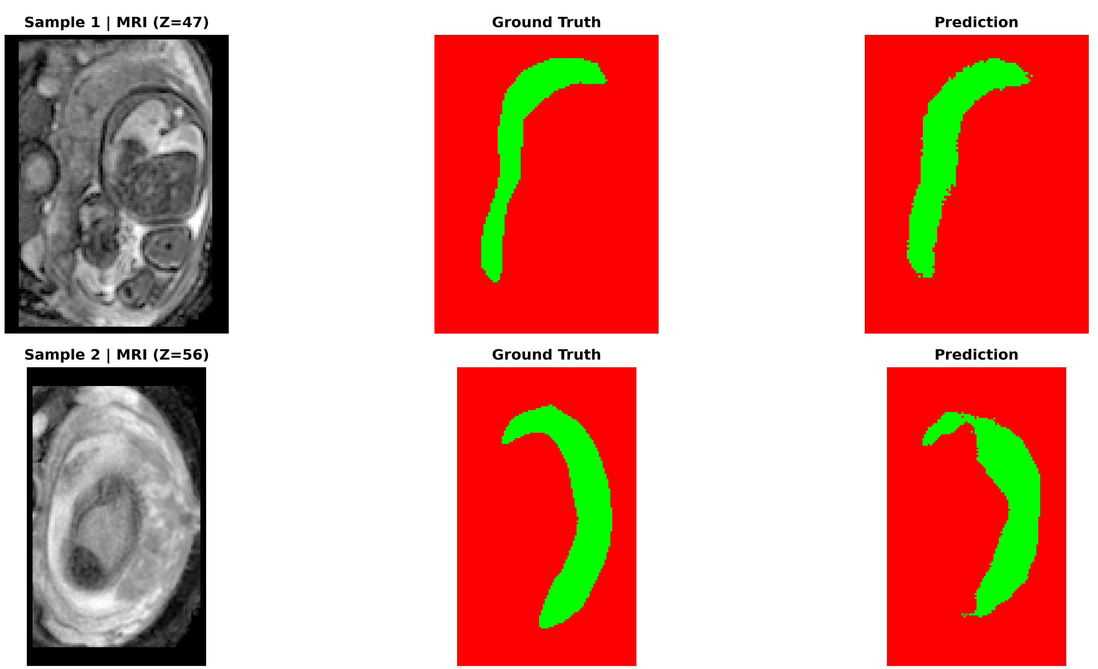
U-Net
08
Encoder–decoder with skip connections
Baseline model in medical imaging.
Strong inductive bias for locality.
Fast to train compared to heavier models.

Slide 13
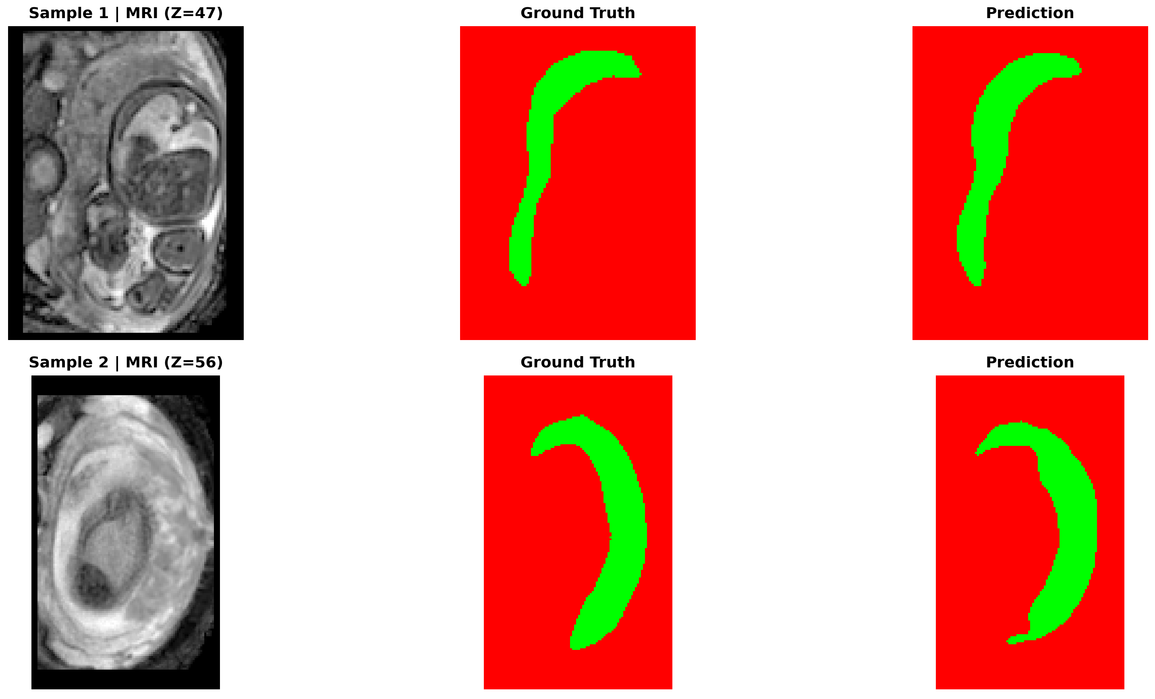
Attention U-Net
09
Attention gates refine skip connections
Gate suppresses irrelevant activations from the encoder.
Helps focus on placenta-like regions.
Often improves boundary quality and reduces false positives.

Slide 14
DynUNet (MONAI)
10
Auto-configured U-Net style network
Automatically adapts depth/strides/kernels to the data spacing.
Strong baseline for 3D segmentation.
Good accuracy, moderate cost.
Insert figure
Insert a small DynUNet diagram or a block schematic (encoder/decoder + skip connections).
Insert qualitative output
Insert a representative DynUNet qualitative example (MRI | GT | Prediction).

Slide 15
SegResNet
11
Residual blocks for deeper 3D models
Residual connections stabilize optimization.
Two variants: lighter vs heavier (filters).
In our runs: among top Dice performers.
Insert figure
Insert a residual block schematic + SegResNet encoder/decoder overview.
Insert curves
Insert SegResNet training curves (Dice & Val loss per epoch).

Slide 16
Transformers in vision
12
Global context, patch tokens, higher cost in 3D
Convert image/volume into patch tokens.
Self-attention models long-range dependencies.
Great for global context; expensive for large 3D volumes.
Swin: hierarchical windows → better scaling than full ViT.

Slide 17
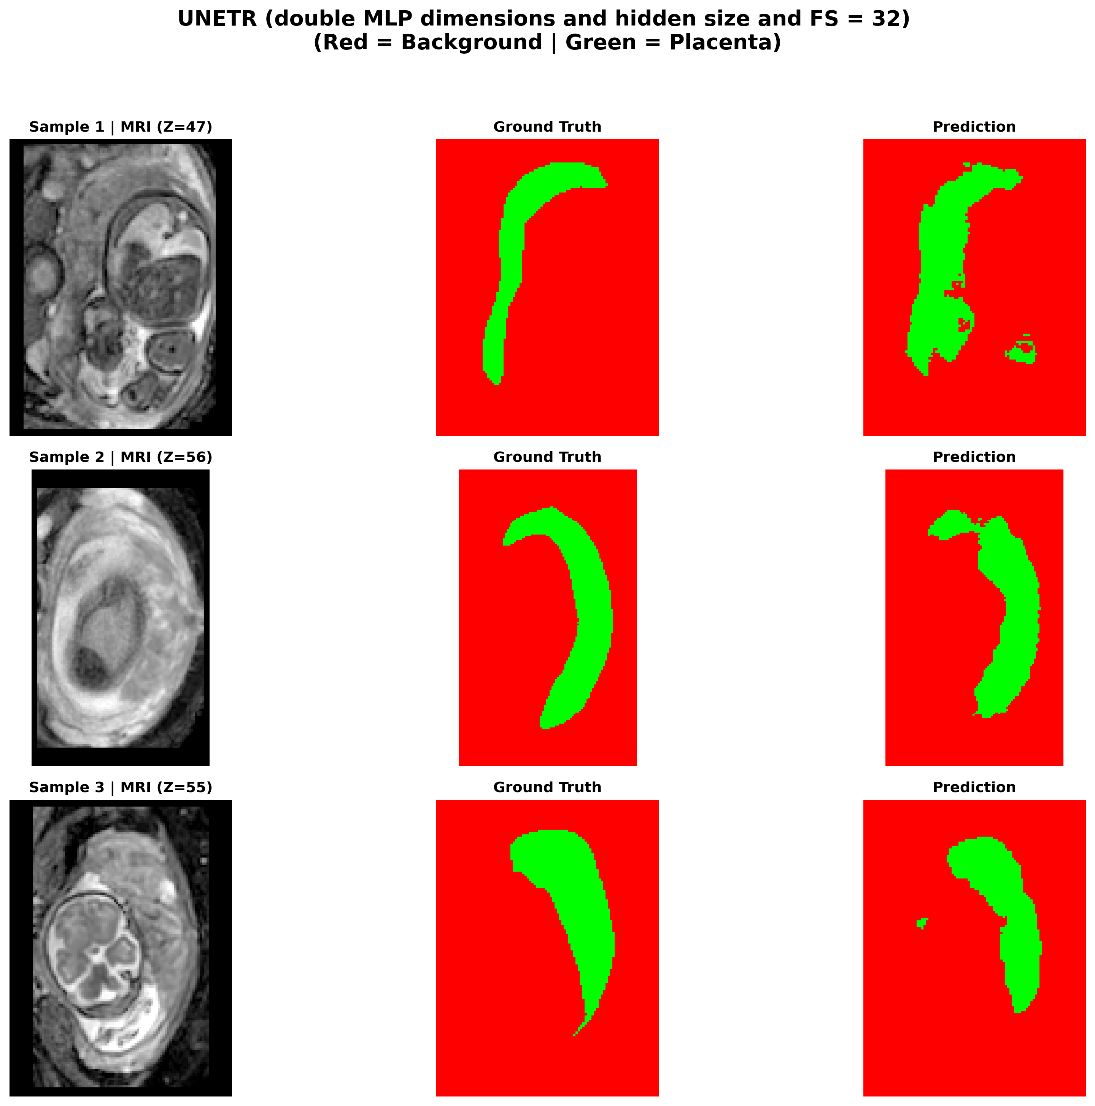
UNETR
13
ViT encoder + U-shaped decoder
Transformer encoder provides global context.
Decoder reconstructs voxel-level mask.
Can underperform with limited data or heavy regularization needs.

Slide 18
SwinUNETR
14
Hierarchical Swin encoder (windowed attention)
Swin attention uses shifted windows → scalable context.
Often strong segmentation performance.
Heavier memory/time footprint in 3D.
Insert figure
Insert SwinUNETR architecture diagram or a block overview (stages + decoder).
Insert qualitative output
Insert a representative SwinUNETR qualitative example.

Slide 19
SSM / Mamba
15
Sequence modeling without full self-attention
State Space Models capture long-range dependencies efficiently.
Mamba-style selective scanning scales well.
Promising for 3D where attention can be costly.
Insert diagram
Insert a simple SSM/Mamba block diagram (input → selective scan → output).

Slide 20
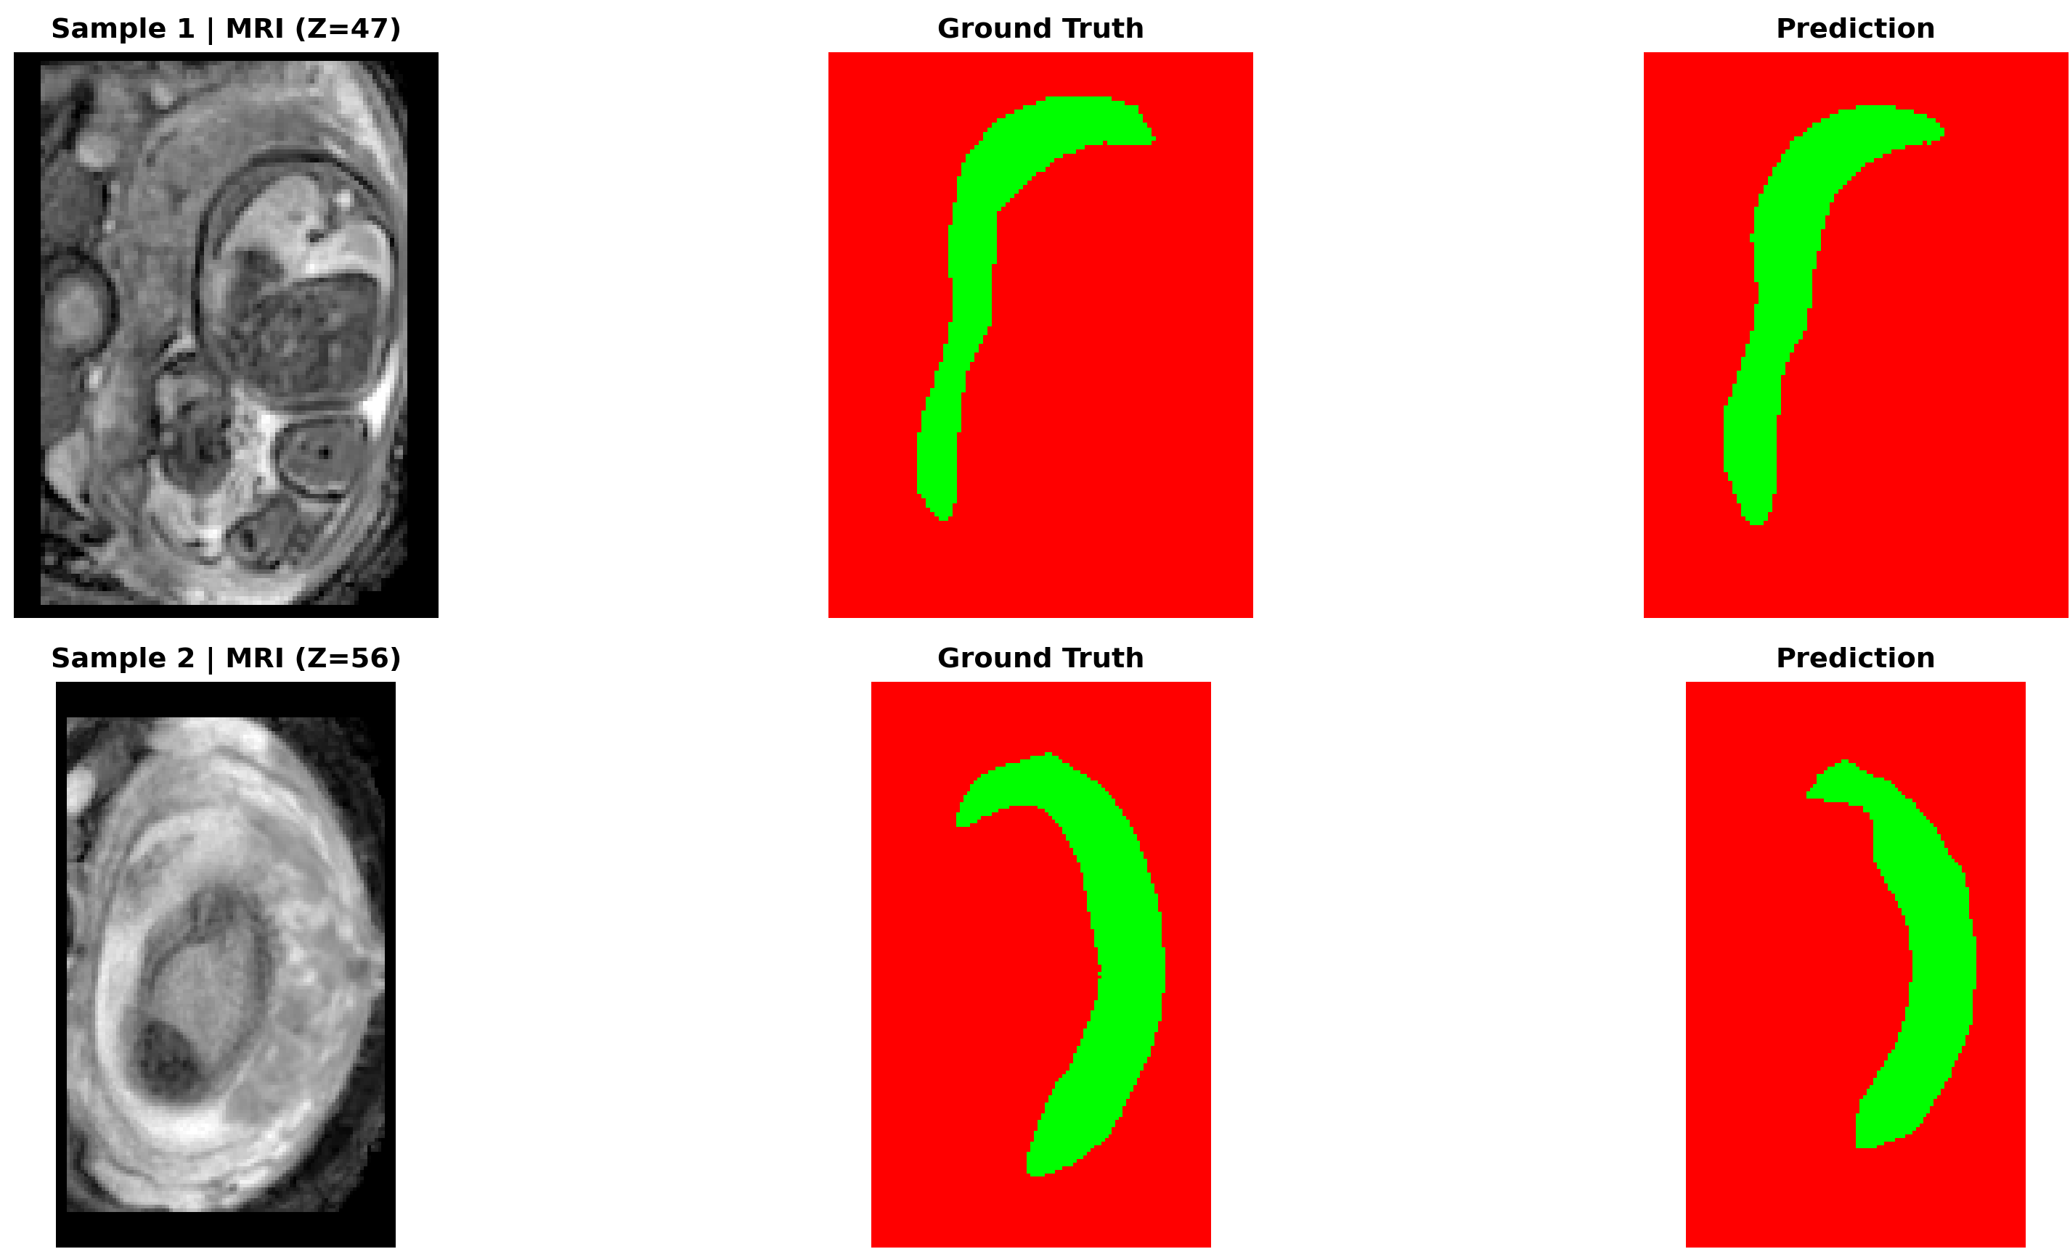
SegMamba
16
SSM/Mamba blocks inside a segmentation backbone
Designed to combine long-range modeling + efficient computation.
In our study: best Dice (Heavier variant).
Qualitatively: stable masks with good overlap in many cases.

Slide 21
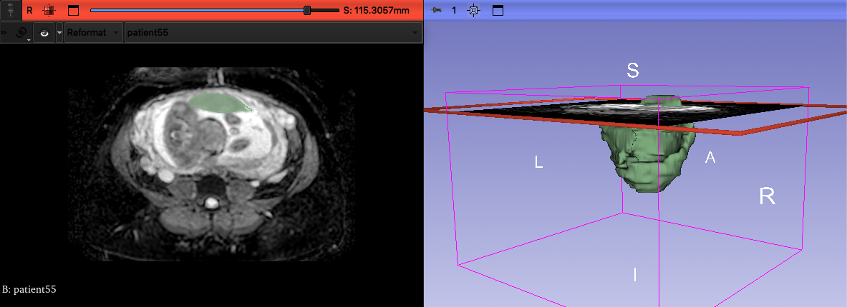
Experiments
Data → Pipeline → Training → Validation → Results

Slide 22
Data
17
3D NIfTI volumes (.nii) + binary masks
Each case: MRI volume + segmentation mask.
Stored as NIfTI (.nii/.nii.gz).
Train/Validation split: 80% / 20% (fixed seed).
Goal: fair comparison across all models.
Train 80%
Val 20%

Slide 23
Compute platform
18
Kaggle Notebook + NVIDIA T4 GPU
Environment: Kaggle (Python + MONAI + PyTorch).
GPU: NVIDIA Tesla T4.
Patch-based training to fit 3D volumes in memory.
Consistent settings for fair model comparison.
GPU
NVIDIA T4
Patch training
+ SWI inference

Slide 24
Pre-processing pipeline
19
MONAI transforms (deterministic → cached)
Load +
channel-first
Orientation
(RAS)
Resample
(spacing)
Intensity
scaling
Foreground
crop
Patch sampling
+ augments
Note: deterministic steps cached on disk, while augmentations are stochastic during training.
Why: reduce background, standardize geometry, improve sample efficiency.
Patch sampling addresses class imbalance and GPU limits.

Slide 25
Training setup
20
Loss • optimizer • scheduler
Insert specifics from your code:
Loss: [e.g., DiceLoss + CrossEntropyLoss] (insert exact config).
Optimizer: [e.g., AdamW] (lr = …, weight decay = …).
Scheduler: [e.g., CosineAnnealing / ReduceLROnPlateau] (insert).
Epochs: 120 • best model selected by validation mean Dice.

Slide 26
Validation & inference
21
EMA + Sliding Window Inference (SWI)
EMA: smooths weights → more stable validation.
SWI: run the model on overlapping 3D patches.
Aggregate predictions to reconstruct the full 3D mask.
Compute metrics on the reconstructed volume.
3D volume
Overlapping patches
(sliding window)
Aggregated mask
+ metrics

Slide 27
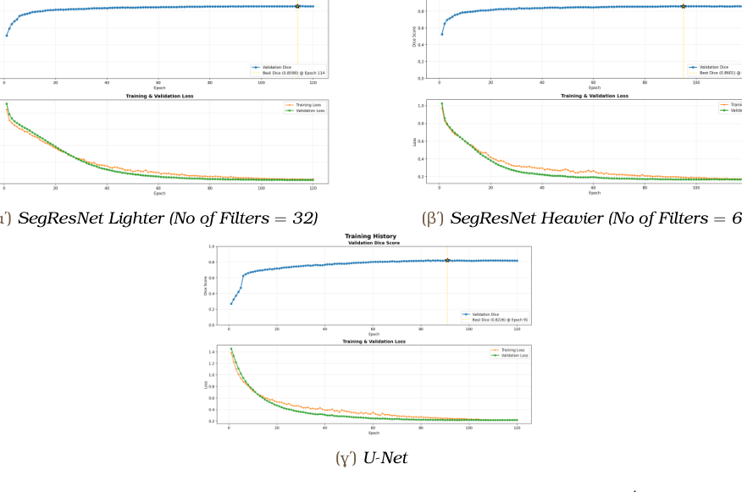
Results
22
Metrics + training curves
Validation Dice (best epoch)
Training curves (Dice & Val loss)
Best: SegMamba (H) ≈ 0.8606 • SegResNet (H) ≈ 0.8601
Runtime (indicative)

Slide 28
Qualitative results
23
MRI | Ground Truth | Prediction (examples)
U-Net
UNETR
Attention U-Net
SegMamba (Heavier)

