Slide 1

Delivery System
Anh Nguyen
Hai Dang Nguyen

Slide 2

Objective
Help customer transport their package day & night
Customer can tracking their package location
Help customer earn their own benefits

Slide 3
Technology
Front End : JavaFX
BackEnd : Java
Database : SQLite
Nonfunctional requirement : performance, memory management, UI Design

Slide 4
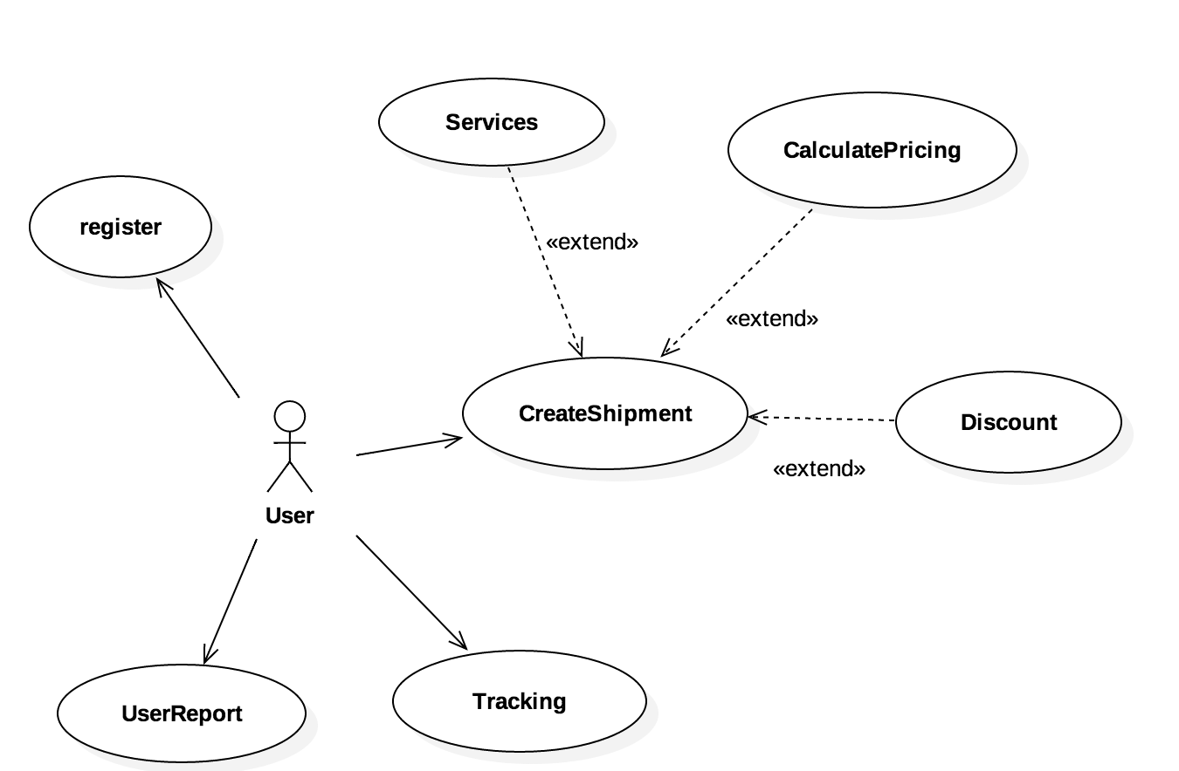
Use Cases

Slide 5
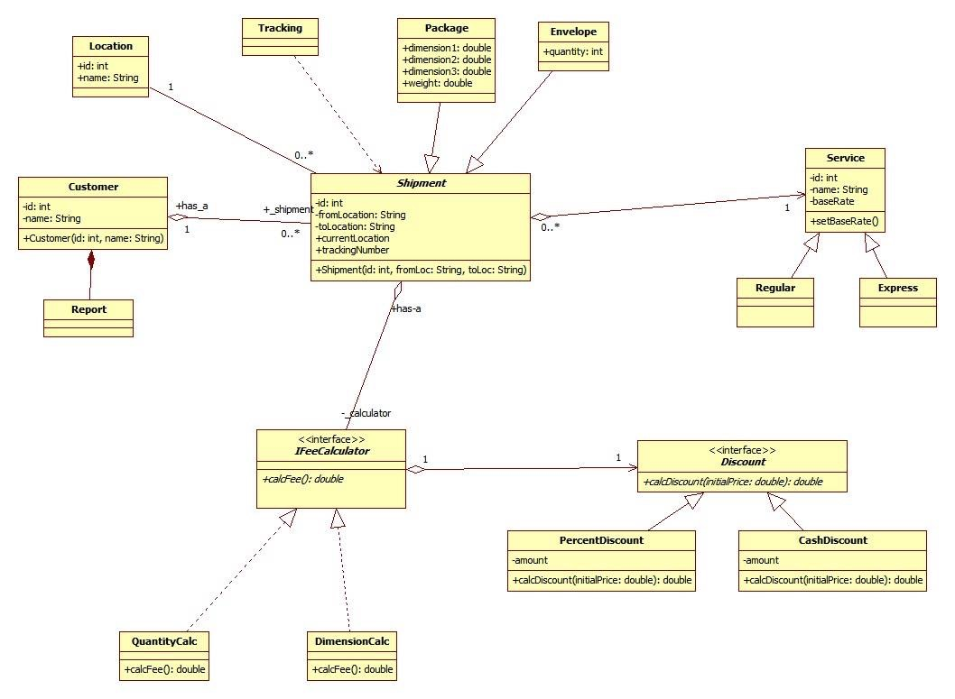
System UML

Slide 6
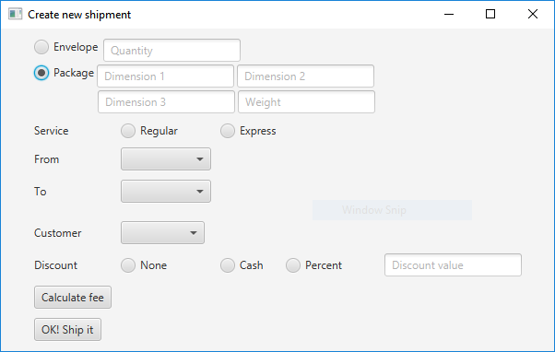
Shipment & Pricing ?

Slide 7
“Talk is cheap, show me the code”
–Linus Torvalds

Slide 8
Q & A

