Slide 1
Semi-Global Stereo Matching with Surface Orientation Priors
Daniel Scharstein Tatsunori Taniai Sudipta N. Sinha
Middlebury College RIKEN AIP Microsoft Research

Slide 2
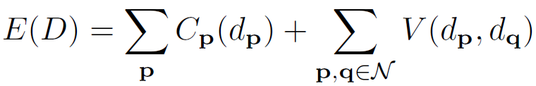
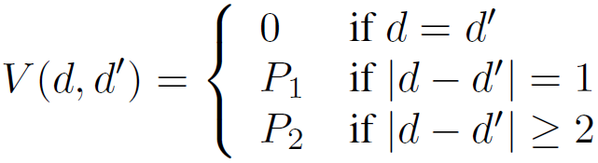
Semi Global Matching [Hirschmüller 2005]
Approximates 2D MRF using 1D optimization along 8 cardinal directions
Fronto parallel bias
Inaccurate on slanted untextured surfaces
Notes:
SGM is a widely used stereo matching technique that
combines the efficiency of local methods and the accuracy of global methods.
It works by approximating a 2D MRF optimization problem with several 1D scanline optimizations.
SGM uses a first order smoothness prior
This favors fronto-parallel surfaces
This is why SGM can be inaccurate on slanted untextured surfaces.

Slide 3

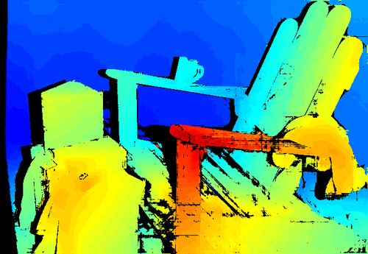
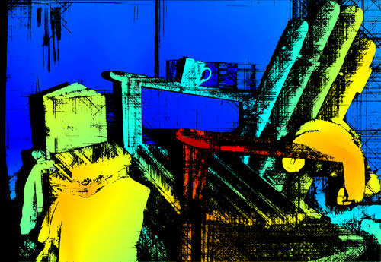
Fronto Parallel Bias
Input
SGM @ quarter resolution
SGM @ full resolution
black pixels have high uncertainty [Drory+ 2014]
Notes:
This bias is more dominant when processing high resolution images.
The output on the left was obtained at quarter resolution
whereas
On the right is the full resolution output.
Here pixels with high uncertainty are shown in black ..

Slide 4
SGM-P: SGM with orientation priors
What if we knew the surface slant?
Replace fronto-parallel bias with bias parallel to surface
How can it be done in a discrete setting?
Main Insight:
Rasterize disparity surface prior (at arbitrary depth)
Adjust V(d, d’) to follow discrete disparity “steps”
Notes:
We extend SGM to address this issue
If we know the surface slant, we could try to introduce a bias parallel to the slanted surface.
Main question is how can we do this in a discrete setting ?
Our main insight was that this can be done by rasterizing a disparity surface and finding where the discrete steps occur
We then adjust the pairwise term in the MRF – the new V terms encourages the solution to follow the discrete steps.

Slide 5
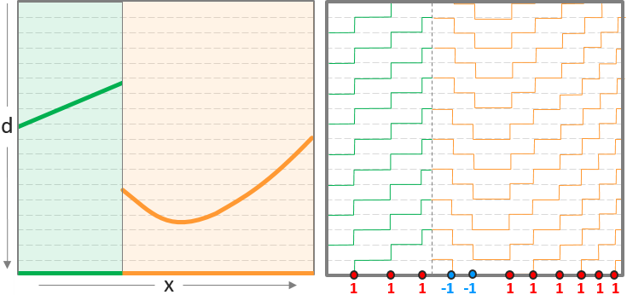

SGM-P: 2D orientation priors
Notes:
Here is the idea explained in pictures

Slide 6
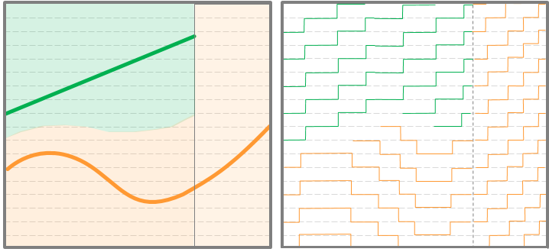
SGM-P: 3D orientation priors
Jump locations vary with disparity
Notes:
Here is an example of a labeling computed using graph cuts.
each pseudo-color indicates a different plane or pair of planes.
Pixels assigned to two planes are inferred as reflective pixels (beta = 1)
And here are the corresponding depth maps for the front and rear layers ..

Slide 7
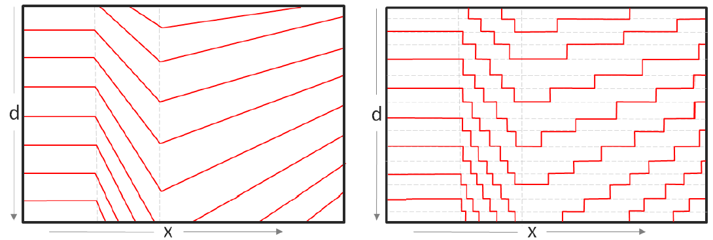
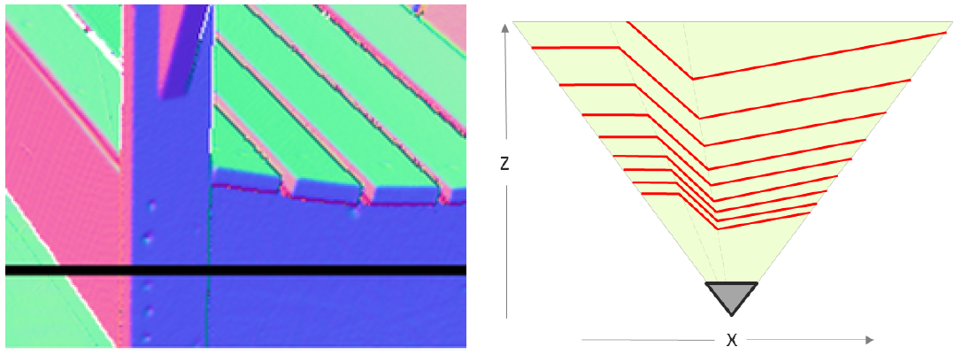
SGM-P: Surface Normal Prior
From surface normal map, derive multiple disparity surfaces;
Disparity surface orientations vary with disparity
Requires 3D orientation prior; steps not vertically aligned

Slide 8
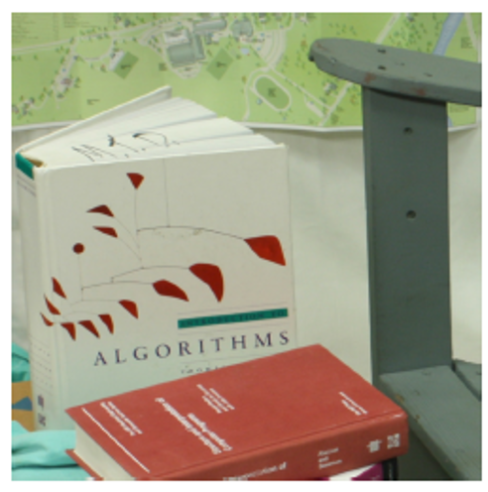
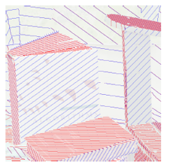
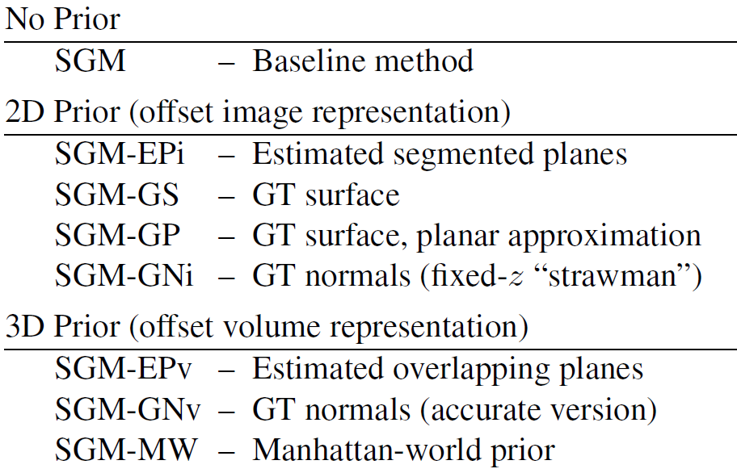
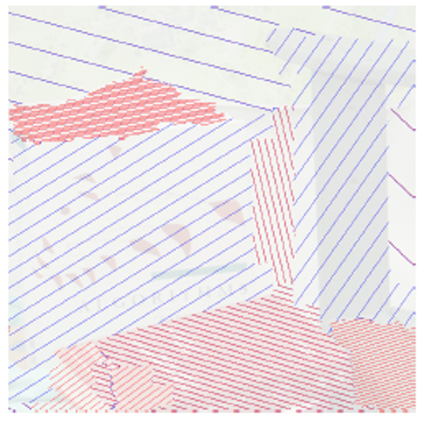
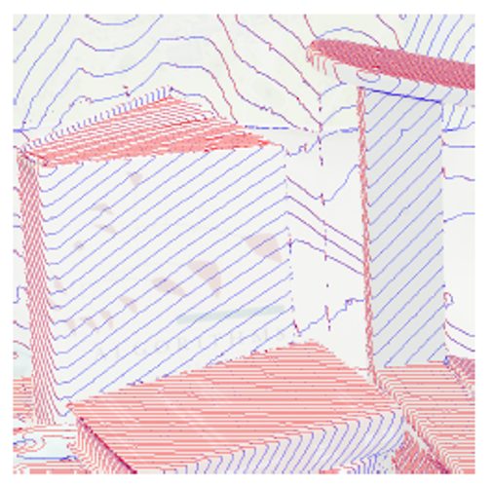
SGM-P: Where do we get priors?
Algorithm Variants
Notes:
We explore many ways to obtain the orientation priors,
-- including using ground truth oracles.
Shown on the right are 2D offset images obtained with three different variants

Slide 9
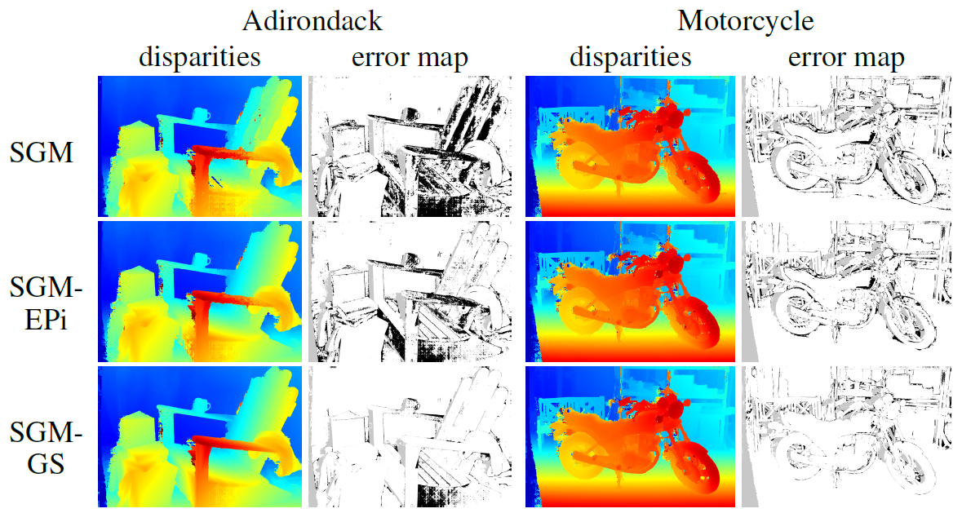
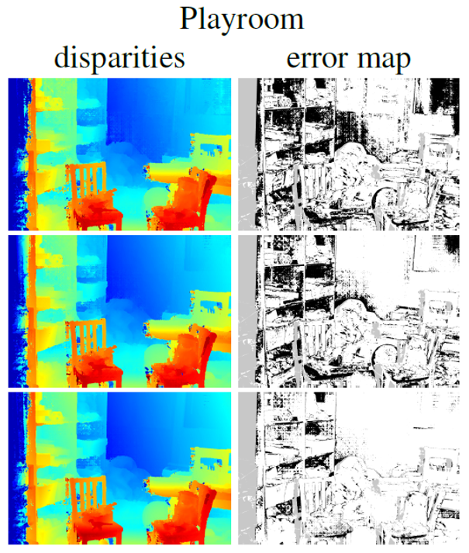
SGM-P: Results
s
Notes:
Here are some qualitative results from the Middlebury training set
Each row shows the result of a different algorithm
SGM-EPi refers to our method where the prior is obtained by fitting local planes to a low resolution disparity map
SGM-GS refers to one of the ground truth oracles ..
Black pixels in the error maps indicate erroneous pixels, where the errors are greater than 2 pixels

Slide 10
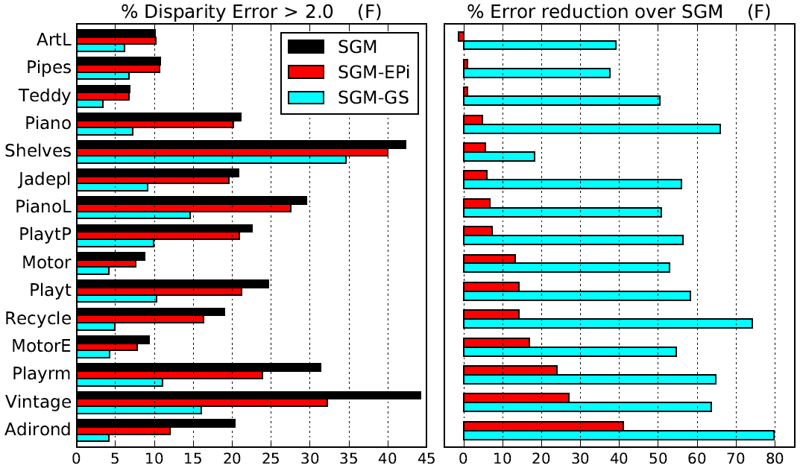
SGM-P: Results
Huge accuracy gain possible /w SGM-GS (oracle prior)
Significant gain /w SGM-EPi (estimated planar prior)
Soft constraint; inaccurate prior does not hurt accuracy

Slide 11
Summary
Extension of SGM; uses precomputed surface orientation priors
More accurate on slanted untextured scenes
Small runtime overhead
When prior is inaccurate, accuracy no worse than standard SGM
Notes:
To conclude, I presented an extension of SGM that incorporates precomputed surface orientation priors
It is more accurate on slanted untextured scenes
It has a very small overhead
We showed that when the prior is perfect, huge performance gains are possible

Slide 12
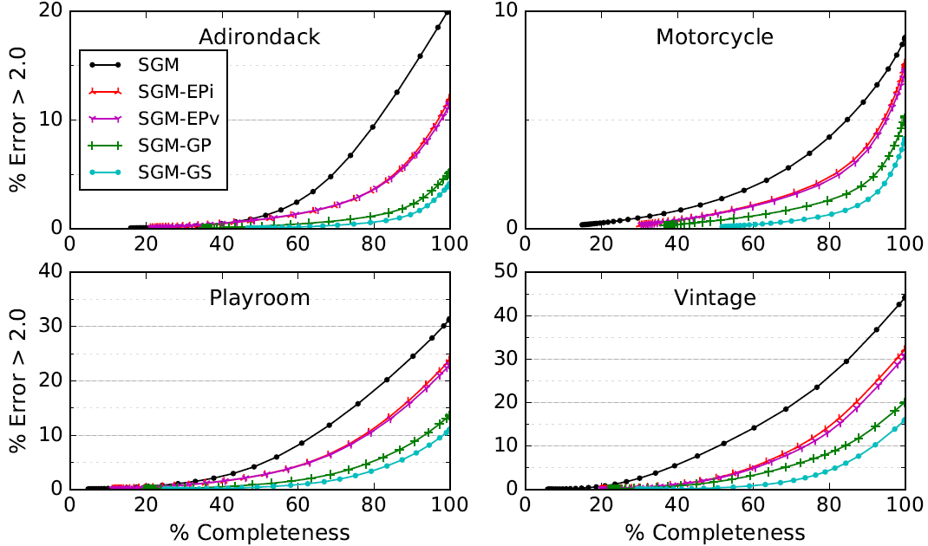
SGM-P: Results
Notes:
Here is an example of a labeling computed using graph cuts.
each pseudo-color indicates a different plane or pair of planes.
Pixels assigned to two planes are inferred as reflective pixels (beta = 1)
And here are the corresponding depth maps for the front and rear layers ..

Slide 13
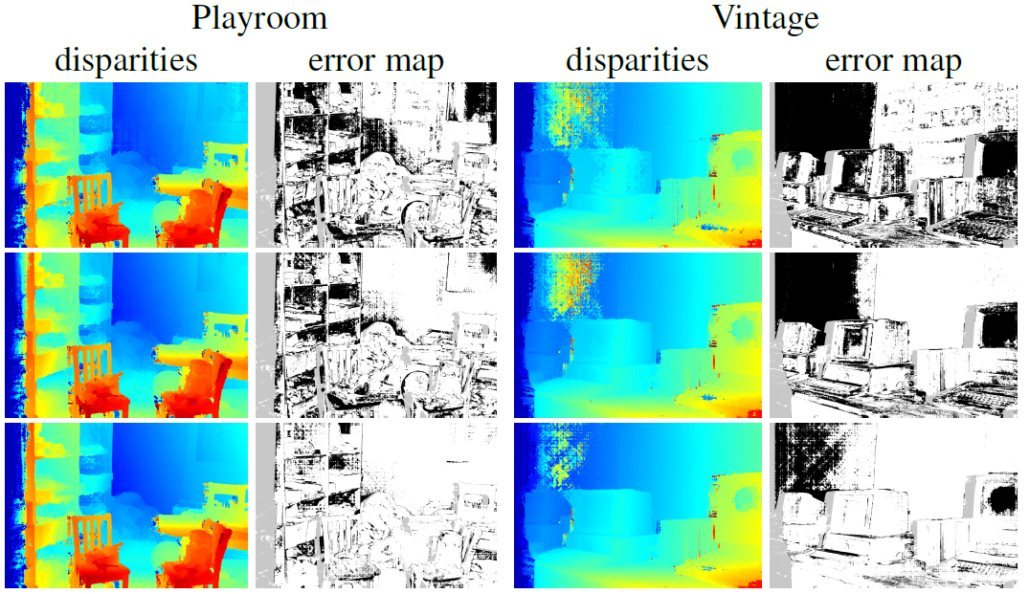
SGM-P: Results
s

