Slide 1

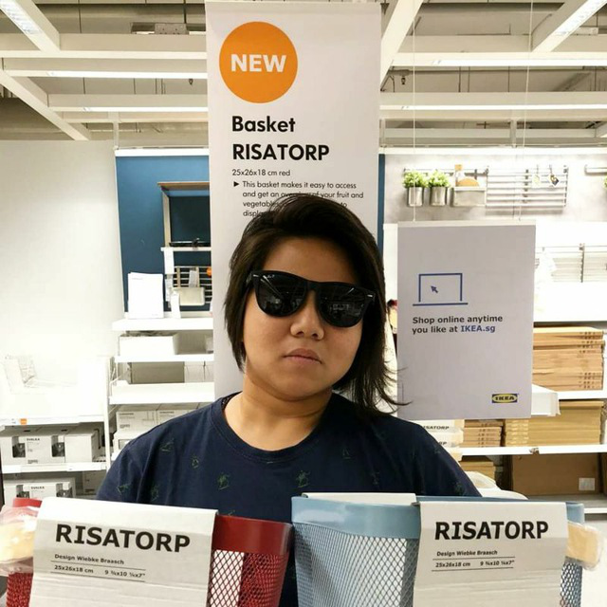
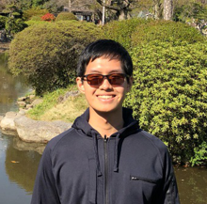
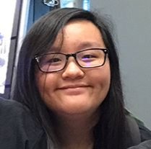
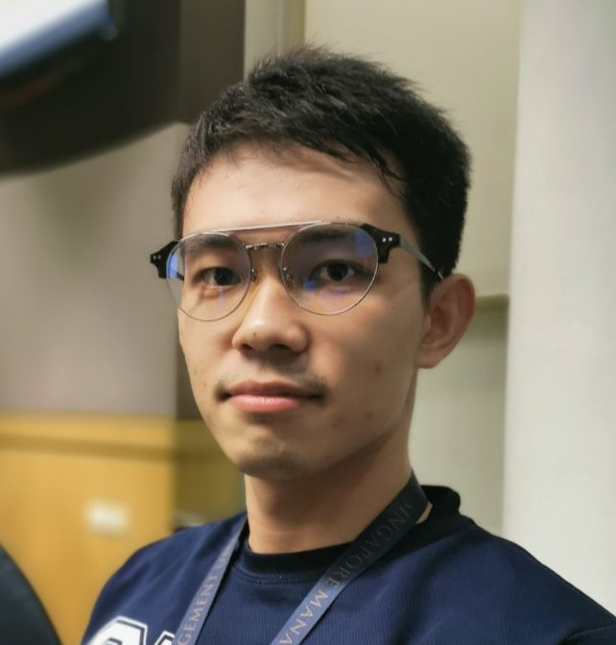
PM Review
G7T1 Team SPAM
Minh
Risa
Eugene
Francine
Piao

Slide 2
Functionalities
01
Plan to add additional search filters for finding courses (e.g. instructors)
02
No plan to drop functionalities or use any PHP frameworks
03
Finished login and bootstrap functionalities

Slide 3
Cloud Deployment Info
01
IP Address:
18.191.241.117
02
Admin Password:
nFHPBQz6VmLwR

Slide 4

Schedule
5
Iteration 5
Week 13
Iteration 4
4
Week 11 – 12
Iteration 2
3
Iteration 3
Week 7 – 8
Week 9 –10
Iteration 1
2
1
Week 5 – 6
5 iterations total

Slide 5
Iteration 1 (W5-W6)
Initial project scheduling (PM)
Login (Coders)
Classes & DAOs (Coders)
Bootstrapping (Coders)
Testing (All)
Debugging (All)
Deployment to Cloud (PM)
PM Review & Preparation (All)
Revise Schedule for Iter. 2 (PM)

Slide 6
Iteration 2 (W7-W8)
Iteration 1 Review & Briefing (PM)
Placing Bids (Coders)
Additional search functions (Coders)
Drop bid and sections (Coders)
Round 1 Clearing (Coders)
Bid results (Coders)
Test cases and debugging (All)
Preparation for Demo/progress update (All)
Revise Schedule if needed (PM)

Slide 7
Iteration 3 (W9-W10)
Iteration 2 Review & Briefing (PM)
Round 2 Clearing (Coders)
JSON Integration (Coders)
Documentation (All)
Testcases (All)
Debugging (All)
Preparation for UAT (All)
Revise Schedule if needed (PM)

Slide 8
Iteration 4 (W11-W12)
Iteration 3 Review & Briefing (PM)
Review feedback from UAT (All)
Make necessary changes (All)
Testing (All)
Any remaining documentation (All)
Deployment (All)

Slide 9
Iteration 5 (W13)
Iteration 4 Review & Briefing (PM)
Final Presentation Preparation (All)

Slide 10
Milestones
PM Review
Application Demo
User Acceptance Testing
Post-UAT Review
Final Presentation
Buffer Time: W8 – Recess Week
Saturdays/Sundays
W13 – Prep for Milestone 5

Slide 11
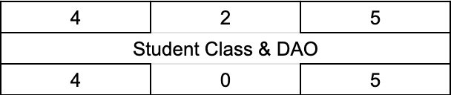
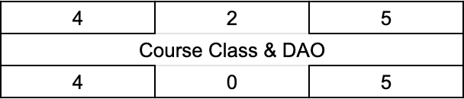
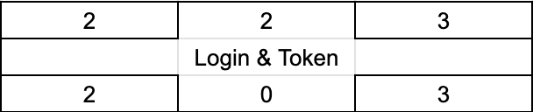
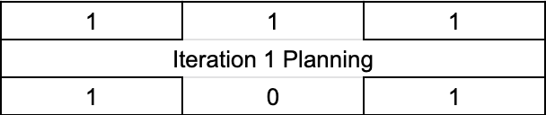
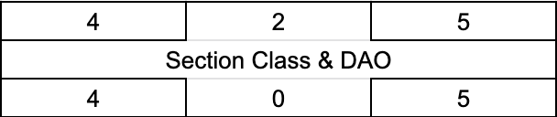
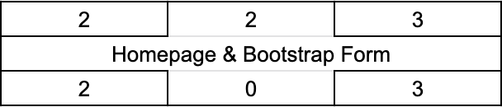
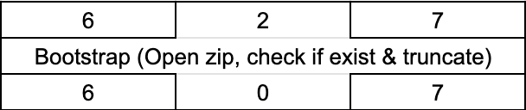
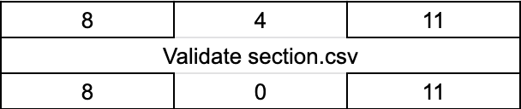
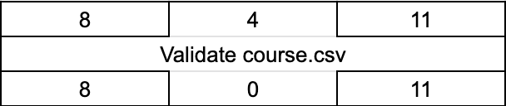
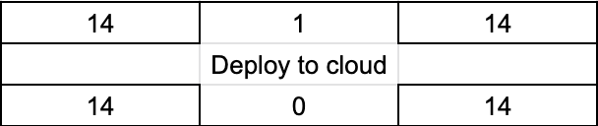
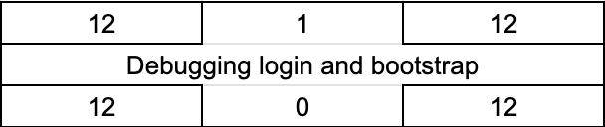
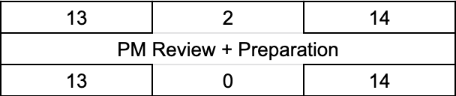
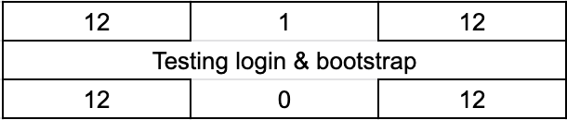
Iteration 1 Critical Path
.
.
.
.
.
.
.
.
.
.
.
.

Slide 12

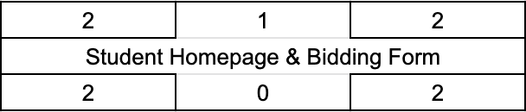

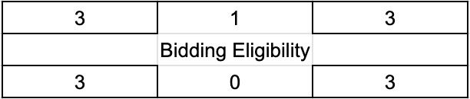
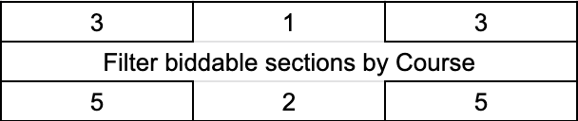

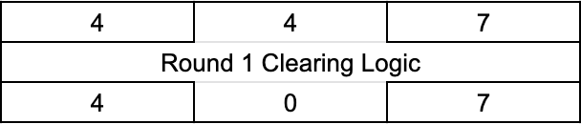
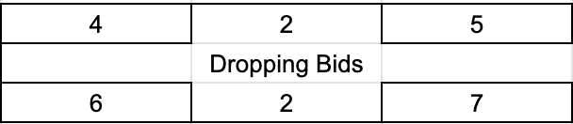

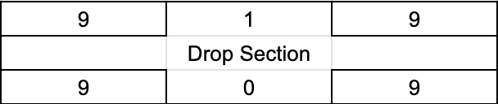
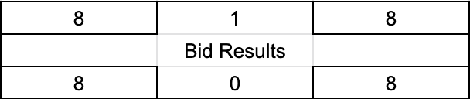
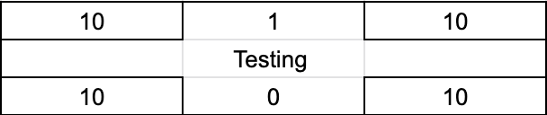
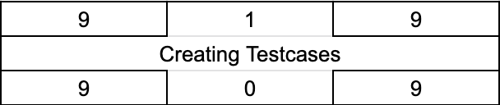
Iteration 2 Critical Path
.
.
.
.

Slide 13


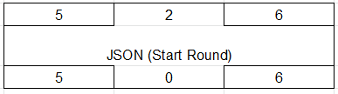

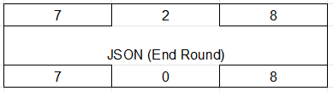


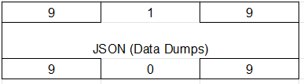



Iteration 3 Critical Path
.
.
.
.

Slide 14







Iteration 4 Critical Path

Slide 15


Iteration 5 Critical Path

Slide 16
Bug Metrics
Number of Bugs: 12
4 in Login
8 in Bootstrap
Total Points: 61
20 from Login
41 from Bootstrap
Further programming put on hold. Debugging session held on 28/09/2019 (Saturday). All bugs listed are resolved.

Slide 17
Roles &
Responsibilities
Iteration 1
Milestone - PM Review
Project Manager
Eugene
Pair programming Grp 1
Pair programming Grp 2
Minh
Risa
Piao
Francine

Slide 18
Roles &
Responsibilities
Iteration 2
Milestone - Demo
Project Manager
Minh
Pair programming Grp 1
Pair programming Grp 2
Eugene
Piao
Risa
Francine

Slide 19
Roles &
Responsibilities
Iteration 3
Milestone - UAT
Project Manager
Piao
Pair programming Grp 1
Pair programming Grp 2
Eugene
Risa
Minh
Francine

Slide 20
Roles &
Responsibilities
Iteration 4
Milestone – Post-UAT Review
Project Manager
Risa
Pair programming Grp 1
Pair programming Grp 2
Eugene
Francine
Minh
Piao

Slide 21
Roles &
Responsibilities
Iteration 5
Milestone – Final Presentation
Project Manager
Francine
Pair programming Grp 1
Pair programming Grp 2
Eugene
Minh
Piao
Risa

