Slide 1
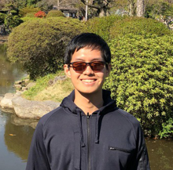
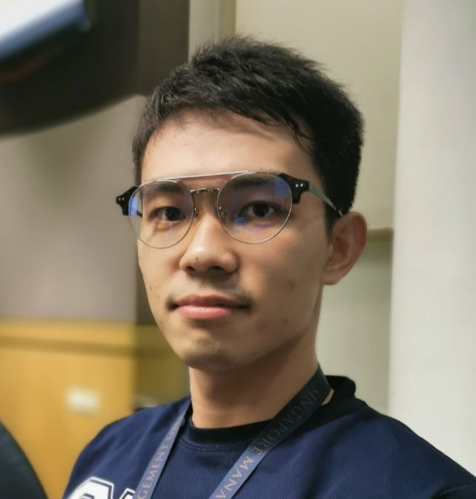

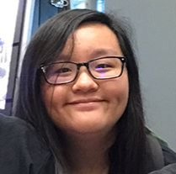
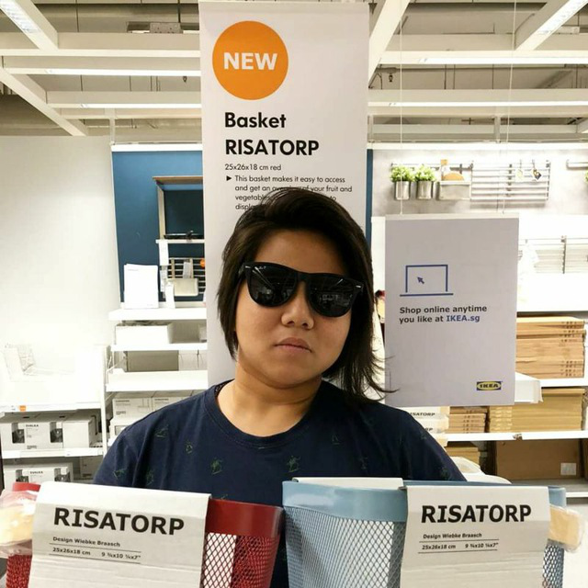
Progress Update
Week 9
G7T1 Team SPAM
Eugene
Piao
Minh
Francine
Risa

Slide 2
Functionalities
01
Finished first bidding round
02
No plan to drop functionalities or use any PHP frameworks
03
Plan to add additional search filters for finding courses (e.g. instructors)

Slide 3
Cloud Deployment Info
01
IP Address:
18.191.241.117
02
Admin Password:
nFHPBQz6VmLwR

Slide 4

Schedule
5
Iteration 5
Week 13
Iteration 4
4
Week 11 – 12
Iteration 2
3
Iteration 3
Week 7 – 8
Week 9 –10
Iteration 1
2
1
Week 5 – 6
5 iterations total

Slide 5
Iteration 2 (W7-W8)
Iteration 1 Review & Briefing (PM)
Placing Bids (Coders)
Additional search functions (Coders)
Drop bid and sections (Coders)
Round 1 Clearing (Coders)
Bid results (Coders)
Test cases and debugging (All)
Preparation for Demo/progress update (All)
Revise Schedule if needed (PM)

Slide 6
Iteration 3 (W9-W10)
Iteration 2 Review & Briefing (PM)
Additional Search Functions(Coders) *New*
Drop Section(Coders) *New*
Round 2 Clearing (Coders)
JSON Integration (Coders)
Documentation (All)
Testcases (All)
Debugging (All)
Preparation for UAT (All)
Revise Schedule if needed (PM)

Slide 7
Iteration 4 (W11-W12)
Iteration 3 Review & Briefing (PM)
Review feedback from UAT (All)
Make necessary changes (All)
Testing (All)
Any remaining documentation (All)
Deployment (All)

Slide 8
Iteration 5 (W13)
Iteration 4 Review & Briefing (PM)
Final Presentation Preparation (All)

Slide 9
Milestones
PM Review
Application Demo (Current)
User Acceptance Testing
Post-UAT Review
Final Presentation
Buffer Time: W8 – Recess Week
Saturdays/Sundays
W13 – Prep for Milestone 5

Slide 10
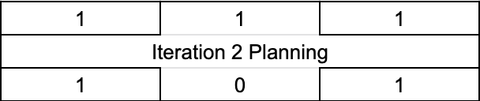
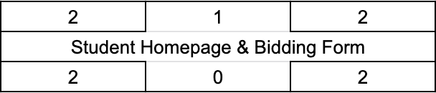

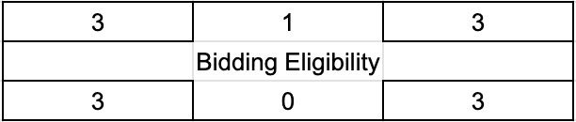
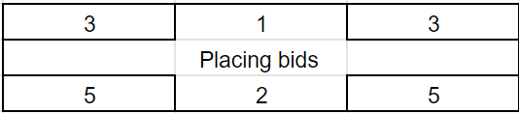

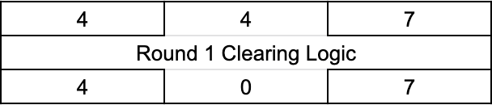
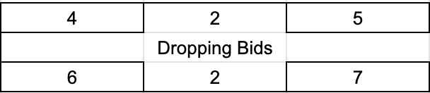

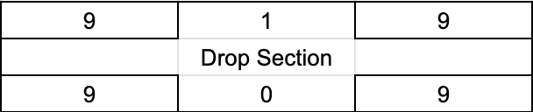
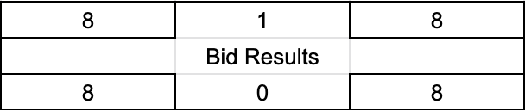
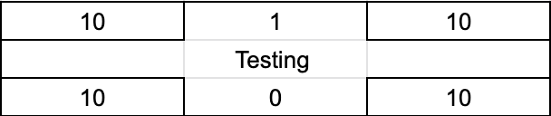
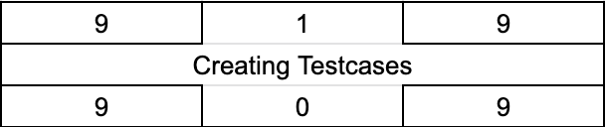
Iteration 2 Critical Path

Slide 11


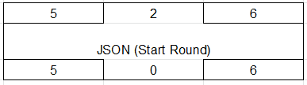

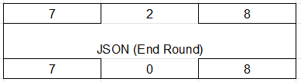


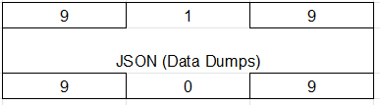



Iteration 3 Critical Path (Outdated)
.
.
.
.

Slide 12
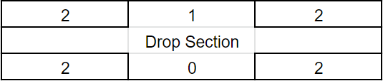
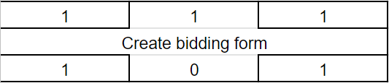
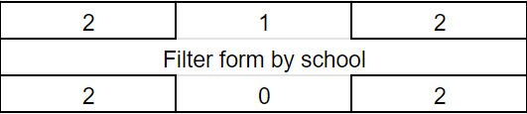
Iteration 3 Critical Path (New)
.
.
.
.

Slide 13







Iteration 4 Critical Path

Slide 14


Iteration 5 Critical Path

Slide 15
Bug Metrics
Number of Bugs: 24
12 in Bootstrap
8 in Clearing Logic
4 in Adding Bids
Total Points: 159
55 from Clearing logic
20 from Adding Bids
84 from Bootstrap
Further programming put on hold. Debugging session held on 13/10/2019 (Sunday). Some bugs listed are unresolved.

Slide 16
Roles &
Responsibilities
Iteration 2
Milestone - Demo
Project Manager
Minh
Pair programming Grp 1
Pair programming Grp 2
Eugene
Piao
Risa
Francine

Slide 17
Roles &
Responsibilities
Iteration 3
Milestone - UAT
Project Manager
Piao
Pair programming Grp 1
Pair programming Grp 2
Eugene
Risa
Minh
Francine

Slide 18
Roles &
Responsibilities
Iteration 4
Milestone – Post-UAT Review
Project Manager
Risa
Pair programming Grp 1
Pair programming Grp 2
Eugene
Francine
Minh
Piao

Slide 19
Roles &
Responsibilities
Iteration 5
Milestone – Final Presentation
Project Manager
Francine
Pair programming Grp 1
Pair programming Grp 2
Eugene
Minh
Piao
Risa

