Slide 1

12-Factor-App,
Build Cloud Ready Applications
2018-02-01, Uwe Eisele / Dieter Baier, UAS Frankfurt
Notes:
Folie <Foliennummer>

Slide 2
Introduction
Vorstellung Uwe / Dieter
Firmavorstellung
„Our passion is to develop high quality SW for our customers. We work toghether within agile teams. Due to the composition of our teams we find a balance between experience and innovation“
One of the different paradigmens
<Foliennummer>
<Foliennummer>
26.01.2018
22.01.2018
Notes:
Folie <Foliennummer>

Slide 3
The Twelve-Factor App (https://12factor.net)
  (From the manifesto itself)
  Methodology for building SAAS apps that
    Use declarative formats for setup automation
    Have a clean contract with the underlying operating system
    Are suitable for deployment on modern cloud platforms
    Minimize divergence between development and production
    Can scale up without significant changes to tooling, architecture or development practices
    Can be applied to apps written in any programming language, and which use any combination of backing services.
It is a triangulation on ideal practices for app development, paying particular attention to the dynamics of
the organic growth of an app over time, the dynamics of collaboration between developers working on
the app’s codebase, and avoiding the cost of software erosion
<Foliennummer>
<Foliennummer>
26.01.2018
22.01.2018
Notes:
Folie <Foliennummer>

Slide 4
The Twelve-Factor App (https://12factor.net)
Strict seperation of the three dev-steps – no way to change the app during runtime
One codebase, many deploys
Can be started or stopped at a moment‘s notice
I
Codebase
V
Build, release, run
IX
Disposability
Never relies on implicit existence of system-wide packages
Use the same backing services in all stages
II
Dependencies
Stateless and share nothing
VI
Processes
X
Dev/prod parity
Strict seperation of code and config
Is completely self-contained and doesn‘t rely on runtime services
Logs to the output stream and doesn‘t concern of ist storage
III
Config
VII
Port binding
XI
Logs
Doesn‘t distinct between a local or remote service
It‘s processes are ‚first class citizens‘
Provide possibilities to run run one-time-tasks within the same environment
IV
Backing Services
VIII
Concurrency
XII
Admin processes
<Foliennummer>
26.01.2018
Notes:
Folie <Foliennummer>

Slide 5
The Twelve-Factor App (https://12factor.net)
SW – Quality Model ISO/IEC 9126
M aintainability
R eliability
F unctionality
U sability
E fficiency
P ortability
<Foliennummer>
<Foliennummer>
26.01.2018
22.01.2018
Notes:
Folie <Foliennummer>

Slide 6
The Twelve-Factor App (https://12factor.net)
U
R
U
R
U
I
Codebase
V
Build, release, run
IX
Disposability
P
M
P
R
U
R
U
R
II
Dependencies
VI
Processes
X
Dev/prod parity
P
M
E
M
F
R
F
U
U
U
III
Config
VII
Port binding
XI
Logs
P
M
P
M
U
R
U
U
IV
Backing Services
VIII
Concurrency
XII
Admin processes
P
M
E
M
P
M
<Foliennummer>
26.01.2018
Notes:
Folie <Foliennummer>

Slide 7
The Twelve-Factor App – An Example https://github.com/ntuas
  The smart fridge – an example from IoT
    The fridge recognizes new products put into it
    The fridge recognizes if products where taken from it
    The fridge orders missing products on demand
<Foliennummer>
<Foliennummer>
26.01.2018
22.01.2018
Notes:
Folie <Foliennummer>

Slide 8
The Twelve-Factor App – An Example https://github.com/ntuas
Service Registry
Sensor
Inbound Gateway
Backend
Public LB
<Foliennummer>
<Foliennummer>
26.01.2018
22.01.2018
Notes:
Folie <Foliennummer>

Slide 9
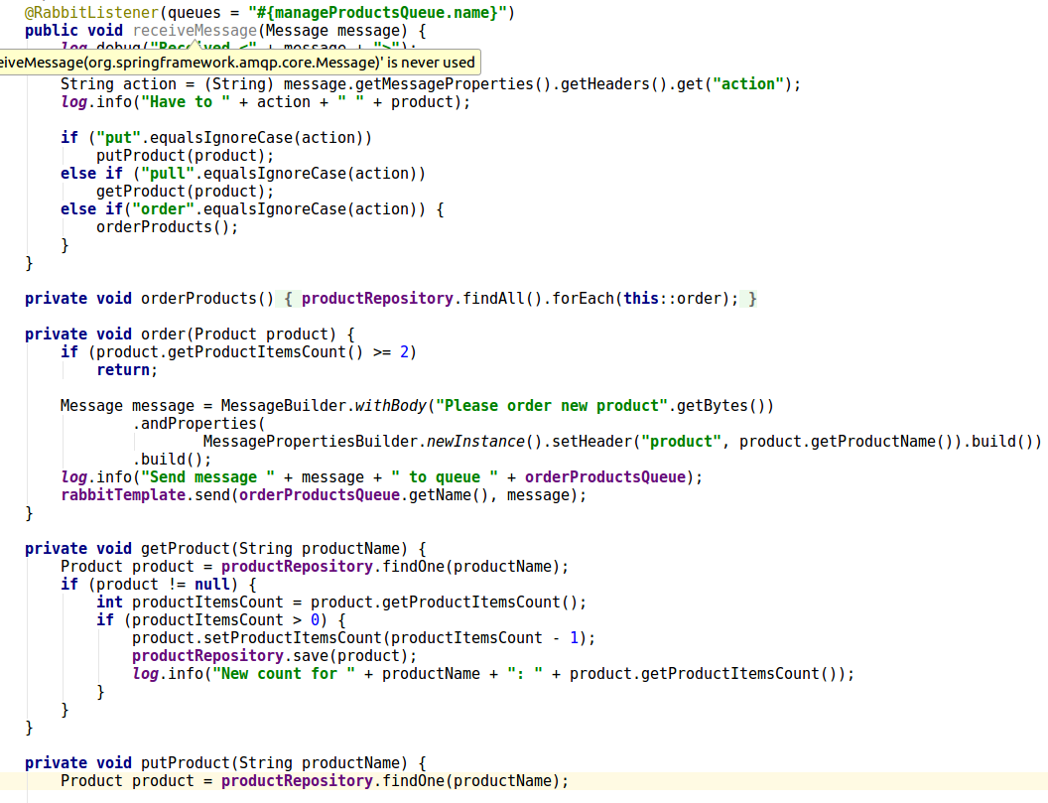
The Twelve-Factor App – Code Examples https://github.com/ntuas
<Foliennummer>
<Foliennummer>
26.01.2018
22.01.2018
Notes:
Folie <Foliennummer>

Slide 10
The Twelve-Factor App - Outlook
Still missing something?
III
Config
V
Build, release, run
XI
Logs
XII
Admin processes
<Foliennummer>
<Foliennummer>
26.01.2018
22.01.2018
Notes:
Folie <Foliennummer>

Slide 11
12-Factor-App,
Build Cloud Ready Applications
2018-02-01, Uwe Eisele / Dieter Baier, UAS Frankfurt
Notes:
Folie <Foliennummer>

