Slide 1
Consumer’s Externality
Smoker
Or
Non-Smoker?
PRESENTED BY Peter Lai , Vela Wu , Gabriel Argemí
菸一支一支一支的點

Slide 2

CONTENTS
Introduction
01
02
Approach
Conclusion
03

Slide 3
Chapter
1
Introduction

Slide 4
Introduction
Negative
Positive
What is an externality?

Slide 5
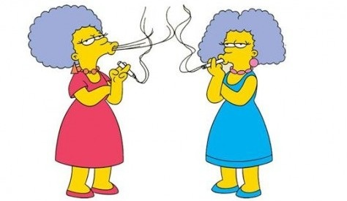
Introduction
Negative externality :
Social cost may be generated
Market price doesn’t include the cost

Slide 6
Introduction
The external costs of tobacco :
the damages to health that generates environmental smoke to passive smokers.
the calls "Financial or fiscal externalities" originate in companies with systems of health and social security financed by general taxes or by public insurance that do not adjust the premium because of the higher risk associated with tobacco consumption.

Slide 7
Introduction
Smoker :
pay tobacco excise taxes
cost of a possible lung cancer and other disease

Slide 8


Introduction
If smokers become addicted…
no need for public intervention
addiction was compatible with the full sovereignty of the consumer .

Slide 9
Introduction
different tobacco control measures
increase the price of cigarettes
the total prohibition of smoking in restaurants
tax

Slide 10

Introduction
The tax is a tool that serves to make the cost of private consumption includes the external cost.

Slide 11
Chapter
2
Approach

Slide 12

Approach
Theoretical approach to the problem：
two goods, cigarettes and money.
Two utility function : Smoker and Non-smoker
both work for the only producer who produces the cigarettes and pays a wage to our two individuals.

Slide 13

Approach
1. Producer problem :
$π={pq}−lw$
2. Utility Function:
Smoker :
$U_{s}=aq_{s}^{α}−pq+wl_{s}−cl_{s}^{δ}−tq_{s}$
Non-Smoker :
$U_{N}=−bq_{s}^{β}+wl_{n}−cl_{n}^{δ}$
Total utility of this society is:
$U_{T}=aq_{s}^{α}−bq_{s}^{β}−pq+wl−cl_{}^{δ}−tq_{s}$

Slide 14
Approach
Code
click

Slide 15
Chapter
3
Conclusion

Slide 16
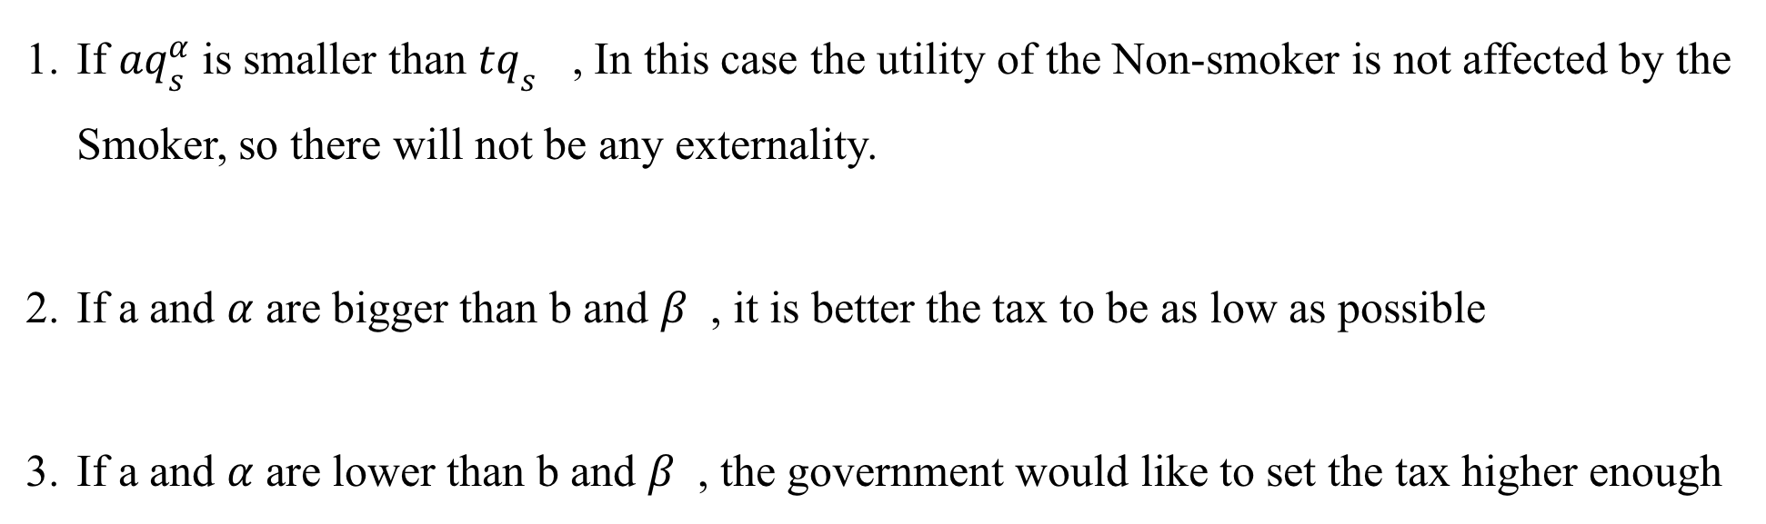
Conclusion
If $aq_{s}^{α}$ is smaller than $tq_{s}$ , In this case the utility of the Non-smoker is not affected by the Smoker, so there will not be any externality.
If a and $α$ are bigger than b and $β$ , it is better the tax to be as low as possible
If a and $α$ are lower than b and $β$ , the government would like to set the tax higher enough

Slide 17
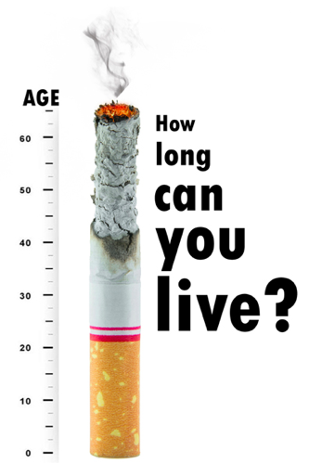
Conclusion

Slide 18
Conclusion

Slide 19

Conclusion

Slide 20
章節
Chapter
4
合作與目標
點擊此處更換文本1ppt.com.com，點擊此處更換文本1ppt.com.com ，點擊此處更換文本1ppt.com.com，點擊此處更換文本點擊此處更換文本點擊此處更換文本點擊此處更換文本

Slide 21
合作與目標
點擊此處更換文本1ppt.com.com，點擊此處更換文本1ppt.com.com
點擊此處更換文本1ppt.com.com，點擊此處更換文本1ppt.com.com
點擊此處更換文本1ppt.com.com，點擊此處更換文本1ppt.com.com
點擊此處更換文本1ppt.com.com，點擊此處更換文本1ppt.com.com
點擊此處更換文本1ppt.com.com，點擊此處更換文本1ppt.com.com

Slide 22
合作與目標
標題文本預設
點擊此處更換文本1ppt.com.com，點擊此處更換文本1ppt.com.com
標題文本預設
標題文本預設
點擊此處更換文本1ppt.com.com，點擊此處更換文本1ppt.com.com
點擊此處更換文本1ppt.com.com，點擊此處更換文本1ppt.com.com
標題文本預設
標題文本預設
點擊此處更換文本1ppt.com.com，點擊此處更換文本1ppt.com.com
點擊此處更換文本1ppt.com.com，點擊此處更換文本1ppt.com.com

Slide 23
合作與目標
50%
75%
30%
98%
標題文本預設
標題文本預設
標題文本預設
標題文本預設
點擊此處更換文本1ppt.com.com，點擊此處更換文本點擊此處更換文本
點擊此處更換文本1ppt.com.com，點擊此處更換文本點擊此處更換文本
點擊此處更換文本1ppt.com.com，點擊此處更換文本點擊此處更換文本
點擊此處更換文本1ppt.com.com，點擊此處更換文本點擊此處更換文本

Slide 24
合作與目標
標題文本預設
點擊此處更換文本1ppt.com.com，點擊此處更換文本1ppt.com.com
標題文本預設
標題文本預設
點擊此處更換文本1ppt.com.com，點擊此處更換文本1ppt.com.com
標題文本預設
點擊此處更換文本1ppt.com.com，點擊此處更換文本1ppt.com.com
PPT模板下載：www.1ppt.com/moban/ 行業PPT模板：www.1ppt.com/hangye/
節日PPT模板：www.1ppt.com/jieri/ PPT素材下載：www.1ppt.com/sucai/
PPT背景圖片：www.1ppt.com/beijing/ PPT圖表下載：www.1ppt.com/tubiao/
優秀PPT下載：www.1ppt.com/xiazai/ PPT教程： www.1ppt.com/powerpoint/
Word教程： www.1ppt.com/word/ Excel教程：www.1ppt.com/excel/
資料下載：www.1ppt.com/ziliao/ PPT課件下載：www.1ppt.com/kejian/
範文下載：www.1ppt.com/fanwen/ 試卷下載：www.1ppt.com/shiti/
教案下載：www.1ppt.com/jiaoan/
字體下載：www.1ppt.com/ziti/

Slide 25

Thanks for Listening

