Slide 1
INEQUALITY
GROUP 3
Notes:
Hello everybody we are group number 3, and we are going to give a brief introduction about inequality. In our model we consider the inequality of utility, although until now we have only focused on the income inequality, as it is the easiest to .

Slide 2
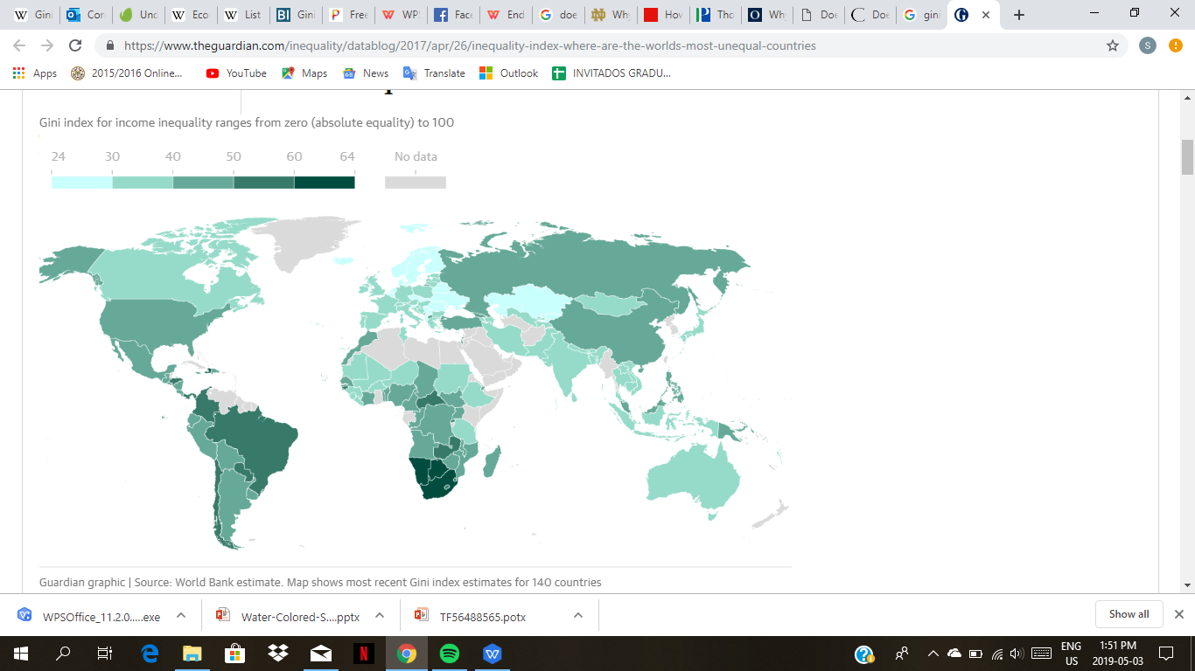
Why it matters
Gini index for income inequality ranges from zero (absolute equality) to 100
How it matters?
Descriptive measure
Guardian graphic | Source: World Bank estimate. Map shows most recent Gini index estimates for 140 countries
Notes:
Like almost everything in economics, there are not straight forward answers to these questions. I will explain why. For this, let's look at this map. Now, we will talk about the different ways of measuring inequality later, but this takes the most famous one, GINI coefficient and applies it to the income inequality of the different countries. Now I am from Paraguay... should I be worried that it's marked in dark green? Depends on who you ask.

Slide 3


Why it matters
Maybe it is just a healthy stage.
Notes:
Maybe it just reflects the state of the country, that it is growing and there are still very poor people. If you think about a family of 5 kids, there are years where their heights are more unequal, but when they are all grown up, the girls and boys of the family tend to have similar heights. In this view, trying to adress inequality per se, just how it would be very detrimental to the health of that family, would be very detrimental to the health of an economy.

Slide 4
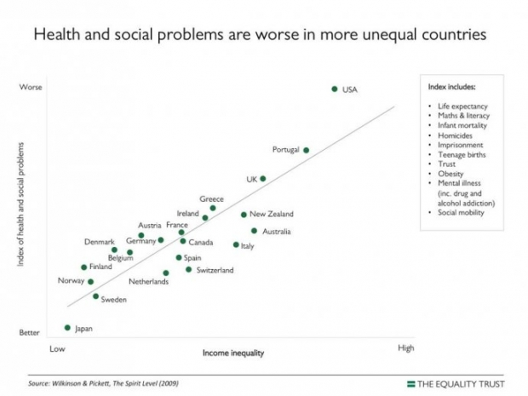
Why it matters
https://www.equalitytrust.org.uk/why-more-equality
Notes:
In the other hand, people like Richard G. Wilkinson and Kate Pickett, from the some people have argued, that inequality is highly correlated with other measures that try to capture the wellbeing of the society. In this view high inequality is associated with a number of societie's illnesses. The book they have presented has been criticised becauso data is provided on the estimated equations, or on relevant statistical tests, but we show this to show the intuition behidn these arguments. They go as far as to say

Slide 5
Why it matters
“For example, the evidence suggests that if we halved inequality here:
Murder rates could halve
Mental illness could reduce by two thirds
Obesity could halve
Imprisonment could reduce by 80%
Teen births could reduce by 80%
Levels of trust could increase by 85%”
https://www.equalitytrust.org.uk/why-more-equality
Notes:
Now we do not seek to resolve this debate, but we want to bring about a tool

Slide 6


Our Approach
Measurement
Simulation of different scenarios
Working Economy Simulation
Demonstrate the difference of inequality measurements
Adress inequality per se by utility transfers.
Notes:
Now we do not seek to resolve this debate, but we want to bring about a tool that will in the first instance be able to measure inequality in a society. For this we have build a Working Economy Simulation and Michelle will be talking about our progress in this aspect in a short while. Then, we want to demonstrate how the different measurements might produce different results, and Ricky is going to talk about it. Lastly, we are entertaining the idea of providing a dinamic in the code that demonstrates different outcomes with utility transfers. We will go in deep about that later.

Slide 7
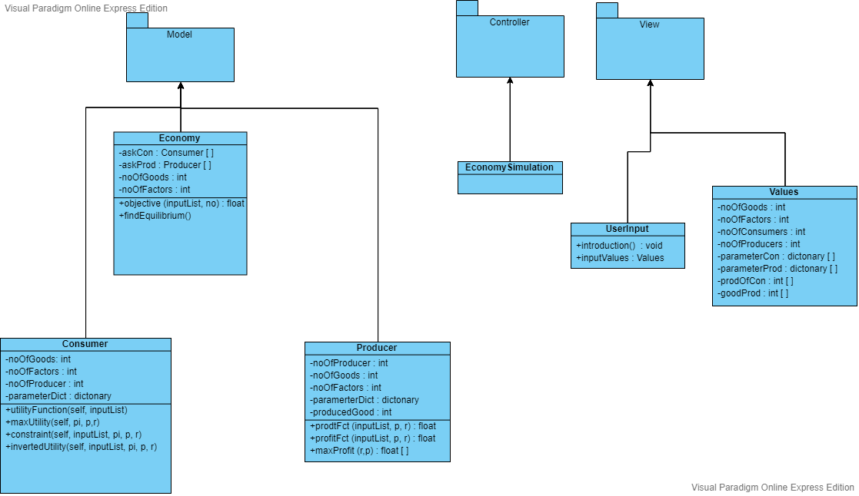
Progress

Slide 8
Different Indicators
Gini coefficient or index
S80/S20

Slide 9
Gini coefficient
What is it?
It is an economic measure that we use to calculate the income inequality that exists among the population.
How do we express it?
The coefficient ranges from 0 (or 0%) to 1 (or 100%), with 0 representing perfect equality and 1 representing perfect inequality.

Slide 10
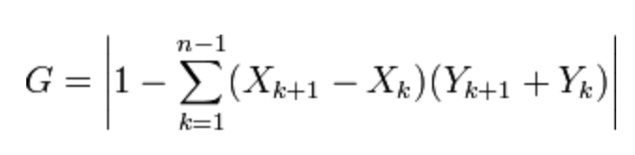
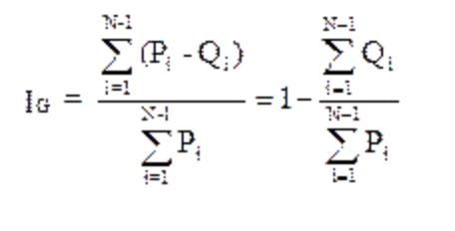
Gini coefficient
How do we calculate it?
X= People
Y= Income accumulation ratio
P= % accumulation of people
Q= % Income accumulation ratio

Slide 11
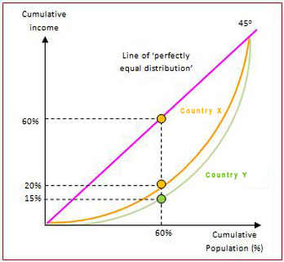
Gini coefficient
Representartion
Lorenz curve

Slide 12
Gini coefficient
Pros
Cons
•Requires comprehensive individual level data
•Requires more sophisticated computations
•Generally regarded as gold standard in economic work
•Incorporates all data
•Allows direct comparison between units with different size populations
•Attractive intuitive interpretation

Slide 13
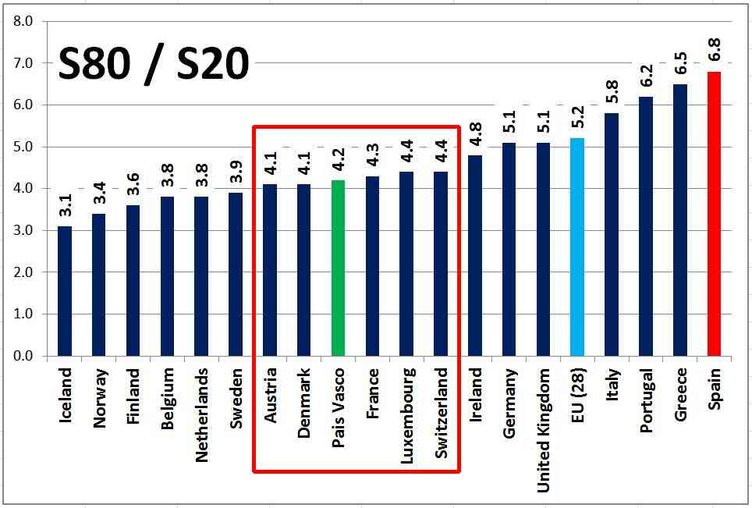
S80/S20
The S80/S20 ratio is calculated as the ratio of the mean income received by the 20% of the population with the highest income to that received by the 20% of the population with the lowest income.

Slide 14
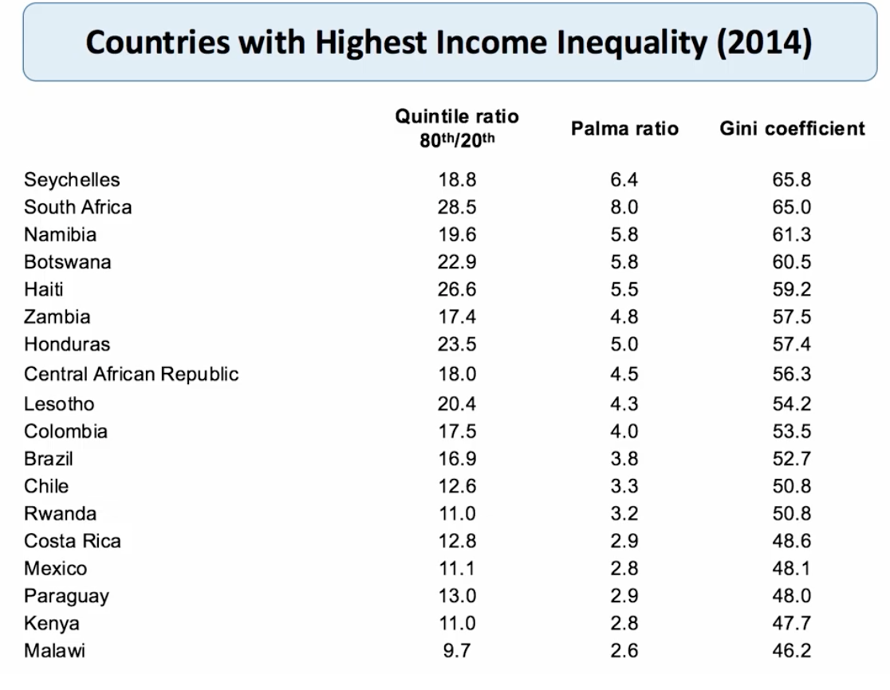

Slide 15
The problem with these approaches is that they only measure relative inequality.
If the incomes of the poor grow asfast as those of the rich, these measures will stay the same over time, but the difference in income from a one percent growth for the poor versus a one percent growth for someone already rich can be significant

Slide 16
Roadmap: changes
User Input
Inform the user of the right numbers, and give out errors if it wrong numbers are inputted .

Slide 17


If we were to adress inequality per se
Change to share approach
Independent of opinions
Now only 100 percent share holders.
As to see what happens to aggregate utility if transfers were made.
Change our consumer utility function
Adress collective action problem?
It will consider inequality as an externality that harms the individual.
If people were better off in a more equal society, why doesn't everybody just give more of their utility to the poor?

