Slide 1
Machine Learning HW5
MLTAs
ntueemlta2024@gmail.com

Slide 2
Links
Code template
Report template
Math problems

Slide 3
Outline
HW4 Intro - Knight and Pawn
Tasks Description
Prerequisites
Soft update
ε-greedy algorithm
Upper Confidence Bound (UCB)
Regulations & Grading

Slide 4
Knight and Pawn

Slide 5
Task Description
Catch the pawn with your knight as soon as possible

Slide 6
Task Description
Rule
Goal: catch the pawn with a knight
Board setting: a standard 8*8 chess board with 8 fixed obstacles at the center of the board (d4,d5,e4,e5,c3,c6,f3,f6)
Initialization: a pawn and a knight at two random different positions (not on the obstacles)
In each round, the RL agent moves the knight according to the chess rules and should not move onto the obstacles. Then, the pawn moves downward one grid with a fixed probability. Catch the pawn before 50 rounds.

Slide 7
Task Description
Reinforcement Learning formulation
Finite-state MDP (tabular method)
State : {position of the knight} ✕ {position of the pawn} → total 64*64 states
Action : all legal movements of the knight → At most 8 possible actions
Transition : randomness from the pawn
Reward : Define your own reward.
(Default : 1 if the knight catches the pawn; -0.001 otherwise)
Discount factor : Define your own discount factor (Default : 1, no discount)
(But the evaluation is related to how early you catch the pawn.)
Learning Algorithm : Value iteration
Update the value function.

Slide 8
Prerequisites

Slide 9
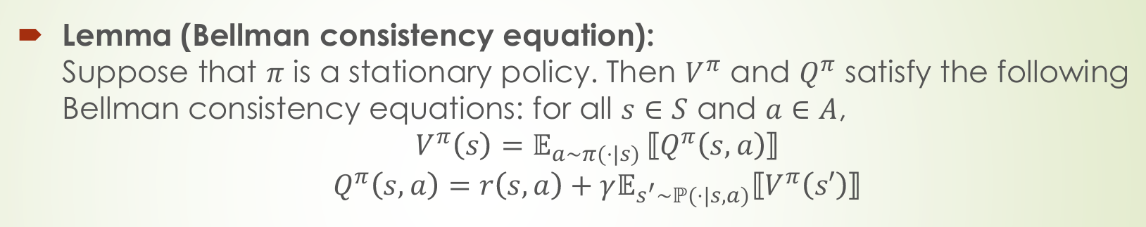
Recap
How about V^{𝛑}(s)?
Please express V^{𝛑}(s) in terms of V^{𝛑} in your report.

Slide 10
Soft Update
In practice, assume your agent took action a in state s and get into state s’,
the updated value is directly updated into
V^{𝛑}(s) ← r(s, a) + 𝛾V^{𝛑}(s’),
which is called the hard update. On the other hand, soft update is a technique used to gradually update the parameters of a target (to be updated) network or value function towards the parameters of a source (computed) network or value function. It ensures smoother learning and avoids instability, particularly in environments with high variance or stochasticity. That is
V^{𝛑}(s) ← 𝛕 · (r(s, a) + 𝛾V^{𝛑}(s’)) + (1-𝛕) · V^{𝛑}(s).

Slide 11

ε-greedy algorithm
The epsilon-greedy algorithm balances exploration and exploitation by choosing a random action with probability 𝜖 and the action with the highest estimated value with probability 1−𝜖. That is,
where r ~ Uniform(0,1) and S' is reached from S by a.

Slide 12
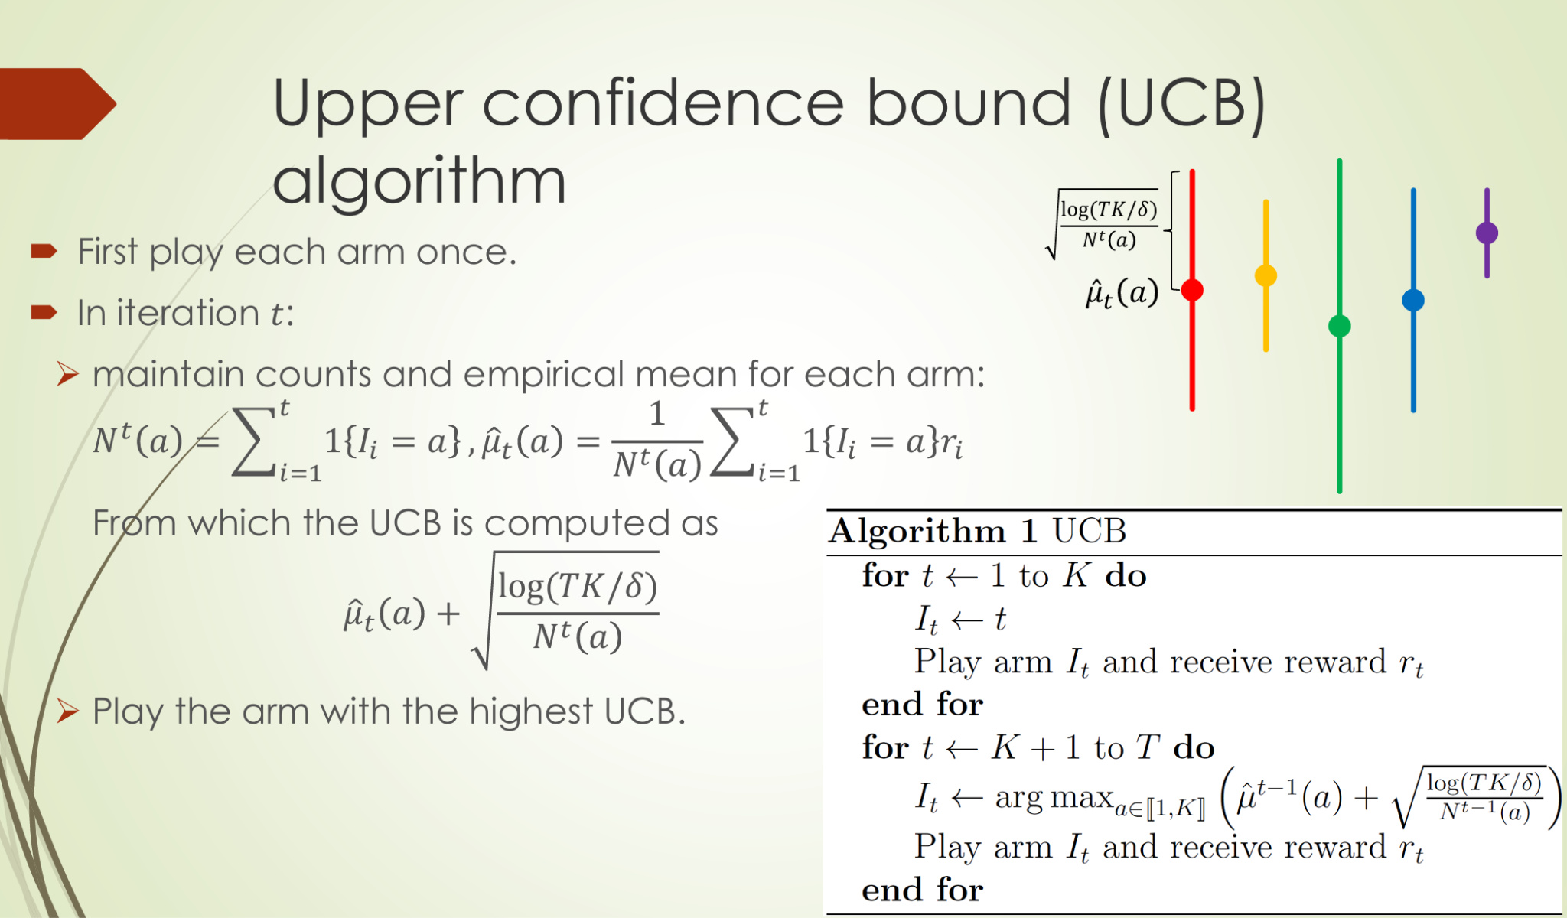

Upper Confidence Bound (UCB)

Slide 13
Regulations & Grading

Slide 14
Grading Policy - Deadline
Cool Deadline: 2024/12/20 23:59:59 (GMT+8)

Slide 15
Grading Criteria
Evaluation
Submit your V^{𝛑}(s) table as an csv file
Total 200 test cases
100 public cases
100 private cases
These cases have different initial knight and pawn positions.
Score for each case :
TA will run a program with fixed random seed for fairness (transition)
If you catch the pawn in step i, the score for this case will be 100-i
If you failed to catch the pawn, the score for this case will be 0

Slide 16
Grading Criteria
Performance score - 4%
超過public leaderboard simple baseline分數 (50.00) : 1%
超過public leaderboard strong baseline分數 (93.46) : 1%
超過private leaderboard simple baseline分數 (50.00) : 1%
超過private leaderboard strong baseline分數 (94.18) : 1%
code template
Programming report - 2%
report template
Math problem - 6%
math problem
若有和其他修課同學討論，請務必於題號前標明collaborator（含姓名、學號）

Slide 17
Cool Submissions
在Cool上分別繳交以下檔案：
report.pdf
math.pdf
code.ipynb
value_table.npy

Slide 18
Grading Policy - Others
Lateness
Cool 遲交每小時分數*0.95，兩天後歸0
有特殊原因請找助教
Runtime Error
當程式錯誤，造成助教無法順利執行，請在公告時間內寄信向助教說明，修好之後重新執行所得kaggle部分分數將x0.5。

Slide 19
學術倫理
Cheating
抄code、抄report （含之前修課同學）
開設kaggle多重分身帳號註冊competition
教授與助教群保留請同學到辦公室解釋coding作業的權利

