Slide 1
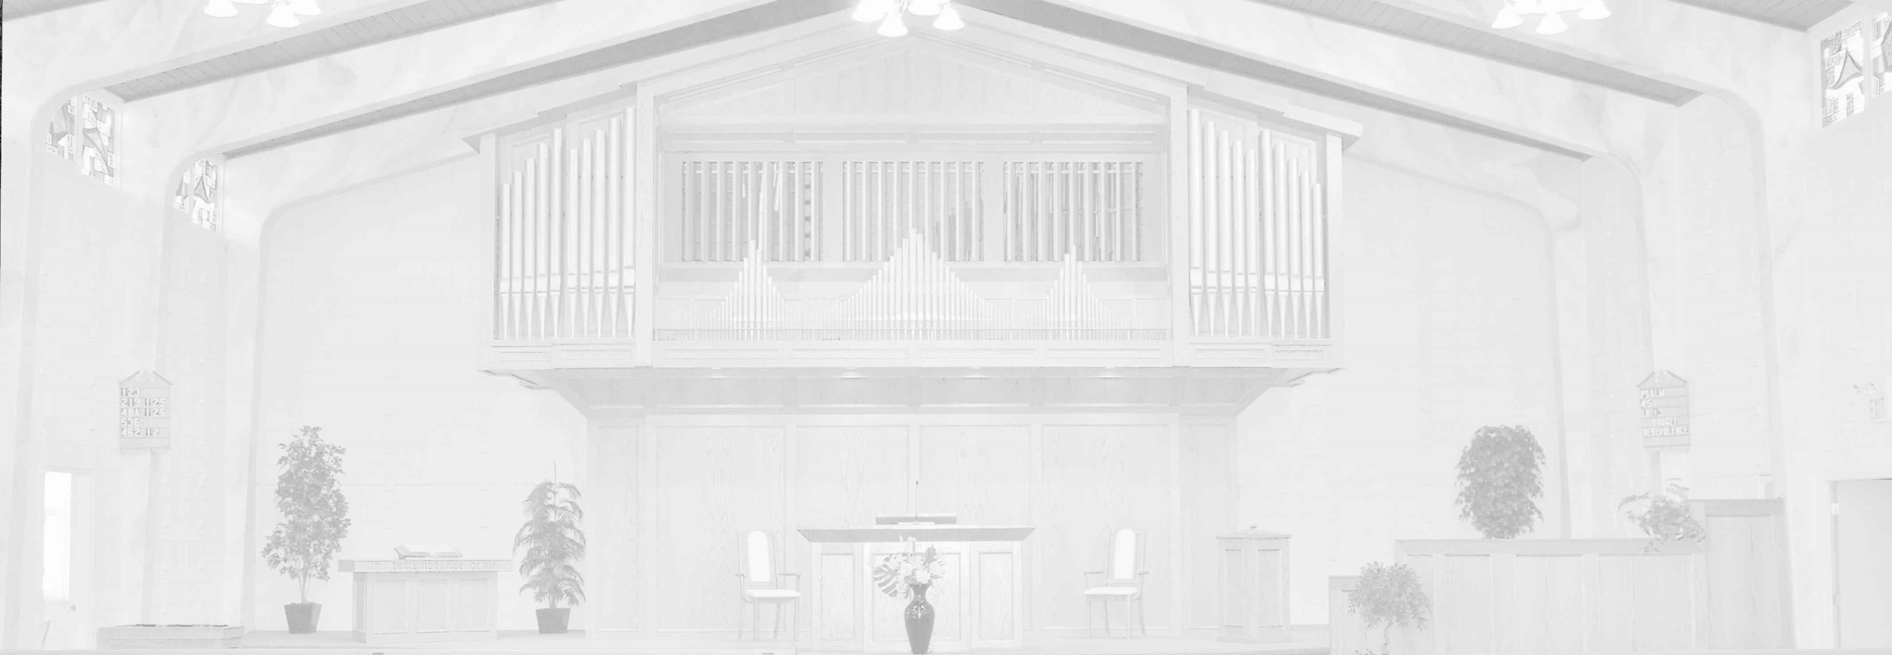
HEADER
DATE, SERVICE
SCRIPTURE
“TITLE”
PASTOR

Slide 2
Offerings
Budget
OFFERING
Giving details have been provided to members. Others who may wish to give may contact the church for additional details.

Slide 3
Apostles Creed
I believe in God the Father Almighty,
Maker of heaven and earth.
I believe in Jesus Christ, his only begotten Son, our Lord;
who was conceived by the Holy Spirit, born of the virgin Mary;
suffered under Pontius Pilate;
was crucified dead and buried;
he descended into hell;
the third day he arose again from the dead;
he ascended into heaven,
and sits at the right hand of God the Father Almighty;
from there he shall come to judge the living and the dead.
I believe in the Holy Spirit;
the holy catholic church;
the communion of saints;
the forgiveness of sins;
the resurrection of the body;
and the life everlasting. Amen.

