Slide 1
Route discovery
joseph
Jan 21, 2017

Slide 2
How does emitter know the sink ?
S
Emitter
A
B
C
B
A
D
Sink

Slide 3
Route Discovery: create reverse path
S
Emitter
Broadcast RREQ
Re-Broadcast RREQ
Re-Broadcast RREQ
ffff | A | D | A | 0
ffff | B | D | A | 1
ffff | C | D | A | 2
A
B
C
dest | next | hop | seq
dest | next | hop | seq
dest | next | hop | seq
B
A
A | A | 1
A | B | 2
D
Sink
dest | next | hop | seq
A | C | 3

Slide 4
Route Discovery: create forward path
S
Emitter
Unicast RREP
Unicast RREP
Unicast RREP
A | B | A | D | 2
B | C | A | D | 1
C | D | A | D | 0
A
B
C
dest | next | hop | seq
dest | next | hop | seq
dest | next | hop | seq
B
A
D | B | 3
A | A | 1
A | B | 2
D | C | 2
D | D | 1
D
Sink
dest | next | hop | seq
A | C | 3

Slide 5
Infinitely broadcast

Slide 6
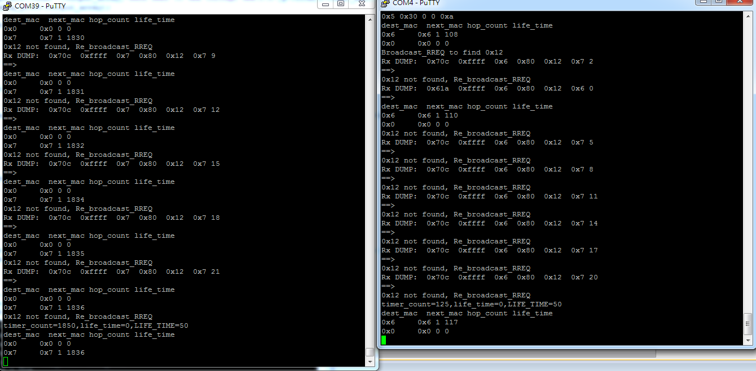
Screenshot : Infinite loop

Slide 7
Infinite loop
A and B try to find the route to D and infinitely
broadcast to each other
D
A
B
S

Slide 8
Solution: using Broadcast ID
put unique broadcast ID in the field of pkt_id for each broadcasting
broadcast ID (32bit)=MAC addr (16bit)+ SeqNo (16bit)
Example :
A (MAC: 0x0001) Broadcast RREQ
pkt_id
(Broadcast ID)
1st
B
0xffff | A | D | A | 0 | 0x10000
2nd
0xffff | A | D | A | 0 | 0x10001
3rd
0xffff | A | D | A | 0 | 0x10002

Slide 9

Prevent from Broadcast Strom
Case 1: cannot re-broadcast the packet which is originated from me
0xffff | A | D | A | 0 | 0x10000
E
A
C
S
0xffff | C | D | A | 1 | 0x10000
B

Slide 10
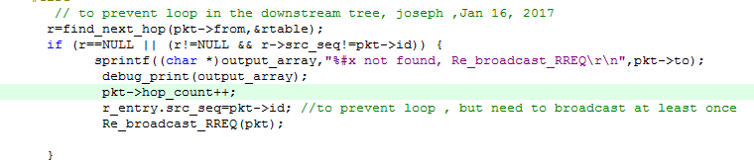
Prevent from Broadcast Strom
Case2: don't re-broadcast the packet from me
0xffff | E | D | A | 2 | 0x10000
E
C
A
0xffff | C | D | A | 2 | 0x10000
if found , we cannot
re-broadcast again
S
B
C's routing table
dest | next | hop | seq
A | A | 1 | 0x10000

Slide 11
when the route is broken

Slide 12
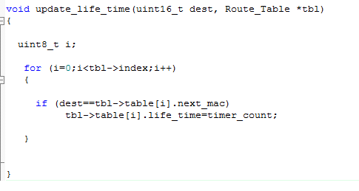
keep valid entry in routing table
whenever the packet is received do update_life_time(Src_Addr,&rtable);
D
Dest_Addr
Src_Addr
F
D | G
H
G
F | D
H's routing table
dest | next | hop | life
F | G | 2
D | D | 1

Slide 13
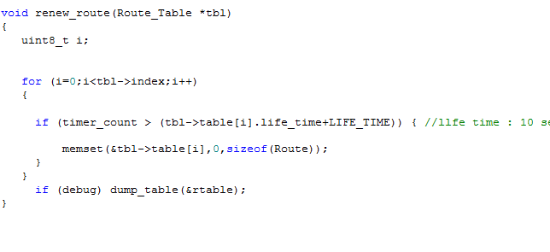
the entry has not been used within 10 seconds will be removed
B
C
dest | next | hop | seq | life_time
B
A

