Slide 1
Questions for Supervised Learning in AE Data
Can ML model predict source angles on waveforms not included in training data?
Ex: Trained on 20 and 40 degree waveforms, can it predict 30 degrees?
How well do these model generalize?
How to measure “generalization”?
Hardware changes, training 20 and 40 degree waveforms with one sensor, can it predict on the other sensor? How close of an angle do the training sets need to include.
Change distance. Distance influences attenuation of signal. At what distance can the model no longer predict the angles?
If generalizes well: how many training examples are needed?
Underlying question for each: feature selection
Dataset pulled on different days, how does the same model perform on both?

Slide 2
Jotting Down Some Thoughts
Attention is all you need
Physics informed
Clustering via autoencoders
Whole waveform vs. parameter based.
Which works better for different distances, aka which can handle attenuation better
PDE analysis / FEA, how do the natural frequencies of the composite change in tension?
Rise time over the course of the minicomposite test
Use location of event to factor damping into the signal?
Get attenuation as a function of distance and see if that improves clustering
In other words, factor in attenuation as a preprocessing step
This would be in the situation that a supervised learning algorithm fails at different distances…

Slide 3
Classification

Slide 4
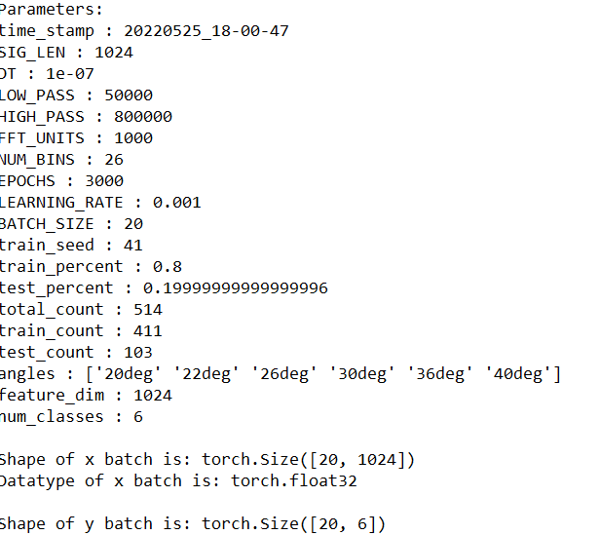
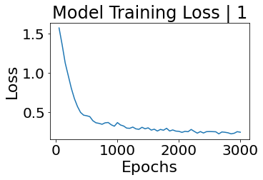
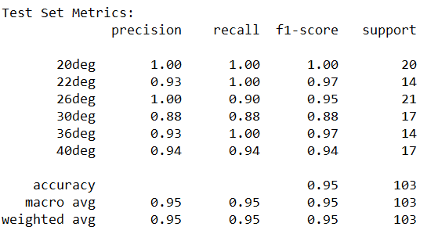
Experiment 01
Angle | # of AE Waveforms
20 | 76
22 | 87
26 | 82
30 | 82
36 | 93
40 | 94

Slide 5
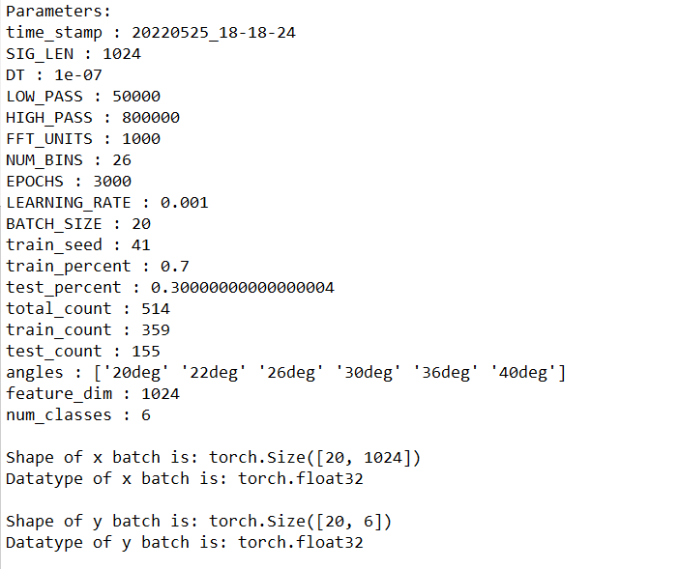
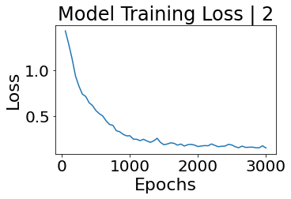
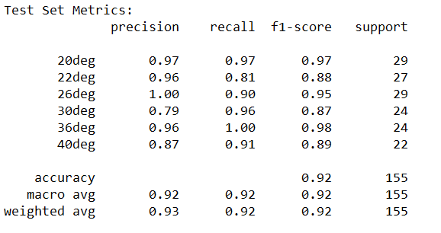
Experiment 02
Angle | # of AE Waveforms
20 | 76
22 | 87
26 | 82
30 | 82
36 | 93
40 | 94

Slide 6
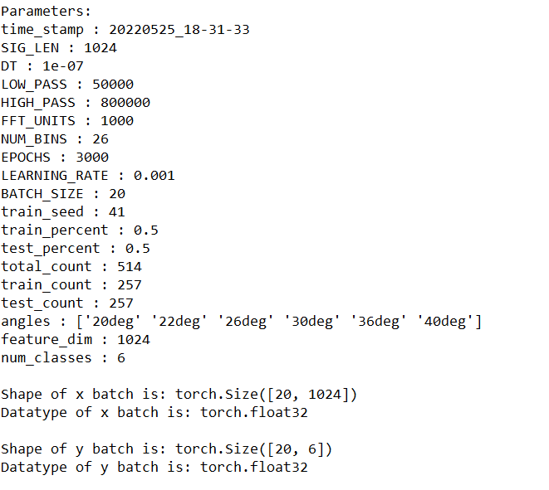
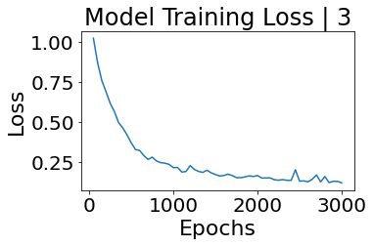
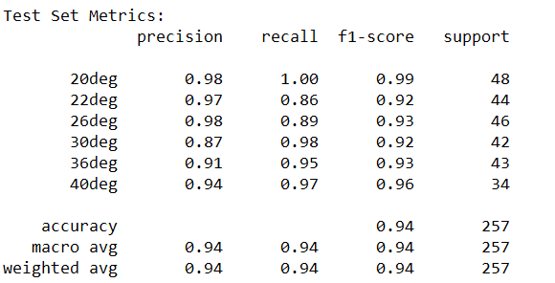
Experiment 03
Angle | # of AE Waveforms
20 | 76
22 | 87
26 | 82
30 | 82
36 | 93
40 | 94

Slide 7
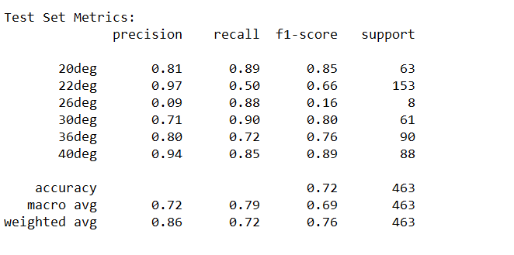
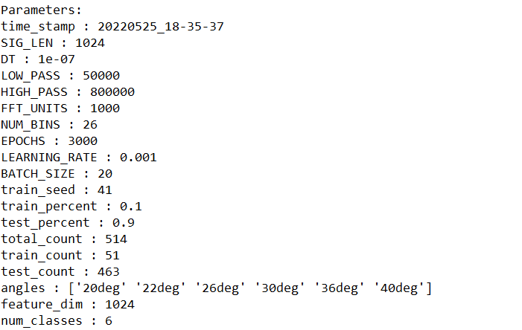
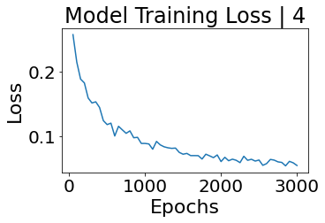
Experiment 04

Slide 8
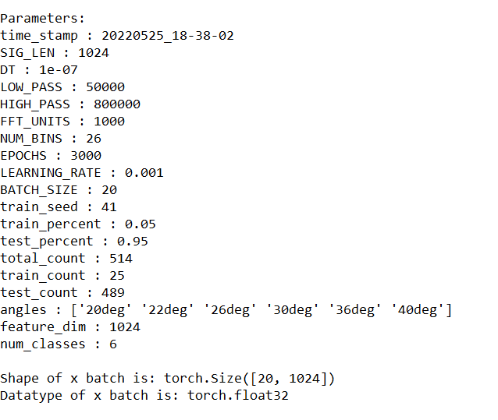
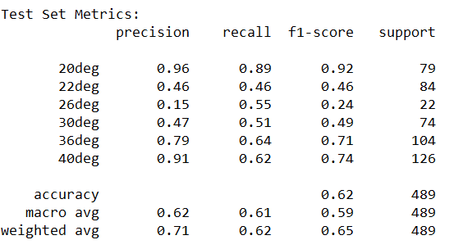
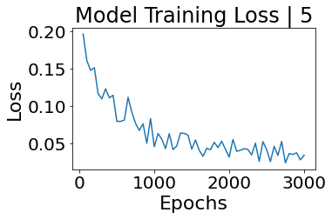
Experiment 05

Slide 9
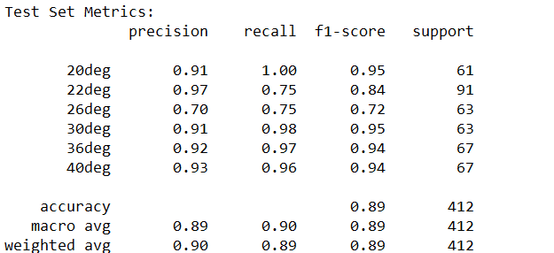
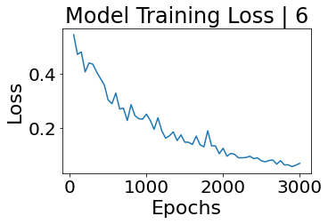
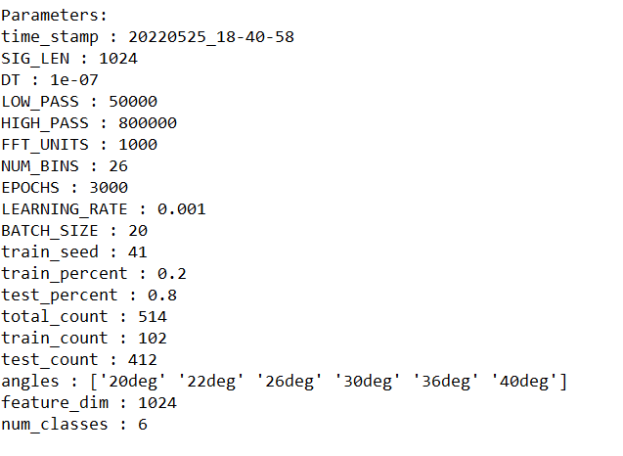
Experiment 06

Slide 10
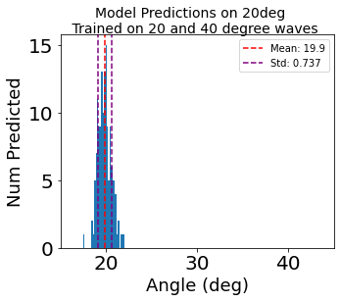
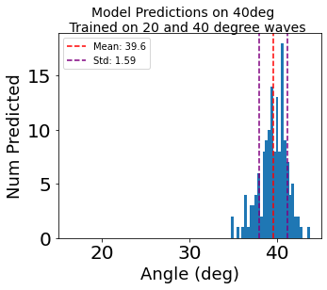
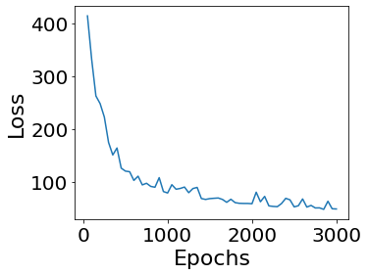
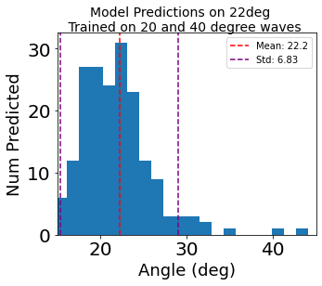
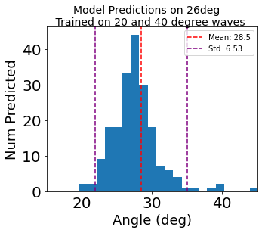
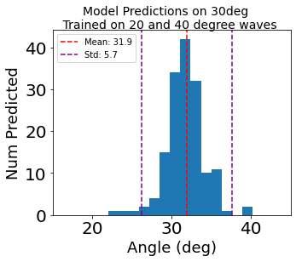
Experiment 02, using the PLB_data which had more examples than the 220426 one
Preliminary Run with Vanilla Neural Network Model (50 Neuron Hidden Layer) Trained on 20 and 40 angles PLB, for 3000 epochs
Predictions on data it was trained on ->
- Feature is entire waveform
(1024 voltage samples per example)
Predictions on data it was not trained on ->

Slide 11
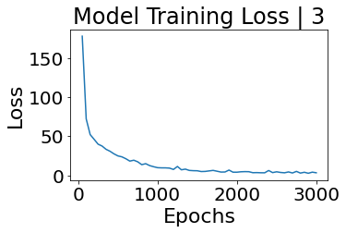
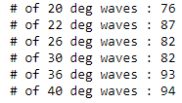
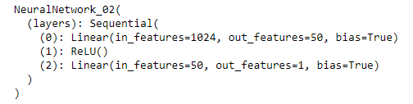
Experiment 03
Dataset: 220426 data files - > 220426_PLB_data
This is the data that was collected all in one day by one person, separate from the data that was pulled from over a long period of time by multiple people
Angle | # of AE Waveforms
20 | 76
22 | 87
26 | 82
30 | 82
36 | 93
40 | 94
Trained on 20 and 40 degrees
Raw Waveform

Slide 12
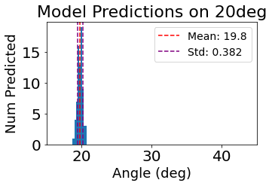
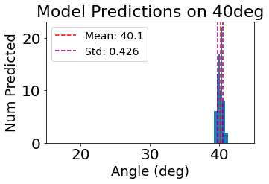
Experiment 03 | Predictions on Training Set (Sanity check, will of course do well on waveform it was trained on)
Model trained on 20 and 40 degree waveforms
Angle | # of AE Waveforms
20 | 76
22 | 87
26 | 82
30 | 82
36 | 93
40 | 94

Slide 13
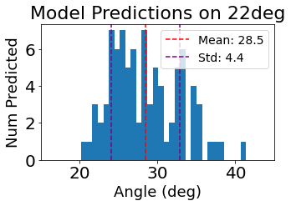
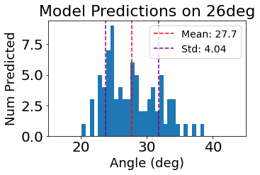
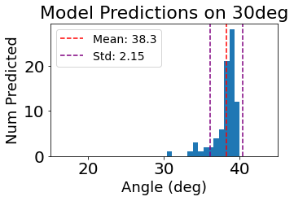
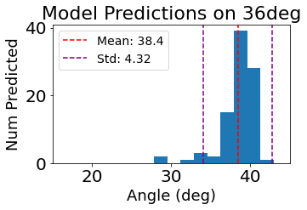
Experiment 03 | Predictions on Test Set Model was not trained on these
After looking at the waveforms, seems like it more has to do with the relationship between the different waveforms rather than the number.
Angle | # of AE Waveforms
20 | 76
22 | 87
26 | 82
30 | 82
36 | 93
40 | 94

Slide 14
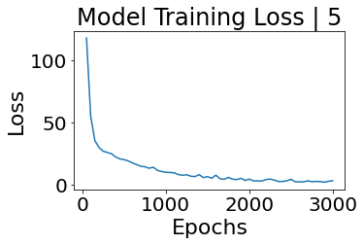
Experiment 05
Trained on 20 and 40 degree
Entire waveform
Angle | # of AE Waveforms
20 | 76
22 | 87
26 | 82
30 | 82
36 | 93
40 | 94

Slide 15
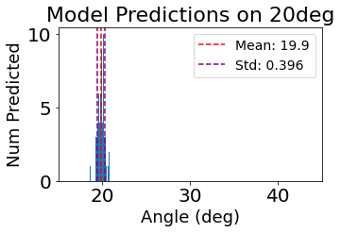
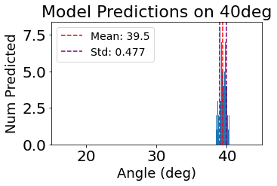
Experiment 05
Angle | # of AE Waveforms
20 | 76
22 | 87
26 | 82
30 | 82
36 | 93
40 | 94

Slide 16
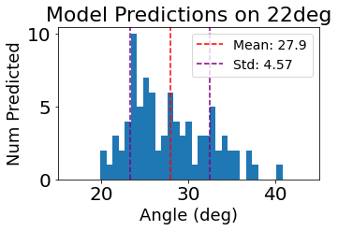
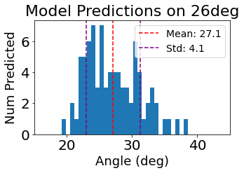
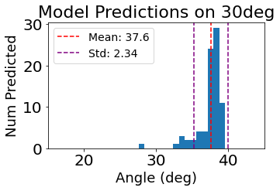
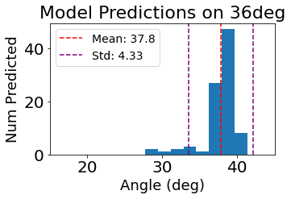
Angle | # of AE Waveforms
20 | 76
22 | 87
26 | 82
30 | 82
36 | 93
40 | 94

Slide 17
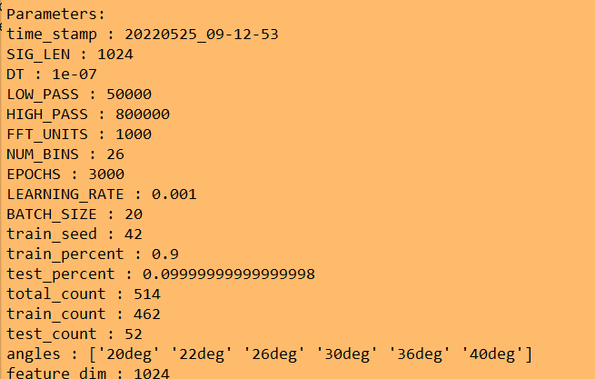
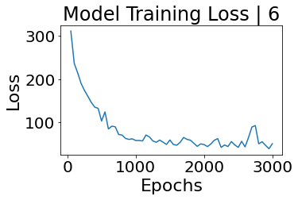
Experiment 06

Slide 18
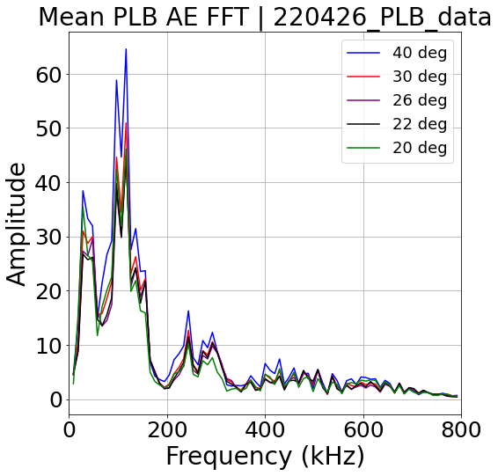
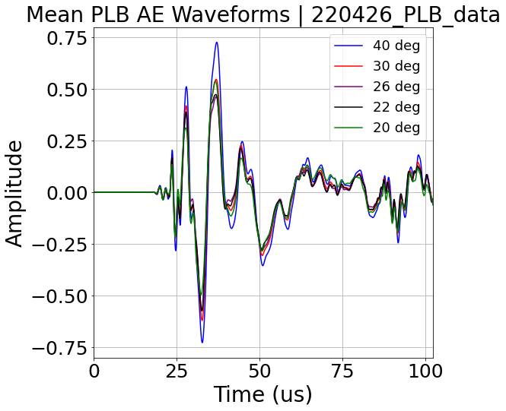
PLB_data Data acquired by multiple people over the course of a few weeks

Slide 19
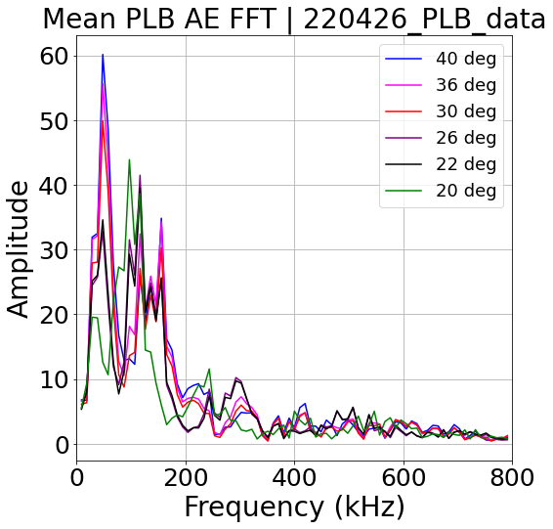
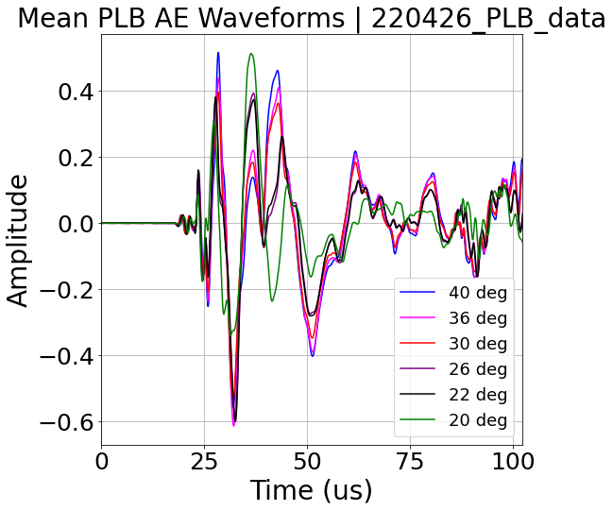
220426_PLB_data
So, the 20, 22, 26 degree have a different peak frequency than the 30,36,40?
Does this have to do with natural frequencies of the aluminum plate? Why would different modes be excited by varying the PLB.
Are there consistently the same waveforms not being able to be classified?

