Slide 1

Web Development Workshop
Please visit
https://secure.imzcy.com/web-dev
to download required materials

Slide 2
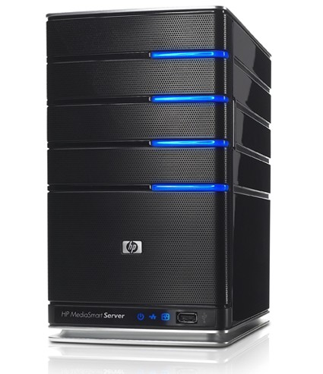

How does this happen?
GET
POST

Slide 3
What is “GET”?
http://ntuoss.com/web-dev/get.php?bootstrap=true
Content of packet sent
GET /web-dev/get.php?bootstrap=true HTTP/1.1
Host: ntuoss.com
User-Agent: Mozilla/5.0
Firefox/2.0.0.8

Slide 4
What is “POST”?
http://ntuoss.com/web-dev/get.php
Content of packet sent
POST /web-dev/get.php HTTP/1.1
Host: ntuoss.com
User-Agent: Mozilla/5.0
Firefox/2.0.0.8
Content-Length: 14
bootstrap=true

Slide 5
Introduction to HTML

Slide 6
Introduction to Bootstrap

Slide 7
Introduction to CSS

Slide 8
Introduction to JavaScript

Slide 9
Introduction to PHP

Slide 10
Test Your Webpage

