Slide 1
類神經網路-期末報告
M10507404 楊庭嘉
M10507405 邱建誠

Slide 2
Task 1
Model and Training Strategy
Validation
Results
References

Slide 3
Model Design

Slide 4
Model Design
A two stage model is employed to combat the inconsistency of data length.
The model consist of two multilayer perceptron, each posses 2 hidden layers with 40 neurons.
Features are separated into two groups according to their data length and are successively fed into corresponding network when training.

Slide 5
Two Stage Training

Slide 6
Two Stage Training

Slide 7
Two Stage Training

Slide 8
Training
Hardware
CPU: Intel i7-6700K @4.0Ghz
GPU: NVIDIA GTX1070 @1797Mhz
 | iterations | Leaning rate | time
Stage 1 | 8000 | 0.0001 | ~20min
Stage 2 | 15000 | 0.0001 | ~10min

Slide 9
Model Validation
Random sub-sampling validation
Randomly select 600 data points and exclude them from training set
Train the model using the remaining data
Use the excluded data as validation set
We take the average MAPE of 20 experiments as validation result
Training Error(MAPE) | Validation Error(MAPE)
0.1597 | 0.1612

Slide 10
Model Validation
We also validate our model on phase 1 testing set, data prior to 2016-10-18 are used as training set in this configuration.
Only the data points within to-predict time windows are used as validation set, that is 8:00~10:00 and 17:00~19:00 from 10-18-2016 to 10-24-2016.
Training Error(MAPE) | Validation Error(MAPE)
0.1585 | 0.1783

Slide 11
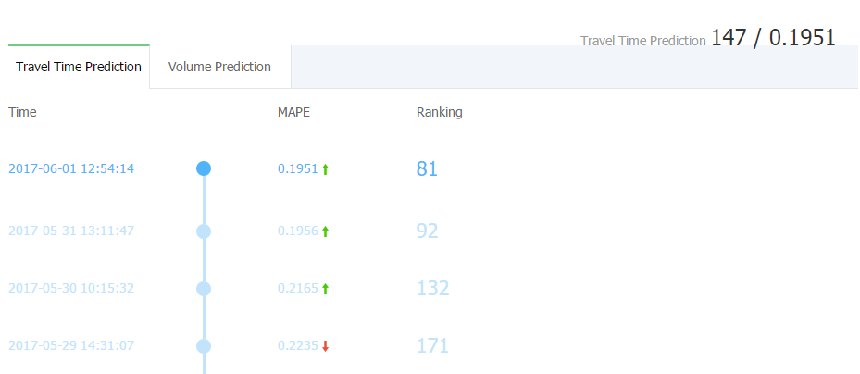
Results
Achieved 0.1951 MAPE on phase two travel time prediction task(task 1), rank 147.

Slide 12
Task 2
Data Features
ANN Architecture
Final Results & Analysis
Improve methods

Slide 13
Data Features
Tollgate id
Direction
Volume
Time
Vehicle model
Whether using etc

Slide 14
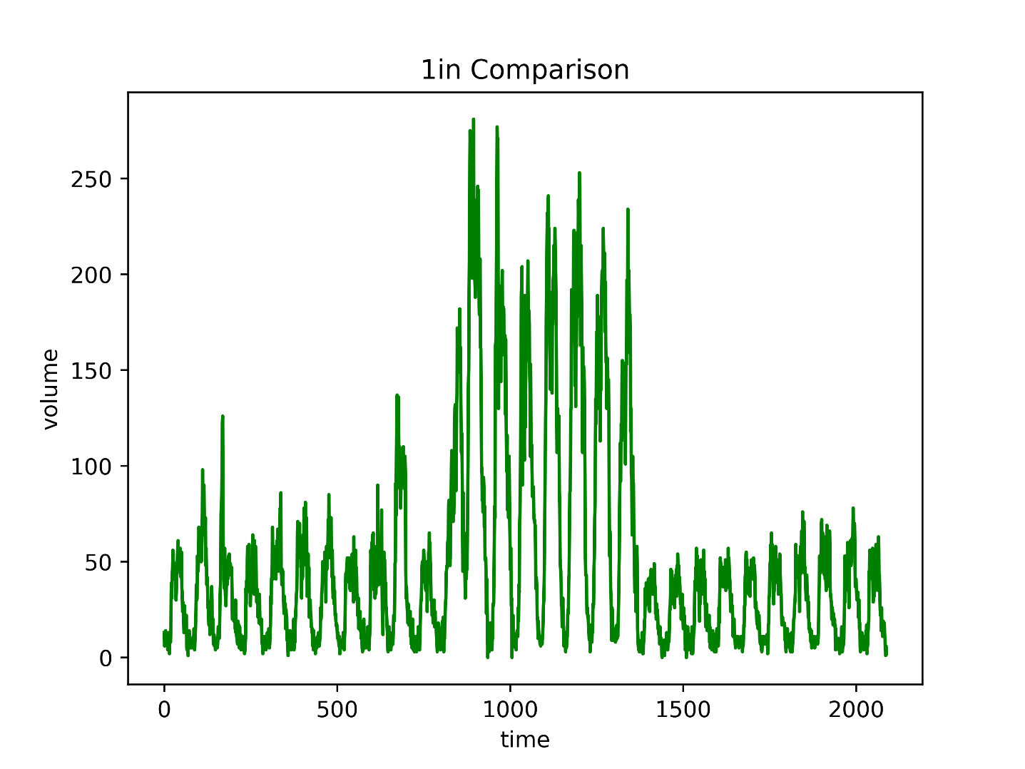
Data Features: volume in training set

Slide 15
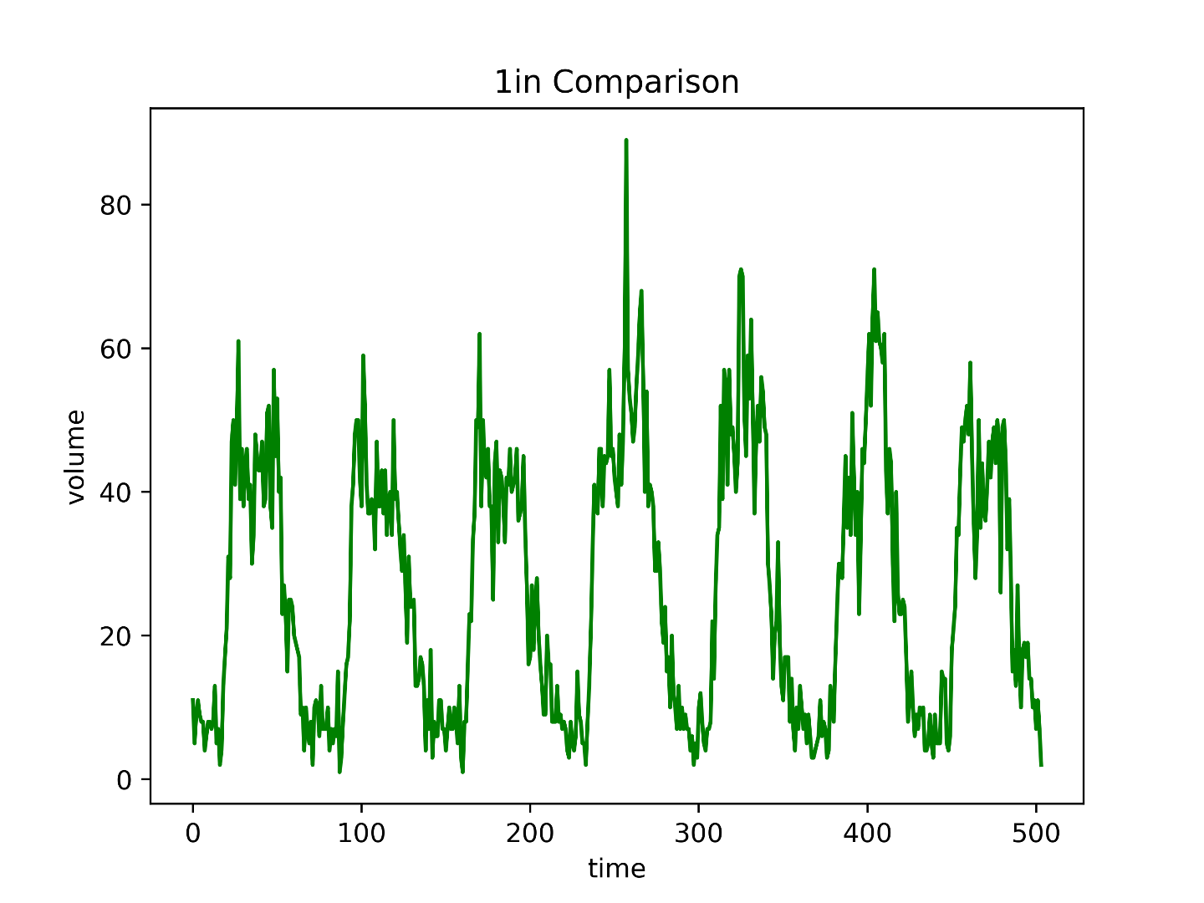
Data Features: volume in testing set

Slide 16
ANN Architecture

Slide 17
ANN Architecture: stage 1
Traffic volume is periodic
Traffic volume may be influenced by previous volume
Use less inputs to make ANN converge faster

Slide 18
ANN Architecture: stage 2
Just get differences between real volume and predicted volume
Narrow ANN to avoid overfitting and make ANN converge faster

Slide 19
ANN Architecture
To make results better, we remove strange data in middle of training data
Use dropout to avoid overfitting

Slide 20
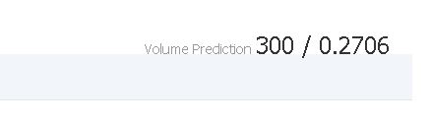
Final Results & Analysis
The MAPE of my test set is 0.17.
Big difference between my test set and contest result.

Slide 21
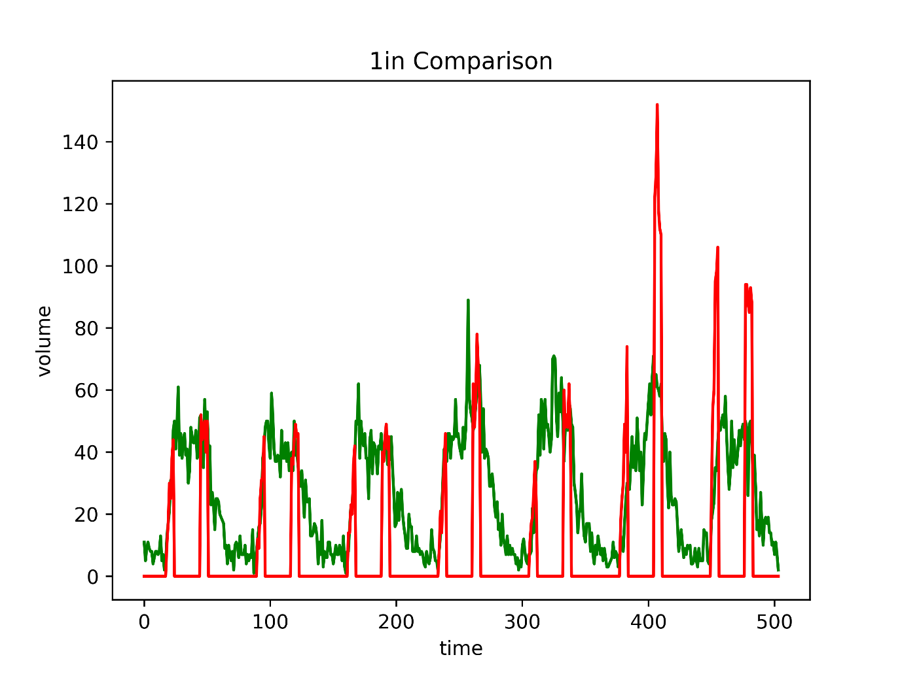
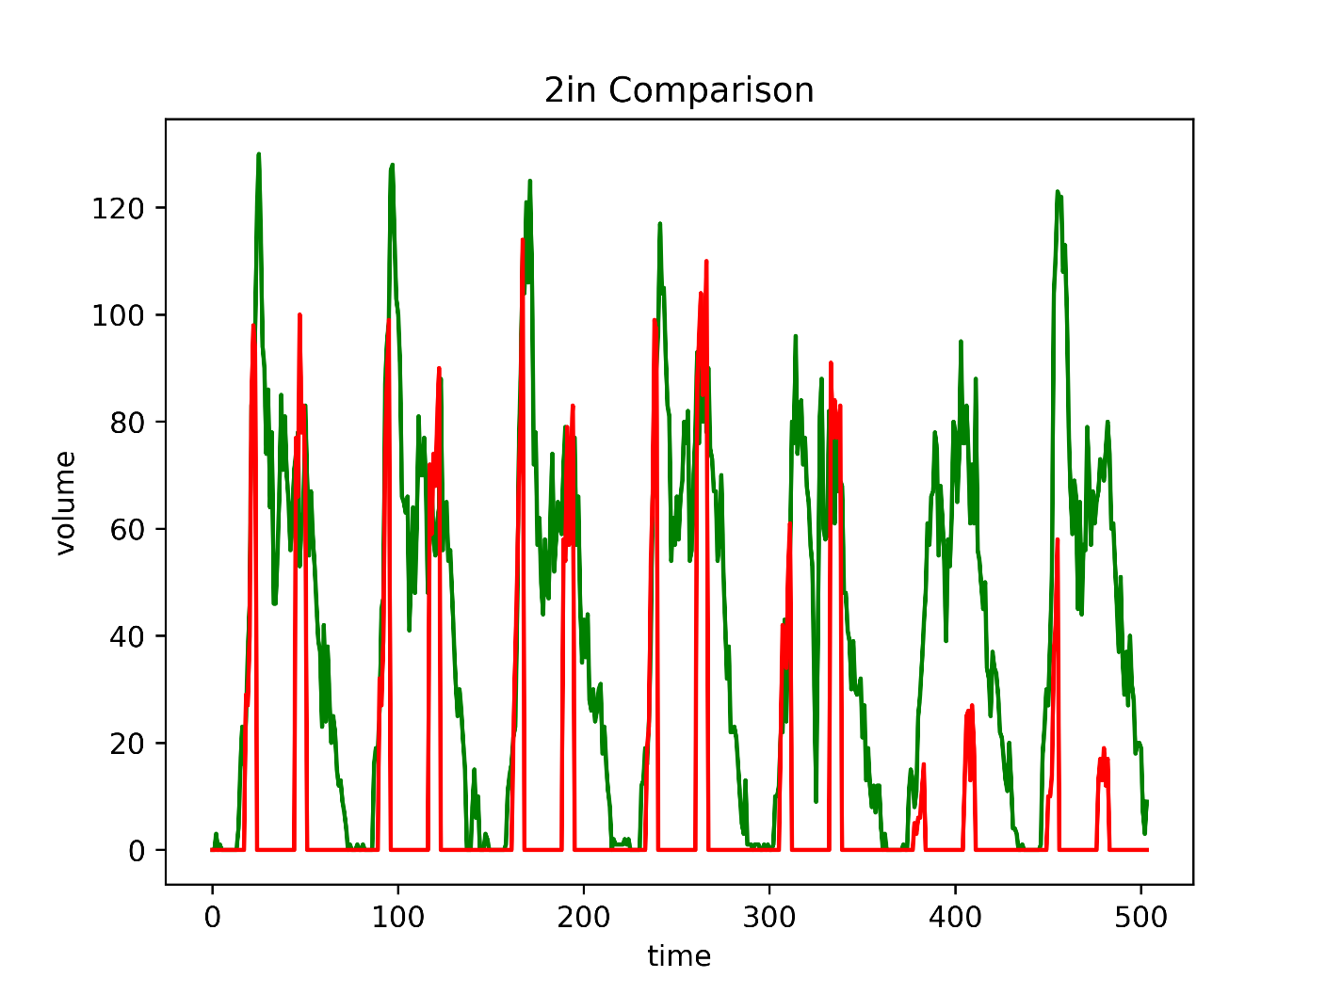
Final Results & Analysis

Slide 22
Final Results & Analysis
The Model of stage 1 only use 2 previous volume, so the output will be too periodic.
The data in the last two days are similar to the strange data, so our model can’t fit well.

Slide 23
Improve methods
use complete data to train ANN
Use the last 6 volume as the inputs

Slide 24
分工
成員 | 工作內容
M10507404 楊庭嘉 | Task 1
M10507405 邱建誠 | Task 2

Slide 25
References
[1]Srivastava, N., Hinton, G., Krizhevsky, A., Sutskever, I., & Salakhutdinov, R. (2014). Dropout: A simple way to prevent neural networks from overfitting. The Journal of Machine Learning Research, 15(1), 1929-1958.
[2]Kingma, D., & Ba, J. (2014). Adam: A method for stochastic optimization. arXiv preprint arXiv:1412.6980.
[3]Kohavi, R. (1995, August). A study of cross-validation and bootstrap for accuracy estimation and model selection. In Ijcai (Vol. 14, No. 2, pp. 1137-1145).

Slide 26
References
[4] Mart´ın Abadi, Ashish Agarwal, Paul Barham, Eugene Brevdo, Zhifeng Chen, Craig Citro, Greg S. Corrado, Andy Davis, Jeffrey Dean, Matthieu Devin, Sanjay Ghemawat, Ian Goodfellow, Andrew Harp, Geoffrey Irving, Michael Isard, Yangqing Jia, Rafal Jozefowicz, Lukasz Kaiser, Manjunath Kudlur, Josh Levenberg, Dan Mane, Rajat Monga, Sherry Moore, Derek Murray, Chris ´ Olah, Mike Schuster, Jonathon Shlens, Benoit Steiner, Ilya Sutskever, Kunal Talwar, Paul Tucker, Vincent Vanhoucke, Vijay Vasudevan, Fernanda Viegas, Oriol ´ Vinyals, Pete Warden, Martin Wattenberg, Martin Wicke, Yuan Yu, and Xiaoqiang Zheng. TensorFlow: Large-scale machine learning on heterogeneous systems, 2015. Software available from tensorflow.org.

