Slide 1
Neural Network Final Project KDD CUP 2017 Task 1: Travel Time Prediction
Members: 陳啟元 M10515017
詹立馨 M10515005
王名宸 M10515094

Slide 2
Outline
Feature Extraction
Data Preprocessing
Model Selection
-Multi-layer Perceptron Neural Network
-Random Forest Regression
Evaluation
Result

Slide 3
Feature Extraction
Time
Hour
Minute
Weekday
Intersection
Tollgate
Weather
Precipitation
Wind direction
Temperature
Humidity

Slide 4
Feature preprocessing
Normalization
Calculate mean and standard deviation to scale the variance (for weather features)
Categorical feature encoding
one-hot encoding
Weekday 1 ➔ [0,0,0,0,0,0,1]
Weekday 2 ➔ [0,0,0,0,0,1,0]
….
Weekday 7 ➔ [1,0,0,0,0,0,0]

Slide 5
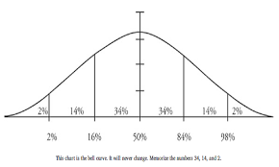
Travel Time consideration
Concept: “Time“ is the key to prediction travel time in the future, so we want to collect the characteristic of “Time” of a day.
Training data
Average time in Time 6-8 a.m.
=> measure traffic status in the day
Testing data
When we have the data of pre-2 hours (6-8, 15-16).
We expect that we can tell what will be going on in next 2 hours.

Slide 6
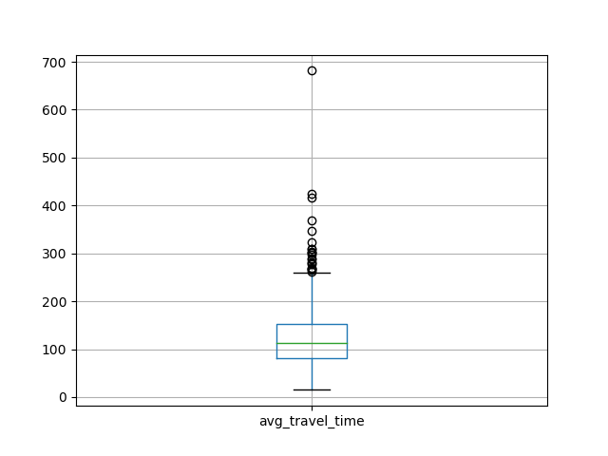
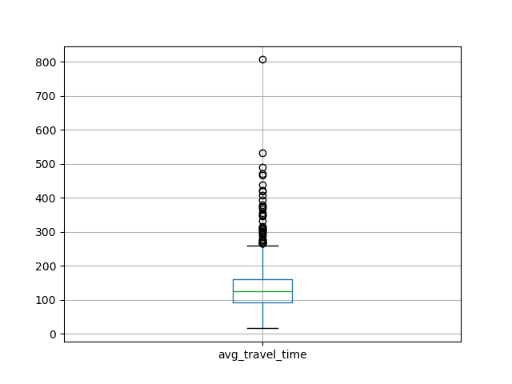
Feature preprocessing (cont’d)
Remove outlier value
Remove data of special day
9/15-9/17, 10/1-10/7
9/18, 10/8, 10/9
7am
8am

Slide 7
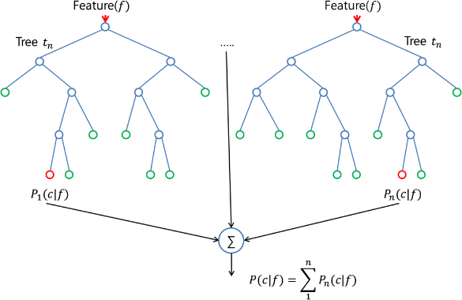
Model Selection
Model 1 :
Random Forest Regression
Developed by Leo Breiman and Adele Cutler. It is a common model to traffic prediction.
Why we use:
1.Suitable for processing high dimension data
2. Easy to be done
3. Enable to find the relation among features.

Slide 8
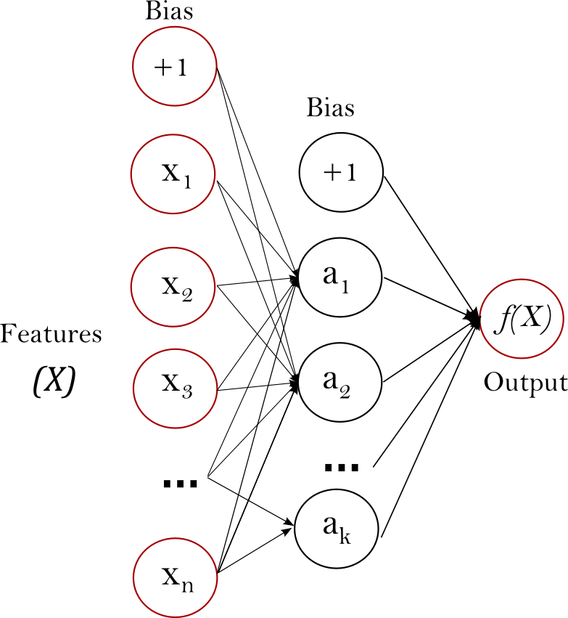
Model Selection (cont’d)
Model 2:
Multi-layer Perceptron Neural Network
Parameter setting:
Grid Search on
Learning rate: [0.05, 0.01, 0.005, 0.001]
Hidden layer size: [100,200,300]
Activation function: [logistic, tanh, relu]

Slide 9
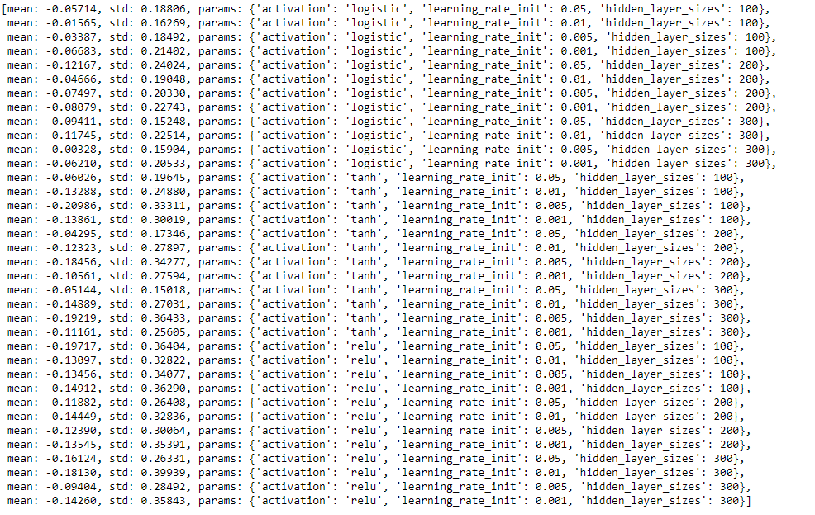
Multi-layer Perceptron Neural Network
Grid Search
Best parameter:
activation: logistic
learning_rate_init: 0.005
hidden_layer_sizes: 300

Slide 10
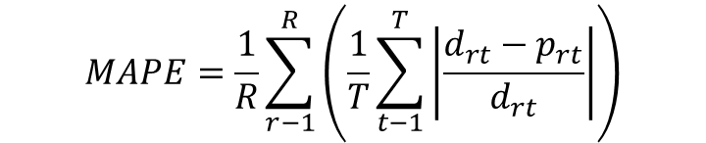
Evaluation
Whole training data: 20903
Training set: 80%
Testing set : 20%
Cross-Validation: 5-fold
Validation MAPE: 0.21 – 0.28
$$MAPE=\frac{1}{R}\sum_{r−1}^{R}{\left(\frac{1}{T}\sum_{t−1}^{T}{\left|\frac{d_{rt}−p_{rt}}{d_{rt}}\right|}\right)}$$

Slide 11
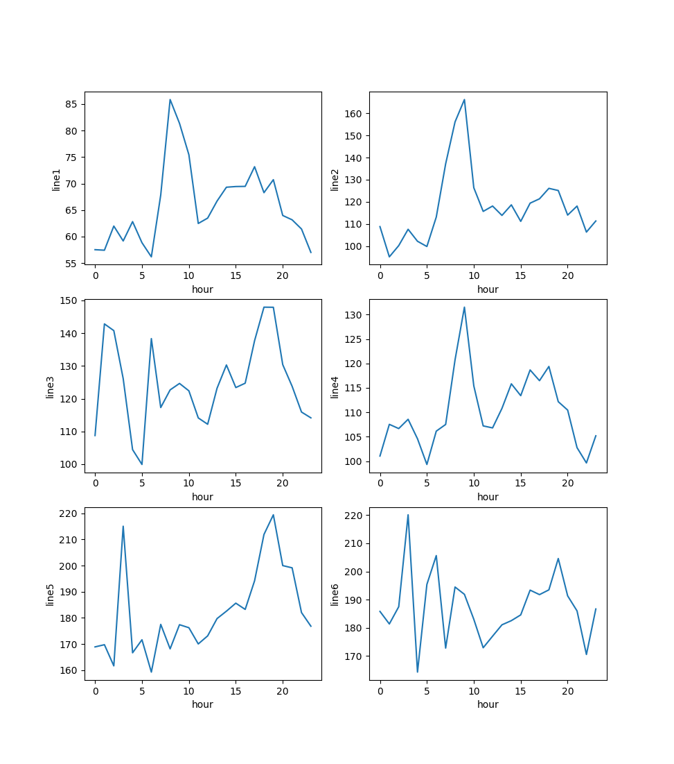
Model Combination
Notes:
vote

Slide 12
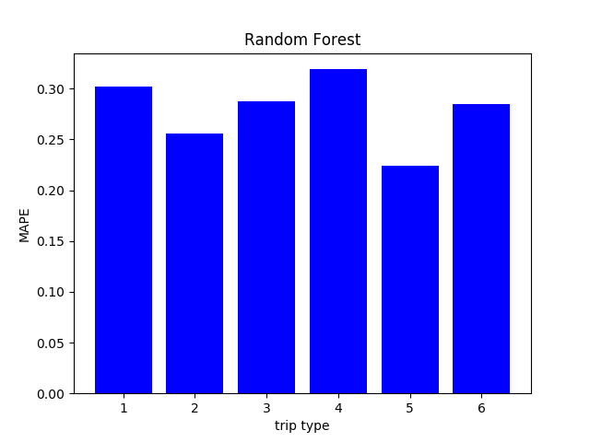
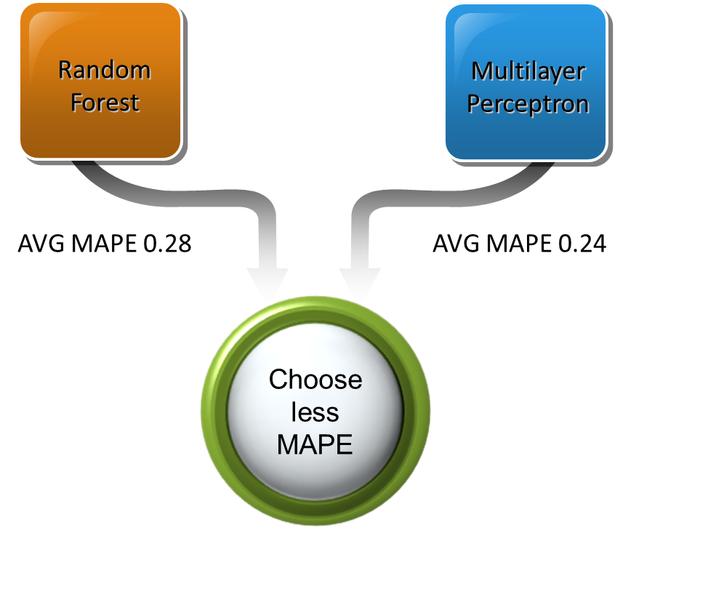
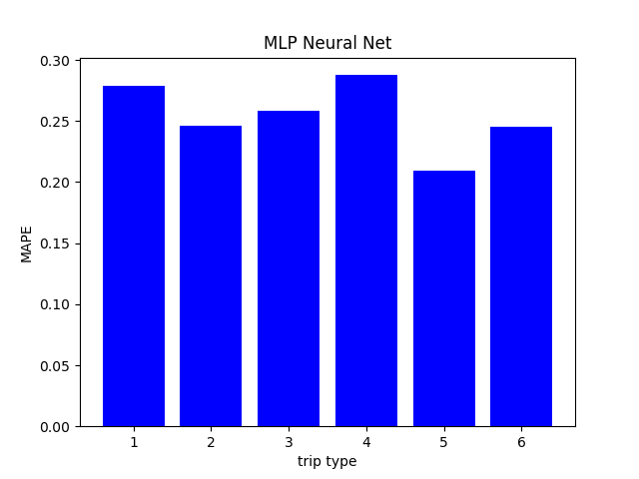

Slide 13
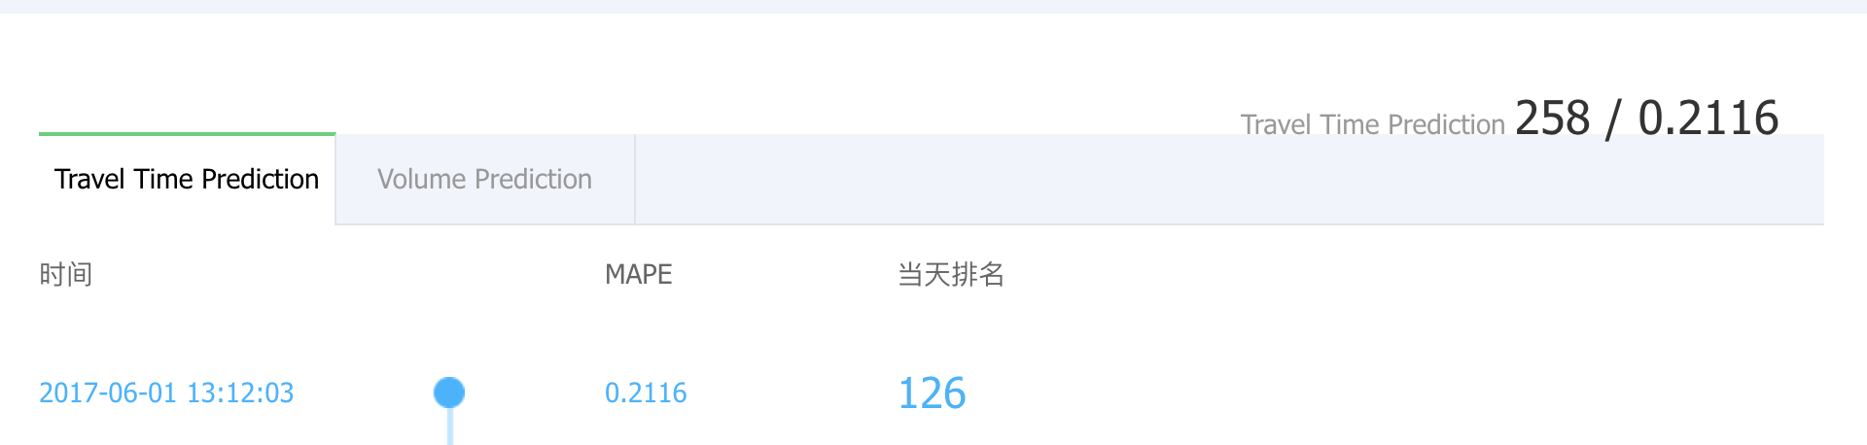
Result

