Slide 1
類神經網路 期中報告
湯京祐 M10515069
高凱昱 M10515091
易洋 M10515801

Slide 2
概要
方法 (feature extraction & selection, data normalization, data filtering, model selection)
工具及平台
現在遇到的問題
精進的部分

Slide 3
feature extraction
“time_window”
“hour”
weather features (table 7)
binding
“starting_time” (table 5)
/
“time” (table 6)
extracting
“date”
“weekday”
“holiday”

Slide 4
feature selection
task1
inter_id, toll_id, (date & time features), weather features (from table7)
task2
toll_id, direction, (date & time features), weather features (from table7)

Slide 5
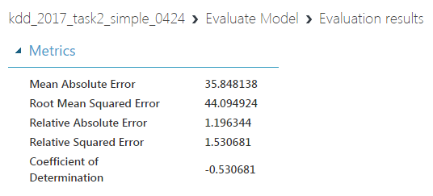
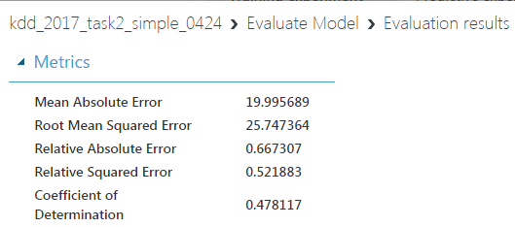
data normalization
normalization includes time features
without time features…

Slide 6
data filtering
e.g.
select ‘travel_time’ < 500

Slide 7
model selection
Boosted Decision Tree Regression (Azure ML)
for NN model…

Slide 8
工具及平台
pandas & Azure ML

Slide 9
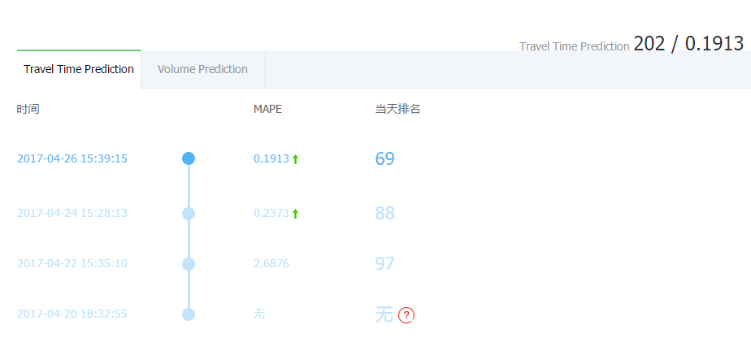
Scoring

Slide 10
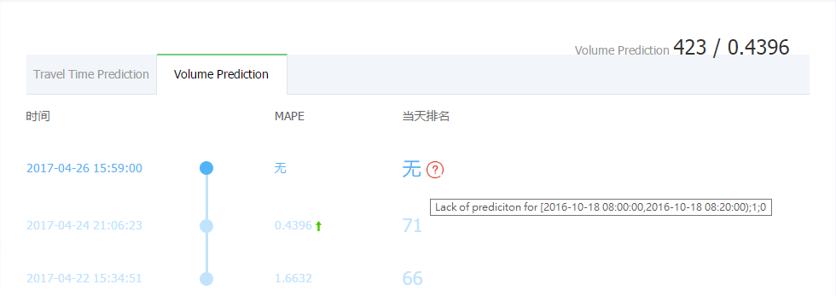

Scoring

Slide 11
未來可精進的部分
更多feature的發掘提取
干擾資料的排除
model的選取及參數調整

Slide 12
thanks for watching!

