Slide 1
KDD Cup 2017
Speaker：陳昶儒、周鴻汶、王仁緯
Prof.：李漢銘 老師

Slide 2
Divide the work
Name | Data processing | Train model
陳昶儒 | v | v
周鴻汶 | v | v
王仁緯 | v | v

Slide 3
Outline
Task 1 (travel time)
Data processing
Train model ( using Microsoft Azure )
Train model ( using Python Tensorflow)
Task 2 (volume)
Data processing
Train model ( using Python Keras)

Slide 4
Task 1 (travel time)

Slide 5
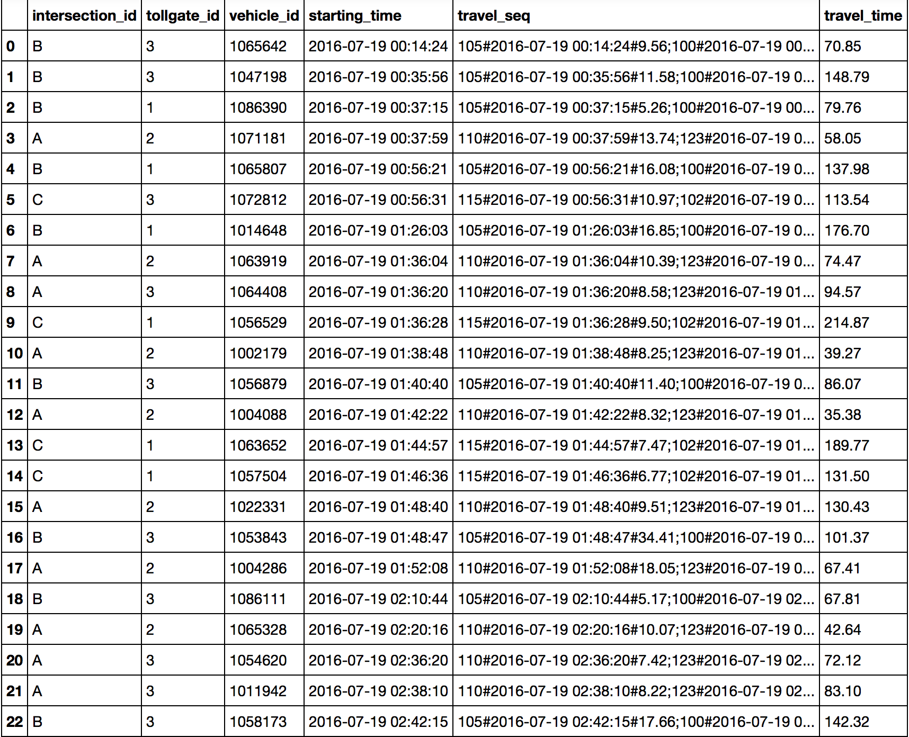
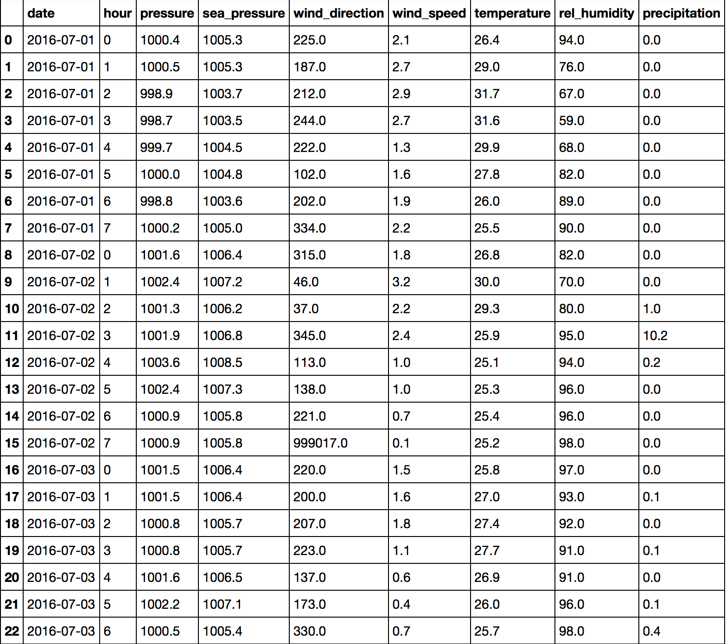
Data processing (travel time)
Original data set :
trajectories data
weather data

Slide 6
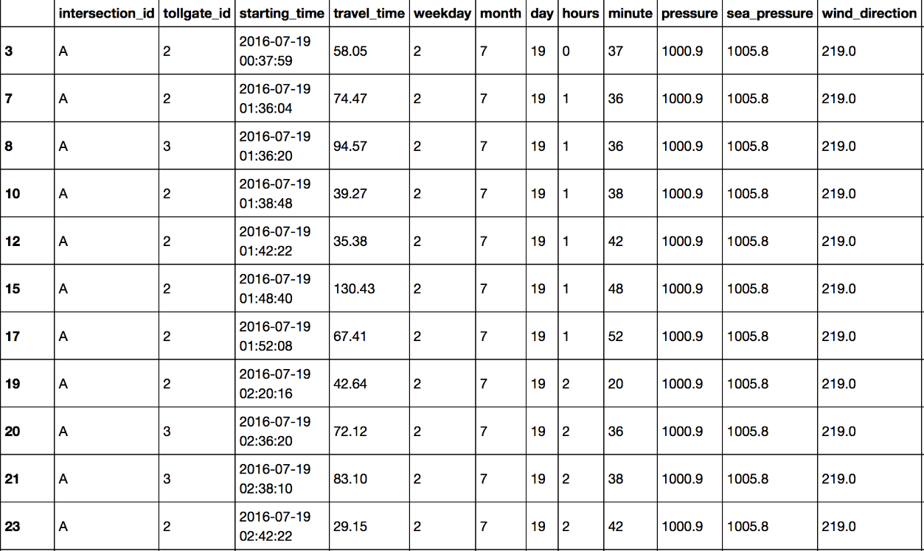
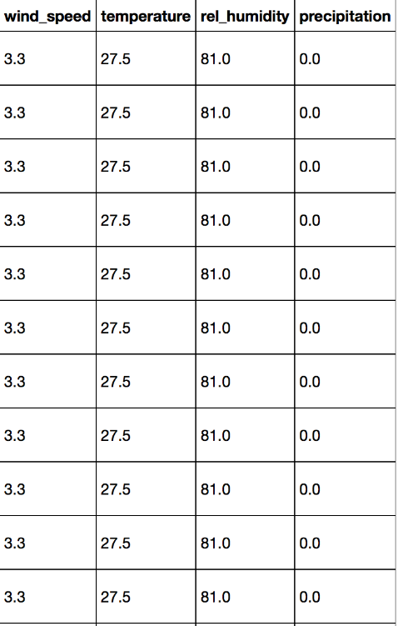
combine the trajectories and weather data
split dataset and use them to train different models
Routes from Intersection A to Tollgates 2 & 3;
Routes from Intersection B to Tollgates 1 & 3;
Routes from Intersection C to Tollages 1 & 3.

Slide 7
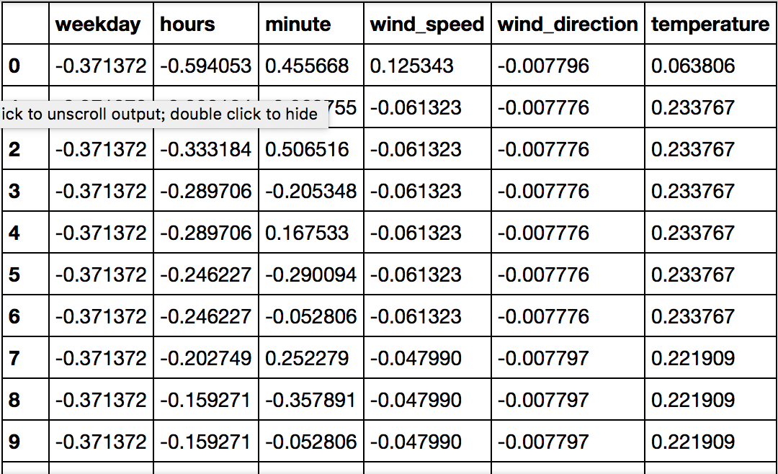
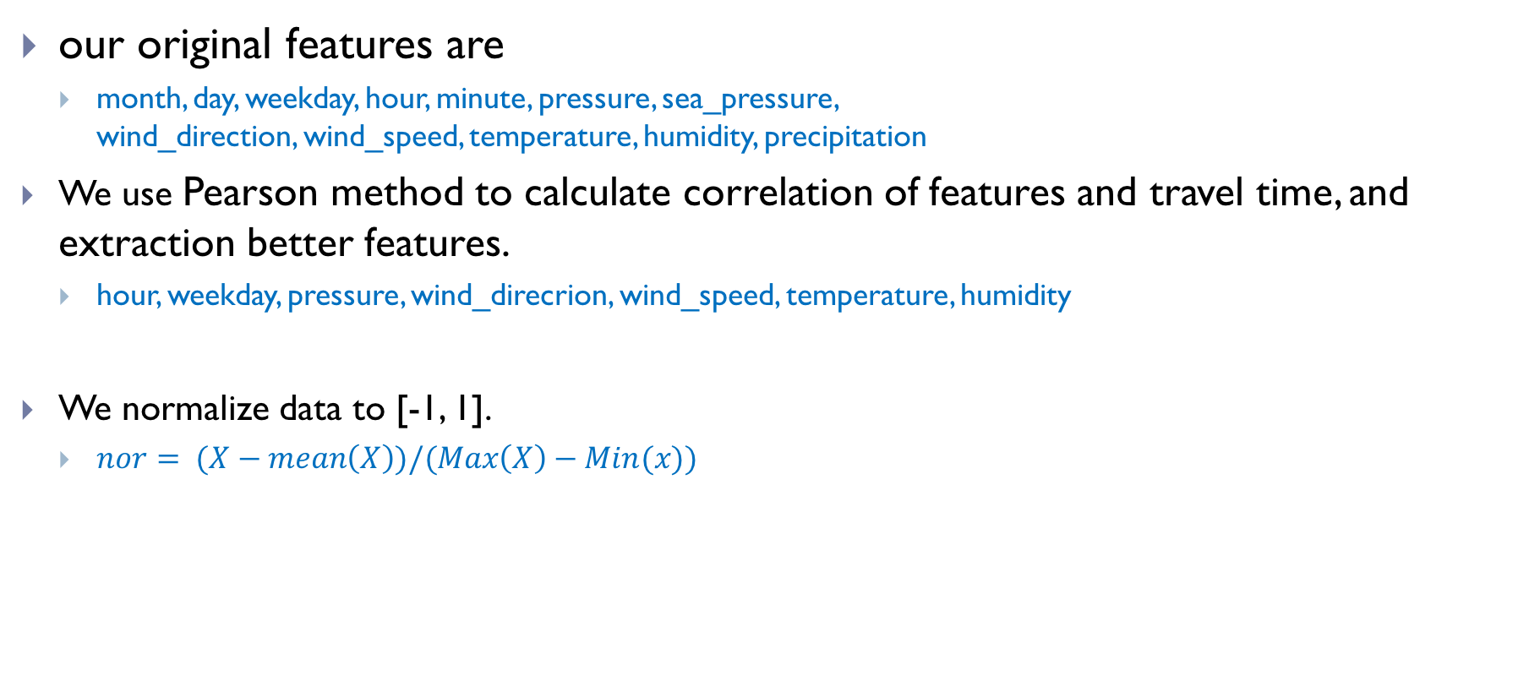
Features correlation and normalization
our original features are
month, day, weekday, hour, minute, pressure, sea_pressure, wind_direction, wind_speed, temperature, humidity, precipitation
We use Pearson method to calculate correlation of features and travel time, and extraction better features.
hour, weekday, pressure, wind_direcrion, wind_speed, temperature, humidity
We normalize data to [-1, 1].
$nor= (X−mean\left(X\right))/(Max\left(X\right)−Min(x))$

Slide 8
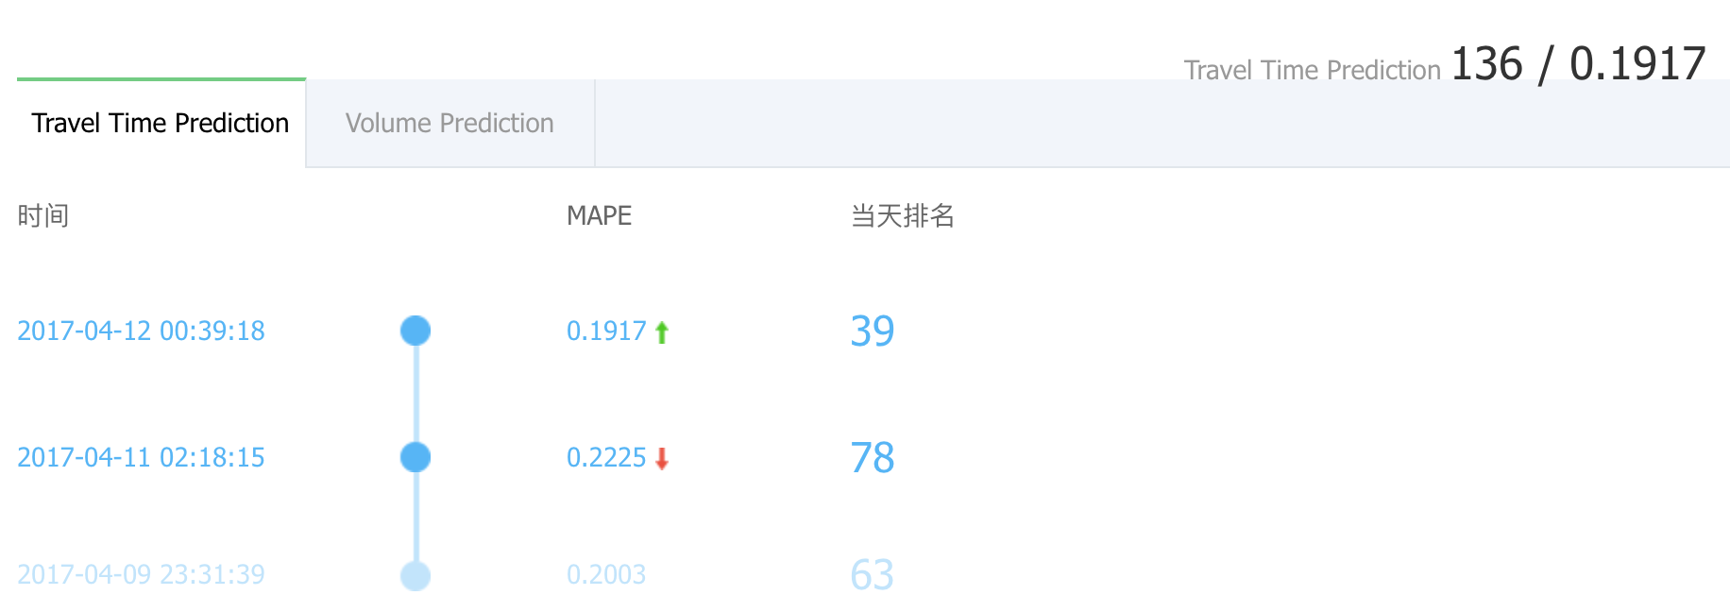
Rank(2017-4-12)

Slide 9
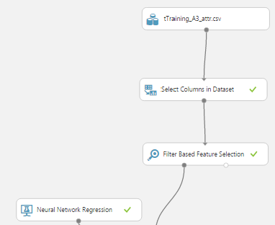
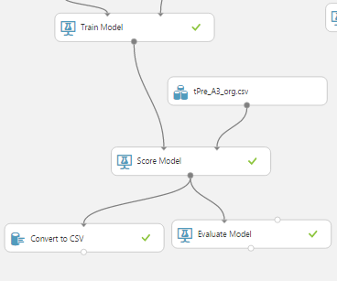
Train model ( using Microsoft Azure )

Slide 10
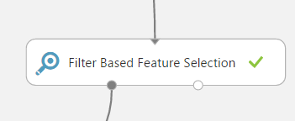
Feature Selection
與travel_time 的相關性
A2 | day | rel_humidity | month | temperature | hours | wind_speed
A3 | day | rel_humidity | wind_speed | month | temperature | weekday
B1 | rel_humidity | temperature | day | hours | weekday | sea_pressure
B3 | month | temperature | sea_pressure | pressure | rel_humidity | day
C1 | rel_humidity | hours | temperature | weekday | precipitation | day
C3 | month | sea_pressure | pressure | temperature | hours | wind_speed

Slide 11

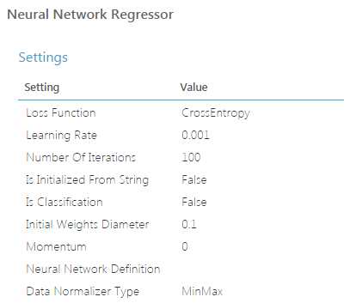
Neural Network parameter
Number of hidden layer:1
Number of hidden nodes:7

Slide 12
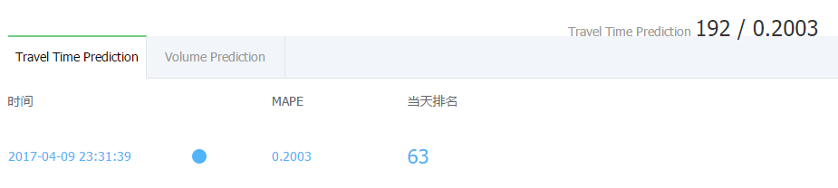
Result

Slide 13
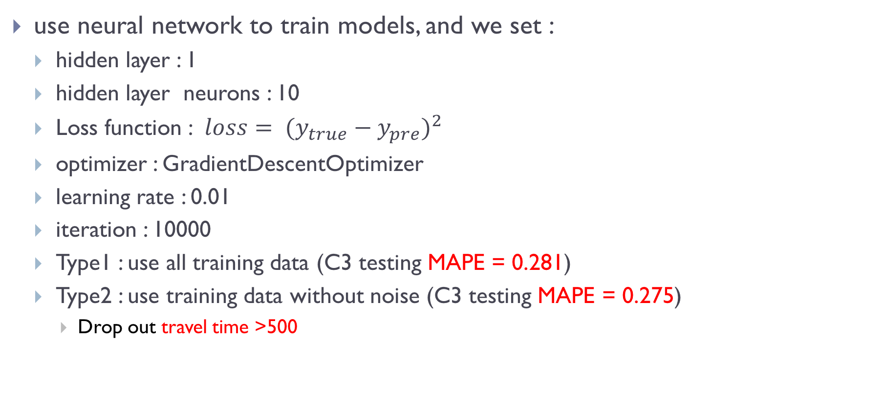
Train model ( using Python Tensorflow)
use neural network to train models, and we set :
hidden layer : 1
hidden layer neurons : 10
Loss function : $loss= {(y_{true}−y_{pre})}^{2}$
optimizer : GradientDescentOptimizer
learning rate : 0.01
iteration : 10000
Type1 : use all training data (C3 testing MAPE = 0.281)
Type2 : use training data without noise (C3 testing MAPE = 0.275)
Drop out travel time >500

Slide 14
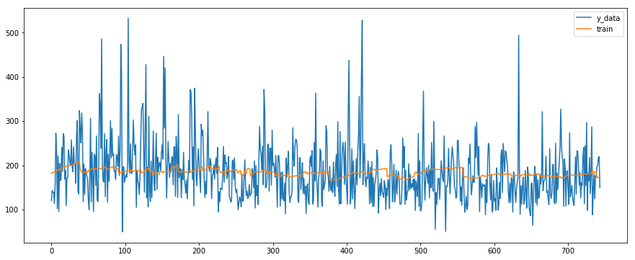
Type1- training plot
Example C3 (8:00 am to 10:00 am) :

Slide 15
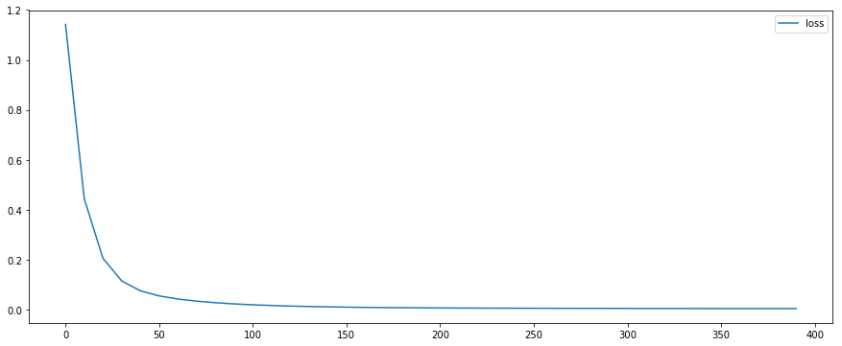
Type1- loss plot
Example C3 :
1.142
0.0034

Slide 16
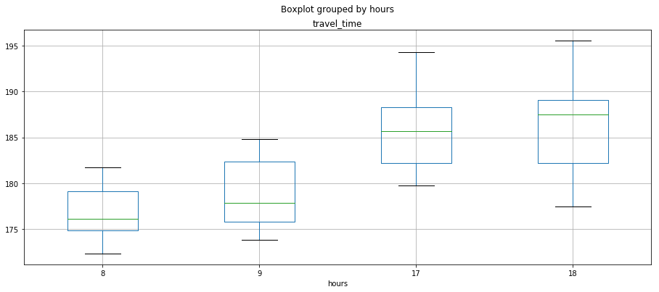
Type1- submission box plot
Example C3 :
195.6
194.3
188.2
189.1
187.5
185.6
184.8
181.7
182.3
182.2
182.1
179.8
179.1
177.8
177.4
176.0
175.7
174.8
173.8
172.3

Slide 17
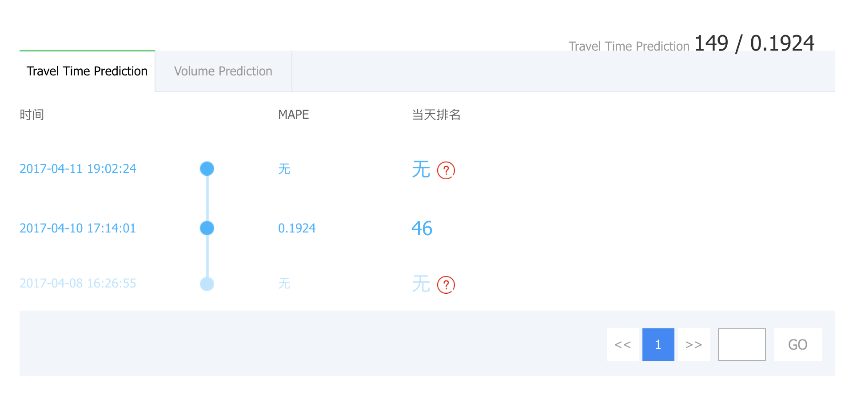
Type1- rank

Slide 18
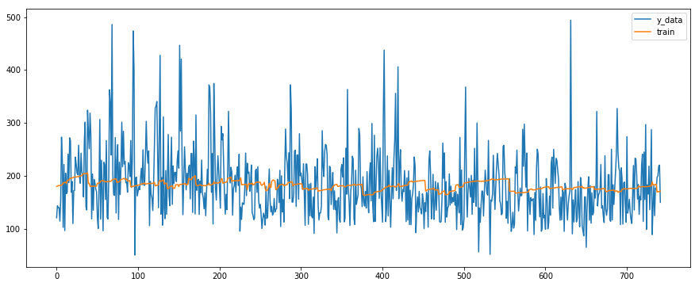
Type2- training plot
Example C3 (8:00 am to 10:00 am) :

Slide 19
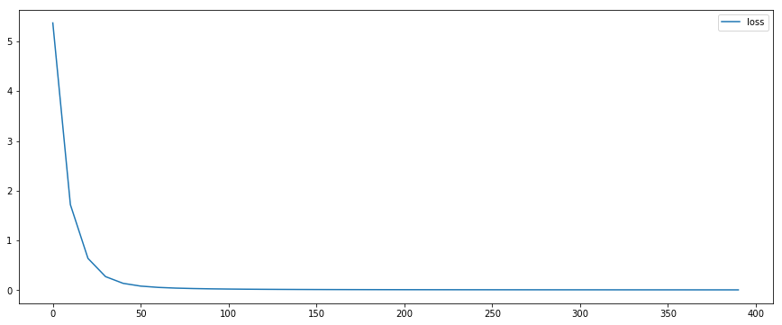
Type2- loss plot
Example C3 :
5.3709898
0.00741

Slide 20
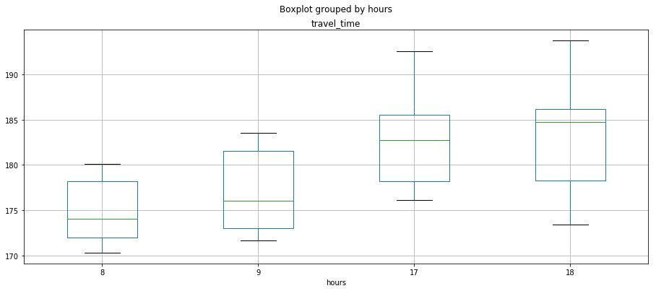
Type2- submission box plot
Example C3 :
193.8
192.5
185.5
186.2
184.8
183.5
182.7
181.5
180.1
178.2
178.2
178.3
176.0
176.1
174.0
173.0
173.4
172.0
171.6
170.3

Slide 21
Type2- rank

Slide 22
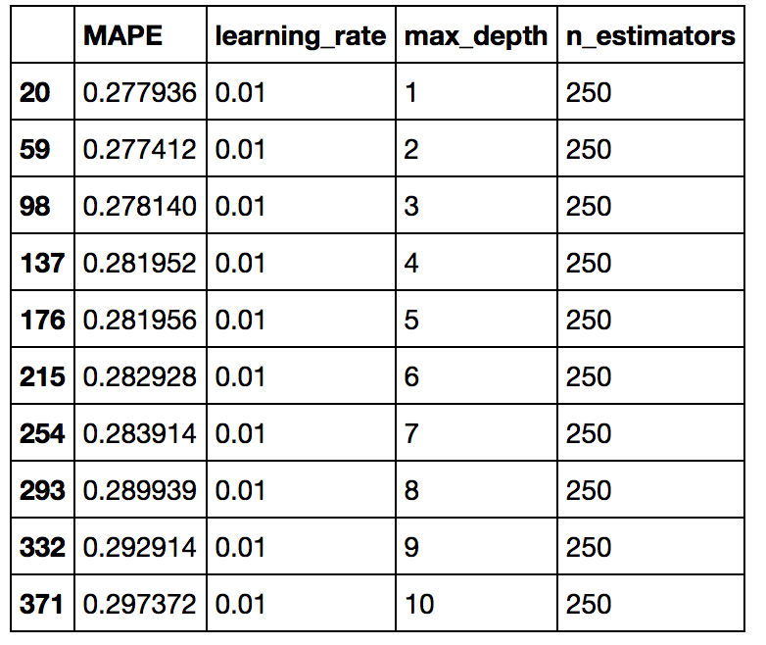
XGboost
max_depth=2 , n_estimators=250, learning_rate=0.01

Slide 23
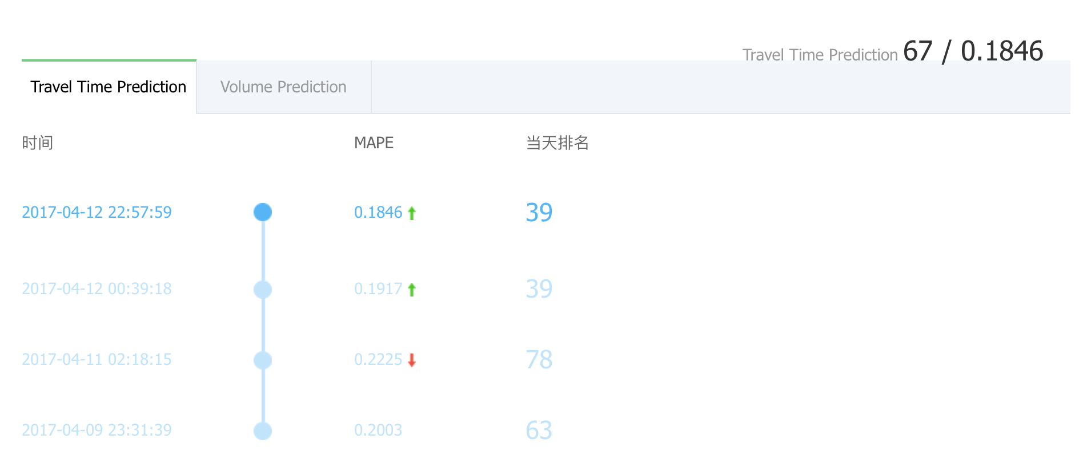
XGboost rank

Slide 24
Task 2 (volume)

Slide 25
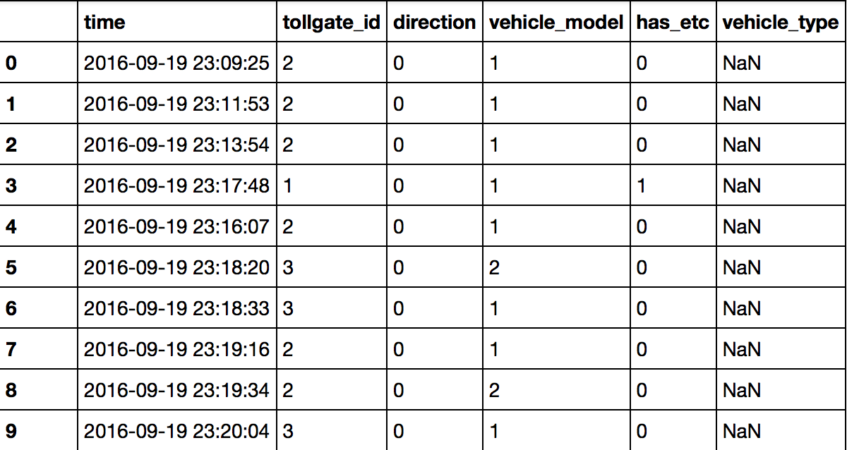
Data processing (volume)
Original data set :
volume data
weather data

Slide 26
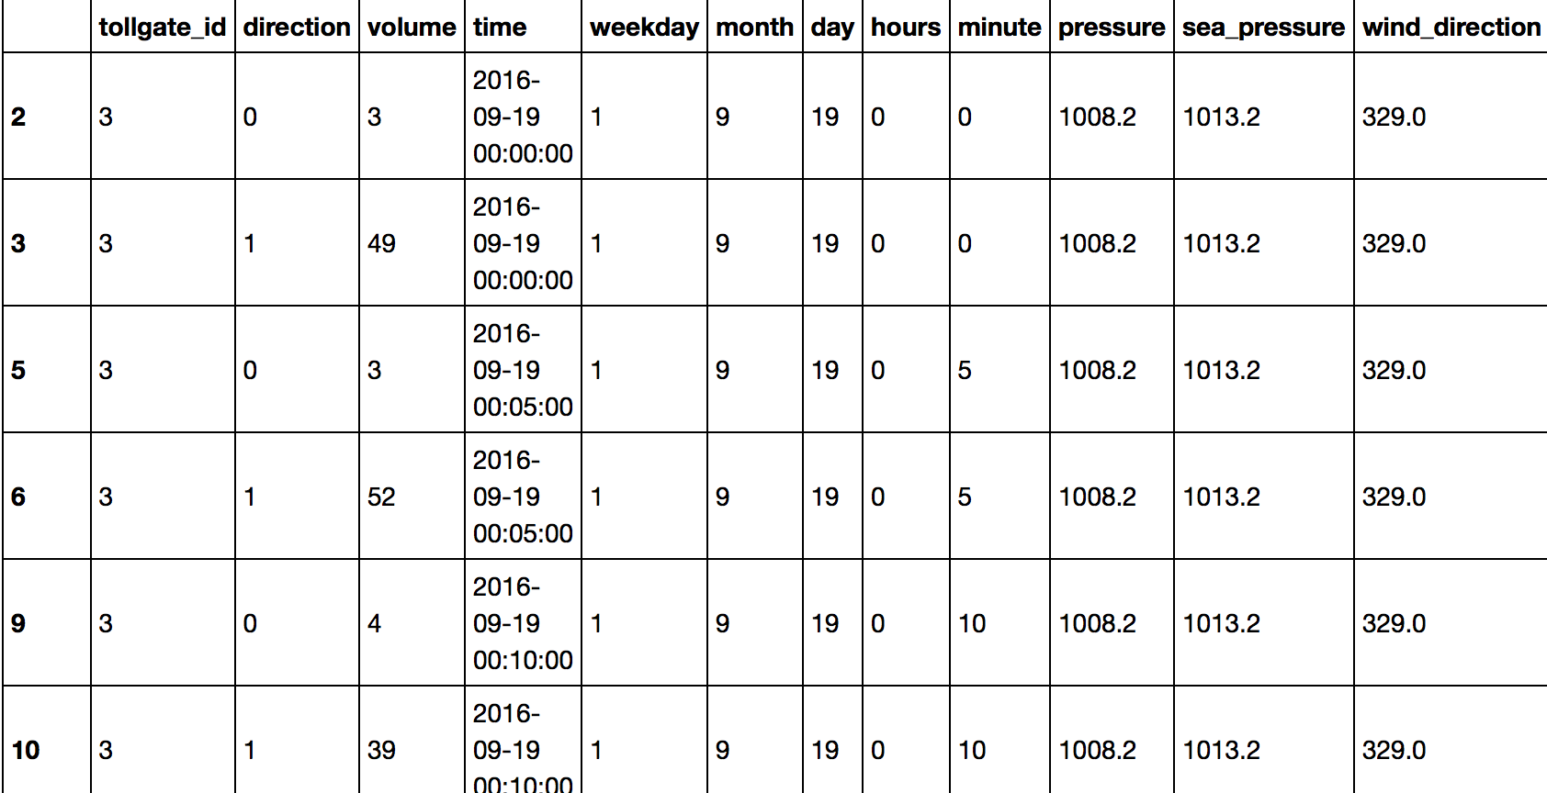
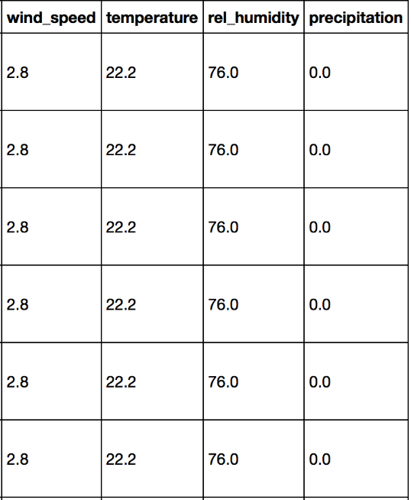
We get every 5-min total volume, and combine volume and weather data.
we also split data to :
entry and exit traffic volumes at tollgates 1, 2 and 3

Slide 27
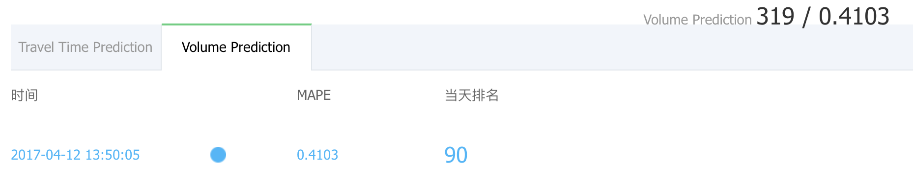
Train models and predict
we choose weekday, hours, pressure, temperature and humidity as feature, and use min-max method to normalize them.
use neural network to train models, and we set :
hidden layer : 1
neurons : 10
optimizer : stochastic gradient descent
batch size : 50
learning rate : 0.001
iteration : 100

Slide 28
Future Work
Select different models : RNN or XGboost
Consider other features : travel_seq , routes(table 4)
Use different NN Architecture types

Slide 29
Thank you for listening

