Slide 1
Progress Reports
KDD 2017
M10507305 陳弘明
M10507307 黃健傑
M10515026 鄒濬安

Slide 2
Outline
Platform & Tool kit
Approach
Problem & Future work

Slide 3
Platform & Tool kit

Slide 4


Slide 5
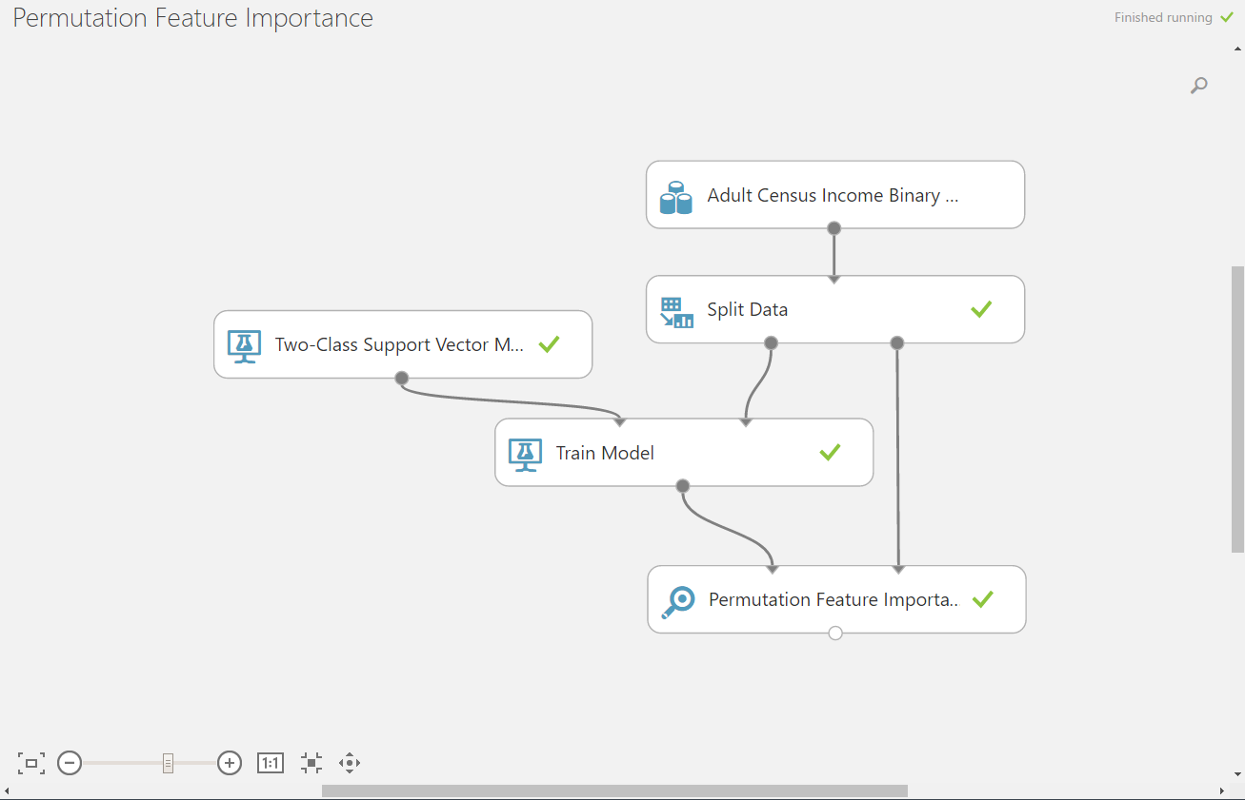
Architecture

Slide 6
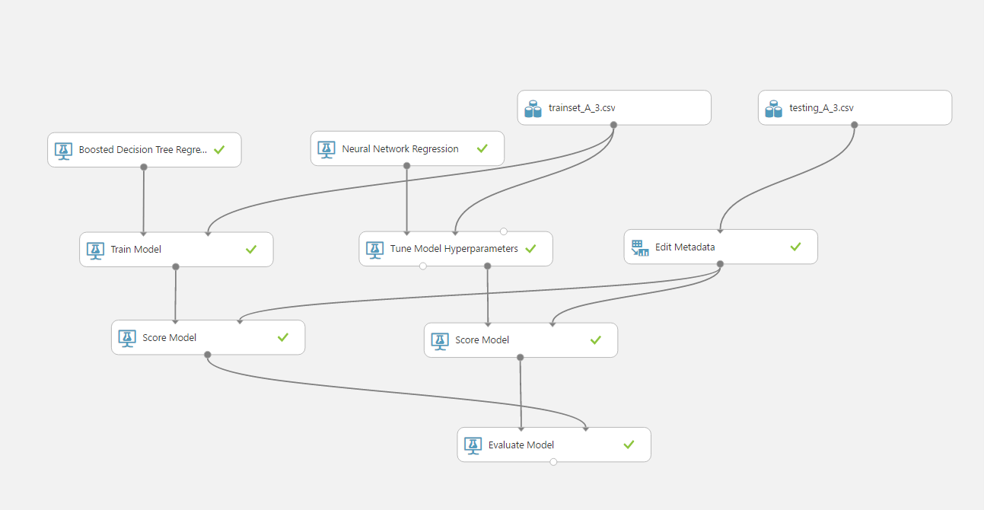
Develop models

Slide 7
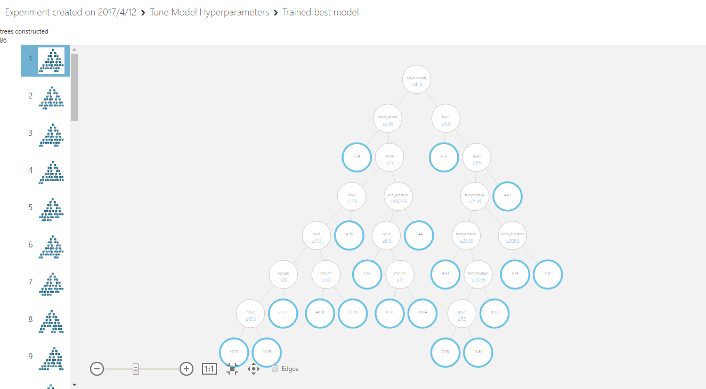
Boosted Decision Tree

Slide 8



Python

Slide 9

Matlab

Slide 10
Approach

Slide 11
Our approach
Pre-process data
Select features
Develop models
Decision Tree, NN Model, Baysian
Tune model hyperparameter
MAPE evaluate

Slide 12
Pre-process data
Data split
Average time in 20 minutes
Merge weather

Slide 13
Pre-processed Data
 | intersection_id | tollgate_id | pressure | sea_pressure | wind_direction | wind_speed | temperature | rel_humidity | precipitation | hour | week | minute | travel_time
0 | 1 | 2 | 1000.9 | 1005.8 | 219 | 3.3 | 27.5 | 81 | 0 | 0 | 2 | 20 | 58.05
1 | 1 | 2 | 1000.9 | 1005.8 | 219 | 3.3 | 27.5 | 81 | 0 | 1 | 2 | 20 | 56.87
2 | 1 | 2 | 1000.9 | 1005.8 | 219 | 3.3 | 27.5 | 81 | 0 | 1 | 2 | 40 | 77.74
3 | 1 | 2 | 1000.9 | 1005.8 | 219 | 3.3 | 27.5 | 81 | 0 | 2 | 2 | 20 | 42.64
4 | 1 | 2 | 1000.9 | 1005.8 | 219 | 3.3 | 27.5 | 81 | 0 | 2 | 2 | 40 | 40.17333333
18 | 1 | 2 | 1000.5 | 1005.3 | 212 | 3.8 | 31.7 | 65 | 0 | 3 | 2 | 20 | 41.92
19 | 1 | 2 | 1000.5 | 1005.3 | 212 | 3.8 | 31.7 | 65 | 0 | 3 | 2 | 40 | 39.43
20 | 1 | 2 | 1000.5 | 1005.3 | 212 | 3.8 | 31.7 | 65 | 0 | 4 | 2 | 0 | 48.13
21 | 1 | 2 | 1000.5 | 1005.3 | 212 | 3.8 | 31.7 | 65 | 0 | 4 | 2 | 20 | 62.10666667
22 | 1 | 2 | 1000.5 | 1005.3 | 212 | 3.8 | 31.7 | 65 | 0 | 4 | 2 | 40 | 46.115
23 | 1 | 2 | 1000.5 | 1005.3 | 212 | 3.8 | 31.7 | 65 | 0 | 5 | 2 | 0 | 49.556

Slide 14
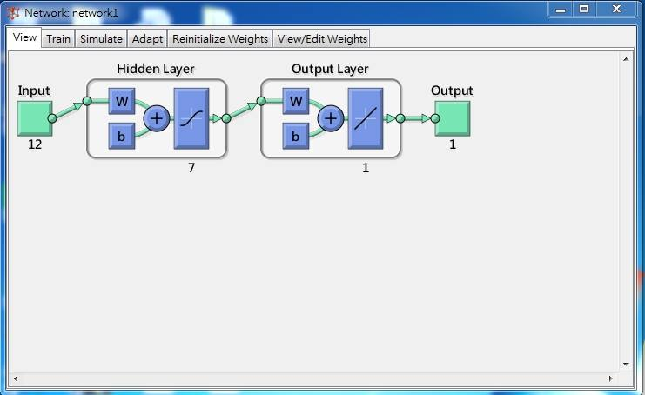
NN Model

Slide 15
Problem & Future work

Slide 16
Problem
How to tuning the parameter of model?
How to solve the problem of overfitting?
Missing data.
Error rate.

