Slide 1
類神經網路-期中報告
M10507404 楊庭嘉
M10507405 邱建誠

Slide 2
Outline
Library – openNN
Neural network structure
Results
Review
Improve methods
Library – TensorFlow
Introduction
Traffic Flow Forecasting using ANN
Results

Slide 3
Library – openNN
Recommended coding interface – Qt.
Programming language – C++.
Support Inter-Processor Communication.

Slide 4
Neural network structure
Input:
Intersection id
Tollgate id
Starting time
Week
Output:
Travel time

Slide 5
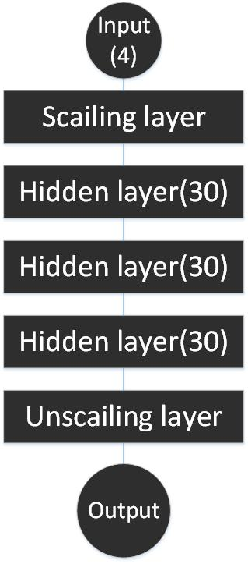
Neural network structure

Slide 6
Results

Slide 7
Review
The growth trend is almost correct, but value is not.
Maybe choose wrong training strategy.
Support from library is not enough, and the library is hard to be used.

Slide 8
Improve methods
Switch to use Tensorflow
Reasons:
Lots of users, it means easier to find solutions.
Good built-in analyzing tool Tensor Board.
Easier to improve internal process.

Slide 9

TensorFlow: Introduction
TensorFlow is an open source software library for machine learning across a range of tasks, and developed by Google to meet their needs for systems capable of building and training neural networks, analogous to the learning and reasoning which humans use.

Slide 10
TensorFlow: Concept
Building
computational graph
Running
computational graph

Slide 11
TensorFlow: Computational Graph
TensorFlow is built around the concept of computational graph
A computational graph is a series of math operations arranged into a graph of nodes

Slide 12
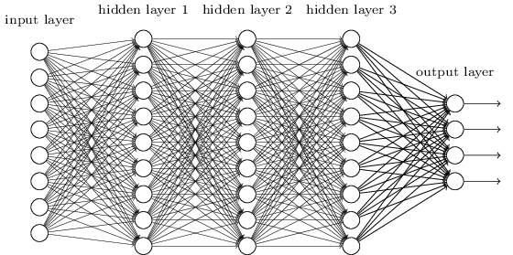
Computational Graph

Slide 13
Basic TensorFlow APIs
Building a multi-layer neural network with 3 hidden layers
x = tf.placeholder(tf.float32, [None, n_input])
x = tf.add(tf.matmul(x,w1),b1)
x = tf.nn.sigmoid(x)
x = tf.add(tf.matmul(x,w2),b2)
x = tf.nn.sigmoid(x)
x = tf.add(tf.matmul(x,w3),b3)
x = tf.nn.sigmoid(x)
output = tf.matmul(x,w4) + b4

Slide 14
Basic TensorFlow APIs
Define Loss Function
mse = tf.reduce_mean(tf.squared_difference(output, y))
tf.reduce_mean computes the mean of elements across dimensions of a tensor
tf.squared_difference returns (x - y)(x - y) element-wise

Slide 15
Basic TensorFlow APIs
Define a training algorithm
optimizer = tf.train.AdamOptimizer(learning_rate=0.001).minimize(mse)
Run the graph
sess = tf.Session()
for epoch in range(n_iters):
sess.run(optimizer,feed_dict={x:batchx, y:batchy})
#run the optimizer node for n_iters iterations
Sess.run(Output,feed_dict={x:data_x})
#run the Output node to obtain output result

Slide 16
Traffic Flow Forecasting (KDD Cup 2017) using Artificial Neural Network

Slide 17
Problem Definition
Task 1: To estimate the average travel time from designated intersections to tollgates, predict the ensuing traffic during 08:00 - 10:00 and 17:00 - 19:00, at 20-minute intervals.
The ETA of a 20-minute time window for a given route is the average travel time of all vehicle trajectories that enter the route in that time window.
Available datasets are: the road network topology in the target area, vehicle trajectories, historical traffic volume at tollgates, and weather data

Slide 18
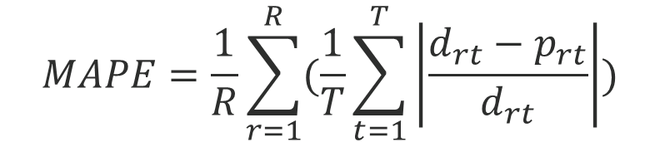

Evaluation Metrics
Mean Absolute Percentage Error (MAPE)
Let $d_{rt}$ and $p_{rt}$ be the actual and predicted average travel time for route r during time window t. The MAPE for travel time prediction is defined as
$$MAPE=\frac{1}{R}\sum_{r=1}^{R}{(\frac{1}{T}\sum_{t=1}^{T}{\left|\frac{d_{rt}−p_{rt}}{d_{rt}}\right|})}$$

Slide 19
Analysis
Input data is a list of 6-tuple containing the information of vehicle trajectories
intersection_id | String
tollgate_id | String
vehicle_id | Integer
starting_time | DateTime
travel_seq | List
travel_time | Integer(in seconds)

Slide 20
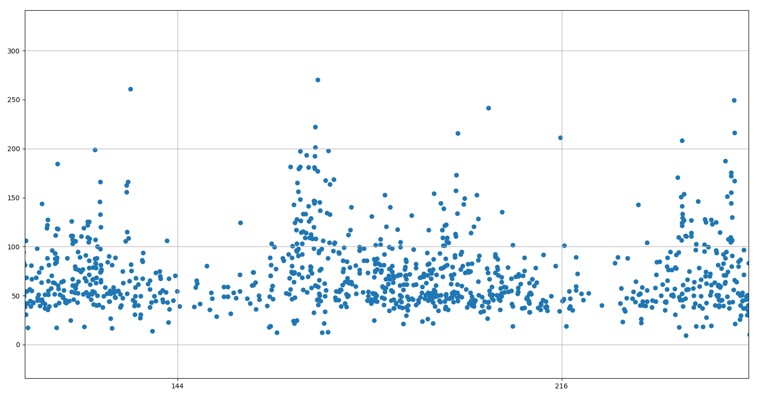
Figure 3. Scatter plot of all vehicle trajectory in a day

Slide 21
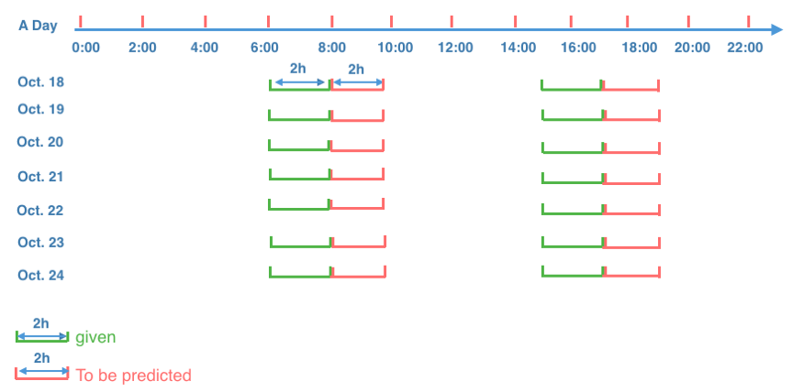
Figure 2. Time Windows for Traffic Prediction

Slide 22
Preprocess
Compute for each 2-min time window, the average travel time from intersection to tollgate of all vehicle entered in that time window

Slide 23
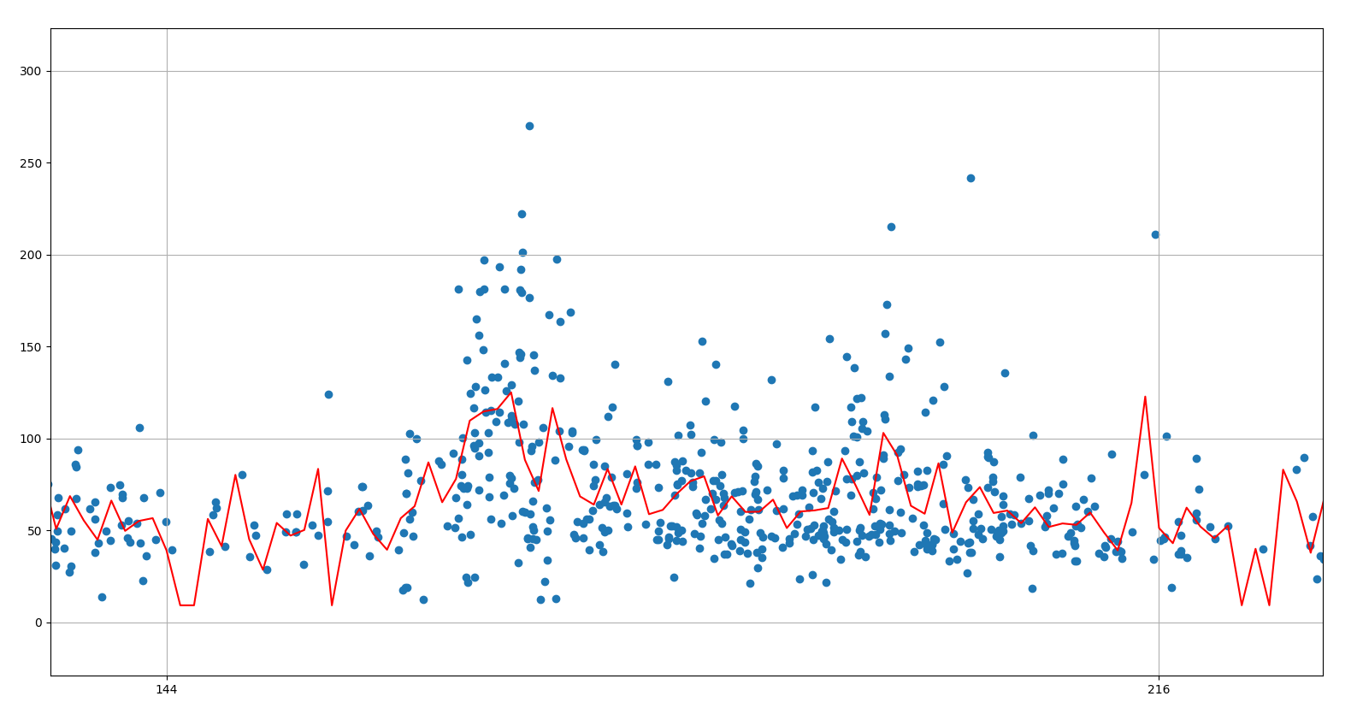
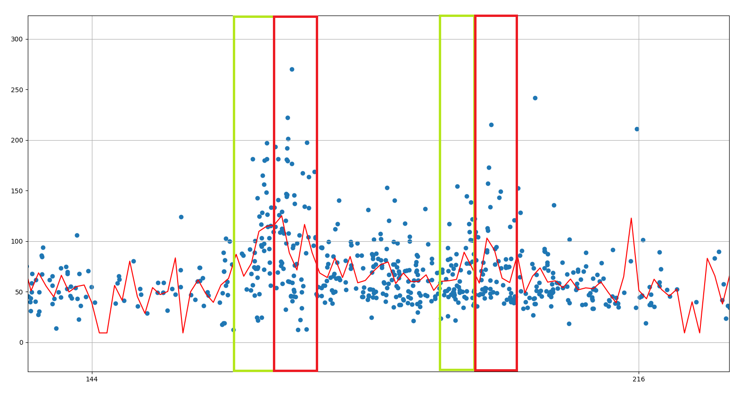

Slide 24
Construct the Model
We use a multilayer neural network with:
109 inputs(6 time windows of previous 3 days for each of 6 routes and time of the day)
Train all 6 routes in a single network
3 hidden layers, each has 80 neurons
36 outputs(6 estimations for each of 6 routes)
Trains for 4000 iterations on a GTX1070 GPU takes ~6 min

Slide 25
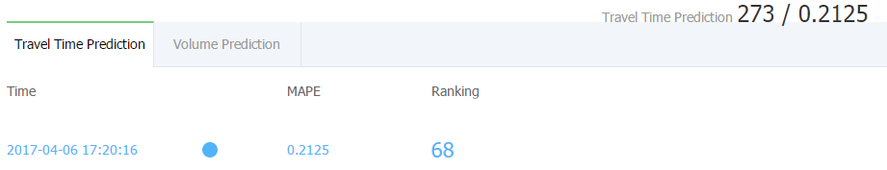
Predictive Results
As for 4/11/2017, we achieved a MAPE of 0.2125 and was rank 273 out of 3211 participants

Slide 26
Review
Lower the learning rate
Switch to RNN
Incorporate more data into the predictive model
weather data
link topology

Slide 27
Teamwork
楊庭嘉 M10507404 | 邱建誠 M10507405
Task 1資料分析、資料處理、模型建立 TensorFlow library研究 | Task 2資料分析、資料處理、模型建立

