Slide 1
KDD Cup 2017
M10515031 黃佳郁
M10515036 謝奇元
M10515104 羅煜賢
指導教授：李漢銘 教授

Slide 2
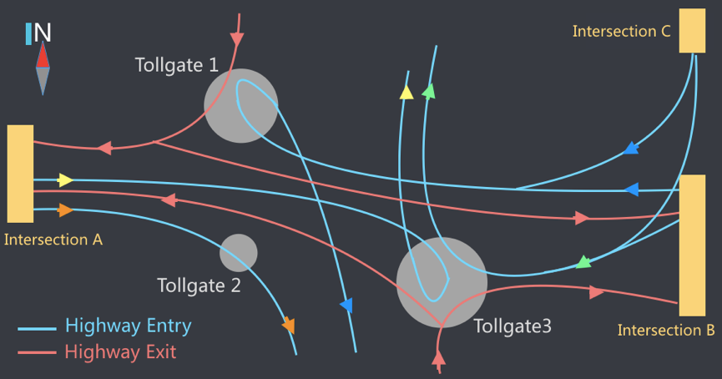
Problem Description
TASK 1:
Travel Time Prediction
For every 20-minute time window, estimate the average travel time of each route.
Intersection A - Tollgates 2 & 3
Intersection B - Tollgates 1 & 3
Intersection C - Tollgates 1 & 3
TASK 2:
Traffic Volume Prediction
For every 20-minute time window, predict the entry and exit traffic volumes at tollgates 1, 2 and 3.
Competition website : KDD Cup 2017

Slide 3

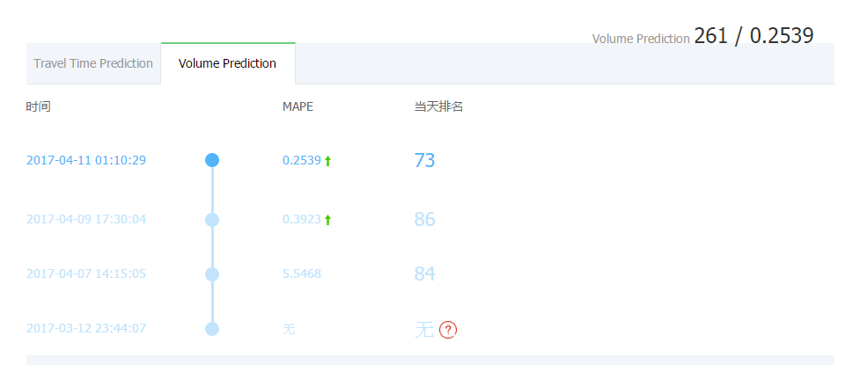
Grade

Slide 4
How To Do?

Slide 5
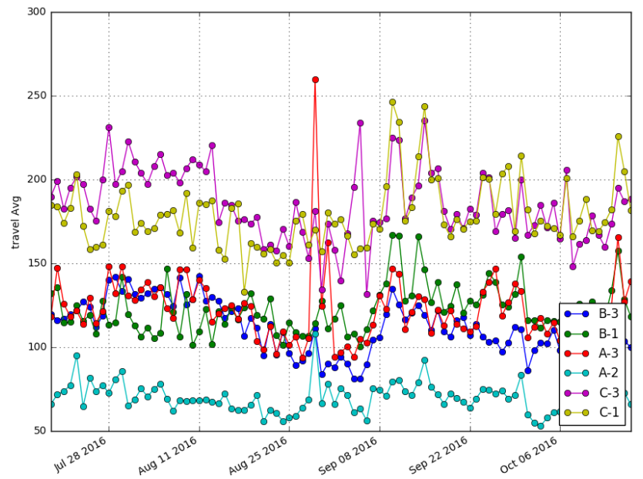

Slide 6
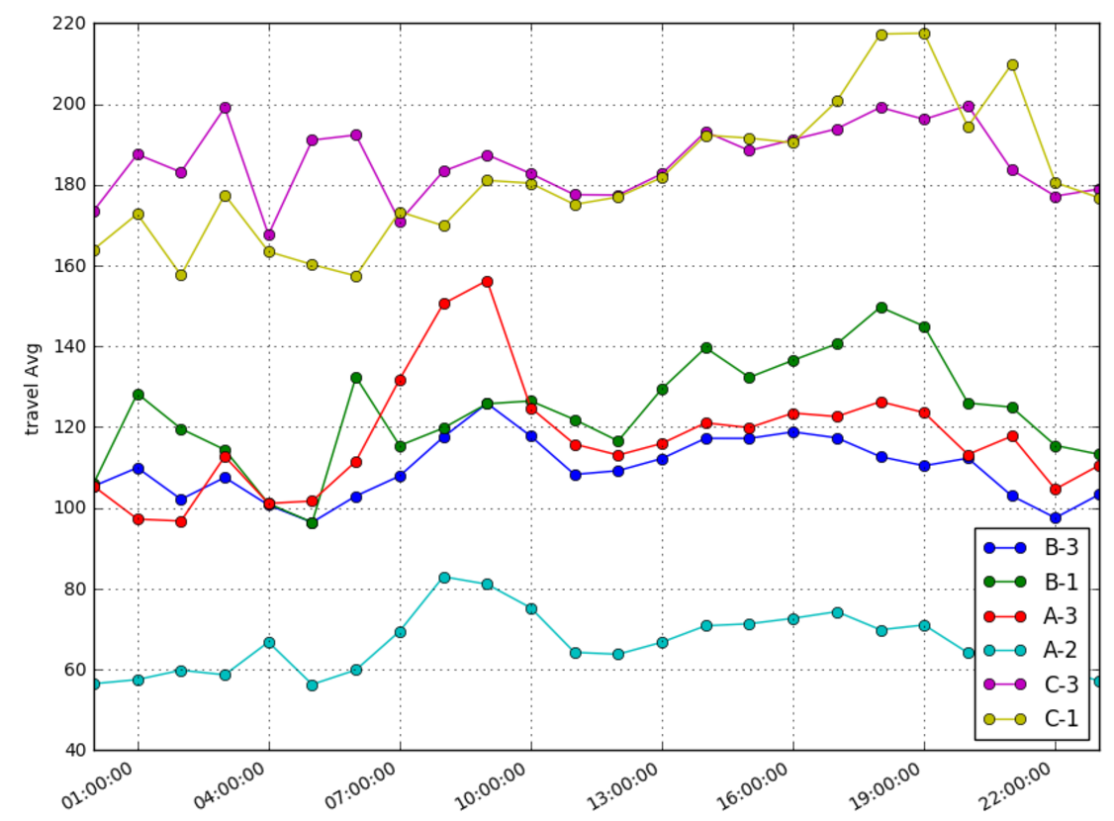

Slide 7
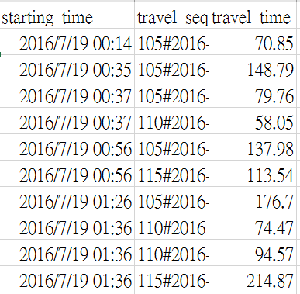
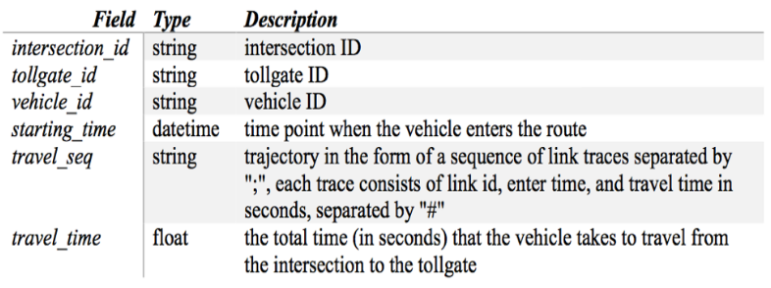
Linear Regression
Task 1
What day?
Start point time
Spending time of each link of this route
Total travel time
Table 5

Slide 8
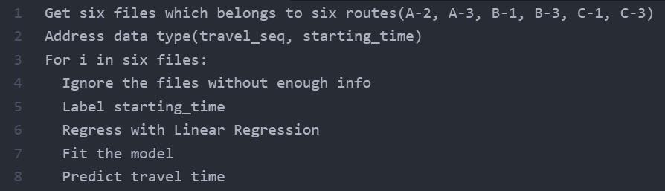
TASK 1

Slide 9
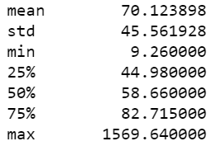
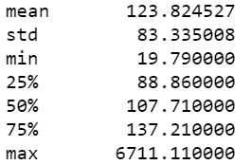
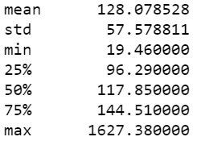
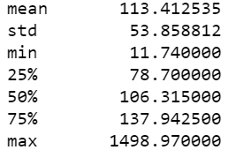
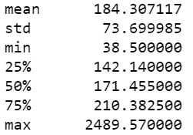
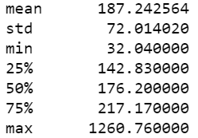
Problem - Travel Time
A-2
A-3
B-1
B-3
C-1
C-3

Slide 10
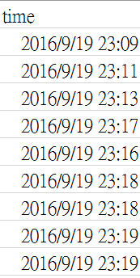
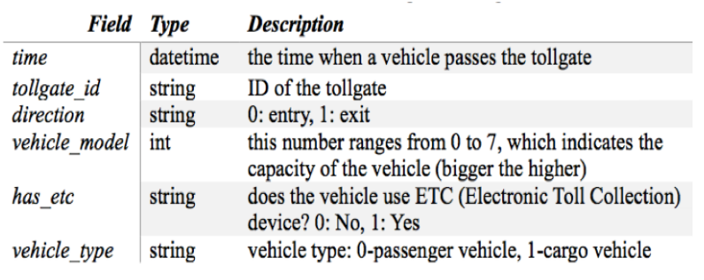
Linear Regression
Task 2
What day?
Time range
One unit / 20 min
8-10, 17-19
Volume of two previous time range
if 8:00-8:20 => 7:20-7:40, 7:40-8:00
Average volume of the same time range(8-10 or 17-19) of that day
Table 6

Slide 11
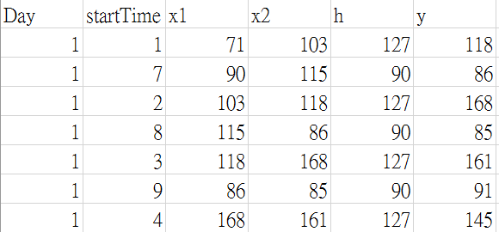
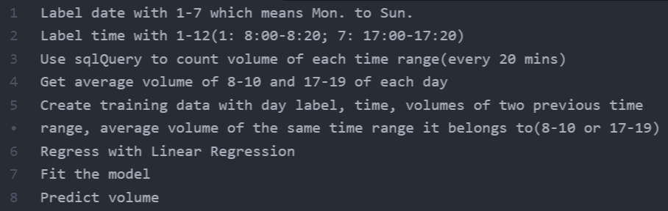
TASK 2

Slide 12





Tools
VM
OS: Ubuntu
RAM: 3GB
Anaconda
iPython Notebook
MySQL
SQL Query
sklearn

Slide 13
Future Work
Address noise data
Try to give weight to each feature
Predict with more features, e.g. temperature, humidity, width of each link
Try to train and predict with xgboost
In some competition, this was used by first place participant
Test deep learning module, e.g. Keras
To improve the efficiency, we expect to use cloud computing technique

Slide 14
Thanks!

