Slide 1
KDD CUP 2017 Travel Time Prediction
Members: 陳啟元 M10515017
詹立馨 M10515005
王名宸 M10515094

Slide 2
Outline
1. Environment introduction
2.Feature Extraction
3.Model Selection
-XGBoost
-Randon Forest
4.Evaluation
5.Future Work

Slide 3
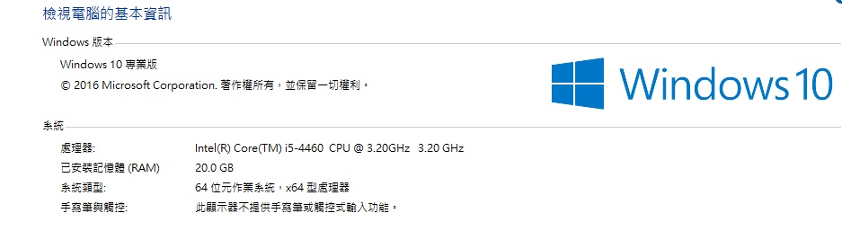
Environment introduction
Python ver.2.7on Jupyter
PC environment: (VGA GTX 750Ti)

Slide 4
Feature Extraction
Concept: “Time“ is the key to prediction travel time in the future
so we want to collect the characteristic of “Time” of a day.
When we have the data of pre-2 hours . We expect that we can tell what will be going on in next 2 hours.
Our features:
1. time_window (per 20 mins)
2. intersection_id
3. tollgate_id
4. avg_travel_time : the average travel time of the same time period of intersection to tollgate
5. valuePrecipitation: Precipitation of each time period.
6. WindCondition: (not finish yet)

Slide 5
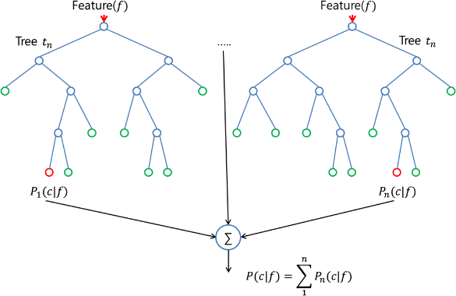
Model Selection
Random Forest
Developed by Leo Breiman and Adele Cutler. It is a common model to traffic prediction.
Why we use:
1.Suitable for processing high dimension data
2. Easy to be done
3. Enable to find the relation among features.

Slide 6
Model Selection
Xgboost(eXtreme Gradient Boosting)
Started by Tianqi Chen in Distributed (Deep) Machine Learning Community (DMLC) group. Next is provide on python and R. Now is also Julia, Scala , Java…
Why we use:
1. It belongs to boosting family
2. It is from Gradient Boosting Machine
3.It conquer the time consuming problem (speed up as 10 times)
4.Higher precision

Slide 7
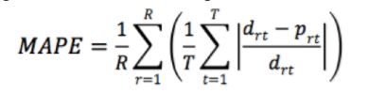
Evaluation
Whole training data: 25144
Training set: 80%
Testing set : 20%
Score : 0.322

Slide 8
Future Work & Problems
1. Try to take benefit of vehicle attribute and link attribute to enhance Prediction precision.
2. Finish WindCondition feature extraction
3. Use xgboot to have result compare with Random forest.
4. Try to find the relation among time windows
5. Keep working on feature extraction

