Slide 1
KDD CUP 期中報告
第13組
組員:丁立安、楊晴淮、林冠伶

Slide 2
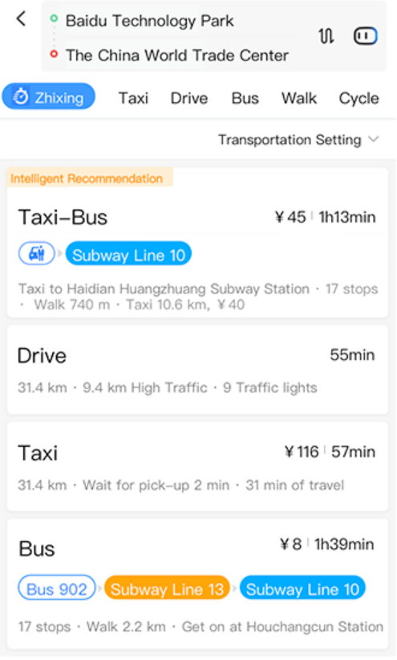
目的
根據用戶的出行目的，幫助用戶制定出合適的出行計劃，例如步行、騎自行車、自駕、公共交通等方式。

Slide 3
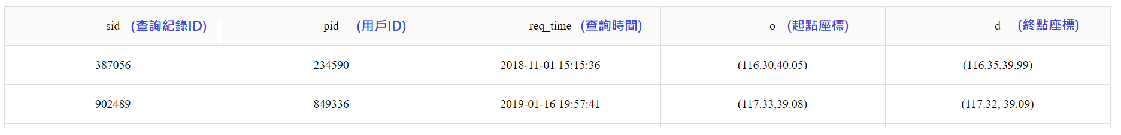
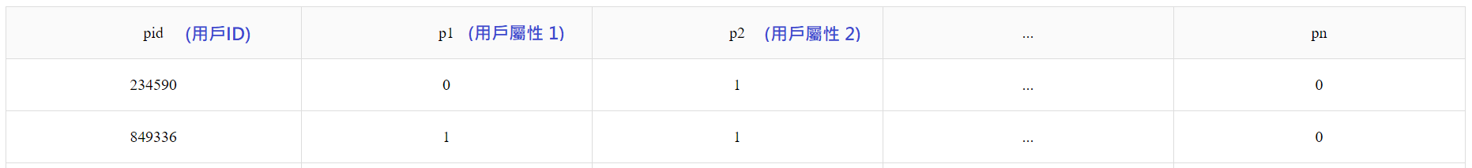
Data description
Query record
User attributes

Slide 4
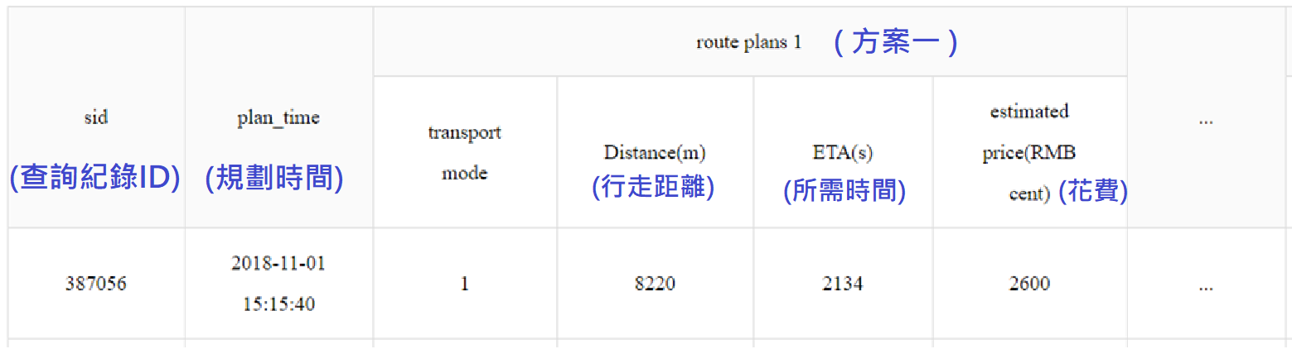
Data description
Display record
Click record

Slide 5
預處理
時間:
星期 (一 ~ 日)
當日時間
Rank feature :
plans ranking (百度推薦)
Plans features:
距離（平均值，最小值，最大值，STD）
價格（平均值，最小值，最大值，STD）
時間（平均值，最小值，最大值，STD）

Slide 6
預處理
Train Features :
經緯度
用戶資訊
用戶ID
12 模式 ( 包含未點選 )
距離、時間、花費、推薦排名

Slide 7
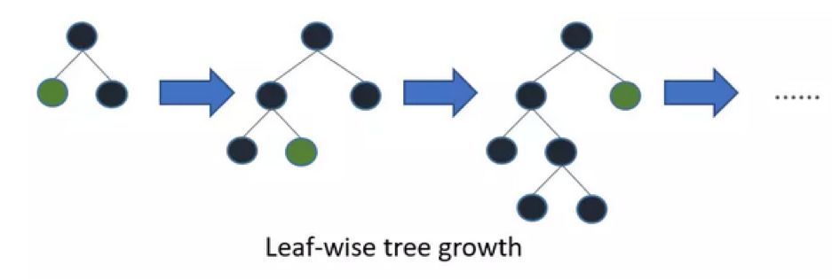
實作方法
Win10 python3.5
LightGBM
一個梯度boosting框架，使用基於學習算法的決策樹。

Slide 8
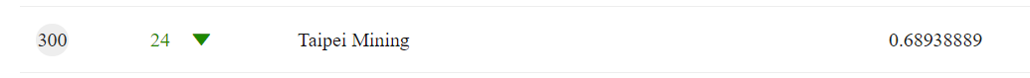
總結
分數: 0.689
最新排名: 300 / 598
目前第一名 : 0.7043
3、4、6、8的結果準確率較低，不過佔整體比例極小。
1、7、9的結果準確率約在0.5~0.8，佔整體資料0.18~0.05，有較大的進步空間。

Slide 9
Future work
有效的將 user attribute 的維度降低，提升資料複雜度提升效能
將當地的天氣資訊一併考慮
對北京交通更了解(train10~11/test12)
節日、特殊日期(會不會導致誤判)、時段

Slide 10
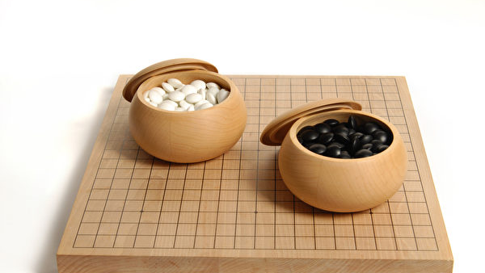
AlphaGO

Slide 11
AlphaGO
Deep convolutional neural network(DCNN)
Monte Carlo tree search(MCTS)
Policy network + Value network

Slide 12
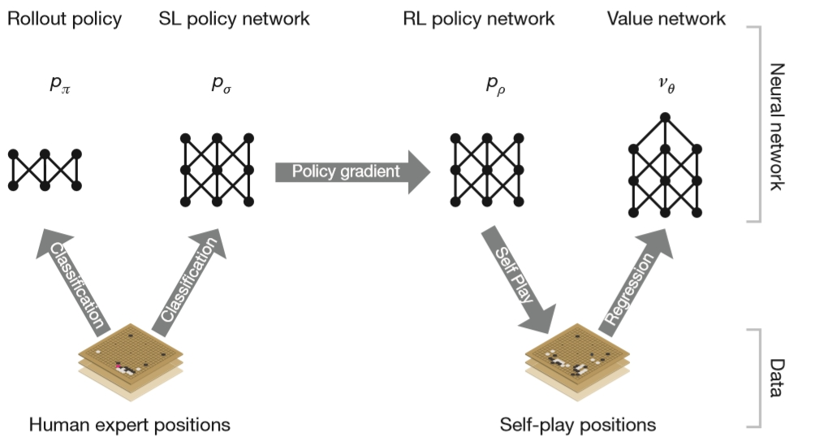
faster
DCNN
train
MCTS
KGS Data

Slide 13
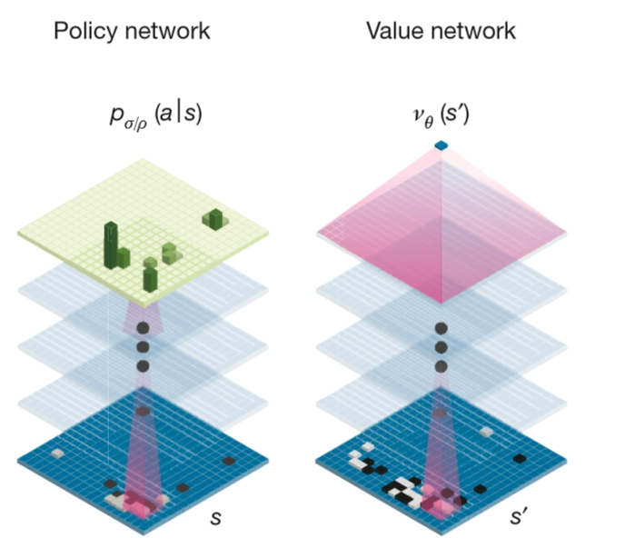
Policy network(classification)：
Predicts move.
Output：probability distribution
Value network(evaluation)：
Predicts outcome from a position.
Output：prediction of the game
1 for win, -1 for lose

Slide 14
Policy network = Supervised learning (SLp)
+ Reinforcement learning(RLp)
Initially bootstrapped with KDG data at SLp.
Mimic human play
Improve RLp by self-play
Value network：similar to policy network
Use RLp self-play to train.
Backpropagation to modify parameter.

Slide 15
Now there’s…
a policy network that tells us what moves are promising
a value network that tells us how good a board position is
To combine,
use Monte Carlo tree search(MCTS).

Slide 16
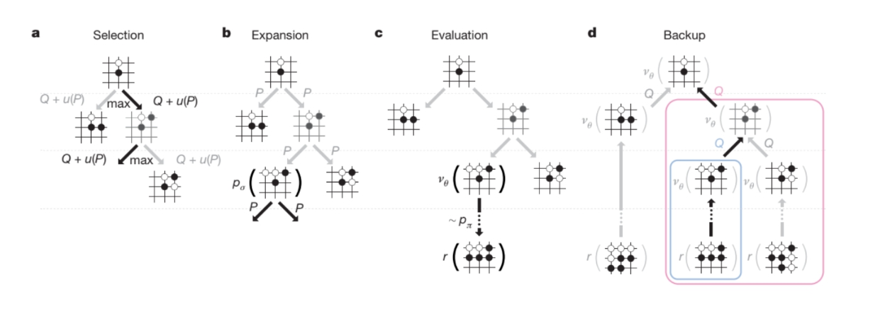
MCTS
Simulating moves suggested by the policy and the value network is the best way to find the next move.

Slide 17
Selection：Uses policy and value network to prioritize the search.
→Reduce search calculation
Expansion： Reward the newly visited, decay when visited repeatedly. →Explore diversity moves.
Evaluation：Simulate using rollout policy instead of SLp/RLp.
→Speed up the simulation.
Backup：Use the result of evaluation for backpropagation.
→Decide move.

Slide 18
AlphaGo Zero
Features：
Tells only the rule and learn by itself.
Found formula that was not yet found by human.
Takes only 40 days to succeed AlphaGO.
The algorithm is much easier.

Slide 19
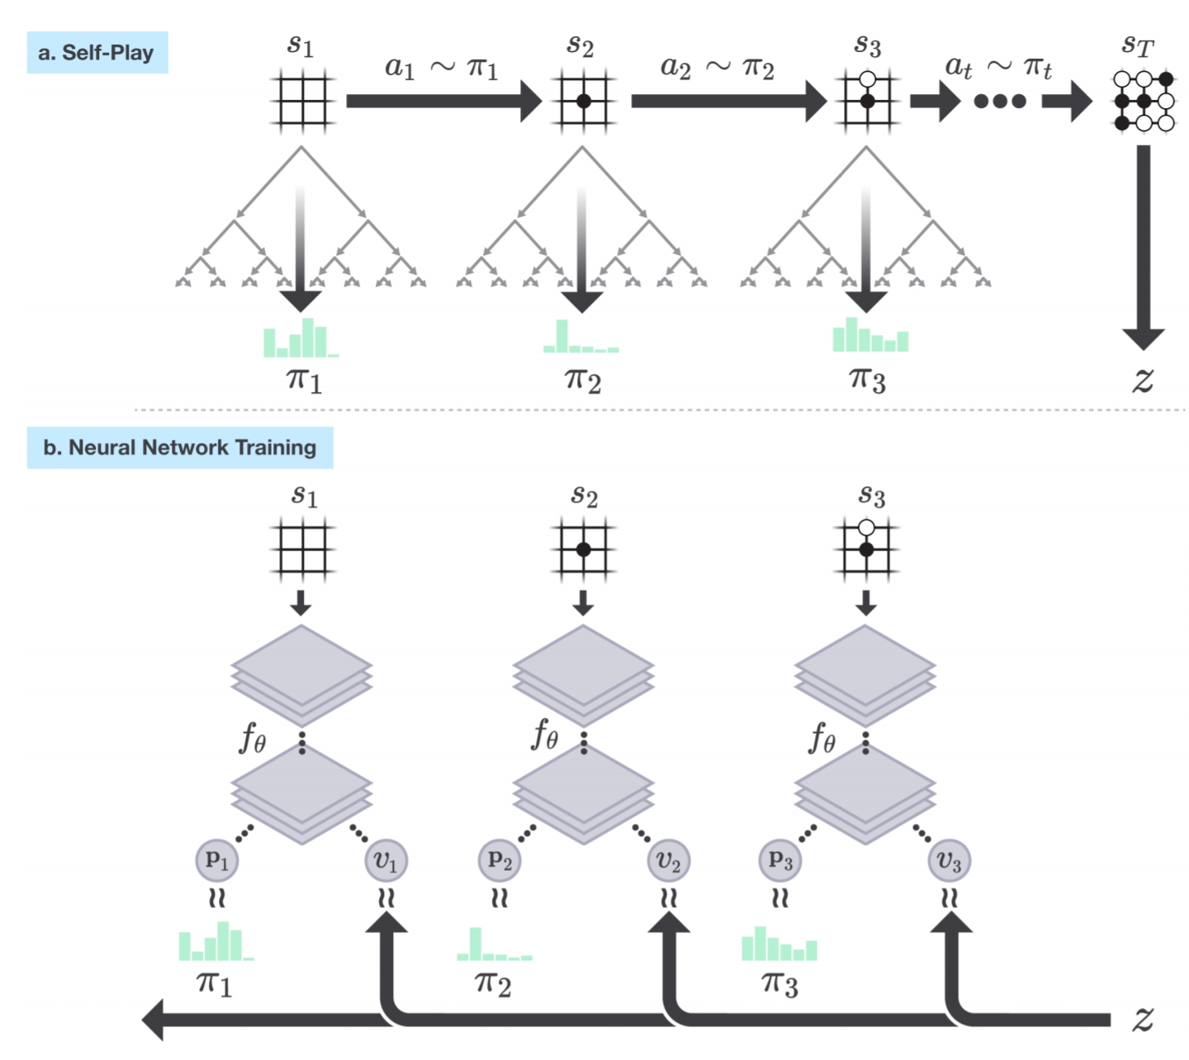
Self-play reinforcement learning

Slide 20
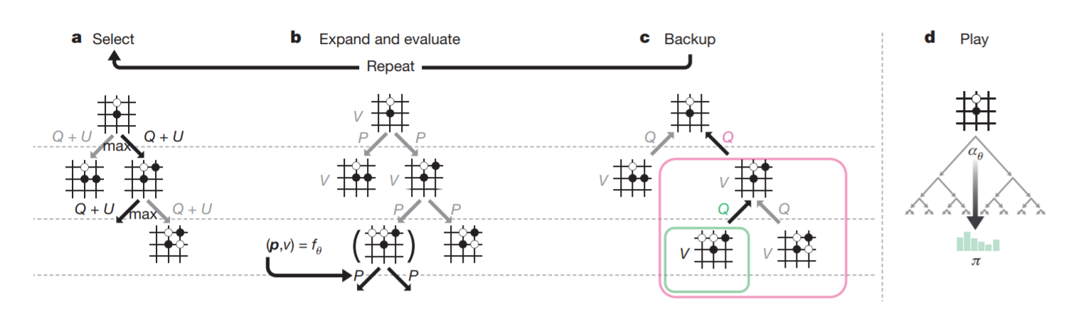
Monte-Carlo tree search in AlphaGo Zero

Slide 21
ResNet
current chess state S_ {t} :
v( S_{t} ) : The chance of winning of current state
P( a_{t+1} | S_{t} ) : The probability of next position
The self-played manual is used to train ResNet, fit input S_{t}, output P( a_{t+1} | S_{t} ) vector and v( S_{t} ) .

Slide 22
Upper Confidence Bound
It is used to encourage the discovery of new position.
The less a position has been visited, the higher the score of UCB( a_{t+1} ) is.

Slide 23
Training
Considering the equities of the next hand, including of v ( S_{t+1} ), P ( a_{t+1} | S_{t} ), and UCB( a_{t+1} ) .
score the position of each of the next hand.
Take the highest scorer to guide MCTS and decide where to place the next piece.

Slide 24
Training
With the improved MCTS, continue to let the machine play against itself in order to gain more GO manual.
ResNet is trained again with the new data to improve the estimation accuracy of the win rate and the probability of the new position.
Repeat this cycle to improve the ResNet.

Slide 25
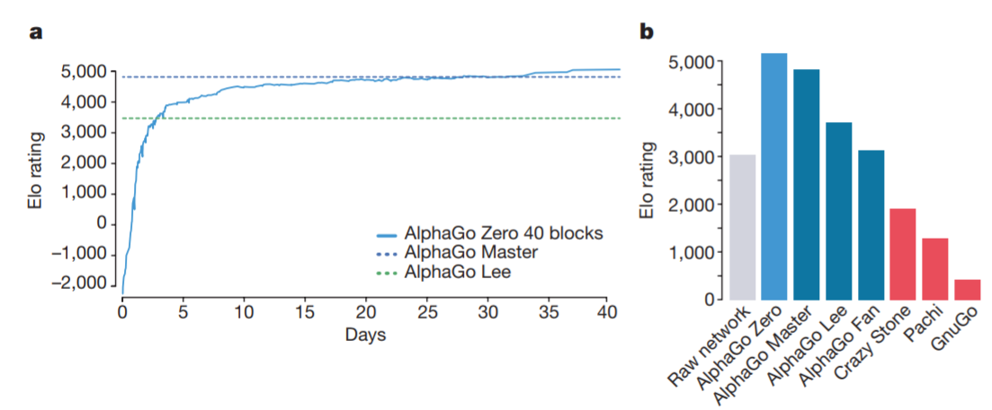
Different version of AlphaGo

