Slide 1
KDD CUP 2019 成果規劃
第十組
組員:謝宗廷、王稚淇、林律恩
2019/5/2

Slide 2
Quries
將 o, d 分別存成四個feature :
o d
"116.29,39.97", "116.32,39.96"
o1: [116.29] o2: [39.97]
d1: [116.32] d2: [39.96]

Slide 3
Plans
Price missing data 用 0 代替
利用TF-IDF來判斷每個session的transport_mode出現頻率
  Ex: 有3個選項，transport_mode分別為1, 3, 5，則儲存為[word_1 word_3 word_5]
TF-IDF結果再透過SVD降維成10維陣列
其他feature: 距離、價錢和距離的最小值、最大值、平均值和標準差及第一個可以選擇的transport_mode。

Slide 4
Profile
將原本63維的Profile利用SVD降維成20維。

Slide 5
Gradient Boost Machine 結果

Slide 6
Introduction
AlphaGo Fan
  Network trained with supervised and reinforcement learning.
AlphaGo Zero:
  self-trained without the human domain knowledge and no pre-training with human games.
Notes:
AlphaGo Fan主要是用人類專業比賽數據的supervised的方式去訓練。
AlphaGo Zero用的是完全獨立的學習演算法來訓練，是利用自我對弈的方式來不斷變強，網路也提升樹的搜尋能力
10 bias
7840 weight 10*784
784 image 28*28

Slide 7
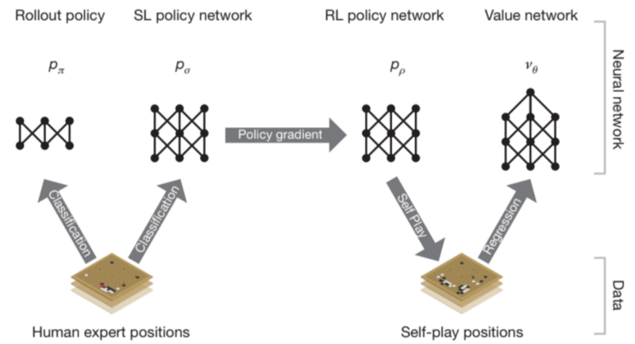
AlphaGo Fan - Policy Networks₋₁
Notes:
We create another policy called rollout policy πwhich use a more simple linear softmax classifier. It takes 2 μs to compute each move instead of the 3 ms in the SL policy network. This rollout policy has a lower 24.2% accuracy (compared to 55.7%) but it is 1500x faster.
主要應用了一個策略跟3個網路分別是Supervised learning的網路去做起初的訓練，強化網路主要讓alpha go 自我對弈可以穩定訓練過程，防止overfitting。

Slide 8
AlphaGo Fan - Policy Networks₋₂
Supervised learning of policy networks:
  Build on prior work on predicting expert moves in the game of go using supervised learning.
  A 13-layer network trained from 30 million positions from the KSG Go server.
  Also trained a rollout policy, faster but less accurate.
Notes:
We create another policy called rollout policy πwhich use a more simple linear softmax classifier. It takes 2 μs to compute each move instead of the 3 ms in the SL policy network. This rollout policy has a lower 24.2% accuracy (compared to 55.7%) but it is 1500x faster.
SL策略網路共13層，運用KGS的3千萬個棋局去做監督式訓練，準度高達55.7%
作者也訓練一個下棋策略P$π$主要是使用softmax分類，雖然這部分的準確度掉到24.2%但是選擇下棋的秒數卻從3ms降到2us。

Slide 9
AlphaGo Fan - Policy Networks₋₃
Reinforcement learning of policy networks:
  Duplicates the SL policy network.
  Use the policy gradient reinforcement learning to improve RL policy network iteratively.
Value network:
  Trained by regression to predict the expected outcome(whether the player wins or not)
Notes:
We create another policy called rollout policy πwhich use a more simple linear softmax classifier. It takes 2 μs to compute each move instead of the 3 ms in the SL policy network. This rollout policy has a lower 24.2% accuracy (compared to 55.7%) but it is 1500x faster.
延續Supervised learning network結果，用迭代的方式進行梯度強化學習訓練(自我對弈)，使RL策略網路對SL策略網路的勝率高於80%。
最後通過回歸訓練預測是否輸贏 value network V$θ$

Slide 10
AlphaGo Zero
  AlphaGo Zero uses the black and white stones from the board as input features.
  AlphaGo Zero uses a single neural network rather than separate policy and value networks(Like in AlphaGo Fan).
    The single neural network outputs both move probabilities and an outcome prediction value.
Notes:
AlphaGo Zero是一個完全獨立的學習方式透過自我對弈的增強學習來訓練像是由一個嬰兒自我訓練成為一個專家。它只使用棋盤上的黑白子做輸入特徵(之前的AlphaGO有人工建的特徵)。
AlphaGo Zero主要是單一個神經網路，作者開發了一種能在訓練過程中完成前向搜尋的增強學習演算法，目的為了快速和提高精準度

Slide 11
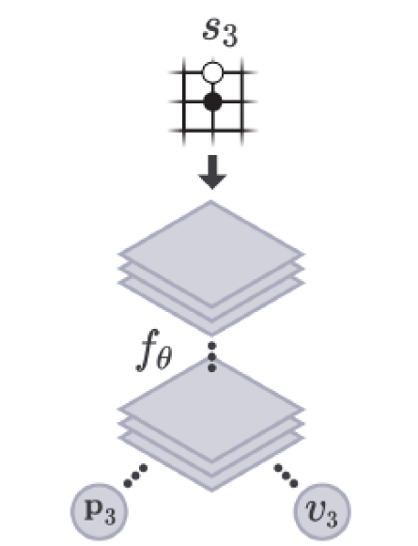
AlphaGo Zero - Deep network
  Reinforcement learning:
    Uses policy p to control what action should we take, and a value function v to measure how good to be in a particular state.
    Single deep network composed of convolutional layer to estimate both p and v
    p: probability distribution over moves
    v: probability of the current player
    winning the game.
Notes:
一種新的強化學習演算法將，像是Reinforcement learnin和value learning結合到單一框架中
神經網路將原始位置S當作輸入，傳遞到參數θ，並且輸出表示移動概率分布的向量P和表示S當前獲勝的概率V，並且使預測勝率V和遊戲獲勝Z之間的最小誤差
P:每個移動選擇的概率
v:當前玩家從位子S獲勝的機率
。
The chance of taking a move a from the board position s
A:動作 s:棋盤上的狀態 p:win
Started with random weights.

Slide 12
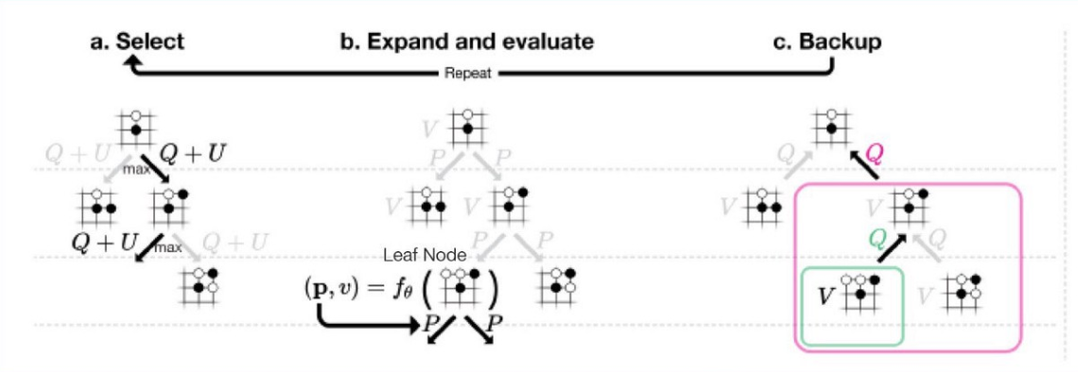
Monte Carlo Tree Search (MCTS)
  Used in both AlphaGo Fan and AlphaGo Zero
Notes:
The Q value serves a similar purpose as the policy p estimated by the deep network f ///// chance of winning
U: confidence bound that depends on a stored prior probability p and visit count N for that edge.
A每次選擇都會選取Q值(移動直)最大的加上U信心區間(U取決於prior probability 和走訪次數N)
B展開葉子節點，通過P和V來推算局面S。
C更新行動價值Q等於在該行動下的子樹中的所有評估V的均值。

Slide 13
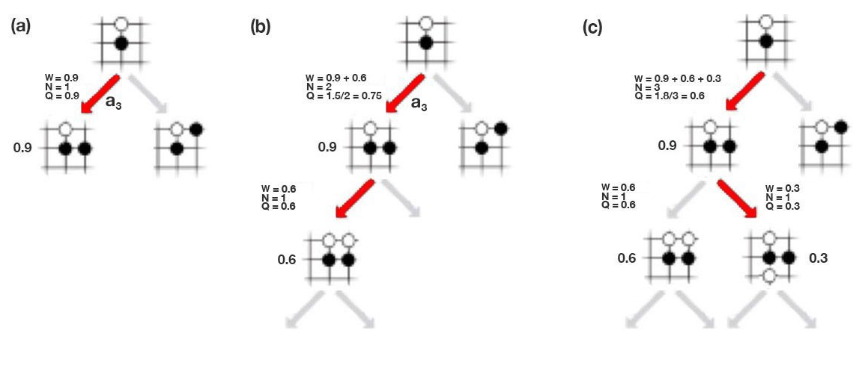
Monte Carlo Tree Search (MCTS)
Notes:
up with a 0.9 chance of winning. So Q is 0.9.
The Q value serves a similar purpose as the policy p estimated by the deep network f
1600 searches for each tree
W:所有的Q加起來
N:下了幾次
C A3被選三次

Slide 14
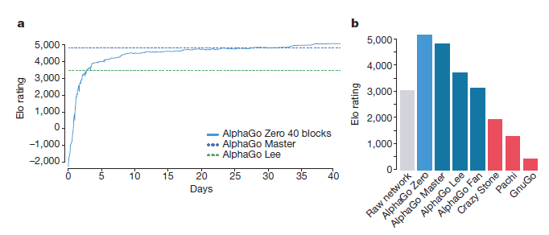
Performances
Notes:
Figure a. learning curve of alphago zero over 40 days
Figure b comparison of different alphagos

Slide 15
Thanks for your attention

