Slide 1
KDD-CUP2019 SKRAI_NTUST
第四組
M10715062 戈善磊
M10715012 蔡亦凱
M10702253 吳冠毅

Slide 2
Content
Our Achievements so Far
Data Analysis
Features Using
Classifiers Training

Slide 3
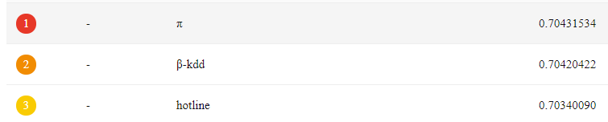

Phase1 Achievement

Slide 4
PART I:
Exploratory Data Analysis & Feature Engineering

Slide 5

Data Analysis in phase I
Mix with Outlier &
Missing value problem !!
OD-pair GPS position
Query Time
Profiles
Distance
Plans choice
Price
Distance
Eta
Transport mode
Select One Mode or None

Slide 6
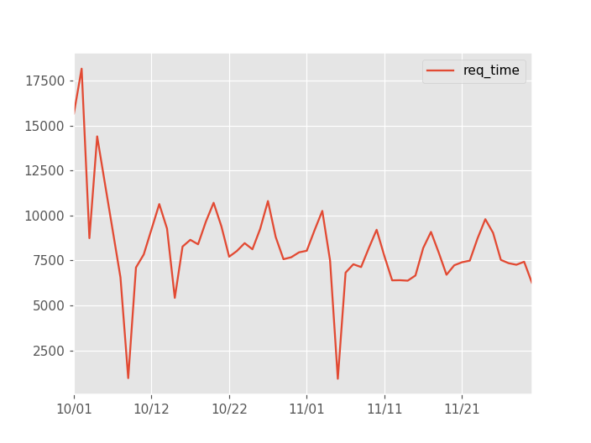
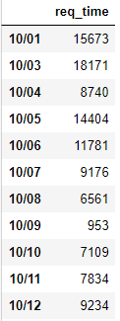
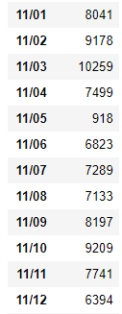
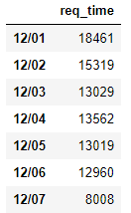
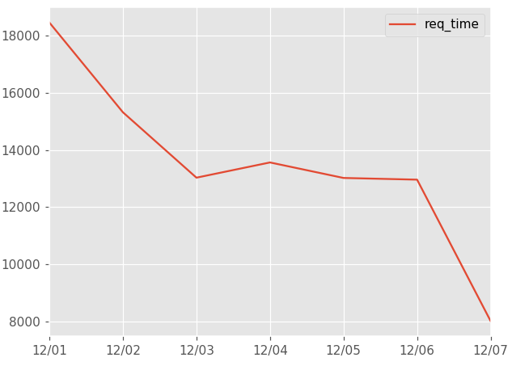
Time Query
In Train
10/02 : X
In Test

Slide 7
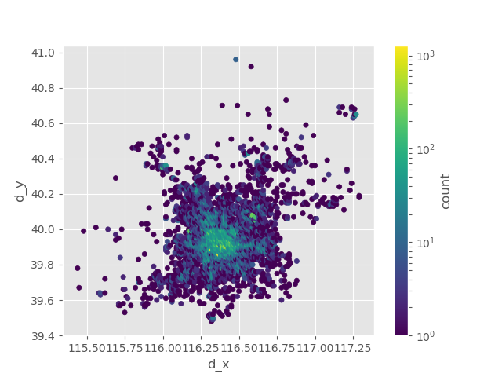
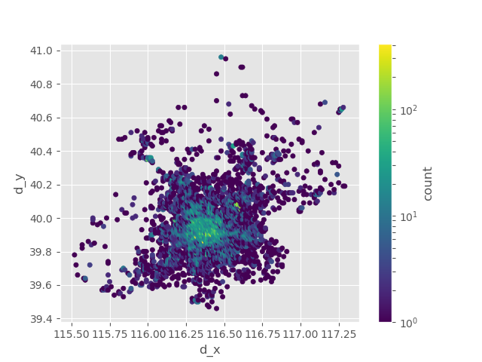
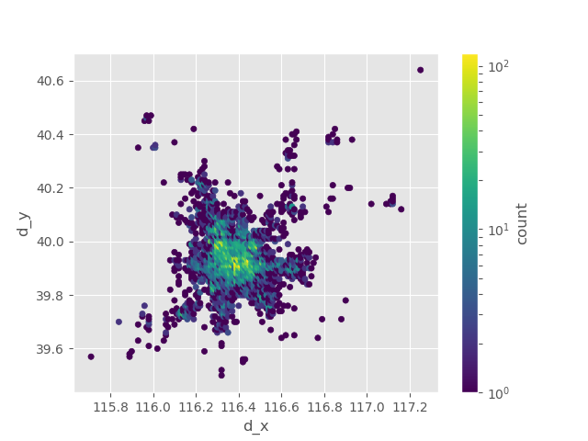
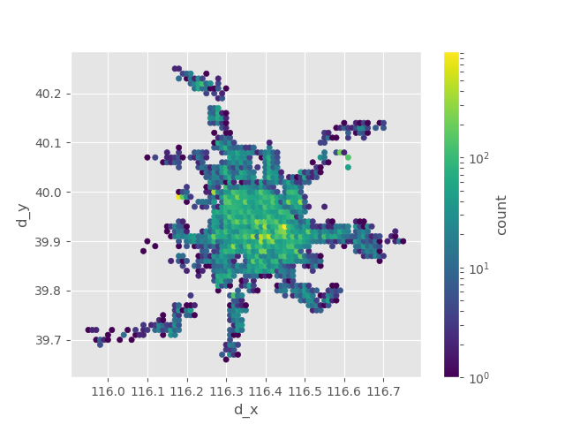
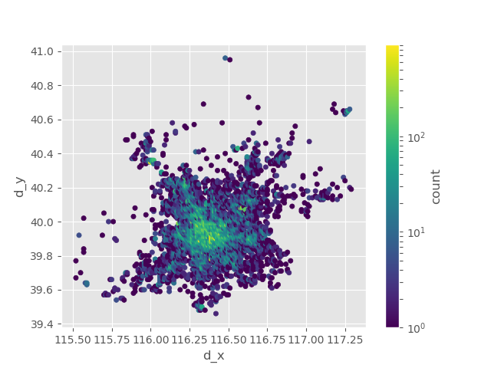
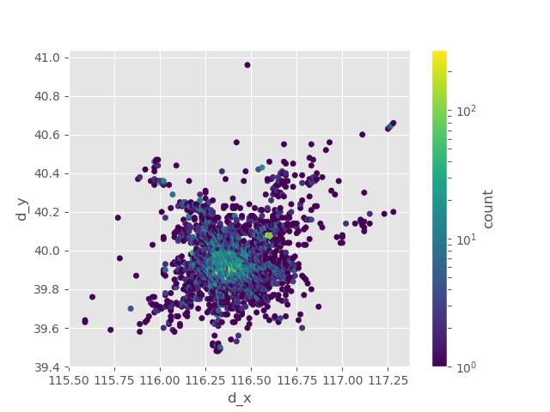
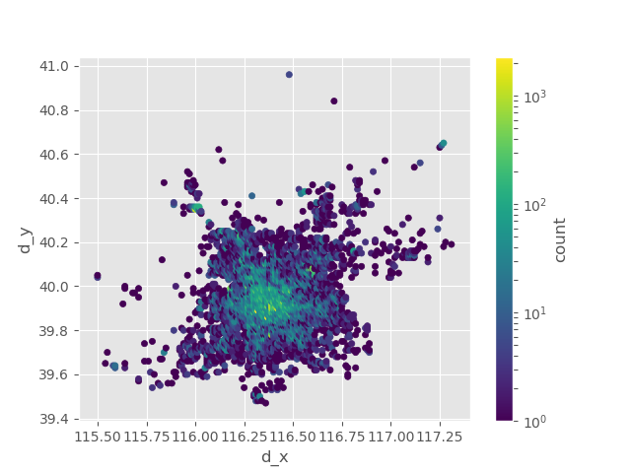
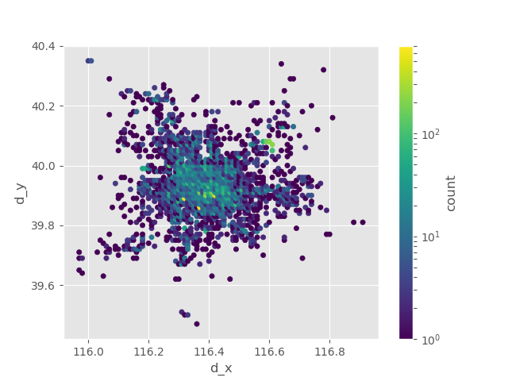
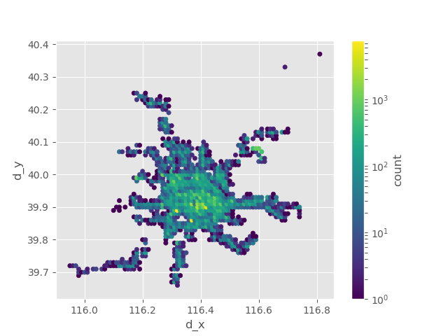
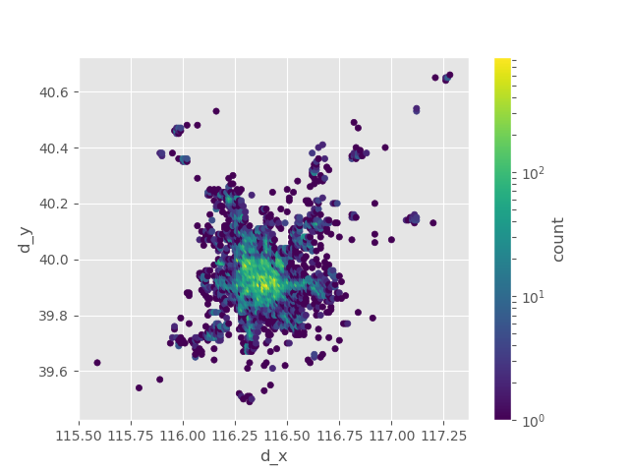
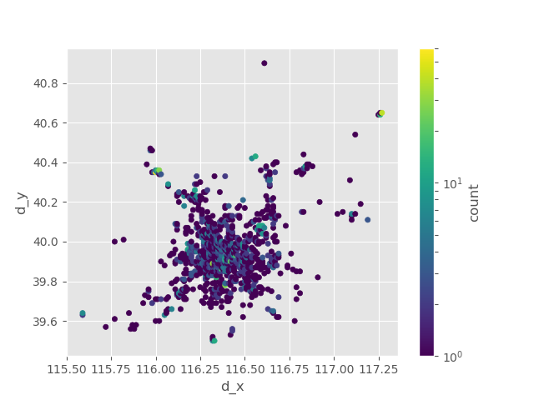
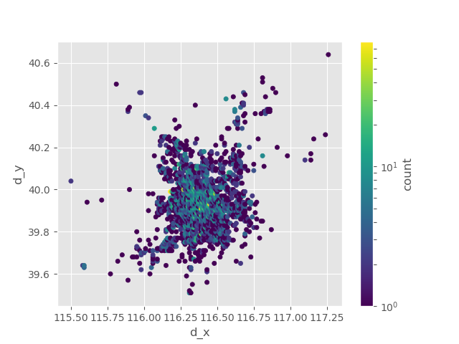
GPS Position In Each Mode
d

Slide 8
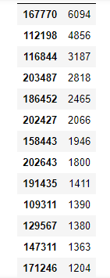
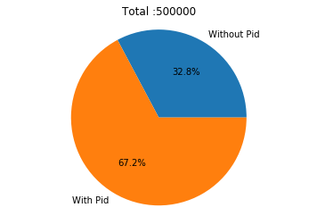
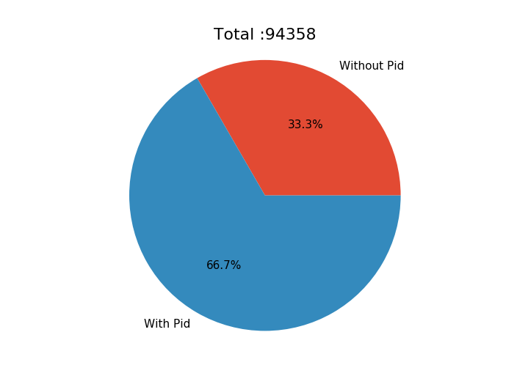
Profiles (66 attributes)
PID Appearance
Train : 50,0000
Test : 9,4358

Slide 9
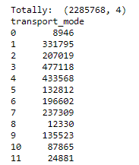
Plans choice
Price
Distance
Eta
Transport mode
Through Train & Test
Max: 7 choice
Train
Test

Slide 10
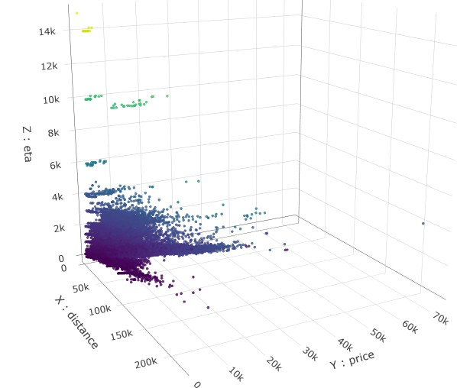
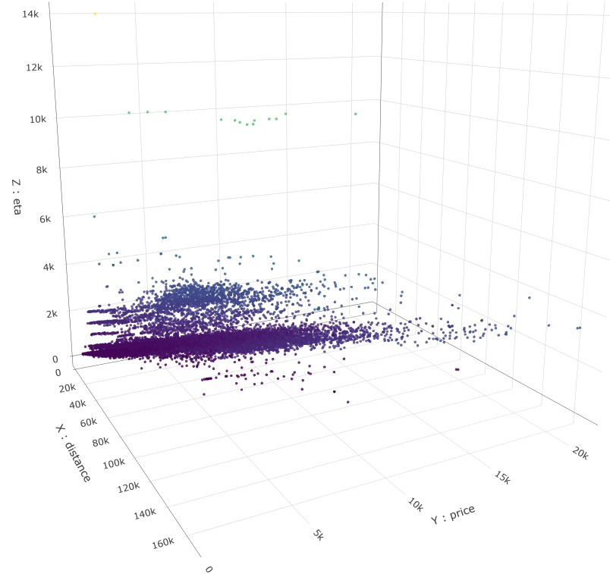
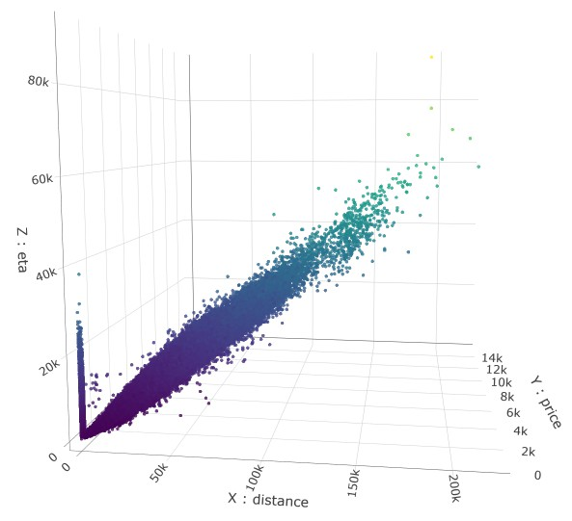
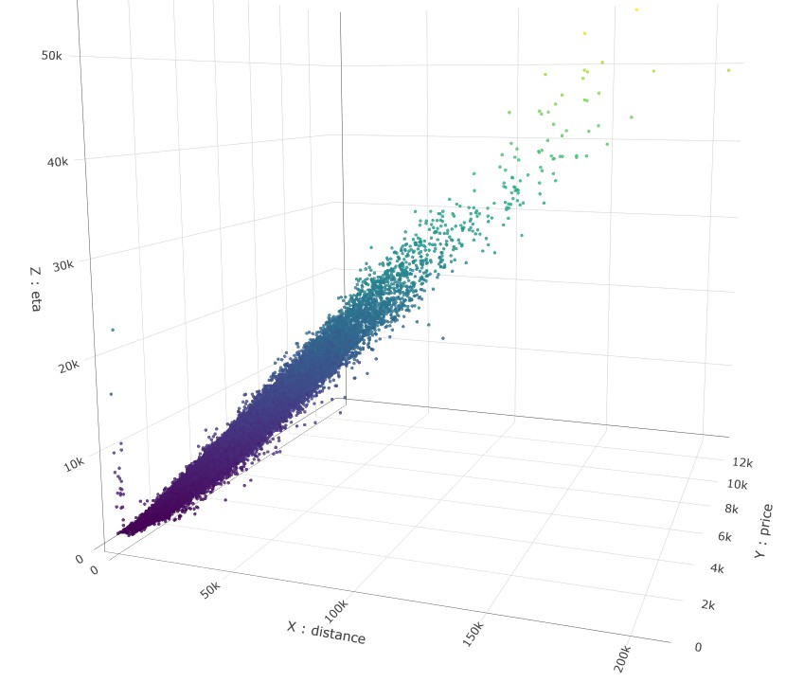
Plans pattern (1)
Train
Test
Mode 1
Train
Test
Mode 4

Slide 11
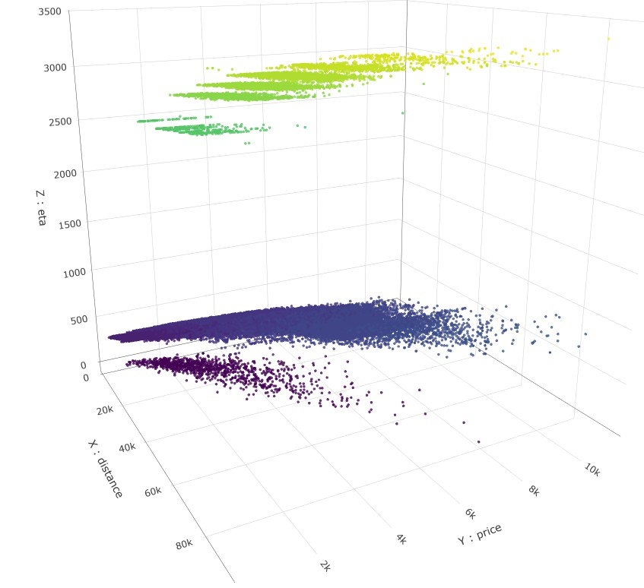
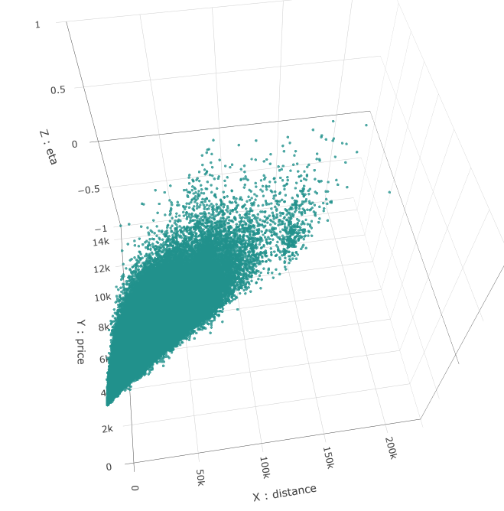
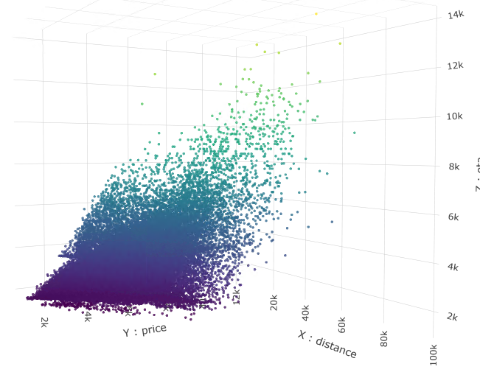
Plans pattern (2)
Mode 2
Mode 3
Mode 10

Slide 12
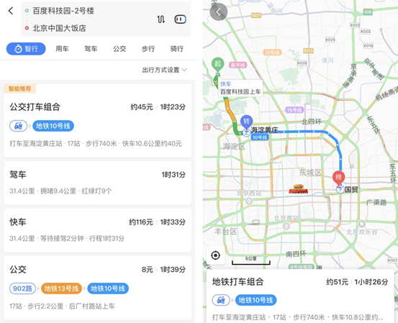

DATA in Phase II
Train | Test
Old_Phase 1 : Beijing 50,0000 | Old Beijing 9,4358
Phase2-1: Beijing (More suburbs) 50,0000 | New Beijing + Shanghai + Hong Kong 30,4916
Phase2-2 Shanghai + Hong Kong 150,0000

Slide 13
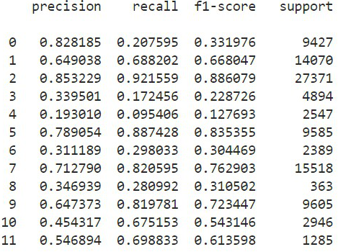
Features Using
Time:
Month, week of year, Weekday , Hour
GPS:
OD pair , Mohnton distance
Profiles (66)
Raw Plans
Each mode of
Rank, Eta , Price, Distance
Weather

Slide 14
PART II:
Model selection
& Classifier Training

Slide 15
Our Platform
CPU: i9-7900X CPU @ 3.30GHz
Memory: 64G
GPU : 1080 Ti 11G

Slide 16
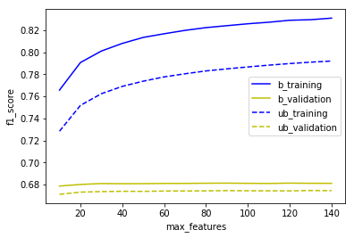
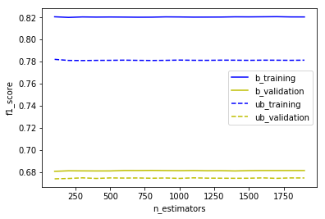
Random Forest
Tuning for max_features:
Parameters Tuning:
n_estimators : [100,2000]
max_depth : [10,100]
max_features : [10,150]
min_samples_leaf : [1,20]
class_weight : balanced
50
Tuning for n_estimators :
800

Slide 17
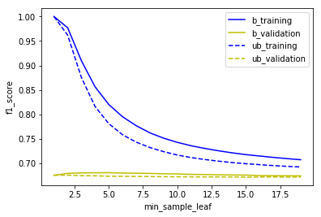
Random Forest (2)
Tuning for min_sample_leaf:
5

Slide 18
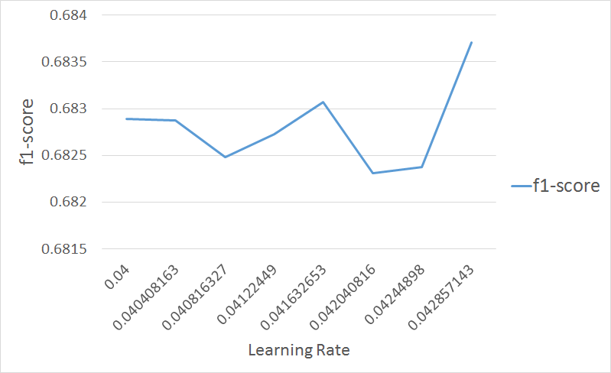
LightGBM
The Training Curve
Leaf-wise (Best-first) Tree Growth
Parameters Tuning:
smaller learning_rate [0.04, 0.1]
larger n_estimators [100, 2500]
larger max_bin [100, 150]
larger num_leaves [32, 128]
f1-score: 0.65 -> 0.69

Slide 19
The end

Slide 20
Appendix
組員分工
M10702253 吳冠毅：Feature Engineering、Data Analyzing
M10715012 蔡亦凱：Training and tuning LightGBM
M10715062 戈善磊：Feature Engineering、Data Analyzing、Training Model、Team consultant

Slide 21
Appendix
心得
第一次參加這種比賽，覺得新鮮又刺激。到後來別組一直超越我們，搞得我們很緊張，然後一天只有兩次上傳機會，實在太少了！甚至想說乾脆多開幾個分身帳號算了。最後大家的分數都差在小數點第三位，其實我覺得不管排名如何，各組事實上都訓練出了不錯的Model。
資料前處理很重要；一個Model表現不好就換另一個；調整參數更是不得馬虎。如果要得到好的分數，以上缺一不可。還好我們組員都很罩，大家都有自己厲害的地方，還有強大的電腦讓我們一直調參數。

