Slide 1
KDD CUP 期末報告
M10715090 鄭思元
M10715067 林書宇
M10715086 鍾瑀芯

Slide 2
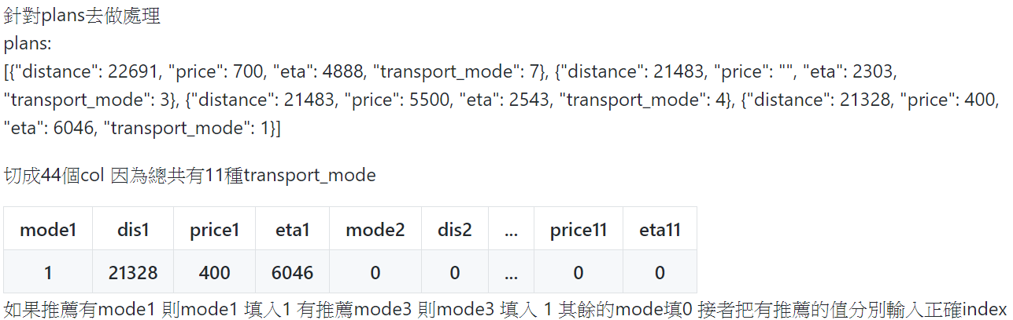
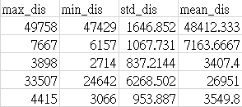
Preprocessing
How we deal with the features of plans :
我們把每一筆data的distance, price, eta
都計算出max, min, std, mean

Slide 3
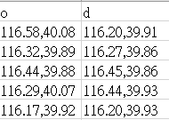
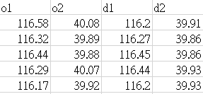
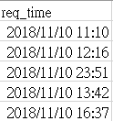
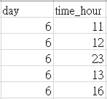
Preprocessing(cont’d)
Split [“o”, ”d”] to [“o1”, ”o2”, ”d1”, ”d2”]
Take the req_time’s hour and day as feature

Slide 4
How we predict
Like train_data we do the same preprocessing, but the final predict length is 94358 rows ( i.e. test_queries.csv ‘s length).
So we can know that there must have some “sid” didn’t have plans.
We give these rows answer : 0 (none_click class)

Slide 5
How we predict(cont’d)
Next, we can find out some “sid” didn’t have “pid”, so we give these rows the most recommended plan(because almost 70% people will choose the most recommended plan).
Final, we predict the remaining data.

Slide 6
model
We use Randomforest :
Use all the feature and the label is [click_mode]
Hyperparameter : n_estimators : 350, max_depth : 20

Slide 7
Rank

Slide 8
Discussion
We have tried to add weather feature but it didn’t improve the score.
We think the profile is hard to analysis.

Slide 9
Discussion(cont’d)
We can find out that almost every team’s score are similar (the score gap between each team is about 0.001), so it probably means that the data is hard to predict (base on the human reaction is complexity), so maybe we can’t only think about how to improve our model, we need to choose another way to enhance our score (e.g. evaluate method).

Slide 10
Reflection
Join KDD cup let us knows that many people is engage in this field and have strong skills, so we need to pay more attention in the computer science, join more competition to improve our skill.

Slide 11
Division of work
Data preprocessing : M10715067林書宇
M10715086鍾瑀芯
Model, presentation : M10715090鄭思元

Slide 12
THANKS!
Q & A

