Slide 1


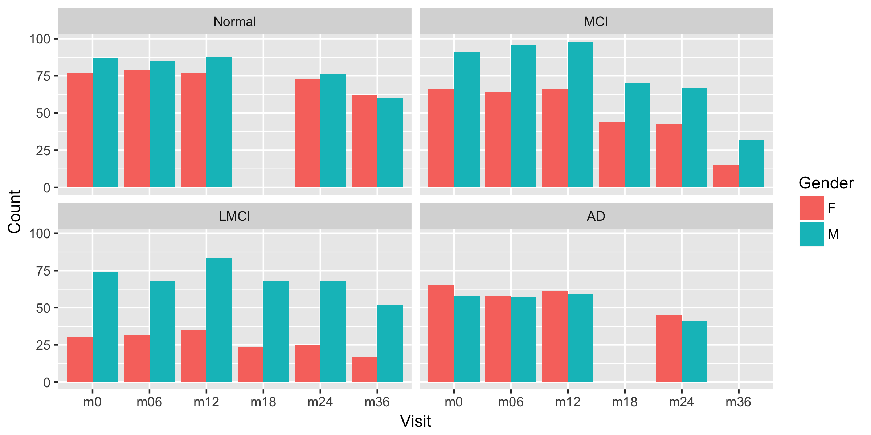
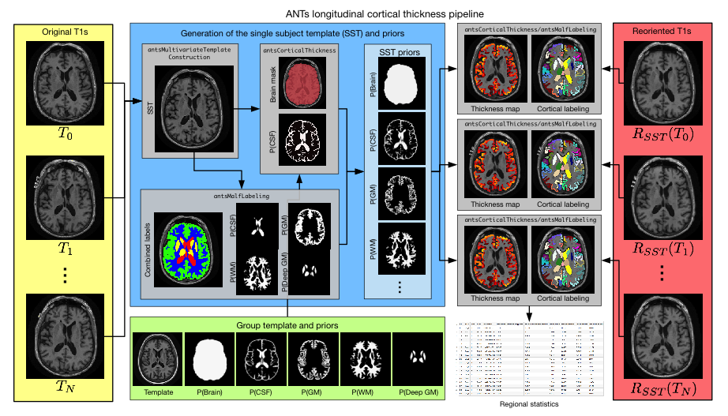
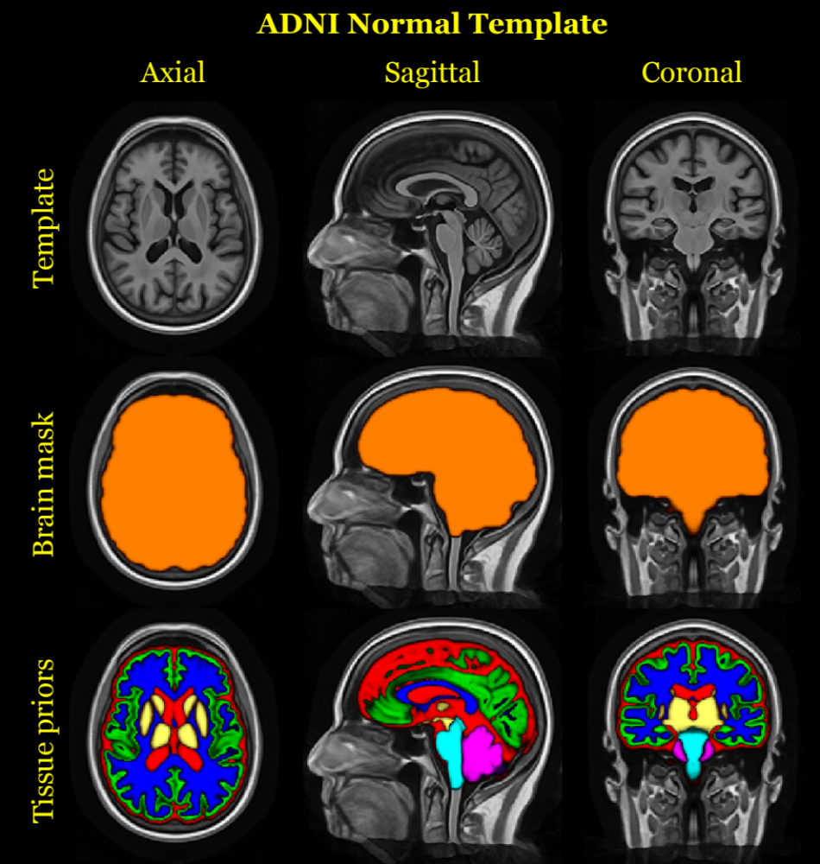
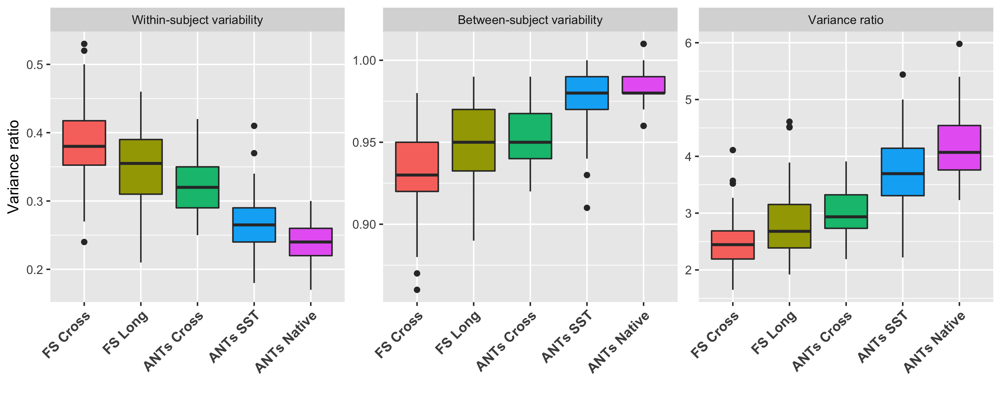
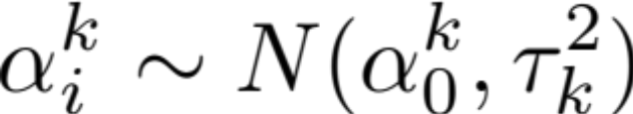
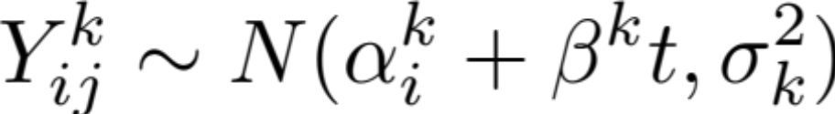
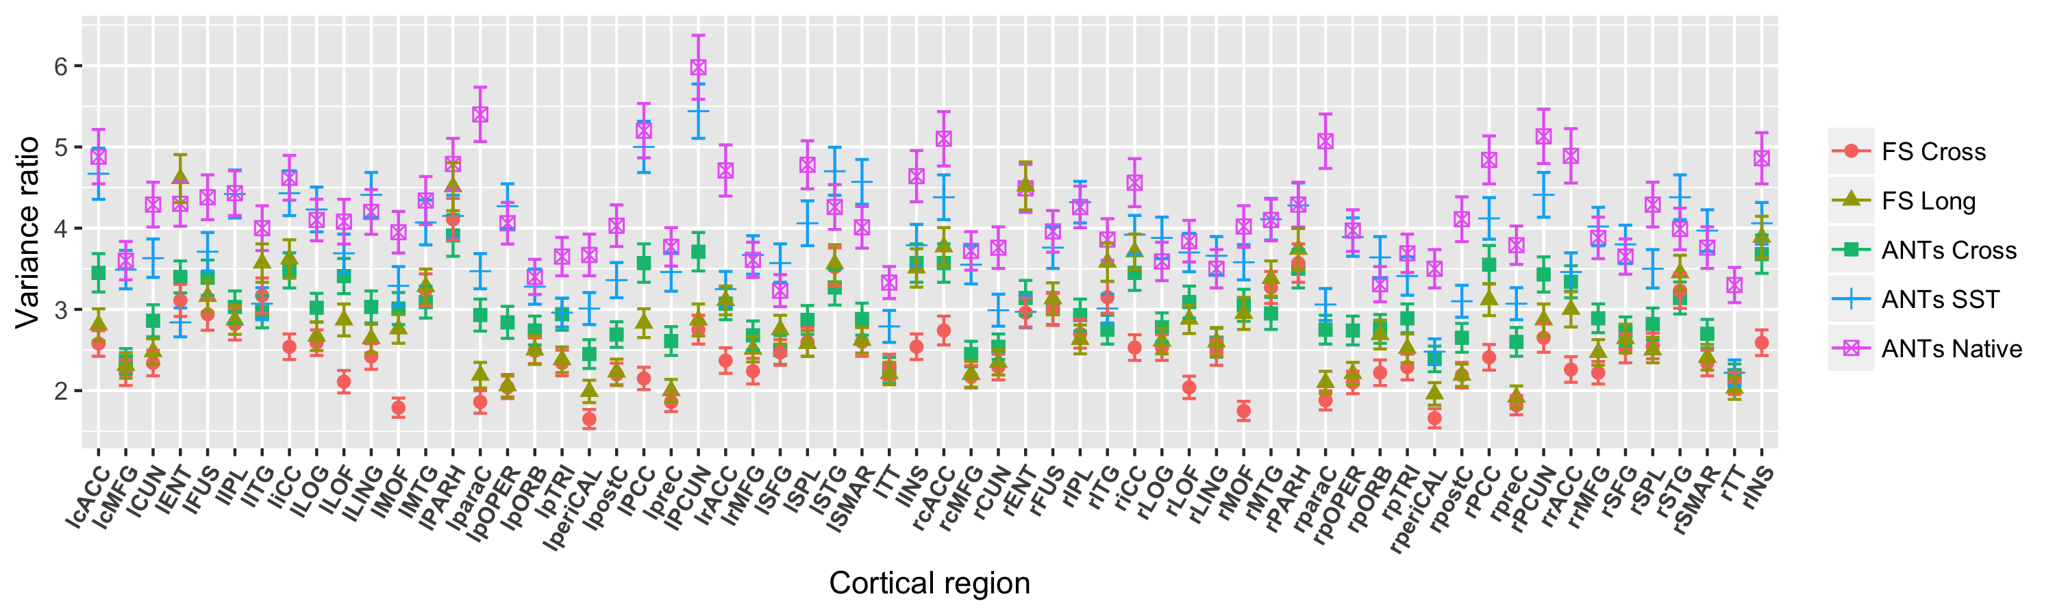
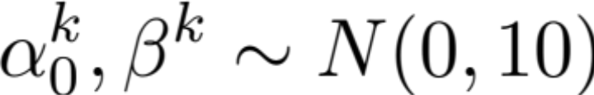
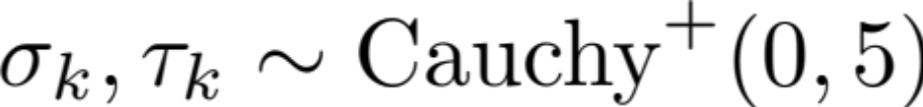


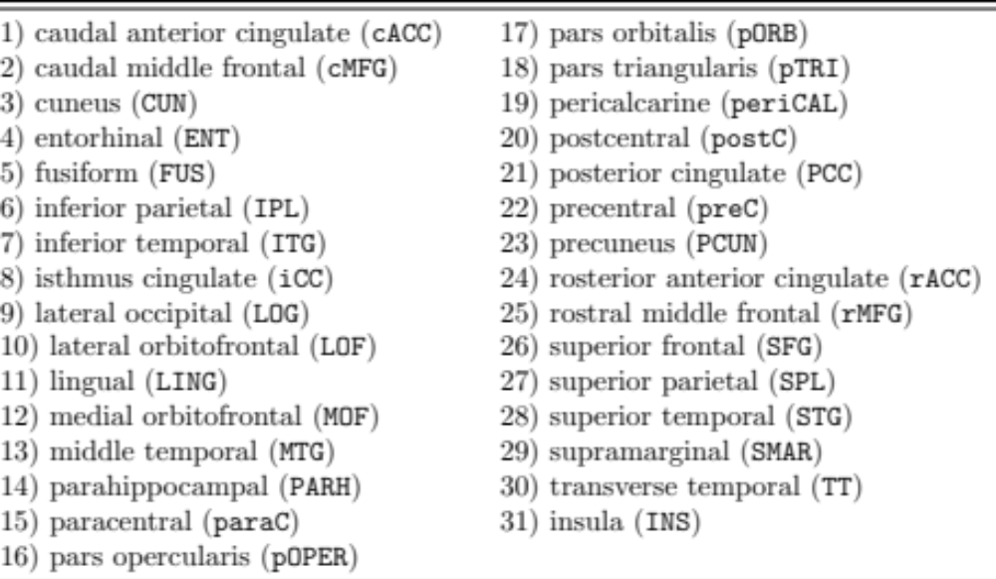
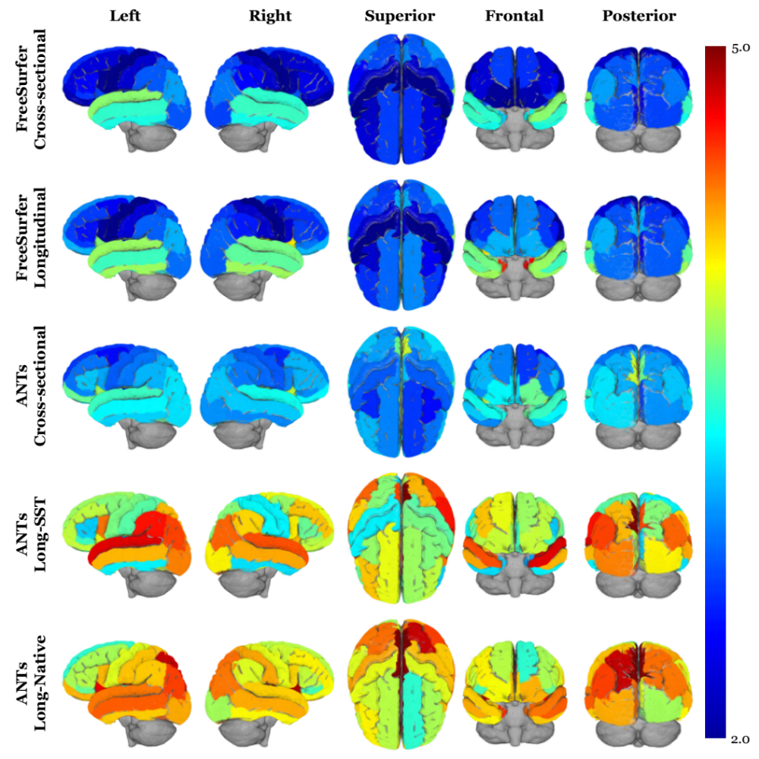

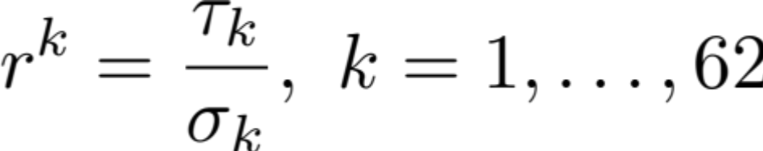


The ANTs Longitudinal Cortical Thickness Pipeline
Nicholas Tustison^{1,2}, Andrew Holbrook³, Jared Roberts², Brian Avants⁴, Philip Cook⁵, James Stone¹, Daniel Gillen³ & Michael Yassa² for the Alzheimer’s Disease Neuroimaging Initiative
¹Department of Radiology and Medical Imaging, University of Virginia, ²Department of Neurobiology and Behavior, University of California, Irvine, ³Department of Statistics, University of California, Irvine, ⁴Biogen, Cambridge, ⁵Department of Radiology, University of Pennsylvania
BACKGROUND
Longitudinal studies of development or disease in the human brain have motivated the acquisition of large neuroimaging data sets and the concomitant development of robust methodological and statistical tools for quantifying neurostructural changes.
Longitudinal-specific strategies for acquisition and processing have potentially significant benefits including more consistent estimates of intra-subject parameters while retaining predictive power.
Much research has been devoted to exploring methodologies for properly exploiting longitudinal studies and avoiding various forms of processing bias.¹
Previously² we introduced the Advanced Normalization Tools (ANTs) cortical thickness framework which leverages various pre-processing, registration, segmentation, and other image analysis tools that members of the ANTs and Insight Toolkit (ITK) open- source communities have developed over the years and disseminated publicly.
We introduce the longitudinal version of the ANTs cortical thickness pipeline and demonstrate its utility on the publicly available ADNI-1 data set. In addition, we demonstrate that certain longitudinal processing choices have significant impact on measurement qual- ity in terms of within-subject and between-subject variances.
ADNI-1 imaging data
ANTs longitudinal pipeline
615 total subjects:
  186 cognitive normals
  178 MCI
  128 LMCI
  123 AD
ADNI ANTs template and priors
(Offline): Group template and prior probability image creation.
Unbiased single-subject template (SST) creation.
Application of the ANTs cross sectional pipeline to the SST. This processes the SST based on the group template.
Creation of the SST prior probability maps.
(Optional): Transform each individual time point to the SST.
Application of the ANTs cross-sectional pipeline – with SST as reference template – to each individual time-point image.
Joint label fusion to determine the cortical ROIs for analysis.
RESULTS
DISCUSSION
Evaluation strategy
Global variability comparison
Conclusions
Comparative assessment utilized LME models to determine the between-subject to within-subject variance ratios where higher values indicate greater discriminative capacity.
In the majority of regions ANTs pipelines outperformed their FreeSurfer counterparts with longitudinal processing in the native space (ANTs Native) performing the best.
ANTs SST outperformed ANTs Cross over the majority of regions. Regional disparities point to increases in both between-subject and within-subject variances which might be an additional interpolation artifact.
Future direction
FS Long slightly outperformed all pipelines in the left and right entorhinal regions. This motivates the development of an ANTs-based entorhinal specific pipeline.
For the following cortical thickness pipelines:
  FreeSurfer cross-sectional (FS Cross)
  FreeSurfer longitudinal (FS Long)
  ANTs cross-sectional (ANTs Cross)
  ANTs processed in SST space (ANTs SST)
  ANTs processed in native space (ANTs Native)
using the Bayesian LME model
Regional variability comparison
we compute the within-, , and between-subject, , variances for each of the 62 Desikan-Killiany-Tourville³ cortical regions:
Reuter et al. (2012). Within-subject template estimation for unbiased longitudinal image analysis. NeuroImage.
Tustison et al. (2014). Large-scale evaluation of ANTs and FreeSurfer cortical thickness measurements. NeuroImage.
Klein and Tourville (2012). 101 labeled brain images and a consistent human cortical labeling protocol. Frontiers in Neuroscience.
We then calculate the following variance ratio as a comparative performance metric:
Variance ratio
Funding support provided by NIMH R01 MH102392 and NIA R21 AG049220, P50 AG16573.
Contact: ntustiso@uci.edu
www.yassalab.org

