Slide 1

Collision Avoidance Testing for Autonomous Vehicles with Global Map Modeling
ICRA 2021 – Submission 2176
Yun Tang, Yuan Zhou*, Fenghua Wu, Yang Liu, Jun Sun, Wuling Wang, Gang Wang

Slide 2
Types of Discovered Issues
Wrong yielding actions
Wrong overtaking
Wrong switch from yielding to overtaking
Emergency braking too soft
Lack of coordinated collision avoidance
Decision conflicts
Incorrect prediction
Obstacle failures

Slide 3
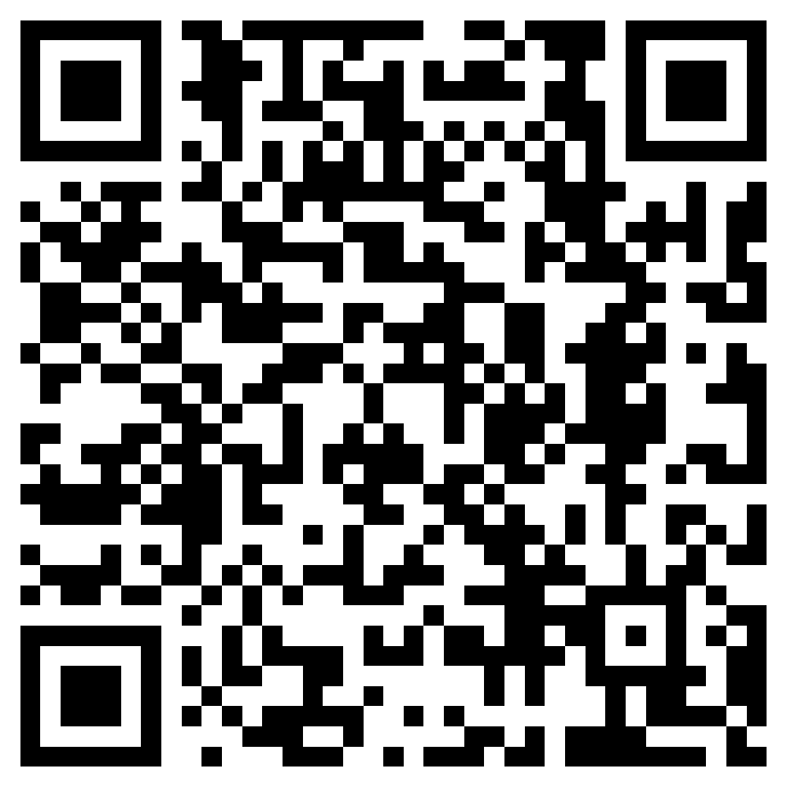
Thank You
https://av-testing.github.io/atlas/

