Slide 1
堆疊(stack)

Slide 2
Stack vs. Queue
(Logically view)
“Push”
“Pop”
Conceptual views:
In a stack, the element deleted from the set is the one most recently inserted → A stack uses a last-in first-out (LIFO) policy.
In a queue, the element deleted is always the one that has been in the set for the longest time → A queue uses a first-in first-out (FIFO) policy.
…
“Enqueue”
…
“Dequeue”

Slide 3
Use an Array to Implement a Stack
Stack-Empty(S)
if S.top == -1
return true;
else return false;
. . .
Push
S[3]
S[2]
S.top
S[1]
We assume that the array doe not overflow, but this is not true…
Push(S, x)
S.top++;
S[S.top] = x;
. . .
x
S[3]
Pop
. . .
S[2]
S[1]
S[3]
Pop(S)
if Stack-Empty(S)
error underflow;
else
S.top--;
return S[S.top+1];
S[0]
S[2]
S.top
S[1]
(S[-1])
S[0]
The element S[-1] does not actually exist!
S.top
(S[-1])

Slide 4
Use an Array to Implement a Queue
0
1
2
3
4
5
6
7
8
9
10
11
0
1
2
3
4
5
6
7
8
9
10
11
S
15
6
9
8
4
S
3
5
15
6
9
8
4
17
Q.head=6
Q.tail=11
Q.tail=2
Q.head=6
Insert Key 17 to tail
Insert Keys 3 and 5 to tail
Delete Key 15 to tail
0
1
2
3
4
5
6
7
8
9
10
11
0
1
2
3
4
5
6
7
8
9
10
11
S
15
6
9
8
4
17
S
3
5
15
6
9
8
4
17
Q.tail=(11+1)%12=0
Q.head=6
Q.tail=2
Q.head=67
Exercise: Complete the following functions:
Queue-Empty (check if the queue is empty)
Enqueue (insert an item to the queue)
Dequeue (delete an item from the queue)

Slide 5
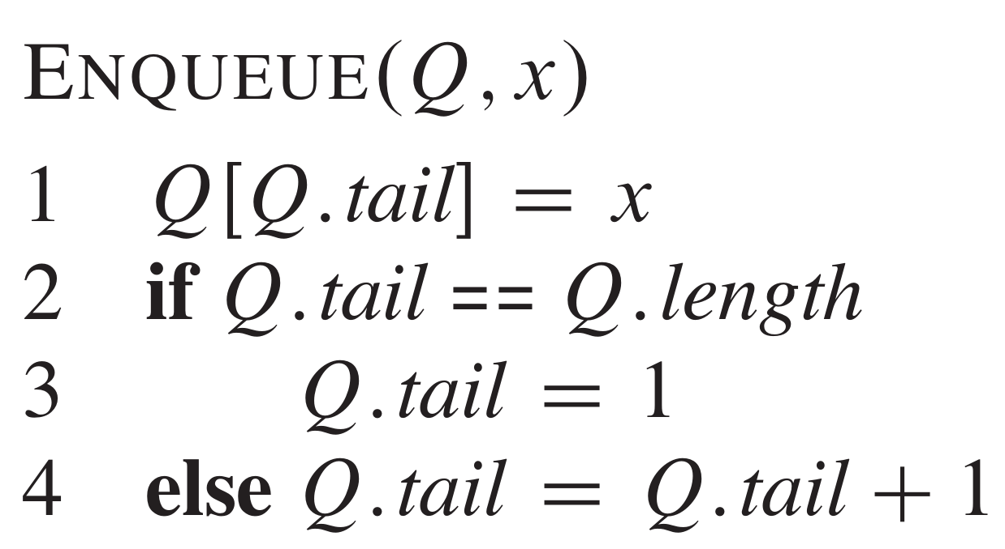
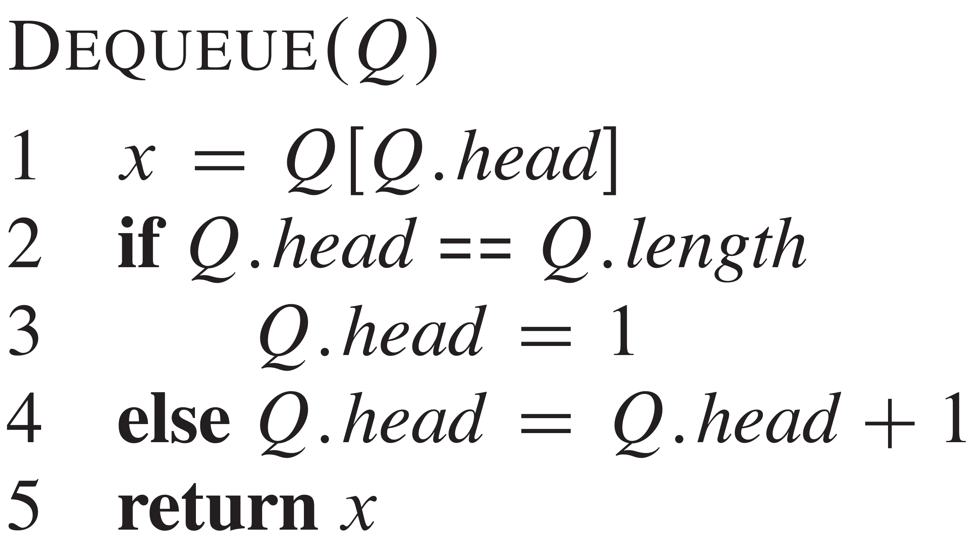
Solutions (with Some Problems)

Slide 6
Underflow vs. Overflow
If a queue or stack is implemented using a limited-size array,
Overflows occur when we insert an element (by enqueue or push) to a full queue or stack.
Underflows may occur if we try to remove an element (by dequeue or pop) from an empty queue or stack.

Slide 7
Week3 例題9
一個有括號的多項式 +, -, *,判斷括號是否有對稱，若有對稱，
把最底層的括號的運算式與運算值印出
輸入說明:
輸入有括號的多項式，例如:(((2+5)+2)*3)
輸出說明:
若括號有對稱，印出最底層的括號的運算式與運算值
若括號沒有對稱，則印出ERROR INPUT

Slide 8
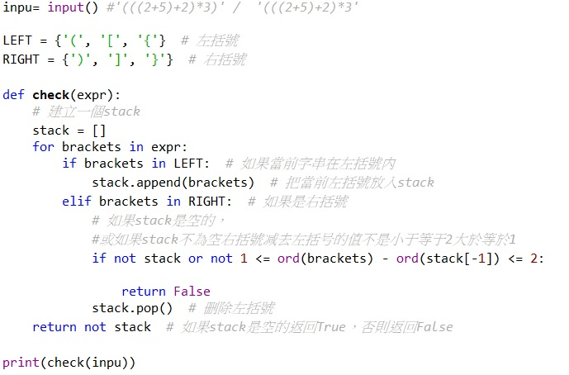
Stack code

