Slide 1

OSINT – Praktische Anwendung für Aufdeckung von PII

Slide 2
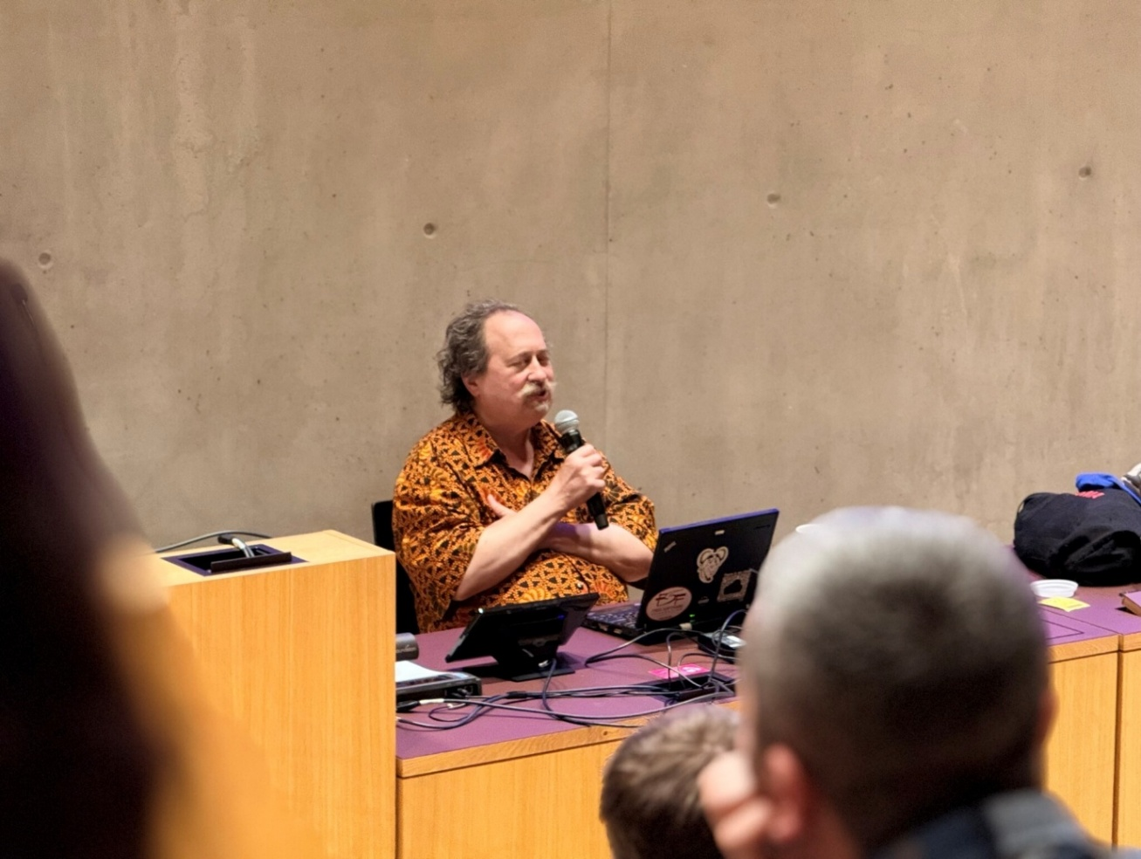
URL: https://hub.hslu.ch/informatik/wp-content/blogs.dir/632/files/sites/3/IMG_2792.jpeg
Dateiname: IMG_2792.jpeg
Dateihash SHA256: 696cf8556f94eba1e61f89b498a358a6c4258104889435b20cf26ae0dda45fe0

Slide 3
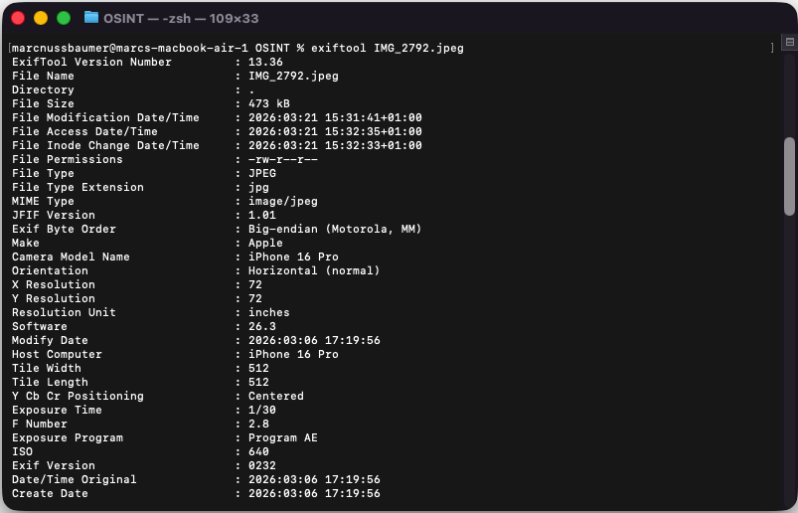
Analyse der Metadaten
root@localhost:~#
exiftool IMG_2792.jpeg
root@macbook-air-1 OSINT % exiftool IMG_2792.jpeg
ExifTool Version Number : 13.36
File Name : IMG_2792.jpeg
Directory : .
File Size : 473 kB
File Modification Date/Time : 2026:03:21 15:31:41+01:00
File Access Date/Time : 2026:03:21 15:32:35+01:00
File Inode Change Date/Time : 2026:03:21 15:32:33+01:00
File Permissions : -rw-r--r--
File Type : JPEG
File Type Extension : jpg
MIME Type : image/jpeg
JFIF Version : 1.01
Exif Byte Order : Big-endian (Motorola, MM)
Make : Apple
Camera Model Name : iPhone 16 Pro
Orientation : Horizontal (normal)
X Resolution : 72
Y Resolution : 72
Resolution Unit : inches
Software : 26.3
Modify Date : 2026:03:06 17:19:56
Host Computer : iPhone 16 Pro
Tile Width : 512
Tile Length : 512
Y Cb Cr Positioning : Centered
Exposure Time : 1/30
F Number : 2.8
Exposure Program : Program AE
ISO : 640
Exif Version : 0232
Date/Time Original : 2026:03:06 17:19:56
Create Date : 2026:03:06 17:19:56
Offset Time : +01:00
Offset Time Original : +01:00
Offset Time Digitized : +01:00
Components Configuration : Y, Cb, Cr, -
Shutter Speed Value : 1/30
Aperture Value : 2.8
Brightness Value : 0.8687238296
Exposure Compensation : 0
Metering Mode : Spot
Flash : Off, Did not fire
Focal Length : 15.7 mm
Subject Area : 2375 1349 752 756
Maker Note Version : 16
Run Time Flags : Valid
Run Time Value : 89313365583791
Run Time Scale : 1000000000
Run Time Epoch : 0
AE Stable : Yes
AE Target : 194
AE Average : 178
AF Stable : Yes
Acceleration Vector : -0.9866973169 0.01503637992 -0.1990106403
Focus Distance Range : 0.31 - 1.05 m
Image Capture Type : Scene
Live Photo Video Index : 2151688244
Luminance Noise Amplitude : 0.02520384637
Photos App Feature Flags : 0
HDR Headroom : 1.00999999
AF Performance : 429 1 12
Signal To Noise Ratio : 22.36657143
Photo Identifier : A682D3D6-4DDB-4F3D-96A0-FFA57B37DD89
Color Temperature : 2703
Camera Type : Back Normal
Focus Position : 107
HDR Gain : 0.6753929261
AF Measured Depth : 996
AF Confidence : 100
Sub Sec Time Original : 718
Sub Sec Time Digitized : 718
Flashpix Version : 0100
Color Space : Uncalibrated
Exif Image Width : 4032
Exif Image Height : 3024
Sensing Method : One-chip color area
Scene Type : Directly photographed
Custom Rendered : Portrait
Exposure Mode : Auto
White Balance : Auto
Focal Length In 35mm Format : 120 mm
Scene Capture Type : Standard
Lens Info : 2.220000029-15.65999985mm f/2.2-2.8
Lens Make : Apple
Lens Model : iPhone 16 Pro back triple camera 15.66mm f/2.8
Composite Image : General Composite Image
GPS Latitude Ref : North
GPS Longitude Ref : East
GPS Altitude Ref : Above Sea Level
GPS Time Stamp : 16:19:50
GPS Speed Ref : km/h
GPS Speed : 0
GPS Img Direction Ref : True North
GPS Img Direction : 197.0987472
GPS Dest Bearing Ref : True North
GPS Dest Bearing : 197.0987472
GPS Date Stamp : 2026:03:06
GPS Horizontal Positioning Error: 13.12772189 m
Profile CMM Type : Apple Computer Inc.
Profile Version : 4.0.0
Profile Class : Display Device Profile
Color Space Data : RGB
Profile Connection Space : XYZ
Profile Date Time : 2022:01:01 00:00:00
Profile File Signature : acsp
Primary Platform : Apple Computer Inc.
CMM Flags : Not Embedded, Independent
Device Manufacturer : Apple Computer Inc.
Device Model :
Device Attributes : Reflective, Glossy, Positive, Color
Rendering Intent : Perceptual
Connection Space Illuminant : 0.9642 1 0.82491
Profile Creator : Apple Computer Inc.
Profile ID : 0
Profile Description : Display P3
Profile Copyright : Copyright Apple Inc., 2022
Media White Point : 0.96419 1 0.82489
Red Matrix Column : 0.51512 0.2412 -0.00105
Green Matrix Column : 0.29198 0.69225 0.04189
Blue Matrix Column : 0.1571 0.06657 0.78407
Red Tone Reproduction Curve : (Binary data 32 bytes, use -b option to extract)
Chromatic Adaptation : 1.04788 0.02292 -0.0502 0.02959 0.99048 -0.01706 -0.00923 0.01508 0.75168
Blue Tone Reproduction Curve : (Binary data 32 bytes, use -b option to extract)
Green Tone Reproduction Curve : (Binary data 32 bytes, use -b option to extract)
XMP Toolkit : XMP Core 6.0.0
Creator Tool : 26.3
Date Created : 2026:03:06 17:19:56.718
Image Width : 2048
Image Height : 1536
Encoding Process : Baseline DCT, Huffman coding
Bits Per Sample : 8
Color Components : 3
Y Cb Cr Sub Sampling : YCbCr4:2:0 (2 2)
Run Time Since Power Up : 24:48:33
Aperture : 2.8
Image Size : 2048x1536
Megapixels : 3.1
Scale Factor To 35 mm Equivalent: 7.7
Shutter Speed : 1/30
Create Date : 2026:03:06 17:19:56.718+01:00
Date/Time Original : 2026:03:06 17:19:56.718+01:00
Modify Date : 2026:03:06 17:19:56+01:00
GPS Altitude : 429.4 m Above Sea Level
GPS Date/Time : 2026:03:06 16:19:50Z
GPS Latitude : 47 deg 8' 35.93" N
GPS Longitude : 8 deg 25' 58.60" E
Circle Of Confusion : 0.004 mm
Field Of View : 17.1 deg
Focal Length : 15.7 mm (35 mm equivalent: 120.0 mm)
GPS Position : 47 deg 8' 35.93" N, 8 deg 25' 58.60" E
Hyperfocal Distance : 22.34 m
Light Value : 5.2
Lens ID : iPhone 16 Pro back triple camera 15.66mm f/2.8
Camera Model Name: iPhone 16 Pro
Create Date: 2026:03:06 17:19:56
GPS Latitude: 47 deg 8' 35.93" N
GPS Longitude: 8 deg 25' 58.60" E

Slide 4

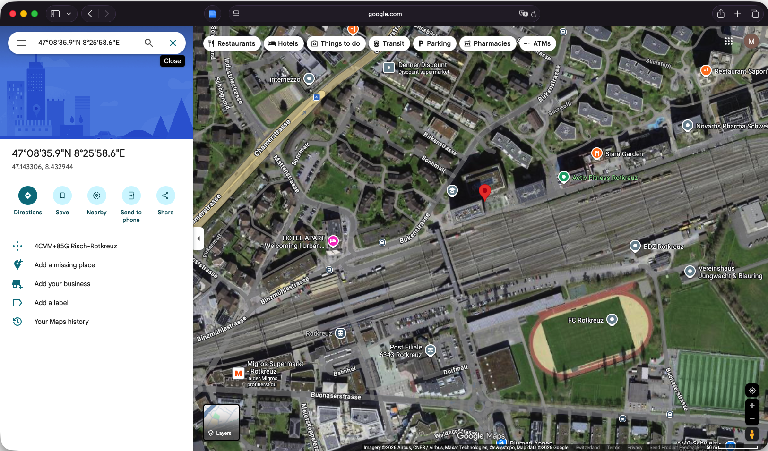
Standort des Aufnahmeortes

Slide 5
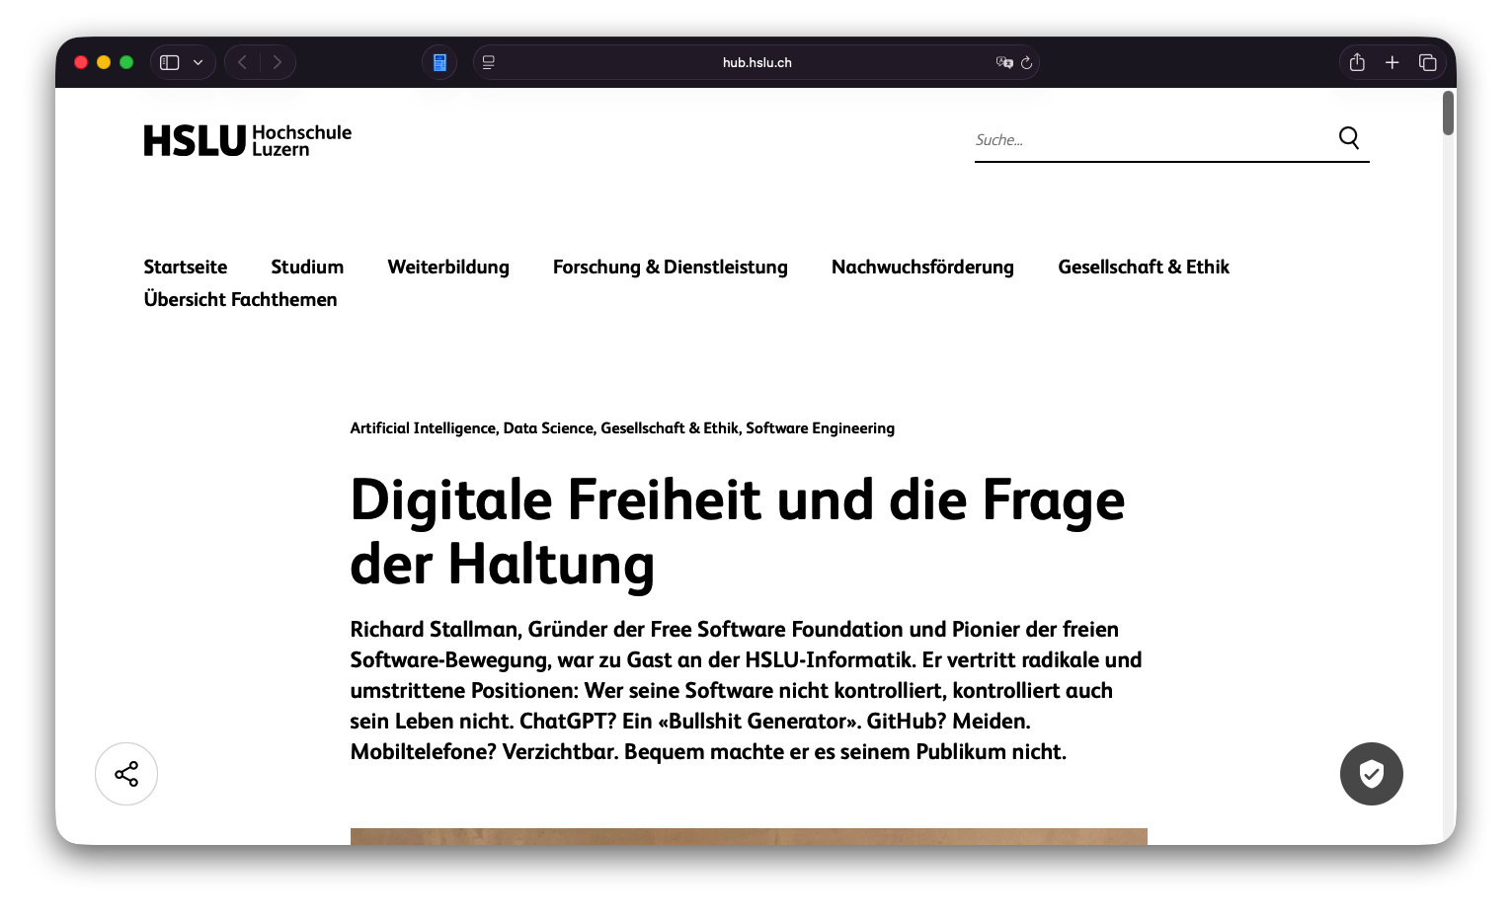
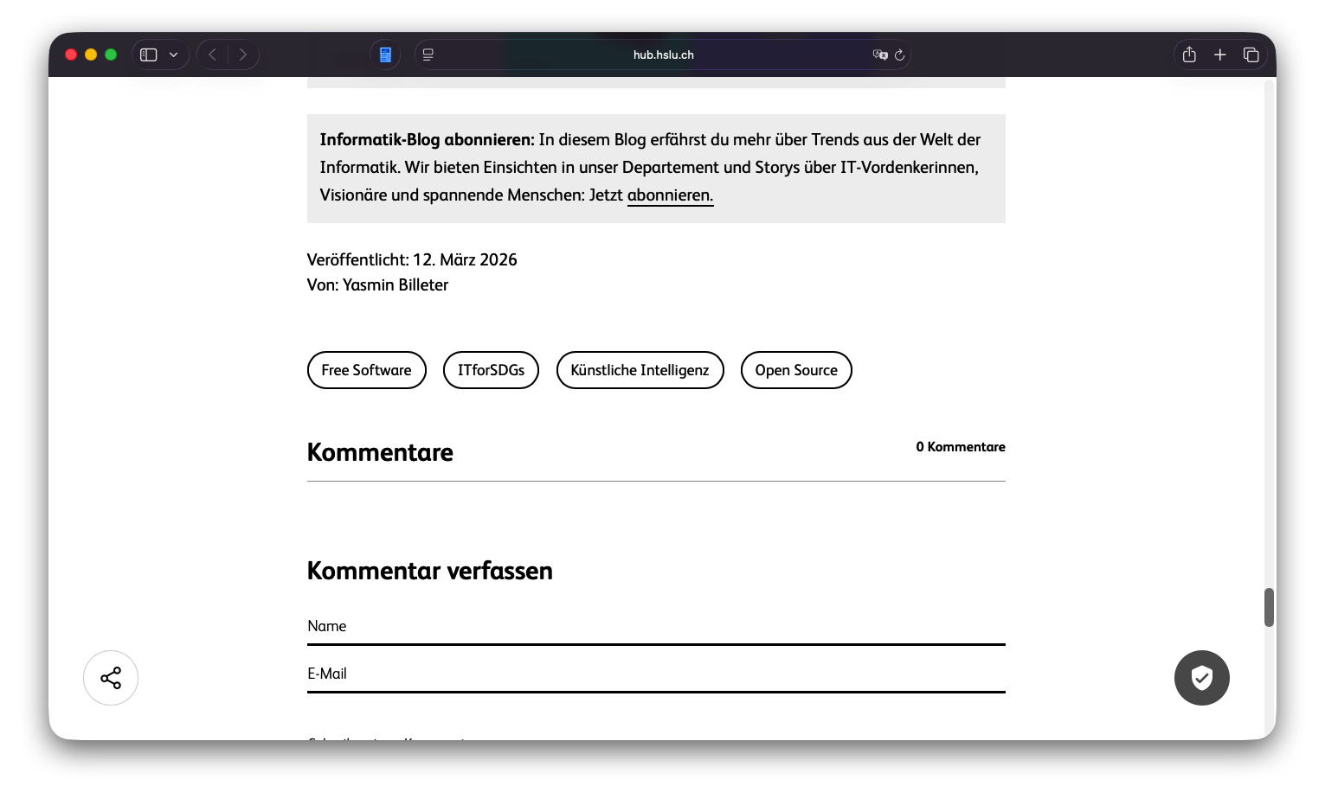
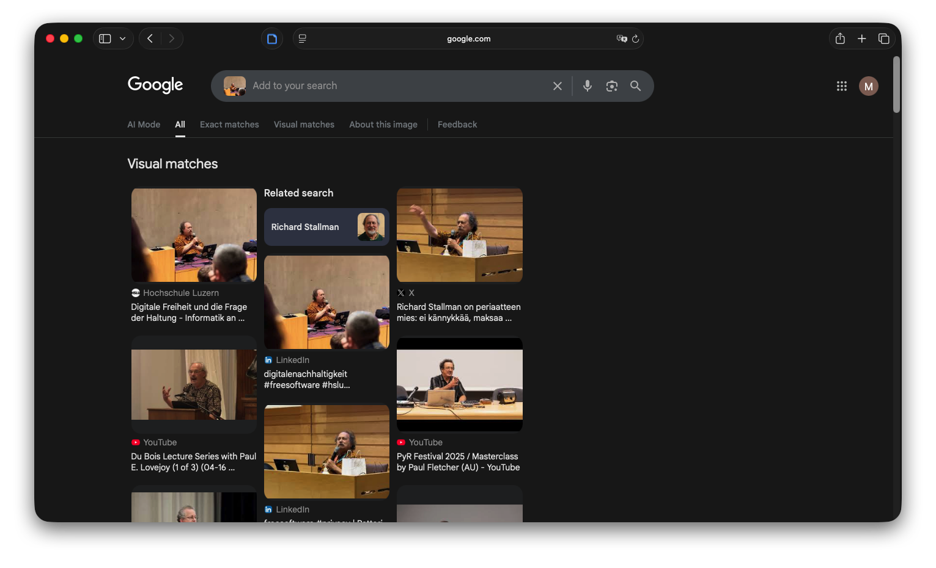
Ursprungsquelle durch Google Search

Slide 6
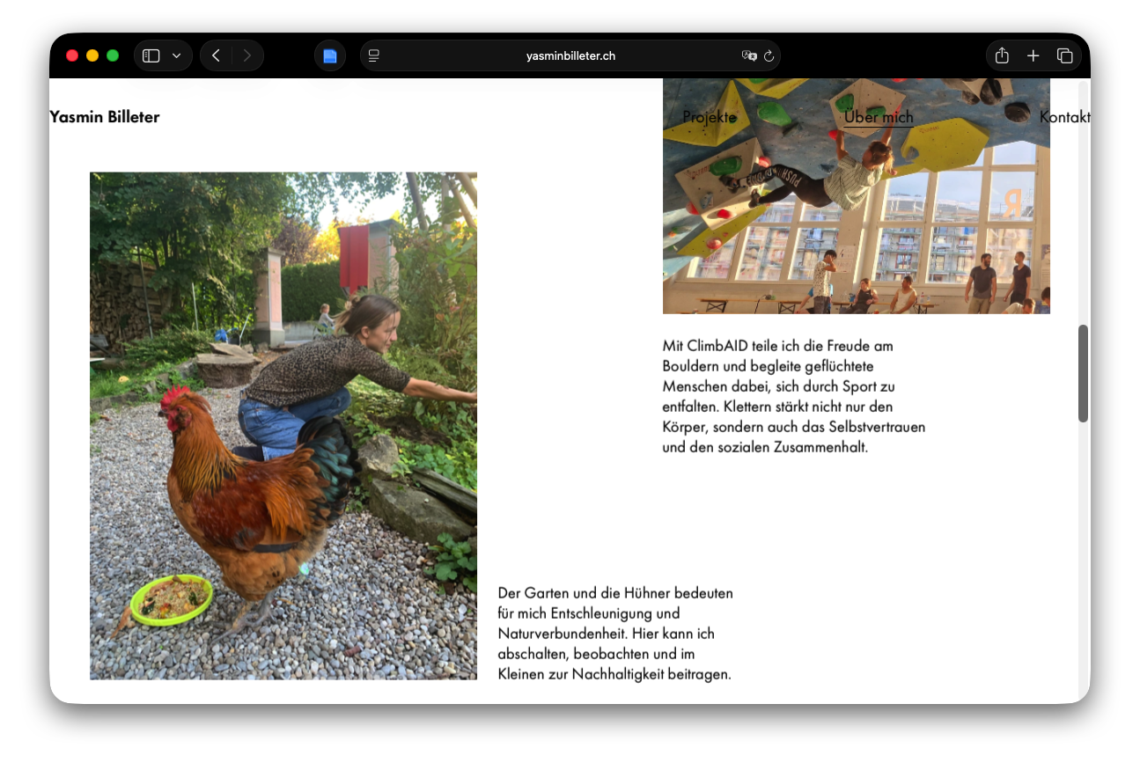
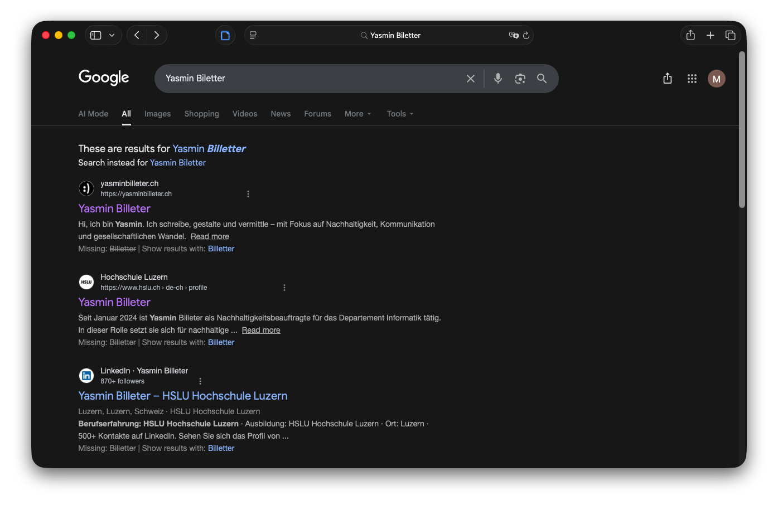
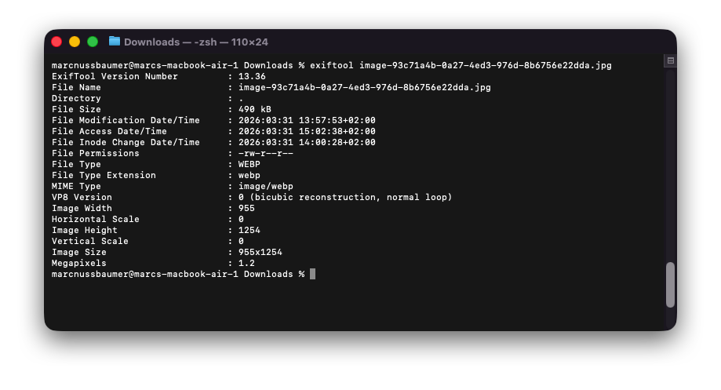
Yasmin Biletter - Autorin

Slide 7
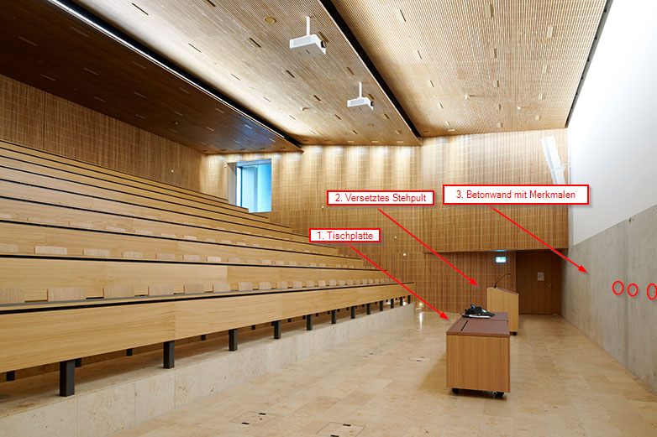
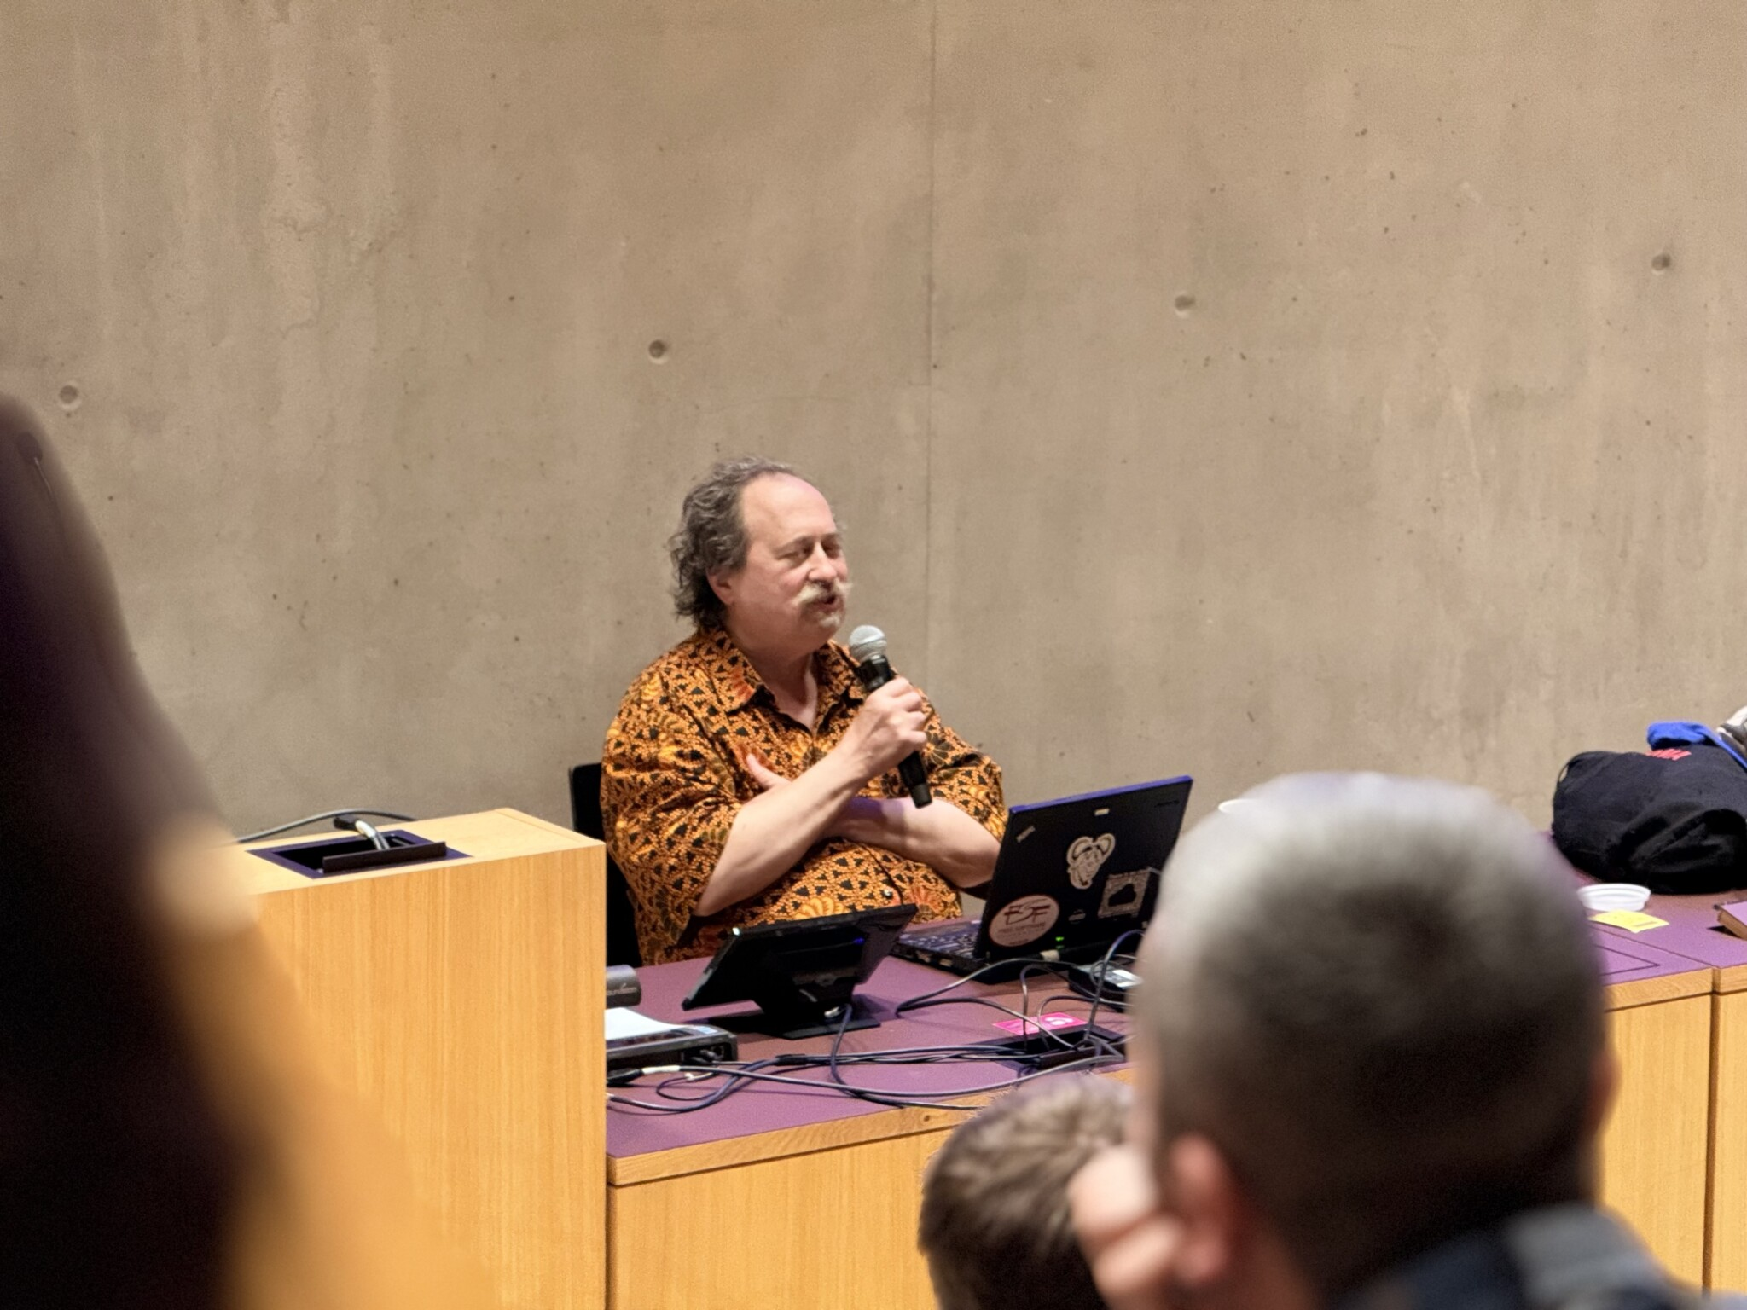
Bildinhaltsanalyse

Slide 8

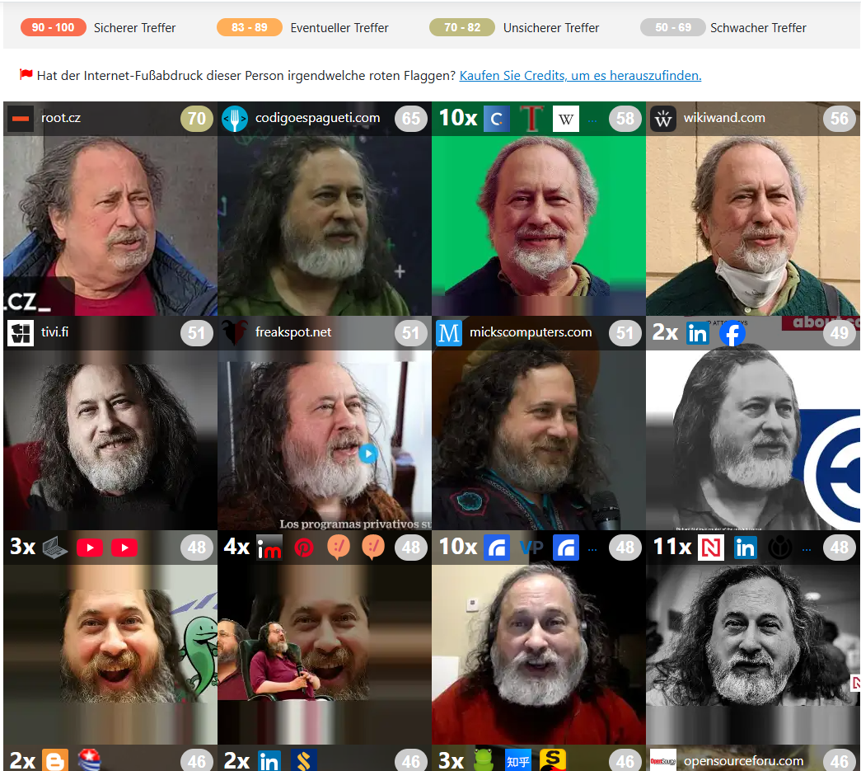
Von Bild zu Person
Information zur Persönlichkeit und weitere Quellen

Slide 9




Risikobewertung
Bewegungsprofil
GPS-Koordinaten
Zeitstempel

Slide 10




Prävention und Massnahmen
Inhalt des Bildes vor dem Hochladen prüfen
Metadatenbereinigung
metaClean
ExifStrip
ExifTools

