Slide 1
NEW AVIATION CONTROLS ENGINEER ONBOARDING
Simulink in the Aerospace
Controls Lifecycle
A practical guide from requirements and control-law models to HIL results and certification evidence
REQUIRE
MODEL
VERIFY
EVIDENCE
FLIGHT-CONTROL SOFTWARE IS AN UNBROKEN CHAIN
AVIATION CONTROLS ENGINEERING ONBOARDING
01
Notes:
Timing: 1 minute
Suggested visual:
A four-stage signal path—Require, Model, Verify, Evidence—sets the throughline for the course.
Speaker notes:
Welcome the new engineer and establish the scope: this is not a block-by-block product tutorial and not a complete certification course. It is a practical mental model for how a controls engineer works inside an aerospace Model-Based Design program. The central idea is that the Simulink model sits inside a governed evidence chain. A good control law is necessary, but it is not sufficient. The engineer must also understand where the behavior came from, how interfaces are controlled, how tests prove the requirement, and how results become reviewable life-cycle data. The pitch-rate-limiter example will reappear throughout the session so every artifact feels connected rather than abstract.
Key teaching points:
• Simulink is one part of a controlled software lifecycle.
• The course follows one behavior from requirement to HIL evidence.
• The target outcome is practical onboarding, not standards interpretation.

Slide 2
ORIENTATION
The executable model is the engineering hub
Requirements
Simulation
EXECUTABLE
MODEL
Control design
MODEL-BASED DESIGN
Verification
The same behavior can be discussed, simulated, reviewed, tested, integrated, and traced.
AVIATION CONTROLS ENGINEERING ONBOARDING
02
Notes:
Timing: 1.5 minutes
Suggested visual:
An executable model at the center connects requirements, control design, simulation, and verification.
Speaker notes:
Explain Model-Based Design as a lifecycle pattern, not merely drawing blocks. The model is executable: it has time, data types, sample rates, state, interfaces, and observable behavior. Requirements can link to model elements; tests can stimulate the model; generated code can be compared with model behavior; the same interfaces can later connect to architecture and hardware benches. This shared representation reduces translation between a control-law equation, a software implementation, and a test procedure—but it does not remove the need for reviews, independent verification, or configuration control. The model’s formal role must be defined in the project plans: it may be a design model, a source model used for code generation, or another project-defined artifact.
Key teaching points:
• Model-Based Design keeps the model central across the lifecycle.
• Execution exposes dynamic behavior before hardware is available.
• The project defines the certification role of each model.
[Sources]
- https://www.mathworks.com/help/simulink/gs/model-based-design.html
- https://www.faa.gov/documentLibrary/media/Advisory_Circular/AC_20-115D.pdf

Slide 3
ORIENTATION
Navigate the entire aerospace evidence chain
Read a model — identify blocks, signals, hierarchy, buses, parameters, and timing
Build a component — turn a testable control requirement into a reviewable subsystem
Verify behavior — create harnesses, test cases, callbacks, and traceable results
Integrate with confidence — interpret compile, Jenkins, and HIL outcomes as evidence
1 LANGUAGE
2 CONTROL LAWS
3 ASSURANCE
4 AUTOMATION
5 HIL + EVIDENCE
Keep asking: What requirement does this element implement, and what result proves it?
AVIATION CONTROLS ENGINEERING ONBOARDING
03
Notes:
Timing: 1 minute
Suggested visual:
Four learning objectives and a five-part route map show the cumulative learning progression.
Speaker notes:
Set expectations for the session. A MATLAB-experienced engineer already understands variables, functions, plots, and numerical analysis. The new skills are graphical execution semantics, explicit interfaces and timing, requirements-based verification, and the evidence discipline required in airborne software. Tell the learner to keep one question active throughout the deck: what requirement does this artifact implement, and what objective evidence proves the behavior? That question connects model readability, test design, traceability, CI failures, and HIL results. The route map also helps the audience understand why certification appears early rather than being appended at the end.
Key teaching points:
• The course builds from model literacy to lifecycle literacy.
• Aerospace work requires both correct behavior and reviewable evidence.
• The recurring question is requirement-to-result traceability.

Slide 4
01 • INTRODUCTION TO SIMULINK
MATLAB computes; Simulink exposes behavior
MATLAB
SIMULINK
Best at — scripts, algorithms, matrices, optimization, data analysis
Execution — statements and functions run in defined order
View — variables, arrays, figures, tables, reports
Best at — dynamic systems, feedback, hybrid logic, integration
Execution — blocks exchange signals over simulated time
View — data flow, hierarchy, state, sample time, interfaces
They are one environment: MATLAB configures, analyzes, automates, and reports on Simulink models.
AVIATION CONTROLS ENGINEERING ONBOARDING
04
Notes:
Timing: 2 minutes
Suggested visual:
A balanced MATLAB-versus-Simulink comparison converges into one integrated workflow.
Speaker notes:
Connect the learner’s existing MATLAB knowledge to Simulink. MATLAB is ideal for calculations, data conditioning, parameter studies, optimization, and post-processing. Simulink adds an executable block-diagram representation of a dynamic system. The arrows are not simply a visual ordering of statements; they carry typed values over simulated time, and blocks may maintain internal state. In daily work the tools are tightly coupled: a MATLAB script may open a project, configure a model, run a test suite, analyze logs, and publish a report. Aerospace teams use Simulink because control laws, plant dynamics, sensor processing, mode logic, interfaces, and tests can be reviewed in a shared environment before flight hardware exists.
Key teaching points:
• Simulink is a block-diagram environment for dynamic simulation and Model-Based Design.
• Graphical data flow complements—not replaces—MATLAB scripting.
• Time, state, data type, and interface semantics are first-class concerns.
[Sources]
- https://www.mathworks.com/help/simulink/getting-started-with-simulink.html
- https://www.mathworks.com/help/simulink/gs/model-based-design.html

Slide 5
01 • INTRODUCTION TO SIMULINK
A Simulink project is more than the model
FILE
PRIMARY ROLE
WHAT YOU WILL DO WITH IT
.slx
Simulink model
Open, edit, simulate, compile/update, reference, and review
.m
MATLAB code
Automate builds/tests, define functions, callbacks, analyses, and reports
.mlx
MATLAB live code
Combine executable code with formatted explanation and inline results
.mldatx
Simulink Test binary
Organize test suites/cases or store exported test results; edit via Test Manager/API
.sldd
Data dictionary
Control parameters, signal types, bus objects, and shared design data
Version-control the whole configuration—not only the .slx file.
AVIATION CONTROLS ENGINEERING ONBOARDING
05
Notes:
Timing: 2 minutes
Suggested visual:
A five-row project-file map distinguishes model, MATLAB, live code, test, and dictionary artifacts.
Speaker notes:
Walk through the file types the engineer will encounter. The .slx file holds a Simulink model. MATLAB .m files contain scripts, functions, or classes; projects often use them for automation and callbacks. An .mlx file is a binary live script or live function that can combine code, narrative, and inline output. An .mldatx file is a binary Simulink Test artifact. It can contain Test Manager test definitions, and exported result sets can also use the extension. Do not treat it as a text file; use Test Manager or supported APIs. Add .sldd because a data dictionary is frequently essential to controlled model data. A reproducible configuration includes the model plus its tests, dictionaries, scripts, referenced models, project settings, and tool versions.
Key teaching points:
• Know which files define behavior, data, automation, and evidence.
• .mldatx is binary and should be managed with supported tools.
• A model without its configuration is not reproducible.
[Sources]
- https://www.mathworks.com/help/matlab/ref/visdiff.html
- https://www.mathworks.com/help/matlab/ref/type.html
- https://www.mathworks.com/help/sltest/ref/sltest.testmanager.testfile-class.html
- https://www.mathworks.com/help/simulink/ug/determine-where-to-store-data-for-simulink-models.html

Slide 6
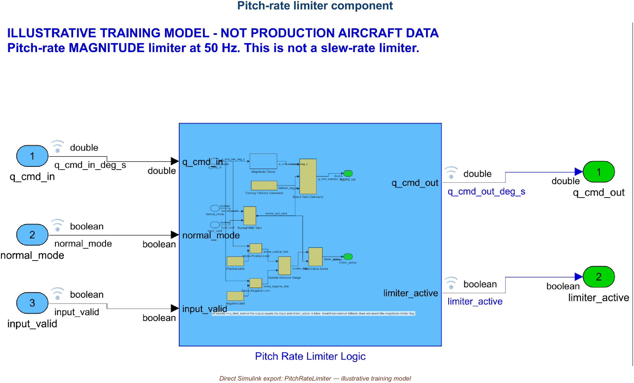
01 • INTRODUCTION TO SIMULINK
The editor exposes structure and diagnostics
Illustrative training model • typed ports, explicit 50 Hz contract, and reviewable hierarchy
AVIATION CONTROLS ENGINEERING ONBOARDING
06
Notes:
Timing: 2 minutes
Suggested visual:
An authentic export of the delivered PitchRateLimiter top level labels typed ports, hierarchy, and 50 Hz execution.
Speaker notes:
Orient the learner before discussing individual blocks. The Library Browser supplies reusable blocks and project libraries. The center canvas shows data flow and hierarchy. The Property Inspector and block dialogs expose parameters, data types, limits, and sample-time settings. Simulation controls run the model, but an aerospace workflow often launches simulations and tests from project scripts or CI. Diagnostics are not background noise: compile/update messages reveal unresolved references, dimension mismatches, type conflicts, sample-time problems, and configuration issues. Encourage the engineer to learn keyboard navigation, signal highlighting, model hierarchy, and compile diagnostics early; these save more time than memorizing every library block.
Key teaching points:
• The canvas is only one part of the working environment.
• Properties and diagnostics define execution semantics.
• Project libraries and automation matter as much as built-in blocks.
[Sources]
- https://www.mathworks.com/help/simulink/getting-started-with-simulink.html
V2 artifact update: The visual is an authentic export of the delivered PitchRateLimiter.slx top level after model update. It shows the typed component interface, 50 Hz execution contract, and implementation hierarchy. The example is illustrative training content, not production aircraft data. [Sources - V2 artifact] - Local: models/PitchRateLimiter.slx
V2 artifact update: The visual is an authentic export of the delivered PitchRateLimiter.slx top level after model update. It shows the typed component interface, 50 Hz execution contract, and implementation hierarchy. The example is illustrative training content, not production aircraft data. [Sources - V2 artifact] - Local: models/PitchRateLimiter.slx
V2 artifact update: The visual is an authentic export of the delivered PitchRateLimiter.slx top level after model update. It shows the typed component interface, 50 Hz execution contract, and implementation hierarchy. The example is illustrative training content, not production aircraft data. [Sources - V2 artifact] - Local: models/PitchRateLimiter.slx

Slide 7
01 • INTRODUCTION TO SIMULINK
A small grammar scales to aircraft functions
LIBRARY — approved reusable content
Buses and dictionaries keep interfaces explicit
BLOCK — one operation or dynamic element
FlightControl
Subsystem
SensorBus
SIGNAL — typed value carried over time
q_rate
alpha
Mach
validity
SUBSYSTEM — encapsulated behavior and interface
FCS_Data.sldd
Bus types • parameters • units
STRUCTURE
BUS = interface contract DICTIONARY = controlled design data
AVIATION CONTROLS ENGINEERING ONBOARDING
07
Notes:
Timing: 2 minutes
Suggested visual:
A hierarchy of library, block, signal, and subsystem sits beside a bus and data-dictionary interface example.
Speaker notes:
Define the core vocabulary. A block performs an operation: gain, filter, integrator, switch, lookup, saturation, state chart, or custom algorithm. Signals carry values between blocks and should have meaningful names, units, dimensions, types, and rates. A subsystem creates hierarchy and an interface around related behavior. Libraries provide controlled reusable blocks. A bus groups related signals through a port; it is valuable when the interface is defined by a Simulink.Bus object rather than by appearance alone. A data dictionary stores persistent design data such as parameters, bus objects, enumerations, and signal definitions. The point is not to hide complexity. The point is to expose it at the right level while keeping contracts controlled.
Key teaching points:
• Blocks express behavior; signals express data flow.
• Subsystems manage hierarchy and review scope.
• Buses and data dictionaries turn visual connections into controlled interfaces.
[Sources]
- https://www.mathworks.com/help/simulink/ug/interface-design.html
- https://www.mathworks.com/help/simulink/ug/determine-where-to-store-data-for-simulink-models.html

Slide 8
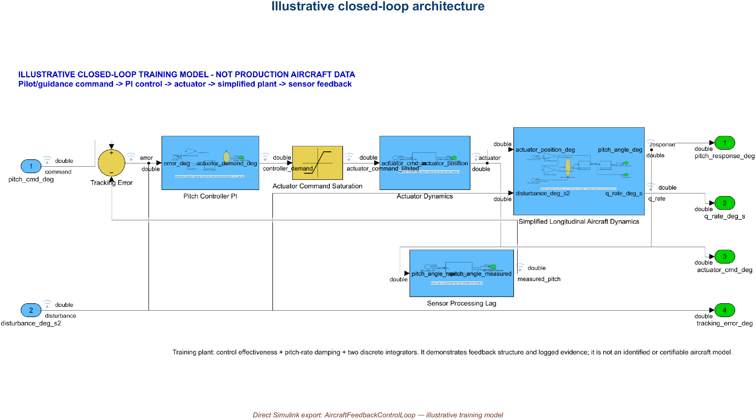
01 • INTRODUCTION TO SIMULINK
Flight-control models begin with a closed loop
Illustrative training model • command → controller → actuator/plant → sensor → feedback
AVIATION CONTROLS ENGINEERING ONBOARDING
08
Notes:
Timing: 2 minutes
Suggested visual:
An authentic export of the delivered closed-loop feedback model shows command, control, plant, sensor, feedback, and disturbance paths.
Speaker notes:
Use this loop as the mental map for most later diagrams. The pilot or guidance system provides a command. The controller compares commanded and measured behavior and produces an actuator command. Actuator dynamics and aircraft dynamics create motion. Sensor processing returns measured pitch, roll, rate, altitude, acceleration, or other states. Disturbances and uncertainty enter through gusts, aerodynamic variation, mass properties, failures, and latency. In Simulink, the plant model may be simple for a unit test and far more detailed for system simulation. The control-law model must be evaluated for stability, tracking, disturbance rejection, saturation, mode transitions, invalid data, timing, and interfaces—not simply whether one nominal plot looks correct.
Key teaching points:
• Feedback closes the loop from aircraft response to controller.
• The plant and sensors are part of the verification environment.
• The operating envelope and fault cases define the real test space.
[Sources]
- https://www.mathworks.com/help/simulink/slref/designing-a-high-angle-of-attack-pitch-mode-control.html
- https://www.mathworks.com/help/simulink/slref/designing-a-guidance-system-in-matlab-and-simulink.html
V2 artifact update: The visual is an authentic export of AircraftFeedbackControlLoop.slx. The delivered simplified training plant includes command and disturbance inputs, error calculation, controller, saturation, actuator/aircraft dynamics, sensor lag, feedback, and logged signals. It is a desktop training model, not production aircraft data. [Sources - V2 artifact] - Local: models/AircraftFeedbackControlLoop.slx - https://www.mathworks.com/help/simulink/ug/data-format-for-logged-simulation-data.html
V2 artifact update: The visual is an authentic export of AircraftFeedbackControlLoop.slx. The delivered simplified training plant includes command and disturbance inputs, error calculation, controller, saturation, actuator/aircraft dynamics, sensor lag, feedback, and logged signals. It is a desktop training model, not production aircraft data. [Sources - V2 artifact] - Local: models/AircraftFeedbackControlLoop.slx - https://www.mathworks.com/help/simulink/ug/data-format-for-logged-simulation-data.html
V2 artifact update: The visual is an authentic export of AircraftFeedbackControlLoop.slx. The delivered simplified training plant includes command and disturbance inputs, error calculation, controller, saturation, actuator/aircraft dynamics, sensor lag, feedback, and logged signals. It is a desktop training model, not production aircraft data. [Sources - V2 artifact] - Local: models/AircraftFeedbackControlLoop.slx - https://www.mathworks.com/help/simulink/ug/data-format-for-logged-simulation-data.html

Slide 9
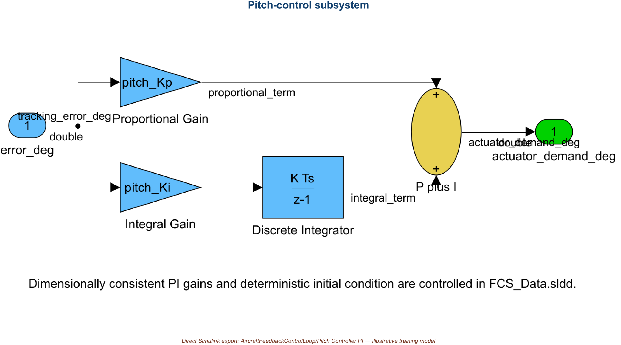
02 • CONTROLS ENGINEERING IN SIMULINK
Control-law math maps to reusable patterns
Illustrative training subsystem • parameterized PI law and deterministic integrator state
AVIATION CONTROLS ENGINEERING ONBOARDING
09
Notes:
Timing: 2 minutes
Suggested visual:
The real Pitch Controller subsystem exposes proportional and integral paths with controlled parameters.
Speaker notes:
Relate familiar control concepts to model patterns. A Gain block implements a scalar or matrix gain. Filters can be represented as transfer functions, discrete filters, state-space blocks, or explicit difference equations. Integrators represent continuous or discrete accumulation and require careful initial-condition handling. Lookup tables implement calibrated or scheduled behavior across operating conditions. Stateflow is commonly used for modes, guards, transitions, and fault logic. Saturation and rate-limiting blocks protect actuators and commands—but distinguish a magnitude limiter from a slew-rate limiter. Sensor processing often includes scaling, validity, filtering, voting, and unit conversion; actuator paths may include command shaping, rate limits, position limits, and monitoring.
Key teaching points:
• Choose blocks that preserve the intended mathematics and execution semantics.
• Scheduling connects one control-law structure to a changing flight envelope.
• Limits and mode logic are requirements, not cosmetic safeguards.
[Sources]
- https://www.mathworks.com/help/simulink/slref/designing-a-guidance-system-in-matlab-and-simulink.html
- https://www.mathworks.com/help/simulink/slref/designing-a-high-angle-of-attack-pitch-mode-control.html
V2 artifact update: The visual is the actual Pitch Controller subsystem from the delivered feedback model. The proportional and integral paths resolve controlled values from FCS_Data.sldd, and the discrete integrator uses a deterministic initial condition. [Sources - V2 artifact] - Local: models/AircraftFeedbackControlLoop.slx, Pitch Controller subsystem
V2 artifact update: The visual is the actual Pitch Controller subsystem from the delivered feedback model. The proportional and integral paths resolve controlled values from FCS_Data.sldd, and the discrete integrator uses a deterministic initial condition. [Sources - V2 artifact] - Local: models/AircraftFeedbackControlLoop.slx, Pitch Controller subsystem
V2 artifact update: The visual is the actual Pitch Controller subsystem from the delivered feedback model. The proportional and integral paths resolve controlled values from FCS_Data.sldd, and the discrete integrator uses a deterministic initial condition. [Sources - V2 artifact] - Local: models/AircraftFeedbackControlLoop.slx, Pitch Controller subsystem

Slide 10
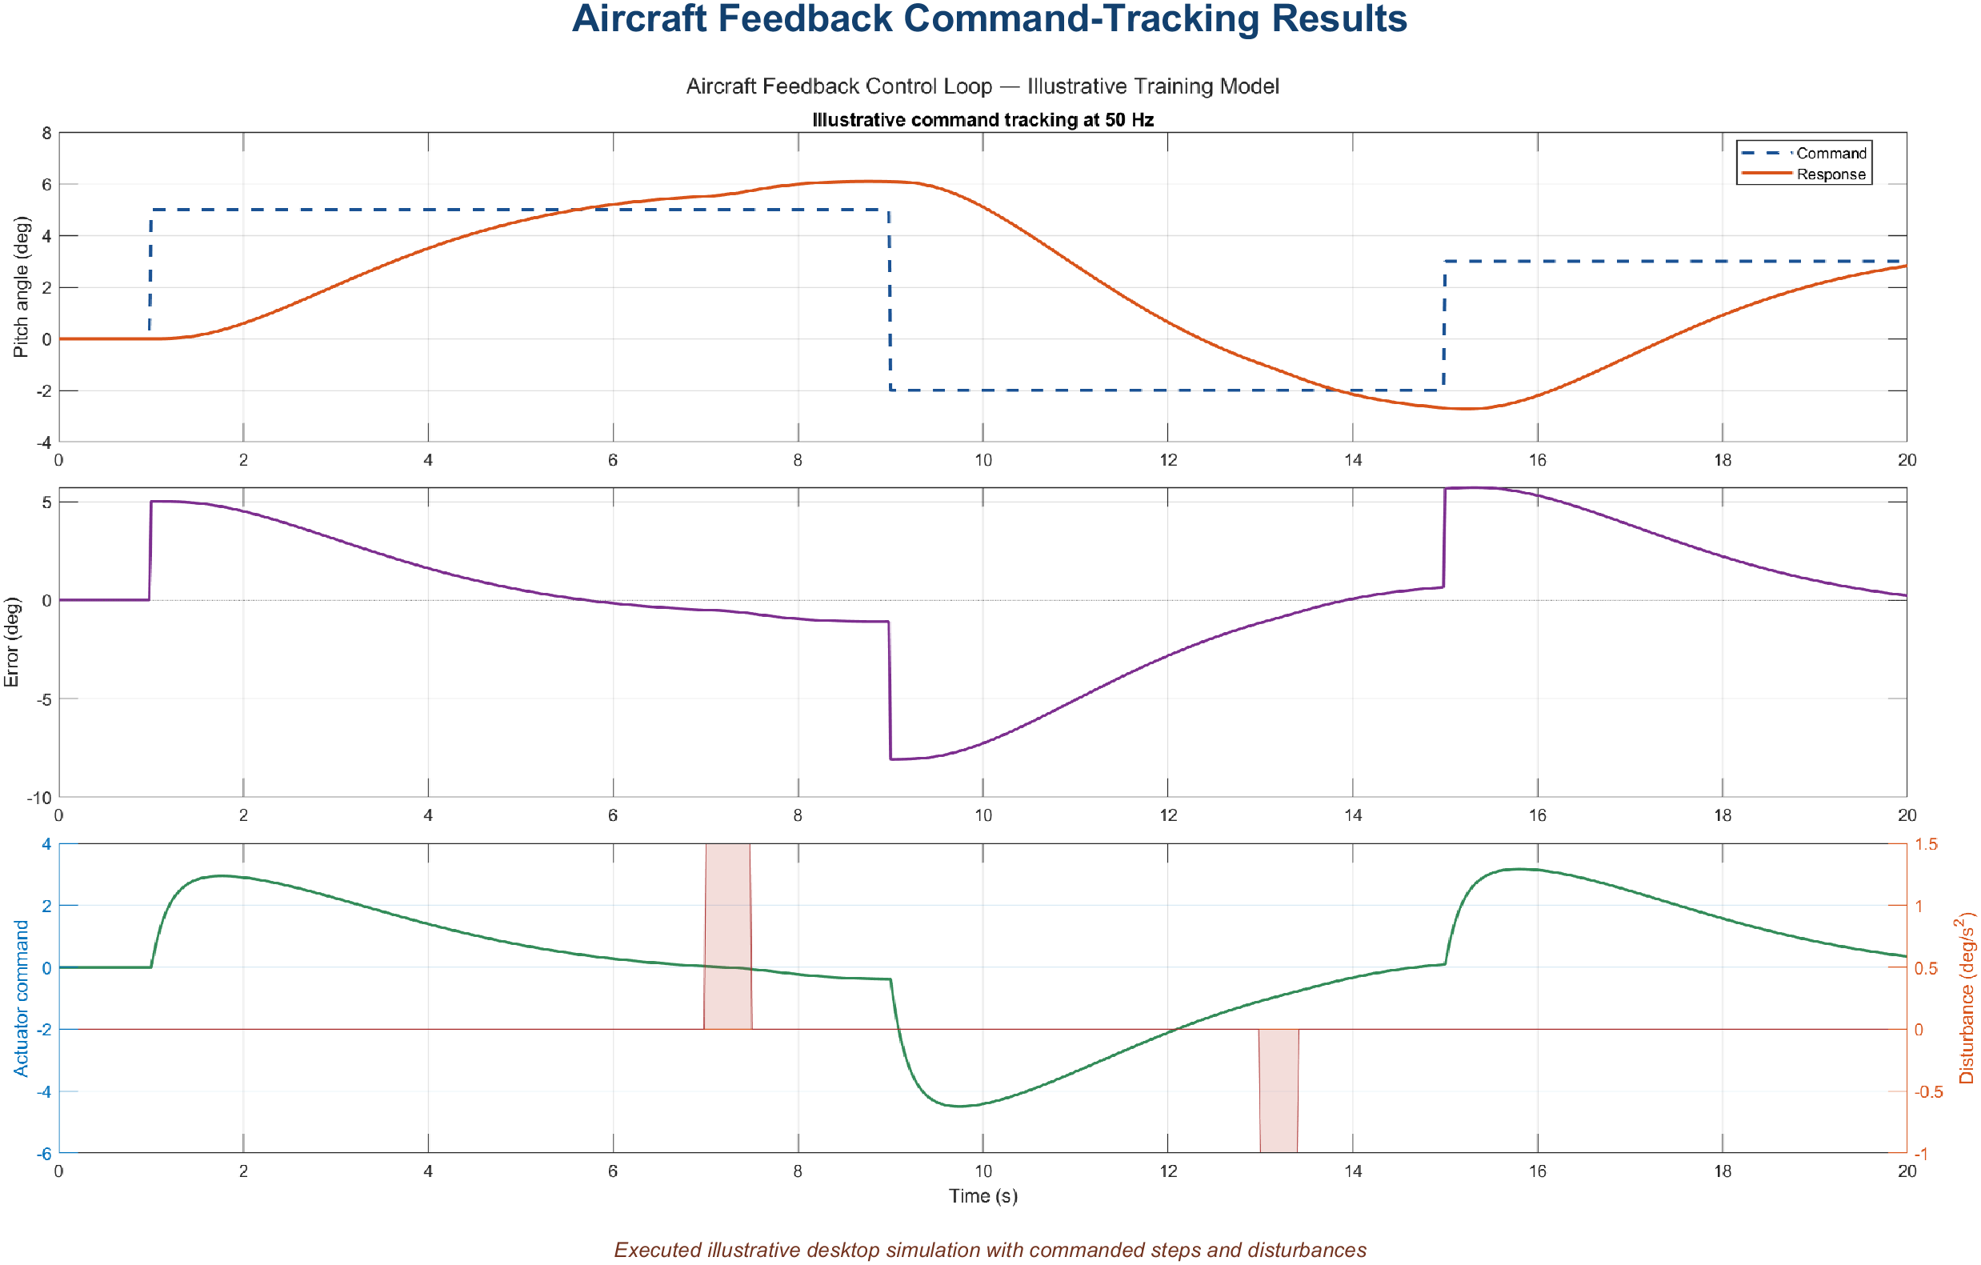
02 • CONTROLS ENGINEERING IN SIMULINK
Pitch, roll, and altitude share one discipline
Executed desktop simulation • simplified training plant; command, response, error, and actuator are logged
AVIATION CONTROLS ENGINEERING ONBOARDING
10
Notes:
Timing: 1.5 minutes
Suggested visual:
An actual desktop simulation plot shows command, measured response, error, actuator response, and a disturbance.
Speaker notes:
Contrast the loops without turning the slide into a control-theory lecture. Pitch and roll inner loops often regulate rate or attitude and drive control surfaces. Altitude hold is usually an outer loop that creates a pitch or vertical-speed command for an inner loop. The exact architecture varies, but the modeling discipline is consistent: explicit inputs and outputs, defined units and coordinate conventions, sample rates, limits, valid modes, scheduling variables, and fallback behavior. During model review, a sign error or unit mismatch can be more dangerous than a badly tuned gain, because a nominal desktop test may not expose it across every interface and mode.
Key teaching points:
• Nested loops turn high-level objectives into inner-loop commands.
• Interfaces and conventions must be reviewable at every loop boundary.
• Nominal plots do not replace boundary, mode, and fault verification.
[Sources]
- https://www.mathworks.com/help/simulink/slref/designing-a-high-angle-of-attack-pitch-mode-control.html
V2 artifact update: The visual is an executed desktop command-tracking result from the simplified training loop. It plots logged command, response, error, and actuator signals under a scheduled command and injected disturbance. It is not HIL evidence and does not represent production aircraft performance. [Sources - V2 artifact] - Local: screenshots/command_tracking_plot.png
V2 artifact update: The visual is an executed desktop command-tracking result from the simplified training loop. It plots logged command, response, error, and actuator signals under a scheduled command and injected disturbance. It is not HIL evidence and does not represent production aircraft performance. [Sources - V2 artifact] - Local: screenshots/command_tracking_plot.png
V2 artifact update: The visual is an executed desktop command-tracking result from the simplified training loop. It plots logged command, response, error, and actuator signals under a scheduled command and injected disturbance. It is not HIL evidence and does not represent production aircraft performance. [Sources - V2 artifact] - Local: screenshots/command_tracking_plot.png

Slide 11
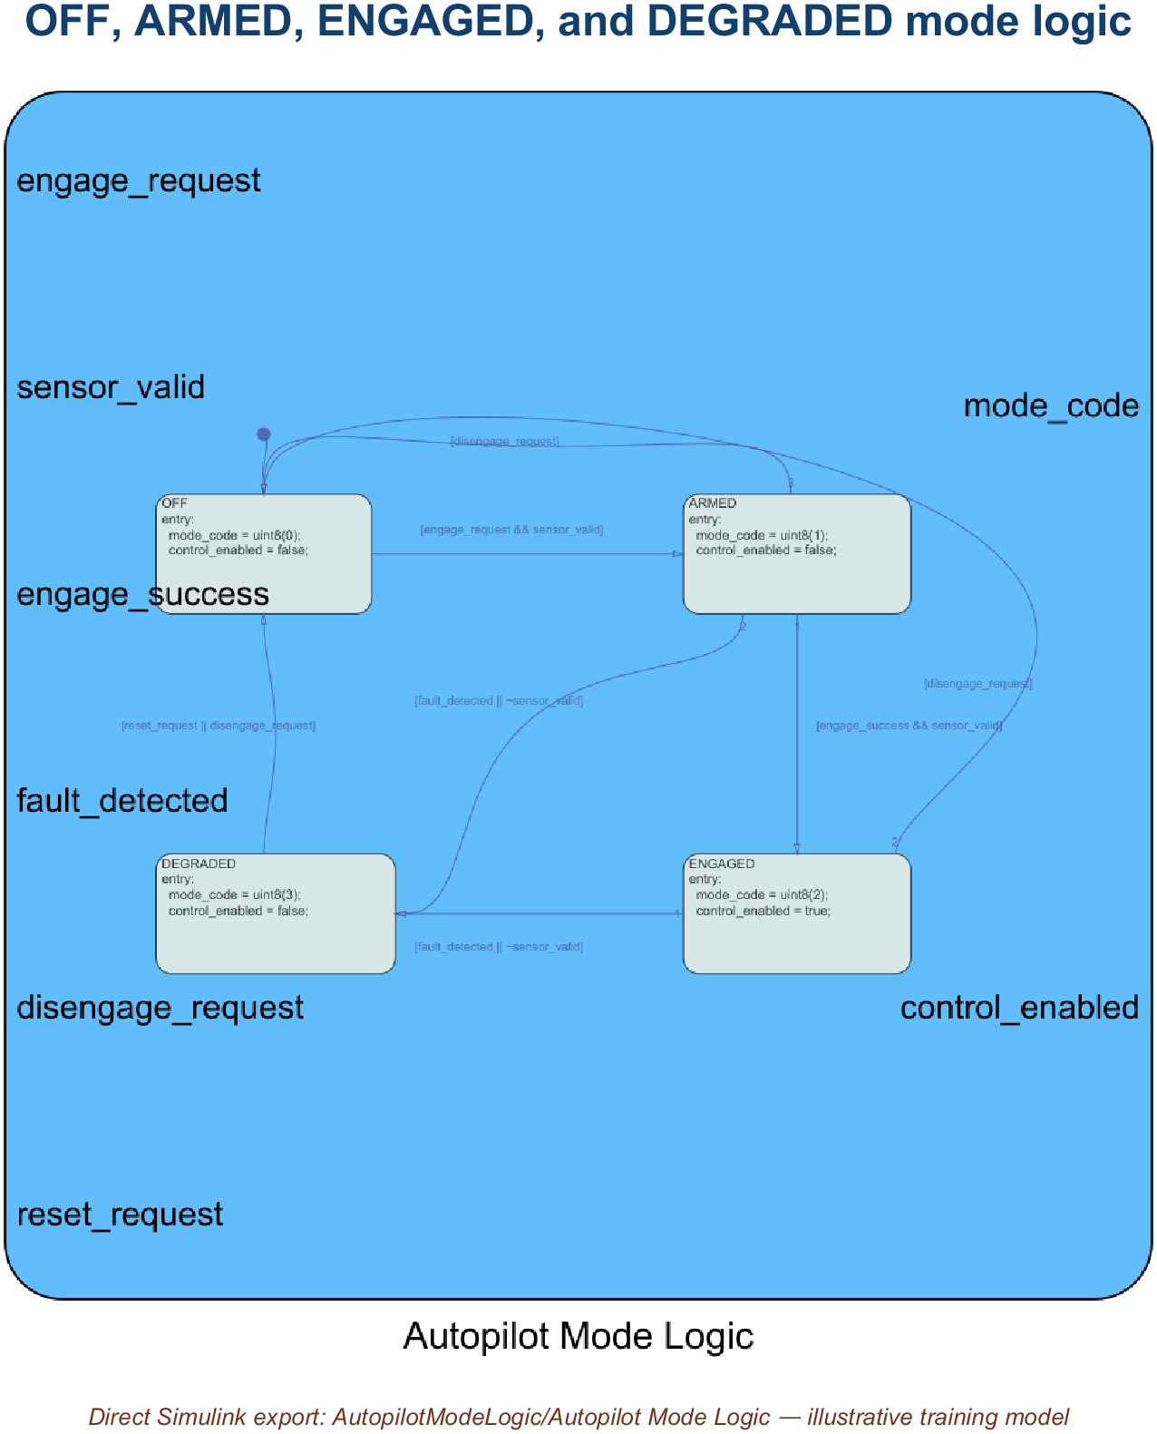
02 • CONTROLS ENGINEERING IN SIMULINK
Modes select the law; schedules adapt it
Illustrative Stateflow training model • guards govern OFF, ARMED, ENGAGED, and DEGRADED
AVIATION CONTROLS ENGINEERING ONBOARDING
11
Notes:
Timing: 2 minutes
Suggested visual:
The real Stateflow chart shows OFF, ARMED, ENGAGED, and DEGRADED states with guarded transitions.
Speaker notes:
Explain the separation of concerns. Mode logic decides whether a control law is off, armed, engaged, or degraded and specifies the guards for transitions. Stateflow is a common representation, but explicit Simulink logic may also be used. Scheduling changes gains or limits as functions of Mach, altitude, angle of attack, center of gravity, or aircraft configuration. A schedule is not a mode switch unless the requirement defines it that way; interpolation and breakpoint behavior matter. Verification must cover transition guards, persistence, priorities, temporal behavior, boundary points, extrapolation policy, and invalid scheduling data. The new engineer should never assume that a colorful state diagram or smooth lookup surface is self-explanatory—each transition and breakpoint needs requirements and tests.
Key teaching points:
• State machines govern discrete modes and transitions.
• Lookup tables adapt continuous behavior across the envelope.
• Transitions and breakpoints are first-class boundary tests.
[Sources]
- https://www.mathworks.com/help/simulink/slref/designing-a-guidance-system-in-matlab-and-simulink.html
- https://www.mathworks.com/help/simulink/getting-started-with-simulink.html
V2 artifact update: Stateflow is licensed on this computer, so the visual is the real chart in AutopilotModeLogic.slx. OFF is the default state; guarded transitions cover pilot request, sensor validity, successful engagement, detected fault/invalid data, and reset/disengagement. [Sources - V2 artifact] - Local: models/AutopilotModeLogic.slx - https://www.mathworks.com/help/stateflow/state-transition-charts.html
V2 artifact update: Stateflow is licensed on this computer, so the visual is the real chart in AutopilotModeLogic.slx. OFF is the default state; guarded transitions cover pilot request, sensor validity, successful engagement, detected fault/invalid data, and reset/disengagement. [Sources - V2 artifact] - Local: models/AutopilotModeLogic.slx - https://www.mathworks.com/help/stateflow/state-transition-charts.html
V2 artifact update: Stateflow is licensed on this computer, so the visual is the real chart in AutopilotModeLogic.slx. OFF is the default state; guarded transitions cover pilot request, sensor validity, successful engagement, detected fault/invalid data, and reset/disengagement. [Sources - V2 artifact] - Local: models/AutopilotModeLogic.slx - https://www.mathworks.com/help/stateflow/state-transition-charts.html

Slide 12
03 • DO-178C OVERVIEW
DO-178C demands evidence—not diagrams
DO-178C
DO-331
Defines — objectives, activities, and life-cycle data
Scales — rigor according to software level
Covers — planning, development, verification, CM, QA, liaison
Supplements — DO-178C for model-based development and verification
Clarifies — model roles, model standards, verification, and traceability
Does not — make models or generated code automatically compliant
The project plans define whether a model is specification, design, source, or verification material—and which objectives apply.
AVIATION CONTROLS ENGINEERING ONBOARDING
12
Notes:
Timing: 2 minutes
Suggested visual:
Two complementary columns separate the base DO-178C objectives from the DO-331 model-based supplement.
Speaker notes:
Frame DO-178C correctly. FAA AC 20-115D recognizes DO-178C and applicable supplements as an acceptable means of compliance for airborne software; it is not a regulation and not a product certificate. The standard is objective-based. It expects planned processes and evidence showing that applicable objectives are satisfied. DO-331 supplements the base guidance when models are used for development or verification. The project must define each model’s role because that determines which standards, reviews, verification activities, traceability, and tool considerations apply. Emphasize that generated code and automated tests can reduce manual effort, but automation does not remove responsibility for correct requirements, model standards, independent verification where required, configuration control, or credible results.
Key teaching points:
• DO-178C is an objectives-and-evidence framework.
• DO-331 applies model-based guidance alongside DO-178C.
• A model’s planned certification role controls how it must be verified.
[Sources]
- https://www.faa.gov/documentLibrary/media/Advisory_Circular/AC_20-115D.pdf
- https://www.rtca.org/do-178/
V3 terminology clarification: - Prefer the training-example title “Gas Turbine Controls: Model-Based Development with Independent Verification,” not “independent compliance.” - DO-178C is an accepted means of compliance, not a standalone software certificate. DO-331 supplements DO-178C for model-based development and verification. - A Simulink model is not automatically compliant; its planned role, traceability, reviews, verification, configuration control, and lifecycle data determine what credit may be requested. [Sources] - https://www.faa.gov/regulations_policies/advisory_circulars/index.cfm/go/document.information/documentID/1032046 - https://www.faa.gov/documentLibrary/media/Order/FAA_Order_8110.49A.pdf

Slide 13
03 • DO-178C OVERVIEW
Software levels scale rigor with consequence
LEVEL
ASSOCIATED FAILURE CONDITION
ENGINEERING IMPLICATION
A
Catastrophic
Highest rigor; most objectives and independence
B
Hazardous / Severe-Major
Very high rigor
C
Major
Substantial requirements and verification rigor
D
Minor
Reduced objective set
E
No Effect
No DO-178C objectives apply to the software
The system safety assessment assigns the software level; the controls team does not choose it for convenience.
AVIATION CONTROLS ENGINEERING ONBOARDING
13
Notes:
Timing: 2 minutes
Suggested visual:
A five-level ladder links Levels A through E to failure conditions and increasing assurance rigor.
Speaker notes:
Introduce the levels without turning them into arbitrary quality grades. The system safety process determines the effect of software failure and allocates the software level. Level A corresponds to a catastrophic failure condition, B to hazardous or severe-major, C to major, D to minor, and E to no effect. More safety-critical software must satisfy more objectives and greater verification independence. Avoid implying that every flight-control function is automatically Level A; allocation depends on system architecture and failure effects. For the engineer, the level changes review rigor, coverage expectations, independence, configuration evidence, and the acceptable use or qualification of tools. It never changes the basic obligation to implement the requirement correctly.
Key teaching points:
• Levels come from system safety analysis.
• Rigor increases as failure consequence increases.
• Software level affects objectives, independence, and evidence strategy.
[Sources]
- https://www.faa.gov/aircraft/air_cert/design_approvals/dah/software
- https://www.faa.gov/documentLibrary/media/Advisory_Circular/AC_20-115D.pdf
V3 software-level and independence clarification: - Say “DO-178C Software Level A” when discussing software objectives. Use a broader system Development Assurance Level only when discussing the system-level allocation that informed the software level. - Independence applies to designated verification objectives under approved plans. Avoid the blanket claim that an author can never participate in review; where independence is required, the author should not be the sole independent verifier of their own work. [Sources] - https://www.faa.gov/regulations_policies/advisory_circulars/index.cfm/go/document.information/documentID/1032046 - https://www.faa.gov/documentLibrary/media/Order/FAA_Order_8110.49A.pdf

Slide 14
03 • DO-178C OVERVIEW
Traceability turns artifacts into evidence
Requirement
Model element
Test case
Verification result
BIDIRECTIONAL: every artifact has a reason to exist; every requirement has objective coverage
EVIDENCE PACKAGE
plans + standards
review records
test procedures + results
coverage + analyses
configuration + problem reports
Pipeline and test results are evidence inputs—not automatic approval.
AVIATION CONTROLS ENGINEERING ONBOARDING
14
Notes:
Timing: 2 minutes
Suggested visual:
A bidirectional chain links requirement, model element, test case, and result above an evidence package.
Speaker notes:
Define traceability as a practical navigation system. Forward trace answers: where is this requirement implemented and how is it verified? Backward trace answers: why does this model element, parameter, test, or code path exist? Gaps can reveal missing tests, unintended functionality, or unreviewed derived behavior. Verification evidence includes more than pass/fail plots: approved plans and standards, review records, procedures, requirements-based results, applicable coverage and analyses, configuration records, quality records, and problem reports. A Jenkins job or HIL campaign can produce valuable evidence, but the project must control the configuration, link results to requirements, review failures and waivers, and retain the artifacts required by the plans.
Key teaching points:
• Traceability must work in both directions.
• Evidence includes reviews, analyses, configuration, and results.
• Automation produces evidence only when configuration and meaning are controlled.
[Sources]
- https://www.mathworks.com/help/slrequirements/ug/create-and-store-links.html
- https://www.mathworks.com/help/slrequirements/ug/find-and-link-unlinked-requirements-with-a-traceability-matrix.html
- https://www.faa.gov/documentLibrary/media/Order/FAA_Order_8110.49A.pdf
V3 evidence clarification: - A passing pipeline or test result is an evidence input. It is not certification approval by itself. - MIL, SIL, PIL, HIL, bench, and system-integration testing are different verification environments. This training project did not perform HIL testing. [Sources] - https://www.faa.gov/documentLibrary/media/Order/FAA_Order_8110.49A.pdf

Slide 15
03 • DO-178C OVERVIEW
The V-model links every definition to its verification
REQUIREMENTS ↔ BIDIRECTIONAL TRACEABILITY
MODEL-BASED · MATLAB / SIMULINK
INDEPENDENT VERIFICATION ACTIVITIES
INTEGRATION + EXECUTION ENVIRONMENTS
DEFINE + DECOMPOSE · REVIEW GATES G1–G5
PAIR EACH LEVEL
INTEGRATE + VERIFY + VALIDATE
System / engine
requirements
G1
System verification
+ validation
Software high-level
requirements (HLR)
G2
Software integration
verification
Software architecture / design
+ low-level requirements
G3
Component / unit
verification
Simulink models
+ C/H source code
G4
MIL / SIL · analysis
+ coverage
Executable
object code
G5
PIL / target · HIL / bench
+ system integration
CONTROLLED SOFTWARE BASELINE
configuration · trace links · review records
Agile changes the cadence; it does not remove ordered reviews, traceability, controlled baselines, or planned independence.
AVIATION CONTROLS ENGINEERING ONBOARDING
15
Notes:
Timing: 3 minutes
Walk the V down the left from system/engine requirements through HLR, architecture/design and low-level requirements, model/source implementation, and executable object code. The controlled software baseline is the configuration-controlled vertex. Then walk up the right through target and integration environments, MIL/SIL analysis and coverage, component or unit verification, software integration verification, and system verification and validation. The dashed two-headed links emphasize bidirectional traceability: each definition has planned verification, and every result identifies the definition and controlled configuration it covers.
Use the four callouts to separate responsibilities:
- Model-based software development uses MATLAB/Simulink as planned lifecycle tools and artifacts; a Simulink model is not automatically compliant.
- Requirements need bidirectional traceability into implementation, verification procedures, results, reviews, and problem dispositions.
- Independence applies to designated verification objectives under approved plans. An author is not categorically prohibited from participating in review, but should not be the sole independent verifier of their own work where independence is required.
- MIL, SIL, PIL, HIL, bench, and system-integration testing are distinct verification environments. PIL is an execution environment and is not automatically synonymous with unit testing. Call a test HIL only when actual controller or target hardware, a real-time plant environment, and physical I/O are used. This training project performed no HIL testing.
Certification and lifecycle language:
- Prefer the example title “Gas Turbine Controls: Model-Based Development with Independent Verification,” not “independent compliance.”
- DO-178C is an accepted means of compliance, not a standalone software certificate. DO-331 supplements DO-178C for model-based development and verification.
- Use “DO-178C Software Level A” unless the discussion is explicitly about a broader system Development Assurance Level allocation.
- Agile and waterfall can both be used. Agile changes cadence, not the need for lifecycle data, ordered reviews, traceability, configuration control, controlled baselines, planned verification, or designated independence.
- A passing pipeline or test result is evidence input, not certification approval by itself.
[Sources]
- https://www.faa.gov/regulations_policies/advisory_circulars/index.cfm/go/document.information/documentID/1032046
- https://www.faa.gov/documentLibrary/media/Order/FAA_Order_8110.49A.pdf
- https://www.nasa.gov/reference/systems-engineering-handbook/

Slide 16
04 • PROJECT DEVELOPMENT FLOW
Part 1 — plan, specify, develop, and test
1 DO-178C / DO-331
objective set
2 Certification plan
+ PSAC strategy
3 System
requirements
6 Unit-test
design
5 Create Simulink
component
4 Component / software
requirements
7 Create / edit
.mldatx
8 Configure
callbacks
9 Verify component
behavior
Illustrative project implementation of a DO-178C / DO-331-aligned lifecycle
AVIATION CONTROLS ENGINEERING ONBOARDING
16
Notes:
Timing: 2 minutes
Suggested visual:
A nine-step serpentine flow moves from assurance objectives and planning through component behavior verification.
Speaker notes:
Walk the first half slowly. DO-178C and DO-331 define the objective framework; the project’s certification and software plans define how the team will satisfy it. System requirements are decomposed into software or component requirements with interfaces and acceptance criteria. The engineer creates a Simulink component using controlled interfaces and data. Unit-test design begins from requirements, not from the diagram. Simulink Test definitions are organized in .mldatx files, while callbacks or external .m functions establish deterministic setup and cleanup. The component is then verified against its requirements. Clarify that this exact tool sequence is a realistic company workflow, not a sequence prescribed by DO-178C. The compliance obligation is satisfaction of applicable objectives with controlled evidence.
Key teaching points:
• Planning defines the model and tool roles before implementation.
• Test design starts from requirements and acceptance criteria.
• The .mldatx and callbacks support verification; they are not requirements themselves.
[Sources]
- https://www.faa.gov/documentLibrary/media/Advisory_Circular/AC_20-115D.pdf
- https://www.rtca.org/do-178/
- https://www.mathworks.com/help/sltest/ref/sltest.testmanager.testfile-class.html
- https://www.mathworks.com/help/sltest/ug/specify-test-properties-in-the-test-manager.html
V3 lifecycle clarification: - Agile and waterfall are both usable lifecycle organizations. Whichever cadence is selected, approved plans still have to account for lifecycle data, traceability, reviews, configuration control, controlled baselines, verification objectives, and planned independence. - Review gates should be ordered around stable inputs and exit criteria even when development iterates in short increments. [Sources] - https://www.faa.gov/documentLibrary/media/Order/FAA_Order_8110.49A.pdf - https://www.nasa.gov/reference/systems-engineering-handbook/

Slide 17
04 • PROJECT DEVELOPMENT FLOW
Part 2 — integrate, automate, prove
10 Integrate into
architecture
11 Architecture
compile / update
12 Run Jenkins
pipeline
15 Re-run affected
then full pipeline
14 Fix root cause
+ add protection
13 Review first
meaningful failure
FAILURE LOOP
16 Pass controlled
pipeline
17 Execute planned
integration tests
18 Final verification
evidence
A green pipeline is a gate to the next activity—not proof that every certification objective is complete.
AVIATION CONTROLS ENGINEERING ONBOARDING
17
Notes:
Timing: 2 minutes
Suggested visual:
A second nine-step serpentine flow covers integration, compile, CI failure loops, HIL, and final evidence.
Speaker notes:
Continue from verified component behavior. Integration places the component into a referenced-model or architecture framework and connects controlled interfaces. Compile or model update is a semantic gate: it resolves references and catches type, dimension, rate, variant, and configuration problems. Jenkins then orchestrates repeatable checks, builds, tests, and reports. When the pipeline fails, investigate the first meaningful failure rather than treating every downstream message as independent. Fix the root cause, add a regression test or check where appropriate, re-run the affected scope, and then run the controlled full pipeline. A passing configuration can proceed to HIL, where real hardware, real I/O, real-time execution, faults, and closed-loop plant behavior are evaluated. Final evidence assembles results with configuration identity, trace links, reviews, and dispositions.
Key teaching points:
• Compile validates model semantics, not requirements compliance.
• CI failures are a feedback loop, not a paperwork step.
• HIL and pipeline results must remain linked to requirements and configuration.
[Sources]
- https://www.mathworks.com/help/simulink/ug/overview-of-model-referencing-1.html
- https://www.jenkins.io/doc/book/pipeline/
- https://www.mathworks.com/discovery/hardware-in-the-loop-hil.html
- https://www.faa.gov/documentLibrary/media/Advisory_Circular/AC_20-115D.pdf
V3 environment clarification: - The visible sequence is conceptual; this project did not execute Jenkins or HIL. “Execute planned integration tests” means use the environments required by the approved verification strategy. - MIL, SIL, PIL, HIL, bench, and system-integration testing are different environments. PIL is target-code execution and is not automatically unit testing. - Use “HIL” only when actual controller or target hardware, a real-time plant environment, and physical I/O are present. - A green pipeline or passing test is evidence input, not approval. [Sources] - https://www.faa.gov/documentLibrary/media/Order/FAA_Order_8110.49A.pdf - https://www.nasa.gov/reference/systems-engineering-handbook/

Slide 18
05 • REQUIREMENTS DEVELOPMENT
A testable requirement is precise and observable
SYSTEM
Aircraft shall maintain commanded pitch attitude within allocated performance limits.
INTERFACE
q_cmd_in uses deg/s, positive nose-up, valid range −40…+40, at 50 Hz.
COMPONENT
In Normal mode, clamp commanded pitch rate to the inclusive range −12…+12 deg/s.
DERIVED
A rate-validity status is needed to select the degraded limit; feed it back to system/safety review.
ACCEPTANCE CRITERIA | observable output • tolerance • response time • applicable modes • invalid-input behavior
AVIATION CONTROLS ENGINEERING ONBOARDING
18
Notes:
Timing: 2 minutes
Suggested visual:
Four requirement levels—system, interface, component, and derived—use a consistent flight-control example.
Speaker notes:
Show how ambiguity is removed through decomposition. A system requirement states the aircraft-level need. Interface requirements define units, sign conventions, ranges, rates, validity, and ownership. Component or software requirements define observable behavior. Derived requirements arise from design choices or newly identified constraints and must be explicitly identified and fed into the project’s system and safety processes. Acceptance criteria make verification unambiguous by defining outputs, tolerances, timing, modes, and invalid-input behavior. The pitch-rate-limiter values are training data, not program data. Distinguish magnitude limiting in degrees per second from slew-rate limiting in degrees per second squared; selecting the wrong Simulink block would implement a different requirement.
Key teaching points:
• Requirements should be observable and testable.
• Interface requirements prevent unit, sign, rate, and validity ambiguity.
• Derived behavior must be identified, traced, and assessed—not hidden in the model.
[Sources]
- https://www.mathworks.com/help/slrequirements/ug/create-and-store-links.html
- https://www.faa.gov/documentLibrary/media/Advisory_Circular/AC_20-115D.pdf

Slide 19
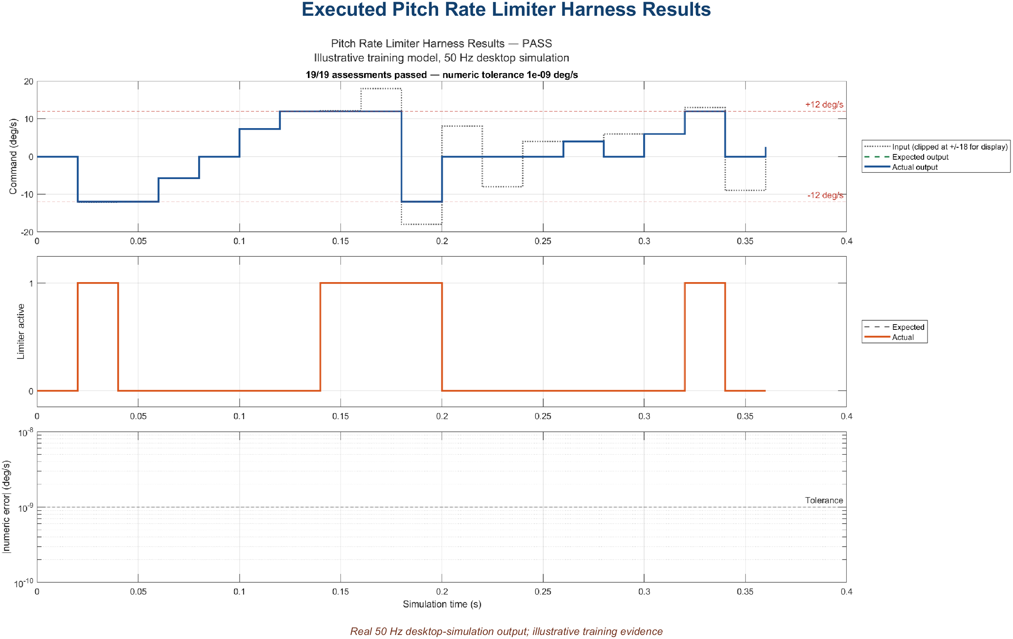
05 • REQUIREMENTS DEVELOPMENT
One limiter requirement, one chain of proof
Executed desktop tests • boundaries, modes, validity, active flag, tolerance, and 50 Hz timing
AVIATION CONTROLS ENGINEERING ONBOARDING
19
Notes:
Timing: 2 minutes
Suggested visual:
An executed result plot summarizes the real limiter boundary, mode, validity, flag, tolerance, and timing assessments.
Speaker notes:
Use the example to make traceability tangible. PRL-001 specifies inclusive magnitude limits. The implementing model element is a magnitude saturation function, not a rate-of-change limiter. Boundary tests include just below, exactly at, inside, exactly at the positive boundary, and just above. The result records pass/fail plus the controlled configuration, tool environment, and report identity. During review, each link should be navigable in both directions. A result that cannot identify the exact model and test configuration is weak evidence. A model element without a requirement may indicate unintended functionality. A requirement without a test or analysis is an uncovered obligation.
Key teaching points:
• Choose the model element that matches the physical quantity in the requirement.
• Boundary values prove inclusive/exclusive semantics.
• Results must identify the exact configuration they verified.
[Sources]
- https://www.mathworks.com/help/slrequirements/ug/create-and-store-links.html
- https://www.mathworks.com/help/slrequirements/ug/find-and-link-unlinked-requirements-with-a-traceability-matrix.html
- https://www.mathworks.com/help/sltest/gs/test-planning-and-strategies.html
V2 artifact update: The visual is generated from the executed PitchRateLimiter assessment results. The retained CSV/MAT/HTML artifacts cover boundaries, nominal and large values, fallback, transitions, initialization, limiter_active, tolerance, and 50 Hz timing. Executed result: 19 of 19 recorded assessments passed. This is desktop training evidence, not certification approval. [Sources - V2 artifact] - Local: results/PitchRateLimiter_TestResults.csv - Local: docs/PitchRateLimiter_Requirements_Traceability.csv
V2 artifact update: The visual is generated from the executed PitchRateLimiter assessment results. The retained CSV/MAT/HTML artifacts cover boundaries, nominal and large values, fallback, transitions, initialization, limiter_active, tolerance, and 50 Hz timing. Executed result: 19 of 19 recorded assessments passed. This is desktop training evidence, not certification approval. [Sources - V2 artifact] - Local: results/PitchRateLimiter_TestResults.csv - Local: docs/PitchRateLimiter_Requirements_Traceability.csv
V2 artifact update: The visual is generated from the executed PitchRateLimiter assessment results. The retained CSV/MAT/HTML artifacts cover boundaries, nominal and large values, fallback, transitions, initialization, limiter_active, tolerance, and 50 Hz timing. Executed result: 19 of 19 recorded assessments passed. This is desktop training evidence, not certification approval. [Sources - V2 artifact] - Local: results/PitchRateLimiter_TestResults.csv - Local: docs/PitchRateLimiter_Requirements_Traceability.csv

Slide 20
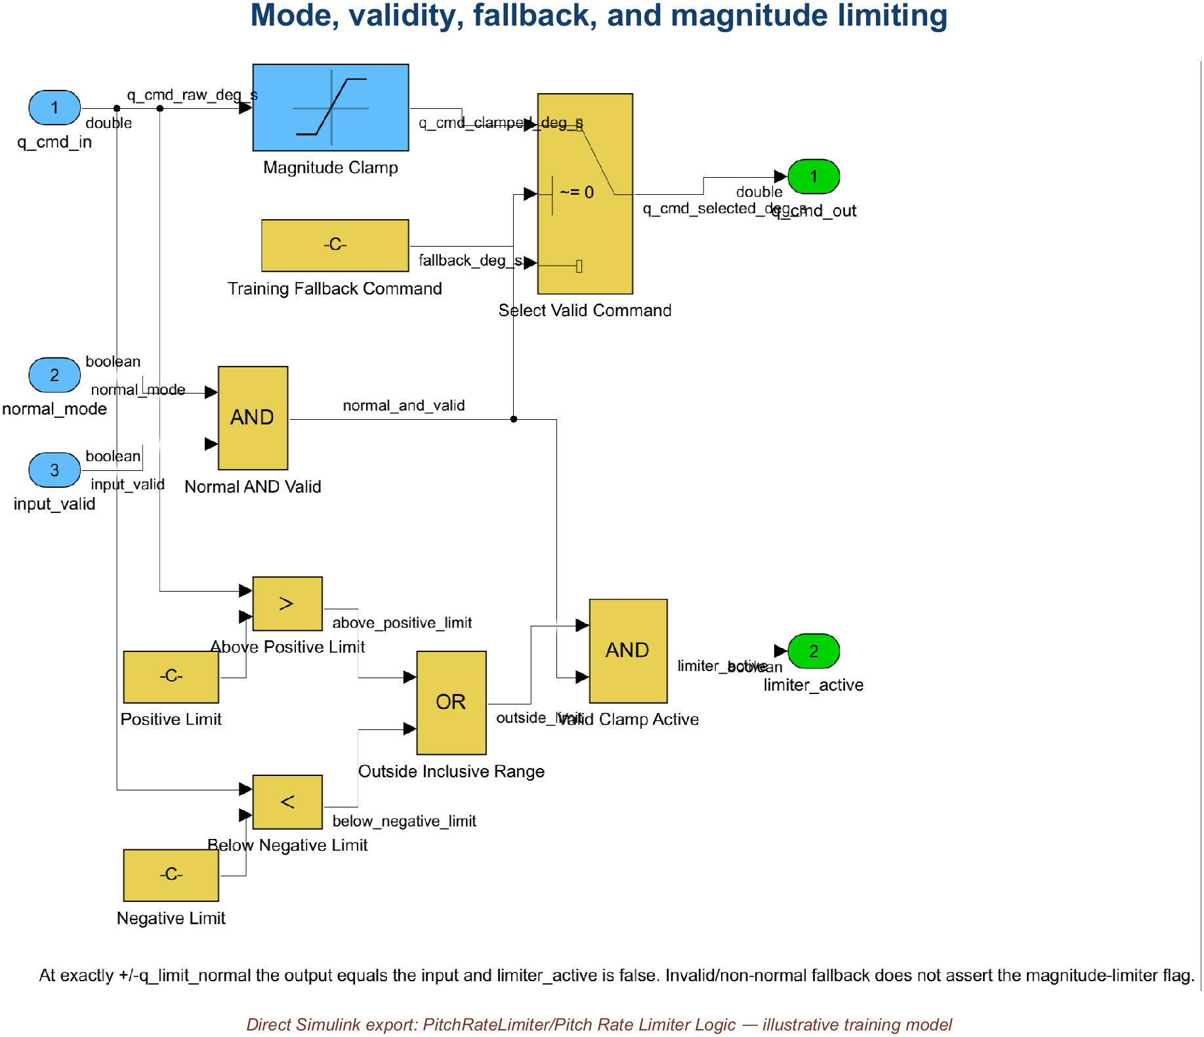
06 • SIMULINK DEVELOPMENT
Build the component in six reviewable steps
Magnitude clamp—not a slew-rate limiter • invalid or non-normal command falls back to zero
AVIATION CONTROLS ENGINEERING ONBOARDING
20
Notes:
Timing: 2 minutes
Suggested visual:
The real Pitch Rate Limiter Logic subsystem shows magnitude saturation, validity selection, fallback, and active-flag logic.
Speaker notes:
Walk the development sequence. Start with a subsystem whose responsibility can be stated in one sentence. Create input and output ports with controlled types, dimensions, units, and sample times. Add only the logic needed by the requirements. Parameterize tunable or project-controlled values in the designated dictionary rather than scattering numeric literals. Define the interface through bus or port specifications and link requirements to the relevant model elements. Compile or update early to catch semantic errors. Then run a focused test before expanding the component. The mockup is intentionally simple: if the real model is hard to review at this level, add hierarchy rather than accepting a wall of blocks.
Key teaching points:
• Interfaces come before internal complexity.
• Controlled parameters replace unexplained literals.
• Compile and test at the smallest meaningful increment.
[Sources]
- https://www.mathworks.com/help/simulink/getting-started-with-simulink.html
- https://www.mathworks.com/help/simulink/ug/interface-design.html
- https://www.mathworks.com/help/simulink/ug/determine-where-to-store-data-for-simulink-models.html
V2 artifact update: The visual is the real implementation subsystem. It uses a Saturation block for the inclusive magnitude clamp and an explicit zero fallback when either validity condition is false. The model contains no slew-rate dynamics; it is a magnitude limiter. [Sources - V2 artifact] - Local: models/PitchRateLimiter.slx, Pitch Rate Limiter Logic subsystem
V2 artifact update: The visual is the real implementation subsystem. It uses a Saturation block for the inclusive magnitude clamp and an explicit zero fallback when either validity condition is false. The model contains no slew-rate dynamics; it is a magnitude limiter. [Sources - V2 artifact] - Local: models/PitchRateLimiter.slx, Pitch Rate Limiter Logic subsystem
V2 artifact update: The visual is the real implementation subsystem. It uses a Saturation block for the inclusive magnitude clamp and an explicit zero fallback when either validity condition is false. The model contains no slew-rate dynamics; it is a magnitude limiter. [Sources - V2 artifact] - Local: models/PitchRateLimiter.slx, Pitch Rate Limiter Logic subsystem

Slide 21
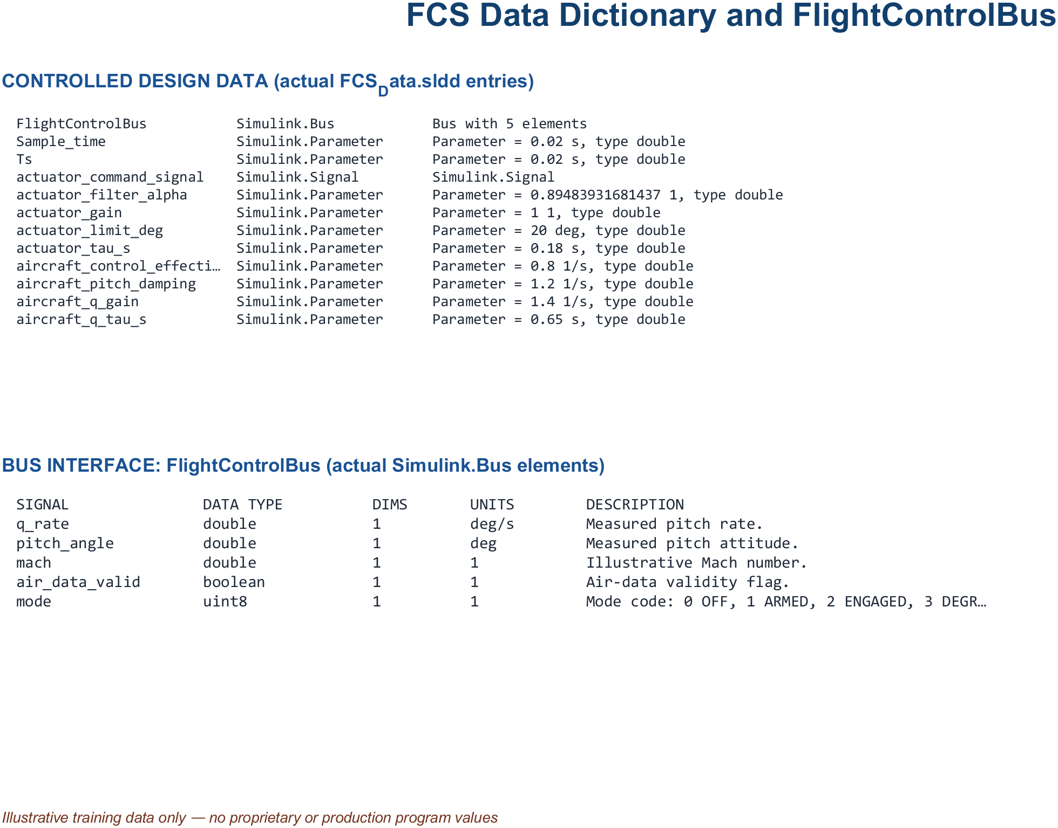
06 • SIMULINK DEVELOPMENT
Explicit interfaces make integration predictable
Actual FCS_Data.sldd inventory • FlightControlBus and controlled illustrative parameters
AVIATION CONTROLS ENGINEERING ONBOARDING
21
Notes:
Timing: 2 minutes
Suggested visual:
A dictionary-derived inventory shows FlightControlBus elements and controlled training parameters from FCS_Data.sldd.
Speaker notes:
Clarify three concepts that are often confused. A model reference provides modular behavior in a separately managed model and can support isolated testing and incremental workflows. A bus groups related interface elements, reducing line clutter while preserving a defined contract when backed by bus objects. A data dictionary stores the shared types, parameters, enumerations, and bus definitions. Integration quality depends on ownership: which component produces each element, which consumes it, what units and rates apply, and how validity is represented. A bus is not a license to move an unstructured bundle of data. Interfaces should be narrow, named, versioned, and reviewed.
Key teaching points:
• Model references support modular development and isolated verification.
• Buses group signals but must preserve explicit contracts.
• Dictionaries centralize controlled definitions and parameters.
[Sources]
- https://www.mathworks.com/help/simulink/ug/overview-of-model-referencing-1.html
- https://www.mathworks.com/help/simulink/ug/interface-design.html
- https://www.mathworks.com/help/simulink/ug/determine-where-to-store-data-for-simulink-models.html
V2 artifact update: The visual is derived from the actual FCS_Data.sldd entries and FlightControlBus definition. The bus contains q_rate, pitch_angle, mach, air_data_valid, and mode; controlled parameters include sample time, gains, filter coefficients, limits, and initial conditions. [Sources - V2 artifact] - Local: data/FCS_Data.sldd - https://www.mathworks.com/help/simulink/ug/what-is-a-data-dictionary.html - https://www.mathworks.com/help/simulink/slref/simulink.bus.html
V2 artifact update: The visual is derived from the actual FCS_Data.sldd entries and FlightControlBus definition. The bus contains q_rate, pitch_angle, mach, air_data_valid, and mode; controlled parameters include sample time, gains, filter coefficients, limits, and initial conditions. [Sources - V2 artifact] - Local: data/FCS_Data.sldd - https://www.mathworks.com/help/simulink/ug/what-is-a-data-dictionary.html - https://www.mathworks.com/help/simulink/slref/simulink.bus.html
V2 artifact update: The visual is derived from the actual FCS_Data.sldd entries and FlightControlBus definition. The bus contains q_rate, pitch_angle, mach, air_data_valid, and mode; controlled parameters include sample time, gains, filter coefficients, limits, and initial conditions. [Sources - V2 artifact] - Local: data/FCS_Data.sldd - https://www.mathworks.com/help/simulink/ug/what-is-a-data-dictionary.html - https://www.mathworks.com/help/simulink/slref/simulink.bus.html

Slide 22
06 • SIMULINK DEVELOPMENT
Reviewable models make intent obvious
01
NAME FOR MEANING
PitchRateLimiter, q_cmd_in, air_data_valid—not Subsystem3 or u1
02
LABEL THE CONTRACT
units, type, dimensions, sample time, range, validity, ownership
03
FLOW LEFT TO RIGHT
commands and data enter consistently; outputs leave consistently
04
ONE LEVEL, ONE STORY
use hierarchy when a reviewer cannot summarize the diagram quickly
05
REUSE CONTROLLED CONTENT
libraries and references—never copy/paste divergence
If the diagram needs a verbal apology, refactor the diagram.
AVIATION CONTROLS ENGINEERING ONBOARDING
22
Notes:
Timing: 1.5 minutes
Suggested visual:
Five model-review rules are presented as a large-format engineering checklist.
Speaker notes:
Stress that readability is a verification feature. Reviewers should be able to see the main signal path, understand the hierarchy, identify interfaces, and locate the requirement-linked behavior without tracing crossings and unlabeled lines. Names should carry engineering meaning. Signal labels should include the concepts needed by the project—often units, types, dimensions, rates, validity, and ownership. Layout should establish a consistent flow. A subsystem should have one clear responsibility, and library or referenced content should be reused under configuration control rather than copied. Clever compression, hidden data stores, masked side effects, and undocumented callbacks may make a model look smaller while making the lifecycle harder to verify.
Key teaching points:
• Readability reduces review error and investigation time.
• Naming and labeling are part of the interface contract.
• Controlled reuse prevents silent divergence.
[Sources]
- https://www.mathworks.com/help/slcheck/ref/model-advisor-checks-for-do-178cdo-331-industry-standards.html
- https://www.mathworks.com/help/simulink/ug/interface-design.html

Slide 23
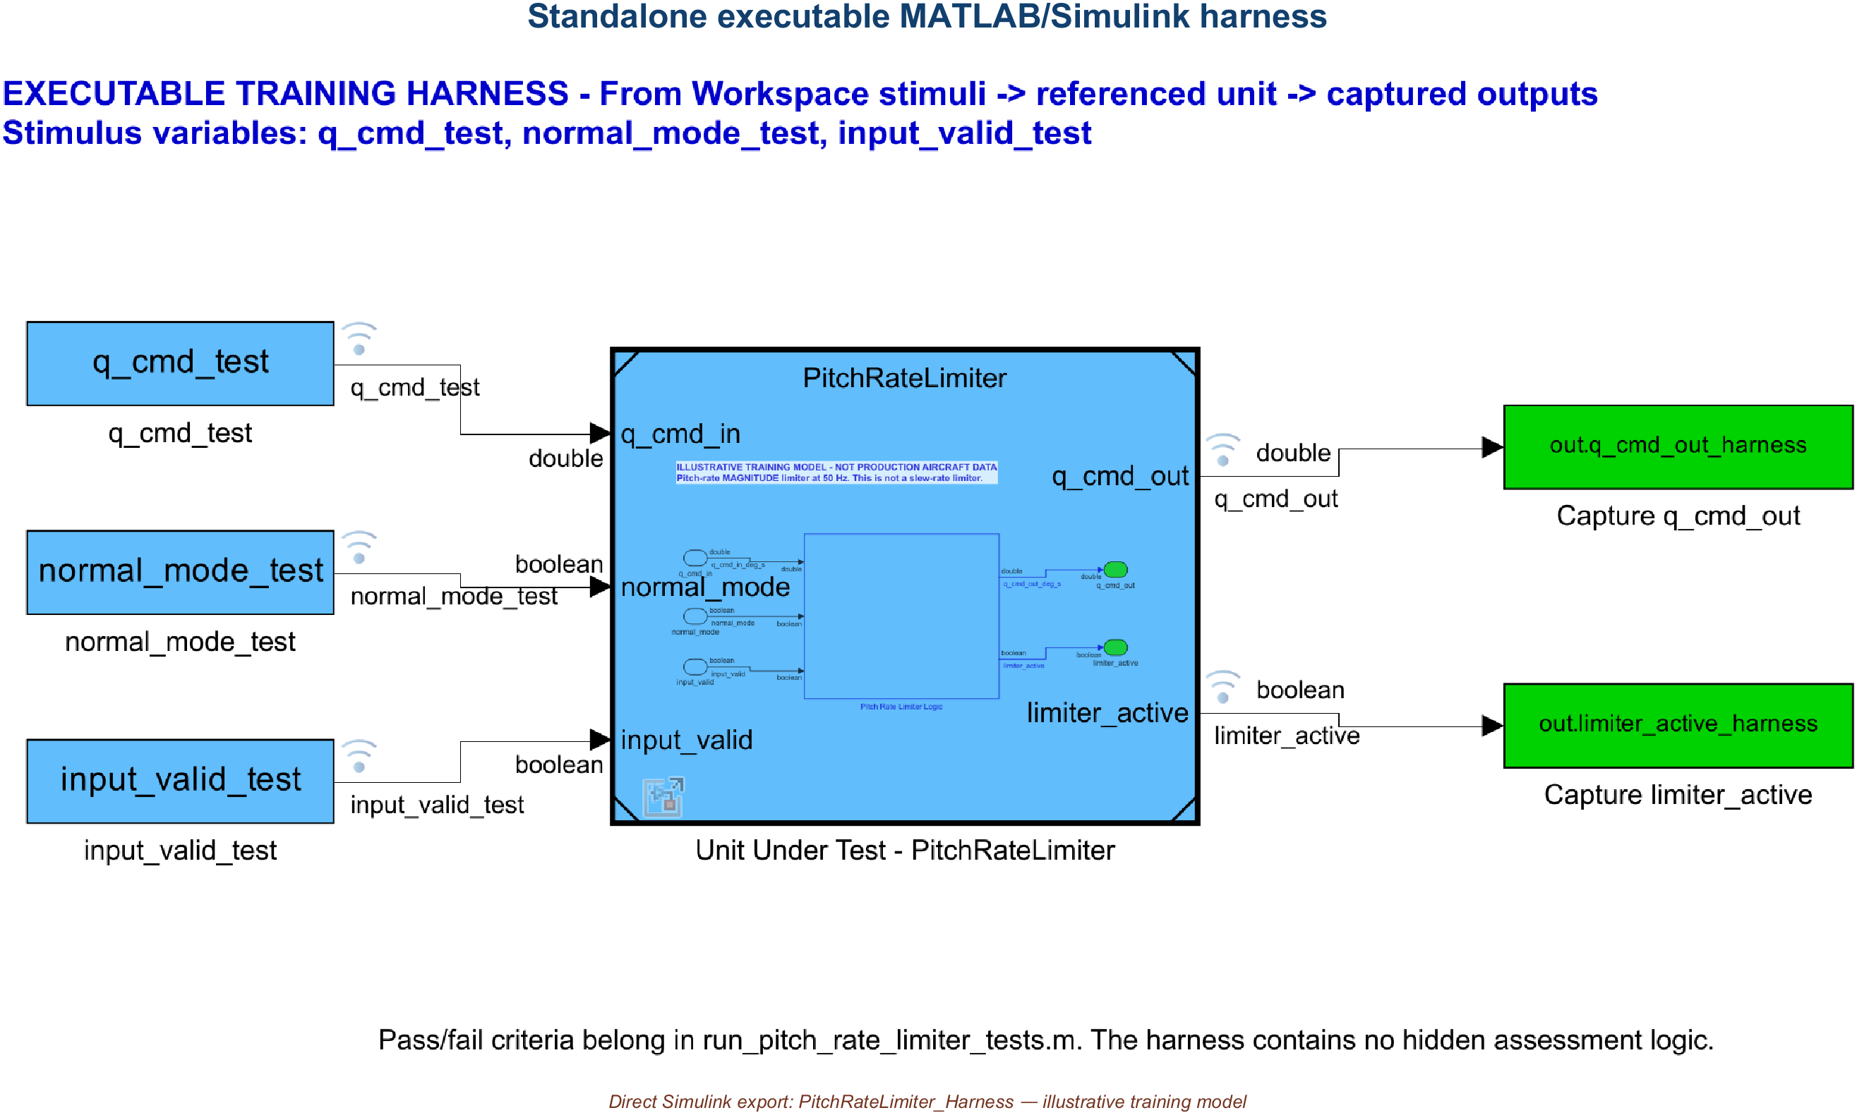
07 • UNIT TESTING
A harness makes expectations executable
Standalone executable harness • Simulink Test unavailable; assessment logic remains in MATLAB
AVIATION CONTROLS ENGINEERING ONBOARDING
23
Notes:
Timing: 2 minutes
Suggested visual:
The real standalone PitchRateLimiter_Harness model shows sources, referenced component, and retained outputs.
Speaker notes:
Because Simulink Test is unavailable, the delivered project uses a standalone executable Simulink harness. From Workspace blocks provide deterministic q_cmd_in, normal_mode, and input_valid signals at 50 Hz. A Model block references PitchRateLimiter, and To Workspace blocks retain q_cmd_out and limiter_active. run_pitch_rate_limiter_tests.m evaluates expected values, active-flag behavior, numeric tolerance, and timing outside the harness. This preserves the important separation: the harness supplies and captures data, while the requirement oracle remains in reviewable assessment code. No .mldatx file is manufactured.
Key teaching points:
• Harnesses isolate the component without modifying production logic.
• Expected behavior comes from requirements and acceptance criteria.
• Unit tests provide fast, precise, repeatable regression evidence.
[Sources]
- https://www.mathworks.com/products/simulink-test.html
- https://www.mathworks.com/help/sltest/gs/test-planning-and-strategies.html
V2 artifact update: Simulink Test is unavailable, so the visual is a real standalone Simulink harness rather than an sltest harness. From Workspace sources drive a Model block referencing PitchRateLimiter, and To Workspace sinks retain objective outputs. Pass/fail logic remains in run_pitch_rate_limiter_tests.m. No .mldatx was manufactured. [Sources - V2 artifact] - Local: models/PitchRateLimiter_Harness.slx - General product concept: https://www.mathworks.com/help/sltest/gs/create-a-test-harness.html
V2 artifact update: Simulink Test is unavailable, so the visual is a real standalone Simulink harness rather than an sltest harness. From Workspace sources drive a Model block referencing PitchRateLimiter, and To Workspace sinks retain objective outputs. Pass/fail logic remains in run_pitch_rate_limiter_tests.m. No .mldatx was manufactured. [Sources - V2 artifact] - Local: models/PitchRateLimiter_Harness.slx - General product concept: https://www.mathworks.com/help/sltest/gs/create-a-test-harness.html
V2 artifact update: Simulink Test is unavailable, so the visual is a real standalone Simulink harness rather than an sltest harness. From Workspace sources drive a Model block referencing PitchRateLimiter, and To Workspace sinks retain objective outputs. Pass/fail logic remains in run_pitch_rate_limiter_tests.m. No .mldatx was manufactured. [Sources - V2 artifact] - Local: models/PitchRateLimiter_Harness.slx - General product concept: https://www.mathworks.com/help/sltest/gs/create-a-test-harness.html

Slide 24
07 • UNIT TESTING
Strong tests target boundaries and failures
TEST CLASS
PITCH-RATE-LIMITER EXAMPLE
WHAT IT PROVES
Nominal
q_cmd = +5.0 → +5.0 deg/s
no unnecessary modification
Boundary
−12.0 and +12.0 → unchanged
inclusive limits
Just outside
−12.1 → −12.0; +12.1 → +12.0
correct clamping
Mode / invalid
Normal false or input invalid → specified fallback
guard and degraded behavior
Timing
step and transient inputs at 50 Hz
same-frame response / no overrun
Add combinations when requirements interact: mode × validity × boundary × schedule breakpoint.
AVIATION CONTROLS ENGINEERING ONBOARDING
24
Notes:
Timing: 2 minutes
Suggested visual:
A five-row test matrix applies nominal, boundary, invalid, and timing tests to the Pitch Rate Limiter.
Speaker notes:
Explain test design as a deliberate coverage strategy. Nominal cases show ordinary behavior. Exact boundaries prove inclusive or exclusive semantics. Just-inside and just-outside values expose comparison and numerical errors. Invalid inputs and mode changes verify fallback and state transitions. Timing cases verify discrete execution and response latency. When features interact, use a small combinatorial matrix rather than testing each dimension in isolation. For a magnitude limiter, do not call the Simulink Rate Limiter block unless the requirement limits slew rate. Also test numeric types and fixed-point behavior if applicable, because saturation boundaries can move under scaling or conversion.
Key teaching points:
• Boundary values are more informative than many random nominal points.
• Mode and validity behavior must be tested explicitly.
• Test interactions when requirements share logic or state.
[Sources]
- https://www.mathworks.com/help/sltest/gs/test-planning-and-strategies.html
- https://www.mathworks.com/products/simulink-test.html

Slide 25
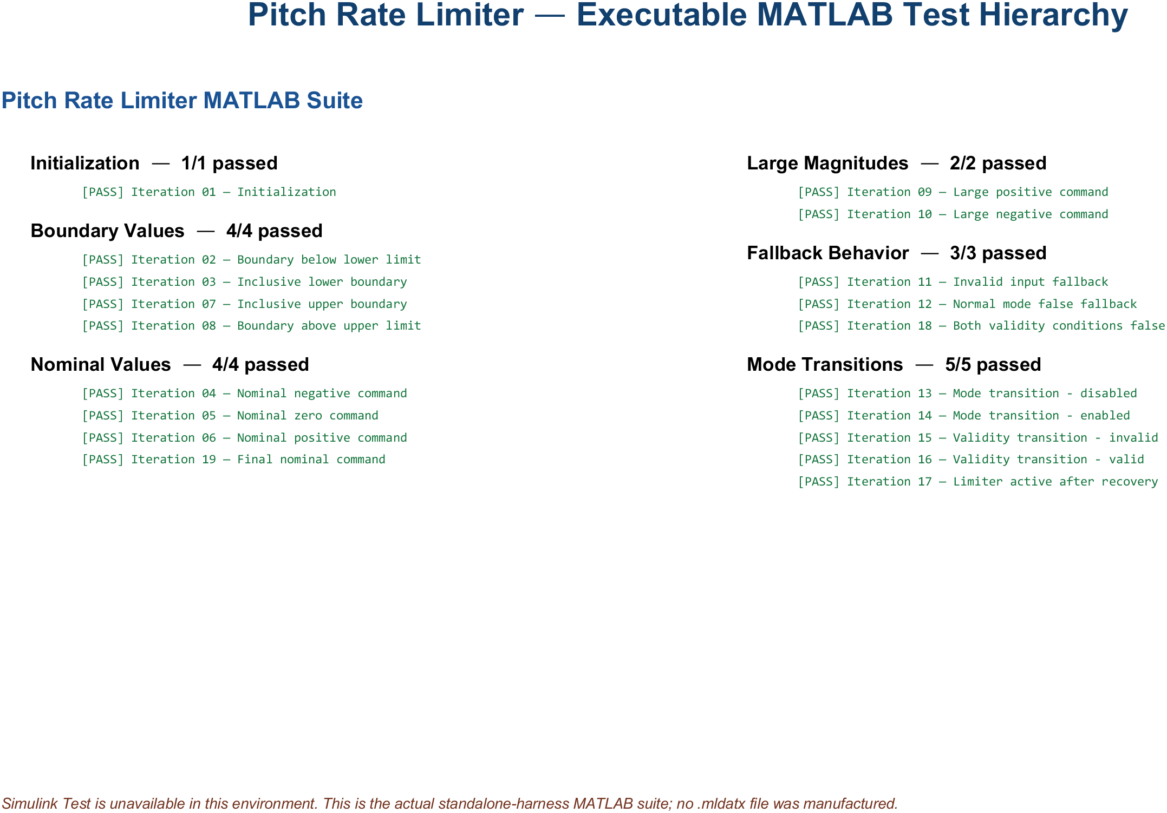
08 • MLDATX TEST FILES
MATLAB tests preserve intent without .mldatx
No .mldatx manufactured • executed MATLAB suite with retained CSV, MAT, HTML, and image results
AVIATION CONTROLS ENGINEERING ONBOARDING
25
Notes:
Timing: 2 minutes
Suggested visual:
An actual report summary shows the executable MATLAB fallback used because Simulink Test is unavailable.
Speaker notes:
Simulink Test is not installed or licensed on this computer, so the delivered project deliberately contains no .mldatx file. The authentic visual summarizes the executable MATLAB assessment suite and retained CSV, MAT, HTML, and PNG results. In a licensed environment, Test Manager can organize test files, suites, cases, callbacks, assessments, and iterations. That organization is useful, but the artifact alone would still require controlled configuration, traceability, review, and disposition of failures. The fallback used here is explicit, repeatable, and honest about the available products.
Key teaching points:
• Test files organize reusable test intent and hierarchy.
• Requirements links make cases reviewable and reportable.
• Definition files and exported result sets serve different lifecycle purposes.
[Sources]
- https://www.mathworks.com/help/sltest/ref/sltest.testmanager.testfile-class.html
- https://www.mathworks.com/help/sltest/ug/test-models-using-matlab-based-simulink-tests.html
V2 environment note: Simulink Test is not installed or licensed. The title and visual therefore document the legitimate executable MATLAB fallback and retained HTML/CSV/MAT results. No .mldatx file was created. Executed result: 19 of 19 recorded assessments passed. In a licensed environment, Test Manager can organize suites, cases, and iterations, but the artifact would still require controlled configuration, review, traceability, and failure disposition. [Sources - V2 artifact] - Local: scripts/run_pitch_rate_limiter_tests.m - https://www.mathworks.com/help/sltest/ug/test-iterations.html
V2 environment note: Simulink Test is not installed or licensed. The title and visual therefore document the legitimate executable MATLAB fallback and retained HTML/CSV/MAT results. No .mldatx file was created. Executed result: 19 of 19 recorded assessments passed. In a licensed environment, Test Manager can organize suites, cases, and iterations, but the artifact would still require controlled configuration, review, traceability, and failure disposition. [Sources - V2 artifact] - Local: scripts/run_pitch_rate_limiter_tests.m - https://www.mathworks.com/help/sltest/ug/test-iterations.html
V2 environment note: Simulink Test is not installed or licensed. The title and visual therefore document the legitimate executable MATLAB fallback and retained HTML/CSV/MAT results. No .mldatx file was created. Executed result: 19 of 19 recorded assessments passed. In a licensed environment, Test Manager can organize suites, cases, and iterations, but the artifact would still require controlled configuration, review, traceability, and failure disposition. [Sources - V2 artifact] - Local: scripts/run_pitch_rate_limiter_tests.m - https://www.mathworks.com/help/sltest/ug/test-iterations.html

Slide 26
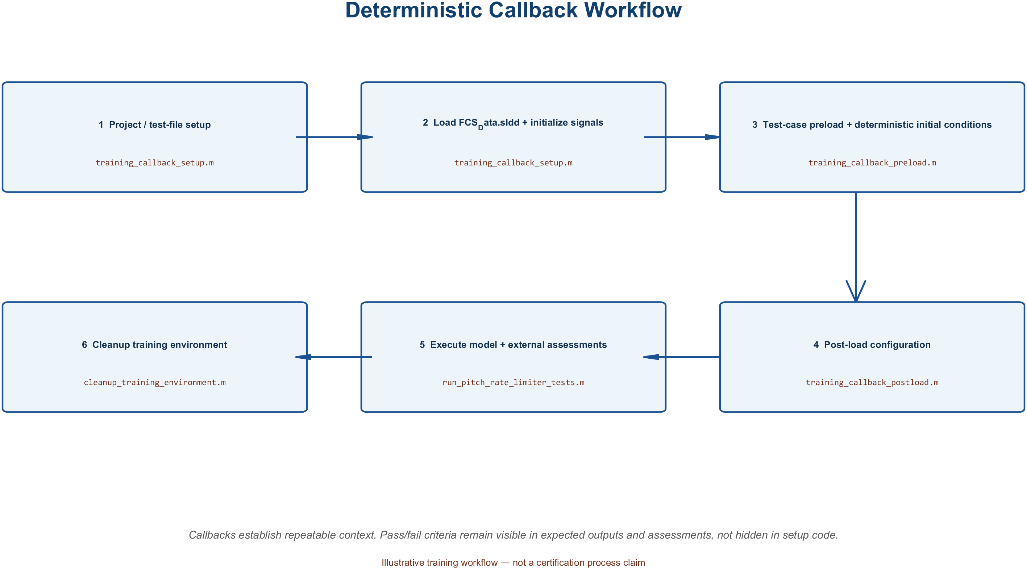
09 • CALLBACK SCRIPTS
Callbacks make tests deterministic
Actual external callback functions • setup, preload, post-load, simulate/assess, and cleanup
AVIATION CONTROLS ENGINEERING ONBOARDING
26
Notes:
Timing: 2 minutes
Suggested visual:
A generated view of the delivered external callback functions shows setup through cleanup.
Speaker notes:
Define callbacks as MATLAB code invoked at lifecycle events. Simulink models have callbacks such as PreLoadFcn, PostLoadFcn, InitFcn, StartFcn, and StopFcn. Simulink Test provides file and suite Setup/Cleanup callbacks and test-case Pre-load, Post-load, and Cleanup callbacks. Projects may place substantial callback logic in reviewed external .m functions, but a separate file is a convention, not a product requirement. Use callbacks to open the project, load controlled data, configure the environment, initialize deterministic signals, and restore state. Keep the primary verification oracle in assessments, expected outputs, baselines, or custom criteria—not hidden inside a cleanup script. Callback ordering matters, especially in parallel execution and when model callbacks also modify state.
Key teaching points:
• Callbacks establish and clean up deterministic conditions.
• Execution order and workspace scope matter.
• Do not hide the requirement’s pass/fail logic in ad hoc setup code.
[Sources]
- https://www.mathworks.com/help/sltest/ug/specify-test-properties-in-the-test-manager.html
- https://www.mathworks.com/help/sltest/ug/test-execution-order.html
- https://www.mathworks.com/help/simulink/ug/model-callbacks.html
V2 artifact update: The visual is generated from the delivered external callback functions. Setup opens controlled project data, preload establishes deterministic inputs and initial conditions, post-load configures the model, and cleanup closes only generated resources. The verification oracle remains in the assessment script. [Sources - V2 artifact] - Local: scripts/training_callback_setup.m, training_callback_preload.m, training_callback_postload.m, training_callback_cleanup.m - https://www.mathworks.com/help/simulink/callback-functions.html
V2 artifact update: The visual is generated from the delivered external callback functions. Setup opens controlled project data, preload establishes deterministic inputs and initial conditions, post-load configures the model, and cleanup closes only generated resources. The verification oracle remains in the assessment script. [Sources - V2 artifact] - Local: scripts/training_callback_setup.m, training_callback_preload.m, training_callback_postload.m, training_callback_cleanup.m - https://www.mathworks.com/help/simulink/callback-functions.html
V2 artifact update: The visual is generated from the delivered external callback functions. Setup opens controlled project data, preload establishes deterministic inputs and initial conditions, post-load configures the model, and cleanup closes only generated resources. The verification oracle remains in the assessment script. [Sources - V2 artifact] - Local: scripts/training_callback_setup.m, training_callback_preload.m, training_callback_postload.m, training_callback_cleanup.m - https://www.mathworks.com/help/simulink/callback-functions.html

Slide 27
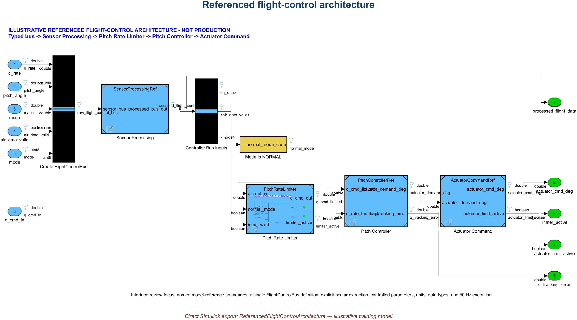
10 • ARCHITECTURE INTEGRATION
Integration succeeds when interfaces agree
Updated architecture • model references, explicit routing, FlightControlBus, and resolved interfaces
AVIATION CONTROLS ENGINEERING ONBOARDING
27
Notes:
Timing: 2 minutes
Suggested visual:
The authentic referenced architecture model shows FlightControlBus, model references, and explicit routing.
Speaker notes:
Describe integration as the moment local assumptions meet system contracts. Model references must resolve to the intended versions. Bus definitions, dimensions, data types, units, sample times, rate transitions, enumerations, variants, and parameters must agree. Compile or model update propagates these properties and often exposes errors before simulation. Model checks can add project and DO-178C/DO-331 modeling-standard checks. A clean compile is necessary but not sufficient: it proves semantic consistency in the configured model, not that the behavior satisfies requirements. After integration, add component-interaction tests for coupling, scheduling, mode coordination, and data validity.
Key teaching points:
• Integration failures usually expose inconsistent contracts or configuration.
• Compile/update is a fast semantic gate.
• Behavioral compliance still requires requirements-based verification.
[Sources]
- https://www.mathworks.com/help/simulink/ug/overview-of-model-referencing-1.html
- https://www.mathworks.com/help/simulink/ug/interface-design.html
- https://www.mathworks.com/help/slcheck/ref/model-advisor-checks-for-do-178cdo-331-industry-standards.html
V2 artifact update: The visual is the delivered ReferencedFlightControlArchitecture.slx after update/compile. It uses explicit routing, FlightControlBus, and referenced sensor-processing, limiter, controller, and actuator-command models. Architecture validation: 8 of 8 delivered models updated successfully. A clean update demonstrates semantic consistency, not requirements compliance. [Sources - V2 artifact] - Local: models/ReferencedFlightControlArchitecture.slx and child models - https://www.mathworks.com/help/simulink/model-reference.html
V2 artifact update: The visual is the delivered ReferencedFlightControlArchitecture.slx after update/compile. It uses explicit routing, FlightControlBus, and referenced sensor-processing, limiter, controller, and actuator-command models. Architecture validation: 8 of 8 delivered models updated successfully. A clean update demonstrates semantic consistency, not requirements compliance. [Sources - V2 artifact] - Local: models/ReferencedFlightControlArchitecture.slx and child models - https://www.mathworks.com/help/simulink/model-reference.html
V2 artifact update: The visual is the delivered ReferencedFlightControlArchitecture.slx after update/compile. It uses explicit routing, FlightControlBus, and referenced sensor-processing, limiter, controller, and actuator-command models. Architecture validation: 8 of 8 delivered models updated successfully. A clean update demonstrates semantic consistency, not requirements compliance. [Sources - V2 artifact] - Local: models/ReferencedFlightControlArchitecture.slx and child models - https://www.mathworks.com/help/simulink/model-reference.html

Slide 28
11 • CONTINUOUS INTEGRATION
Jenkins makes verification repeatable
Commit
Jenkinsfile
Build / Update
Model Checks
Tests
Reports + Artifacts
GROOVY / JENKINSFILE
orchestrates stages, agents, parameters, parallel branches, retention
MATLAB + SIMULINK
opens project, compiles models, runs checks and .mldatx suites, emits CI results
ROBOT FRAMEWORK
optional keyword-driven orchestration for benches, external interfaces, and system tests
Use continuous integration and verification automation—not automatic deployment to airborne software.
AVIATION CONTROLS ENGINEERING ONBOARDING
28
Notes:
Timing: 2 minutes
Suggested visual:
A six-stage Jenkins pipeline sits above three responsibility lanes for Groovy, MATLAB/Simulink, and Robot Framework.
Speaker notes:
Explain Jenkins as an automation server, not a Simulink-aware verifier by itself. A version-controlled Jenkinsfile defines stages and provides reviewability and history. Pipeline syntax can be Declarative or Scripted; Scripted Pipeline uses a Groovy-based DSL. A configured agent invokes MATLAB, opens the project, compiles or updates models, runs model checks and tests, and publishes CI-compatible reports. Robot Framework may be used as an optional keyword-driven layer to control benches, external interfaces, or higher-level system tests; it is not a DO-178C requirement and has no automatic certification status. The valuable outcome is a reproducible, controlled run with retained logs, results, environment information, and configuration identity.
Key teaching points:
• Jenkins orchestrates; project scripts perform the engineering work.
• Pipeline-as-code improves reviewability and repeatability.
• A pipeline pass becomes useful evidence only with controlled configuration and traceability.
[Sources]
- https://www.jenkins.io/doc/book/pipeline/
- https://www.jenkins.io/doc/book/pipeline/jenkinsfile/
- https://www.mathworks.com/help/sltest/ug/output-results-for-continuous-integration-systems.html
- https://robotframework.org/robotframework/latest/RobotFrameworkUserGuide.html
V3 pipeline clarification: - A passing pipeline shows that configured steps passed on a controlled agent and baseline. It is evidence input, not certification approval by itself, and does not remove review, traceability, configuration, problem-report, or independence objectives. [Sources] - https://www.faa.gov/documentLibrary/media/Order/FAA_Order_8110.49A.pdf

Slide 29
12 • FAILURE INVESTIGATION
Classify the first meaningful failure
PIPELINE FAILURE
Can you reproduce it
with the controlled command?
NO
Compare agent, licenses, paths,
project startup, data, versions
YES — compile/static
Interface • type • dimension • rate
reference • parameter • variant
YES — functional
Stimulus • expected result • tolerance
mode • initial state • timing
Fix root cause → add regression protection → re-run affected scope → run controlled full pipeline
AVIATION CONTROLS ENGINEERING ONBOARDING
29
Notes:
Timing: 2 minutes
Suggested visual:
A triage flow splits an unreproducible failure from semantic/compile and functional/test failures.
Speaker notes:
Teach disciplined triage. Preserve the failing log, build identifier, commit, configuration, agent, and first meaningful error. Try the controlled local command rather than improvising a different workflow. If the failure does not reproduce, compare environment: MATLAB release, licensed products, project startup, path order, data dictionaries, environment variables, cached artifacts, and agent configuration. If it reproduces, classify it. Compile and static failures usually point to references, types, dimensions, rates, parameters, variants, or standards. Functional failures require checking stimulus, expected output, tolerance, modes, initial state, timing, and the actual requirement. Fix the root cause, add a regression test or check, and re-run both the affected scope and the controlled full pipeline.
Key teaching points:
• Preserve the exact failing configuration before investigation.
• Classify environment, semantic, and behavioral failures separately.
• Every meaningful defect should leave regression protection behind.
[Sources]
- https://www.jenkins.io/doc/book/pipeline/
- https://www.mathworks.com/help/sltest/ug/output-results-for-continuous-integration-systems.html
- https://www.mathworks.com/help/sltest/ug/test-execution-order.html

Slide 30
13 • HARDWARE-IN-THE-LOOP
HIL tests real hardware in a virtual aircraft
Flight-Control Computer
production software + processor
Test Host
scenarios • automation • logs
Physical I/O + Loads
A/D • D/A • discrete • bus
REAL HARDWARE
Real-Time Plant Simulation
aircraft • actuators • sensors • environment
FAULT INJECTION
stale sensor • bus dropout • actuator jam • power cycle
REAL-TIME TARGET
AVIATION CONTROLS ENGINEERING ONBOARDING
30
Notes:
Timing: 2 minutes
Suggested visual:
A closed-loop HIL architecture connects test host, real flight-control computer, physical I/O, and a real-time plant with fault injection.
Speaker notes:
Correct the common oversimplification that software runs ‘in the HIL hardware.’ In controller HIL, the production software normally executes on the real flight-control computer or representative controller hardware. Its real analog, digital, discrete, and communication interfaces connect through I/O and load hardware to a real-time target. The target simulates aircraft dynamics, actuators, sensors, environment, and failures. The test host orchestrates scenarios and collects results. HIL exposes hardware/software integration, scaling, wiring, latency, scheduling, bus behavior, startup, resets, and fault response that desktop model-in-the-loop tests cannot fully reproduce. The real-time plant still has modeling assumptions, so HIL does not equal flight test or prove every requirement automatically.
Key teaching points:
• The real controller closes the loop with a simulated plant in real time.
• Physical I/O and timing are central HIL test targets.
• HIL complements MIL/SIL/PIL and other verification—it does not replace them.
[Sources]
- https://www.mathworks.com/discovery/hardware-in-the-loop-hil.html
- https://www.mathworks.com/help/sltest/sil-pil-and-hil-tests.html
V3 HIL clarification: - This slide describes a possible program verification environment; this training project did not perform HIL. - Only call testing HIL when actual controller or target hardware, a real-time plant environment, and physical I/O are used. PIL/target execution, bench testing, and system integration are distinct environments and should be named precisely. [Sources] - https://www.faa.gov/documentLibrary/media/Order/FAA_Order_8110.49A.pdf - https://www.nasa.gov/reference/systems-engineering-handbook/

Slide 31
13 • HARDWARE-IN-THE-LOOP
HIL pass criteria must be quantitative
OBJECTIVE
EXAMPLE TEST
PASS CRITERIA
Functional
Sweep q_cmd through ±12 deg/s
output clamps within specified tolerance
Timing
50 Hz frame under worst-case load
no overrun; latency and jitter within allocation
Interfaces
exercise scaling, validity, and bus updates
units, range, freshness, and status correct
Fault response
stale air data / bus dropout / reset
specified degraded state within required time
Evidence
repeat on released configuration
IDs, logs, procedures, results, and links retained
A beautiful trace is not a pass criterion. State the tolerance, time, configuration, and required evidence.
AVIATION CONTROLS ENGINEERING ONBOARDING
31
Notes:
Timing: 2 minutes
Suggested visual:
A five-row HIL verification matrix pairs objectives, realistic tests, and quantitative pass criteria.
Speaker notes:
Turn HIL from a demo into verification. Functional tests connect inputs and outputs to requirement tolerances. Timing tests specify frame rate, latency, jitter, and overrun criteria. Interface tests verify scaling, units, freshness, status, protocol behavior, and electrical behavior as applicable. Fault tests inject realistic stale data, dropouts, resets, actuator failures, and power transitions and verify the required response time and state. Evidence criteria require the released software, hardware, plant, I/O, test, and tool configurations to be identifiable. Plots support analysis, but a reviewer needs quantitative criteria, procedures, logs, results, trace links, and dispositions.
Key teaching points:
• Every HIL test needs an explicit requirement and quantitative oracle.
• Timing, interfaces, and faults are core HIL objectives.
• Configuration identity determines whether a result is reusable evidence.
[Sources]
- https://www.mathworks.com/discovery/hardware-in-the-loop-hil.html
- https://www.mathworks.com/help/sltest/sil-pil-and-hil-tests.html
- https://www.faa.gov/documentLibrary/media/Advisory_Circular/AC_20-115D.pdf
V3 execution-environment clarification: - HIL criteria are meaningful only for a setup with actual controller or target hardware, real-time plant execution, and physical I/O. No such setup was used by this project. - MIL, SIL, PIL, HIL, bench, and system-integration results answer different questions. PIL is an execution environment and is not automatically synonymous with unit testing. - Passing results remain evidence inputs and do not constitute certification approval. [Sources] - https://www.faa.gov/documentLibrary/media/Order/FAA_Order_8110.49A.pdf - https://www.nasa.gov/reference/systems-engineering-handbook/

Slide 32
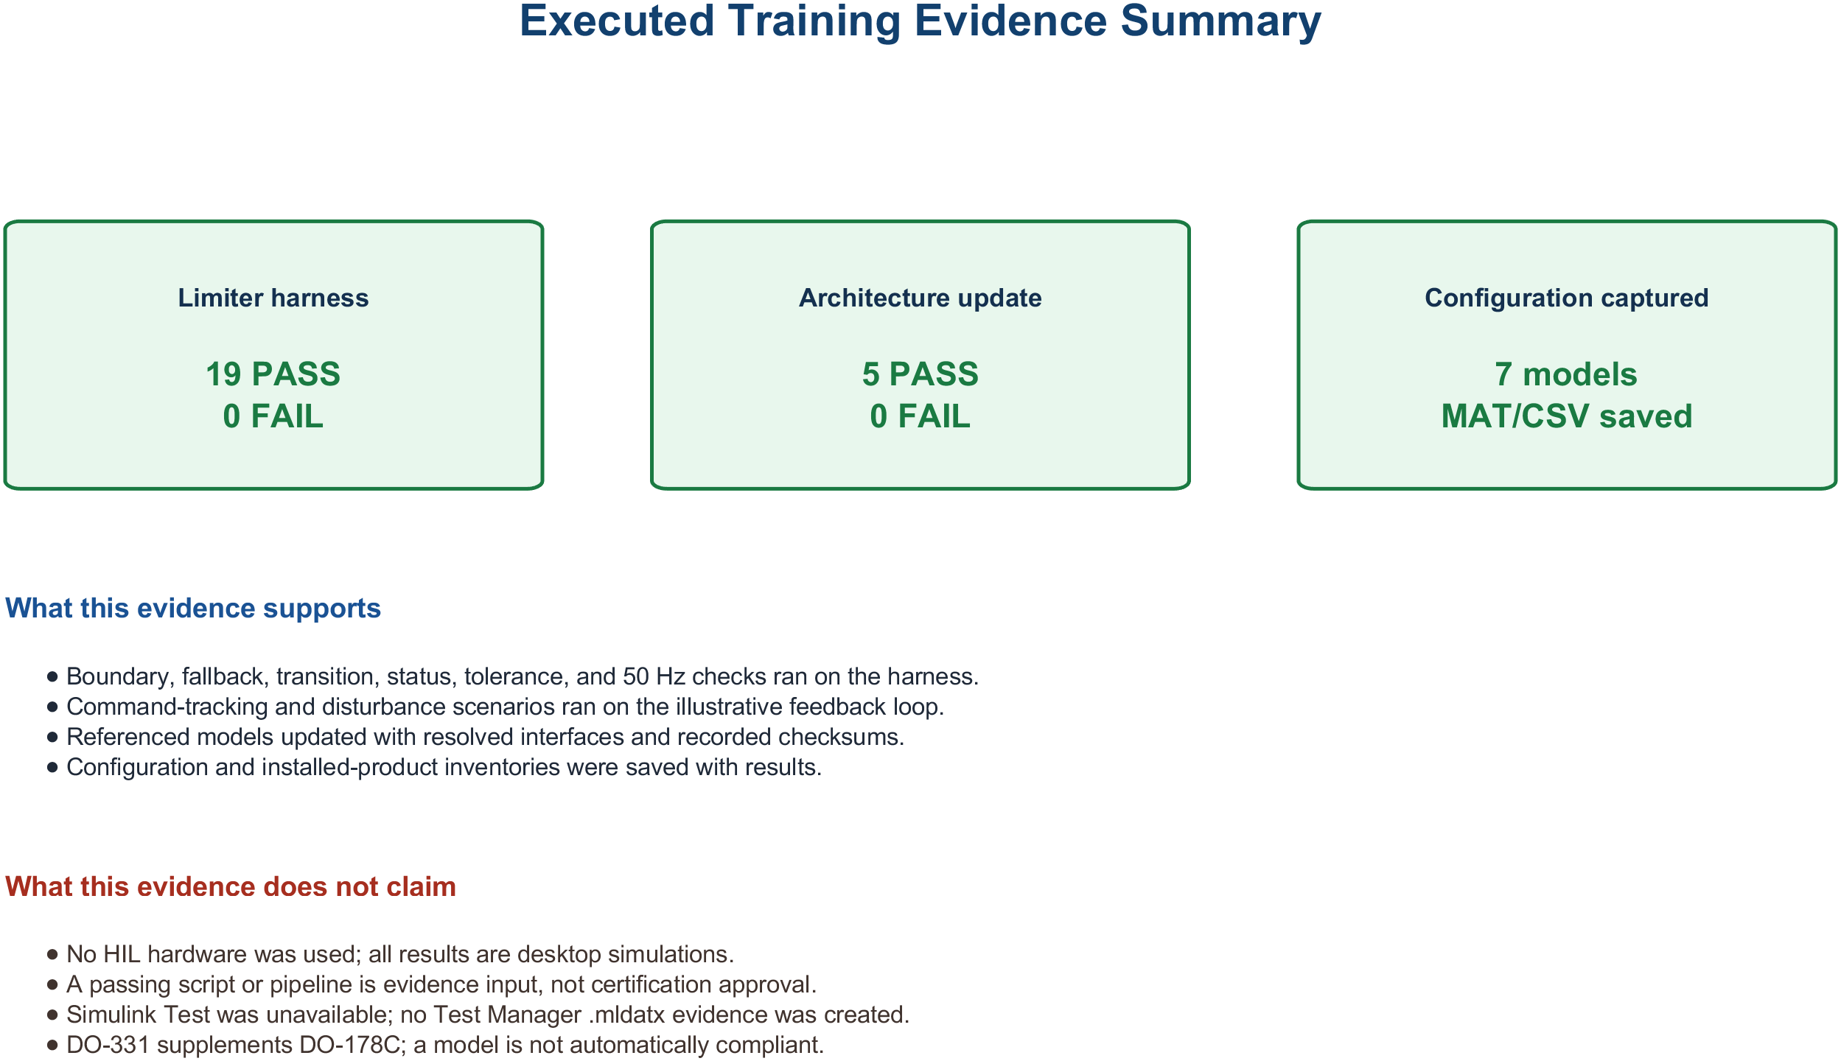
14 • COMPLETE END-TO-END EXAMPLE
One limiter, one unbroken evidence chain
Verified desktop training chain • no Jenkins or HIL execution claimed
AVIATION CONTROLS ENGINEERING ONBOARDING
32
Notes:
Timing: 2 minutes
Suggested visual:
An executed desktop evidence summary connects requirements, controlled artifacts, tests, results, and validation without HIL claims.
Speaker notes:
Narrate the verified desktop training chain only. PRL-001 through PRL-005 define the illustrative limiter behavior and interface expectations. FCS_Data.sldd controls parameters and FlightControlBus. PitchRateLimiter.slx implements the magnitude clamp and fallback; the standalone harness executes deterministic 50 Hz stimuli; MATLAB assessments retain actual and expected values, pass/fail, configuration, and reports; the referenced architecture update validates interface consistency. No .mldatx, Jenkins run, HIL hardware, generated code, or certification approval is claimed. The value is a reproducible, inspectable training evidence path—not a completed aircraft certification package.
Key teaching points:
• Every step produces or consumes controlled lifecycle data.
• The same requirement stays visible from model to HIL.
• Evidence is complete only when results, configuration, reviews, and dispositions agree.
[Sources]
- https://www.faa.gov/documentLibrary/media/Advisory_Circular/AC_20-115D.pdf
- https://www.mathworks.com/help/slrequirements/ug/create-and-store-links.html
- https://www.mathworks.com/help/sltest/ref/sltest.testmanager.testfile-class.html
- https://www.jenkins.io/doc/book/pipeline/
- https://www.mathworks.com/discovery/hardware-in-the-loop-hil.html
V2 artifact update: The replacement visual summarizes the verified desktop training chain only: requirement IDs, controlled data/model artifacts, standalone harness, executable assessments, retained results, and architecture update validation. Executed result: 19 of 19 recorded assessments passed. Architecture validation: 8 of 8 delivered models updated successfully. No Jenkins pipeline or HIL hardware was executed, and no certification approval is claimed. [Sources - V2 artifact] - Local: results/validation_summary.txt - https://www.faa.gov/documentLibrary/media/Order/FAA_Order_8110.49A.pdf
V2 artifact update: The replacement visual summarizes the verified desktop training chain only: requirement IDs, controlled data/model artifacts, standalone harness, executable assessments, retained results, and architecture update validation. Executed result: 19 of 19 recorded assessments passed. Architecture validation: 8 of 8 delivered models updated successfully. No Jenkins pipeline or HIL hardware was executed, and no certification approval is claimed. [Sources - V2 artifact] - Local: results/validation_summary.txt - https://www.faa.gov/documentLibrary/media/Order/FAA_Order_8110.49A.pdf
V2 artifact update: The replacement visual summarizes the verified desktop training chain only: requirement IDs, controlled data/model artifacts, standalone harness, executable assessments, retained results, and architecture update validation. Executed result: 19 of 19 recorded assessments passed. Architecture validation: 8 of 8 delivered models updated successfully. No Jenkins pipeline or HIL hardware was executed, and no certification approval is claimed. [Sources - V2 artifact] - Local: results/validation_summary.txt - https://www.faa.gov/documentLibrary/media/Order/FAA_Order_8110.49A.pdf
V3 evidence-chain clarification: - For this training project, the demonstrated chain ends with controlled desktop models, harnesses, assessments, retained results, and architecture update/compile evidence. It does not extend to HIL. - Any future PIL, target, bench, HIL, or system-integration evidence must identify its specific execution environment and controlled baseline. [Sources] - https://www.faa.gov/documentLibrary/media/Order/FAA_Order_8110.49A.pdf

Slide 33
15 • KEY TAKEAWAYS
Align behavior, interfaces, and evidence
WHAT TO REMEMBER
FIRST 30 DAYS
Simulink — executable data flow, state, timing, and hierarchy
DO-178C / DO-331 — planned objectives, model role, verification, and evidence
Testing — requirements first; boundaries, modes, failures, and timing
Automation — repeatable checks and results under controlled configuration
HIL — real controller, physical I/O, real-time plant, quantitative criteria
01 open the project correctly
02 trace one requirement end-to-end
03 modify one small component
04 add one boundary test
05 reproduce one CI failure locally
06 observe one HIL run + evidence review
When the chain is unbroken, certification becomes a review of evidence—not a rescue project.
AVIATION CONTROLS ENGINEERING ONBOARDING
33
Notes:
Timing: 1.5 minutes plus questions
Suggested visual:
A two-column close summarizes the lifecycle and gives the new engineer a practical first-30-days checklist.
Speaker notes:
Synthesize the course rather than repeating slide titles. Simulink makes dynamic behavior executable and reviewable. DO-178C and DO-331 place that behavior inside planned objectives and evidence. Good requirements define conditions, boundaries, interfaces, timing, and observable results. Unit tests, .mldatx organization, callbacks, architecture compile, Jenkins, and HIL each answer different questions; none replaces the others. Encourage the engineer to learn the local project by tracing one real requirement end to end, making one small controlled change, adding a boundary test, reproducing one pipeline failure, and watching how a HIL run is reviewed and retained. End with questions focused on the organization’s actual plans, standards, model role, toolchain, and evidence repositories.
Key teaching points:
• Correct control behavior and correct lifecycle evidence must stay synchronized.
• Each verification environment targets a different class of risk.
• The fastest onboarding path is one small end-to-end change under the project process.
[Sources]
- https://www.mathworks.com/help/simulink/gs/model-based-design.html
- https://www.faa.gov/documentLibrary/media/Advisory_Circular/AC_20-115D.pdf
- https://www.mathworks.com/discovery/hardware-in-the-loop-hil.html
V3 closing clarification: - DO-178C is an accepted means of compliance, not a standalone software certificate; DO-331 supplements it for model-based development and verification. - Agile or waterfall cadence does not remove lifecycle data, traceability, reviews, configuration control, controlled baselines, or designated independence. - This project did not perform HIL. A passing pipeline or test is evidence input, not approval by itself. [Sources] - https://www.faa.gov/regulations_policies/advisory_circulars/index.cfm/go/document.information/documentID/1032046 - https://www.faa.gov/documentLibrary/media/Order/FAA_Order_8110.49A.pdf - https://www.nasa.gov/reference/systems-engineering-handbook/

