Slide 1
NEW AVIATION CONTROLS ENGINEER ONBOARDING
Simulink in the Aerospace Controls Lifecycle
First-session workflow • model hierarchy • desktop MIL evidence • assurance context
REQUIRE
MODEL
VERIFY
EVIDENCE
FLIGHT-CONTROL SOFTWARE IS AN UNBROKEN CHAIN
AVIATION CONTROLS ENGINEERING ONBOARDING
01
Notes:
Timing: 1 minute
Frame this as first-time-user onboarding for aviation controls engineers: operate the saved Simulink models, understand their roles, inspect results, and trace one classroom requirement to retained evidence. The examples are executable and reviewable, but deliberately small and non-production.
Caveats
- Illustrative classroom requirements — not production aircraft data or an approved certification baseline.
- The package demonstrates desktop model work; it is not a completed certification package.
[Sources]
- README.md
- results/validation_summary.txt

Slide 2
ORIENTATION
Absolute summary: executable training evidence with bounded claims
EVIDENCE SNAPSHOT • MATLAB R2023b UPDATE 8 • DESKTOP WINDOWS • 27 AUG 2026
8 / 8
19 / 19
24 / 24
5 / 5
MODELS UPDATED
SAMPLE ASSESSMENTS
REQUIRED EXPORTS
GRT MODELS BUILT
diagram update / compile
3 row checks + suite timing
validator-defined artifacts
top standalone + four refs
WHAT IS RETAINED
WHAT THIS IS NOT
✓ 8 Simulink / Stateflow models with explicit roles
✓ FCS_Data.sldd + five-element FlightControlBus
✓ one SDI run • five signals • three aligned plots
✓ standalone PitchRateLimiter harness + scripted oracle
✓ CSV • MAT • HTML • PNG • build log • generated C
× production aircraft data or approved baseline
× Simulink Test / Test Manager suite
× production or Embedded Coder approval
× SIL • PIL • HIL • bench • system integration
× Model Advisor / Polyspace / RCF completion
× certification approval
BUILD BOUNDARY • the standalone executable was compiled, not executed or SIL/PIL-verified
AVIATION CONTROLS ENGINEERING ONBOARDING
02
Notes:
Timing: 2 minutes
Orient the learner to the absolute evidence snapshot. The package retains eight delivered models that update, one controlled data dictionary with a five-element bus, one saved SDI run, and one standalone limiter harness assessed at nineteen sample times. The fresh package validation retains 8/8 model updates, 19/19 passing limiter assessments, and 24/24 required exports. A separate controlled 2026-08-27 scripted slbuild generated and compiled five GRT models: the top standalone target plus four referenced targets.
Caveats
- The 5/5 code-generation build is separate from the validator's 24/24 exported-artifact count.
- The generated executable was built but not executed or SIL/PIL-verified.
- This remains illustrative desktop-MIL training evidence, not production aircraft data or certification approval.
[Sources]
- README.md
- results/validation_summary.txt
- results/top_level_codegen_v7_evidence/ReferencedFlightControlArchitecture_slbuild.log
- results/environment_inventory.txt
- results/FCS_DataDictionary_Inventory.csv
- results/FlightControlBus_Inventory.csv

Slide 3
ORIENTATION
Overall completion checklist: verified, explained, or future
STATUS WORDS ARE PART OF THE EVIDENCE: VERIFIED ≠ EXPLAINED ≠ FUTURE
VERIFIED NOW
EXPLAINED / DEMO
FUTURE / OPEN
✓ 8/8 model updates
✓ 19/19 assessed samples
✓ 24/24 required exports
✓ SDI run + view + session
✓ 5/5 GRT models built
✓ logging vs test points
✓ model settings review
✓ Ctrl+D vs Run vs Ctrl+B
✓ harness input provenance
✓ SDI + result-plot reading
✓ dictionary + bus access
○ retained Model Advisor report
○ Bug Finder result
○ Code Prover result
○ project-defined RCF / required sign-off
○ SIL / PIL / HIL evidence
○ production-code approval
OVERALL COMPLETION = retained objective result + explainable workflow + explicitly owned open gate
AVIATION CONTROLS ENGINEERING ONBOARDING
03
Notes:
Timing: 2 minutes
Use three status words deliberately. VERIFIED means objective artifacts are retained now. EXPLAINED means the deck teaches the workflow and points to the relevant controls or files. FUTURE means no retained completion artifact exists and the activity must still be performed under the approved program process. This prevents an instructional placeholder from being mistaken for engineering evidence.
Caveats
- Model Advisor, Polyspace Bug Finder, Polyspace Code Prover, and the program-defined RCF are not completed evidence in this package.
- SIL, PIL, HIL, bench, and system-integration execution remain outside the retained evidence.
[Sources]
- results/validation_summary.txt
- results/top_level_codegen_v7_evidence/ReferencedFlightControlArchitecture_slbuild.log
- results/environment_inventory.txt
- results/MATLAB_ProductInventory.csv

Slide 4
ORIENTATION
The executable model is the engineering hub
Requirements
Simulation
EXECUTABLE
MODEL
Control design
MODEL-BASED DESIGN
Verification
The same behavior can be discussed, simulated, reviewed, tested, integrated, and traced.
AVIATION CONTROLS ENGINEERING ONBOARDING
04
Notes:
Timing: 2 minutes
Use this hub to establish the model roles before opening files. AircraftFeedbackControlLoop is the standalone closed-loop learning model; ReferencedFlightControlArchitecture is the integration parent; four models are referenced children; AutopilotModeLogic is a separate Stateflow example; and PitchRateLimiter_Harness is the independent component-test harness.
Caveats
- A top-level model is selected for the engineering task; there is no single model that serves every role.
- AutopilotModeLogic is not a child of the referenced integration architecture.
[Sources]
- README.md
- models/AircraftFeedbackControlLoop.slx
- models/ReferencedFlightControlArchitecture.slx

Slide 5
ORIENTATION
Your first session: orient, execute, inspect, trace
KEEP ASKING
1
OPERATE
2
READ HIERARCHY
open • Ctrl+D • run • stop
top → child → subsystem → harness
Which model is top level for this task?
What configuration and data are active?
What action did I perform?
What artifact supports the claim?
3
EXPOSE SEMANTICS
4
BUILD DELIBERATELY
units • types • logging • settings
active model • target • retained files
5
TRACE INPUTS
6
READ EVIDENCE
script • timeseries • SLDD • bus
SDI transients • 19-case plots
START HERE
completion checklist
↓
folder initialization
↓
correct top-level model
7
CLOSE THE LOOP
traceability • open gates • sign-off
AVIATION CONTROLS ENGINEERING ONBOARDING
05
Notes:
Timing: 2 minutes
Preview the expanded learning sequence. Start from the completion checklist, initialize the folder-based package, choose the correct top-level model, expose semantics and instrumentation, distinguish update from execution and build, inspect the harness inputs and dictionary contract, read the saved SDI and limiter plots, and finish by separating retained evidence from future assurance gates.
Caveats
- This is a learning path, not a substitute for approved project procedures.
- There is no MATLAB Project file; initialization is folder-based.
[Sources]
- README.md
- scripts/initialize_training_data.m
- results/validation_summary.txt

Slide 6
01 • FIRST SESSION
MATLAB computes; Simulink exposes behavior
MATLAB
SIMULINK
Best at — scripts, algorithms, matrices, optimization, data analysis
Execution — statements and functions run in defined order
View — variables, arrays, figures, tables, reports
Best at — dynamic systems, feedback, hybrid logic, integration
Execution — blocks exchange signals over simulated time
View — data flow, hierarchy, state, sample time, interfaces
They are one environment: MATLAB configures, analyzes, automates, and reports on Simulink models.
AVIATION CONTROLS ENGINEERING ONBOARDING
06
Notes:
Timing: 2 minutes
MATLAB and Simulink are complementary. MATLAB prepares controlled data, automates operations, evaluates results, and writes evidence; Simulink exposes executable time behavior, hierarchy, state, interfaces, and sample times. In this repository, MATLAB scripts drive and assess the saved Simulink models.
Caveats
- The distinction is about representation and workflow, not competing tools.
- A script that runs a model is not itself proof that every lifecycle objective is satisfied.
[Sources]
- scripts/run_training_simulations.m
- scripts/run_pitch_rate_limiter_tests.m
- https://www.mathworks.com/help/simulink/gs/model-based-design.html

Slide 7
01 • FIRST SESSION
Start in the repository, then distinguish every action
01
02
03
04
05
06
07
INITIALIZE
OPEN
UPDATE
RUN
STOP
BUILD
TEST
Command Window
Ctrl+O / open_system
Modeling • Ctrl+D
Simulation • Ctrl+T
Simulation • Stop
Apps • Ctrl+B
MATLAB driver
Prepare paths + FCS_Data.sldd
Choose the correct top level
Compile and propagate semantics
Execute desktop model behavior
Interrupt the current execution
Configured code generation only
Run harness assessments
FIRST CLOSED-LOOP SESSION — MATLAB EQUIVALENTS
SUCCESS LOOKS LIKE
projectRoot = 'D:\GitHub\aviation-controls-simulink-training';
addpath(fullfile(projectRoot,'scripts'), fullfile(projectRoot,'models'), fullfile(projectRoot,'data'));
initialize_training_data(projectRoot);
open_system(fullfile(projectRoot,'models','AircraftFeedbackControlLoop.slx'));
set_param('AircraftFeedbackControlLoop','SimulationCommand','update');
sim('AircraftFeedbackControlLoop');
run_pitch_rate_limiter_tests(projectRoot);
• Training data dictionary ready
• Update completes without an error
• Simulation outputs appear under results/
• Limiter driver writes CSV + MAT
• Human-readable HTML + PNG appear under reports/
Build remains optional and scope-dependent; no production-code claim is made.
AVIATION CONTROLS ENGINEERING ONBOARDING
07
Notes:
Timing: 3 minutes
Start MATLAB R2023b in the repository, add the scripts, models, and data folders to the path, run initialize_training_data(projectRoot), and open models/AircraftFeedbackControlLoop.slx for the first closed-loop exercise. Update the diagram, run, stop if needed, and inspect outputs under results; use the helper scripts for repeatable simulations and evidence refresh.
Caveats
- There is no MATLAB Project .prj file in this repository; say initialize the training package, not open a project file.
- Use refresh_onboarding_artifacts after layout-safe changes; regenerate_all recreates models and can overwrite manually cleaned layouts.
[Sources]
- README.md
- scripts/initialize_training_data.m
- scripts/refresh_onboarding_artifacts.m
- https://www.mathworks.com/help/simulink/slref/simulinkeditor.html

Slide 8
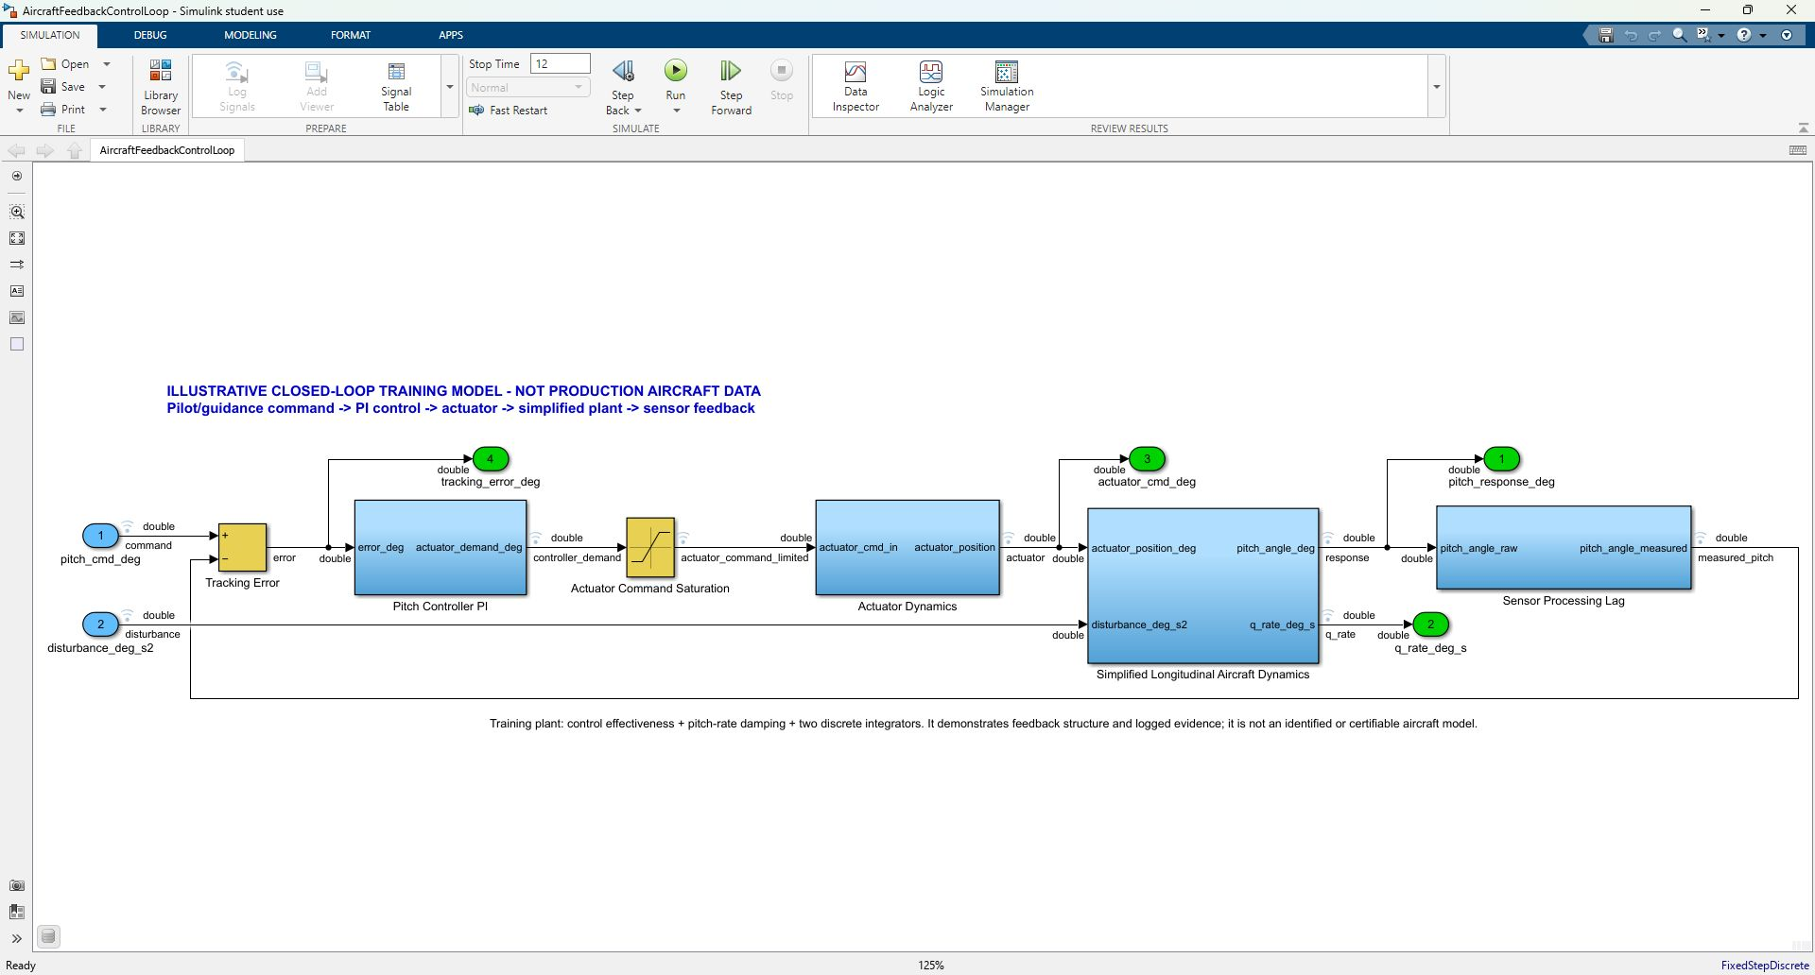
01 • FIRST SESSION
The toolstrip tells you where each action lives
SIMULATION
Open • Run • Stop • Data Inspector
DEBUG
Diagnostics • Information Overlays
MODELING
Update Model • configuration
FORMAT
Layout • labels • visual review
APPS
Testing tools • code generation
Select the tab, then the action. Open, update, run, stop, build, and test create different engineering states and evidence.
AVIATION CONTROLS ENGINEERING ONBOARDING
08
Notes:
Timing: 3 minutes
Orient learners to the Simulation, Debug, Modeling, Format, and Apps tabs. Open chooses the artifact; Update Diagram or Ctrl+D compiles and propagates model semantics; Run executes a simulation; Stop interrupts it; Build or Ctrl+B is a separate configured code-generation action; and test execution invokes the harness driver and assessments.
Caveats
- Update/compile is not simulation, and Run is not Build.
- The package makes no production-code, generated-code verification, SIL, PIL, or HIL claim; Embedded Coder is unavailable.
[Sources]
- results/environment_inventory.txt
- https://www.mathworks.com/help/simulink/slref/simulinkeditor.html
- https://www.mathworks.com/help/simulink/ug/summary-of-mouse-and-keyboard-actions.html
- https://www.mathworks.com/help/rtw/ug/generating-code-using-simulink-coder.html

Slide 9
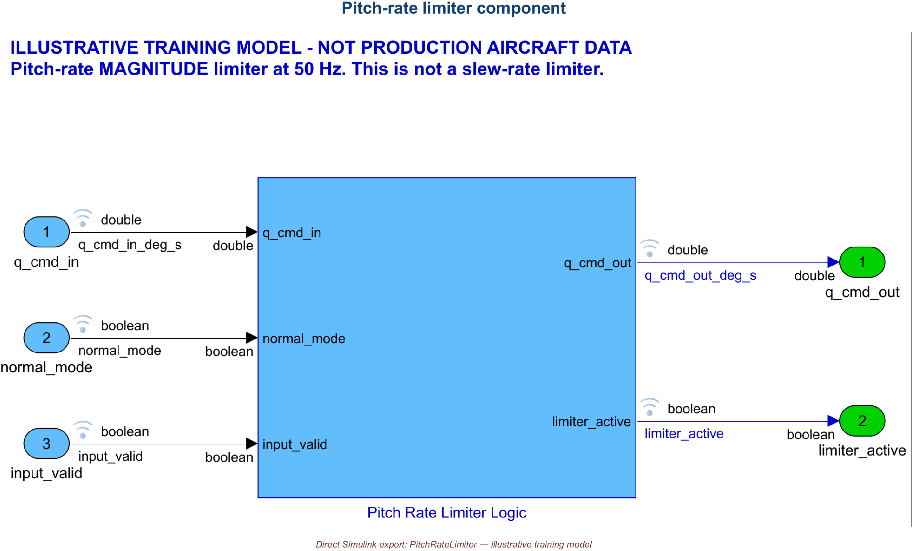
01 • FIRST SESSION
Turn model displays on—and off—for focus
DEBUG → INFORMATION OVERLAYS
PORT UNITS
ShowPortUnits
DATA TYPES
ShowPortDataTypes
DIMENSIONS
ShowLineDimensions
SIGNAL NAMES
line labels + propagated names
LOGGING BADGES
DataLogging + model SignalLogging
TEST POINTS
ShowTestPointIcons, when supported
MODEL OVERLAYS — units, types, dimensions, names, and log/test-point badges annotate the diagram.
SDI MARKERS — cursors and data points annotate logged traces. Neither display changes behavior.
AVIATION CONTROLS ENGINEERING ONBOARDING
09
Notes:
Timing: 3 minutes
Use Debug > Information Overlays to reveal port units, data types, signal dimensions, names, and logging or test-point badges; turn each display off again when it obscures structure. These overlays describe model semantics and instrumentation. Simulation Data Inspector markers and cursors instead annotate plotted samples after data has been logged.
Caveats
- A marker does not create or delete a logged data point.
- Some overlays require a successful model update before propagated attributes are available, and exact toolstrip grouping can vary by release or selection.
[Sources]
- https://www.mathworks.com/help/simulink/ug/displaying-units.html
- https://www.mathworks.com/help/simulink/ug/working-with-test-points.html
- https://www.mathworks.com/help/simulink/ug/view-the-signal-logging-configuration.html
- https://www.mathworks.com/help/simulink/gui/signallogging.html

Slide 10
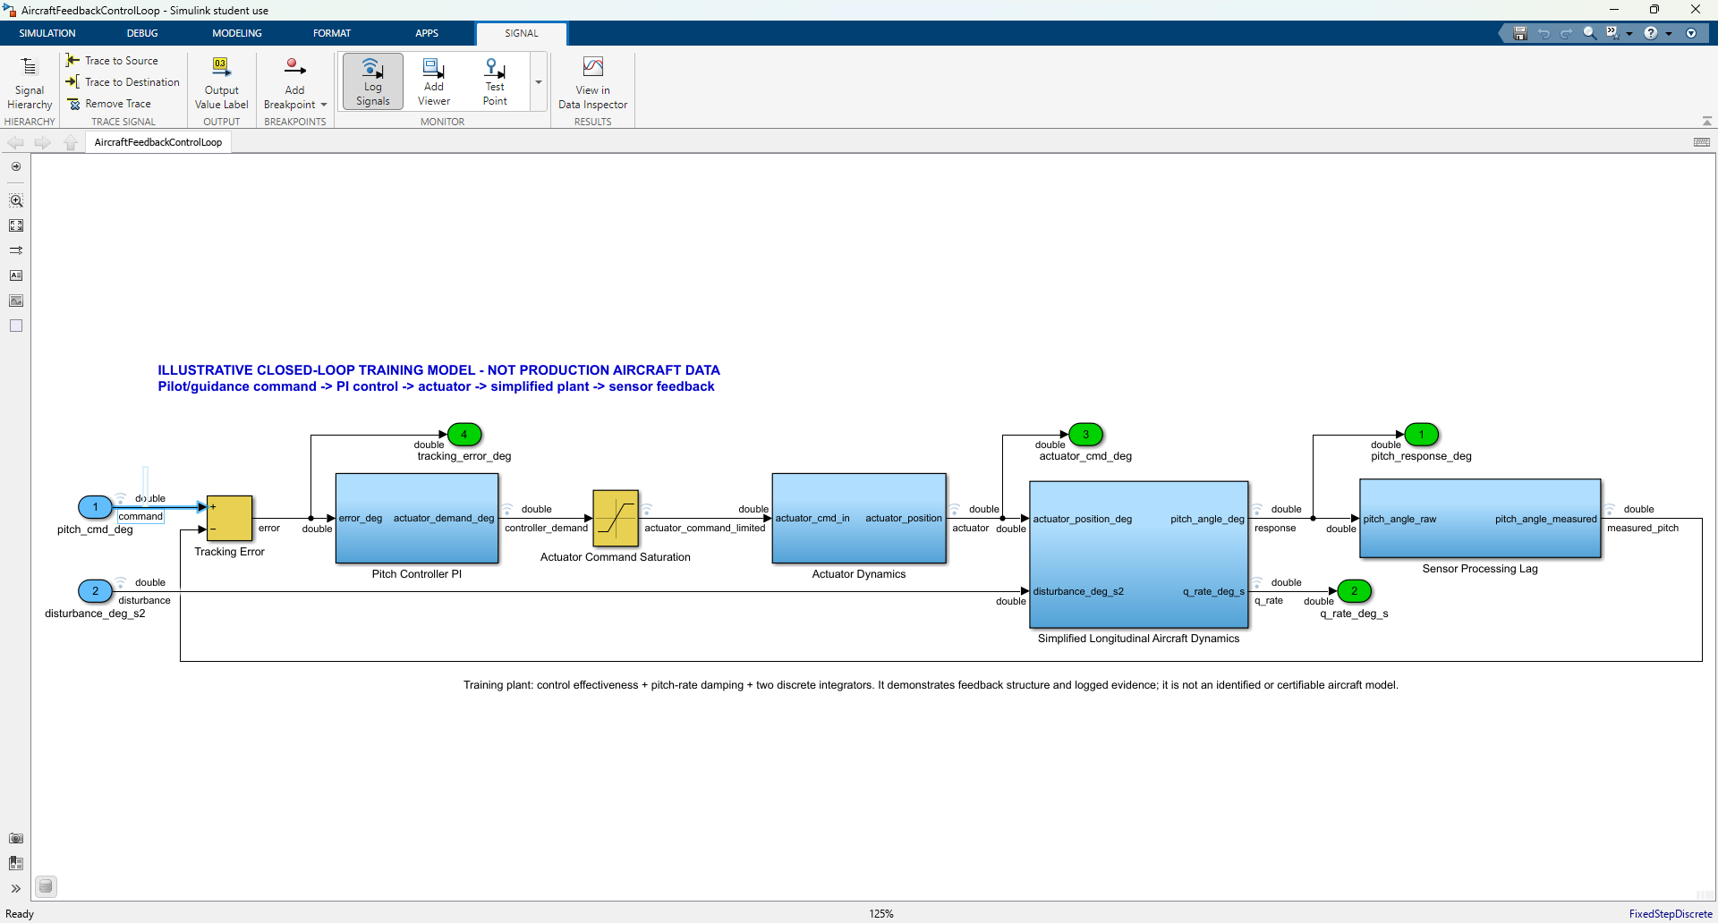
01 • HANDS-ON DEMO
Log signals for evidence; use test points for required observability
DO THIS LIVE
LOG A SIGNAL
1 Select the signal line
2 Signal tab > Log Signals
3 Run the model
4 View in Data Inspector
LOGGED SIGNAL
Use for time history, SDI comparisons, regression plots, and retained simulation evidence. Dataset data commonly appears in logsout.
TEST POINT
Use when an internal signal must remain observable despite optimization. It does not enable signal logging; control and review it separately.
SAVED PACKAGE • signal logging ON in 8/8 models • 52 logged ports • 0 test points
AVIATION CONTROLS ENGINEERING ONBOARDING
10
Notes:
Timing: 4 minutes plus live demo
Select a signal line in AircraftFeedbackControlLoop, open the contextual Signal tab, choose Log Signals, run the model, and open View in Data Inspector. Use signal logging when the time history itself is evidence or must be compared across runs. Use a test point only when an internal signal must remain observable despite model optimizations—for example, a planned debug, test, or generated-code observability need. A signal may be both logged and a test point, but the settings are independent. The saved package currently has signal logging enabled for all eight models, 52 ports marked for logging, and zero ports marked as test points.
Caveats
- Marking a test point does not enable Dataset signal logging.
- Test points can inhibit optimizations such as signal-storage reuse and block reduction, so use them selectively and review them as controlled design settings.
- The green numbered ovals in the supplied screenshot are model Outport blocks; the blue line indicators show logged signals.
[Sources]
- scripts/create_training_models.m
- scripts/training_callback_postload.m
- https://www.mathworks.com/help/simulink/gui/signallogging.html
- https://www.mathworks.com/help/simulink/ug/working-with-test-points.html

Slide 11
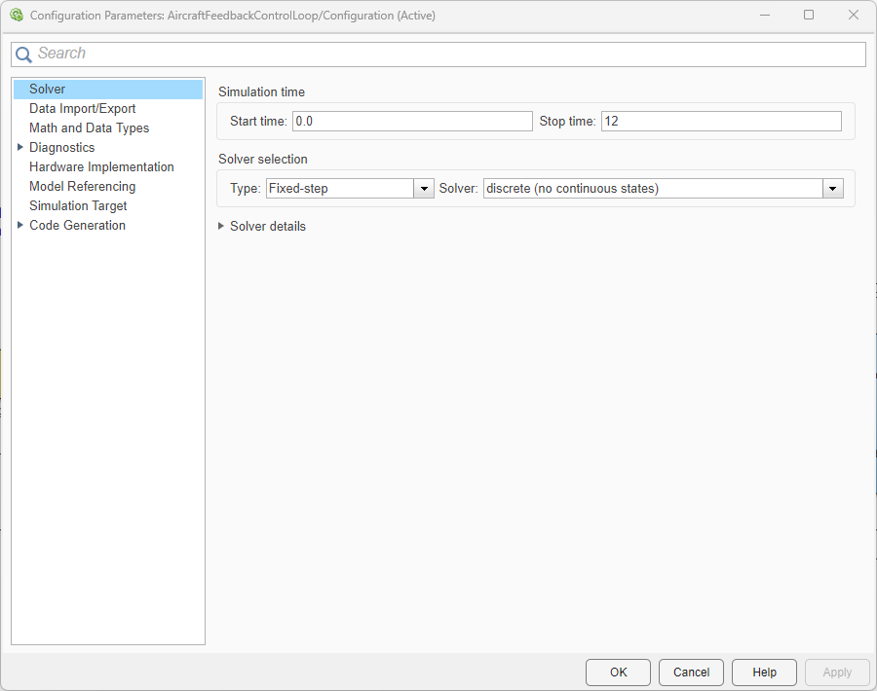
01 • HANDS-ON DEMO
Check the active model settings before update, simulation, or build
CTRL+E • MODELING > MODEL SETTINGS
1 CHECK THE ACTIVE SET
Confirm the intended top model or referenced model. The dialog title should identify the active configuration.
2 REVIEW TASK-CRITICAL PANES
Solver • logging • diagnostics • hardware • model referencing • simulation target • code generation, when applicable.
3 CHANGE UNDER CONTROL
Record rationale → Apply/OK → Ctrl+D → rerun affected simulations and assessments → retain evidence.
CAPTURED HERE • active Configuration • stop time 12 s • Fixed-step • discrete (no continuous states)
AVIATION CONTROLS ENGINEERING ONBOARDING
11
Notes:
Timing: 4 minutes plus live demo
Open the active Configuration Parameters dialog with Ctrl+E or Modeling > Model Settings. Confirm that you are editing the intended top model or referenced model, then inspect the panes that control the task: Solver, Data Import/Export and logging, Diagnostics, Hardware Implementation, Model Referencing, and Code Generation when build output is planned. In the supplied capture, AircraftFeedbackControlLoop is the active configuration, the stop time is 12 seconds, and the solver is fixed-step and discrete. After an intentional change, record the rationale, apply the setting, press Ctrl+D, rerun the affected simulation or assessments, and retain the resulting evidence.
Caveats
- Opening the dialog is not itself a verification result.
- The screenshot does not expose the fixed-step-size field because Solver details is collapsed; results/SimulationConfiguration.csv records the fixed step as Sample_time.
- For a referenced model, use the Model Settings arrow and select the referenced-model settings or open that model as the top model.
[Sources]
- results/SimulationConfiguration.csv
- scripts/create_training_models.m
- https://www.mathworks.com/help/simulink/ug/configuration-parameters-dialog-box-overview.html
- https://www.mathworks.com/help/simulink/gui/solver-pane.html

Slide 12
01 • HANDS-ON DEMO
Model Advisor checks the selected component against chosen rules
WORKFLOW ILLUSTRATED • NO RETAINED MODEL ADVISOR RESULT IN THIS PACKAGE
01
02
03
04
05
SCOPE
SELECT
RUN
REVIEW
RETAIN
Modeling > Model Advisor
Select the exact model or subsystem
Choose a named check set
By Product or By Task
Run Checks
Honor license and update requirements
Read every status
Address findings and exclusions
Rerun and save report
Baseline + check IDs + results
RETAIN AS CONTROLLED EVIDENCE
DOES NOT, BY ITSELF, PROVE
• model / subsystem and version
• selected check configuration and IDs
• Passed / Failed / Warning / Incomplete results
• exclusions, fixes, dispositions, and rerun
• saved report tied to the reviewed baseline
• requirements are correct and complete
• all referenced models were analyzed
• tests and coverage are adequate
• findings received independent disposition
• certification or final design approval
MODEL REFERENCE NOTE • run the intended checks on referenced models explicitly; do not assume the top-model scan enters every Model block.
AVIATION CONTROLS ENGINEERING ONBOARDING
12
Notes:
Timing: 4 minutes
Demonstrate the Model Advisor workflow on the exact component in scope: Modeling > Model Advisor, choose the model or subsystem, select a named check set by product or task, run the checks, review every result status, address findings and exclusions, rerun, then save the report with the model baseline and check identifiers. For a model-reference hierarchy, analyze referenced models explicitly before the top model when the selected checks require it.
Caveats
- This slide illustrates the workflow; no Model Advisor configuration, report, or result artifact was found in the training package.
- Unless a check documents otherwise, Model Advisor does not analyze inside Model blocks; referenced models must be selected explicitly.
- A successful run call means the analysis ran, not that every check passed. Model Advisor does not certify the component or replace requirements, tests, independent review, or approved plans.
[Sources]
- results/MATLAB_ProductInventory.csv
- https://www.mathworks.com/help/simulink/ug/select-and-run-model-advisor-checks.html
- https://www.mathworks.com/help/simulink/slref/simulink.modeladvisor.runcheck.html

Slide 13
01 • HANDS-ON DEMO
Placeholders: Bug Finder screens code; Code Prover deepens proof
FUTURE PLACEHOLDERS • NOT EXECUTED • NO POLYSPACE PRODUCT OR REPORT IN THIS PACKAGE
POLYSPACE BUG FINDER
POLYSPACE CODE PROVER
Fast static scan for reported defects and rule deviations
Deeper formal analysis for selected run-time error checks
• probable coding defects and security issues
• MISRA / CERT / CWE and project-rule findings
• code metrics and early developer triage
• review, fix, justify, and retain dispositions
Boundary: finding-oriented; it does not prove that all defects are absent.
• analyzes control and data flow without executing code
• attempts proof over the analyzed code and paths
• green = proven for that check and scope
• orange = possible / unproven; red = definite
Boundary: conclusions depend on controlled code, configuration, and assumptions.
FUTURE INSERT • BUG FINDER RESULT / REPORT
FUTURE INSERT • CODE PROVER RESULT / REPORT
GATE PREREQUISITES
controlled C/C++ baseline • target/compiler/options • assumptions/stubs • licensed tool/configuration • reviewed findings/report • traceability
AVIATION CONTROLS ENGINEERING ONBOARDING
13
Notes:
Timing: 3 minutes
Treat these as future code-analysis gates after code exists and the target, compiler, options, assumptions, and reporting process are controlled. Bug Finder performs a faster static scan for reported coding defects, security issues, rule violations, and metrics. Code Prover performs deeper formal static analysis and attempts to prove the absence of selected run-time errors over the analyzed code and paths. Retain the configuration, findings, dispositions, report, code baseline, and trace links.
Caveats
- These are placeholders only: neither Polyspace product nor any Polyspace result or report appears in the package inventory.
- Bug Finder does not prove the absence of all defects. Code Prover conclusions are limited to the analyzed code, configuration, assumptions, and checks.
- Neither tool directly proves model requirements compliance, test adequacy, certification approval, SIL, PIL, or HIL execution.
[Sources]
- results/MATLAB_ProductInventory.csv
- https://www.mathworks.com/help/bugfinder/
- https://www.mathworks.com/help/bugfinder/gs/use-bug-finder-and-code-prover.html
- https://www.mathworks.com/help/codeprover/getting-started-with-polyspace-code-prover.html

Slide 14
02 • MODEL HIERARCHY & GALLERY
The current job determines which model is top level
STANDALONE CLOSED LOOP
REFERENCED INTEGRATION
SEPARATE TRAINING MODELS
AircraftFeedbackControlLoop.slx
standalone simulation top level
ReferencedFlightControl
Architecture.slx • integration parent
AutopilotModeLogic.slx • separate root
Pitch Controller PI
SensorProcessingRef.slx
referenced child
Autopilot Mode Logic
Stateflow chart • internal
Actuator Dynamics
PitchRateLimiter.slx
→ Pitch Rate Limiter Logic
PitchRateLimiter_Harness.slx
independent harness
Simplified Longitudinal
Aircraft Dynamics
PitchControllerRef.slx
→ Pitch Rate PI
Unit Under Test - PitchRateLimiter
model reference
Sensor Processing Lag
ActuatorCommandRef.slx
referenced child
Root model • referenced child • internal subsystem/chart • independent harness
AVIATION CONTROLS ENGINEERING ONBOARDING
14
Notes:
Timing: 2 minutes
Read the hierarchy by role. The standalone feedback loop contains four internal subsystems; the Stateflow model contains Autopilot Mode Logic; the referenced architecture owns four child models; PitchRateLimiter and PitchControllerRef each expose one meaningful internal subsystem; and the harness references the same limiter component used by integration.
Caveats
- Use the exact saved path AutopilotModeLogic/Autopilot Mode Logic; Stateflow describes the technology, not the block name.
- Referenced child models, internal subsystems, and an independent harness are different hierarchy relationships.
[Sources]
- README.md
- screenshots/VisualManifest.csv
- https://www.mathworks.com/help/simulink/ug/overview-of-model-referencing-1.html

Slide 15
02 • MODEL HIERARCHY & GALLERY
AircraftFeedbackControlLoop closes the training loop
ROOT MODEL
models/AircraftFeedbackControlLoop.slx • standalone closed-loop training model
AVIATION CONTROLS ENGINEERING ONBOARDING
15
Notes:
Timing: 2 minutes
Trace AircraftFeedbackControlLoop from pitch command through controller, actuator, simplified longitudinal plant, and sensor lag back to the error calculation. The model logs command, response, error, actuator, and disturbance signals for the retained desktop run.
Caveats
- This is a simplified standalone training loop, not production aircraft dynamics.
- Its simulation result is MIL evidence only.
[Sources]
- models/AircraftFeedbackControlLoop.slx
- screenshots/AircraftFeedbackControlLoop_Editor.jpg
- results/AircraftFeedback_CommandTracking.csv

Slide 16
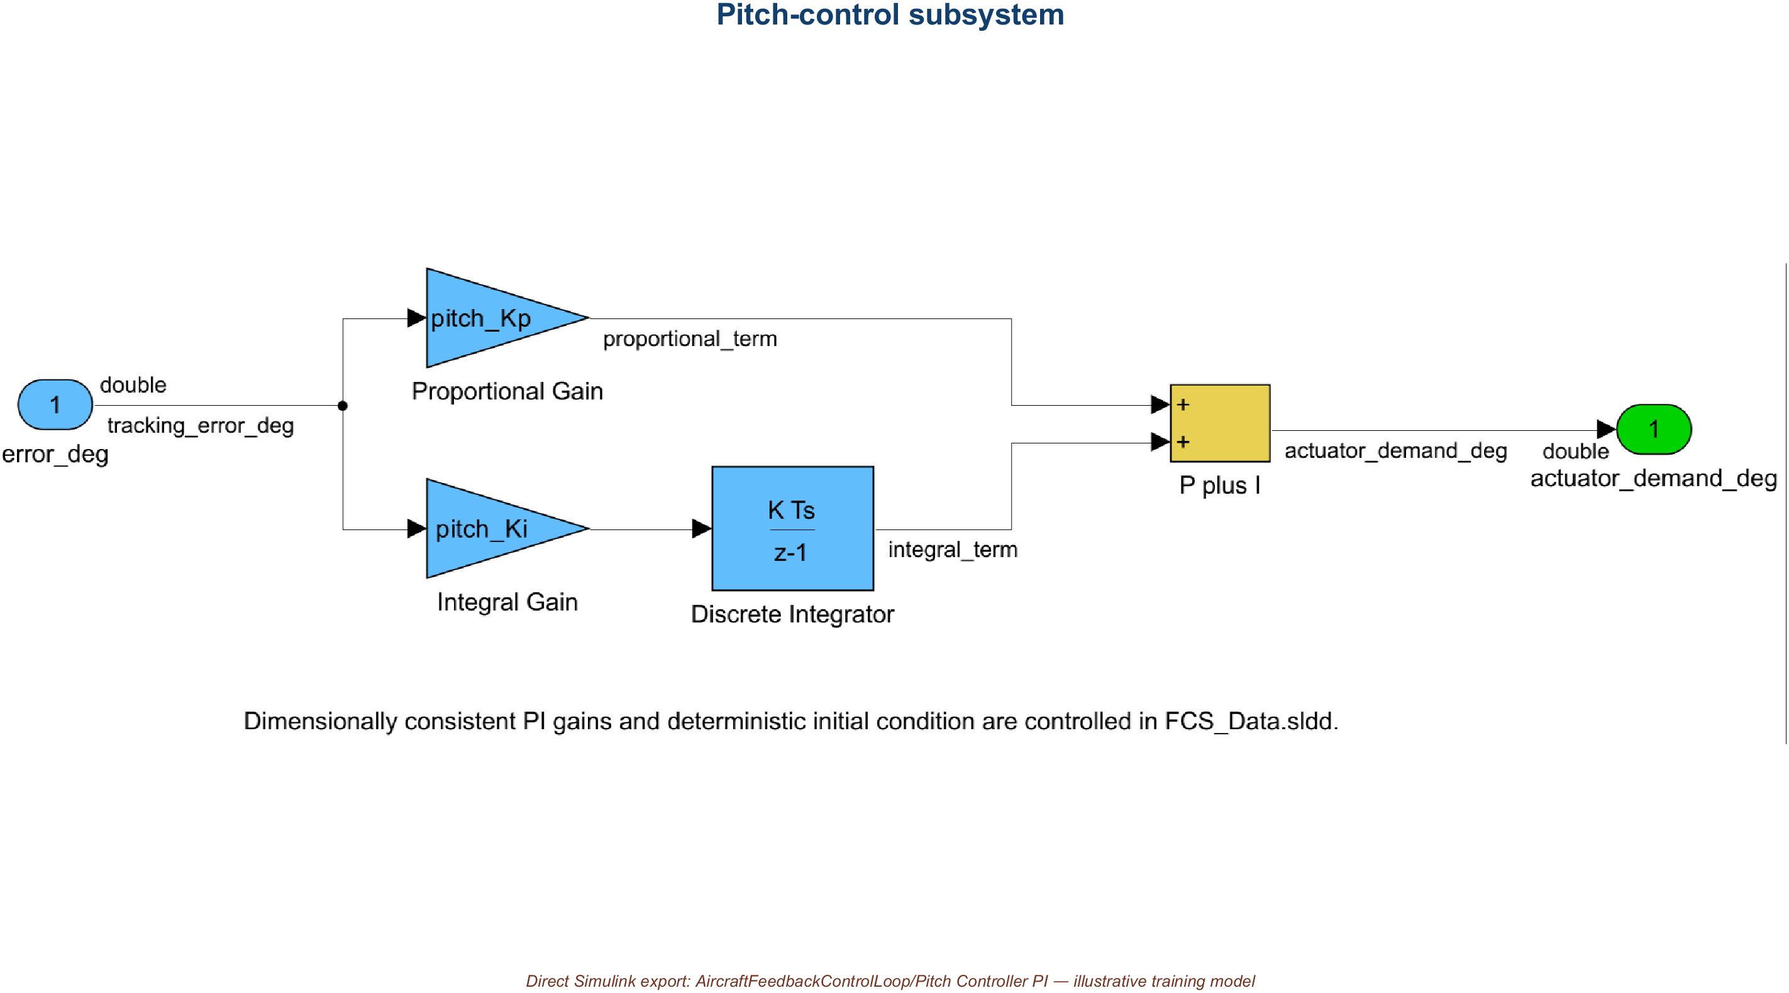
02 • MODEL HIERARCHY & GALLERY
Pitch Controller PI turns tracking error into demand
INTERNAL SUBSYSTEM
AircraftFeedbackControlLoop/Pitch Controller PI
AVIATION CONTROLS ENGINEERING ONBOARDING
16
Notes:
Timing: 2 minutes
Inside AircraftFeedbackControlLoop/Pitch Controller PI, identify proportional and integral paths and the discrete state. The separate subsystem boundary lets reviewers distinguish controller behavior from actuator saturation, plant dynamics, and sensing.
Caveats
- The gains and initial condition come from controlled training data and are not aircraft-program values.
[Sources]
- models/AircraftFeedbackControlLoop.slx
- screenshots/AircraftFeedback_PitchController.png
- data/FCS_Data.sldd

Slide 17
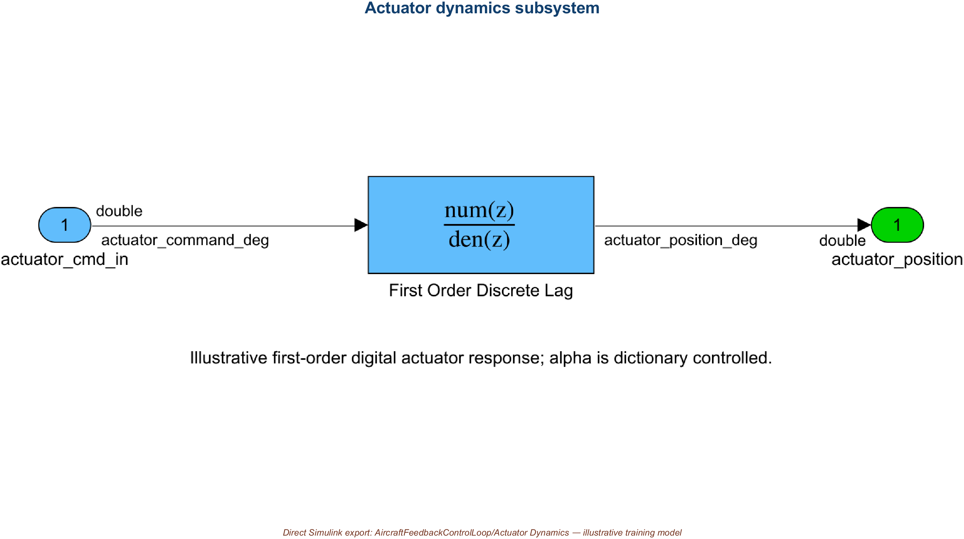
02 • MODEL HIERARCHY & GALLERY
Actuator Dynamics converts demand into position
INTERNAL SUBSYSTEM
AircraftFeedbackControlLoop/Actuator Dynamics
AVIATION CONTROLS ENGINEERING ONBOARDING
17
Notes:
Timing: 2 minutes
AircraftFeedbackControlLoop/Actuator Dynamics turns controller demand into a bounded, lagged actuator response. Point out where amplitude limiting and discrete dynamics enter, then connect those choices to explicit units, parameters, and initial state.
Caveats
- This actuator is an illustrative dynamic element, not a qualified actuator model or hardware measurement.
[Sources]
- models/AircraftFeedbackControlLoop.slx
- screenshots/AircraftFeedback_ActuatorDynamics.png
- data/FCS_Data.sldd

Slide 18
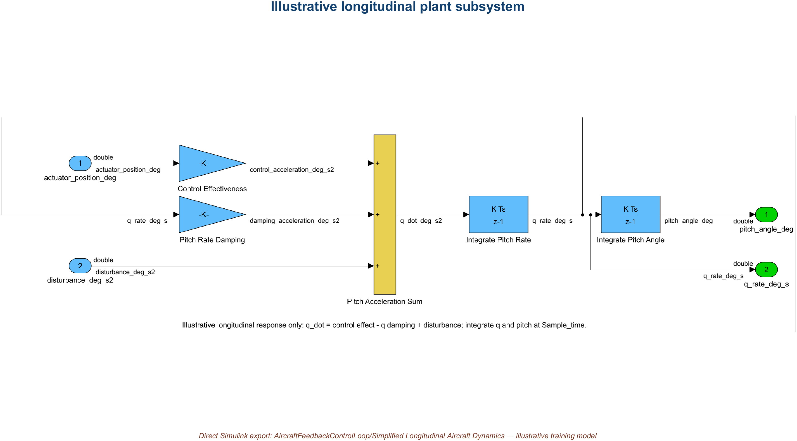
02 • MODEL HIERARCHY & GALLERY
Longitudinal dynamics turn actuator motion into response
INTERNAL SUBSYSTEM
AircraftFeedbackControlLoop/Simplified Longitudinal Aircraft Dynamics
AVIATION CONTROLS ENGINEERING ONBOARDING
18
Notes:
Timing: 2 minutes
AircraftFeedbackControlLoop/Simplified Longitudinal Aircraft Dynamics converts actuator command and disturbance into pitch-rate and pitch-angle response. Use the view to discuss state, feedback, and disturbance entry without treating the coefficients as validated aerodynamics.
Caveats
- The plant is intentionally simplified and unsuitable for aircraft-performance claims.
[Sources]
- models/AircraftFeedbackControlLoop.slx
- screenshots/AircraftFeedback_LongitudinalPlant.png
- data/FCS_Data.sldd

Slide 19
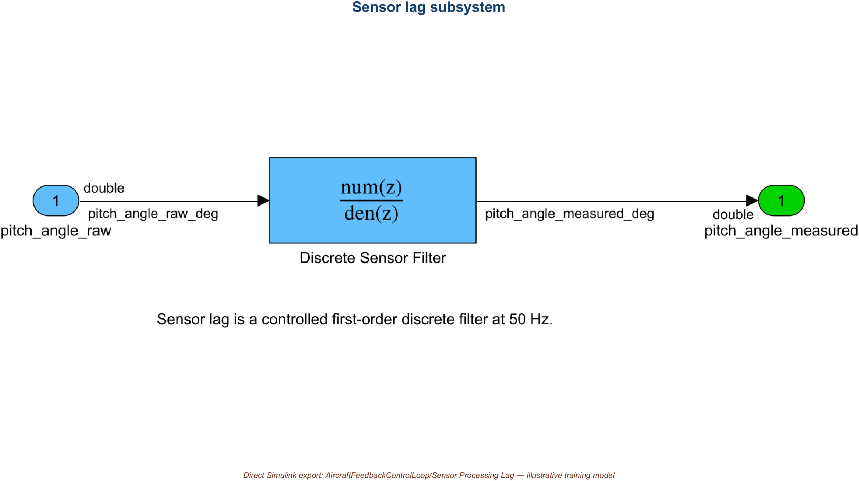
02 • MODEL HIERARCHY & GALLERY
Sensor Processing Lag exposes measurement dynamics
INTERNAL SUBSYSTEM
AircraftFeedbackControlLoop/Sensor Processing Lag
AVIATION CONTROLS ENGINEERING ONBOARDING
19
Notes:
Timing: 2 minutes
AircraftFeedbackControlLoop/Sensor Processing Lag closes the loop with a discrete filtered measurement. Ask learners to identify the filter state, controlled coefficient, initial condition, output unit, and relationship between model rate and apparent response delay.
Caveats
- A desktop sensor-lag model is not sensor qualification or bench evidence.
[Sources]
- models/AircraftFeedbackControlLoop.slx
- screenshots/AircraftFeedback_SensorProcessingLag.png
- data/FCS_Data.sldd

Slide 20
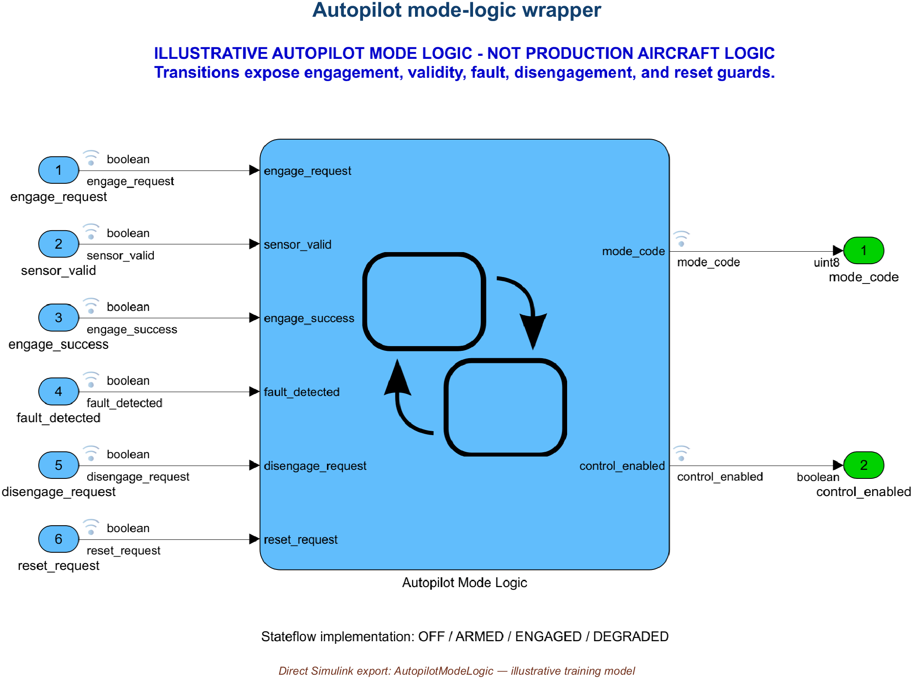
02 • MODEL HIERARCHY & GALLERY
AutopilotModeLogic wraps mode behavior in explicit interfaces
ROOT MODEL
models/AutopilotModeLogic.slx • separate Stateflow training model
AVIATION CONTROLS ENGINEERING ONBOARDING
20
Notes:
Timing: 2 minutes
At the AutopilotModeLogic root, identify external mode requests, validity and fault inputs, the Stateflow subsystem, and the documented mode output. The root view is the interface contract; the transition behavior is one level down.
Caveats
- The mode codes and transitions are illustrative classroom behavior, not an approved autopilot specification.
[Sources]
- models/AutopilotModeLogic.slx
- screenshots/AutopilotModeLogic_Model.png
- data/FCSMode.m

Slide 21
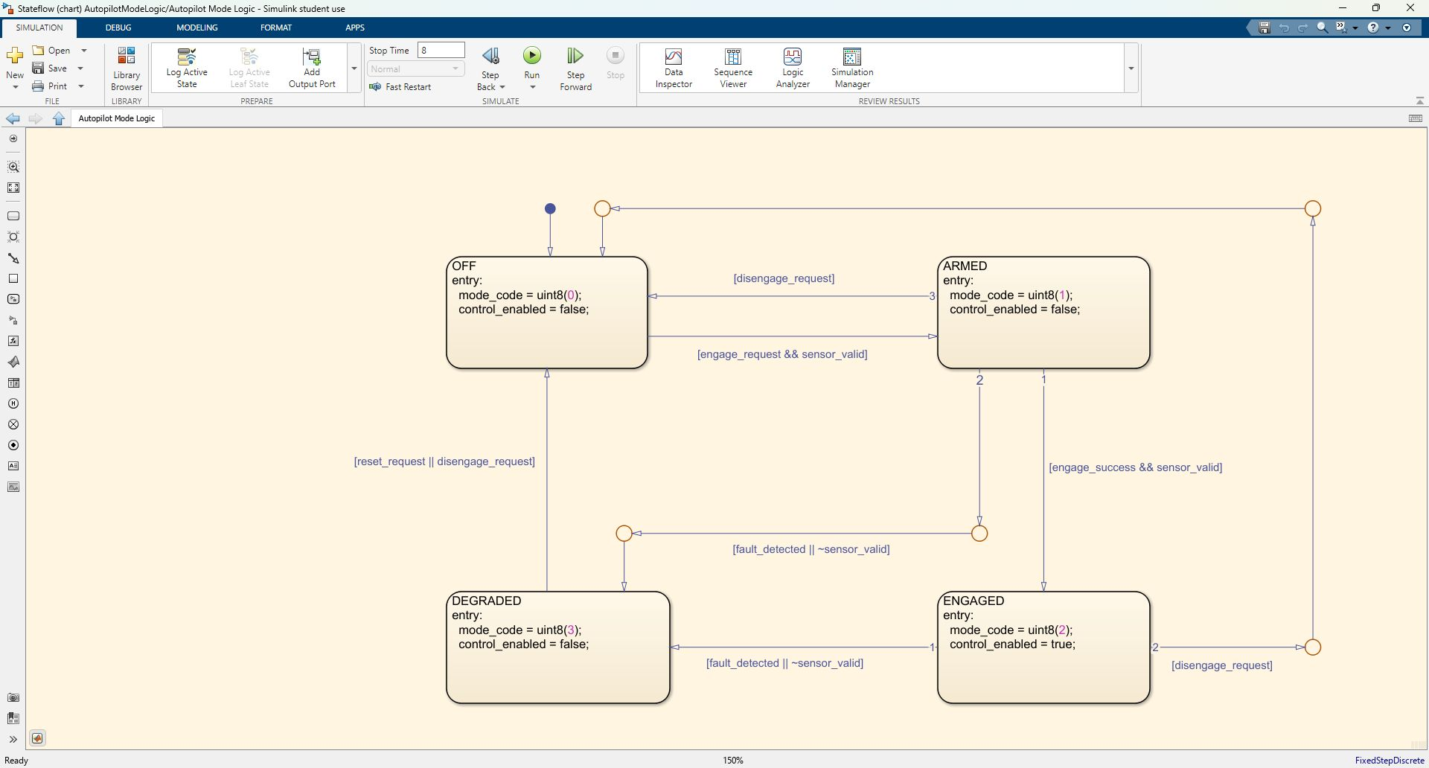
02 • MODEL HIERARCHY & GALLERY
Stateflow guards OFF, ARMED, ENGAGED, and DEGRADED
INTERNAL STATEFLOW VIEW
AutopilotModeLogic/Autopilot Mode Logic • Stateflow chart
AVIATION CONTROLS ENGINEERING ONBOARDING
21
Notes:
Timing: 2 minutes
Open AutopilotModeLogic/Autopilot Mode Logic and read OFF, ARMED, ENGAGED, and DEGRADED as executable state logic. Follow guards and reset paths, then relate them to the retained mode-sequence result rather than relying only on visual inspection.
Caveats
- The exact current block and chart name is Autopilot Mode Logic; do not prefix the saved path with Stateflow.
- A visited-state plot is evidence for this scenario, not exhaustive state or transition coverage.
[Sources]
- models/AutopilotModeLogic.slx
- screenshots/AutopilotModeLogic_Stateflow_Editor.jpg
- results/AutopilotModeSequence.csv
- https://www.mathworks.com/help/stateflow/state-transition-charts.html

Slide 22
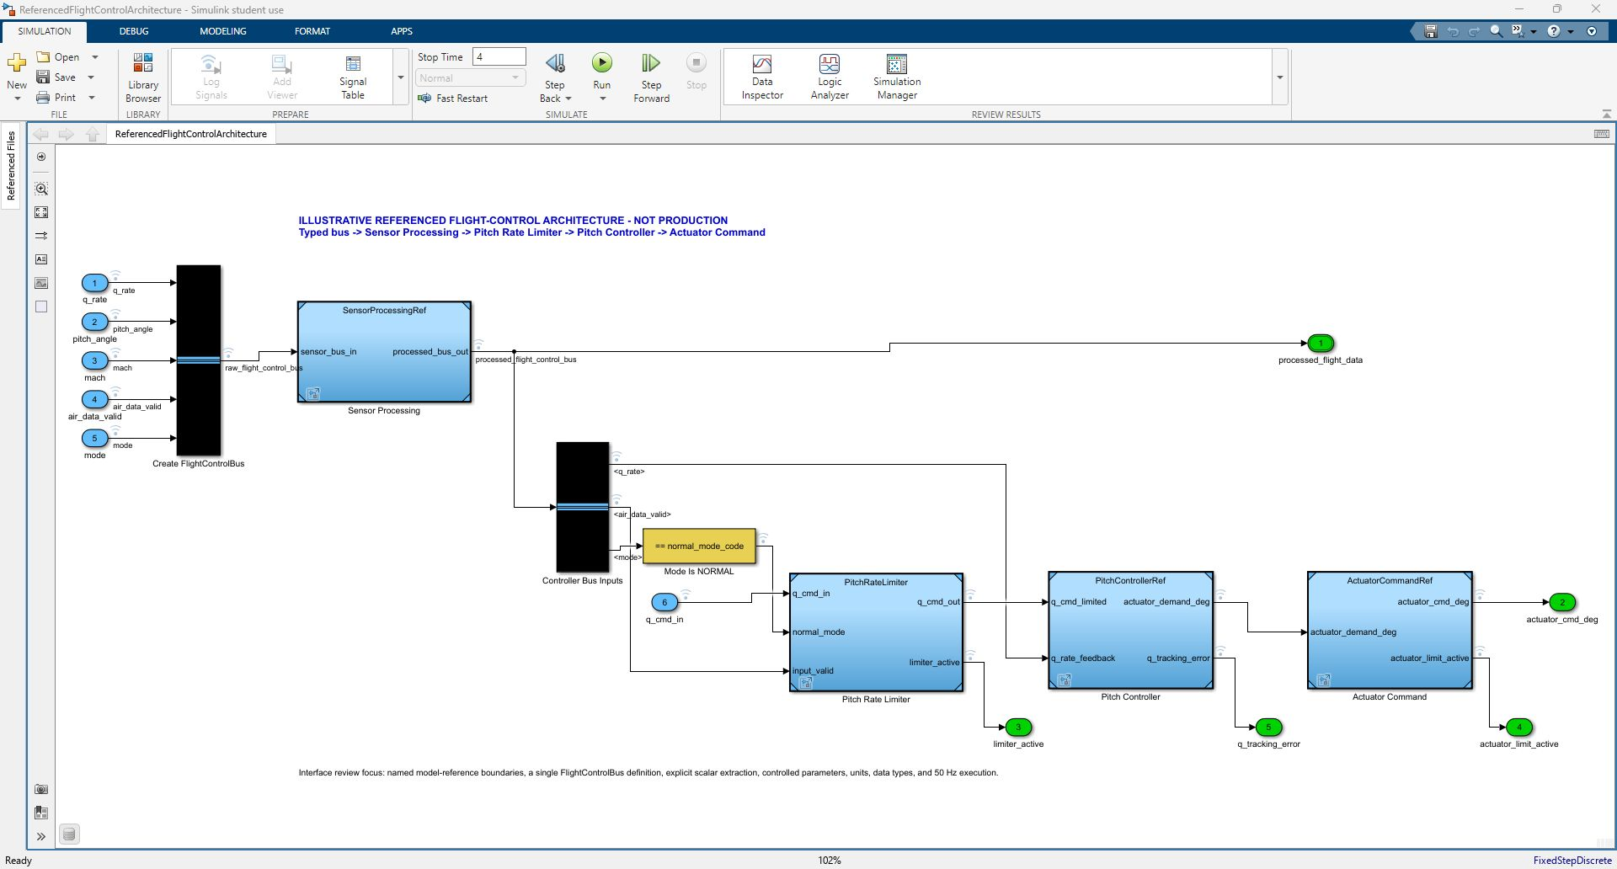
02 • MODEL HIERARCHY & GALLERY
ReferencedFlightControlArchitecture is the integration top level
INTEGRATION PARENT
models/ReferencedFlightControlArchitecture.slx • model-reference integration parent
AVIATION CONTROLS ENGINEERING ONBOARDING
22
Notes:
Timing: 3 minutes
ReferencedFlightControlArchitecture is the integration parent. It creates FlightControlBus, invokes Sensor Processing, Pitch Rate Limiter, Pitch Controller, and Actuator Command Model blocks, and exposes integrated outputs. Model-reference boundaries make ownership and interface compatibility reviewable.
Caveats
- The architecture update proves resolvable interfaces and configuration, not compliance with behavioral requirements.
- On the verified student license, Accelerator Model blocks fall back to Normal mode.
[Sources]
- models/ReferencedFlightControlArchitecture.slx
- screenshots/ReferencedFlightControlArchitecture_Editor.jpg
- results/ReferencedArchitecture_Validation.csv
- https://www.mathworks.com/help/simulink/ug/overview-of-model-referencing-1.html

Slide 23
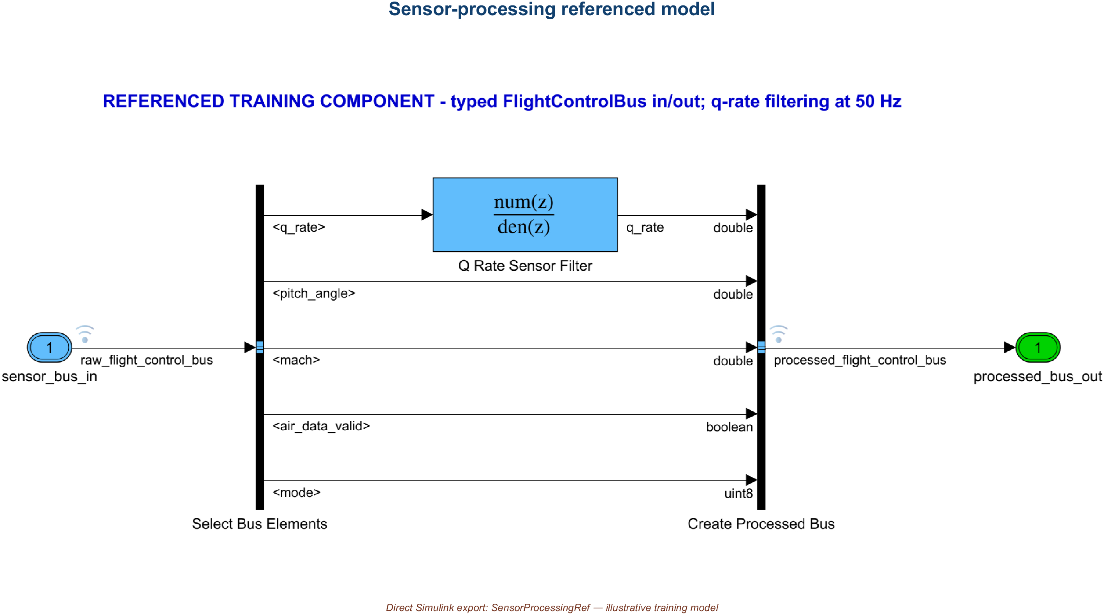
02 • MODEL HIERARCHY & GALLERY
SensorProcessingRef owns the referenced sensor contract
REFERENCED CHILD
models/SensorProcessingRef.slx
AVIATION CONTROLS ENGINEERING ONBOARDING
23
Notes:
Timing: 2 minutes
SensorProcessingRef is the referenced sensor-processing child. Review its FlightControlBus input and output, validity handling, filtering, and explicit interface rather than reading it as an isolated top-level simulation.
Caveats
- Its primary role here is a referenced integration component, not the standalone closed-loop entry point.
[Sources]
- models/SensorProcessingRef.slx
- screenshots/SensorProcessingRef_Model.png
- results/FlightControlBus_Inventory.csv

Slide 24
02 • MODEL HIERARCHY & GALLERY
PitchRateLimiter is a separately managed component
REFERENCED CHILD / COMPONENT
models/PitchRateLimiter.slx • standalone component and referenced child
AVIATION CONTROLS ENGINEERING ONBOARDING
24
Notes:
Timing: 2 minutes
PitchRateLimiter is both a reviewable component model and a referenced child. Its root exposes q_cmd_in, normal_mode, input_valid, q_cmd_out, and limiter_active at the controlled 50 Hz sample time, while implementation detail remains inside Pitch Rate Limiter Logic.
Caveats
- This is a magnitude limiter, not a slew-rate limiter.
- The values and requirements are illustrative training data.
[Sources]
- models/PitchRateLimiter.slx
- screenshots/PitchRateLimiter_Model.png
- docs/PitchRateLimiter_Requirements_Traceability.csv

Slide 25
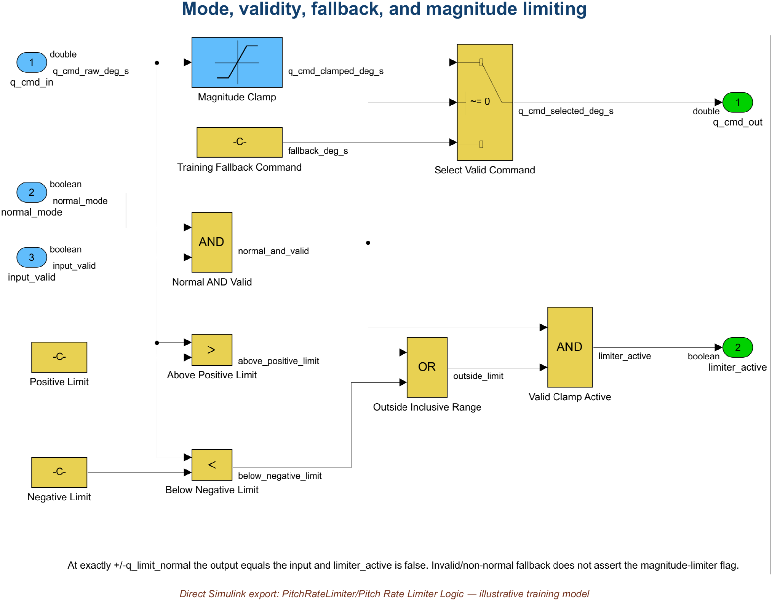
02 • MODEL HIERARCHY & GALLERY
Pitch Rate Limiter Logic clamps magnitude and controls fallback
INTERNAL SUBSYSTEM
PitchRateLimiter/Pitch Rate Limiter Logic
AVIATION CONTROLS ENGINEERING ONBOARDING
25
Notes:
Timing: 3 minutes
Inside PitchRateLimiter/Pitch Rate Limiter Logic, Magnitude Clamp applies the inclusive ±q_limit_normal bound; Normal AND Valid controls Select Valid Command; Training Fallback Command supplies zero; and the comparison and logic blocks form limiter_active. Use the exact block names because they anchor traceability.
Caveats
- Exactly ±12 deg/s is not clamped active; strictly outside the limits is active only during valid Normal operation.
- Do not describe Magnitude Clamp as rate-of-change limiting.
[Sources]
- models/PitchRateLimiter.slx
- screenshots/PitchRateLimiter_Implementation.png
- docs/PitchRateLimiter_Requirements_Traceability.csv

Slide 26
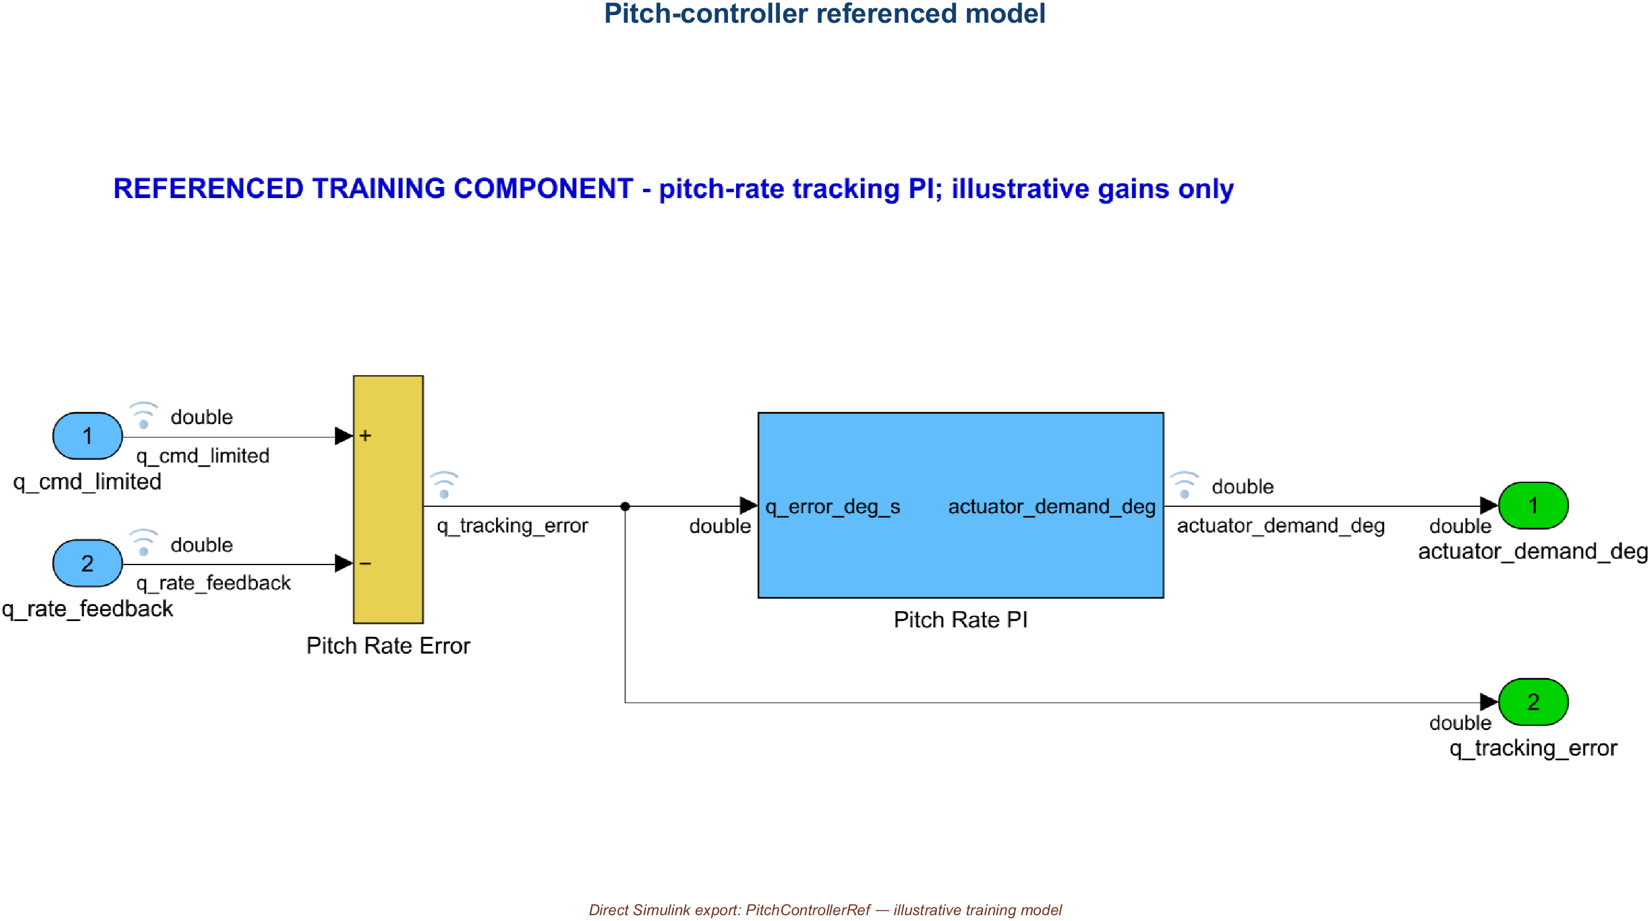
02 • MODEL HIERARCHY & GALLERY
PitchControllerRef defines the referenced controller boundary
REFERENCED CHILD
models/PitchControllerRef.slx
AVIATION CONTROLS ENGINEERING ONBOARDING
26
Notes:
Timing: 2 minutes
PitchControllerRef is the referenced controller child used by the integration parent. Its root contract accepts limited command and feedback and produces actuator demand and tracking error, separating interface review from the internal PI implementation.
Caveats
- Do not confuse this referenced child with AircraftFeedbackControlLoop/Pitch Controller PI; they are distinct saved artifacts.
[Sources]
- models/PitchControllerRef.slx
- screenshots/PitchControllerRef_Model.png

Slide 27
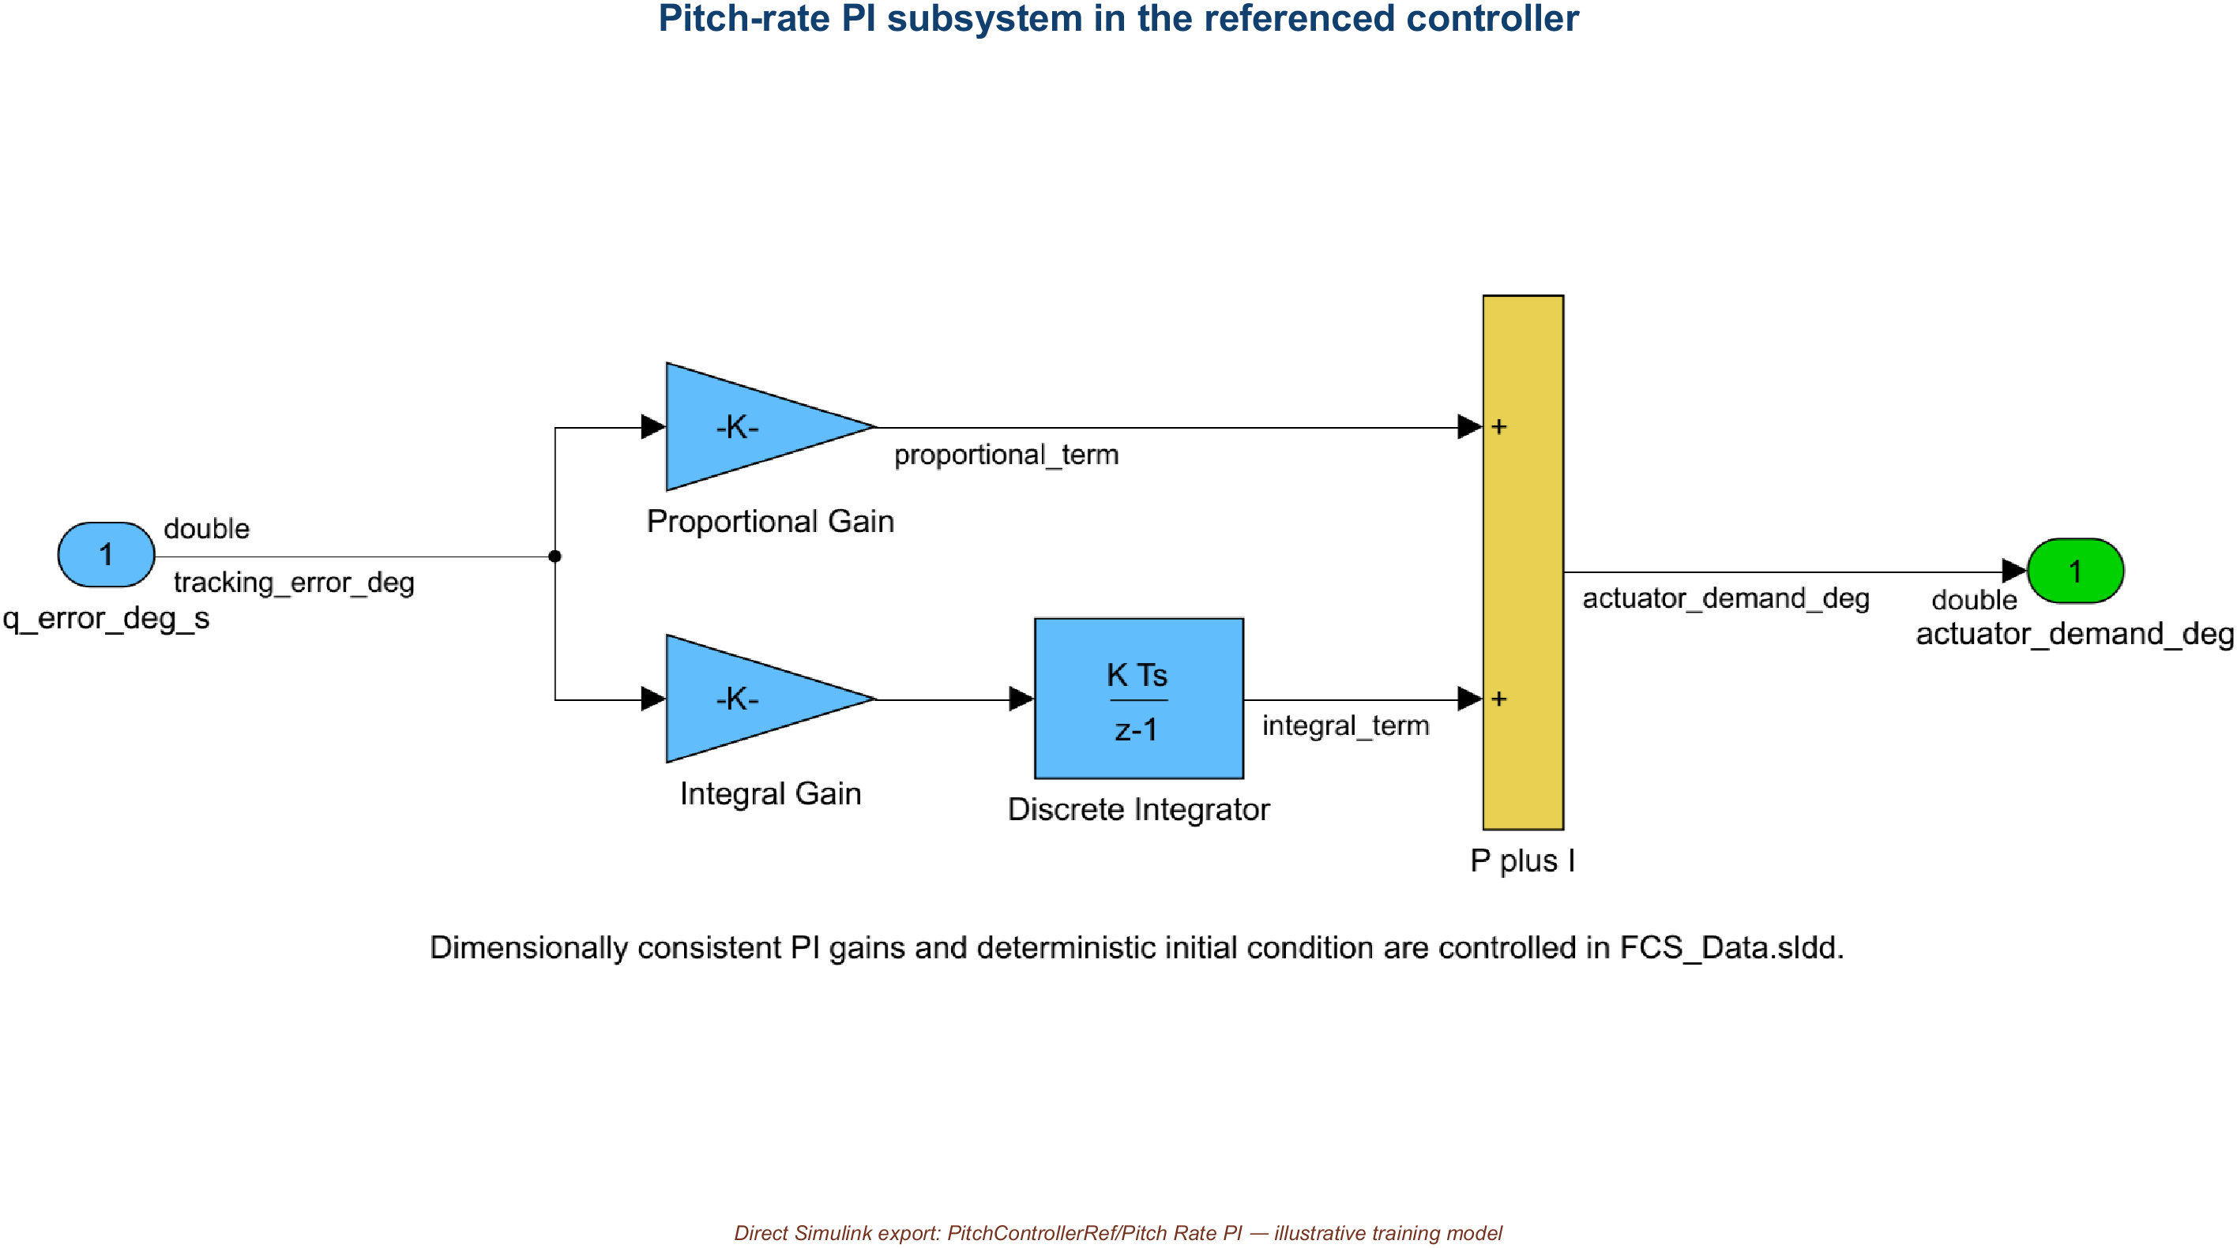
02 • MODEL HIERARCHY & GALLERY
Pitch Rate PI implements the referenced control law
INTERNAL SUBSYSTEM
PitchControllerRef/Pitch Rate PI
AVIATION CONTROLS ENGINEERING ONBOARDING
27
Notes:
Timing: 2 minutes
PitchControllerRef/Pitch Rate PI exposes the referenced controller's proportional and integral behavior. Review its error formation, gains, integrator state, and output contract, then return to the parent model to see how the component is connected.
Caveats
- The exact internal path is PitchControllerRef/Pitch Rate PI.
[Sources]
- models/PitchControllerRef.slx
- screenshots/PitchControllerRef_PitchRatePI.png
- data/FCS_Data.sldd

Slide 28
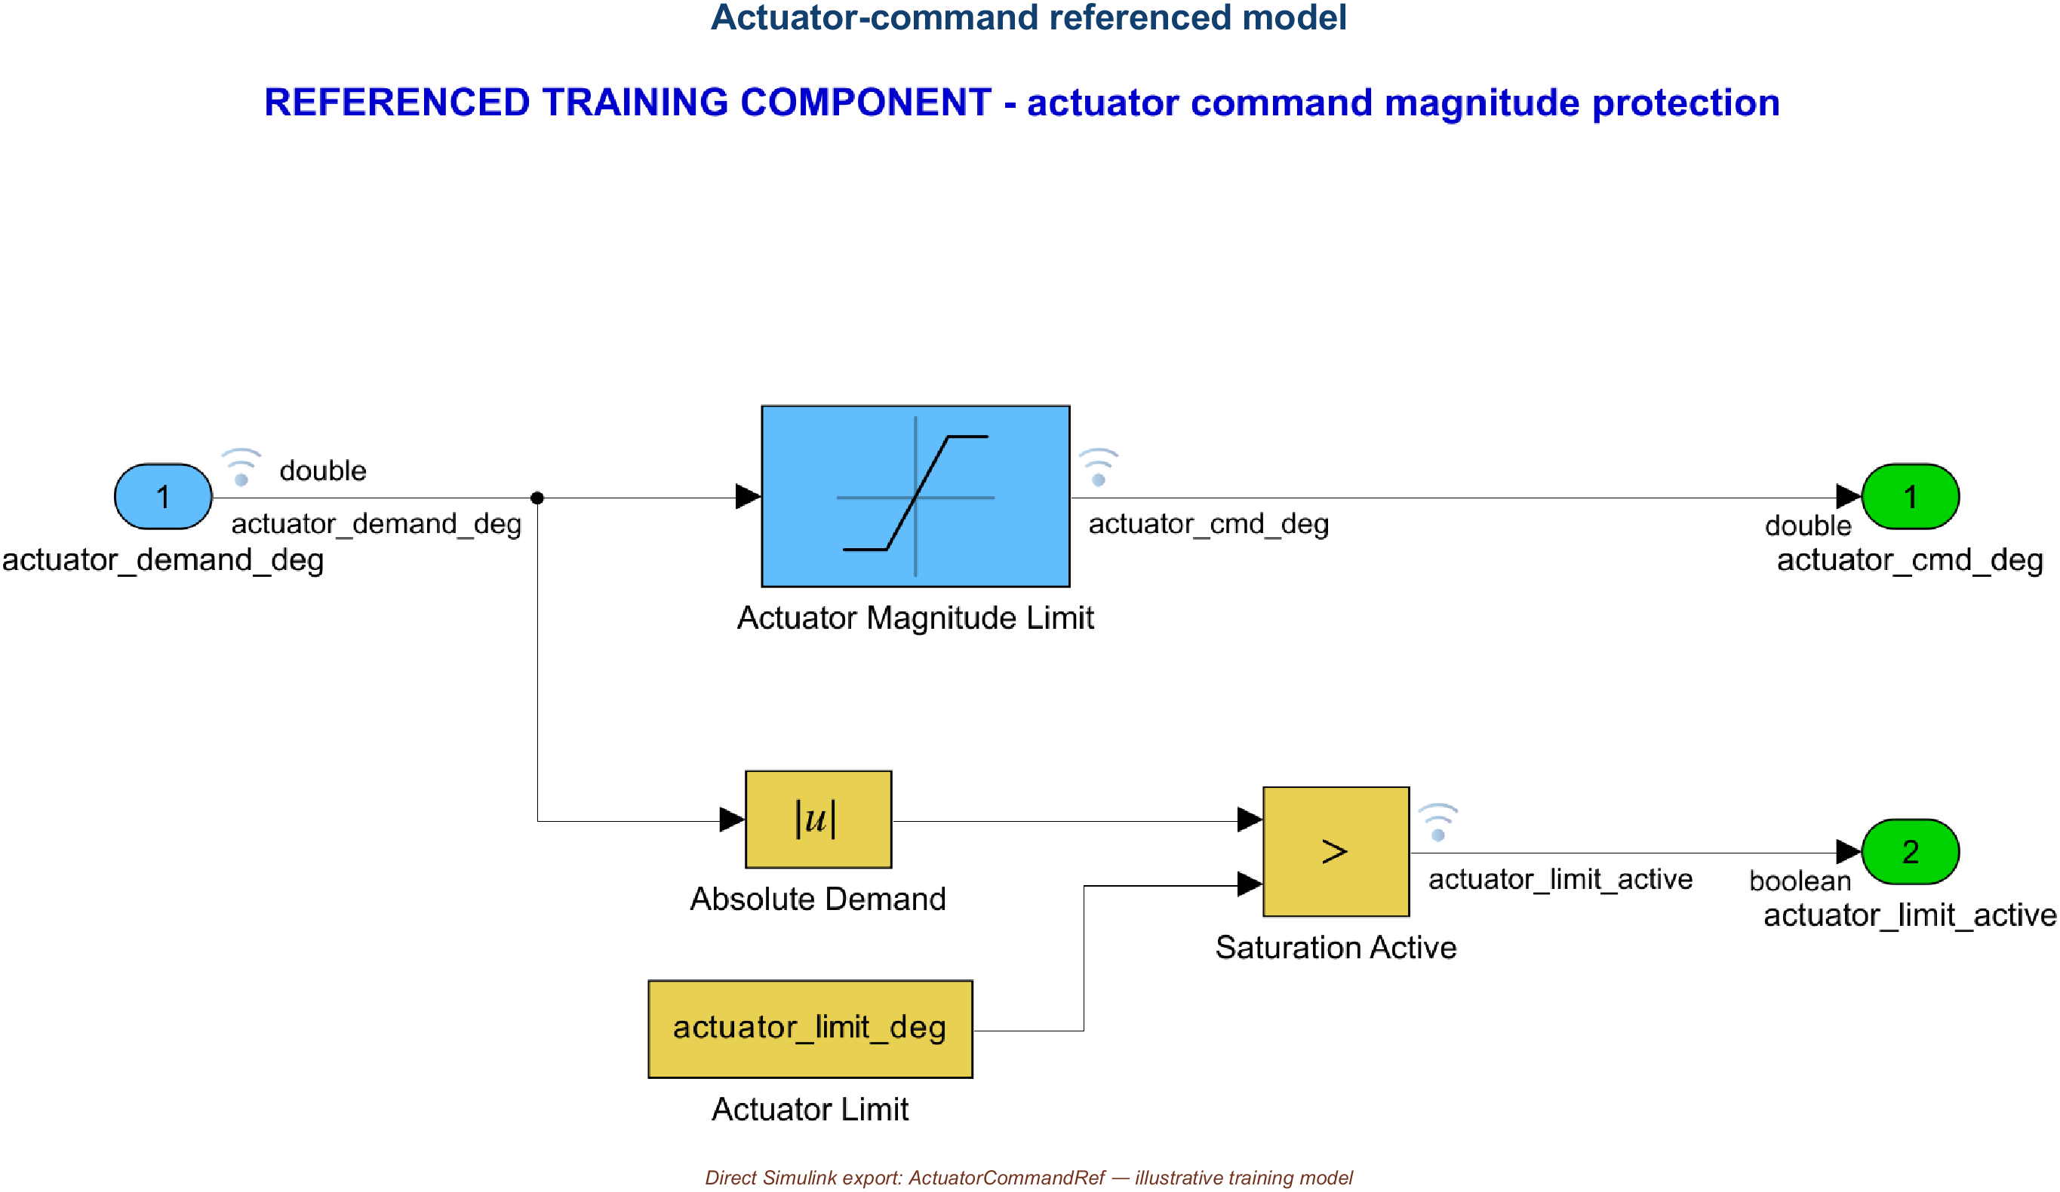
02 • MODEL HIERARCHY & GALLERY
ActuatorCommandRef owns command limiting and status
REFERENCED CHILD
models/ActuatorCommandRef.slx
AVIATION CONTROLS ENGINEERING ONBOARDING
28
Notes:
Timing: 2 minutes
ActuatorCommandRef is the referenced actuator-command child. It receives actuator demand and returns the bounded command plus an active-status output, making command limiting and status propagation explicit at the integration boundary.
Caveats
- This component demonstrates interface and command-processing patterns; it is not actual actuator hardware or HIL evidence.
[Sources]
- models/ActuatorCommandRef.slx
- screenshots/ActuatorCommandRef_Model.png

Slide 29
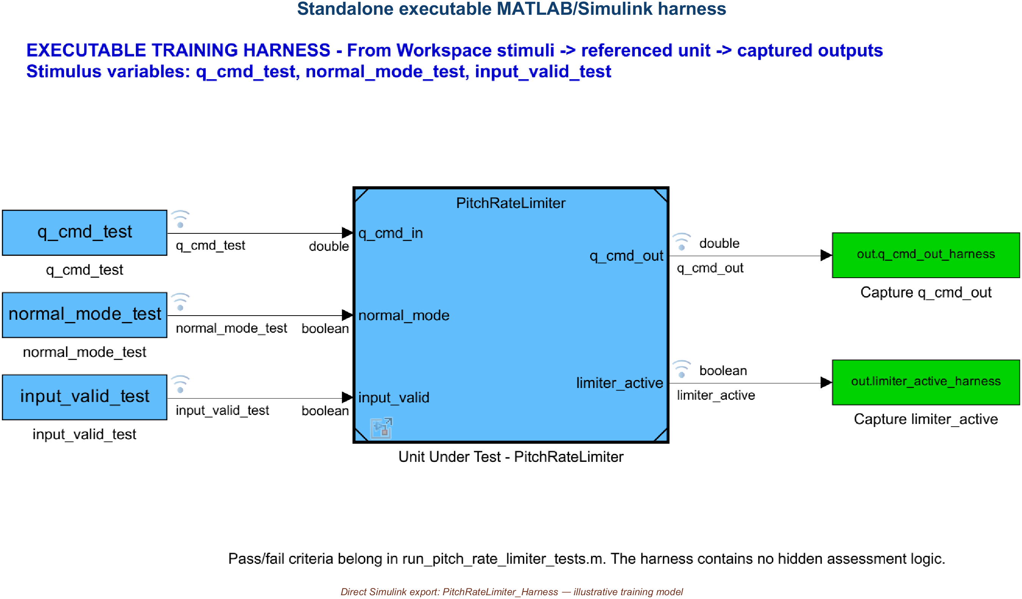
02 • MODEL HIERARCHY & GALLERY
PitchRateLimiter_Harness isolates the unit under test
q_cmd_test • normal_mode_test • input_valid_test ← created by scripts/run_pitch_rate_limiter_tests.m • no standalone stimulus file
AVIATION CONTROLS ENGINEERING ONBOARDING
29
Notes:
Timing: 3 minutes
PitchRateLimiter_Harness is an independent executable Simulink model. The three From Workspace blocks read q_cmd_test, normal_mode_test, and input_valid_test. The exact Model block Unit Under Test - PitchRateLimiter references PitchRateLimiter with SimulationMode=Normal, and To Workspace blocks capture q_cmd_out_harness and limiter_active_harness.
Caveats
- The real nineteen-point stimulus is created by run_pitch_rate_limiter_tests.m; it is not loaded from a standalone stimulus CSV.
- Pressing Run on the saved harness uses benign two-sample placeholders, not the retained assessment sequence.
- This is not a Simulink Test or Test Manager harness.
[Sources]
- models/PitchRateLimiter_Harness.slx
- screenshots/PitchRateLimiter_Harness.png
- scripts/run_pitch_rate_limiter_tests.m
- scripts/create_training_models.m

Slide 30
02 • HARNESS DEMO
The harness inputs come from one script and three timeseries
THREE PRIMARY ARTIFACTS IN THE HARNESS EXECUTION PATH
INJECTED INTO THE HARNESS MODEL WORKSPACE
data/FCS_Data.sldd
q_cmd_test • normal_mode_test • input_valid_test
1
Sample_time = 0.02 s
q_limit_normal = 12 deg/s
fallback = 0
THREE REPRESENTATIVE ROWS FROM THE 19-POINT SEQUENCE
scripts/run_pitch_rate_limiter_tests.m
t(s) q_cmd N V expected active
2
defines 19 rows
creates 3 timeseries
owns expected values + oracle
0.12 +12.0 1 1 +12.0 0
0.14 +12.1 1 1 +12.0 1
0.20 +8.0 1 0 0.0 0
3
models/PitchRateLimiter_Harness.slx
From Workspace → UUT
Model block in Normal simulation mode
To Workspace captures
N = Normal mode • V = Input valid
ONE 0.36 s DESKTOP-MIL RUN • 19 ASSESSED SAMPLE TIMES • NO STANDALONE STIMULUS CSV • NO TEST MANAGER SUITE
AVIATION CONTROLS ENGINEERING ONBOARDING
30
Notes:
Timing: 4 minutes
Show where the harness inputs actually come from. FCS_Data.sldd supplies the managed 0.02 second sample time, the twelve degree-per-second magnitude limit, and zero fallback. run_pitch_rate_limiter_tests.m defines nineteen rows, creates q_cmd_test, normal_mode_test, and input_valid_test timeseries, injects them into the harness model workspace, overrides stop time to 0.36 seconds, and simulates once. The harness consumes those variables and the MAT file retains all three input timeseries with the assessed outputs and summary.
Caveats
- Nineteen of nineteen means one deterministic desktop-MIL simulation assessed at nineteen sample times, not nineteen independent simulations.
- There is no standalone stimulus input file and no Test Manager suite file.
- The driver refreshes managed dictionary entries before execution; experiment only in an authorized copy.
[Sources]
- scripts/run_pitch_rate_limiter_tests.m
- models/PitchRateLimiter_Harness.slx
- data/FCS_Data.sldd
- results/PitchRateLimiter_TestResults.mat
- results/PitchRateLimiter_TestResults.csv

Slide 31
02 • HARNESS DEMO
In the harness, Ctrl+D validates the diagram; Ctrl+B crosses into build
ACTIVE MODEL MATTERS • UPDATE THE HARNESS; BUILD THE INTEGRATION TOP LEVEL FOR THIS EVIDENCE
Ctrl+D
Ctrl+B
UPDATE MODEL / DIAGRAM
BUILD ACTIVE MODEL
IN THE HARNESS
• evaluate parameters
• propagate types / dimensions / timing
• resolve PitchRateLimiter reference
• catch update-time errors
• do not advance simulation time
INTERACTIVE ACTION: Ctrl+B
• active model: ReferencedFlightControlArchitecture
• target: grt.tlc
• generate C + report
• compile/link top + four references
• create standalone Windows executable
RETAINED RESULT
8 / 8 delivered models updated / compiled
RETAINED SCRIPTED slbuild
PASS • 5 / 5 models • 1:56.965
PROVENANCE • Ctrl+B is the interactive analogue; retained evidence used scripted slbuild with the same active GRT configuration.
BOUNDARY • executable built, not run • no Embedded Coder / SIL / PIL / approval claim
AVIATION CONTROLS ENGINEERING ONBOARDING
31
Notes:
Timing: 4 minutes plus demonstration
In the harness, press Ctrl+D first. Update Model evaluates parameters, propagates data types, dimensions, and sample times, resolves the referenced component, and exposes update-time errors without advancing simulation time. The package validator used the equivalent SimulationCommand update and retains 8/8. Ctrl+B is the interactive target-dependent build action. The retained integration evidence used scripted slbuild with the same active ReferencedFlightControlArchitecture GRT configuration and generated and compiled five models: the top model plus four references.
Caveats
- Build the model that matches the task; building the harness is not the same as building the integration top level.
- The top executable was built but not run, SIL-tested, PIL-tested, or approved for production.
- One non-fatal warning disabled root-level Dataset output logging for the build; compile and link still completed.
[Sources]
- scripts/validate_training_project.m
- .codex/pptx_v7_build/build_top_level_evidence.m
- results/validation_summary.txt
- results/top_level_codegen_v7_evidence/ReferencedFlightControlArchitecture_slbuild.log
- https://www.mathworks.com/help/simulink/ug/using-the-sim-command.html
- https://www.mathworks.com/help/simulink/slref/slbuild.html

Slide 32
02 • BUILD DEMO
The retained top-level GRT build creates a traceable file tree
SELECTED BUILD OUTPUT
GENERATED TOP-MODEL C • LINES 8–19 + 25–28
top_level_codegen_v7_evidence/
├─ ReferencedFlightControlArchitecture_slbuild.log
├─ codegen/
│ ├─ ReferencedFlightControlArchitecture.exe
│ ├─ ReferencedFlightControlArchitecture_grt_rtw/
│ │ ├─ ReferencedFlightControlArchitecture.c
│ │ ├─ ReferencedFlightControlArchitecture.h
│ │ └─ html/index.html
│ └─ slprj/grt/
│ ├─ SensorProcessingRef/
│ ├─ PitchRateLimiter/
│ ├─ PitchControllerRef/
│ └─ ActuatorCommandRef/
└─ cache/ReferencedFlightControlArchitecture.slxc
* Code generation for model "ReferencedFlightControlArchitecture".
*
* Model version : 1.8
* Simulink Coder version : 23.2 (R2023b) 01-Aug-2023
* C source code generated on : Thu Aug 27 09:52:15 2026
*
* Target selection: grt.tlc
* Note: GRT includes extra infrastructure and instrumentation for prototyping
* Embedded hardware selection: Intel->x86-64 (Windows64)
* Code generation objectives: Unspecified
* Validation result: Not run
*/
⋮ editorial omission — source lines 20–24
#include "ActuatorCommandRef.h"
#include "PitchControllerRef.h"
#include "PitchRateLimiter.h"
#include "SensorProcessingRef.h"
Top source/report and a 192 KiB executable sit outside the four child slprj/grt targets.
BUILD_STATUS=PASS • top executable created • 5/5 models built • 0 already up to date • 1:56.965
Warning: Dataset root-output logging disabled; compile/link completed. Executable not run; code-generation validation not run; no SIL/PIL.
AVIATION CONTROLS ENGINEERING ONBOARDING
32
Notes:
Timing: 4 minutes
Read the retained build evidence from left to right. The selected tree identifies the stable build root, the standalone Windows executable, the top-model generated-code folder and report, the four referenced-child targets under slprj/grt, and the cache. The generated top-model C header records R2023b, grt.tlc, Windows x86-64, code-generation validation not run, and includes for all four referenced interfaces. The diary log records successful completion, 5 of 5 models built, zero models already up to date, and a duration of 1 minute 56.965 seconds. Ctrl+B is the interactive analogue; this retained run was produced by scripted slbuild.
Caveats
- The build produced a 196,608-byte executable; this deck does not claim that executable was run.
- GRT is a prototyping target, not Embedded Coder production-airborne output.
- Code-generation validation and Advisor checks were not run.
[Sources]
- .codex/pptx_v7_build/build_top_level_evidence.m
- results/top_level_codegen_v7_evidence/ReferencedFlightControlArchitecture_slbuild.log
- results/top_level_codegen_v7_evidence/codegen/ReferencedFlightControlArchitecture_grt_rtw/ReferencedFlightControlArchitecture.c
- results/top_level_codegen_v7_evidence/codegen/ReferencedFlightControlArchitecture_grt_rtw/html/index.html
- https://www.mathworks.com/help/simulink/slref/slbuild.html
- https://www.mathworks.com/help/rtw/ug/build-process-folders.html

Slide 33
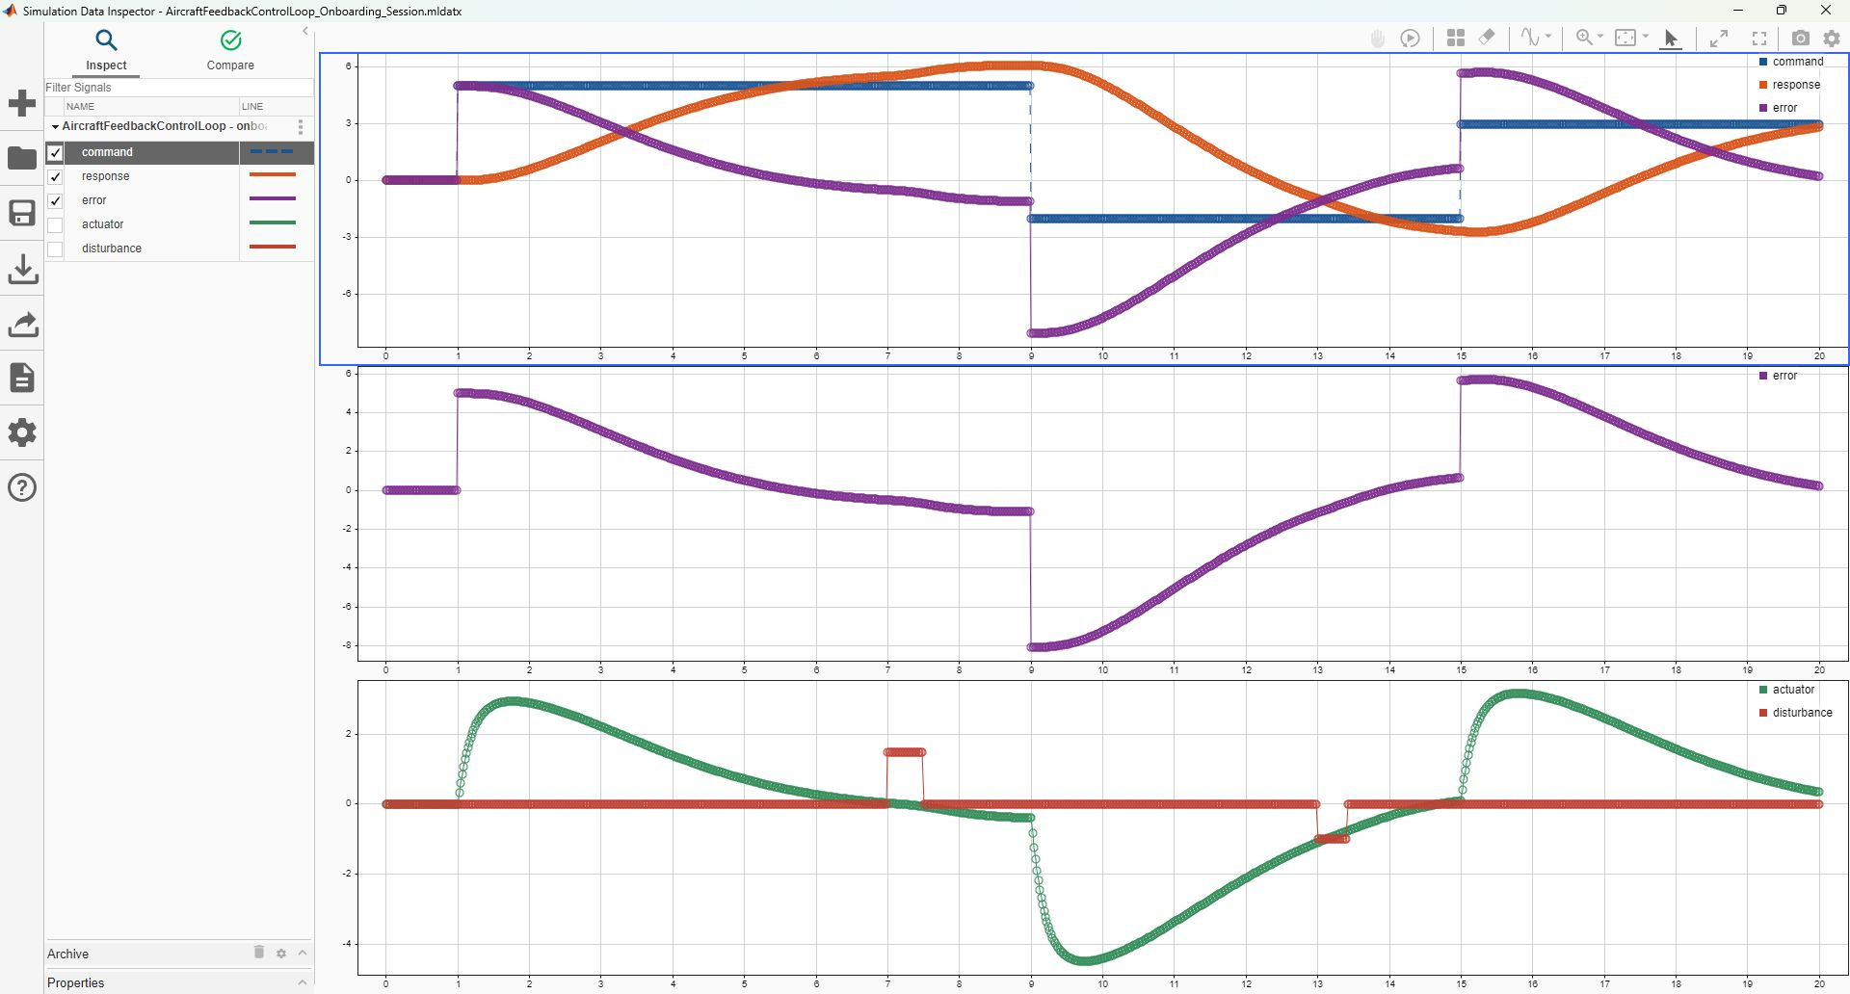
03 • SIMULATION DATA INSPECTOR
Data Inspector reveals one saved run
SAVED REFERENCE
1 RUN
5 SIGNALS
3 PLOTS
1001 POINTS / SIGNAL
0.02 s SPACING
View = layout / styling
Session = retained signal data
Both .mldatx files are SDI artifacts.
NEXT → READ THE CAUSAL STORY
AVIATION CONTROLS ENGINEERING ONBOARDING
33
Notes:
Timing: 3 minutes
This is an authentic Simulation Data Inspector capture of the saved AircraftFeedbackControlLoop onboarding reference run. The retained session contains one run, five signals, and a three-by-one layout. The saved view controls plot assignment, legends, grid, and markers; the saved session contains the signal data. Use this slide to orient to the UI, then use the next slide to read the causal behavior.
Caveats
- The two retained .mldatx files are SDI artifacts, not Simulink Test or Test Manager artifacts.
- Loading the reference session can replace current SDI state only when the caller explicitly permits it; the helper creates recoverable backups.
[Sources]
- screenshots/SimulationDataInspector_Onboarding.jpg
- data/SimulationDataInspector/AircraftFeedbackControlLoop_Onboarding_View.mldatx
- results/SimulationDataInspector/AircraftFeedbackControlLoop_Onboarding_Session.mldatx
- scripts/open_data_inspector_reference.m

Slide 34
03 • SIMULATION DATA INSPECTOR
Read the SDI run from command, to error, to control effort
TOP
command steps + dynamic response + model-logged tracking error
MIDDLE
logged error alone: jumps, decay, and overshoot become legible
BOTTOM
actuator effort beside disturbance timing: correlate cause and response
BOTTOM PLOT MIXES UNITS • actuator: deg • disturbance: deg/s² • compare timing/trend, not vertical magnitude
AVIATION CONTROLS ENGINEERING ONBOARDING
34
Notes:
Timing: 4 minutes
Read the three aligned plots as one story. The top plot overlays command, dynamic response, and the model-logged tracking error. The middle plot isolates that logged error so step jumps, decay, and overshoot are legible. The bottom plot places actuator effort beside disturbance timing so the learner can correlate cause and response. The saved run retains 1001 points per signal from zero to twenty seconds with 0.02-second point spacing.
Caveats
- Call Error_deg the model-logged tracking error; do not assume it is an independently recomputed same-row command minus response.
- The bottom plot overlays actuator degrees and disturbance degrees per second squared; compare timing and trend, not vertical magnitude.
- Use cursor measurements or the retained CSV for exact values rather than visual estimation alone.
[Sources]
- screenshots/SimulationDataInspector_Onboarding.jpg
- results/AircraftFeedback_CommandTracking.csv
- scripts/update_data_inspector.m
- scripts/run_training_simulations.m

Slide 35
04 • ASSURANCE CONTEXT
DO-178C defines objectives; DO-331 addresses model use
DO-178C
DO-331
Defines — objectives, activities, and life-cycle data
Scales — rigor according to software level
Covers — planning, development, verification, CM, QA, liaison
Supplements — DO-178C for model-based development and verification
Clarifies — model roles, model standards, verification, and traceability
Does not — make models or generated code automatically compliant
The project plans define whether a model is specification, design, source, or verification material—and which objectives apply.
AVIATION CONTROLS ENGINEERING ONBOARDING
35
Notes:
Timing: 3 minutes
FAA AC 20-115D recognizes DO-178C as an accepted means of compliance with applicable airworthiness regulations and recognizes DO-331 as its model-based development and verification supplement. Project plans determine how a model is used and which objectives and lifecycle data apply.
Caveats
- DO-178C is not a standalone software certificate.
- DO-331 supplements DO-178C; a Simulink model is not automatically compliant.
[Sources]
- https://www.faa.gov/regulations_policies/advisory_circulars/index.cfm/go/document.information/documentID/1032046
- https://www.faa.gov/documentLibrary/media/Order/FAA_Order_8110.49A.pdf

Slide 36
04 • ASSURANCE CONTEXT
Software levels scale rigor—and independence is planned
DO-178C SOFTWARE LEVEL
INDEPENDENCE IS OBJECTIVE-SPECIFIC
A
Catastrophic
highest applicable rigor + independence
PLANNED
Approved plans designate which verification objectives require independence.
B
Hazardous / Severe-Major
very high rigor
ROLE-BASED
C
Major
substantial verification rigor
Where required, the author is not the sole independent verifier of their own work.
D
Minor
reduced objective set
EVIDENCED
Review records identify the verifier, activity, baseline, findings, and disposition.
E
No Effect
no DO-178C objectives apply
Use “DO-178C Software Level A” unless discussing a broader system DAL allocation.
AVIATION CONTROLS ENGINEERING ONBOARDING
36
Notes:
Timing: 3 minutes
Software level originates in the system safety process and drives the applicable objective and independence framework. Say DO-178C Software Level A when discussing software; reserve DAL terminology for the broader system allocation context. Independence is planned for designated verification objectives and must be demonstrated through roles and evidence.
Caveats
- An author should not be the sole independent verifier of their own work where independence is required.
- A summary slide cannot replace the approved plans, certification basis, or objective tables.
[Sources]
- https://www.faa.gov/regulations_policies/advisory_circulars/index.cfm/go/document.information/documentID/1032046
- https://www.faa.gov/documentLibrary/media/Order/FAA_Order_8110.49A.pdf

Slide 37
04 • ASSURANCE CONTEXT
Traceability turns artifacts into evidence
Requirement
Model element
Test case
Verification result
BIDIRECTIONAL: every artifact has a reason to exist; every requirement has objective coverage
EVIDENCE PACKAGE
plans + standards
review records
test procedures + results
coverage + analyses
configuration + problem reports
Pipeline and test results are evidence inputs—not automatic approval.
AVIATION CONTROLS ENGINEERING ONBOARDING
37
Notes:
Timing: 3 minutes
Traceability is bidirectional: requirement to implementing artifact and objective verification, then result and model element back to justified intent. This package demonstrates that chain through a traceability CSV, an executable script, retained CSV/MAT results, and a human-readable report.
Caveats
- The package has no live Simulink Requirements links because Simulink Requirements is unavailable.
- A passing pipeline or test result is evidence input, not certification approval.
[Sources]
- docs/PitchRateLimiter_Requirements_Traceability.csv
- results/environment_inventory.txt
- https://www.faa.gov/documentLibrary/media/Order/FAA_Order_8110.49A.pdf
- https://www.mathworks.com/help/slrequirements/ug/create-and-store-links.html

Slide 38
04 • ASSURANCE CONTEXT
The V-model pairs every definition with verification
REQUIREMENTS ↔ BIDIRECTIONAL TRACEABILITY
MODEL-BASED · MATLAB / SIMULINK
INDEPENDENT VERIFICATION ACTIVITIES
INTEGRATION + EXECUTION ENVIRONMENTS
DEFINE + DECOMPOSE · REVIEW GATES G1–G5
PAIR EACH LEVEL
INTEGRATE + VERIFY + VALIDATE
System / engine
requirements
G1
System verification
+ validation
Software high-level
requirements (HLR)
G2
Software integration
verification
Software architecture / design
+ low-level requirements
G3
Component / unit
verification
Simulink models
+ C/H source code
G4
MIL / SIL · analysis
+ coverage
Executable
object code
G5
PIL / target · HIL / bench
+ system integration
CONTROLLED SOFTWARE BASELINE
configuration · trace links · review records
Agile changes the cadence; it does not remove ordered reviews, traceability, controlled baselines, or planned independence.
AVIATION CONTROLS ENGINEERING ONBOARDING
38
Notes:
Timing: 3 minutes
Use the V-model as a relationship map between definition, realization, and verification rather than as a mandate for one schedule. Agile and waterfall can both organize compliant work, but cadence never removes lifecycle data, traceability, reviews, configuration control, baselines, problem reporting, or required independence.
Caveats
- Process labels do not establish compliance; approved plans and objective evidence do.
[Sources]
- https://www.nasa.gov/reference/systems-engineering-handbook/
- https://www.faa.gov/documentLibrary/media/Order/FAA_Order_8110.49A.pdf

Slide 39
05 • REQUIREMENTS & TRACEABILITY
Illustrative requirements make the training chain explicit
SYSTEM
PSYS-001
Before the pitch controller, constrain a valid Normal-mode pitch-rate command to |q_cmd| ≤ 12 deg/s; otherwise substitute 0 deg/s.
SOFTWARE HLR SWHLR-001 / PRL-001
When normal_mode and input_valid are true, q_cmd_out = min(max(q_cmd_in, −12), +12); otherwise q_cmd_out = 0 deg/s.
SOFTWARE LLR / DESIGN SWLLR-001
Magnitude Clamp applies ±q_limit_normal; Normal AND Valid drives Select Valid Command; Training Fallback Command is 0 deg/s.
STATUS + TIMING PRL-003 / PRL-004
limiter_active is true only outside ±12 during valid Normal mode; the component updates at 50 Hz with no added state dynamics.
Illustrative classroom requirements — not production aircraft data or an approved certification baseline.
AVIATION CONTROLS ENGINEERING ONBOARDING
39
Notes:
Timing: 3 minutes
Walk from the classroom system intent through a software HLR and an implementation-oriented LLR or design statement. Connect the inclusive ±12 deg/s behavior, zero fallback, limiter status, and 50 Hz execution to PRL-001 through PRL-005 and the exact saved blocks.
Caveats
- Illustrative classroom requirements — not production aircraft data or an approved certification baseline.
- PSYS-001, SWHLR-001, and SWLLR-001 are presentation-level classroom mappings; the repository traceability CSV contains PRL-001 through PRL-005.
[Sources]
- docs/PitchRateLimiter_Requirements_Traceability.csv
- models/PitchRateLimiter.slx
- https://www.faa.gov/regulations_policies/advisory_circulars/index.cfm/go/document.information/documentID/1032046

Slide 40
05 • REQUIREMENTS & TRACEABILITY
One limiter requirement traces to one executed result
1 • SYSTEM
2 • SOFTWARE HLR
3 • SOFTWARE LLR
4 • MODEL ELEMENT
PSYS-001
command-path protection
→
SWHLR-001 / PRL-001
inclusive ±12 deg/s allocation
→
SWLLR-001
apply the magnitude clamp
→
PitchRateLimiter/Pitch Rate Limiter Logic/Magnitude Clamp
↓
8 • ASSOCIATION
7 • ITERATION 8
6 • EXECUTED CASE
5 • HARNESS
←
PRL-001, PRL-003, PRL-004
trace backward to intent
←
input 12.1 • expected 12 • actual 12
error 0 • tolerance 1e-9 • PASS
←
run_pitch_rate_limiter_tests.m
“Boundary above upper limit”
PitchRateLimiter_Harness/Unit Under Test - PitchRateLimiter
VISIBLE RESULT • t = 0.14 s • normal_mode = true • input_valid = true • limiter_active expected/actual = true • every recorded check passed
Desktop Simulink model execution (MIL); not SIL, PIL, or HIL.
Traceability is demonstrated through CSV, script, model-path, and result associations—not live Simulink Requirements links.
AVIATION CONTROLS ENGINEERING ONBOARDING
40
Notes:
Timing: 4 minutes
Read the chain in both directions: PSYS-001 to SWHLR-001 / PRL-001 to SWLLR-001 to PitchRateLimiter/Pitch Rate Limiter Logic/Magnitude Clamp to PitchRateLimiter_Harness/Unit Under Test - PitchRateLimiter to run_pitch_rate_limiter_tests.m, case Boundary above upper limit, to retained Iteration 8. The row records input 12.1 deg/s, expected 12, actual 12, zero numeric error, tolerance 1e-9, and PASS.
Caveats
- Desktop Simulink model execution (MIL); not SIL, PIL, or HIL.
- The literal AssociatedRequirement value is: PRL-001 magnitude limiting; PRL-003 status; PRL-004 50 Hz execution.
- The PSYS/SWHLR/SWLLR identifiers are illustrative mappings layered over the retained PRL association.
[Sources]
- docs/PitchRateLimiter_Requirements_Traceability.csv
- scripts/run_pitch_rate_limiter_tests.m
- results/PitchRateLimiter_TestResults.csv
- results/PitchRateLimiter_TestResults.mat

Slide 41
06 • VERIFICATION WORKFLOW
The harness sits inside a controlled relative-file flow
1
INITIALIZE
2
DEFINE + INJECT
3
EXECUTE
initialize_training_data.m
restores managed SLDD entries
→
run_pitch_rate_limiter_tests.m
19 rows + 3 timeseries + oracle
→
PitchRateLimiter_Harness.slx
From Workspace → referenced UUT
4
CAPTURE
5
ASSESS
6
RETAIN
q_cmd_out_harness
limiter_active_harness
→
3 row checks
+ suite-level 50 Hz spacing
→
CSV • MAT • HTML • PNG
MAT also retains 3 input timeseries
MANUAL HARNESS RUN ≠ RETAINED SUITE • saved model uses two-sample placeholders
Execute run_pitch_rate_limiter_tests(projectRoot) to refresh the baseline, inject the 19-point sequence, simulate once, and write evidence.
AVIATION CONTROLS ENGINEERING ONBOARDING
41
Notes:
Timing: 3 minutes
Follow the controlled relative-file flow. initialize_training_data restores managed dictionary entries. run_pitch_rate_limiter_tests defines the nineteen-row stimulus, creates and injects three timeseries, and owns the visible oracle. PitchRateLimiter_Harness contains the From Workspace sources and referenced unit under test. The driver captures outputs and stores four pass fields per row: three row-specific checks plus one suite-level 50 Hz spacing result repeated on all nineteen rows. It writes CSV, MAT, HTML, and PNG, and the MAT file also retains qCommandInput, normalModeInput, and inputValidInput.
Caveats
- The generated CSV, MAT, HTML, and PNG come from one execution; they are multiple views of the same run, not independent experiments.
- The saved harness manual-Run placeholders do not reproduce the nineteen-point suite.
[Sources]
- scripts/initialize_training_data.m
- scripts/run_pitch_rate_limiter_tests.m
- models/PitchRateLimiter_Harness.slx
- results/PitchRateLimiter_TestResults.mat
- reports/PitchRateLimiter_TestReport.html

Slide 42
06 • VERIFICATION WORKFLOW
Strong tests target boundaries, modes, failures, and timing
TEST CLASS
PITCH-RATE-LIMITER EXAMPLE
WHAT IT PROVES
Nominal
q_cmd = +5.0 → +5.0 deg/s
no unnecessary modification
Boundary
−12.0 and +12.0 → unchanged
inclusive limits
Just outside
−12.1 → −12.0; +12.1 → +12.0
correct clamping
Mode / invalid
Normal false or input invalid → specified fallback
guard and degraded behavior
Timing
step and transient inputs at 50 Hz
same-frame response / no overrun
Add combinations when requirements interact: mode × validity × boundary × schedule breakpoint.
AVIATION CONTROLS ENGINEERING ONBOARDING
42
Notes:
Timing: 3 minutes
The 19-case matrix covers initialization, nominal values, inclusive boundaries, just-outside and large magnitudes, invalid or non-Normal fallback, transitions, limiter_active, timestamps, and 50 Hz spacing. Each case records actual and expected outputs rather than relying on a visual waveform judgment.
Caveats
- The PRL-004 traceability CSV says timing within 1e-12 s, while the executable uses max(1e-12, Sample_time × 1e-9), which is 2e-11 s at 0.02 s. The retained observed step is exactly 0.02 s and passes, but do not claim the script used a 1e-12 timing tolerance without reconciling the sources.
- The numeric output tolerance is consistently 1e-9 deg/s.
[Sources]
- scripts/run_pitch_rate_limiter_tests.m
- results/PitchRateLimiter_TestResults.csv
- docs/PitchRateLimiter_Requirements_Traceability.csv

Slide 43
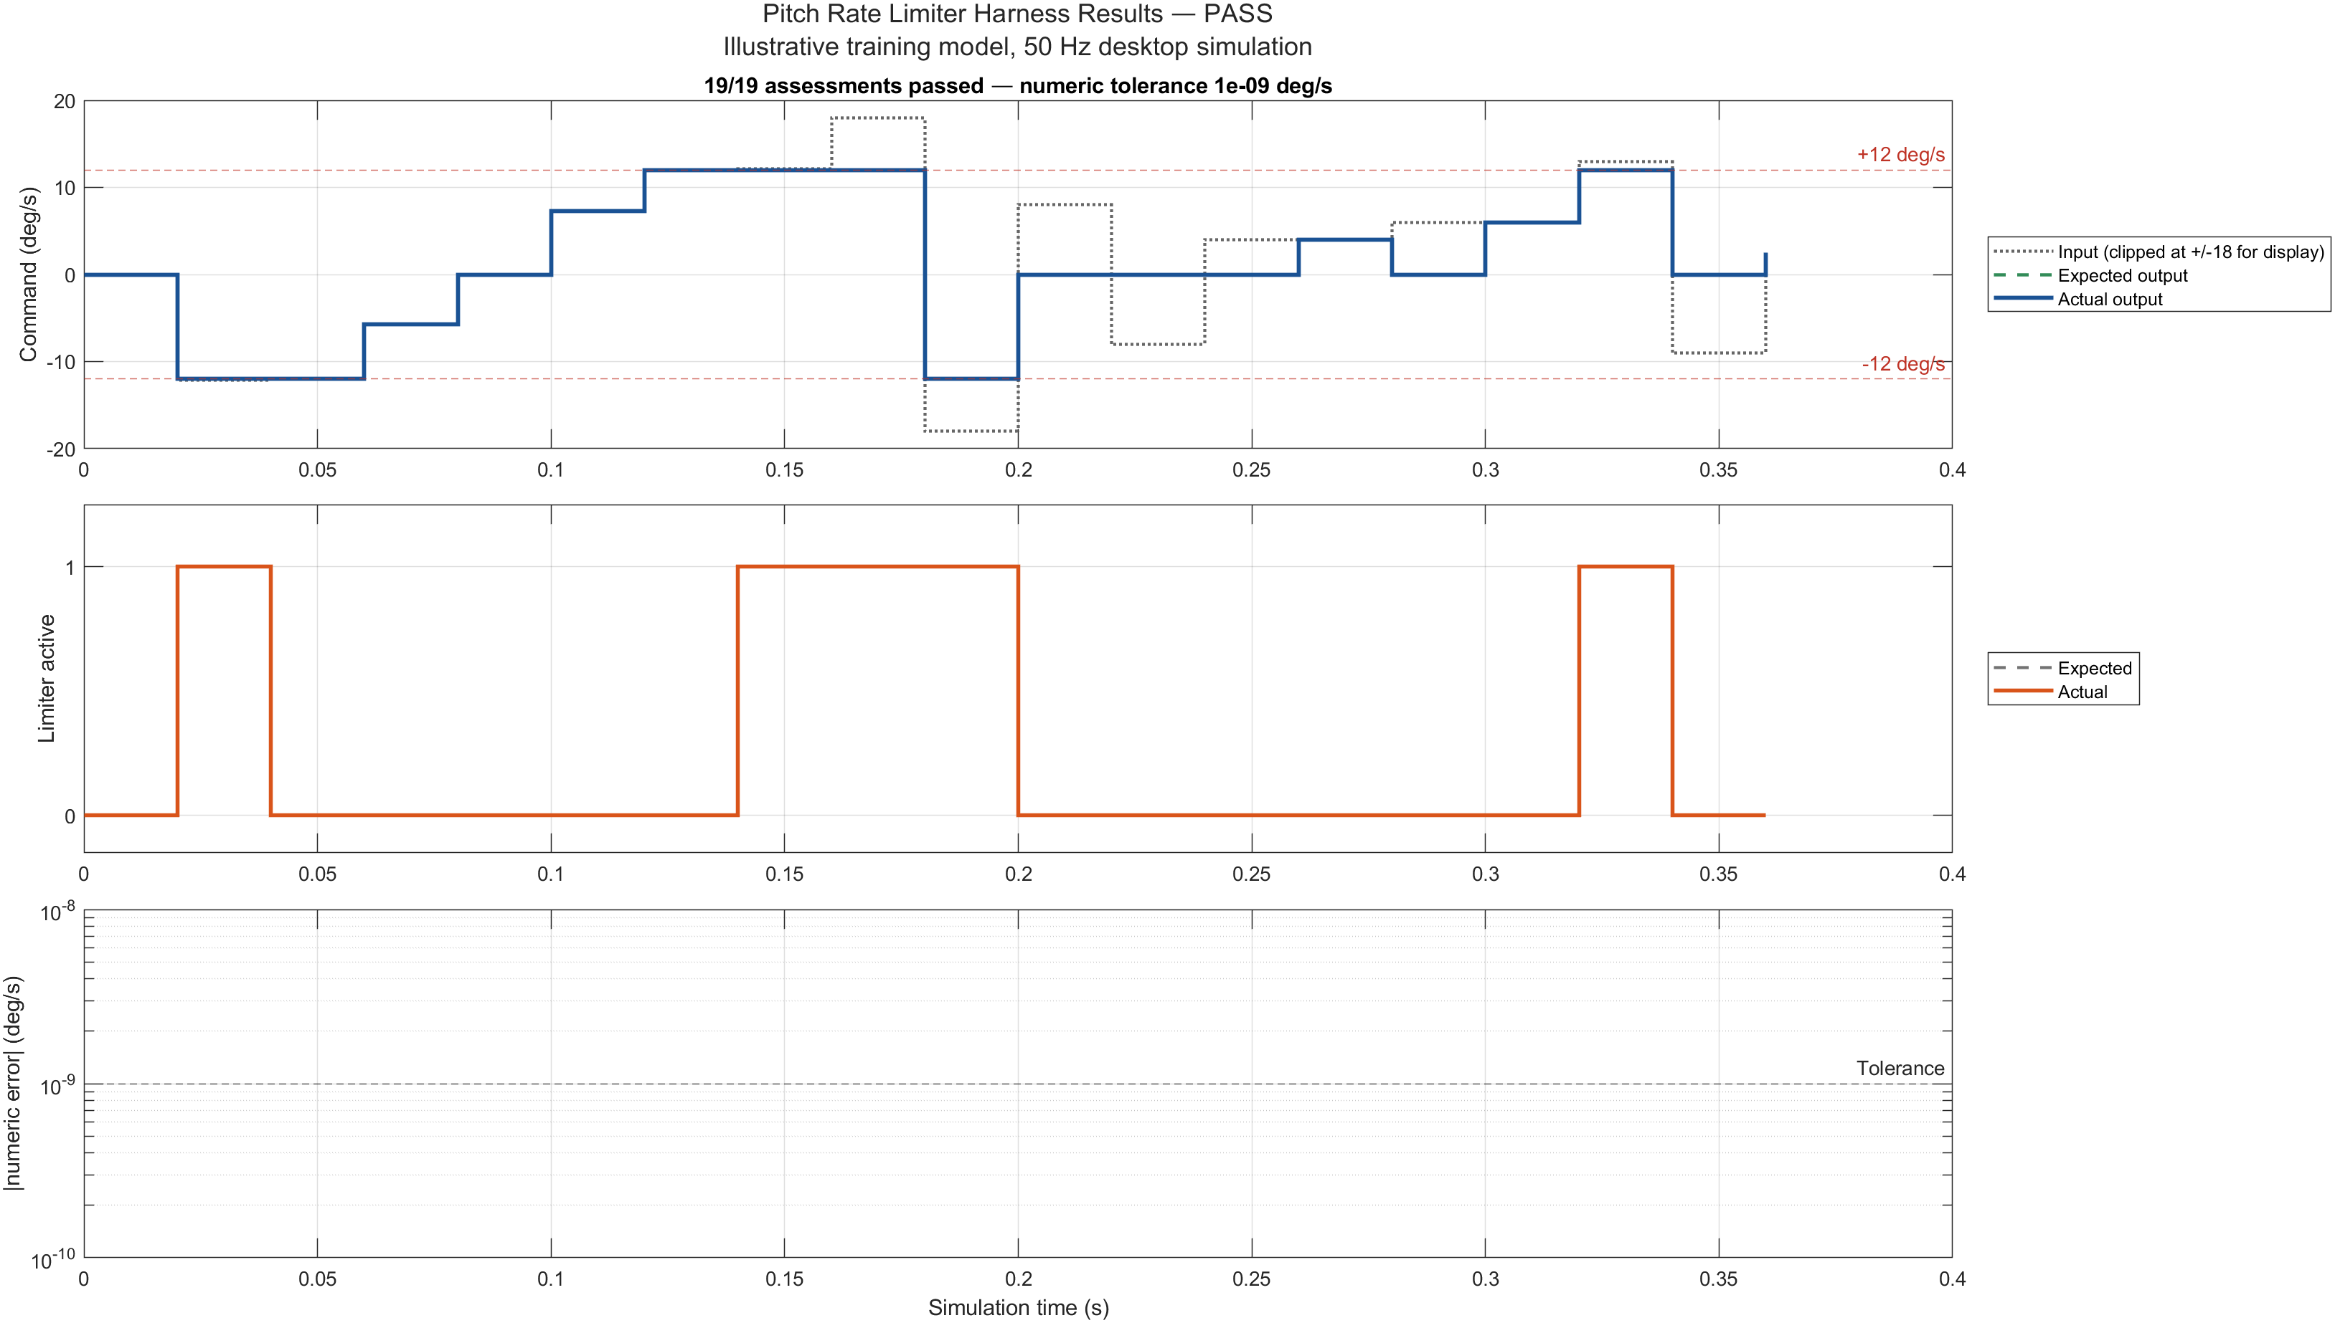
06 • VERIFICATION WORKFLOW
The limiter suite retains 19 passing assessments
19 / 19
ASSESSED SAMPLE TIMES
PASSED
one 0.36 s MIL run
0.02 s point spacing
0 failed rows
3 row checks:
numeric • active • timestamp
+ suite timing copied to rows
NEXT → READ ALL THREE PANELS
Executable MATLAB assessment of a standalone Simulink harness • not 19 independent simulations • not Test Manager
AVIATION CONTROLS ENGINEERING ONBOARDING
43
Notes:
Timing: 3 minutes
State the retained result precisely. One deterministic 0.36-second desktop-MIL simulation was assessed at nineteen 50 Hz sample times. Every row retains true NumericPass, LimiterActivePass, TimestampPass, and Timing50HzPass fields; the first three are row-specific, while the single suite-level 50 Hz spacing result is copied to every row. The CSV, MAT, HTML, and PNG are retained views produced by the same driver execution. Use the next slide to interpret each plot rather than relying only on the 19/19 badge.
Caveats
- This is not nineteen independent simulations and not a Simulink Test or Test Manager suite.
- The graph is supporting evidence; the row-level CSV/MAT checks determine the retained pass status.
[Sources]
- results/PitchRateLimiter_TestResults.csv
- results/PitchRateLimiter_TestResults.mat
- reports/PitchRateLimiter_TestReport.html
- reports/PitchRateLimiter_TestReport.png
- scripts/run_pitch_rate_limiter_tests.m

Slide 44
06 • VERIFICATION WORKFLOW
Read the 19-case result plot from top to bottom
TOP • OUTPUT
Input is clipped to ±18 only for display. Expected and actual overlap; valid Normal-mode inputs clamp at ±12, otherwise fallback is 0.
MIDDLE • ACTIVE
Expected and actual limiter state overlap. True only when Normal + valid + strictly outside ±12; inclusive ±12 is inactive.
BOTTOM • ERROR
Absolute error vs 1e-9 on a log axis. Every error is exactly zero, so no positive trace can be drawn—blank is not missing data.
1 initialization • 4 boundary • 4 nominal • 2 large magnitude • 3 fallback • 5 mode transitions
Each row retains 3 row-specific pass fields + the suite-level Timing50HzPass copied to all 19 rows.
AVIATION CONTROLS ENGINEERING ONBOARDING
44
Notes:
Timing: 4 minutes
Read the result plot top to bottom. The top panel clips only the displayed input to plus or minus eighteen so the plus and minus one-thousand cases remain readable; expected and actual outputs overlap, valid Normal-mode commands clamp at plus or minus twelve, and invalid or disabled rows use zero fallback. The middle panel shows expected and actual limiter_active overlapping; active is true only when Normal and valid are true and the input is strictly outside the inclusive limits. The bottom panel is absolute numeric error on a log axis against 1e-9. Every retained error is exactly zero, so no positive error trace can appear on the log axis. Each row retains three row-specific pass fields plus the suite-level timing result.
Caveats
- A visually blank bottom panel means zero positive error values in this retained run, not missing data.
- The executable timing tolerance is 2e-11 seconds while the traceability CSV states 1e-12; exact 0.02-second spacing passes either value, so the retained result is unaffected.
- Use shows or retains evidence of, not proves certification compliance.
[Sources]
- reports/PitchRateLimiter_TestReport.png
- results/PitchRateLimiter_TestResults.csv
- scripts/run_pitch_rate_limiter_tests.m
- docs/PitchRateLimiter_Requirements_Traceability.csv

Slide 45
06 • VERIFICATION WORKFLOW
Callbacks create context; the test driver owns the oracle
TWO SEPARATE EXECUTION PATHS • DO NOT DRAW A PIPELINE BETWEEN THEM
CALLBACK EXAMPLE
RETAINED LIMITER ASSESSMENT
1 callback_workflow_example.m
1 initialize_training_data.m
↓
↓
2 preload calls setup when context is absent
2 create + inject 3 test timeseries
↓
↓
3 setup creates Dataset/context; preload stores state
3 simulate PitchRateLimiter_Harness once
↓
↓
4 postload configures standalone PitchRateLimiter
4 assess outputs + status + time + suite spacing
↓
↓
5 optional standalone simulation
5 retain CSV • MAT • HTML • PNG
NO HARNESS DRIVER • NO ORACLE • NO EVIDENCE REPORT
run_pitch_rate_limiter_tests.m OWNS ORACLE + EVIDENCE
KEY DISTINCTION • callback_workflow_example.m never invokes run_pitch_rate_limiter_tests.m
AVIATION CONTROLS ENGINEERING ONBOARDING
45
Notes:
Timing: 3 minutes
Keep the two execution paths separate. The callback example calls training_callback_preload. When context is absent, preload calls training_callback_setup; setup creates the Dataset and context, and preload stores the returned state. training_callback_postload then configures the standalone PitchRateLimiter model, and the example may optionally simulate it. That lane does not invoke the retained harness driver and does not own an oracle or evidence report. Separately, run_pitch_rate_limiter_tests initializes the baseline, creates and injects q_cmd_test, normal_mode_test, and input_valid_test into PitchRateLimiter_Harness, simulates once, assesses the results, and retains CSV, MAT, HTML, and PNG.
Caveats
- The test driver is not invoked by callback_workflow_example.m.
- The deterministic callback Dataset is created by training_callback_setup.m; preload obtains and stores that context.
- Callbacks create context; the retained driver owns the assessment oracle and evidence files.
[Sources]
- scripts/callback_workflow_example.m
- scripts/training_callback_preload.m
- scripts/training_callback_setup.m
- scripts/training_callback_postload.m
- scripts/run_pitch_rate_limiter_tests.m

Slide 46
06 • VERIFICATION WORKFLOW
FCS_Data.sldd controls shared parameters and interfaces
31 DESIGN DATA ENTRIES • 26 Simulink.Parameter • 4 Simulink.Signal • 1 Simulink.Bus
REPRESENTATIVE SHARED DEFINITIONS
FlightControlBus • FIVE SCALAR ELEMENTS
Sample_time
0.02 s
50 Hz base rate
q_rate
double • deg/s
measured pitch rate
q_limit_normal
12 deg/s
inclusive magnitude limit
pitch_angle
double • deg
measured pitch attitude
q_fallback_command
0 deg/s
disabled / invalid fallback
mach
double • 1
pitch_Kp / pitch_Ki
0.6 (1) / 0.025 (1/s)
feedback-controller gains
illustrative Mach number
air_data_valid
boolean • 1
actuator_limit_deg
20 deg
illustrative command limit
validity flag
normal_mode_code
uint8(2)
ENGAGED training code
mode
uint8 • 1
0 OFF • 1 ARMED • 2 ENGAGED • 3 DEGRADED
WHAT IS DEFINED HERE → HOW TO OPEN AND QUERY IT ON THE NEXT SLIDE
AVIATION CONTROLS ENGINEERING ONBOARDING
46
Notes:
Timing: 3 minutes
FCS_Data.sldd is the shared Design Data source. The current dictionary contains thirty-one entries: twenty-six Simulink.Parameter objects, four Simulink.Signal objects, and one Simulink.Bus. Representative values include Sample_time 0.02 seconds, q_limit_normal 12 degrees per second, and q_fallback_command zero. FlightControlBus defines five scalar elements—q_rate, pitch_angle, mach, air_data_valid, and mode—with controlled types, units, dimensions, and descriptions. The next slide shows how to open and query them.
Caveats
- A dictionary and bus define controlled data and structure; they do not by themselves prove semantic correctness.
- The values are illustrative classroom data, not production aircraft data.
[Sources]
- data/FCS_Data.sldd
- results/FCS_DataDictionary_Inventory.csv
- results/FlightControlBus_Inventory.csv
- scripts/initialize_training_data.m
- https://www.mathworks.com/help/simulink/ug/what-is-a-data-dictionary.html
- https://www.mathworks.com/help/simulink/slref/simulink.bus.html

Slide 47
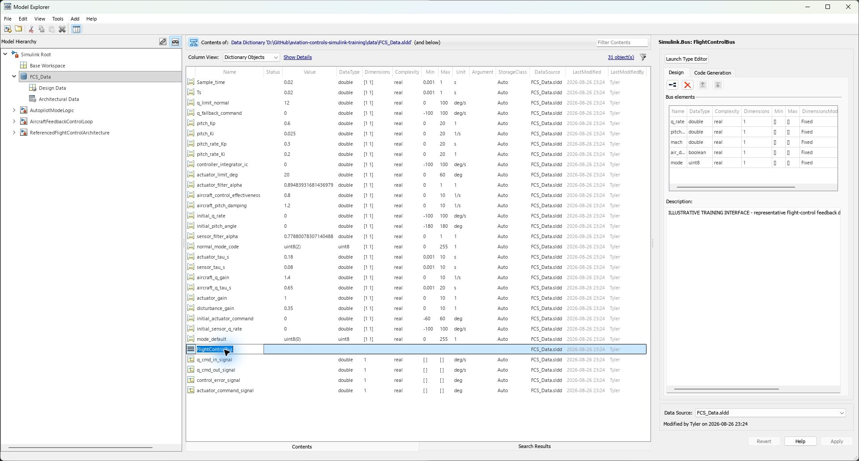
06 • VERIFICATION WORKFLOW
Open FCS_Data.sldd, then inspect FlightControlBus
HOW TO ACCESS IT
1 INITIALIZE
add scripts, models, data
run initialize_training_data(projectRoot)
2 GUI
open data/FCS_Data.sldd
Model Explorer → Design Data
select FlightControlBus
3 MATLAB API
dd = Simulink.data.dictionary.open( ...
'data/FCS_Data.sldd');
sec = getSection(dd,'Design Data');
4 REVIEW
results/FCS_DataDictionary_Inventory.csv
results/FlightControlBus_Inventory.csv
INSPECTION VIEW • initialization writes/restores managed classroom entries; experiment only in an authorized copy
AVIATION CONTROLS ENGINEERING ONBOARDING
47
Notes:
Timing: 4 minutes plus demonstration
Use the authentic Model Explorer capture to locate the dictionary and inspect FlightControlBus. Add scripts, models, and data to the MATLAB path, run initialize_training_data(projectRoot), and open data/FCS_Data.sldd in Model Explorer. In the Design Data section, select FlightControlBus to inspect its five elements. The MATLAB API reaches the same entries through Simulink.data.dictionary.open, getSection, getEntry, and getValue. Retained CSV inventories provide readable review views.
Caveats
- Initialization restores the scripted classroom baseline for managed names; make experiments only in an authorized copy.
- The screenshot is authentic Model Explorer evidence and the dictionary was not modified while capturing it.
- Close the dictionary when finished and follow the project's change-control process before editing shared data.
[Sources]
- screenshots/FCS_Data_ModelExplorer_FlightControlBus.jpg
- data/FCS_Data.sldd
- scripts/initialize_training_data.m
- results/FCS_DataDictionary_Inventory.csv
- results/FlightControlBus_Inventory.csv
- https://www.mathworks.com/help/simulink/slref/simulink.data.dictionary.open.html

Slide 48
06 • VERIFICATION WORKFLOW
Reviewable models make intent obvious
01
NAME FOR MEANING
PitchRateLimiter, q_cmd_in, air_data_valid—not Subsystem3 or u1
02
LABEL THE CONTRACT
units, type, dimensions, sample time, range, validity, ownership
03
FLOW LEFT TO RIGHT
commands and data enter consistently; outputs leave consistently
04
ONE LEVEL, ONE STORY
use hierarchy when a reviewer cannot summarize the diagram quickly
05
REUSE CONTROLLED CONTENT
libraries and references—never copy/paste divergence
If the diagram needs a verbal apology, refactor the diagram.
AVIATION CONTROLS ENGINEERING ONBOARDING
48
Notes:
Timing: 2 minutes
Reviewability comes from explicit intent at each level: meaningful names, compact interfaces, visible units and types, controlled sample times, separated responsibilities, and hierarchy that a reviewer can summarize before opening detail. Apply the checklist to one model and ask where each claim is defined and verified.
Caveats
- Good diagram appearance supports review but does not replace requirements, objective checks, configuration control, or independent verification.
[Sources]
- screenshots/VisualManifest.csv
- https://www.mathworks.com/help/simulink/ug/interface-design.html
- https://www.nasa.gov/reference/systems-engineering-handbook/

Slide 49
07 • AUTOMATION & ENVIRONMENTS
CI automates evidence production—not approval
Commit
Jenkinsfile
Build / Update
Model Checks
Tests
Reports + Artifacts
GROOVY / JENKINSFILE
orchestrates stages, agents, parameters, parallel branches, retention
MATLAB + SIMULINK
initializes the repository, updates models, runs checks and the MATLAB harness driver; the two retained .mldatx files are SDI artifacts—not Test Manager suites
ROBOT FRAMEWORK
optional keyword-driven orchestration for benches, external interfaces, and system tests
A green pipeline is controlled evidence input—not certification approval.
AVIATION CONTROLS ENGINEERING ONBOARDING
49
Notes:
Timing: 3 minutes
Treat CI as an orchestrator around controlled engineering commands: initialize, update models, run simulations and assessments, validate outputs, and retain reports. A green stage says the configured steps passed on that agent and baseline; reviewers still examine warnings, scope, traceability, failures, and configuration.
Caveats
- No Jenkins pipeline was executed for this package.
- A passing pipeline is evidence input, not certification approval.
[Sources]
- results/validation_summary.txt
- scripts/validate_training_project.m
- https://www.mathworks.com/help/sltest/ug/output-results-for-continuous-integration-systems.html
- https://www.faa.gov/documentLibrary/media/Order/FAA_Order_8110.49A.pdf

Slide 50
07 • AUTOMATION & ENVIRONMENTS
Classify the first meaningful failure
PIPELINE FAILURE
Can you reproduce it
with the controlled command?
NO
Compare agent, licenses, paths,
project startup, data, versions
YES — compile/static
Interface • type • dimension • rate
reference • parameter • variant
YES — functional
Stimulus • expected result • tolerance
mode • initial state • timing
Fix root cause → add regression protection → re-run affected scope → run controlled full pipeline
AVIATION CONTROLS ENGINEERING ONBOARDING
50
Notes:
Timing: 3 minutes
Investigate failures from the first reproducible difference: confirm release, license, paths, dictionary, model baseline, and command; then separate update/compile diagnostics from simulation or assessment failures. Correct the root cause, add focused regression protection, rerun the affected scope, and finally rerun the controlled full set.
Caveats
- Do not suppress warnings or loosen tolerances merely to create a green status.
- The validator accepts only the documented Model-block license fallback warning.
[Sources]
- scripts/validate_training_project.m
- results/validation_summary.txt
- results/environment_inventory.txt

Slide 51
07 • AUTOMATION & ENVIRONMENTS
MIL, SIL, PIL, HIL, bench, and system integration are distinct
MIL
SIL
PIL
Model/control logic executes with model plant or model environment.
Generated software executes on the host using a software build.
Generated code executes on a target processor or representative processor.
EXECUTED HERE
NOT PERFORMED
NOT AUTOMATICALLY UNIT TESTING
HIL
BENCH
SYSTEM INTEGRATION
Real controller/target hardware + real-time plant + physical I/O.
Hardware subsystem with instrumentation, loads, and controlled stimuli.
Integrated aircraft/system environment with representative interfaces.
NOT PERFORMED
CONCEPT ONLY
CONCEPT ONLY
Desktop Simulink model execution (MIL); not SIL, PIL, or HIL.
AVIATION CONTROLS ENGINEERING ONBOARDING
51
Notes:
Timing: 4 minutes
Keep execution environments distinct: MIL executes the model; SIL executes generated source code; PIL executes generated object code on a target processor; HIL uses actual controller or target hardware, physical I/O, and a real-time plant environment; bench and system-integration tests add their own controlled contexts. Name the actual environment in every retained result.
Caveats
- Desktop Simulink model execution (MIL); not SIL, PIL, or HIL.
- PIL is an execution environment and is not automatically synonymous with unit testing.
- Only call testing HIL when actual controller or target hardware, a real-time plant environment, and physical I/O are used. This package performed no HIL.
[Sources]
- results/environment_inventory.txt
- https://www.mathworks.com/help/sltest/sil-pil-and-hil-tests.html
- https://www.mathworks.com/discovery/hardware-in-the-loop-hil.html

Slide 52
07 • AUTOMATION & ENVIRONMENTS
The retained status counts reconcile when their scopes stay separate
8 / 8
19 / 19
24 / 24
5 / 5
DELIVERED MODELS
ASSESSED SAMPLES
REQUIRED EXPORTS
GRT MODELS BUILT
updated / compiled
3 row checks + suite timing
validator-defined files
top standalone + four refs
VALIDATION RECHECK • 2026-08-27 10:05 • MATLAB R2023b Update 8
Update warnings accepted only for student-license Accelerator → Normal fallback in the architecture and harness.
KEEP THE SCOPES SEPARATE
5/5 build evidence is not part of 24/24 exports • 8/8 update does not mean eight files edited • executable built, not run
AVIATION CONTROLS ENGINEERING ONBOARDING
52
Notes:
Timing: 3 minutes
Report the freshly rechecked status without combining unlike counts. The 2026-08-27 package validation retains 8/8 delivered models updated, 19/19 limiter sample assessments passing, and 24/24 required exports present. Separately, the controlled top-level GRT build generated and compiled the parent and four referenced targets, 5/5. These are complementary evidence records with different scopes.
Caveats
- 8/8 means diagram update/compile accepted; it does not mean eight files were edited.
- 24/24 counts one HTML report, twenty-one named visual exports, and two SDI .mldatx artifacts; it does not include the new build tree.
- 5/5 means code generation and compilation completed; the executable was not run.
[Sources]
- results/validation_summary.txt
- scripts/validate_training_project.m
- results/top_level_codegen_v7_evidence/ReferencedFlightControlArchitecture_slbuild.log

Slide 53
07 • AUTOMATION & ENVIRONMENTS
Demonstrated evidence is narrower than certification evidence
THIS PACKAGE DEMONSTRATES
THIS PACKAGE DOES NOT CLAIM
✓ current saved models update / compile
✓ standalone desktop MIL behavior
✓ model-reference integration structure
✓ scripted limiter harness assessment
✓ CSV + script + path + result associations
✓ one saved SDI run, view, and session
✓ retained CSV, MAT, HTML, PNG, and exports
✓ controlled GRT build: 5/5 models built
× production aircraft data or approved baseline
× live Simulink Requirements links
× Simulink Test / Test Manager suite
× production / embedded-airborne code approval
× generated-code verification or executable verification
× SIL, PIL, HIL, bench, or system integration
× certification approval
× automatic compliance from a model or pipeline
Exactly two .mldatx files are retained, and both are Simulation Data Inspector artifacts. The GRT executable was built—not executed.
AVIATION CONTROLS ENGINEERING ONBOARDING
53
Notes:
Timing: 3 minutes
The package now demonstrates saved models, controlled data, model update, desktop MIL simulation, a standalone limiter harness, executable MATLAB assessments, traceable reports, a recoverable SDI view/session, and a controlled GRT top-level build. It still does not claim production-aircraft data, an approved baseline, live Requirements links, a Test Manager suite, production or embedded-airborne code approval, generated-code verification, SIL, PIL, HIL, bench, system integration, or certification approval.
Caveats
- The GRT build is a training/prototyping artifact; it does not turn MIL evidence into code verification.
- The two retained .mldatx files are SDI artifacts only.
[Sources]
- README.md
- results/validation_summary.txt
- results/top_level_codegen_v7_evidence/ReferencedFlightControlArchitecture_slbuild.log
- https://www.faa.gov/regulations_policies/advisory_circulars/index.cfm/go/document.information/documentID/1032046

Slide 54
08 • COMPLETION & SIGN-OFF
A project-defined RCF may record required review and sign-off
PROJECT PLACEHOLDER • RCF NOT SUPPLIED OR COMPLETED IN THIS TRAINING PACKAGE
VERIFICATION RECORD
REVIEW / SIGN-OFF
Model / component: __________________________
Baseline / version / checksum: ________________
Allocated system requirement IDs: _____________
Verification method and acceptance criteria: ______
Executed evidence IDs and results: ______________
Model settings / test / build configuration: _______
Findings, anomalies, and dispositions: ____________
Required review scope completed: ☐ Yes ☐ No
Model owner / author: ________________________
Signature / date: _____________________________
Reviewer / independent verifier (if required): ______
Signature / date: _____________________________
Approver / designated authority: _________________
Signature / date: _____________________________
Completion status: ☐ Accepted ☐ Conditional ☐ Open
Conditions / open items: _______________________
EXIT CONDITION • controlled baseline + traceability + executed evidence + resolved findings + review/signature(s) required by approved process
RCF is project-defined: use the approved form and authority; do not invent an acronym expansion or treat this slide as a completed approval record.
AVIATION CONTROLS ENGINEERING ONBOARDING
54
Notes:
Timing: 3 minutes
Treat this as a project-defined completion-record placeholder, not a universal definition of RCF. Use only the approved program form and authority. A real record may identify the model baseline, allocated system requirements, verification criteria, executed evidence, configuration, findings, reviewers, dispositions, dates, and required acceptance. Where the approved process requires independence, the author should not be the sole independent verifier of their own work.
Caveats
- Do not expand RCF or assign it a universal closure function, authority, or independence requirement unless the approved program plan or form does so.
- No RCF, reviewer signature, independent-verification record, or approval record was supplied in this training package.
- Passing MIL assessments, Model Advisor checks, or Polyspace findings are evidence inputs; they are not substitutes for the review and acceptance required by the approved process.
[Sources]
- results/validation_summary.txt
- docs/PitchRateLimiter_Requirements_Traceability.csv
- https://www.faa.gov/documentLibrary/media/Order/FAA_Order_8110.49A.pdf
- https://www.faa.gov/regulations_policies/advisory_circulars/index.cfm/go/document.information/documentID/1032046
- https://www.nasa.gov/reference/systems-engineering-handbook/

Slide 55
08 • FIRST-WEEK TAKEAWAYS
Your first week should produce one repeatable chain
WHAT TO REMEMBER
FIRST-WEEK CHECKLIST
MODEL ROLE
choose the top level that matches the task
ACTION
update, run, build, and test are different
INPUTS + CONFIGURATION
script, dictionary, bus, settings, and timeseries are evidence context
RESULTS
read the plots and row-level checks together
ASSURANCE
name what is retained and what remains future
01 initialize folders + open the correct top level
02 Ctrl+D the harness; run the scripted assessment
03 inspect the retained top-level build tree + generated C
04 explain one SDI transient across all three plots
05 locate the three harness inputs and their source script
06 open FCS_Data.sldd and inspect FlightControlBus
07 explain all three 19-case result panels + stored pass fields
08 trace one requirement and name each open assurance gate
VERIFIED STARTING POINT • 8/8 updates • 19/19 assessed samples • 24/24 exports • 5/5 GRT models built
AVIATION CONTROLS ENGINEERING ONBOARDING
55
Notes:
Timing: 2 minutes
Close with the repeatable chain the learner should produce. Initialize the folder-based package, choose the correct top-level model, update before execution, run the limiter driver rather than the saved placeholders, inspect the real top-level build tree, explain one SDI transient and all three limiter-result panels, open the dictionary and bus, and trace one requirement to retained evidence. Finish by naming which gates remain future or unsigned.
Caveats
- End on reproducible engineering practice, not a claim of certification, HIL completion, code verification, or signed approval.
[Sources]
- README.md
- results/validation_summary.txt
- results/top_level_codegen_v7_evidence/ReferencedFlightControlArchitecture_slbuild.log
- https://www.nasa.gov/reference/systems-engineering-handbook/

