Slide 1
NEW AVIATION CONTROLS ENGINEER ONBOARDING
Simulink in the Aerospace Controls Lifecycle
First-session orientation • self-guided limiter creation lab • desktop MIL evidence • bounded assurance context
SELF-GUIDED • keep PowerPoint Notes view and README.md open side-by-side
REQUIRE
MODEL
VERIFY
EVIDENCE
FLIGHT-CONTROL SOFTWARE IS AN UNBROKEN CHAIN
AVIATION CONTROLS ENGINEERING ONBOARDING
01
Notes:
Timing: 1 minute
Mode: Briefing
Prerequisite: None.
Set the learner's mission: use this package to understand, create, update, run, inspect, and explain an illustrative aviation-controls component without mistaking training evidence for production or certification evidence. Self-guided learners need PowerPoint Notes view and README.md side-by-side because recovery details live there.
Do
- Confirm that MATLAB is open at the repository root, this is the v8 deck, Notes are visible, and README.md is open beside it.
Expected
- The learner can state that the 48-slide core is an executable onboarding route and slides 49-55 are references.
Recovery
- If the repository or v8 deck is not available, stop and obtain the controlled training package before proceeding.
Caveats
- Illustrative desktop-MIL training only; no production aircraft data or certification approval.
[Sources]
- README.md

Slide 2
00 • ORIENTATION
Absolute summary: the retained baseline is executable, but its claims are bounded
8 / 8
19 / 19
24 / 24
5 / 5
MODEL UPDATE / COMPILE
ACCEPTED
ASSESSMENT POINTS
PASS
VALIDATOR-DEFINED
EXPORTS PRESENT
GRT MODELS
BUILT
RETAINED BASELINE
LEARNER OUTCOME
Eight saved models; all referenced Model blocks saved in Normal mode
Create an authorized limiter practice model from controlled data
FCS_Data.sldd: 31 Design Data entries and a five-element bus
Explain saved settings versus run-time overrides
One saved SDI run, one harness driver, and traceable result files
Use Ctrl+D, Run, and build for their distinct purposes
Portable top-level GRT build helper plus retained v8 build evidence
Read the SDI and limiter plots and name every unsupported claim
BOUNDARY • desktop training evidence only • executable built, not run • no SIL/PIL/HIL, Model Advisor result, Polyspace result, RCF, or certification approval
AVIATION CONTROLS ENGINEERING ONBOARDING
02
Notes:
Timing: 2 minutes
Mode: Briefing
Prerequisite: Slide 1 orientation.
Present the absolute snapshot without combining unlike counts. The package retains 8/8 accepted model updates, 19/19 passing limiter assessment rows, and 24/24 required exports present. The two Model-reference parents emit the exact known R2023b Student-license fallback message even though all five saved Model blocks are asserted Normal. Separately, the controlled top-level GRT build generated and compiled 5/5 models.
Do
- Open results/validation_summary.txt and results/top_level_codegen_v8_evidence/Build_Evidence_Manifest.txt beside the slide.
Expected
- The learner can locate each count in its owning evidence record and explain its scope.
Recovery
- If a file is missing, record the package as incomplete; do not infer status from the slide alone.
Caveats
- The validator reads retained CSV results and checks required-file presence; it does not establish result freshness or content hashes.
- The GRT executable was built but not executed; code-generation validation and SIL/PIL were not run.
- Git dirty at build was 1, so the retained build is tied to the manifest and local working-tree state, not a clean commit alone.
[Sources]
- results/validation_summary.txt
- results/top_level_codegen_v8_evidence/Build_Evidence_Manifest.txt
- results/top_level_codegen_v8_evidence/ReferencedFlightControlArchitecture_slbuild.log

Slide 3
00 • ORIENTATION
Completion means baseline evidence, learner demonstration, and owned open gates
STATUS WORDS ARE PART OF THE EVIDENCE: VERIFIED ≠ EXPLAINED ≠ FUTURE
RETAINED / PRESENT
EXPLAINED / DEMO
FUTURE / OPEN
✓ 8/8 model updates
✓ 19/19 assessment rows
✓ 24/24 named exports present
(presence-only check)
✓ SDI view + session present
(freshness not established)
✓ 5/5 GRT models built
✓ logging vs test points
✓ model settings review
✓ Ctrl+D vs Run vs Ctrl+B
✓ harness input provenance
✓ SDI + result-plot reading
✓ dictionary + bus access
○ retained Model Advisor report
○ Bug Finder result
○ Code Prover result
○ project-defined RCF / required sign-off
○ SIL / PIL / HIL evidence
○ production-code approval
OVERALL COMPLETION = retained objective result + explainable workflow + explicitly owned open gate
AVIATION CONTROLS ENGINEERING ONBOARDING
03
Notes:
Timing: 3 minutes
Mode: Briefing and checklist
Prerequisite: Slide 2 evidence snapshot.
Define completion as three layers: package baseline present, learner demonstrations completed, and program assurance gates closed by the authorized people. A green retained artifact is not a substitute for an unsigned or unperformed gate.
Do
- Mark each checklist item as Retained, Learner-demonstrated, or Open, and identify the evidence path or required owner.
Expected
- The learner distinguishes current evidence from activities that must still be performed or signed off.
Recovery
- If ownership or acceptance criteria are unknown, leave the item Open and escalate to the project authority rather than inventing closure.
Caveats
- Model Advisor, Polyspace Bug Finder, Polyspace Code Prover, SIL/PIL/HIL, and the project-defined RCF sign-off are not completed evidence in this package.
[Sources]
- README.md
- results/validation_summary.txt
- results/environment_inventory.txt
- results/top_level_codegen_v8_evidence/Build_Evidence_Manifest.txt

Slide 4
00 • ORIENTATION
Three learning routes + reference appendix
01
02
03
04
INSTRUCTOR ONBOARDING
SELF-GUIDED CREATION LAB
ASSURANCE WORKFLOW
REFERENCE APPENDIX
Slides 1–12, 20–34, 47–48
Slides 13–19
Slides 35–46
Slides 49–55
Orient, operate, interpret, and close
Build the practice limiter safely
Advisor, traceability, CI, environments, sign-off
Glossary, model gallery, overlays, callbacks
RECOMMENDED NEW-HIRE ROUTE • 1–12 → 13–19 → 20–34 → 35–48 • use 49–55 when a reference view is needed
AVIATION CONTROLS ENGINEERING ONBOARDING
04
Notes:
Timing: 2 minutes
Mode: Route selection
Prerequisite: Slides 1-3.
Choose a route before presenting: instructor onboarding uses slides 1-12, 20-34, and 47-48; self-guided model creation uses slides 13-19; assurance review uses slides 35-46; slides 49-55 are references.
Do
- Select the route that matches the learner's assignment and note any skipped prerequisites.
Expected
- The learner knows where to start, what to perform, and where supporting model views live.
Recovery
- If the learner cannot complete the preflight, return to slides 7-8 before entering a hands-on route.
Caveats
- Skipping slides changes teaching order, not the evidence status of the package.
[Sources]
- README.md

Slide 5
00 • ORIENTATION
The executable model is the engineering hub
Requirements
Simulation
EXECUTABLE
MODEL
Control design
MODEL-BASED DESIGN
Verification
The same behavior can be discussed, simulated, reviewed, tested, integrated, and traced.
AVIATION CONTROLS ENGINEERING ONBOARDING
05
Notes:
Timing: 2 minutes
Mode: Briefing
Prerequisite: Route selected on slide 4.
Use the model hub to connect models, data, scripts, results, reports, and screenshots. The executable source is the repository; the deck is the navigation and interpretation layer.
Do
- Locate the models, data, scripts, results, reports, screenshots, and docs folders in the repository root.
Expected
- The learner can name which folder owns model source, controlled data, execution drivers, and retained evidence.
Recovery
- If the folder layout differs, confirm the active repository root and version before running commands.
Caveats
- Screenshots support orientation; saved models, scripts, and result files are the inspectable artifacts.
[Sources]
- README.md

Slide 6
00 • ORIENTATION
Your mission is to build, execute, explain, and hand off one chain
MISSION • create a uniquely named limiter + matching practice harness, execute its learner-local evidence, and defend every claim
1
CREATE
2
CONFIGURE
3
UPDATE
ports • parameters • logic
dictionary • 50 Hz • logging
Ctrl+D • resolve semantics
4
EXECUTE
5
EXPLAIN
6
HAND OFF
practice driver • one 0.36 s MIL run
SDI • plots • traceability
checklist • open gates
PASS CONDITION • another new hire can repeat the chain from the repository root without relying on the author’s memory
AVIATION CONTROLS ENGINEERING ONBOARDING
06
Notes:
Timing: 2 minutes
Mode: Mission briefing
Prerequisite: Slides 1-5.
The capstone is reproducibility: initialize the package, choose the right top level, update it, run the controlled limiter driver, inspect SDI and result plots, locate the dictionary and bus, inspect the top-level build tree, and identify open assurance gates.
Do
- Read the capstone deliverables and reserve a place to record paths, observations, and open gates.
Expected
- The learner can describe the final demonstration before beginning the lab.
Recovery
- If the assignment requires a different target or project process, record that delta before executing this training workflow.
Caveats
- The capstone demonstrates onboarding competence; it does not grant approval authority.
[Sources]
- README.md
- results/validation_summary.txt

Slide 7
01 • PREPARE & ORIENT
Pass the environment preflight before changing a model
READY
BASELINE / BUILD
STOP & RECOVER
Current Folder is the repository root
FCS_Data.sldd, models, and scripts exist
Root/dictionary/product check fails
MATLAB + Simulink available
8/8, 19/19, and 24/24 retained
Compiler is missing or not selected
Stateflow available for the full baseline
GRT build: Windows + Simulink Coder
Unexpected dirty/shared-data change appears
Authorized working copy; Notes + README open
Supported C/C++ compiler is selected
Do not run a writer during orientation-only review
WRITE BOUNDARY • initialization saves FCS_Data.sldd; baseline drivers replace fixed evidence files. Orientation-only open/inspect steps do neither.
AVIATION CONTROLS ENGINEERING ONBOARDING
07
Notes:
Timing: 4 minutes
Mode: Hands-on preflight
Prerequisite: Repository copied locally; MATLAB R2023b environment available.
Verify location, products, model files, controlled data, and retained evidence before modifying anything. The full baseline requires Stateflow. Reproducing the retained GRT executable additionally requires Windows, Simulink Coder, and a selected supported C/C++ compiler; the retained run used Microsoft Visual C++ 2017.
Do
- Set projectRoot=pwd, assert README.md exists, inspect results/environment_inventory.txt, confirm Stateflow for the full baseline, and query the selected C compiler before any GRT build.
Expected
- Preflight finds the repository root, eight delivered models, the data dictionary, scripts, and current validation artifacts.
Recovery
- If any prerequisite fails, correct the working folder or installation; do not regenerate models as a first response.
Caveats
- Product availability can differ from the retained environment inventory.
- A local installation match does not establish project qualification or approval.
- Orientation-only open/inspect steps are separate from initialization and drivers that write the dictionary or retained evidence.
[Sources]
- README.md
- results/environment_inventory.txt
- results/MATLAB_ProductInventory.csv
- results/validation_summary.txt

Slide 8
01 • PREPARE & ORIENT
Initialize the repository with portable commands and refresh evidence deliberately
WRITE-PRODUCING REFRESH • authorize dictionary and retained-evidence replacement before running this sequence
projectRoot = pwd;
assert(isfile(fullfile(projectRoot,'README.md')), ...
'Start MATLAB in the repository root.');
addpath(fullfile(projectRoot,'scripts'), ...
fullfile(projectRoot,'models'), ...
fullfile(projectRoot,'data'));
initialize_training_data(projectRoot);
open_system(fullfile(projectRoot,'models', ...
'AircraftFeedbackControlLoop.slx'));
set_param('AircraftFeedbackControlLoop', ...
'SimulationCommand','update');
run_training_simulations(projectRoot);
run_pitch_rate_limiter_tests(projectRoot);
EXPECTED
Managed dictionary entries refresh
AircraftFeedbackControlLoop updates
Baseline evidence files are replaced
RECOVERY
If the assertion fails, change Current Folder
Use README orientation-only steps when writes are not authorized
The drivers create the retained evidence. A raw Run button press does not recreate the scripted command, disturbance, oracle, or reports.
AVIATION CONTROLS ENGINEERING ONBOARDING
08
Notes:
Timing: 5 minutes
Mode: Hands-on demonstration
Prerequisite: Slide 7 preflight complete.
This is a write-producing refresh, not orientation-only inspection. After authorization, use repository-relative initialization, update the aircraft model, and call the controlled simulation and limiter-test drivers; README.md lists a separate safe open/inspect sequence.
Do
- Run the exact portable command block from the slide from the repository root.
Expected
- AircraftFeedbackControlLoop opens and updates, the training simulations complete, and the limiter driver reports 19/19 passing assessments.
Recovery
- If an assertion fails, reset to the repository root. If update or simulation fails, capture the full MATLAB diagnostic and stop before changing models or evidence files.
Caveats
- initialize_training_data restores managed classroom entries; experiment only in an authorized copy.
- The driver refreshes retained outputs, so treat execution as an evidence-producing action.
[Sources]
- README.md
- scripts/initialize_training_data.m
- scripts/run_training_simulations.m
- scripts/run_pitch_rate_limiter_tests.m

Slide 9
01 • PREPARE & ORIENT
The current job determines which model is top level
STANDALONE CLOSED LOOP
REFERENCED INTEGRATION
SEPARATE TRAINING MODELS
AircraftFeedbackControlLoop.slx
standalone simulation top level
ReferencedFlightControl
Architecture.slx • integration parent
AutopilotModeLogic.slx • separate root
Pitch Controller PI
SensorProcessingRef.slx
referenced child
Autopilot Mode Logic
Stateflow chart • internal
Actuator Dynamics
PitchRateLimiter.slx
→ Pitch Rate Limiter Logic
PitchRateLimiter_Harness.slx
independent harness
Simplified Longitudinal
Aircraft Dynamics
PitchControllerRef.slx
→ Pitch Rate PI
Unit Under Test - PitchRateLimiter
model reference
Sensor Processing Lag
ActuatorCommandRef.slx
referenced child
Root model • referenced child • internal subsystem/chart • independent harness
AVIATION CONTROLS ENGINEERING ONBOARDING
09
Notes:
Timing: 3 minutes
Mode: Model-selection lab
Prerequisite: Path initialized on slide 8.
Choose the model that matches the question. AircraftFeedbackControlLoop teaches closed-loop behavior; PitchRateLimiter_Harness executes the component test path; ReferencedFlightControlArchitecture is the highest-level integration and code-generation target.
Do
- Open all three models and identify the model name shown in each window title.
Expected
- The learner selects ReferencedFlightControlArchitecture for the top-level Ctrl+B/GRT build and PitchRateLimiter_Harness for the limiter execution walkthrough.
Recovery
- If a referenced model cannot resolve, verify the models folder is on the MATLAB path and rerun initialization.
Caveats
- Building the harness is not equivalent to building the integration top level.
[Sources]
- models/AircraftFeedbackControlLoop.slx
- models/PitchRateLimiter_Harness.slx
- models/ReferencedFlightControlArchitecture.slx
- README.md

Slide 10
01 • PREPARE & ORIENT
Choose the workflow before touching a generated model
A
OPERATE DELIVERED BASELINE
B
CREATE A PRACTICE COMPONENT
C
REGENERATE TRAINING PACKAGE
initialize → open → Ctrl+D → run controlled drivers
new authorized copy → attach dictionary → build ports/logic → update
create_training_models / refresh scripts
Default onboarding route
Slides 13–19
Maintainer-only: replaces saved models and visuals
STOP BEFORE OPTION C • regeneration is intentionally broad and can replace layouts, baselines, and evidence; use only when that is the authorized task
AVIATION CONTROLS ENGINEERING ONBOARDING
10
Notes:
Timing: 3 minutes
Mode: Decision briefing
Prerequisite: Repository root and target model known.
Separate safe manual learning from controlled refresh and destructive regeneration. Manual open, inspect, update, and simulation are different from refresh_onboarding_artifacts; regenerate_all/create_training_models can replace managed artifacts.
Do
- Choose the manual lab lane unless the assignment explicitly authorizes refreshing or regenerating evidence.
Expected
- The learner can explain which commands may rewrite dictionary entries, models, screenshots, and results.
Recovery
- If regeneration was started unintentionally, stop, preserve diagnostics, and restore from version control or the controlled package owner.
Caveats
- Do not use create_training_models.m merely to repair a path or product issue.
- Preserve unrelated user changes in a dirty working tree.
[Sources]
- README.md
- scripts/refresh_onboarding_artifacts.m
- scripts/regenerate_all.m
- scripts/create_training_models.m

Slide 11
01 • PREPARE & ORIENT
MATLAB computes; Simulink exposes behavior
MATLAB
SIMULINK
Best at — scripts, algorithms, matrices, optimization, data analysis
Execution — statements and functions run in defined order
View — variables, arrays, figures, tables, reports
Best at — dynamic systems, feedback, hybrid logic, integration
Execution — blocks exchange signals over simulated time
View — data flow, hierarchy, state, sample time, interfaces
They are one environment: MATLAB configures, analyzes, automates, and reports on Simulink models.
AVIATION CONTROLS ENGINEERING ONBOARDING
11
Notes:
Timing: 3 minutes
Mode: Concept briefing
Prerequisite: Slides 7-10.
MATLAB owns commands, scripts, variables, and file orchestration; Simulink owns block-diagram structure, compiled attributes, update, simulation, and target-dependent build. The controlled workflow deliberately uses both.
Do
- Identify one action performed in MATLAB and one performed in the Simulink editor.
Expected
- The learner does not confuse running a MATLAB driver with pressing Run on a saved model or pressing Ctrl+B.
Recovery
- If results differ, first confirm which execution path and workspace supplied the inputs.
Caveats
- Equivalent-looking UI and scripted actions can have different inputs, overrides, and evidence handling.
[Sources]
- README.md
- scripts/run_pitch_rate_limiter_tests.m
- https://www.mathworks.com/help/simulink/ug/using-the-sim-command.html

Slide 12
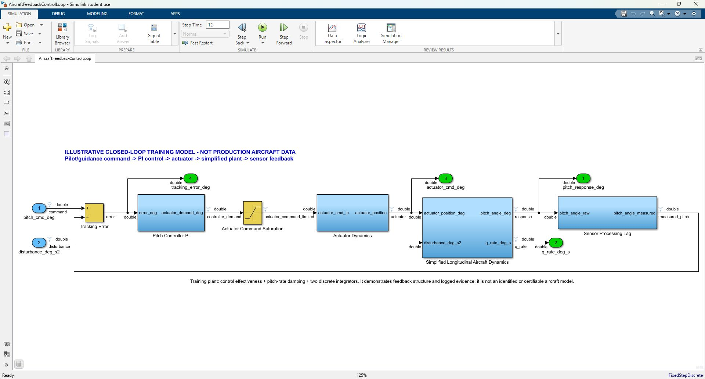
01 • PREPARE & ORIENT
The toolstrip tells you where each action lives
SIMULATION
Open • Run • Stop • Data Inspector
DEBUG
Diagnostics • Information Overlays
MODELING
Update Model • configuration
FORMAT
Layout • labels • visual review
APPS
Testing tools • code generation
Select the tab, then the action. Open, update, run, stop, build, and test create different engineering states and evidence.
AVIATION CONTROLS ENGINEERING ONBOARDING
12
Notes:
Timing: 3 minutes plus demonstration
Mode: UI orientation
Prerequisite: A model open in Simulink.
Orient to the Simulation, Debug, Modeling, Apps, and Signal controls. The Signal tab exposes Log Signals and Test Point actions; the modeling controls provide Model Settings; keyboard shortcuts trigger update or target-dependent build.
Do
- Select a signal, open the Signal tab, locate Log Signals and Test Point, and locate Model Settings without changing the model.
Expected
- The learner can point to the controls used in slides 17-19 and distinguish navigation from execution.
Recovery
- If the contextual Signal tab is hidden, select a signal line or right-click the line and use its properties/context menu.
Caveats
- UI arrangement can vary by MATLAB release and license; use the underlying model property when a ribbon control moves.
[Sources]
- user-provided Image 1: Simulink Signal tab capture
- user-provided Image 2: Configuration Parameters capture

Slide 13
02 • CONTROLLED CREATION LAB
Build lab: recreate the pitch-rate limiter in an authorized working copy
SAFE SANDBOX • create_pitch_rate_limiter_practice(projectRoot,'TLEE')
→ learner_workspace/TLEE/models/PitchRateLimiter_Practice_TLEE.slx + matching Harness.slx
01
SAFE CREATE
02
MODEL SHELL
03
CONFIGURATION
unique tag • no baseline overwrite
five exact ports + dictionary
fixed-step discrete • Sample_time
04
LIMITER LOGIC
05
OBSERVABILITY
06
PRACTICE TEST
AND • clamp • switch • active
logging • test-point rationale
matching harness • learner evidence
SHADOWING GUARD • which -all PitchRateLimiter must resolve first to models/PitchRateLimiter.slx; never add learner_workspace/.../models to the permanent path
AVIATION CONTROLS ENGINEERING ONBOARDING
13
Notes:
Timing: 2 minutes
Mode: Build-lab briefing
Prerequisite: Slides 7-12 complete.
The learner helper creates a uniquely named component and matching harness under learner_workspace/<tag>/models without putting that folder on the permanent path. The six construction gates can then be inspected or manually recreated from the exact table.
Do
- Run create_pitch_rate_limiter_practice(projectRoot,'TLEE'), inspect practiceSummary, and confirm which -all PitchRateLimiter resolves first to the delivered models folder.
Expected
- The learner has a safe component path, matching harness, unique names, and six explicit construction gates.
Recovery
- If no authorized copy is available, switch to read-only observation of the delivered model.
Caveats
- Do not overwrite the delivered training baseline during an exploratory build lab.
[Sources]
- scripts/create_pitch_rate_limiter_practice.m
- README.md

Slide 14
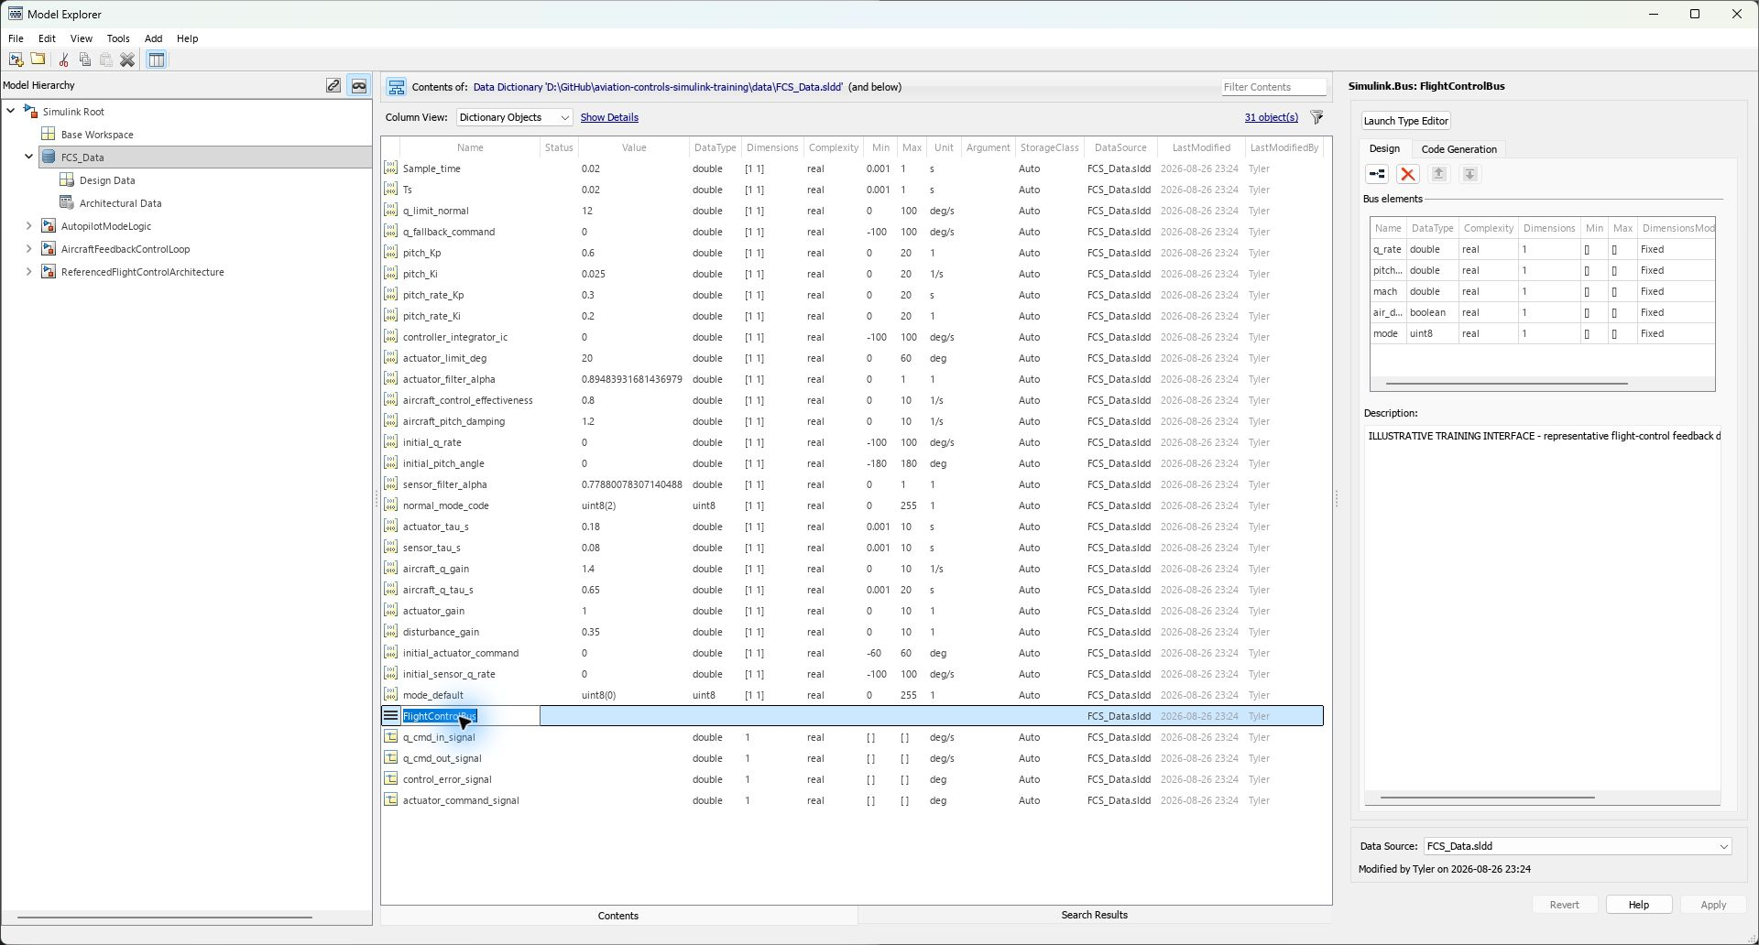
02 • CONTROLLED CREATION LAB
Step 1 — create the model shell and attach the controlled dictionary
STEP 1 OF 6
Start from controlled data, then create the model shell
Run create_pitch_rate_limiter_practice(projectRoot,'TLEE')
Open practiceSummary.ModelFile—not the delivered baseline
Inspect its FCS_Data.sldd attachment and five-port shell
Confirm Fixed-step / discrete and FixedStep = Sample_time
EXPECTED • Sample_time, q_limit_normal, and q_fallback_command resolve from the dictionary
RECOVERY • verify the repository root, dictionary attachment, and path—do not hard-code a user path
AVIATION CONTROLS ENGINEERING ONBOARDING
14
Notes:
Timing: 5 minutes
Mode: Hands-on build lab
Prerequisite: Authorized working copy; slide 13.
Use the safe helper to create the learner model shell under learner_workspace/<tag>/models, then inspect the generated shell and dictionary attachment. This prevents an ambiguous Save As path or a practice model that shadows the delivered UUT.
Do
- Open practiceSummary.ModelFile and verify its exact unique path, FCS_Data.sldd attachment, fixed-step discrete solver, and FixedStep expression Sample_time.
Expected
- The model shell saves, the dictionary resolves, and Ctrl+D does not report unresolved data or solver errors.
Recovery
- Correct dictionary path and solver configuration; do not create base-workspace duplicates of missing controlled entries.
Caveats
- The delivered model is the reference implementation; new construction belongs in an authorized copy.
[Sources]
- scripts/create_pitch_rate_limiter_practice.m
- scripts/initialize_training_data.m
- data/FCS_Data.sldd

Slide 15
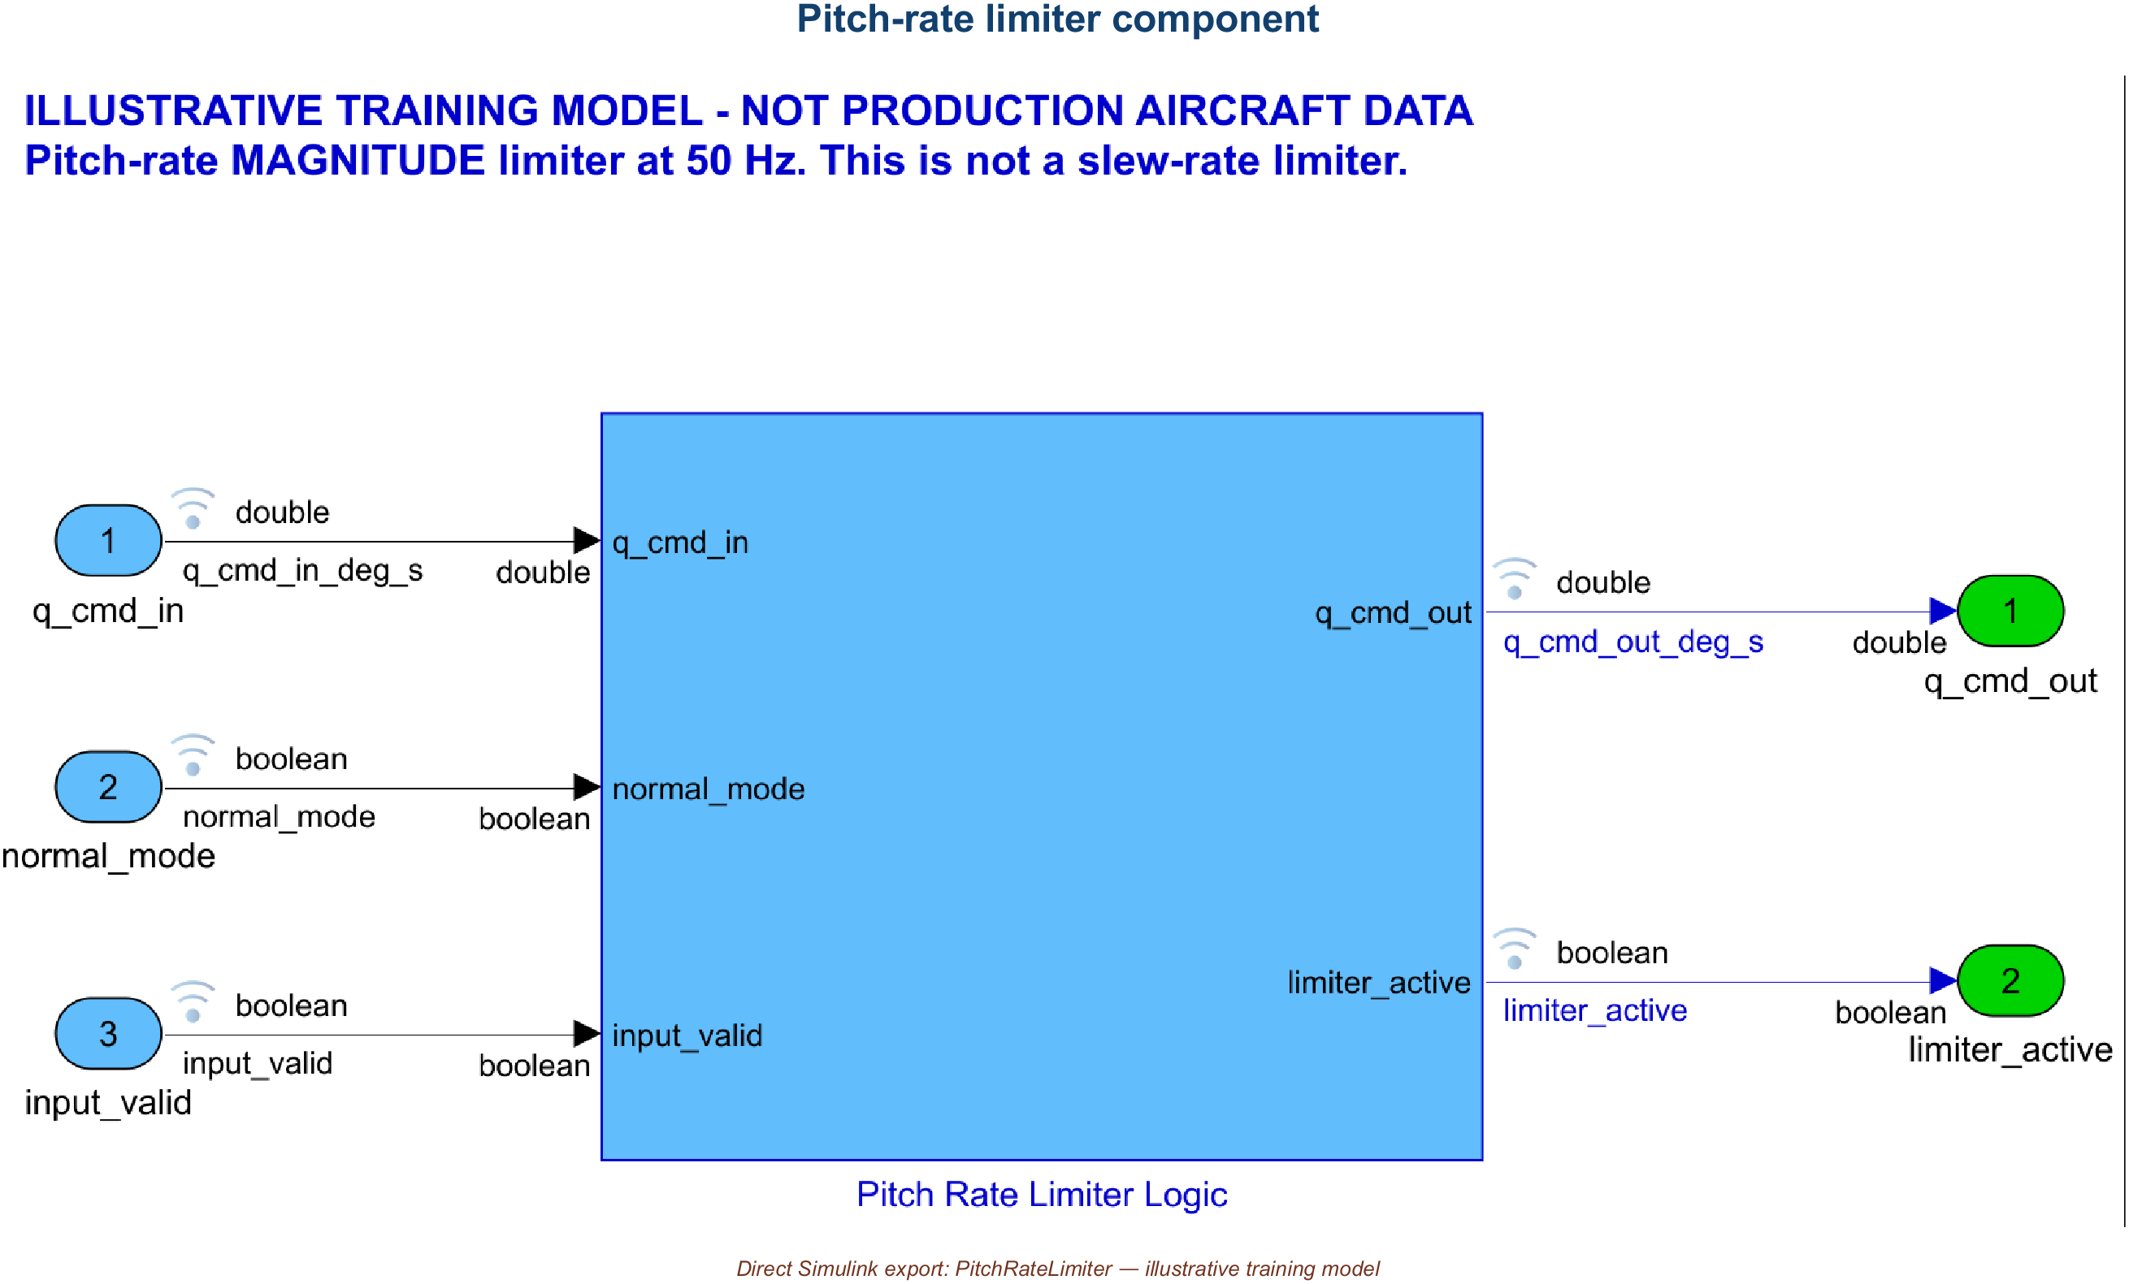
02 • CONTROLLED CREATION LAB
Step 2 — define the component boundary exactly
STEP 2 OF 6
PORT CONTRACT
q_cmd_in
double • deg/s • command
normal_mode
boolean • 1 • enable
input_valid
boolean • 1 • validity
q_cmd_out
double • deg/s • limited output
limiter_active
boolean • 1 • status
CHECK BEFORE LOGIC • names, direction, types, dimensions, units, and status semantics are part of the interface—not decoration
AVIATION CONTROLS ENGINEERING ONBOARDING
15
Notes:
Timing: 5 minutes
Mode: Hands-on build lab
Prerequisite: Compilable shell from slide 14.
Define interfaces before internal logic. Names, dimensions, types, units, sample time, and bus usage are part of the component contract and should be reviewable at the model boundary.
Do
- Add or inspect the component Inports and Outports and compare them with the dictionary and bus inventories.
Expected
- Ctrl+D propagates the intended scalar types and units with no interface mismatch.
Recovery
- Trace the first mismatched port back to its source, dictionary entry, or bus element; correct the contract before adding logic.
Caveats
- Compiled agreement shows interface consistency, not semantic correctness.
[Sources]
- scripts/create_training_models.m
- results/FCS_DataDictionary_Inventory.csv
- results/FlightControlBus_Inventory.csv

Slide 16
02 • CONTROLLED CREATION LAB
Step 3 — implement the clamp, fallback, and active-status logic
MANUAL EQUIVALENT • these settings are the executable contract created by the safe helper; inspect every value before Ctrl+D
BLOCK
TYPE
EXACT PARAMETERS
CONNECTION / PURPOSE
Normal AND Valid
Logical Operator
AND • 2 inputs
normal_mode + input_valid
Magnitude Clamp
Saturation
Upper q_limit_normal • Lower -q_limit_normal
q_cmd_in → clamped command
Training Fallback Command
Constant
Value q_fallback_command • Ts Sample_time
fallback data input
Select Valid Command
Switch
Criteria u2 ~= 0 • Threshold 0.5
clamp / valid / fallback
Above / Below Limit
Relational Operator
> positive • < negative
strictly outside ± limit
Outside Range / Valid Active
Logical Operator
OR • then AND with normal_and_valid
limiter_active status
BOUNDARY SEMANTICS • exactly ±q_limit_normal passes unchanged and limiter_active = false; invalid or non-normal input selects q_fallback_command
AVIATION CONTROLS ENGINEERING ONBOARDING
16
Notes:
Timing: 6 minutes
Mode: Hands-on build lab
Prerequisite: Interfaces compile on slide 15.
Use the exact table: AND with two inputs; Saturation limits q_limit_normal and -q_limit_normal; fallback Constant q_fallback_command at Sample_time; Switch criterion u2 ~= 0 with threshold 0.5; strict > and < comparisons; OR then AND for limiter_active.
Do
- Compare every practice block parameter and connection against the visible table, then trace inside-limit, outside-limit, disabled, and invalid behavior.
Expected
- The learner can predict output and limiter_active for an inside-limit, outside-limit, disabled, and invalid case.
Recovery
- If behavior is ambiguous, return to the traceability acceptance criteria before changing blocks.
Caveats
- The logic and parameter values are illustrative classroom content, not production-aircraft requirements.
[Sources]
- models/PitchRateLimiter.slx
- screenshots/PitchRateLimiter_Implementation.png
- docs/PitchRateLimiter_Requirements_Traceability.csv
- scripts/create_pitch_rate_limiter_practice.m
- scripts/create_training_models.m

Slide 17
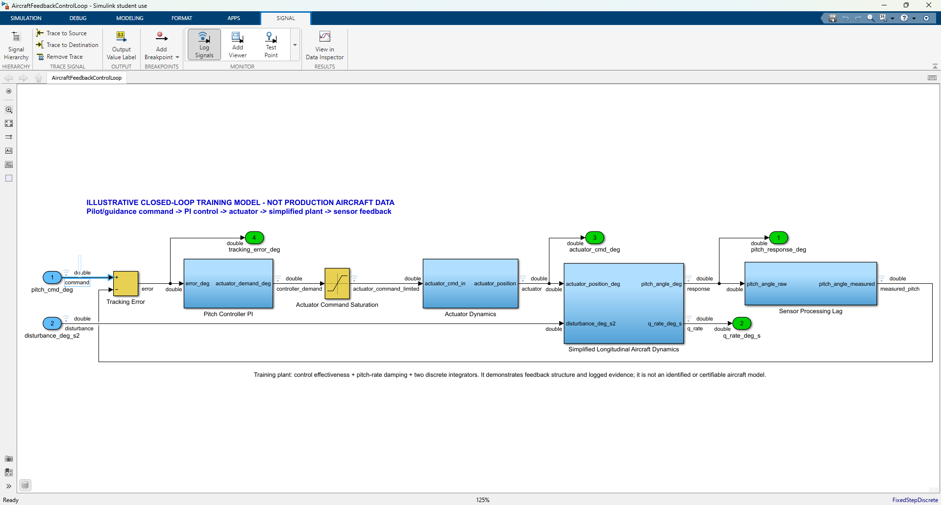
02 • CONTROLLED CREATION LAB
Step 4 — log evidence signals; reserve test points for required observability
DO THIS LIVE
LOG A SIGNAL
1 Select the signal line
2 Signal tab > Log Signals
3 Run the model
4 View in Data Inspector
LOGGED SIGNAL
Use for time history, SDI comparisons, regression plots, and retained simulation evidence. Dataset data commonly appears in logsout.
TEST POINT
Use when an internal signal must remain observable despite optimization. It does not enable signal logging; control and review it separately.
SAVED PACKAGE • signal logging ON in 8/8 models • 52 logged ports • 0 test points
AVIATION CONTROLS ENGINEERING ONBOARDING
17
Notes:
Timing: 5 minutes plus demonstration
Mode: Instrumentation lab
Prerequisite: A compilable signal path from slide 16.
Use signal logging when simulation data must be retained and compared in SDI or a script. Use a test point when the signal must remain observable for testing or code-generation instrumentation even when optimization might otherwise remove it. A signal can be both, but each designation needs a stated purpose.
Do
- Select one analysis signal and enable Log Signals. Inspect, but do not arbitrarily enable, the Test Point control; record why each designation is or is not needed.
Expected
- The logging badge appears and the signal is available in logsout after simulation; test-point status matches the documented observability need.
Recovery
- If the signal is absent from logsout, verify SignalLogging is enabled, the source port is marked for logging, and the expected dataset name is used.
Caveats
- Logging is simulation evidence capture; a test point is an observability designation. Neither alone creates a verification oracle.
- Extra test points can affect generated interfaces or optimization and require project review.
[Sources]
- user-provided Image 1: Simulink Signal tab capture
- scripts/create_training_models.m
- scripts/run_training_simulations.m
- https://www.mathworks.com/help/simulink/ug/export-simulation-data.html

Slide 18
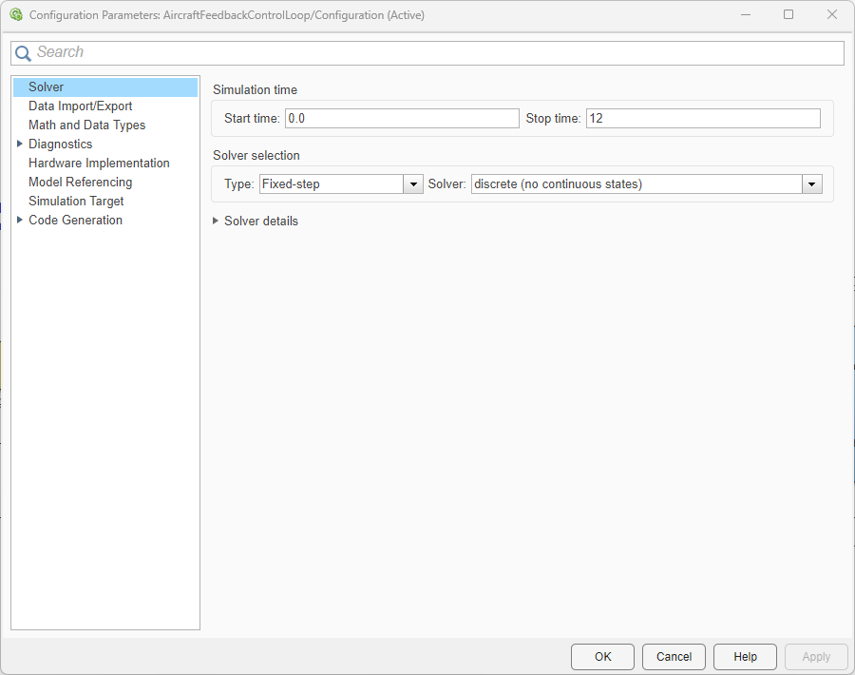
02 • CONTROLLED CREATION LAB
Step 5 — distinguish saved settings from run-time overrides
SAVED ≠ EFFECTIVE
MODEL
SAVED STOP
DRIVER STOP
AircraftFeedbackControlLoop
12 s
20 s
PitchRateLimiter_Harness
2 s
0.36 s
Fixed step
Sample_time
0.02 s
REVIEW • Solver • Data Import/Export • Diagnostics • Hardware Implementation • Model Referencing • Code Generation
Opening Model Settings is inspection—not a verification result. Record the exact saved configuration and any SimulationInput override.
AVIATION CONTROLS ENGINEERING ONBOARDING
18
Notes:
Timing: 5 minutes plus demonstration
Mode: Settings lab
Prerequisite: Target model open; slide 17 complete.
Open Model Settings and distinguish saved configuration from driver overrides. AircraftFeedbackControlLoop is saved with StopTime 12 but the controlled aircraft run uses 20; PitchRateLimiter_Harness is saved with StopTime 2 but the assessment driver uses 0.36. Both use fixed-step discrete execution at 0.02 seconds.
Do
- Open Configuration Parameters, inspect Solver, fixed step, and Stop time, then locate the setModelParameter overrides in the relevant driver.
Expected
- The learner can state both the saved and effective settings for the selected execution path.
Recovery
- If observed settings disagree, identify active configuration references and SimulationInput overrides before editing the saved model.
Caveats
- A screenshot documents where to inspect settings; the saved model and execution driver determine effective values.
- Changing settings can invalidate comparison with retained evidence.
[Sources]
- user-provided Image 2: Configuration Parameters capture
- results/SimulationConfiguration.csv
- scripts/run_training_simulations.m
- scripts/run_pitch_rate_limiter_tests.m

Slide 19
02 • CONTROLLED CREATION LAB
Ctrl+D is the first acceptance gate—and the safest recovery point
Ctrl+D ≡ set_param(model,'SimulationCommand','update')
PARAMETERS
INTERFACES
TIMING
REFERENCES
DIAGNOSTICS
dictionary entries resolve
types, dimensions, and units propagate
sample times compile at 0.02 s
Model blocks resolve in saved Normal mode
no unexpected warning or error remains
IF UPDATE FAILS
1 read the first diagnostic → 2 classify path/data/interface/timing/reference → 3 correct the root cause → 4 Ctrl+D again → 5 only then simulate or build
Update evaluates and compiles the diagram without advancing simulation time and without generating code.
AVIATION CONTROLS ENGINEERING ONBOARDING
19
Notes:
Timing: 4 minutes plus demonstration
Mode: Update gate
Prerequisite: Instrumentation and settings complete.
Press Ctrl+D before running or building. Update evaluates parameters, compiles interfaces, propagates types, dimensions, and sample times, resolves references, and reports update-time errors without advancing simulation time.
Do
- Save the working copy, press Ctrl+D, and inspect the Diagnostic Viewer and compiled attributes.
Expected
- Update completes without warnings or errors and simulation time does not advance.
Recovery
- Resolve the first diagnostic at its source, update again, and do not proceed while warnings or errors remain unexplained.
Caveats
- The retained validator achieved 8/8 updates; it accepts only the exact Student-license Model-block fallback message on the two parent models after asserting all saved ModelReference modes are Normal. Any other warning fails.
[Sources]
- scripts/validate_training_project.m
- results/validation_summary.txt
- https://www.mathworks.com/help/simulink/ug/update-a-block-diagram.html

Slide 20
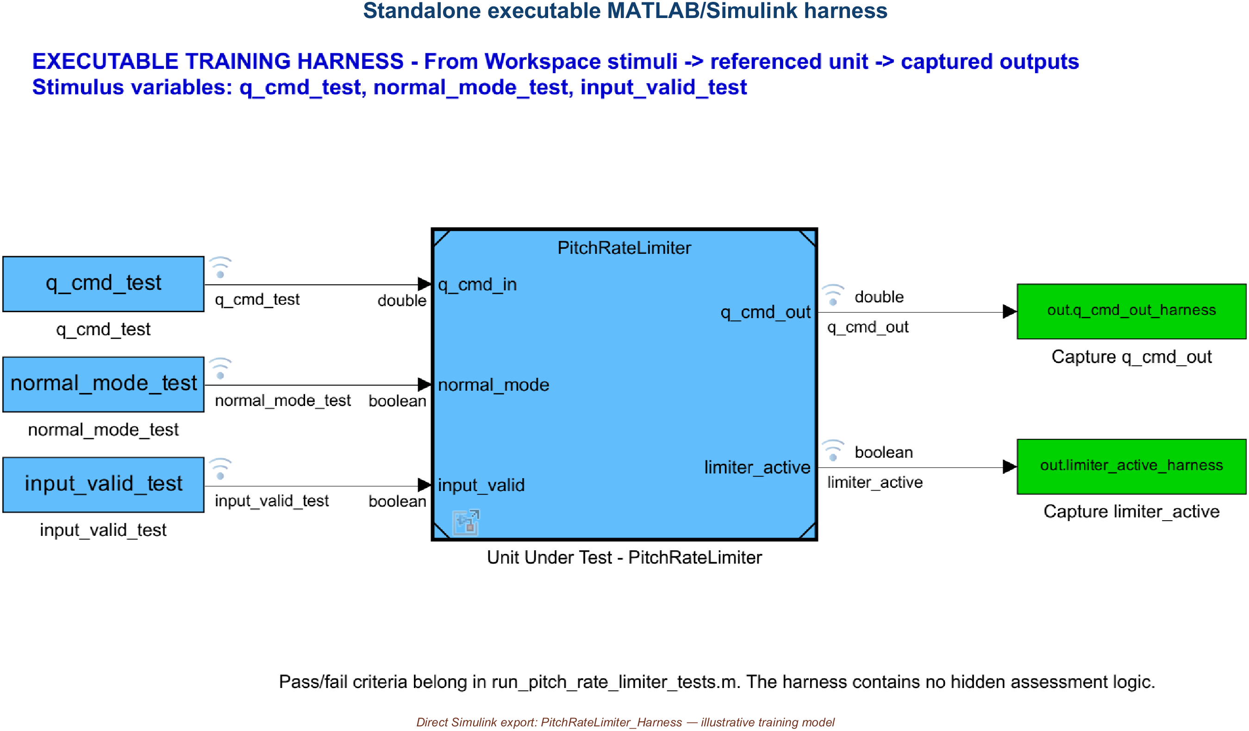
03 • HARNESS & BUILD
The delivered and learner harnesses isolate different UUTs
DELIVERED BASELINE SHOWN • run_pitch_rate_limiter_tests.m → PitchRateLimiter_Harness → delivered PitchRateLimiter
LEARNER PATH • create_pitch_rate_limiter_practice generates a uniquely named matching harness beside the practice UUT
AVIATION CONTROLS ENGINEERING ONBOARDING
20
Notes:
Timing: 4 minutes
Mode: Harness walkthrough
Prerequisite: Path initialized; PitchRateLimiter_Harness open.
The image shows the delivered PitchRateLimiter_Harness and its saved Normal-mode reference to the delivered PitchRateLimiter. The practice helper creates a separate, uniquely named harness that references the learner UUT in the same workspace; never assume the delivered harness tests a practice model.
Do
- Locate the delivered UUT reference and captures, then compare its ModelName with practiceSummary.HarnessFile and the uniquely named learner UUT.
Expected
- The learner identifies which harness targets which UUT and confirms both Model references are saved Normal.
Recovery
- If the UUT does not resolve or uses another mode, restore the models path and the saved Normal-mode baseline before continuing.
Caveats
- This is not a Simulink Test/Test Manager harness or .mldatx test suite.
[Sources]
- models/PitchRateLimiter_Harness.slx
- screenshots/PitchRateLimiter_Harness.png
- scripts/create_pitch_rate_limiter_practice.m
- scripts/create_training_models.m
- scripts/validate_training_project.m

Slide 21
03 • HARNESS & BUILD
The driver creates three timeseries and overrides the saved placeholders
THREE PRIMARY ARTIFACTS IN THE HARNESS EXECUTION PATH
INJECTED INTO THE HARNESS MODEL WORKSPACE
data/FCS_Data.sldd
q_cmd_test • normal_mode_test • input_valid_test
1
Sample_time = 0.02 s
q_limit_normal = 12 deg/s
fallback = 0
THREE REPRESENTATIVE ROWS FROM THE 19-POINT SEQUENCE
scripts/run_pitch_rate_limiter_tests.m
t(s) q_cmd N V expected active
2
defines 19 rows
creates 3 timeseries
owns expected values + oracle
0.12 +12.0 1 1 +12.0 0
0.14 +12.1 1 1 +12.0 1
0.20 +8.0 1 0 0.0 0
3
models/PitchRateLimiter_Harness.slx
From Workspace → UUT
Model block in Normal simulation mode
To Workspace captures
N = Normal mode • V = Input valid
ONE 0.36 s DESKTOP-MIL RUN • 19 ASSESSMENT POINTS • BASELINE DRIVER TARGETS DELIVERED UUT • PRACTICE WRAPPER TARGETS LEARNER UUT
AVIATION CONTROLS ENGINEERING ONBOARDING
21
Notes:
Timing: 4 minutes
Mode: Harness input lab
Prerequisite: Slide 20 harness walkthrough.
The retained input sequence is created in code, not stored as a standalone stimulus CSV. The shared driver defines nineteen rows and three timeseries. The baseline entry point selects the delivered harness; the practice wrapper selects the matching learner harness and learner-local output root.
Do
- Find the test definition and three timeseries in the driver, then inspect the corresponding From Workspace block variable names.
Expected
- Variable names match end to end and the MAT result retains qCommandInput, normalModeInput, and inputValidInput.
Recovery
- If variables are missing, run the controlled driver; do not treat the saved harness placeholders as the assessment input set.
Caveats
- Pressing Run on either saved harness uses benign two-sample placeholders, not the nineteen-point sequence.
- Nineteen assessments are nineteen rows from one simulation, not nineteen independent simulations.
[Sources]
- scripts/run_pitch_rate_limiter_tests.m
- scripts/run_pitch_rate_limiter_practice_tests.m
- models/PitchRateLimiter_Harness.slx
- data/FCS_Data.sldd
- results/PitchRateLimiter_TestResults.mat

Slide 22
03 • HARNESS & BUILD
Choose the driver that matches the UUT you intend to assess
DELIVERED BASELINE DRIVER
LEARNER PRACTICE DRIVER
run_pitch_rate_limiter_tests(projectRoot)
run_pitch_rate_limiter_practice_tests( ...
projectRoot,'TLEE')
Targets delivered PitchRateLimiter_Harness
Targets matching uniquely named practice harness
Replaces fixed results/ and reports/ files
Writes learner_workspace/TLEE/evidence/
Use to reproduce the retained baseline
Does not replace controlled baseline results
SHARED EXECUTABLE ASSESSMENT • three injected timeseries • one 0.36 s simulation • 19 assessment rows • numeric / active / timestamp checks + suite-level 50 Hz spacing • CSV / MAT / HTML / PNG
SAVED HARNESS RUN = BENIGN PLACEHOLDERS • execute the matching driver for assessed evidence • no Test Manager suite
AVIATION CONTROLS ENGINEERING ONBOARDING
22
Notes:
Timing: 4 minutes
Mode: Evidence-path walkthrough
Prerequisite: Slides 20-21.
Choose the driver by UUT. run_pitch_rate_limiter_tests targets the delivered harness, refreshes the managed baseline dictionary, and replaces the official result files. run_pitch_rate_limiter_practice_tests targets the uniquely named learner harness, reads the existing required dictionary entries without reinitializing them, and writes only learner_workspace/<tag>/evidence. Both use the same stimulus/oracle implementation.
Do
- Run the practice wrapper, inspect summary.PracticeModel and summary.OutputRoot, then compare those paths with the delivered baseline driver defaults.
Expected
- The learner can prove which UUT was assessed and where its CSV, MAT, HTML, and PNG were written.
Recovery
- If artifacts disagree, treat the set as stale or mixed and rerun only under authorized evidence-refresh conditions.
Caveats
- Multiple export formats are not independent verification runs.
- The validator reads the retained CSV; it does not rerun this driver.
- The practice wrapper fails preflight if required dictionary entries are missing; it does not repair or rewrite the shared dictionary.
[Sources]
- scripts/initialize_training_data.m
- scripts/run_pitch_rate_limiter_tests.m
- scripts/run_pitch_rate_limiter_practice_tests.m
- scripts/create_pitch_rate_limiter_practice.m
- models/PitchRateLimiter_Harness.slx
- results/PitchRateLimiter_TestResults.csv
- results/PitchRateLimiter_TestResults.mat
- reports/PitchRateLimiter_TestReport.html

Slide 23
03 • HARNESS & BUILD
Ctrl+D, Run, and Ctrl+B answer different questions
Ctrl+D
Run / sim
Ctrl+B / slbuild
UPDATE MODEL
EXECUTE MODEL
GENERATE + COMPILE
Evaluates parameters
Uses current inputs/settings
Uses active target/configuration
Propagates interfaces/sample times
Scripted sim may inject overrides
Generates C/build files
Checks diagram compatibility
Advances time; captures signals
Links a target-dependent product
RESULT: compiled diagram; no time advances
RESULT: MIL outputs/logs; assessed only when driver + oracle run
RESULT: build tree; not executed code evidence
SAFE ORDER • update first → run when behavior is the question → build when generated artifacts are the question
AVIATION CONTROLS ENGINEERING ONBOARDING
23
Notes:
Timing: 5 minutes plus demonstration
Mode: Command comparison
Prerequisite: Correct model selected on slide 9.
Ctrl+D updates without advancing time. Run executes the selected model with its current inputs and settings. Ctrl+B invokes a target-dependent build. For retained assessment use the scripted limiter driver; for retained integration build evidence use build_top_level_grt_evidence on ReferencedFlightControlArchitecture.
Do
- Demonstrate Ctrl+D on the harness, explain why manual Run uses placeholders, and inspect the top-level build script before any Ctrl+B action.
Expected
- The learner predicts the artifact and state change caused by each action and chooses the correct top level.
Recovery
- If the wrong model was run or built, stop, preserve the diagnostic/output location, clean only project-owned temporary artifacts, and restart from the correct target.
Caveats
- An interactive Ctrl+B result depends on the active target and environment; the retained evidence was produced by scripted slbuild.
- The retained executable was not executed or SIL/PIL-verified.
[Sources]
- scripts/run_pitch_rate_limiter_tests.m
- scripts/build_top_level_grt_evidence.m
- results/top_level_codegen_v8_evidence/Build_Evidence_Manifest.txt
- https://www.mathworks.com/help/simulink/slref/slbuild.html

Slide 24
03 • HARNESS & BUILD
The scripted top-level build retains outputs—and a provenance boundary
SCRIPTED slbuild OUTPUT | build_top_level_grt_evidence(projectRoot,'RunLabel','v8_evidence')
VERBATIM GENERATED C • LINES 8–19 + 25–28
results/top_level_codegen_v8_evidence/
├─ Build_Evidence_Manifest.txt
├─ ReferencedFlightControlArchitecture_slbuild.log
├─ codegen/
│ ├─ ReferencedFlightControlArchitecture.exe
│ ├─ ReferencedFlightControlArchitecture_grt_rtw/
│ │ ├─ ReferencedFlightControlArchitecture.c
│ │ └─ html/index.html
│ └─ slprj/grt/
│ ├─ SensorProcessingRef/
│ ├─ PitchRateLimiter/
│ ├─ PitchControllerRef/
│ └─ ActuatorCommandRef/
└─ cache/ReferencedFlightControlArchitecture.slxc
* Code generation for model "ReferencedFlightControlArchitecture".
*
* Model version : 1.9
* Simulink Coder version : 23.2 (R2023b) 01-Aug-2023
* C source code generated on : Thu Aug 27 11:40:47 2026
*
* Target selection: grt.tlc
* Note: GRT includes extra infrastructure and instrumentation for prototyping
* Embedded hardware selection: Intel->x86-64 (Windows64)
* Code generation objectives: Unspecified
* Validation result: Not run
*/
⋮ lines 20–24 omitted
#include "ActuatorCommandRef.h"
#include "PitchControllerRef.h"
#include "PitchRateLimiter.h"
#include "SensorProcessingRef.h"
BUILD_STATUS=PASS • 5/5 models built • 0 already up to date • 1:27.572 • executable 196,608 bytes
Git dirty=1; exact dirty-source snapshot was not retained. Ctrl+B may use other active settings/paths. Executable built—not run; no validation, SIL, or PIL.
AVIATION CONTROLS ENGINEERING ONBOARDING
24
Notes:
Timing: 5 minutes
Mode: Build-evidence walkthrough
Prerequisite: Slide 23 command comparison.
Read the real v8 build tree. The evidence root contains the manifest, MAT summary, diary log, cache, a top-level GRT generated-code/report folder, four referenced targets under codegen/slprj/grt, and ReferencedFlightControlArchitecture.exe. The log records 5 of 5 models built, zero already up to date, in 1 minute 27.572 seconds.
Do
- Open Build_Evidence_Manifest.txt, the slbuild log, the generated top-model C file, and the HTML report from results/top_level_codegen_v8_evidence.
Expected
- The learner locates the parent target, four referenced targets, executable, source, report, and provenance record.
Recovery
- If the tree is absent and a new controlled build is authorized, run build_top_level_grt_evidence(projectRoot,'RunLabel','<unique_label>'); never substitute a screenshot for missing files.
Caveats
- The retained run used scripted slbuild; Ctrl+B is the interactive analogue and may use different active settings or output locations.
- Git dirty at build was 1, but the manifest does not retain the dirty file list, diff, or exact dirty-source snapshot; do not call this build fully reproducible from the manifest alone.
- The target is grt.tlc for desktop training/prototyping, not production airborne code.
- Executable executed: NO; code-generation validation: NO; SIL/PIL: NO.
[Sources]
- scripts/build_top_level_grt_evidence.m
- results/top_level_codegen_v8_evidence/Build_Evidence_Manifest.txt
- results/top_level_codegen_v8_evidence/ReferencedFlightControlArchitecture_slbuild.log
- results/top_level_codegen_v8_evidence/codegen/ReferencedFlightControlArchitecture_grt_rtw/ReferencedFlightControlArchitecture.c
- results/top_level_codegen_v8_evidence/codegen/ReferencedFlightControlArchitecture_grt_rtw/html/index.html

Slide 25
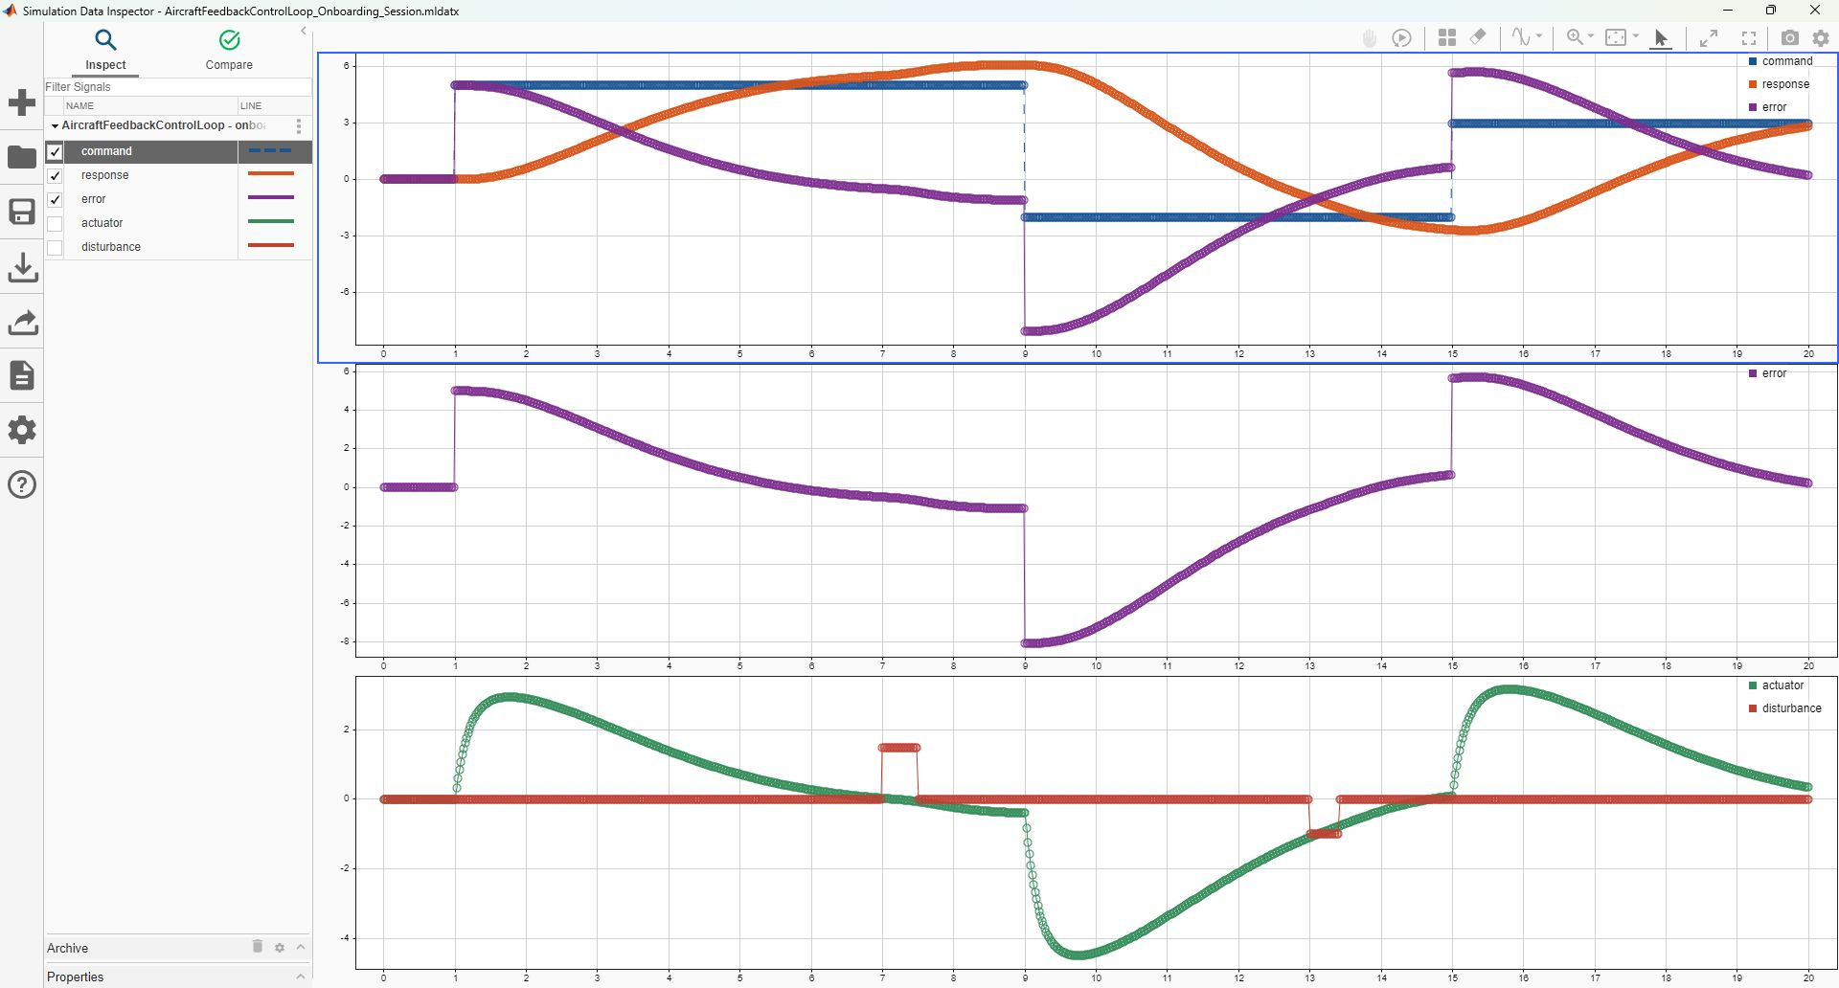
04 • SIMULATION DATA INSPECTOR
Open the saved SDI reference without losing current work
SAVED REFERENCE
1 RUN
5 SIGNALS
3 PLOTS
1001 POINTS / SIGNAL
0.02 s SPACING
View = layout / styling
Session = retained signal data
Both .mldatx files are SDI artifacts.
NEXT → READ THE CAUSAL STORY
AVIATION CONTROLS ENGINEERING ONBOARDING
25
Notes:
Timing: 4 minutes plus demonstration
Mode: SDI demonstration
Prerequisite: Controlled simulation artifacts present.
Open the saved SDI reference safely. The saved view controls layout and display; the saved session holds one run with five signals. The helper requires explicit permission before replacing current SDI state and creates recoverable backups.
Do
- Inspect scripts/open_data_inspector_reference.m, save current work, then load the reference session and view using the helper's guarded workflow.
Expected
- SDI opens with the command/response/error, isolated error, and actuator/disturbance panels.
Recovery
- If current SDI state is important, cancel and export/save it first; restore from the helper-created backup if loading the reference is not desired.
Caveats
- The two .mldatx files are SDI session/view artifacts, not Simulink Test or Test Manager artifacts.
[Sources]
- scripts/open_data_inspector_reference.m
- data/SimulationDataInspector/AircraftFeedbackControlLoop_Onboarding_View.mldatx
- results/SimulationDataInspector/AircraftFeedbackControlLoop_Onboarding_Session.mldatx
- screenshots/SimulationDataInspector_Onboarding.jpg

Slide 26
04 • SIMULATION DATA INSPECTOR
Read the SDI run as one causal story
TOP
command steps + dynamic response + model-logged tracking error
MIDDLE
logged error alone: jumps, decay, and overshoot become legible
BOTTOM
actuator effort beside disturbance timing: correlate cause and response
BOTTOM PLOT MIXES UNITS • actuator: deg • disturbance: deg/s² • compare timing/trend, not vertical magnitude
AVIATION CONTROLS ENGINEERING ONBOARDING
26
Notes:
Timing: 5 minutes
Mode: Graph interpretation
Prerequisite: Slide 25 SDI view open or screenshot visible.
Read the three aligned plots as one causal story. The top overlays command, dynamic response, and model-logged tracking error. The middle isolates error to reveal step jumps and decay. The bottom aligns actuator effort with disturbance timing so cause and response can be correlated.
Do
- Choose one command transition and one disturbance event; follow the same time cursor through all three panels and verify exact values in the retained CSV.
Expected
- The learner explains transient lag, error decay, actuator response, and disturbance correlation without comparing unlike units as magnitudes.
Recovery
- If a visual claim is uncertain, use SDI cursors or results/AircraftFeedback_CommandTracking.csv rather than estimating from pixels.
Caveats
- Error_deg is the model-logged tracking-error signal, not an independently recomputed oracle.
- Actuator degrees and disturbance degrees per second squared share a panel for timing comparison only.
- The retained run contains 1001 samples from 0 to 20 seconds at 0.02-second spacing.
[Sources]
- screenshots/SimulationDataInspector_Onboarding.jpg
- results/AircraftFeedback_CommandTracking.csv
- scripts/update_data_inspector.m
- scripts/run_training_simulations.m

Slide 27
05 • VERIFICATION & DATA
The suite checks functional behavior and timestamp spacing—not WCET
ROW-SPECIFIC
SUITE-LEVEL
NOT MEASURED
NumericPass
Required sample time = 0.02 s
Worst-case execution time
LimiterActivePass
Observed spacing = 0.02 s
Scheduler latency or deadline margin
TimestampPass
Timing50HzPass repeated on 19 rows
Target overrun / processor utilization
EXECUTABLE ACCEPTANCE • |dictionary Sample_time − 0.02| ≤ 2e−11 s AND every retained point spacing is 0.02 s within the same tolerance
Say “50 Hz configuration and retained timestamp spacing passed”—not “the design meets a real-time deadline.”
AVIATION CONTROLS ENGINEERING ONBOARDING
27
Notes:
Timing: 4 minutes
Mode: Timing interpretation
Prerequisite: Limiter driver and traceability files available.
The limiter suite checks configuration and recorded timestamps, not execution-time deadlines. Required sample time is 0.02 seconds, tolerance is max(1e-12, requiredSampleTime times 1e-9), and the retained check requires the dictionary setting and logged spacing to agree.
Do
- Inspect RequiredSampleTime_s, DictionarySampleTime_s, SampleTimeConfigurationPass, observed spacing, TimestampPass, and Timing50HzPass in the result files.
Expected
- The learner can state that retained 50 Hz timestamp spacing and same-sample functional response passed.
Recovery
- If timing fails, first separate dictionary configuration mismatch from logged timestamp-spacing mismatch and investigate the responsible path.
Caveats
- No WCET, scheduling, deadline, overrun, processor-load, or real-time execution claim is supported.
- Desktop-MIL timestamps do not establish target timing performance.
[Sources]
- scripts/run_pitch_rate_limiter_tests.m
- docs/PitchRateLimiter_Requirements_Traceability.csv
- results/PitchRateLimiter_TestResults.csv
- results/PitchRateLimiter_TestResults.mat

Slide 28
05 • VERIFICATION & DATA
One controlled flow creates the inputs, oracle, and retained result views
1
INITIALIZE
2
PRODUCE
3
EXECUTE
4
ASSESS
5
RETAIN
6
VALIDATE
restore managed
classroom data
→
19 rows + three
input timeseries
→
one harness
MIL simulation
→
oracle + four
stored pass fields
→
CSV • MAT
HTML • PNG
→
read CSV + check
required file presence
FRESHNESS BOUNDARY
validate_training_project.m updates the eight delivered models, reads the retained limiter-results CSV, and checks named artifact presence. It does not rerun the limiter suite, recompute the reports, or hash every artifact.
For a release decision, run the producer and executor first; then run the validator against the newly generated evidence.
AVIATION CONTROLS ENGINEERING ONBOARDING
28
Notes:
Timing: 4 minutes
Mode: Verification-workflow walkthrough
Prerequisite: Slides 20-27.
Keep roles explicit: initialization is the baseline producer, the driver is stimulus producer and executor, the harness is connectivity, the driver oracle computes pass fields, and validate_training_project is a later package validator that reads the retained CSV and checks file presence.
Do
- Trace one requirement from input row through harness output, oracle fields, exports, and package-validation summary.
Expected
- The learner can name who produced, executed, assessed, exported, and later checked the artifact set.
Recovery
- If provenance is unclear, do not merge files from different runs; retain timestamps and rerun the controlled producer chain only with authorization.
Caveats
- The limited suite retains 19 passing sample assessments from one deterministic 0.36-second desktop-MIL simulation.
- The validator does not independently rerun the suite or establish export freshness.
[Sources]
- scripts/initialize_training_data.m
- scripts/run_pitch_rate_limiter_tests.m
- models/PitchRateLimiter_Harness.slx
- scripts/validate_training_project.m
- results/validation_summary.txt

Slide 29
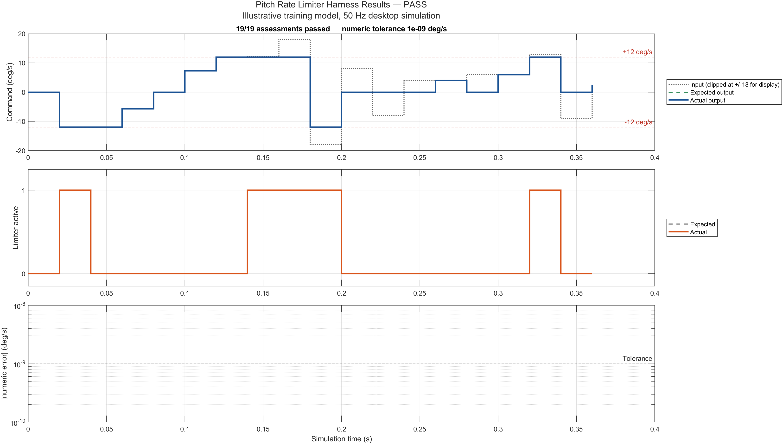
05 • VERIFICATION & DATA
The retained suite assesses 19 rows in one MIL run
19 / 19
ASSESSMENT ROWS
PASSED
one 0.36 s MIL run
0.02 s point spacing
0 failed rows
3 row checks:
numeric • active • timestamp
+ suite timing copied to rows
NEXT → READ ALL THREE PANELS
Executable MATLAB assessment of a standalone Simulink harness • not 19 independent simulations • not Test Manager
AVIATION CONTROLS ENGINEERING ONBOARDING
29
Notes:
Timing: 4 minutes
Mode: Result review
Prerequisite: Controlled limiter results present.
State the result precisely: one 0.36-second desktop-MIL execution was assessed at nineteen rows/instants spaced at 0.02 seconds. All rows retain true NumericPass, LimiterActivePass, TimestampPass, and Timing50HzPass; the first three are row-specific and the suite-level spacing result is repeated on each row.
Do
- Open the CSV and identify boundary, saturation, invalid-input, disabled-mode, and mode-transition rows.
Expected
- The learner can explain why the dashboard says 19/19 and what each pass field represents.
Recovery
- If the badge and row data disagree, trust neither until the controlled driver is rerun and all exports are regenerated together.
Caveats
- This is not nineteen independent tests and not a Test Manager suite.
- The report graphic supports review; CSV/MAT values and executable oracle determine retained status.
[Sources]
- results/PitchRateLimiter_TestResults.csv
- results/PitchRateLimiter_TestResults.mat
- reports/PitchRateLimiter_TestReport.html
- scripts/run_pitch_rate_limiter_tests.m

Slide 30

05 • VERIFICATION & DATA
Read all three result panels before accepting the 19/19 badge
TOP
Input is clipped only for display; expected and actual output overlap. ±12 is inclusive and inactive.
MIDDLE
Expected and actual limiter_active overlap; active only when enabled and strictly outside the limit.
BOTTOM
Absolute numeric error uses a log axis. No positive trace appears because every retained error is exactly zero.
ONE 0.36 s DESKTOP-MIL RUN • 19 assessment rows • required 0.02 s configuration/spacing passed • all numeric errors exactly zero
AVIATION CONTROLS ENGINEERING ONBOARDING
30
Notes:
Timing: 5 minutes
Mode: Graph interpretation
Prerequisite: Slide 29 result overview.
Read the test report top to bottom. The input display is clipped to plus or minus 18 for readability; expected and actual outputs overlap, valid Normal-mode commands clamp at plus or minus 12, and invalid or disabled rows use zero fallback. Expected and actual limiter_active overlap. The log-scale error panel is visually empty because every retained absolute error is exactly zero.
Do
- Select one row from each behavior class and match it across the top, middle, and error panels and the CSV.
Expected
- The learner explains all three panels, including why a blank log-error trace represents zero positive errors rather than missing data.
Recovery
- Use the CSV or MAT file for exact values when plot clipping, overlap, or log scaling hides detail.
Caveats
- Displayed input clipping does not change the executed input values.
- The active flag is true only for valid Normal-mode input strictly outside the inclusive limits.
- Use 'retains evidence of passing checks,' not 'proves certification compliance.'
[Sources]
- reports/PitchRateLimiter_TestReport.png
- results/PitchRateLimiter_TestResults.csv
- scripts/run_pitch_rate_limiter_tests.m
- docs/PitchRateLimiter_Requirements_Traceability.csv

Slide 31
05 • VERIFICATION & DATA
Five limiter requirements trace to explicit model elements and retained results
PRL-001
magnitude clamp
Magnitude Clamp block • associated rows 1–10 and 19
PRL-002
mode + validity fallback
Normal AND Valid / Select Valid Command • rows 11–18
PRL-003
limiter status
Valid Clamp Active • every assessed row
PRL-004
50 Hz execution
required .02 s + retained spacing; tolerance 2e−11 s
PRL-005
same-frame magnitude response
row 10: +1000 → −1000; +12 → −12 next 50 Hz sample
CORRECTED ASSOCIATION • initialization row 1 maps to PRL-001 / PRL-003 / PRL-004; PRL-005 is attached to the real reversal case at row 10
AVIATION CONTROLS ENGINEERING ONBOARDING
31
Notes:
Timing: 5 minutes
Mode: Traceability exercise
Prerequisite: Slides 27-30.
Trace requirements to implementation and specific acceptance evidence. PRL-001 is associated with rows 1-10 and 19; PRL-004 covers 0.02-second configuration and logged spacing within the executable tolerance. PRL-005 covers same-frame magnitude response at row 10, not an unrelated invalid-input row.
Do
- Open docs/PitchRateLimiter_Requirements_Traceability.csv and trace one ID to a model artifact, a result column, and a representative retained row.
Expected
- The learner produces a defensible requirement-to-model-to-check-to-result chain and notices the corrected PRL-005 mapping.
Recovery
- If an ID cannot be tied to an observable criterion and row, mark the trace incomplete and correct the traceability record under change control.
Caveats
- The IDs are training records in CSV, not live Requirements Toolbox links.
- Traceability supports review; it does not replace independent verification or approval.
[Sources]
- docs/PitchRateLimiter_Requirements_Traceability.csv
- models/PitchRateLimiter.slx
- scripts/run_pitch_rate_limiter_tests.m
- results/PitchRateLimiter_TestResults.csv

Slide 32
05 • VERIFICATION & DATA
FCS_Data.sldd controls shared parameters and interfaces
26
4
1
FlightControlBus • FIVE SCALAR ELEMENTS
Simulink.Parameter
Simulink.Signal
Simulink.Bus
q_rate
double
deg/s
pitch_angle
double
deg
REPRESENTATIVE MANAGED PARAMETERS
Sample_time = 0.02 s
q_limit_normal = 12 deg/s
q_fallback_command = 0 deg/s
pitch_Kp = 0.6 (1)
pitch_Ki = 0.025 (1/s)
actuator_limit_deg = 20 deg
mach
double
1
air_data_valid
boolean
1
mode
uint8
1
Initialization writes/restores managed classroom entries. Inspect or experiment only in an authorized copy.
AVIATION CONTROLS ENGINEERING ONBOARDING
32
Notes:
Timing: 4 minutes
Mode: Data-contract briefing
Prerequisite: Initialization complete.
FCS_Data.sldd is the shared Design Data source. It retains 31 entries: 26 Simulink.Parameter objects, four Simulink.Signal objects, and one Simulink.Bus. FlightControlBus has five scalar elements: q_rate, pitch_angle, mach, air_data_valid, and mode.
Do
- Compare Sample_time, q_limit_normal, q_fallback_command, and FlightControlBus between the dictionary and retained inventory CSV files.
Expected
- The learner locates the values, types, units, dimensions, descriptions, and five bus elements.
Recovery
- If inventories and dictionary disagree, treat the inventories as stale and regenerate them only through the controlled initialization/refresh workflow.
Caveats
- The dictionary and bus define controlled structure; they do not by themselves prove semantic correctness.
- Values are illustrative classroom data.
[Sources]
- data/FCS_Data.sldd
- results/FCS_DataDictionary_Inventory.csv
- results/FlightControlBus_Inventory.csv
- scripts/initialize_training_data.m

Slide 33
05 • VERIFICATION & DATA
Inspect FlightControlBus in Model Explorer or through the complete MATLAB API
MODEL EXPLORER
1 run initialization
2 open data/FCS_Data.sldd
3 select Design Data
4 select FlightControlBus
5 expand Elements
dd = Simulink.data.dictionary.open( ...
fullfile(projectRoot,'data','FCS_Data.sldd'));
sec = getSection(dd,'Design Data');
e = getEntry(sec,'FlightControlBus');
bus = getValue(e);
{bus.Elements.Name}
close(dd);
INSPECTION VIEW • initialize writes/restores managed entries; close the dictionary and follow change control before editing shared data
AVIATION CONTROLS ENGINEERING ONBOARDING
33
Notes:
Timing: 5 minutes plus demonstration
Mode: Dictionary access lab
Prerequisite: Slide 32; repository-relative path initialized.
The GUI and MATLAB API expose the same controlled entry. In Model Explorer open data/FCS_Data.sldd, select Design Data and FlightControlBus, or use Simulink.data.dictionary.open, getSection, getEntry, and getValue, then close the dictionary.
Do
- Run the exact API example on the slide and compare the returned element names with the Model Explorer capture and inventory CSV.
Expected
- The command returns q_rate, pitch_angle, mach, air_data_valid, and mode, and the dictionary closes cleanly.
Recovery
- If the entry is unresolved, confirm projectRoot and initialization; do not create a duplicate FlightControlBus in the base workspace.
Caveats
- Initialization can restore managed names; make edits only under the project's data-change process.
- The screenshot was captured for read-only orientation.
[Sources]
- screenshots/FCS_Data_ModelExplorer_FlightControlBus.jpg
- data/FCS_Data.sldd
- results/FlightControlBus_Inventory.csv
- https://www.mathworks.com/help/simulink/slref/simulink.data.dictionary.open.html

Slide 34
05 • VERIFICATION & DATA
Reviewable models make intent obvious
☐ 01 Repository root and authorized working copy confirmed
☐ 06 Logged-signal choices and any test-point need are explained
☐ 02 FCS_Data.sldd attached; managed names resolve
☐ 07 Ctrl+D completes with no unexpected diagnostic
☐ 03 Five-port interface names, directions, types, and units match
☐ 08 Matching practice driver—not saved placeholders—was executed
☐ 04 Fixed-step discrete configuration uses required 0.02 s
☐ 09 Plots, row checks, trace links, and evidence files agree
☐ 05 Model-reference SimulationMode is saved Normal
☐ 10 Unsupported claims and future assurance gates are named
EXIT CONDITION • a reviewer can repeat the learner’s path from the repository root and reach the same bounded conclusion
AVIATION CONTROLS ENGINEERING ONBOARDING
34
Notes:
Timing: 4 minutes
Mode: Peer-review checklist
Prerequisite: Slides 20-33.
Review contracts before aesthetics: exact learner model/harness names, saved Normal reference mode, controlled dictionary, fixed-step/sample-time agreement, explicit input provenance, no unexpected update diagnostic, practice-driver oracle ownership, learner-local evidence paths, traceability, and stated boundaries. The exact known Student-license Model-block message is documented separately from unexpected warnings.
Do
- Have a second person walk the checklist against the repository without relying on the presenter's memory.
Expected
- Each checklist item has a file, model property, command output, or explicitly Open disposition.
Recovery
- For any unsupported item, record the gap and owner; do not mark it complete based only on the deck.
Caveats
- A training peer review is not automatically the independent verification or approval required by a program.
[Sources]
- README.md
- results/validation_summary.txt
- docs/PitchRateLimiter_Requirements_Traceability.csv
- results/top_level_codegen_v8_evidence/Build_Evidence_Manifest.txt

Slide 35
06 • ASSURANCE & TRACEABILITY
Run the program-selected Model Advisor profile on the intended component
OPEN GATE • NO RETAINED RESULT • PROFILE / CHECK IDs: TBD • OWNER: TBD • REPORT PATH: TBD
01
02
03
04
05
SCOPE
SELECT
RUN
REVIEW
RETAIN
Modeling > Model Advisor
Select the exact model or subsystem
Choose a named check set
By Product or By Task
Run Checks
Honor license and update requirements
Read every status
Address findings and exclusions
Rerun and save report
Baseline + check IDs + results
RETAIN AS CONTROLLED EVIDENCE
DOES NOT, BY ITSELF, PROVE
• model / subsystem and version
• selected check configuration and IDs
• Passed / Failed / Warning / Incomplete results
• exclusions, fixes, dispositions, and rerun
• saved report tied to the reviewed baseline
• requirements are correct and complete
• all referenced models were analyzed
• tests and coverage are adequate
• findings received independent disposition
• certification or final design approval
MODEL REFERENCE NOTE • run the intended checks on referenced models explicitly; do not assume the top-model scan enters every Model block.
AVIATION CONTROLS ENGINEERING ONBOARDING
35
Notes:
Timing: 6 minutes plus walkthrough
Mode: Assurance workflow demonstration
Prerequisite: Target component and project check configuration identified.
Use Model Advisor only after the program supplies the component, profile/check IDs, owner, and report path shown as TBD. Then launch Model Advisor, select the approved checks, run them, triage findings, correct or justify them, rerun, and retain the report with model/configuration identity and reviewer disposition.
Do
- Demonstrate how to open Model Advisor and locate check selection and report controls; label the activity FUTURE unless an approved profile is supplied and executed.
Expected
- The learner can explain how a component would be checked and how findings would be verified and retained.
Recovery
- If no approved check profile, report location, or disposition authority is known, stop at the walkthrough and record the gate Open.
Caveats
- No completed Model Advisor run, approved profile, retained report, or disposition record is supplied in this package.
- A passing Advisor run would be one evidence input, not certification approval.
[Sources]
- results/environment_inventory.txt
- results/MATLAB_ProductInventory.csv
- https://www.mathworks.com/help/simulink/model-advisor.html

Slide 36
06 • ASSURANCE & TRACEABILITY
Bug Finder and Code Prover remain future code-analysis gates
FUTURE PLACEHOLDERS • NOT EXECUTED • NO POLYSPACE PRODUCT OR REPORT IN THIS PACKAGE
POLYSPACE BUG FINDER
POLYSPACE CODE PROVER
Fast static scan for reported defects and rule deviations
Deeper formal analysis for selected run-time error checks
• probable coding defects and security issues
• MISRA / CERT / CWE and project-rule findings
• code metrics and early developer triage
• review, fix, justify, and retain dispositions
Boundary: finding-oriented; it does not prove that all defects are absent.
• analyzes control and data flow without executing code
• attempts proof over the analyzed code and paths
• green = proven for that check and scope
• orange = possible / unproven; red = definite
Boundary: conclusions depend on controlled code, configuration, and assumptions.
FUTURE INSERT • BUG FINDER RESULT / REPORT
FUTURE INSERT • CODE PROVER RESULT / REPORT
GATE PREREQUISITES
controlled C/C++ baseline • target/compiler/options • assumptions/stubs • licensed tool/configuration • reviewed findings/report • traceability
AVIATION CONTROLS ENGINEERING ONBOARDING
36
Notes:
Timing: 3 minutes
Mode: Future-evidence placeholder
Prerequisite: Slide 35 assurance workflow.
Reserve distinct controlled locations for Polyspace Bug Finder and Code Prover results. Record tool/version, configuration, source or generated-code baseline, findings, dispositions, reviewer, and rerun status when the approved process requires them.
Do
- Identify the project owner and approved storage location for each future artifact; do not paste an untraceable screenshot into the placeholder.
Expected
- Both placeholders remain visibly Open until traceable reports and dispositions are supplied.
Recovery
- If Polyspace is unavailable or not required, document the authoritative applicability decision instead of implying completion.
Caveats
- No Bug Finder or Code Prover execution or retained result is supplied.
- Tool availability in an inventory does not mean analysis was run.
[Sources]
- results/environment_inventory.txt
- results/MATLAB_ProductInventory.csv
- README.md

Slide 37
06 • ASSURANCE & TRACEABILITY
DO-178C defines objectives; DO-331 addresses model use
DO-178C
DO-331
Defines — objectives, activities, and life-cycle data
Scales — rigor according to software level
Covers — planning, development, verification, CM, QA, liaison
Supplements — DO-178C for model-based development and verification
Clarifies — model roles, model standards, verification, and traceability
Does not — make models or generated code automatically compliant
The project plans define whether a model is specification, design, source, or verification material—and which objectives apply.
AVIATION CONTROLS ENGINEERING ONBOARDING
37
Notes:
Timing: 4 minutes
Mode: Standards briefing
Prerequisite: Basic model-based development context.
Place the training workflow in context: DO-178C addresses airborne software life-cycle objectives and DO-331 supplies model-based development and verification guidance. Project plans determine applicable objectives, tools, independence, records, and acceptance.
Do
- Map one training artifact to a plausible life-cycle data category, then identify what approved project plan would be needed to accept it.
Expected
- The learner can discuss relevance without claiming that the package is compliant or certifiable.
Recovery
- For program-specific interpretations, defer to the approved plans, certification authority, and designated engineering/quality roles.
Caveats
- This deck is educational and not a compliance finding, certification basis, or substitute for approved plans.
[Sources]
- README.md
- https://www.faa.gov/regulations_policies/advisory_circulars/index.cfm/go/document.information/documentID/1032046

Slide 38
06 • ASSURANCE & TRACEABILITY
Software levels scale rigor—and independence is planned
DO-178C SOFTWARE LEVEL
INDEPENDENCE IS OBJECTIVE-SPECIFIC
A
Catastrophic
highest applicable rigor + independence
PLANNED
Approved plans designate which verification objectives require independence.
B
Hazardous / Severe-Major
very high rigor
ROLE-BASED
C
Major
substantial verification rigor
Where required, the author is not the sole independent verifier of their own work.
D
Minor
reduced objective set
EVIDENCED
Review records identify the verifier, activity, baseline, findings, and disposition.
E
No Effect
no DO-178C objectives apply
Use “DO-178C Software Level A” unless discussing a broader system DAL allocation.
AVIATION CONTROLS ENGINEERING ONBOARDING
38
Notes:
Timing: 4 minutes
Mode: Assurance briefing
Prerequisite: Slide 37.
Software level and independence affect the rigor and separation of verification activities, but they are assigned by the program's safety and certification process. The model author should know who may independently verify and who may approve each record.
Do
- Identify the program-defined software level, required independence, verifier, and approver for the learner's actual project; leave blanks for this training package.
Expected
- The learner distinguishes author, reviewer/independent verifier when required, and approving authority.
Recovery
- If roles or level are unknown, treat sign-off as Open and escalate to engineering assurance or certification leadership.
Caveats
- No software level or program-specific independence determination is assigned by this training package.
[Sources]
- README.md
- https://www.faa.gov/documentLibrary/media/Order/FAA_Order_8110.49A.pdf

Slide 39
06 • ASSURANCE & TRACEABILITY
Traceability pairs every definition with verification evidence
REQUIREMENTS ↔ BIDIRECTIONAL TRACEABILITY
MODEL-BASED · MATLAB / SIMULINK
INDEPENDENT VERIFICATION ACTIVITIES
INTEGRATION + EXECUTION ENVIRONMENTS
DEFINE + DECOMPOSE · REVIEW GATES G1–G5
PAIR EACH LEVEL
INTEGRATE + VERIFY + VALIDATE
System / engine
requirements
G1
System verification
+ validation
Software high-level
requirements (HLR)
G2
Software integration
verification
Software architecture / design
+ low-level requirements
G3
Component / unit
verification
Simulink models
+ C/H source code
G4
MIL / SIL · analysis
+ coverage
Executable
object code
G5
PIL / target · HIL / bench
+ system integration
CONTROLLED SOFTWARE BASELINE
configuration · trace links · review records
Agile changes the cadence; it does not remove ordered reviews, traceability, controlled baselines, or planned independence.
AVIATION CONTROLS ENGINEERING ONBOARDING
39
Notes:
Timing: 4 minutes
Mode: Traceability briefing
Prerequisite: Slides 31 and 37-38.
Use bidirectional traceability across allocated requirement, model implementation, verification method, acceptance criterion, execution evidence, result, review, and disposition. The training CSV demonstrates a small local chain; a production process needs the approved system of record.
Do
- Trace PRL-004 forward to its checks and backward from a retained pass row to its requirement ID.
Expected
- The learner can identify missing links, not just follow a one-way hyperlink.
Recovery
- Record any orphan requirement, model behavior, or evidence artifact and assign an owner before baseline closure.
Caveats
- A CSV trace matrix is instructional here; it is not automatically an approved requirements-management baseline.
[Sources]
- docs/PitchRateLimiter_Requirements_Traceability.csv
- scripts/run_pitch_rate_limiter_tests.m
- results/PitchRateLimiter_TestResults.csv
- https://www.nasa.gov/reference/systems-engineering-handbook/

Slide 40
06 • ASSURANCE & TRACEABILITY
The PSYS/SWHLR/SWLLR chain is a classroom mapping, not a live requirements database
SYSTEM
PSYS-001
Before the pitch controller, constrain a valid Normal-mode pitch-rate command to |q_cmd| ≤ 12 deg/s; otherwise substitute 0 deg/s.
SOFTWARE HLR
SWHLR-001 / PRL-001
When normal_mode and input_valid are true, q_cmd_out = min(max(q_cmd_in, −12), +12); otherwise q_cmd_out = 0 deg/s.
SOFTWARE LLR / DESIGN
SWLLR-001
Magnitude Clamp applies ±q_limit_normal; Normal AND Valid drives Select Valid Command; Training Fallback Command is 0 deg/s.
STATUS + TIMING
PRL-003 / PRL-004
limiter_active is true only outside ±12 during valid Normal mode; the component updates at 50 Hz with no added state dynamics.
Illustrative classroom requirements — not production aircraft data or an approved certification baseline.
AVIATION CONTROLS ENGINEERING ONBOARDING
40
Notes:
Timing: 3 minutes
Mode: Evidence-labeling briefing
Prerequisite: Slide 39.
The PRL identifiers displayed in the deck and CSV are presentation/training IDs. They provide readable trace examples but are not live Requirements Toolbox objects or links to an approved external requirement baseline.
Do
- Locate where each displayed ID is defined and where it appears in retained result rows.
Expected
- The learner labels the IDs accurately and does not imply live requirement-link status.
Recovery
- If a project requires live links, create them only in the approved requirements repository and retain link-verification evidence.
Caveats
- No Requirements Toolbox link set or approved requirements database is supplied.
[Sources]
- docs/PitchRateLimiter_Requirements_Traceability.csv
- results/PitchRateLimiter_TestResults.csv
- README.md

Slide 41
07 • AUTOMATION, BOUNDARIES & SIGN-OFF
The CI diagram is conceptual: automation produces evidence, not approval
Commit
Jenkinsfile
Build / Update
Model Checks
Tests
Reports + Artifacts
GROOVY / JENKINSFILE
orchestrates stages, agents, parameters, parallel branches, retention
MATLAB + SIMULINK
initializes the repository, updates models, runs checks and the MATLAB harness driver; the two retained .mldatx files are SDI artifacts—not Test Manager suites
ROBOT FRAMEWORK
optional keyword-driven orchestration for benches, external interfaces, and system tests
A green pipeline is controlled evidence input—not certification approval.
AVIATION CONTROLS ENGINEERING ONBOARDING
41
Notes:
Timing: 4 minutes
Mode: Conceptual workflow
Prerequisite: Controlled local workflow understood.
A CI lane would establish the environment, restore controlled data, update models, run authorized tests, build selected targets, validate artifacts, archive logs, and publish status with traceable provenance. This package supplies local scripts but no executed Jenkins pipeline.
Do
- Map each local script to a possible CI stage and identify required credentials, licenses, artifact retention, and failure gates.
Expected
- The learner produces a conceptual pipeline without claiming that automation has run.
Recovery
- If CI evidence is required, implement and execute it under the project's infrastructure and configuration-management process.
Caveats
- Jenkins executed: NO.
- A conceptual CI diagram is not an executed pipeline or qualification record.
[Sources]
- results/validation_summary.txt
- scripts/refresh_onboarding_artifacts.m
- scripts/build_top_level_grt_evidence.m
- README.md

Slide 42
07 • AUTOMATION, BOUNDARIES & SIGN-OFF
Classify the first meaningful failure
PIPELINE FAILURE
Can you reproduce it
with the controlled command?
NO
Compare agent, licenses, paths,
project startup, data, versions
YES — compile/static
Interface • type • dimension • rate
reference • parameter • variant
YES — functional
Stimulus • expected result • tolerance
mode • initial state • timing
Fix root cause → add regression protection → re-run affected scope → run controlled full pipeline
AVIATION CONTROLS ENGINEERING ONBOARDING
42
Notes:
Timing: 5 minutes
Mode: Troubleshooting briefing
Prerequisite: Slides 19-29.
Classify before fixing: environment/path, controlled data, model update/interface, simulation/input, oracle/acceptance, export/provenance, build, or assurance/sign-off. The earliest failing gate usually provides the clearest diagnostic.
Do
- For a sample failure, record the command, target, first diagnostic, affected artifact, and category before changing anything.
Expected
- The learner proposes a scoped recovery that preserves evidence and avoids destructive regeneration.
Recovery
- Return to the last passing gate, correct one root cause, rerun only the dependent controlled stages, and retain diagnostics and dispositions.
Caveats
- Do not reclassify an unperformed assurance gate as a technical pass/fail.
- Do not overwrite retained evidence while investigating an unexplained discrepancy.
[Sources]
- README.md
- scripts/validate_training_project.m
- scripts/run_pitch_rate_limiter_tests.m
- scripts/build_top_level_grt_evidence.m

Slide 43
07 • AUTOMATION, BOUNDARIES & SIGN-OFF
MIL, SIL, PIL, HIL, bench, and system integration are distinct
MIL
SIL
PIL
Model/control logic executes with model plant or model environment.
Generated software executes on the host using a software build.
Generated code executes on a target processor or representative processor.
EXECUTED HERE
NOT PERFORMED
NOT PERFORMED
HIL
BENCH
SYSTEM INTEGRATION
Real controller/target hardware + real-time plant + physical I/O.
Hardware subsystem with instrumentation, loads, and controlled stimuli.
Integrated aircraft/system environment with representative interfaces.
NOT PERFORMED
CONCEPT ONLY
CONCEPT ONLY
Desktop Simulink model execution (MIL); not SIL, PIL, or HIL.
AVIATION CONTROLS ENGINEERING ONBOARDING
43
Notes:
Timing: 3 minutes
Mode: Status boundary
Prerequisite: Slides 23-24 and 35-42.
Keep the PIL badge explicit: NOT PERFORMED. A successful desktop GRT build produces code and an executable; it does not execute that code in SIL or PIL or compare code behavior with the model.
Do
- Point to Executable executed: NO, Code-generation validation run: NO, and SIL/PIL run: NO in the build manifest.
Expected
- The learner can explain why 5/5 build success does not change PIL status.
Recovery
- If PIL is required, obtain the target, harness, comparison criteria, tools, and approved procedure, then retain a separate execution record.
Caveats
- No SIL, PIL, HIL, bench, or target execution evidence is supplied.
[Sources]
- results/top_level_codegen_v8_evidence/Build_Evidence_Manifest.txt
- results/environment_inventory.txt

Slide 44
07 • AUTOMATION, BOUNDARIES & SIGN-OFF
Status counts reconcile only when scope and freshness stay visible
8 / 8
19 / 19
24 / 24
5 / 5
MODEL UPDATE
LIMITER ROWS
REQUIRED EXPORTS
GRT MODELS BUILT
diagram update/compile accepted
retained sample assessments pass
presence-only validator count
top standalone + four references
WHAT THE VALIDATOR DOES
• updates eight delivered models
• reads the retained limiter CSV
• checks the 24 named export paths
WHAT IT DOES NOT DO
• rerun the limiter suite
• regenerate every report or SDI artifact
• establish freshness with hashes/timestamps
KEEP THE COUNTS SEPARATE • run producers first, then validate the evidence created for the controlled baseline
AVIATION CONTROLS ENGINEERING ONBOARDING
44
Notes:
Timing: 4 minutes
Mode: Validation-status review
Prerequisite: Current results/validation_summary.txt available.
Read validator status with scope and freshness. It updates eight delivered models and requires every saved Model-reference mode to be Normal. On the Student license it accepts only the exact known Model-block fallback message for the two parent models; any other warning fails. It reads the retained limiter CSV and checks 24 named paths, but does not rerun the suite or establish freshness/hashes.
Do
- Open scripts/validate_training_project.m beside the summary and connect each reported count to the code that produces it.
Expected
- The learner states 8/8, 19/19, and 24/24 accurately and includes each limitation.
Recovery
- If current evidence is needed, rerun the controlled producers first, then the validator; preserve the old evidence set according to project rules.
Caveats
- Overall PASS is limited to the checks implemented by this validator.
- Required-file presence is not proof of content correctness, freshness, or common provenance.
- HIL executed: NO; Jenkins executed: NO.
[Sources]
- scripts/validate_training_project.m
- results/validation_summary.txt

Slide 45
07 • AUTOMATION, BOUNDARIES & SIGN-OFF
Demonstrated evidence remains narrower than certification evidence
THIS PACKAGE DEMONSTRATES
THIS PACKAGE DOES NOT CLAIM
✓ current saved models update / compile
✓ standalone desktop MIL behavior
✓ model-reference integration structure
✓ scripted limiter harness assessment
✓ CSV + script + path + result associations
✓ one saved SDI run, view, and session
✓ retained CSV, MAT, HTML, PNG, and exports
✓ controlled GRT build: 5/5 models built
× production aircraft data or approved baseline
× live Simulink Requirements links
× Simulink Test / Test Manager suite
× production / embedded-airborne code approval
× generated-code verification or executable verification
× SIL, PIL, HIL, bench, or system integration
× certification approval
× automatic compliance from a model or pipeline
Exactly two .mldatx files are retained, and both are Simulation Data Inspector artifacts. The GRT executable was built—not executed.
AVIATION CONTROLS ENGINEERING ONBOARDING
45
Notes:
Timing: 4 minutes
Mode: Evidence-boundary briefing
Prerequisite: Slides 2-3 and 35-44.
Summarize what is retained versus explained versus future. Retained: saved models/data, update status, desktop-MIL runs, limiter oracle outputs, SDI artifacts, inventories, and one desktop GRT build. Explained: settings, logging/test-point choices, Advisor workflow, CI concept, and assurance context. Future: executed Advisor/Polyspace, SIL/PIL/HIL, production-code approval, and signed project records.
Do
- For every claimed result, name the exact file. For every future gate, name the required owner or authoritative process.
Expected
- No slide placeholder or instructional workflow is mistaken for completed evidence.
Recovery
- Remove or qualify any claim that lacks a retained artifact or authoritative disposition.
Caveats
- Desktop-MIL and GRT training evidence do not establish production-aircraft suitability or certification compliance.
[Sources]
- README.md
- results/validation_summary.txt
- results/top_level_codegen_v8_evidence/Build_Evidence_Manifest.txt
- results/environment_inventory.txt

Slide 46
07 • AUTOMATION, BOUNDARIES & SIGN-OFF
Use the project-defined review/sign-off record only when required
PROJECT PLACEHOLDER • FORM / PATH: TBD • PROCESS OWNER: TBD • TRIGGER: TBD • NO RCF / SIGNATURE / APPROVAL RECORD SUPPLIED
VERIFICATION RECORD
REVIEW / SIGN-OFF
Model / component: __________________________
Baseline / version / checksum: ________________
Allocated system requirement IDs: _____________
Verification method and acceptance criteria: ______
Executed evidence IDs and results: ______________
Model settings / test / build configuration: _______
Findings, anomalies, and dispositions: ____________
Required review scope completed: ☐ Yes ☐ No
Model owner / author: ________________________
Signature / date: _____________________________
Reviewer / independent verifier (if required): ______
Signature / date: _____________________________
Approver / designated authority: _________________
Signature / date: _____________________________
Completion status: ☐ Accepted ☐ Conditional ☐ Open
Conditions / open items: _______________________
EXIT CONDITION • controlled baseline + traceability + executed evidence + resolved findings + review/signature(s) required by approved process
RCF is project-defined: use the approved form and authority; do not invent an acronym expansion or treat this slide as a completed approval record.
AVIATION CONTROLS ENGINEERING ONBOARDING
46
Notes:
Timing: 5 minutes
Mode: Sign-off placeholder walkthrough
Prerequisite: Program-defined completion form, roles, and authority identified.
Treat RCF as the user's project-defined completion-record placeholder, not a universal acronym or authority. The visible form/path, process owner, and trigger remain TBD until the approved process supplies them. Only then should the record identify model/version/requirements/evidence/configuration/findings and required signatures/dates.
Do
- Locate the approved program form and storage location; identify owner, trigger, required signers, and the evidence package it references.
Expected
- The slide remains an Open placeholder until the approved record is completed and signed after model and verification closure.
Recovery
- If the form, meaning, or authority is unknown, do not invent one; escalate to the project's quality/certification owner and keep the gate Open.
Caveats
- No RCF, signature, independent-verification record, or approval record is supplied in this training package.
- Passing MIL, Model Advisor, or Polyspace checks would be evidence inputs, not substitutes for required review and acceptance.
[Sources]
- results/validation_summary.txt
- docs/PitchRateLimiter_Requirements_Traceability.csv
- https://www.faa.gov/documentLibrary/media/Order/FAA_Order_8110.49A.pdf
- https://www.nasa.gov/reference/systems-engineering-handbook/

Slide 47
08 • CAPSTONE & HANDOFF
Capstone: produce and explain a repeatable training chain
CAPSTONE • create the uniquely named learner component + matching harness, execute learner-local evidence, and explain every boundary
1
PREPARE
2
CREATE
3
INSTRUMENT
4
UPDATE
root • Notes + README • unique tag
safe helper • inspect exact block table
logging choice • test-point rationale
Ctrl+D • explain compiled semantics
5
EXECUTE
6
INTERPRET
7
TRACE
8
BOUND
practice driver • learner-local evidence
practice report + SDI causal story
one requirement → model → evidence
name every future or unsigned gate
PASS • reviewer repeats learner_workspace/<tag> creation + practice assessment; delivered-baseline and learner evidence remain clearly separate
AVIATION CONTROLS ENGINEERING ONBOARDING
47
Notes:
Timing: 15-25 minutes
Mode: Capstone exercise
Prerequisite: Core slides 1-46 reviewed; write permission only where authorized.
Demonstrate the learner-owned chain end to end: preflight, unique tag, safe practice component + matching harness creation, Ctrl+D, practice-driver execution, learner-local 19/19 interpretation, SDI causal reading, dictionary access, one requirement trace, and open-gate declaration. Reproducing the delivered baseline is a separate action.
Do
- Create learner_workspace/<tag>, run its practice assessment, and record exact model/harness/output paths, one SDI transient explanation, all three result-panel explanations, one requirement trace, and remaining assurance gates.
Expected
- A reviewer repeats the learner creation and assessment path without retargeting the delivered harness or overwriting controlled baseline results.
Recovery
- Stop at the first failed gate, classify it using slide 42, preserve diagnostics, and resume only after the prerequisite is restored.
Caveats
- Do not rebuild or refresh evidence merely to obtain a green screen when authorization or provenance is unclear.
- The retained build manifest records Git dirty at build = 1; disclose that provenance when citing it.
[Sources]
- README.md
- scripts/create_pitch_rate_limiter_practice.m
- scripts/run_pitch_rate_limiter_practice_tests.m
- results/validation_summary.txt
- results/top_level_codegen_v8_evidence/Build_Evidence_Manifest.txt
- docs/PitchRateLimiter_Requirements_Traceability.csv

Slide 48
08 • CAPSTONE & HANDOFF
Your first week ends with reproducible evidence and an explicit handoff
THE REPEATABLE CHAIN
BEFORE YOU SAY “DONE”
ROOT + INITIALIZATION
controlled data and paths
MODEL + SETTINGS
interface, logic, timing, observability
UPDATE + EXECUTE + BUILD
three different actions and outputs
EVIDENCE + TRACE
plots, row checks, files, and boundaries
A second person can reproduce the path
Saved settings and execution overrides are recorded
Evidence scopes and freshness are understood
No MIL result is mislabeled as SIL, PIL, HIL, or approval
Program-owned review/sign-off gates have named owners
CORE COURSE COMPLETE • slides 49–55 are the model and workflow reference appendix
AVIATION CONTROLS ENGINEERING ONBOARDING
48
Notes:
Timing: 2 minutes
Mode: Closeout
Prerequisite: Capstone attempted.
Close on repeatable engineering behavior: know the target, initialize explicitly, update before execution, use controlled inputs and oracles, interpret plots causally, retain provenance, trace requirements, and leave unperformed assurance gates visibly Open.
Do
- State one retained result, one evidence limitation, one recovery rule, and one next owner/action.
Expected
- The learner can hand off the package without overclaiming scope or completion.
Recovery
- If any claim cannot be tied to a source, revise the handoff before sign-off.
Caveats
- End state is onboarding readiness, not certification, production-code approval, or signed program acceptance.
[Sources]
- README.md
- results/validation_summary.txt
- results/top_level_codegen_v8_evidence/Build_Evidence_Manifest.txt

Slide 49
APPENDIX • REFERENCE
Glossary: the minimum vocabulary for this workflow
MIL
Model logic executes with a model plant/environment.
Ctrl+B
Interactive code-generation build for the active target.
SDI
Simulation Data Inspector; saved run/session visualization.
Harness
Independent model that supplies inputs and captures outputs.
SLDD
Simulink Data Dictionary; controlled Design Data source.
Oracle
Executable logic that computes expected results/pass status.
Model block
Reference to another Simulink model and simulation mode.
Test point
Preserves signal observability; does not enable logging.
Ctrl+D
Update/compile the diagram without advancing time.
RCF
Project-defined term here; use only the approved program definition/form.
Vocabulary is evidence hygiene: name the model role, action, environment, artifact, and approval status precisely.
AVIATION CONTROLS ENGINEERING ONBOARDING • APPENDIX
49
Notes:
Timing: 2 minutes
Mode: Reference
Prerequisite: None; use as needed.
Use the glossary to align MATLAB, Simulink, MIL, SDI, GRT, SIL, PIL, HIL, WCET, and traceability terms with the boundaries used in this deck.
Do
- Look up any term before using it in an evidence claim.
Expected
- Terminology remains consistent across the learner's handoff.
Recovery
- If a program defines a term differently, cite the approved project definition.
Caveats
- A glossary aids communication and does not assign certification status.
[Sources]
- README.md
- results/environment_inventory.txt

Slide 50
APPENDIX • REFERENCE
Reference: closed-loop model and component roles
ROOT MODEL
models/AircraftFeedbackControlLoop.slx • standalone closed-loop training model
AVIATION CONTROLS ENGINEERING ONBOARDING • APPENDIX
50
Notes:
Timing: 4 minutes
Mode: Reference model walkthrough
Prerequisite: AircraftFeedbackControlLoop open.
Use the aircraft loop and subsystem gallery to understand command, tracking error, controller, saturation, actuator dynamics, plant, sensor lag, disturbance, and feedback as an illustrative closed-loop architecture.
Do
- Trace pitch command to measured feedback and open each referenced subsystem view shown in the gallery.
Expected
- The learner names the causal path and the signals used by the SDI explanation.
Recovery
- If a subsystem view differs, inspect the saved model rather than relying only on the exported image.
Caveats
- The plant and controller are simplified training models, not identified or certifiable aircraft models.
[Sources]
- models/AircraftFeedbackControlLoop.slx
- screenshots/AircraftFeedbackControlLoop_Model.png
- screenshots/AircraftFeedback_PitchController.png
- screenshots/AircraftFeedback_ActuatorDynamics.png
- screenshots/AircraftFeedback_LongitudinalPlant.png
- screenshots/AircraftFeedback_SensorProcessingLag.png

Slide 51
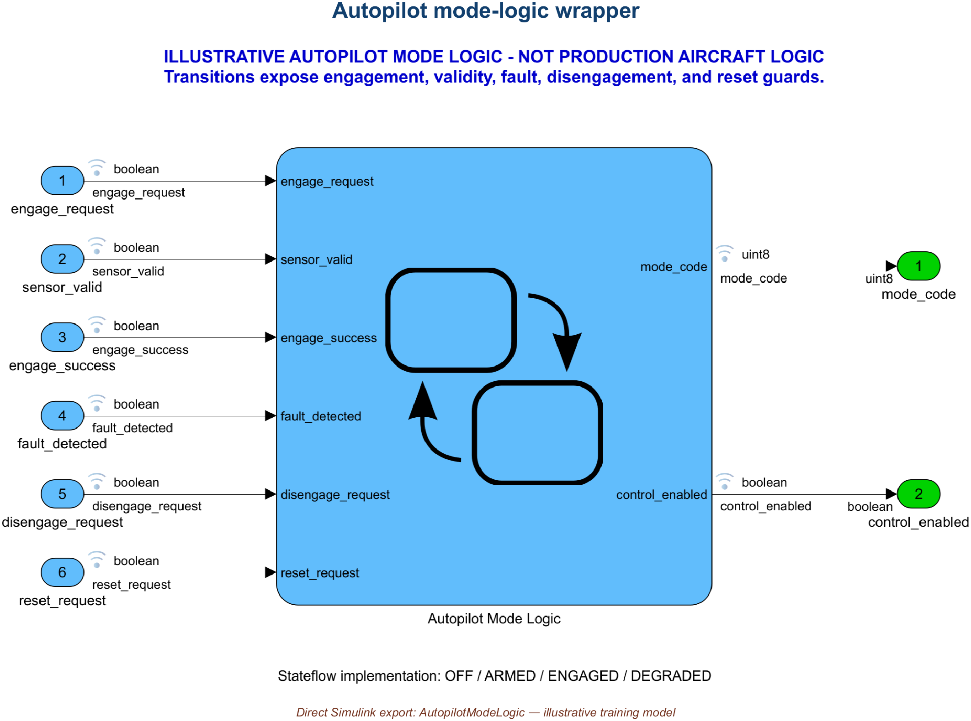
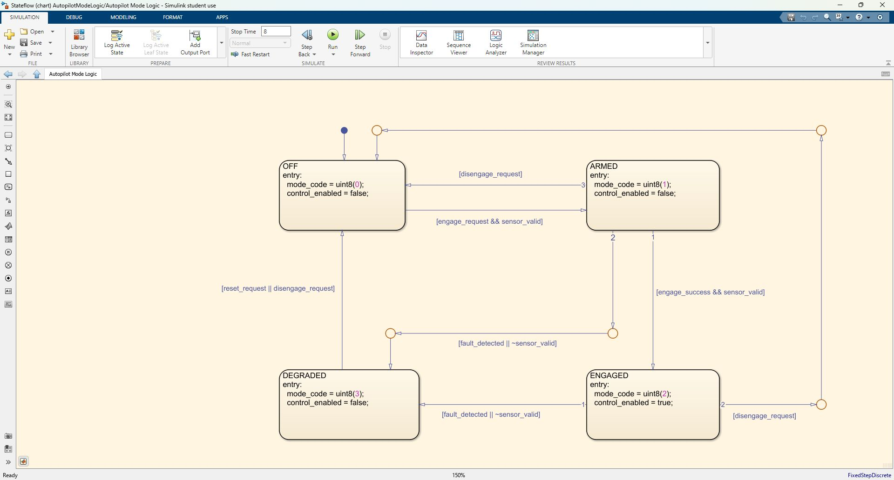
APPENDIX • REFERENCE
Reference: autopilot mode logic and Stateflow behavior
MODEL WRAPPER
Autopilot Mode Logic CHART
Root interfaces make mode inputs, status outputs, and ownership visible.
Exact chart path: AutopilotModeLogic/Autopilot Mode Logic
AVIATION CONTROLS ENGINEERING ONBOARDING • APPENDIX
51
Notes:
Timing: 4 minutes
Mode: Reference model walkthrough
Prerequisite: Stateflow available; AutopilotModeLogic open.
The Stateflow training model illustrates OFF, ARMED, ENGAGED, and DEGRADED behavior and the relationship between chart-level state logic and root-level Simulink interfaces.
Do
- Trace an arm, engage, invalid-data degradation, and reset sequence in the chart and retained mode-sequence output.
Expected
- The learner identifies visited modes and the control-enabled condition.
Recovery
- If Stateflow is unavailable, inspect the exported chart image and retained CSV; do not claim interactive execution.
Caveats
- The mode logic is illustrative and not a production autopilot state machine.
[Sources]
- models/AutopilotModeLogic.slx
- screenshots/AutopilotModeLogic_Stateflow_Editor.jpg
- results/AutopilotModeSequence.csv
- scripts/run_training_simulations.m

Slide 52
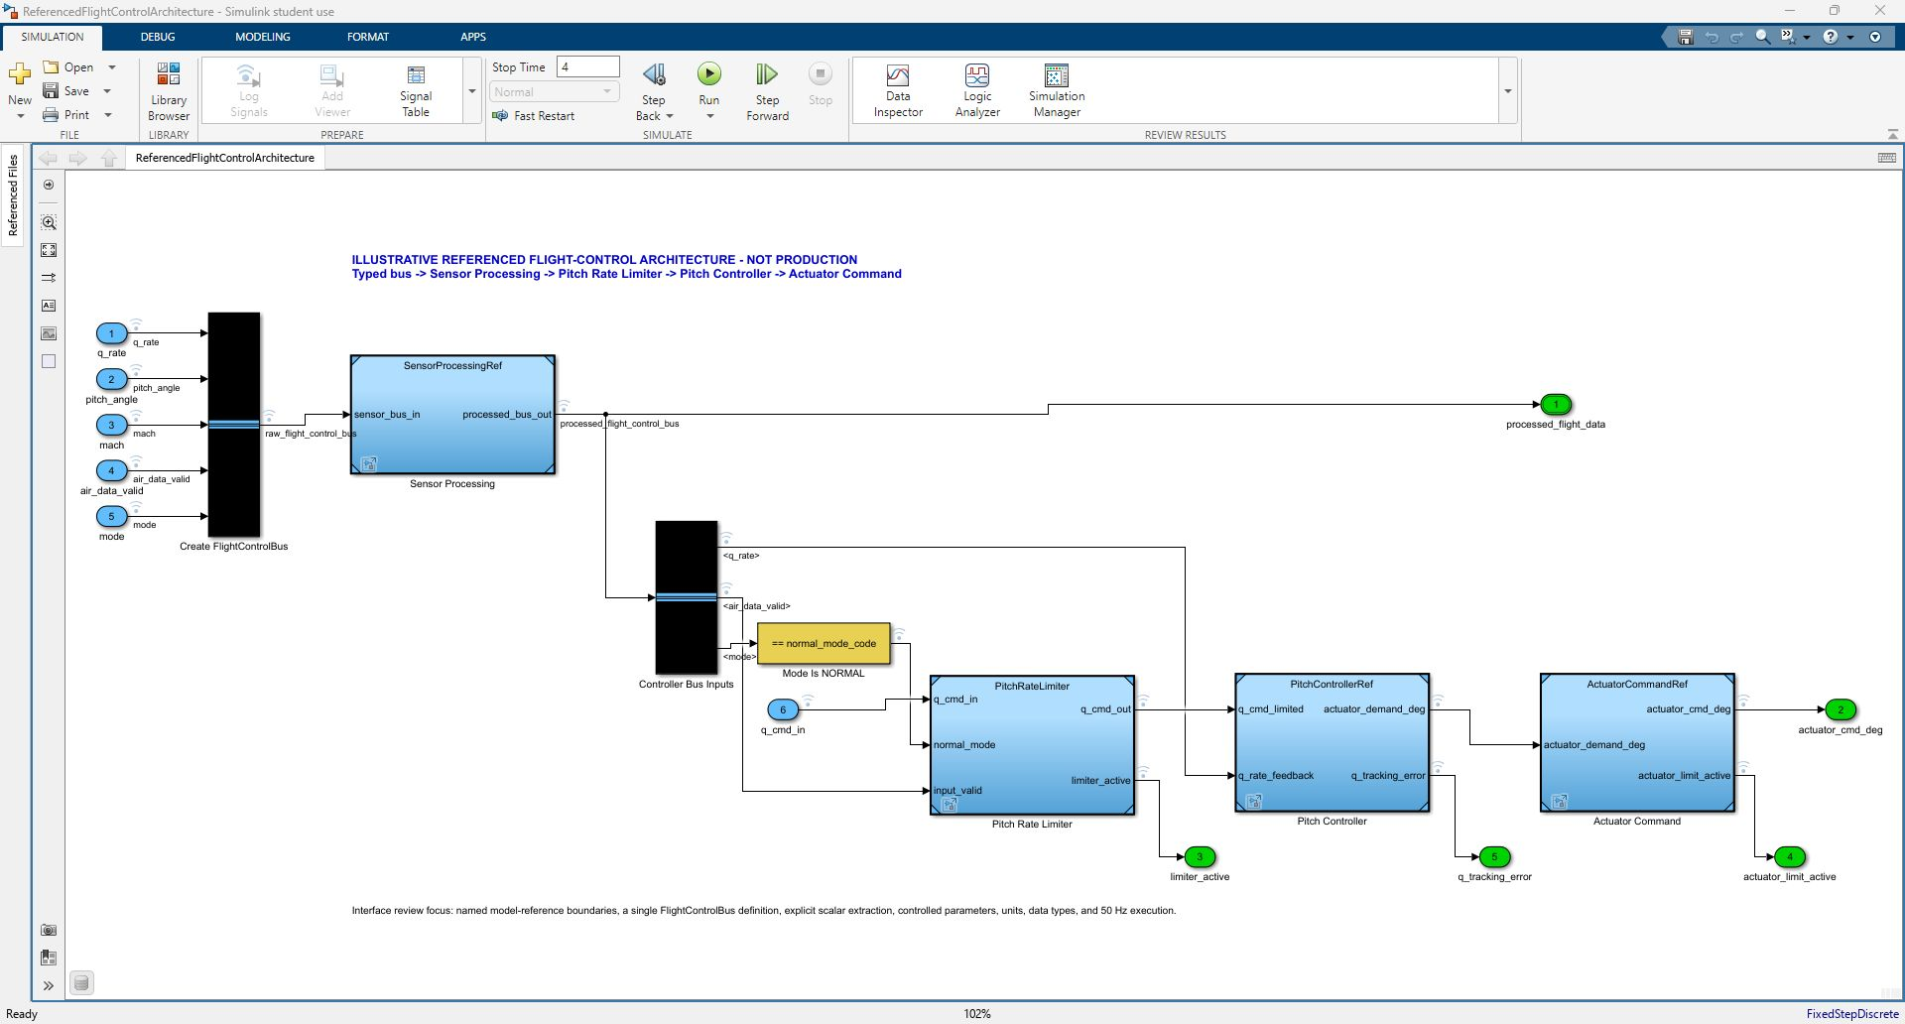
APPENDIX • REFERENCE
Reference: the model-reference integration architecture
INTEGRATION PARENT
models/ReferencedFlightControlArchitecture.slx • model-reference integration parent
AVIATION CONTROLS ENGINEERING ONBOARDING • APPENDIX
52
Notes:
Timing: 4 minutes
Mode: Reference architecture walkthrough
Prerequisite: ReferencedFlightControlArchitecture open.
Use the highest-level architecture to see bus input, sensor processing, mode interpretation, pitch-rate limiting, controller, actuator command, and referenced-model boundaries. This is also the v8 GRT build target.
Do
- Trace the four Model blocks and confirm each saved SimulationMode is Normal.
Expected
- The learner identifies SensorProcessingRef, PitchRateLimiter, PitchControllerRef, and ActuatorCommandRef and relates them to the 5/5 build.
Recovery
- If a reference is unresolved or not Normal, restore the models path and saved baseline before updating or building.
Caveats
- Successful reference resolution and compilation do not establish component verification or production readiness.
[Sources]
- models/ReferencedFlightControlArchitecture.slx
- screenshots/ReferencedFlightControlArchitecture_Model.png
- scripts/validate_training_project.m
- results/top_level_codegen_v8_evidence/ReferencedFlightControlArchitecture_slbuild.log

Slide 53
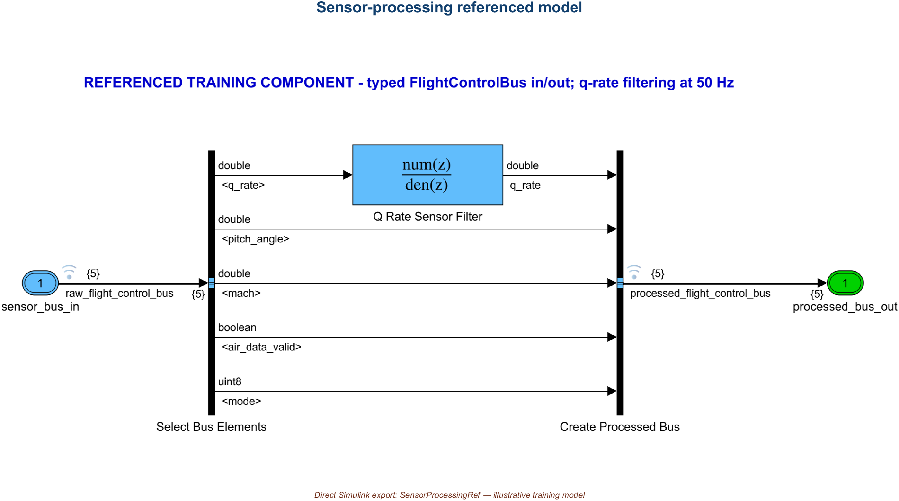
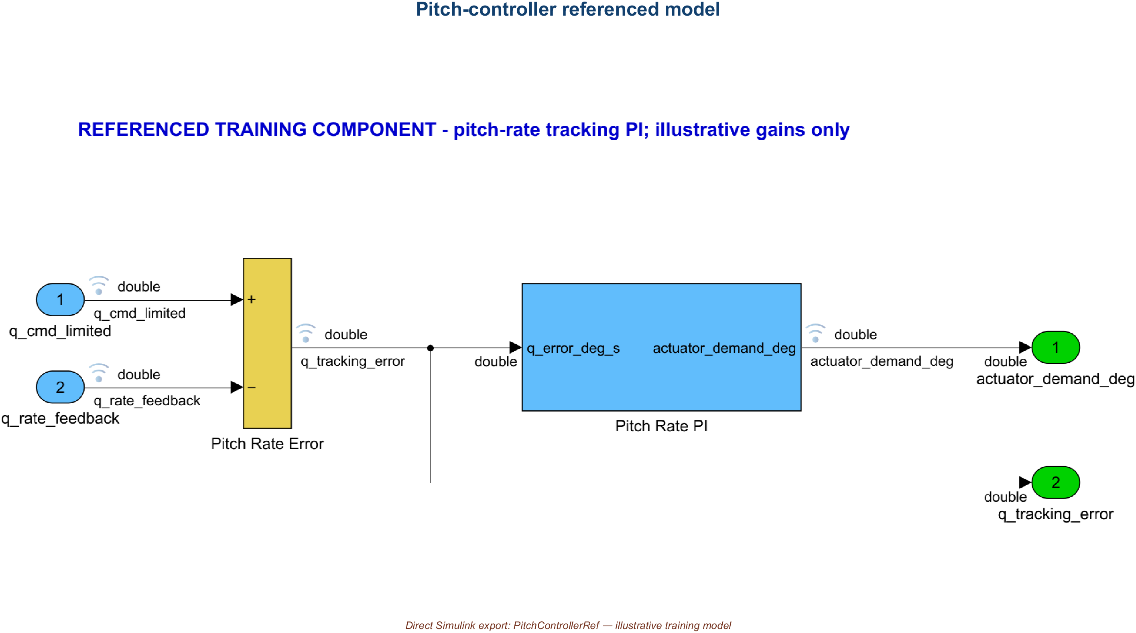
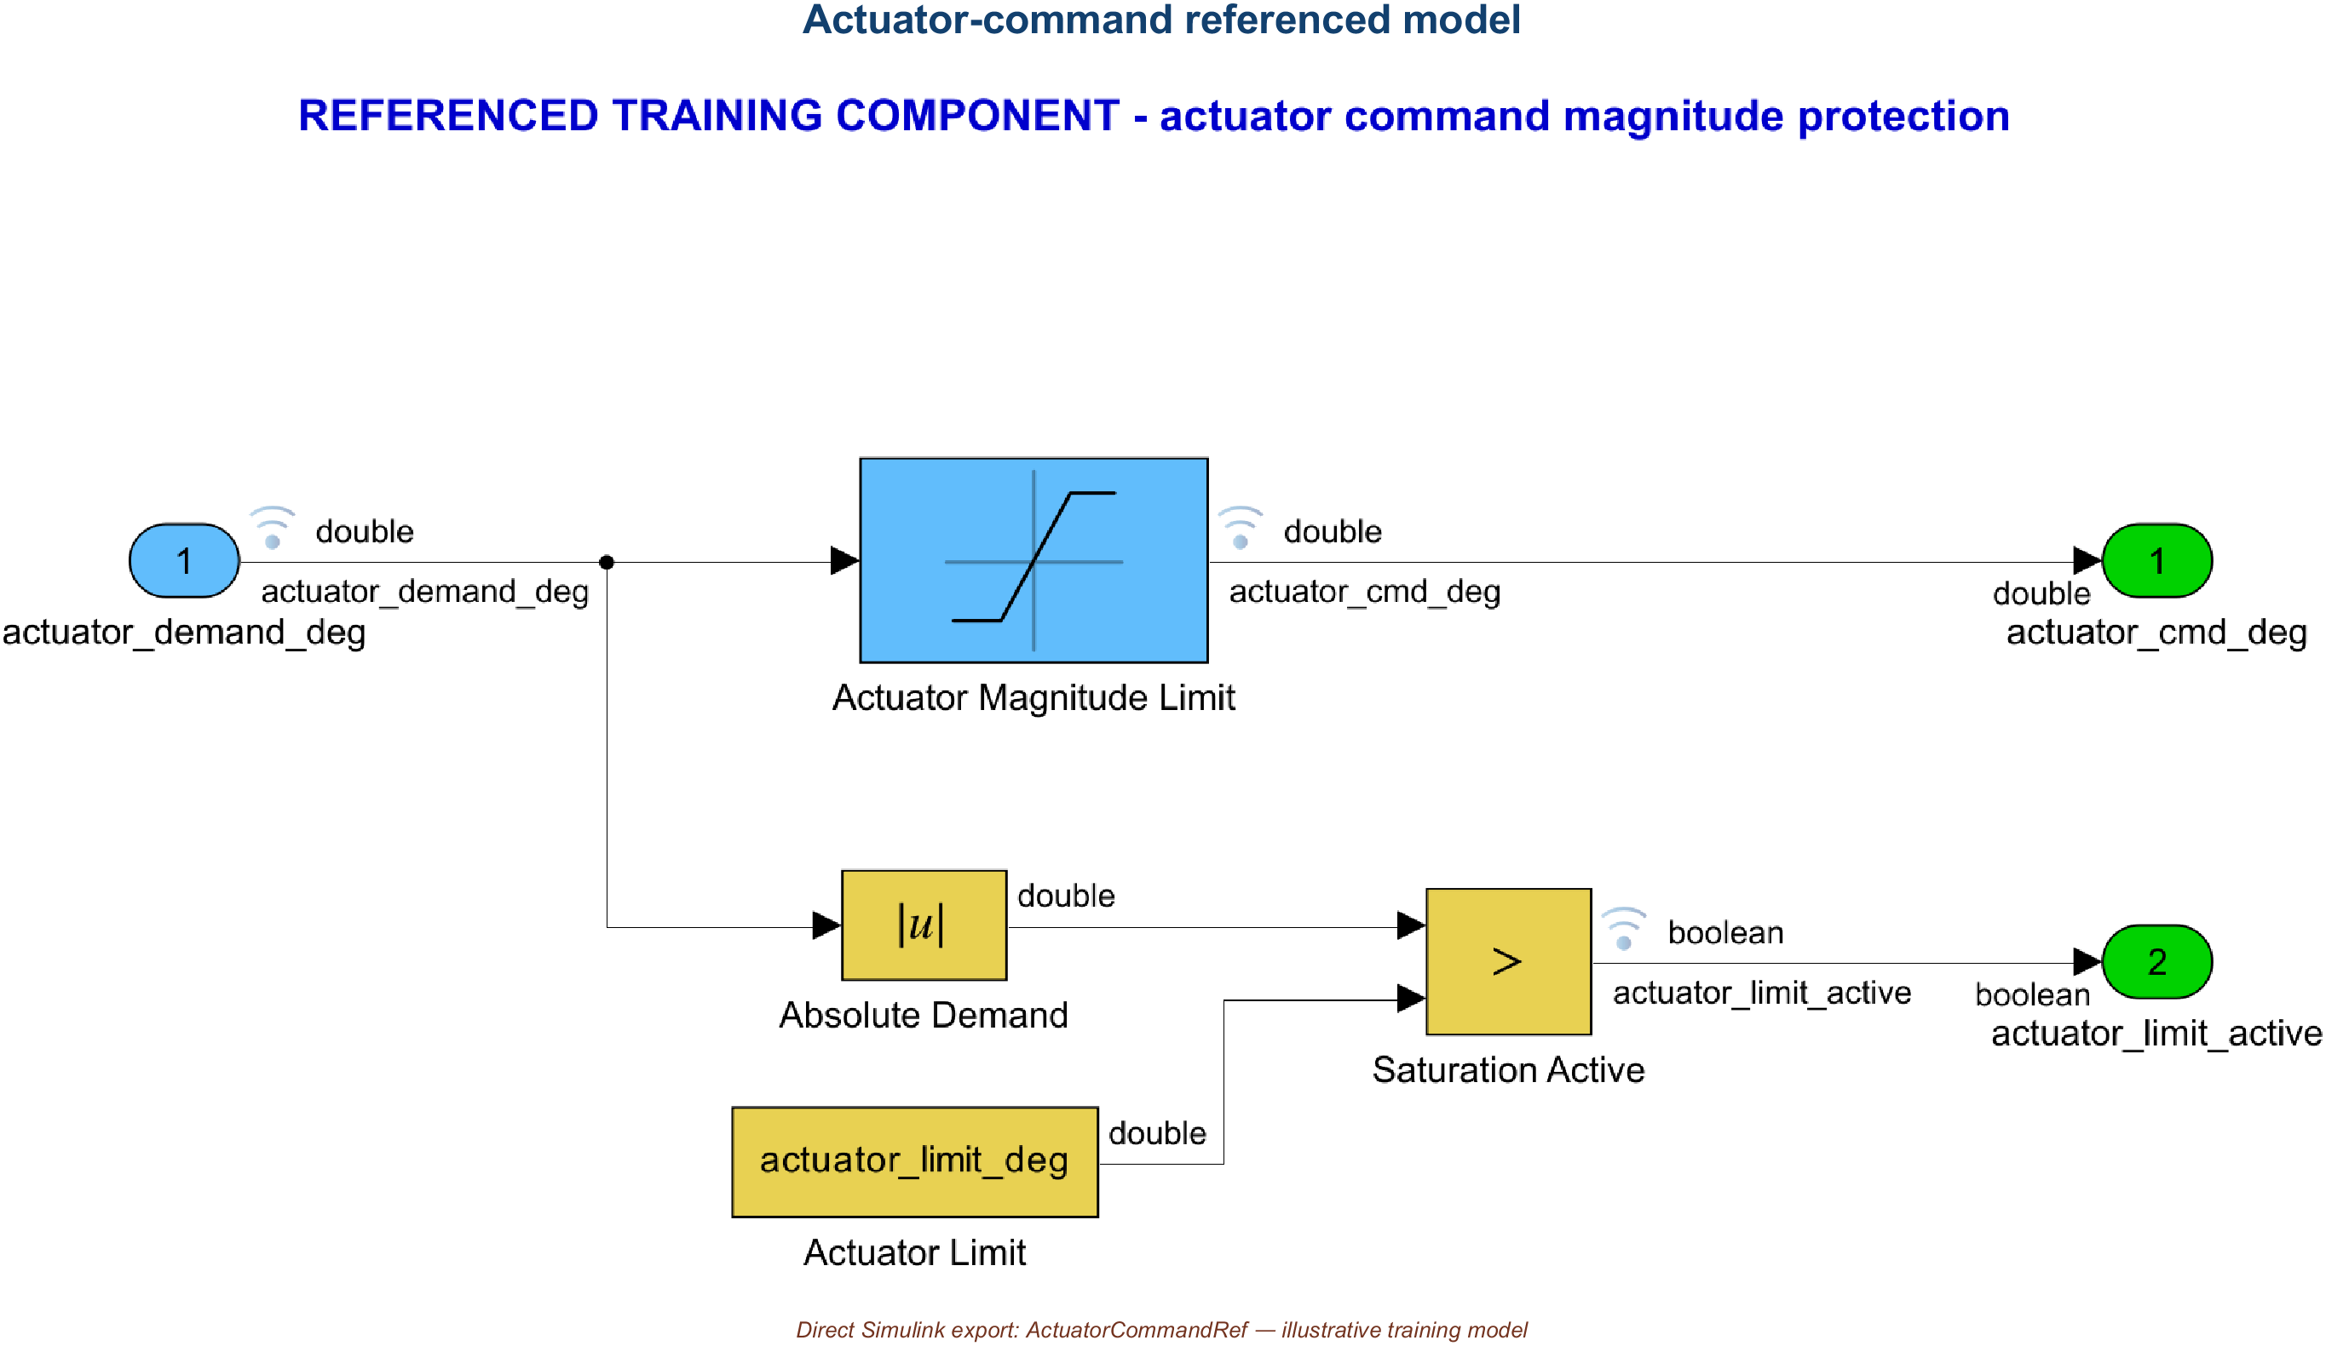
APPENDIX • REFERENCE
Reference: the four referenced component contracts
SensorProcessingRef
PitchRateLimiter
sensor contract
command protection
PitchControllerRef
ActuatorCommandRef
control-law boundary
actuator command/status
The integration parent owns composition; each referenced child owns a focused contract and can be updated, reviewed, and built explicitly.
AVIATION CONTROLS ENGINEERING ONBOARDING • APPENDIX
53
Notes:
Timing: 4 minutes
Mode: Reference contract gallery
Prerequisite: Slide 52.
The component gallery provides reviewable contracts for sensor processing, limiter, controller, and actuator command. Use names, types, units, sample time, parameters, and fallback behavior to reason across reference boundaries.
Do
- Select one component and compare its root ports, dictionary entries, and use in the top architecture.
Expected
- The learner can state the component's inputs, outputs, responsibility, and controlled parameters.
Recovery
- If the contract is unclear, return to the saved model, dictionary inventory, and bus inventory rather than inferring from layout.
Caveats
- The gallery is an orientation aid; the saved model and controlled data are authoritative within this training package.
[Sources]
- screenshots/SensorProcessingRef_Model.png
- screenshots/PitchRateLimiter_Model.png
- screenshots/PitchControllerRef_Model.png
- screenshots/ActuatorCommandRef_Model.png
- results/FCS_DataDictionary_Inventory.csv
- results/FlightControlBus_Inventory.csv

Slide 54

APPENDIX • REFERENCE
Reference: turn model displays on—and off—for focus
DEBUG → INFORMATION OVERLAYS
PORT UNITS
ShowPortUnits
DATA TYPES
ShowPortDataTypes
DIMENSIONS
ShowLineDimensions
SIGNAL NAMES
line labels + propagated names
LOGGING BADGES
DataLogging + model SignalLogging
TEST POINTS
ShowTestPointIcons, when supported
MODEL OVERLAYS — units, types, dimensions, names, and log/test-point badges annotate the diagram.
SDI MARKERS — cursors and data points annotate logged traces. Neither display changes behavior.
AVIATION CONTROLS ENGINEERING ONBOARDING • APPENDIX
54
Notes:
Timing: 3 minutes
Mode: Reference visualization
Prerequisite: Relevant model or result open.
Use overlays to connect visual annotation with the underlying model and results. Labels should identify navigation, signal purpose, or evidence relationship without obscuring the original artifact.
Do
- Choose one overlay and verify every callout against the saved model or retained result file.
Expected
- The learner distinguishes editorial guidance from model-generated annotations and evidence.
Recovery
- If a callout disagrees with the source artifact, correct the overlay and retain the source unchanged.
Caveats
- Editorial overlays are explanatory and are not independent verification evidence.
[Sources]
- screenshots/VisualManifest.csv
- scripts/export_training_visuals.m
- screenshots/TrainingEvidenceSummary.png

Slide 55
APPENDIX • REFERENCE
Reference: callbacks and the retained test driver are separate paths
TWO SEPARATE EXECUTION PATHS • DO NOT DRAW A PIPELINE BETWEEN THEM
CALLBACK EXAMPLE
RETAINED LIMITER ASSESSMENT
1 callback_workflow_example.m
1 initialize_training_data.m
↓
↓
2 preload calls setup when context is absent
2 create + inject 3 test timeseries
↓
↓
3 setup creates Dataset/context; preload stores state
3 simulate PitchRateLimiter_Harness once
↓
↓
4 postload configures standalone PitchRateLimiter
4 assess outputs + status + time + suite spacing
↓
↓
5 optional standalone simulation
5 retain CSV • MAT • HTML • PNG
NO HARNESS DRIVER • NO ORACLE • NO EVIDENCE REPORT
run_pitch_rate_limiter_tests.m OWNS ORACLE + EVIDENCE
KEY DISTINCTION • callback_workflow_example.m never invokes run_pitch_rate_limiter_tests.m
AVIATION CONTROLS ENGINEERING ONBOARDING • APPENDIX
55
Notes:
Timing: 4 minutes
Mode: Reference workflow
Prerequisite: Standalone PitchRateLimiter callback example available.
Keep callback and verification paths separate. The callback example creates and loads deterministic context for standalone exploration; run_pitch_rate_limiter_tests initializes the baseline, injects the nineteen-point harness inputs, simulates, applies the oracle, and writes retained evidence.
Do
- Trace preload, setup, postload, optional standalone simulation, and cleanup, then compare that lane with the harness driver.
Expected
- The learner identifies which path creates context and which path owns the retained assessment oracle and reports.
Recovery
- If callback state persists, run the project cleanup workflow and verify the base/model workspace before executing the harness driver.
Caveats
- callback_workflow_example.m does not invoke the retained harness test driver.
- Callbacks create context; they do not by themselves create verification evidence.
[Sources]
- scripts/callback_workflow_example.m
- scripts/training_callback_preload.m
- scripts/training_callback_setup.m
- scripts/training_callback_postload.m
- scripts/training_callback_cleanup.m
- scripts/run_pitch_rate_limiter_tests.m

