Slide 1
NEW AVIATION CONTROLS ENGINEER ONBOARDING
Simulink in the Aerospace
Controls Lifecycle
A practical guide from requirements and control-law models to HIL results and certification evidence
REQUIRE
MODEL
VERIFY
EVIDENCE
FLIGHT-CONTROL SOFTWARE IS AN UNBROKEN CHAIN
AVIATION CONTROLS ENGINEERING ONBOARDING
01
Notes:
Timing: 1 minute
Suggested visual:
A four-stage signal path—Require, Model, Verify, Evidence—sets the throughline for the course.
Speaker notes:
Welcome the new engineer and establish the scope: this is not a block-by-block product tutorial and not a complete certification course. It is a practical mental model for how a controls engineer works inside an aerospace Model-Based Design program. The central idea is that the Simulink model sits inside a governed evidence chain. A good control law is necessary, but it is not sufficient. The engineer must also understand where the behavior came from, how interfaces are controlled, how tests prove the requirement, and how results become reviewable life-cycle data. The pitch-rate-limiter example will reappear throughout the session so every artifact feels connected rather than abstract.
Key teaching points:
• Simulink is one part of a controlled software lifecycle.
• The course follows one behavior from requirement to HIL evidence.
• The target outcome is practical onboarding, not standards interpretation.

Slide 2
ORIENTATION
The executable model is the engineering hub
Requirements
Simulation
EXECUTABLE
MODEL
Control design
MODEL-BASED DESIGN
Verification
The same behavior can be discussed, simulated, reviewed, tested, integrated, and traced.
AVIATION CONTROLS ENGINEERING ONBOARDING
02
Notes:
Timing: 1.5 minutes
Suggested visual:
An executable model at the center connects requirements, control design, simulation, and verification.
Speaker notes:
Explain Model-Based Design as a lifecycle pattern, not merely drawing blocks. The model is executable: it has time, data types, sample rates, state, interfaces, and observable behavior. Requirements can link to model elements; tests can stimulate the model; generated code can be compared with model behavior; the same interfaces can later connect to architecture and hardware benches. This shared representation reduces translation between a control-law equation, a software implementation, and a test procedure—but it does not remove the need for reviews, independent verification, or configuration control. The model’s formal role must be defined in the project plans: it may be a design model, a source model used for code generation, or another project-defined artifact.
Key teaching points:
• Model-Based Design keeps the model central across the lifecycle.
• Execution exposes dynamic behavior before hardware is available.
• The project defines the certification role of each model.
[Sources]
- https://www.mathworks.com/help/simulink/gs/model-based-design.html
- https://www.faa.gov/documentLibrary/media/Advisory_Circular/AC_20-115D.pdf

Slide 3
ORIENTATION
Your first session: orient, execute, inspect, trace
Operate a model — initialize paths; open, update, run, stop, and inspect results
Navigate the editor — Simulation, Debug, Modeling, and Apps
Read semantics — units, data types, dimensions, timing, and logging
Trace behavior — top level → component → harness → executed evidence
1 START + RUN
2 MODEL HIERARCHY
3 OVERLAYS
4 DATA INSPECTOR
5 TRACEABILITY
Keep asking: Which model am I in, what state is visible, and what evidence proves the requirement?
AVIATION CONTROLS ENGINEERING ONBOARDING
03
Notes:
Timing: 2 minutes
This orientation now previews the first-session actions that follow. The key distinction is between operating the tool, understanding the model hierarchy, reviewing displayed semantics, inspecting logged data, and tracing behavior to evidence. Keep “top level” tied to the current job: simulation, integration, development, or unit verification.
[Sources]
- https://www.mathworks.com/help/simulink/slref/simulinkeditor.html
- https://www.nasa.gov/reference/systems-engineering-handbook/

Slide 4
01 • INTRODUCTION TO SIMULINK
MATLAB computes; Simulink exposes behavior
MATLAB
SIMULINK
Best at — scripts, algorithms, matrices, optimization, data analysis
Execution — statements and functions run in defined order
View — variables, arrays, figures, tables, reports
Best at — dynamic systems, feedback, hybrid logic, integration
Execution — blocks exchange signals over simulated time
View — data flow, hierarchy, state, sample time, interfaces
They are one environment: MATLAB configures, analyzes, automates, and reports on Simulink models.
AVIATION CONTROLS ENGINEERING ONBOARDING
04
Notes:
Timing: 2 minutes
Suggested visual:
A balanced MATLAB-versus-Simulink comparison converges into one integrated workflow.
Speaker notes:
Connect the learner’s existing MATLAB knowledge to Simulink. MATLAB is ideal for calculations, data conditioning, parameter studies, optimization, and post-processing. Simulink adds an executable block-diagram representation of a dynamic system. The arrows are not simply a visual ordering of statements; they carry typed values over simulated time, and blocks may maintain internal state. In daily work the tools are tightly coupled: a MATLAB script may open a project, configure a model, run a test suite, analyze logs, and publish a report. Aerospace teams use Simulink because control laws, plant dynamics, sensor processing, mode logic, interfaces, and tests can be reviewed in a shared environment before flight hardware exists.
Key teaching points:
• Simulink is a block-diagram environment for dynamic simulation and Model-Based Design.
• Graphical data flow complements—not replaces—MATLAB scripting.
• Time, state, data type, and interface semantics are first-class concerns.
[Sources]
- https://www.mathworks.com/help/simulink/getting-started-with-simulink.html
- https://www.mathworks.com/help/simulink/gs/model-based-design.html

Slide 5
01 • INTRODUCTION TO SIMULINK
Five actions start every first Simulink session
ACTION
WHERE
PURPOSE
INITIALIZE
MATLAB Command Window
Run initialize_training_data(projectRoot); add scripts, models, and data to the path.
OPEN
open_system(...) or Ctrl+O
Open AircraftFeedbackControlLoop.slx — the runnable closed-loop simulation entry point.
UPDATE
Modeling → Update Model • Ctrl+D
Compile and propagate types, dimensions, units, and rates; update does not simulate.
RUN / STOP
Simulation → Run • Ctrl+T / F5
Execute the desktop simulation; stop with Ctrl+Shift+T.
BUILD
Apps → Simulink Coder • Ctrl+B
Generate and compile code only when the configured coder and toolchain are in scope.
Update ≠ run ≠ code-generation build. Record which action produced each result.
AVIATION CONTROLS ENGINEERING ONBOARDING
05
Notes:
Timing: 4 minutes
First-session command path:
1. projectRoot = pwd;
2. addpath(fullfile(projectRoot,'scripts'), fullfile(projectRoot,'models'), fullfile(projectRoot,'data'));
3. initialize_training_data(projectRoot);
4. open_system(fullfile(projectRoot,'models','AircraftFeedbackControlLoop.slx'));
5. Update Model with Ctrl+D before the first run; run with Ctrl+T or F5; stop with Ctrl+Shift+T.
Update/compile resolves and propagates model semantics; it is not a simulation. Run executes the desktop model. Ctrl+B is a configured code-generation build, which is a separate action. This training package does not claim generated-code, PIL, or HIL evidence.
The displaced file-type lesson remains useful: .slx is a model, .m is MATLAB code, .mlx is live code, .sldd is controlled design data, and .mldatx is a Simulink Test artifact. This package does not supply a .mldatx file.
[Sources]
- https://www.mathworks.com/help/simulink/ug/summary-of-mouse-and-keyboard-actions.html
- https://www.mathworks.com/help/rtw/ug/generating-code-using-simulink-coder.html

Slide 6
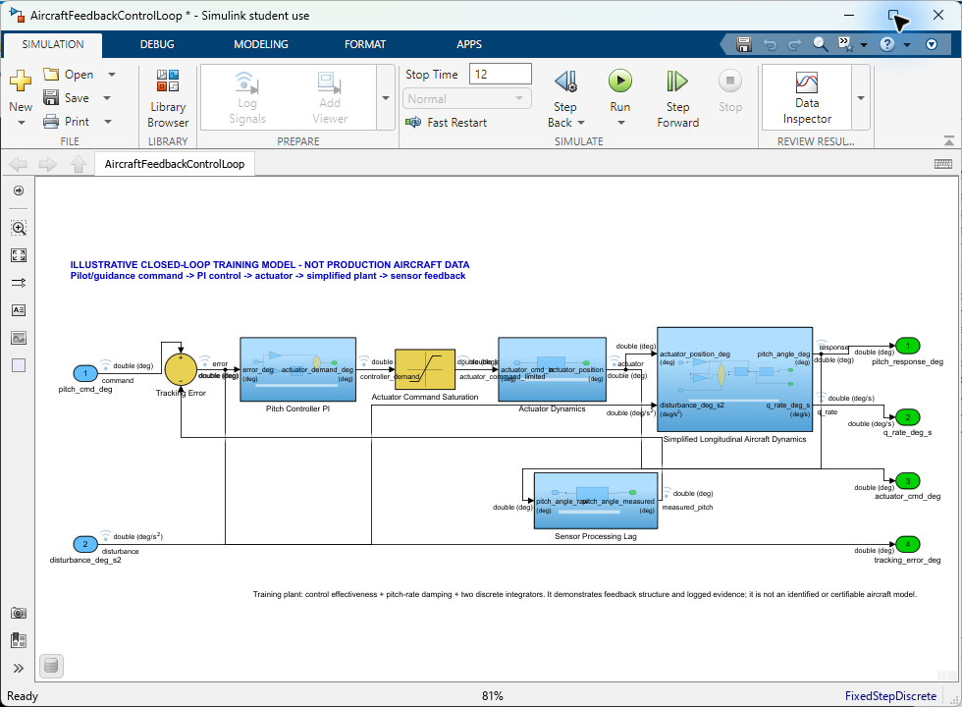
01 • INTRODUCTION TO SIMULINK
The toolstrip tells you where each action lives
SIMULATION
Run • Stop • Data Inspector
DEBUG
Diagnostics • overlays • signal review
MODELING
Update Model • settings • interfaces
APPS
Testing tools • code generation
Authentic R2023b editor • select a tab first, then the action • update, run, inspect, and build are different operations
AVIATION CONTROLS ENGINEERING ONBOARDING
06
Notes:
Timing: 4 minutes
Use this authentic local R2023b editor capture to orient the learner. Start at the toolstrip:
- Simulation: Run, Stop, and Data Inspector.
- Debug: diagnostics and Information Overlays.
- Modeling: Update Model and model configuration/settings.
- Apps: optional products such as testing and code generation.
The visible model is models/AircraftFeedbackControlLoop.slx, the runnable closed-loop training simulation. The title-bar asterisk reflects temporary display settings used for the capture; the source model was not saved or modified.
[Sources]
- https://www.mathworks.com/help/simulink/slref/simulinkeditor.html
- https://www.mathworks.com/help/simulink/ug/summary-of-mouse-and-keyboard-actions.html

Slide 7
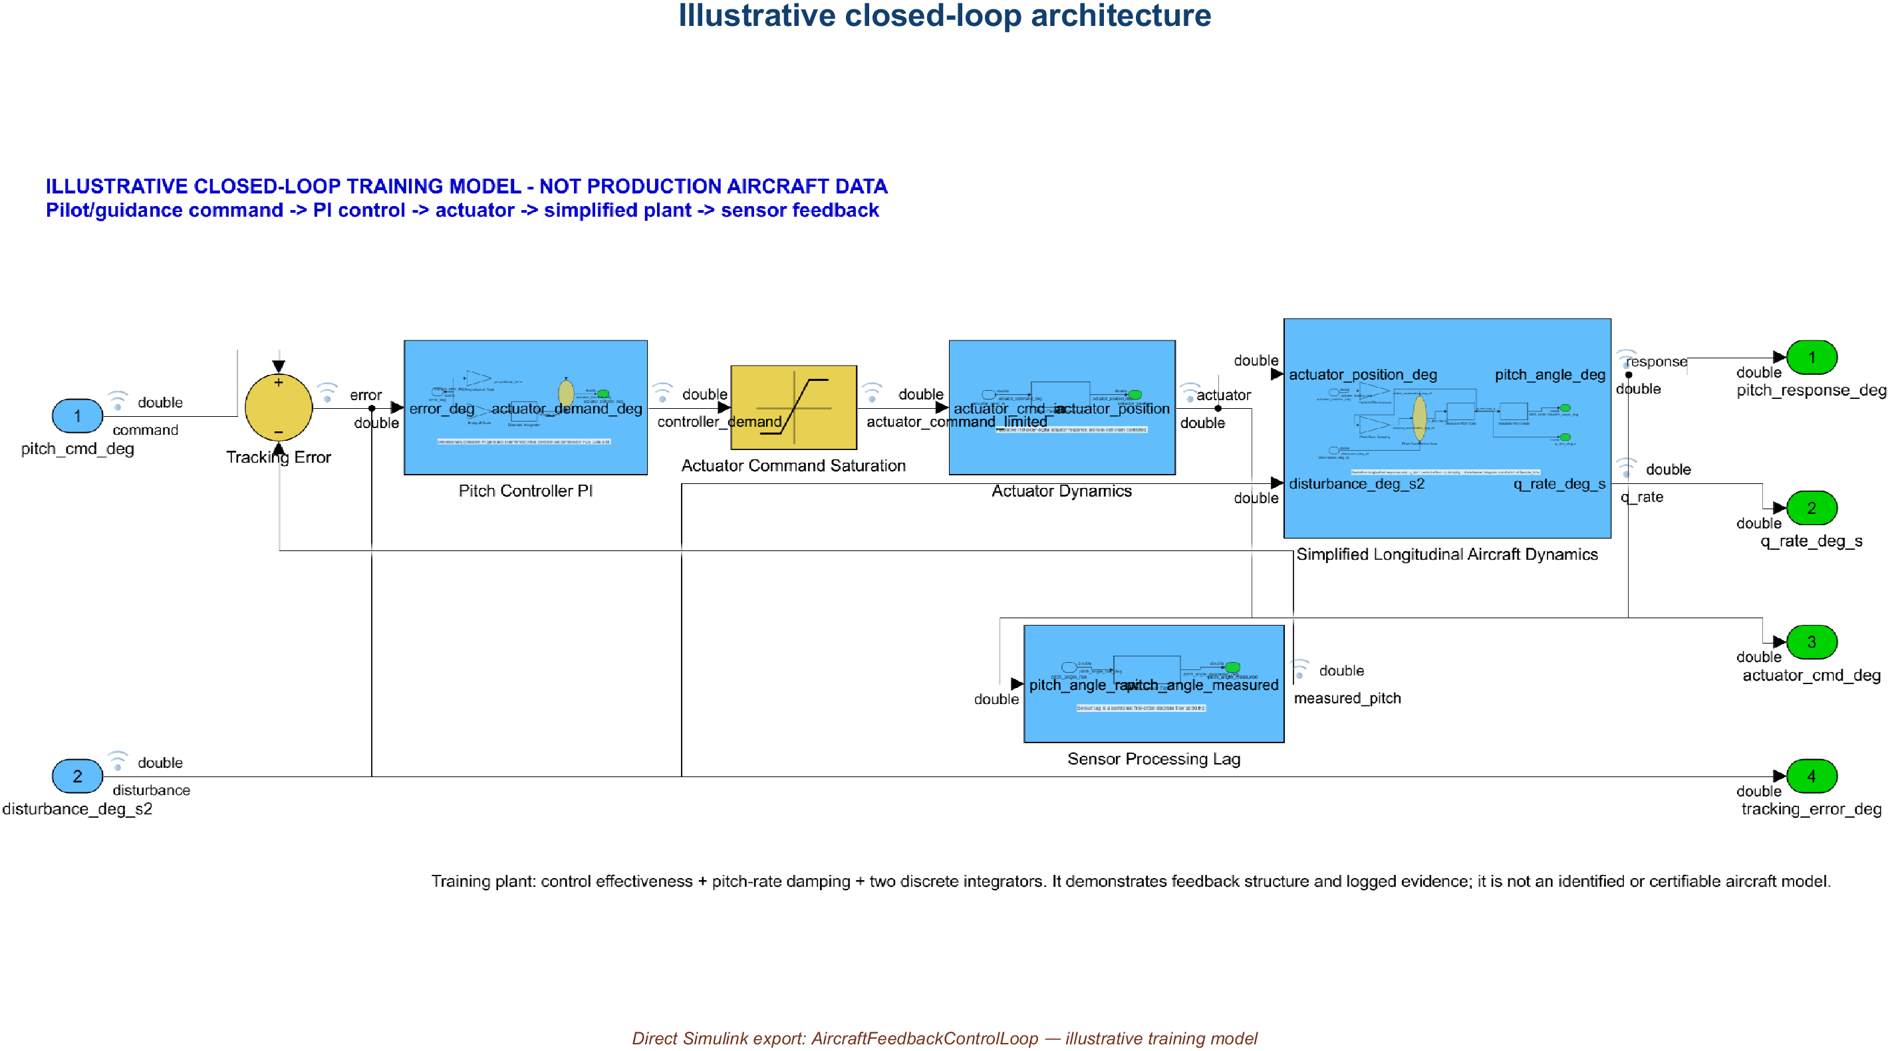
01 • INTRODUCTION TO SIMULINK
Turn review overlays on—and off—for focus
DEBUG → INFORMATION OVERLAYS
UNITS
BASE DATA TYPES
SIGNAL DIMENSIONS
LOG & TESTPOINT
FOCUSED CANVAS — overlays reduced
REVIEW CANVAS — semantics visible
Model overlays annotate the diagram. SDI markers annotate plotted samples. Turning either display on or off does not change model behavior or logged values.
AVIATION CONTROLS ENGINEERING ONBOARDING
07
Notes:
Timing: 4 minutes
From Debug > Information Overlays, show or hide Units, Base Data Types, Signal Dimensions, and Log & Testpoint indicators. Use overlays while reviewing interfaces, then reduce them when the diagram becomes visually crowded. The displayed unit is metadata associated with the port or signal; turning the overlay off does not remove the underlying unit.
Distinguish three ideas:
- A signal can be configured for logging.
- A model overlay can show the logging/test-point badge and other metadata on the diagram.
- An SDI marker shows an exact logged sample on a plotted trace.
[Sources]
- https://www.mathworks.com/help/simulink/slref/simulinkeditor.html
- https://www.mathworks.com/help/simulink/ug/displaying-units.html
- https://www.mathworks.com/help/simulink/gui/signallogging.html
- https://www.mathworks.com/help/simulink/slref/simulink.sdi.setmarkerson.html

Slide 8
01 • INTRODUCTION TO SIMULINK
Know which top-level model you opened
SIMULATE
AircraftFeedbackControlLoop.slx
runnable closed-loop training model
INTEGRATE
ReferencedFlightControl
Architecture.slx
parent model-reference architecture
DEVELOP
PitchRateLimiter.slx + referenced components
component implementation
VERIFY
PitchRateLimiter_Harness.slx
unit-level stimulus and capture
“Top level” means the entry point for the current job—not one universal model.
AVIATION CONTROLS ENGINEERING ONBOARDING
08
Notes:
Timing: 3 minutes
Four entry points are visible because they answer different questions:
- AircraftFeedbackControlLoop.slx: runnable closed-loop system-level training simulation.
- ReferencedFlightControlArchitecture.slx: integration parent containing SensorProcessingRef, PitchRateLimiter, PitchControllerRef, and ActuatorCommandRef model references.
- PitchRateLimiter.slx: software component implementation.
- PitchRateLimiter_Harness.slx: separate unit harness that points to PitchRateLimiter.
Do not imply that AircraftFeedbackControlLoop is the parent of ReferencedFlightControlArchitecture; they are separate top-level models for different jobs.

Slide 9
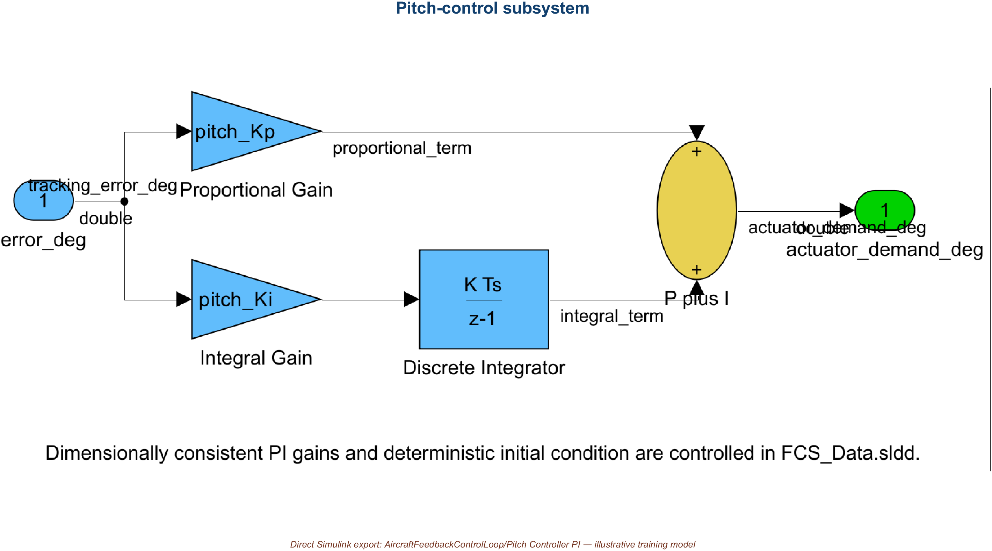
02 • CONTROLS ENGINEERING IN SIMULINK
Control-law math maps to reusable patterns
Illustrative training subsystem • parameterized PI law and deterministic integrator state
AVIATION CONTROLS ENGINEERING ONBOARDING
09
Notes:
Timing: 2 minutes
Suggested visual:
The real Pitch Controller subsystem exposes proportional and integral paths with controlled parameters.
Speaker notes:
Relate familiar control concepts to model patterns. A Gain block implements a scalar or matrix gain. Filters can be represented as transfer functions, discrete filters, state-space blocks, or explicit difference equations. Integrators represent continuous or discrete accumulation and require careful initial-condition handling. Lookup tables implement calibrated or scheduled behavior across operating conditions. Stateflow is commonly used for modes, guards, transitions, and fault logic. Saturation and rate-limiting blocks protect actuators and commands—but distinguish a magnitude limiter from a slew-rate limiter. Sensor processing often includes scaling, validity, filtering, voting, and unit conversion; actuator paths may include command shaping, rate limits, position limits, and monitoring.
Key teaching points:
• Choose blocks that preserve the intended mathematics and execution semantics.
• Scheduling connects one control-law structure to a changing flight envelope.
• Limits and mode logic are requirements, not cosmetic safeguards.
[Sources]
- https://www.mathworks.com/help/simulink/slref/designing-a-guidance-system-in-matlab-and-simulink.html
- https://www.mathworks.com/help/simulink/slref/designing-a-high-angle-of-attack-pitch-mode-control.html
V2 artifact update: The visual is the actual Pitch Controller subsystem from the delivered feedback model. The proportional and integral paths resolve controlled values from FCS_Data.sldd, and the discrete integrator uses a deterministic initial condition. [Sources - V2 artifact] - Local: models/AircraftFeedbackControlLoop.slx, Pitch Controller subsystem
V2 artifact update: The visual is the actual Pitch Controller subsystem from the delivered feedback model. The proportional and integral paths resolve controlled values from FCS_Data.sldd, and the discrete integrator uses a deterministic initial condition. [Sources - V2 artifact] - Local: models/AircraftFeedbackControlLoop.slx, Pitch Controller subsystem
V2 artifact update: The visual is the actual Pitch Controller subsystem from the delivered feedback model. The proportional and integral paths resolve controlled values from FCS_Data.sldd, and the discrete integrator uses a deterministic initial condition. [Sources - V2 artifact] - Local: models/AircraftFeedbackControlLoop.slx, Pitch Controller subsystem

Slide 10
02 • CONTROLS ENGINEERING IN SIMULINK
Control-law math maps to reusable patterns
Illustrative training subsystem • parameterized PI law and deterministic integrator state
AVIATION CONTROLS ENGINEERING ONBOARDING
09
Notes:
Timing: 2 minutes
Suggested visual:
The real Pitch Controller subsystem exposes proportional and integral paths with controlled parameters.
Speaker notes:
Relate familiar control concepts to model patterns. A Gain block implements a scalar or matrix gain. Filters can be represented as transfer functions, discrete filters, state-space blocks, or explicit difference equations. Integrators represent continuous or discrete accumulation and require careful initial-condition handling. Lookup tables implement calibrated or scheduled behavior across operating conditions. Stateflow is commonly used for modes, guards, transitions, and fault logic. Saturation and rate-limiting blocks protect actuators and commands—but distinguish a magnitude limiter from a slew-rate limiter. Sensor processing often includes scaling, validity, filtering, voting, and unit conversion; actuator paths may include command shaping, rate limits, position limits, and monitoring.
Key teaching points:
• Choose blocks that preserve the intended mathematics and execution semantics.
• Scheduling connects one control-law structure to a changing flight envelope.
• Limits and mode logic are requirements, not cosmetic safeguards.
[Sources]
- https://www.mathworks.com/help/simulink/slref/designing-a-guidance-system-in-matlab-and-simulink.html
- https://www.mathworks.com/help/simulink/slref/designing-a-high-angle-of-attack-pitch-mode-control.html
V2 artifact update: The visual is the actual Pitch Controller subsystem from the delivered feedback model. The proportional and integral paths resolve controlled values from FCS_Data.sldd, and the discrete integrator uses a deterministic initial condition. [Sources - V2 artifact] - Local: models/AircraftFeedbackControlLoop.slx, Pitch Controller subsystem
V2 artifact update: The visual is the actual Pitch Controller subsystem from the delivered feedback model. The proportional and integral paths resolve controlled values from FCS_Data.sldd, and the discrete integrator uses a deterministic initial condition. [Sources - V2 artifact] - Local: models/AircraftFeedbackControlLoop.slx, Pitch Controller subsystem
V2 artifact update: The visual is the actual Pitch Controller subsystem from the delivered feedback model. The proportional and integral paths resolve controlled values from FCS_Data.sldd, and the discrete integrator uses a deterministic initial condition. [Sources - V2 artifact] - Local: models/AircraftFeedbackControlLoop.slx, Pitch Controller subsystem

Slide 11
02 • CONTROLS ENGINEERING IN SIMULINK
Control-law math maps to reusable patterns
Illustrative training subsystem • parameterized PI law and deterministic integrator state
AVIATION CONTROLS ENGINEERING ONBOARDING
09
Notes:
Timing: 2 minutes
Suggested visual:
The real Pitch Controller subsystem exposes proportional and integral paths with controlled parameters.
Speaker notes:
Relate familiar control concepts to model patterns. A Gain block implements a scalar or matrix gain. Filters can be represented as transfer functions, discrete filters, state-space blocks, or explicit difference equations. Integrators represent continuous or discrete accumulation and require careful initial-condition handling. Lookup tables implement calibrated or scheduled behavior across operating conditions. Stateflow is commonly used for modes, guards, transitions, and fault logic. Saturation and rate-limiting blocks protect actuators and commands—but distinguish a magnitude limiter from a slew-rate limiter. Sensor processing often includes scaling, validity, filtering, voting, and unit conversion; actuator paths may include command shaping, rate limits, position limits, and monitoring.
Key teaching points:
• Choose blocks that preserve the intended mathematics and execution semantics.
• Scheduling connects one control-law structure to a changing flight envelope.
• Limits and mode logic are requirements, not cosmetic safeguards.
[Sources]
- https://www.mathworks.com/help/simulink/slref/designing-a-guidance-system-in-matlab-and-simulink.html
- https://www.mathworks.com/help/simulink/slref/designing-a-high-angle-of-attack-pitch-mode-control.html
V2 artifact update: The visual is the actual Pitch Controller subsystem from the delivered feedback model. The proportional and integral paths resolve controlled values from FCS_Data.sldd, and the discrete integrator uses a deterministic initial condition. [Sources - V2 artifact] - Local: models/AircraftFeedbackControlLoop.slx, Pitch Controller subsystem
V2 artifact update: The visual is the actual Pitch Controller subsystem from the delivered feedback model. The proportional and integral paths resolve controlled values from FCS_Data.sldd, and the discrete integrator uses a deterministic initial condition. [Sources - V2 artifact] - Local: models/AircraftFeedbackControlLoop.slx, Pitch Controller subsystem
V2 artifact update: The visual is the actual Pitch Controller subsystem from the delivered feedback model. The proportional and integral paths resolve controlled values from FCS_Data.sldd, and the discrete integrator uses a deterministic initial condition. [Sources - V2 artifact] - Local: models/AircraftFeedbackControlLoop.slx, Pitch Controller subsystem

Slide 12
02 • CONTROLS ENGINEERING IN SIMULINK
Control-law math maps to reusable patterns
Illustrative training subsystem • parameterized PI law and deterministic integrator state
AVIATION CONTROLS ENGINEERING ONBOARDING
09
Notes:
Timing: 2 minutes
Suggested visual:
The real Pitch Controller subsystem exposes proportional and integral paths with controlled parameters.
Speaker notes:
Relate familiar control concepts to model patterns. A Gain block implements a scalar or matrix gain. Filters can be represented as transfer functions, discrete filters, state-space blocks, or explicit difference equations. Integrators represent continuous or discrete accumulation and require careful initial-condition handling. Lookup tables implement calibrated or scheduled behavior across operating conditions. Stateflow is commonly used for modes, guards, transitions, and fault logic. Saturation and rate-limiting blocks protect actuators and commands—but distinguish a magnitude limiter from a slew-rate limiter. Sensor processing often includes scaling, validity, filtering, voting, and unit conversion; actuator paths may include command shaping, rate limits, position limits, and monitoring.
Key teaching points:
• Choose blocks that preserve the intended mathematics and execution semantics.
• Scheduling connects one control-law structure to a changing flight envelope.
• Limits and mode logic are requirements, not cosmetic safeguards.
[Sources]
- https://www.mathworks.com/help/simulink/slref/designing-a-guidance-system-in-matlab-and-simulink.html
- https://www.mathworks.com/help/simulink/slref/designing-a-high-angle-of-attack-pitch-mode-control.html
V2 artifact update: The visual is the actual Pitch Controller subsystem from the delivered feedback model. The proportional and integral paths resolve controlled values from FCS_Data.sldd, and the discrete integrator uses a deterministic initial condition. [Sources - V2 artifact] - Local: models/AircraftFeedbackControlLoop.slx, Pitch Controller subsystem
V2 artifact update: The visual is the actual Pitch Controller subsystem from the delivered feedback model. The proportional and integral paths resolve controlled values from FCS_Data.sldd, and the discrete integrator uses a deterministic initial condition. [Sources - V2 artifact] - Local: models/AircraftFeedbackControlLoop.slx, Pitch Controller subsystem
V2 artifact update: The visual is the actual Pitch Controller subsystem from the delivered feedback model. The proportional and integral paths resolve controlled values from FCS_Data.sldd, and the discrete integrator uses a deterministic initial condition. [Sources - V2 artifact] - Local: models/AircraftFeedbackControlLoop.slx, Pitch Controller subsystem

Slide 13
02 • CONTROLS ENGINEERING IN SIMULINK
Control-law math maps to reusable patterns
Illustrative training subsystem • parameterized PI law and deterministic integrator state
AVIATION CONTROLS ENGINEERING ONBOARDING
09
Notes:
Timing: 2 minutes
Suggested visual:
The real Pitch Controller subsystem exposes proportional and integral paths with controlled parameters.
Speaker notes:
Relate familiar control concepts to model patterns. A Gain block implements a scalar or matrix gain. Filters can be represented as transfer functions, discrete filters, state-space blocks, or explicit difference equations. Integrators represent continuous or discrete accumulation and require careful initial-condition handling. Lookup tables implement calibrated or scheduled behavior across operating conditions. Stateflow is commonly used for modes, guards, transitions, and fault logic. Saturation and rate-limiting blocks protect actuators and commands—but distinguish a magnitude limiter from a slew-rate limiter. Sensor processing often includes scaling, validity, filtering, voting, and unit conversion; actuator paths may include command shaping, rate limits, position limits, and monitoring.
Key teaching points:
• Choose blocks that preserve the intended mathematics and execution semantics.
• Scheduling connects one control-law structure to a changing flight envelope.
• Limits and mode logic are requirements, not cosmetic safeguards.
[Sources]
- https://www.mathworks.com/help/simulink/slref/designing-a-guidance-system-in-matlab-and-simulink.html
- https://www.mathworks.com/help/simulink/slref/designing-a-high-angle-of-attack-pitch-mode-control.html
V2 artifact update: The visual is the actual Pitch Controller subsystem from the delivered feedback model. The proportional and integral paths resolve controlled values from FCS_Data.sldd, and the discrete integrator uses a deterministic initial condition. [Sources - V2 artifact] - Local: models/AircraftFeedbackControlLoop.slx, Pitch Controller subsystem
V2 artifact update: The visual is the actual Pitch Controller subsystem from the delivered feedback model. The proportional and integral paths resolve controlled values from FCS_Data.sldd, and the discrete integrator uses a deterministic initial condition. [Sources - V2 artifact] - Local: models/AircraftFeedbackControlLoop.slx, Pitch Controller subsystem
V2 artifact update: The visual is the actual Pitch Controller subsystem from the delivered feedback model. The proportional and integral paths resolve controlled values from FCS_Data.sldd, and the discrete integrator uses a deterministic initial condition. [Sources - V2 artifact] - Local: models/AircraftFeedbackControlLoop.slx, Pitch Controller subsystem

Slide 14
02 • CONTROLS ENGINEERING IN SIMULINK
Control-law math maps to reusable patterns
Illustrative training subsystem • parameterized PI law and deterministic integrator state
AVIATION CONTROLS ENGINEERING ONBOARDING
09
Notes:
Timing: 2 minutes
Suggested visual:
The real Pitch Controller subsystem exposes proportional and integral paths with controlled parameters.
Speaker notes:
Relate familiar control concepts to model patterns. A Gain block implements a scalar or matrix gain. Filters can be represented as transfer functions, discrete filters, state-space blocks, or explicit difference equations. Integrators represent continuous or discrete accumulation and require careful initial-condition handling. Lookup tables implement calibrated or scheduled behavior across operating conditions. Stateflow is commonly used for modes, guards, transitions, and fault logic. Saturation and rate-limiting blocks protect actuators and commands—but distinguish a magnitude limiter from a slew-rate limiter. Sensor processing often includes scaling, validity, filtering, voting, and unit conversion; actuator paths may include command shaping, rate limits, position limits, and monitoring.
Key teaching points:
• Choose blocks that preserve the intended mathematics and execution semantics.
• Scheduling connects one control-law structure to a changing flight envelope.
• Limits and mode logic are requirements, not cosmetic safeguards.
[Sources]
- https://www.mathworks.com/help/simulink/slref/designing-a-guidance-system-in-matlab-and-simulink.html
- https://www.mathworks.com/help/simulink/slref/designing-a-high-angle-of-attack-pitch-mode-control.html
V2 artifact update: The visual is the actual Pitch Controller subsystem from the delivered feedback model. The proportional and integral paths resolve controlled values from FCS_Data.sldd, and the discrete integrator uses a deterministic initial condition. [Sources - V2 artifact] - Local: models/AircraftFeedbackControlLoop.slx, Pitch Controller subsystem
V2 artifact update: The visual is the actual Pitch Controller subsystem from the delivered feedback model. The proportional and integral paths resolve controlled values from FCS_Data.sldd, and the discrete integrator uses a deterministic initial condition. [Sources - V2 artifact] - Local: models/AircraftFeedbackControlLoop.slx, Pitch Controller subsystem
V2 artifact update: The visual is the actual Pitch Controller subsystem from the delivered feedback model. The proportional and integral paths resolve controlled values from FCS_Data.sldd, and the discrete integrator uses a deterministic initial condition. [Sources - V2 artifact] - Local: models/AircraftFeedbackControlLoop.slx, Pitch Controller subsystem

Slide 15
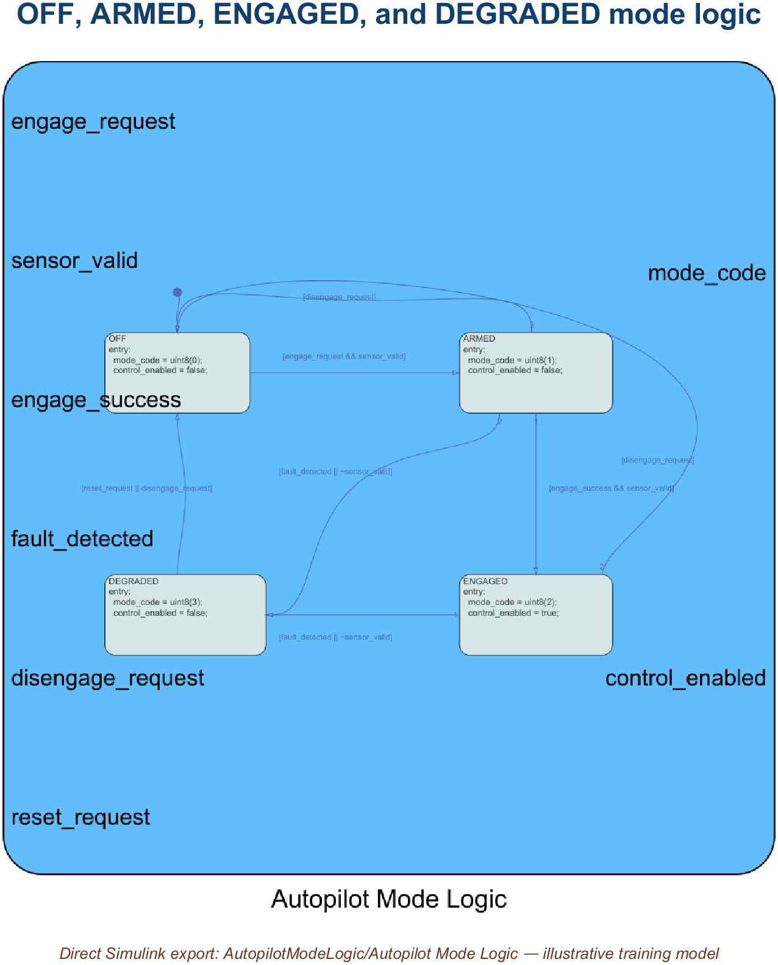
02 • CONTROLS ENGINEERING IN SIMULINK
Modes select the law; schedules adapt it
Illustrative Stateflow training model • guards govern OFF, ARMED, ENGAGED, and DEGRADED
AVIATION CONTROLS ENGINEERING ONBOARDING
11
Notes:
Timing: 2 minutes
Suggested visual:
The real Stateflow chart shows OFF, ARMED, ENGAGED, and DEGRADED states with guarded transitions.
Speaker notes:
Explain the separation of concerns. Mode logic decides whether a control law is off, armed, engaged, or degraded and specifies the guards for transitions. Stateflow is a common representation, but explicit Simulink logic may also be used. Scheduling changes gains or limits as functions of Mach, altitude, angle of attack, center of gravity, or aircraft configuration. A schedule is not a mode switch unless the requirement defines it that way; interpolation and breakpoint behavior matter. Verification must cover transition guards, persistence, priorities, temporal behavior, boundary points, extrapolation policy, and invalid scheduling data. The new engineer should never assume that a colorful state diagram or smooth lookup surface is self-explanatory—each transition and breakpoint needs requirements and tests.
Key teaching points:
• State machines govern discrete modes and transitions.
• Lookup tables adapt continuous behavior across the envelope.
• Transitions and breakpoints are first-class boundary tests.
[Sources]
- https://www.mathworks.com/help/simulink/slref/designing-a-guidance-system-in-matlab-and-simulink.html
- https://www.mathworks.com/help/simulink/getting-started-with-simulink.html
V2 artifact update: Stateflow is licensed on this computer, so the visual is the real chart in AutopilotModeLogic.slx. OFF is the default state; guarded transitions cover pilot request, sensor validity, successful engagement, detected fault/invalid data, and reset/disengagement. [Sources - V2 artifact] - Local: models/AutopilotModeLogic.slx - https://www.mathworks.com/help/stateflow/state-transition-charts.html
V2 artifact update: Stateflow is licensed on this computer, so the visual is the real chart in AutopilotModeLogic.slx. OFF is the default state; guarded transitions cover pilot request, sensor validity, successful engagement, detected fault/invalid data, and reset/disengagement. [Sources - V2 artifact] - Local: models/AutopilotModeLogic.slx - https://www.mathworks.com/help/stateflow/state-transition-charts.html
V2 artifact update: Stateflow is licensed on this computer, so the visual is the real chart in AutopilotModeLogic.slx. OFF is the default state; guarded transitions cover pilot request, sensor validity, successful engagement, detected fault/invalid data, and reset/disengagement. [Sources - V2 artifact] - Local: models/AutopilotModeLogic.slx - https://www.mathworks.com/help/stateflow/state-transition-charts.html

Slide 16
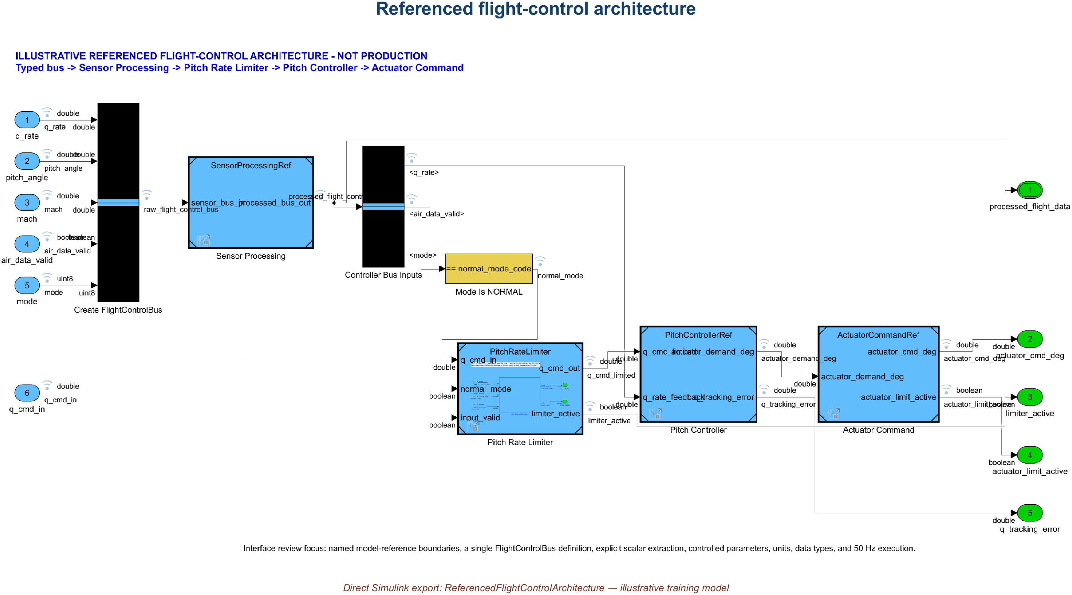
10 • ARCHITECTURE INTEGRATION
ReferencedFlightControlArchitecture is the integration top level
Integration entry point • referenced sensor, limiter, controller, and actuator models • update validates interface consistency
AVIATION CONTROLS ENGINEERING ONBOARDING
27
Notes:
Timing: 3 minutes
Open models/ReferencedFlightControlArchitecture.slx when the job is integration. Its referenced children are SensorProcessingRef, PitchRateLimiter, PitchControllerRef, and ActuatorCommandRef. Update Model before simulation to validate model-reference availability and interface consistency. This is separate from AircraftFeedbackControlLoop.slx, the runnable closed-loop training simulation.
Architecture update/compile evidence is useful input, not approval by itself. This package does not claim HIL execution.
[Sources]
- https://www.mathworks.com/help/simulink/slref/simulinkeditor.html
- https://www.faa.gov/documentLibrary/media/Order/FAA_Order_8110.49A.pdf

Slide 17
10 • ARCHITECTURE INTEGRATION
ReferencedFlightControlArchitecture is the integration top level
Integration entry point • referenced sensor, limiter, controller, and actuator models • update validates interface consistency
AVIATION CONTROLS ENGINEERING ONBOARDING
27
Notes:
Timing: 3 minutes
Open models/ReferencedFlightControlArchitecture.slx when the job is integration. Its referenced children are SensorProcessingRef, PitchRateLimiter, PitchControllerRef, and ActuatorCommandRef. Update Model before simulation to validate model-reference availability and interface consistency. This is separate from AircraftFeedbackControlLoop.slx, the runnable closed-loop training simulation.
Architecture update/compile evidence is useful input, not approval by itself. This package does not claim HIL execution.
[Sources]
- https://www.mathworks.com/help/simulink/slref/simulinkeditor.html
- https://www.faa.gov/documentLibrary/media/Order/FAA_Order_8110.49A.pdf

Slide 18
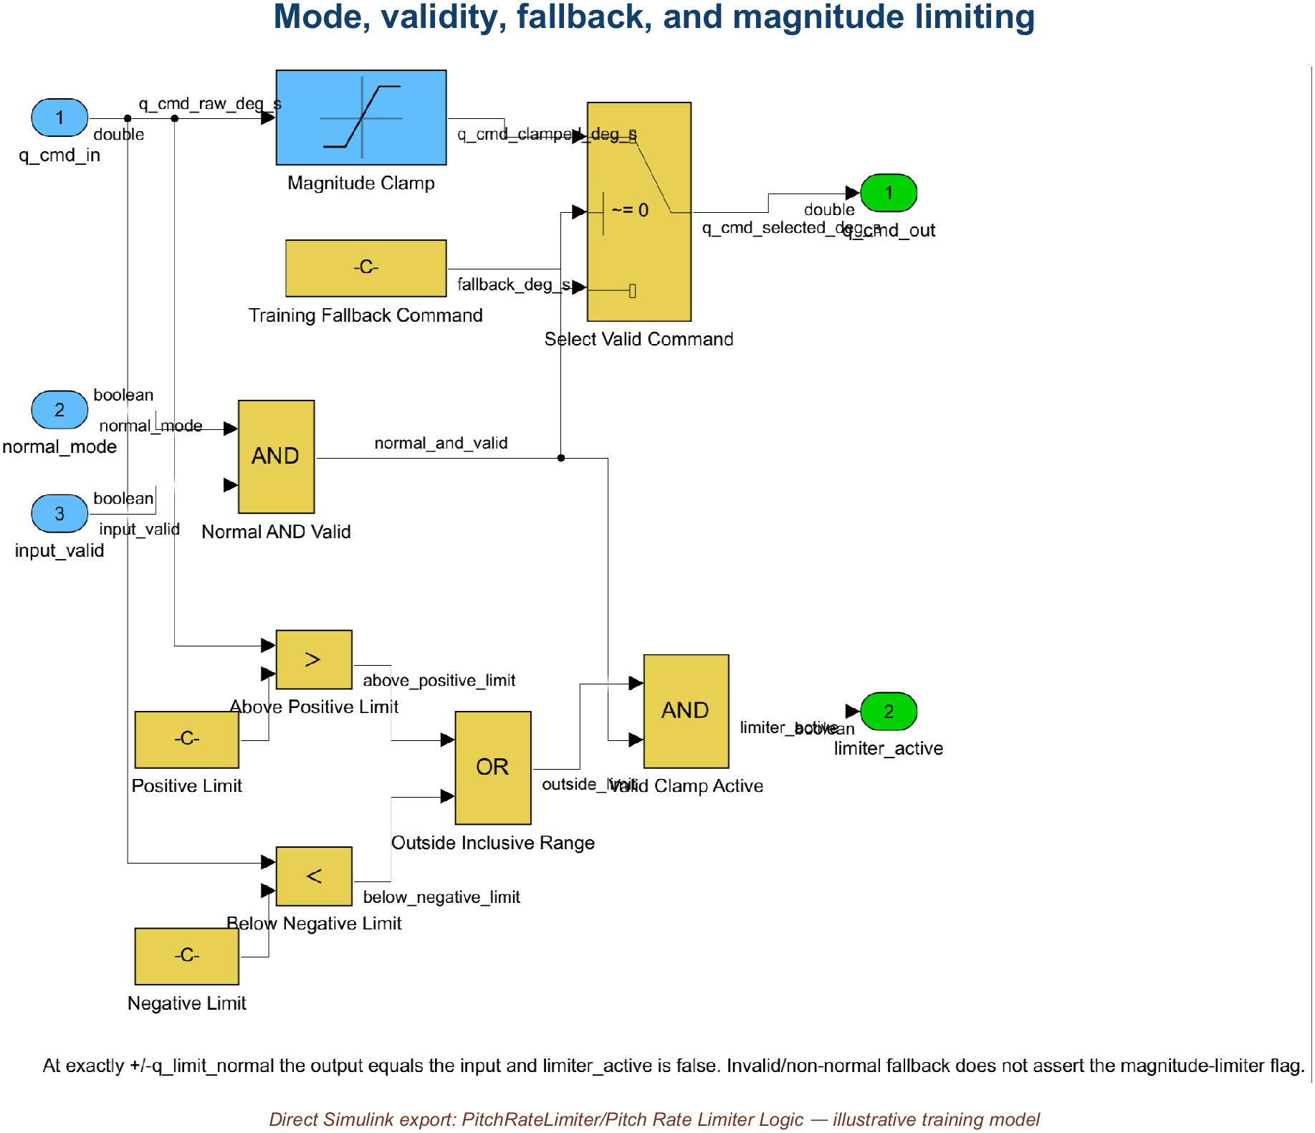
06 • SIMULINK DEVELOPMENT
Build the component in six reviewable steps
Magnitude clamp—not a slew-rate limiter • invalid or non-normal command falls back to zero
AVIATION CONTROLS ENGINEERING ONBOARDING
20
Notes:
Timing: 2 minutes
Suggested visual:
The real Pitch Rate Limiter Logic subsystem shows magnitude saturation, validity selection, fallback, and active-flag logic.
Speaker notes:
Walk the development sequence. Start with a subsystem whose responsibility can be stated in one sentence. Create input and output ports with controlled types, dimensions, units, and sample times. Add only the logic needed by the requirements. Parameterize tunable or project-controlled values in the designated dictionary rather than scattering numeric literals. Define the interface through bus or port specifications and link requirements to the relevant model elements. Compile or update early to catch semantic errors. Then run a focused test before expanding the component. The mockup is intentionally simple: if the real model is hard to review at this level, add hierarchy rather than accepting a wall of blocks.
Key teaching points:
• Interfaces come before internal complexity.
• Controlled parameters replace unexplained literals.
• Compile and test at the smallest meaningful increment.
[Sources]
- https://www.mathworks.com/help/simulink/getting-started-with-simulink.html
- https://www.mathworks.com/help/simulink/ug/interface-design.html
- https://www.mathworks.com/help/simulink/ug/determine-where-to-store-data-for-simulink-models.html
V2 artifact update: The visual is the real implementation subsystem. It uses a Saturation block for the inclusive magnitude clamp and an explicit zero fallback when either validity condition is false. The model contains no slew-rate dynamics; it is a magnitude limiter. [Sources - V2 artifact] - Local: models/PitchRateLimiter.slx, Pitch Rate Limiter Logic subsystem
V2 artifact update: The visual is the real implementation subsystem. It uses a Saturation block for the inclusive magnitude clamp and an explicit zero fallback when either validity condition is false. The model contains no slew-rate dynamics; it is a magnitude limiter. [Sources - V2 artifact] - Local: models/PitchRateLimiter.slx, Pitch Rate Limiter Logic subsystem
V2 artifact update: The visual is the real implementation subsystem. It uses a Saturation block for the inclusive magnitude clamp and an explicit zero fallback when either validity condition is false. The model contains no slew-rate dynamics; it is a magnitude limiter. [Sources - V2 artifact] - Local: models/PitchRateLimiter.slx, Pitch Rate Limiter Logic subsystem

Slide 19
06 • SIMULINK DEVELOPMENT
Build the component in six reviewable steps
Magnitude clamp—not a slew-rate limiter • invalid or non-normal command falls back to zero
AVIATION CONTROLS ENGINEERING ONBOARDING
20
Notes:
Timing: 2 minutes
Suggested visual:
The real Pitch Rate Limiter Logic subsystem shows magnitude saturation, validity selection, fallback, and active-flag logic.
Speaker notes:
Walk the development sequence. Start with a subsystem whose responsibility can be stated in one sentence. Create input and output ports with controlled types, dimensions, units, and sample times. Add only the logic needed by the requirements. Parameterize tunable or project-controlled values in the designated dictionary rather than scattering numeric literals. Define the interface through bus or port specifications and link requirements to the relevant model elements. Compile or update early to catch semantic errors. Then run a focused test before expanding the component. The mockup is intentionally simple: if the real model is hard to review at this level, add hierarchy rather than accepting a wall of blocks.
Key teaching points:
• Interfaces come before internal complexity.
• Controlled parameters replace unexplained literals.
• Compile and test at the smallest meaningful increment.
[Sources]
- https://www.mathworks.com/help/simulink/getting-started-with-simulink.html
- https://www.mathworks.com/help/simulink/ug/interface-design.html
- https://www.mathworks.com/help/simulink/ug/determine-where-to-store-data-for-simulink-models.html
V2 artifact update: The visual is the real implementation subsystem. It uses a Saturation block for the inclusive magnitude clamp and an explicit zero fallback when either validity condition is false. The model contains no slew-rate dynamics; it is a magnitude limiter. [Sources - V2 artifact] - Local: models/PitchRateLimiter.slx, Pitch Rate Limiter Logic subsystem
V2 artifact update: The visual is the real implementation subsystem. It uses a Saturation block for the inclusive magnitude clamp and an explicit zero fallback when either validity condition is false. The model contains no slew-rate dynamics; it is a magnitude limiter. [Sources - V2 artifact] - Local: models/PitchRateLimiter.slx, Pitch Rate Limiter Logic subsystem
V2 artifact update: The visual is the real implementation subsystem. It uses a Saturation block for the inclusive magnitude clamp and an explicit zero fallback when either validity condition is false. The model contains no slew-rate dynamics; it is a magnitude limiter. [Sources - V2 artifact] - Local: models/PitchRateLimiter.slx, Pitch Rate Limiter Logic subsystem

Slide 20
10 • ARCHITECTURE INTEGRATION
ReferencedFlightControlArchitecture is the integration top level
Integration entry point • referenced sensor, limiter, controller, and actuator models • update validates interface consistency
AVIATION CONTROLS ENGINEERING ONBOARDING
27
Notes:
Timing: 3 minutes
Open models/ReferencedFlightControlArchitecture.slx when the job is integration. Its referenced children are SensorProcessingRef, PitchRateLimiter, PitchControllerRef, and ActuatorCommandRef. Update Model before simulation to validate model-reference availability and interface consistency. This is separate from AircraftFeedbackControlLoop.slx, the runnable closed-loop training simulation.
Architecture update/compile evidence is useful input, not approval by itself. This package does not claim HIL execution.
[Sources]
- https://www.mathworks.com/help/simulink/slref/simulinkeditor.html
- https://www.faa.gov/documentLibrary/media/Order/FAA_Order_8110.49A.pdf

Slide 21
02 • CONTROLS ENGINEERING IN SIMULINK
Control-law math maps to reusable patterns
Illustrative training subsystem • parameterized PI law and deterministic integrator state
AVIATION CONTROLS ENGINEERING ONBOARDING
09
Notes:
Timing: 2 minutes
Suggested visual:
The real Pitch Controller subsystem exposes proportional and integral paths with controlled parameters.
Speaker notes:
Relate familiar control concepts to model patterns. A Gain block implements a scalar or matrix gain. Filters can be represented as transfer functions, discrete filters, state-space blocks, or explicit difference equations. Integrators represent continuous or discrete accumulation and require careful initial-condition handling. Lookup tables implement calibrated or scheduled behavior across operating conditions. Stateflow is commonly used for modes, guards, transitions, and fault logic. Saturation and rate-limiting blocks protect actuators and commands—but distinguish a magnitude limiter from a slew-rate limiter. Sensor processing often includes scaling, validity, filtering, voting, and unit conversion; actuator paths may include command shaping, rate limits, position limits, and monitoring.
Key teaching points:
• Choose blocks that preserve the intended mathematics and execution semantics.
• Scheduling connects one control-law structure to a changing flight envelope.
• Limits and mode logic are requirements, not cosmetic safeguards.
[Sources]
- https://www.mathworks.com/help/simulink/slref/designing-a-guidance-system-in-matlab-and-simulink.html
- https://www.mathworks.com/help/simulink/slref/designing-a-high-angle-of-attack-pitch-mode-control.html
V2 artifact update: The visual is the actual Pitch Controller subsystem from the delivered feedback model. The proportional and integral paths resolve controlled values from FCS_Data.sldd, and the discrete integrator uses a deterministic initial condition. [Sources - V2 artifact] - Local: models/AircraftFeedbackControlLoop.slx, Pitch Controller subsystem
V2 artifact update: The visual is the actual Pitch Controller subsystem from the delivered feedback model. The proportional and integral paths resolve controlled values from FCS_Data.sldd, and the discrete integrator uses a deterministic initial condition. [Sources - V2 artifact] - Local: models/AircraftFeedbackControlLoop.slx, Pitch Controller subsystem
V2 artifact update: The visual is the actual Pitch Controller subsystem from the delivered feedback model. The proportional and integral paths resolve controlled values from FCS_Data.sldd, and the discrete integrator uses a deterministic initial condition. [Sources - V2 artifact] - Local: models/AircraftFeedbackControlLoop.slx, Pitch Controller subsystem

Slide 22
10 • ARCHITECTURE INTEGRATION
ReferencedFlightControlArchitecture is the integration top level
Integration entry point • referenced sensor, limiter, controller, and actuator models • update validates interface consistency
AVIATION CONTROLS ENGINEERING ONBOARDING
27
Notes:
Timing: 3 minutes
Open models/ReferencedFlightControlArchitecture.slx when the job is integration. Its referenced children are SensorProcessingRef, PitchRateLimiter, PitchControllerRef, and ActuatorCommandRef. Update Model before simulation to validate model-reference availability and interface consistency. This is separate from AircraftFeedbackControlLoop.slx, the runnable closed-loop training simulation.
Architecture update/compile evidence is useful input, not approval by itself. This package does not claim HIL execution.
[Sources]
- https://www.mathworks.com/help/simulink/slref/simulinkeditor.html
- https://www.faa.gov/documentLibrary/media/Order/FAA_Order_8110.49A.pdf

Slide 23
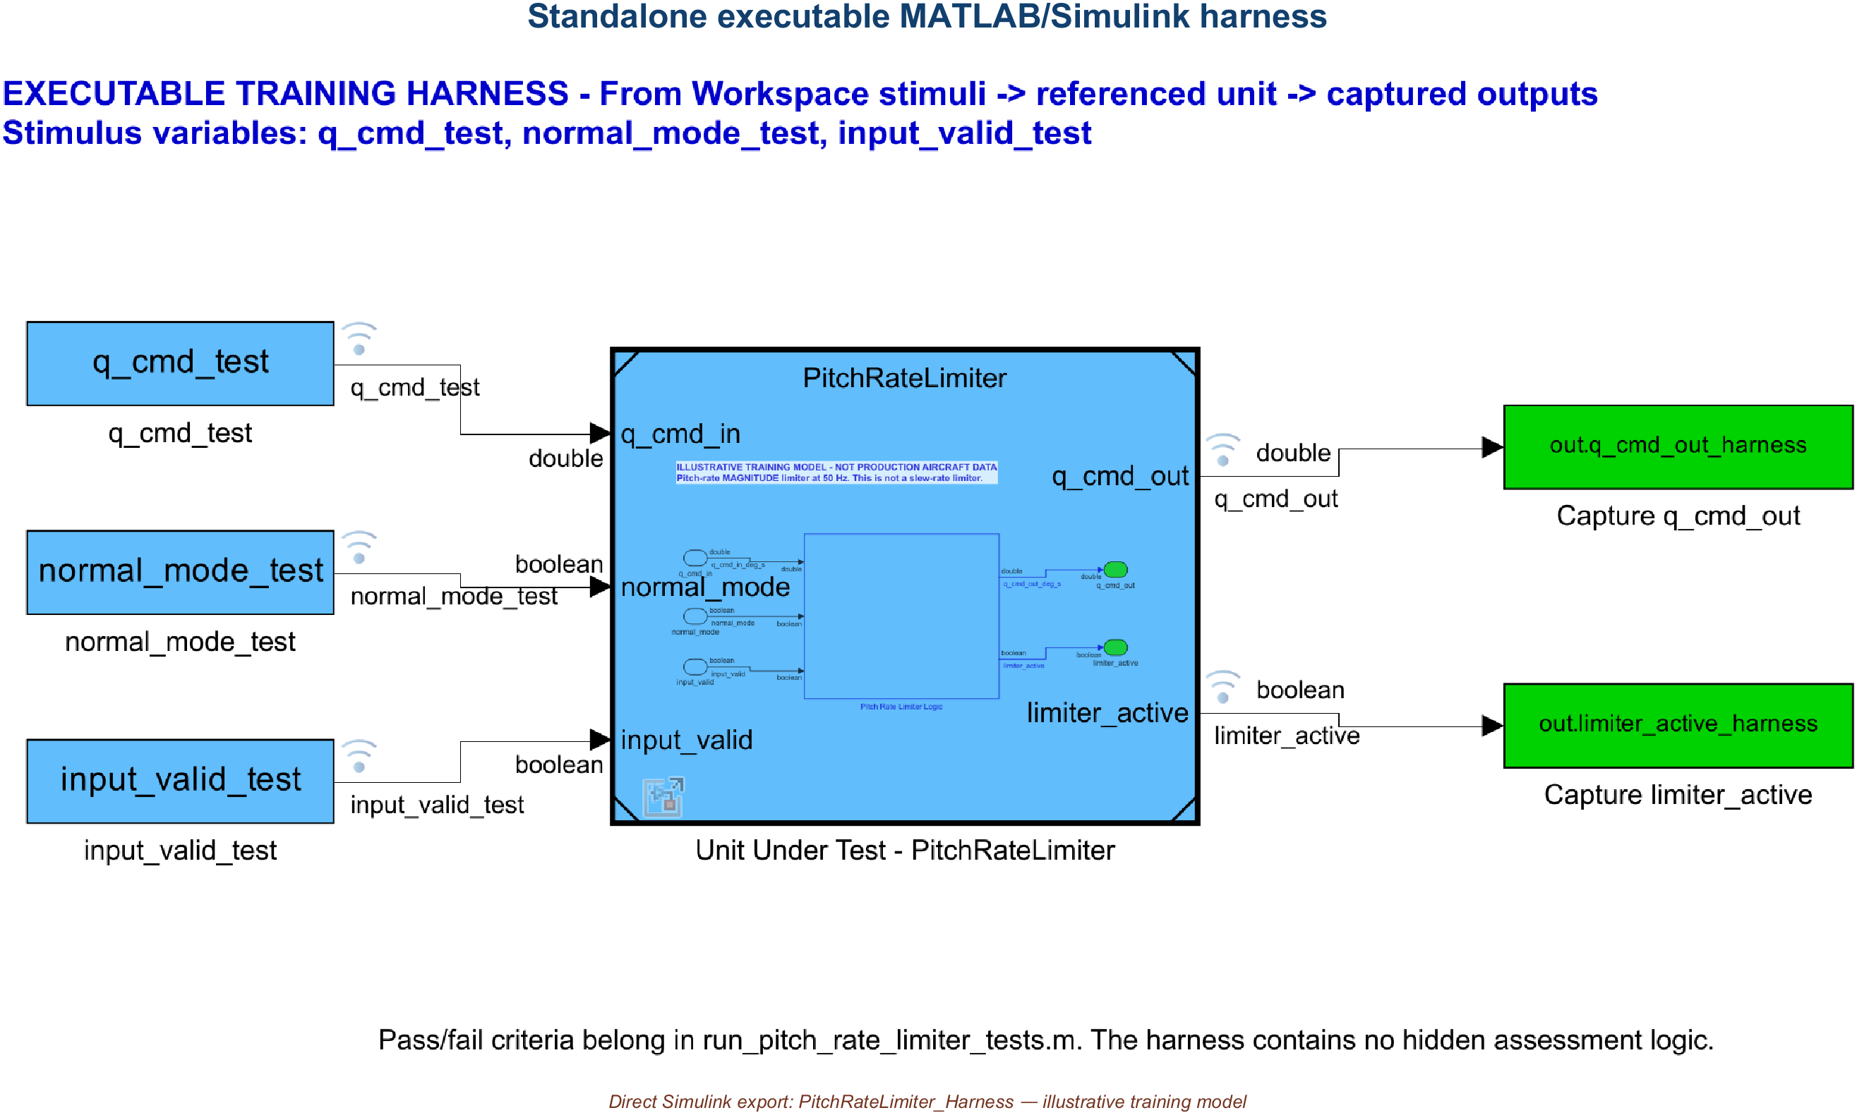
07 • UNIT TESTING
A harness makes expectations executable
Standalone executable harness • Simulink Test unavailable; assessment logic remains in MATLAB
AVIATION CONTROLS ENGINEERING ONBOARDING
23
Notes:
Timing: 2 minutes
Suggested visual:
The real standalone PitchRateLimiter_Harness model shows sources, referenced component, and retained outputs.
Speaker notes:
Because Simulink Test is unavailable, the delivered project uses a standalone executable Simulink harness. From Workspace blocks provide deterministic q_cmd_in, normal_mode, and input_valid signals at 50 Hz. A Model block references PitchRateLimiter, and To Workspace blocks retain q_cmd_out and limiter_active. run_pitch_rate_limiter_tests.m evaluates expected values, active-flag behavior, numeric tolerance, and timing outside the harness. This preserves the important separation: the harness supplies and captures data, while the requirement oracle remains in reviewable assessment code. No .mldatx file is manufactured.
Key teaching points:
• Harnesses isolate the component without modifying production logic.
• Expected behavior comes from requirements and acceptance criteria.
• Unit tests provide fast, precise, repeatable regression evidence.
[Sources]
- https://www.mathworks.com/products/simulink-test.html
- https://www.mathworks.com/help/sltest/gs/test-planning-and-strategies.html
V2 artifact update: Simulink Test is unavailable, so the visual is a real standalone Simulink harness rather than an sltest harness. From Workspace sources drive a Model block referencing PitchRateLimiter, and To Workspace sinks retain objective outputs. Pass/fail logic remains in run_pitch_rate_limiter_tests.m. No .mldatx was manufactured. [Sources - V2 artifact] - Local: models/PitchRateLimiter_Harness.slx - General product concept: https://www.mathworks.com/help/sltest/gs/create-a-test-harness.html
V2 artifact update: Simulink Test is unavailable, so the visual is a real standalone Simulink harness rather than an sltest harness. From Workspace sources drive a Model block referencing PitchRateLimiter, and To Workspace sinks retain objective outputs. Pass/fail logic remains in run_pitch_rate_limiter_tests.m. No .mldatx was manufactured. [Sources - V2 artifact] - Local: models/PitchRateLimiter_Harness.slx - General product concept: https://www.mathworks.com/help/sltest/gs/create-a-test-harness.html
V2 artifact update: Simulink Test is unavailable, so the visual is a real standalone Simulink harness rather than an sltest harness. From Workspace sources drive a Model block referencing PitchRateLimiter, and To Workspace sinks retain objective outputs. Pass/fail logic remains in run_pitch_rate_limiter_tests.m. No .mldatx was manufactured. [Sources - V2 artifact] - Local: models/PitchRateLimiter_Harness.slx - General product concept: https://www.mathworks.com/help/sltest/gs/create-a-test-harness.html

Slide 24
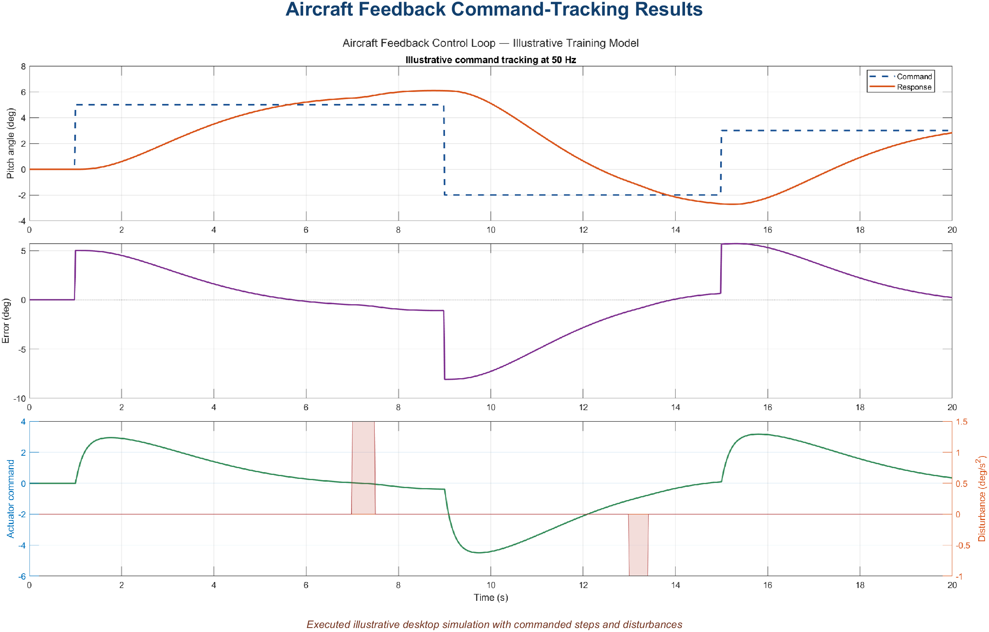
02 • CONTROLS ENGINEERING IN SIMULINK
The Data Inspector makes runs inspectable and comparable
SIMULATION TAB → DATA INSPECTOR
1
LOG
Select only the signals needed for the question.
2
INSPECT
Markers show samples; cursors read time, value, and delta.
3
COMPARE
Baseline vs candidate using time, absolute, and relative tolerances.
4
RETAIN
Run, units, configuration, and result become evidence input.
Retained 50 Hz command-tracking data • SDI is the interactive workspace for samples, cursors, comparisons, and run metadata
AVIATION CONTROLS ENGINEERING ONBOARDING
10
Notes:
Timing: 5 minutes
The visible plot is the authentic retained desktop result from results/AircraftFeedback_CommandTracking.mat. In a live R2023b demonstration:
1. Configure the relevant signals for logging.
2. Run the model, then open Simulation > Data Inspector.
3. Select a run and plot command, response, tracking error, and actuator command.
4. Turn markers on to expose exact logged samples; use cursors to read values and time differences.
5. Use Compare for baseline-versus-candidate results with planned time, absolute, and relative tolerances.
6. Retain run/session metadata with the controlled model and configuration.
Data points are the logged samples. Markers merely make those samples visible; hiding markers does not discard them. A passing comparison remains evidence input, not certification approval by itself.
[Sources]
- https://www.mathworks.com/help/simulink/gui/signallogging.html
- https://www.mathworks.com/help/simulink/slref/simulationdatainspector.html
- https://www.mathworks.com/help/simulink/slref/simulink.sdi.setmarkerson.html
- https://www.mathworks.com/help/simulink/ug/compare-simulation-data.html
- https://www.faa.gov/documentLibrary/media/Order/FAA_Order_8110.49A.pdf

Slide 25
03 • DO-178C OVERVIEW
DO-178C demands evidence—not diagrams
DO-178C
DO-331
Defines — objectives, activities, and life-cycle data
Scales — rigor according to software level
Covers — planning, development, verification, CM, QA, liaison
Supplements — DO-178C for model-based development and verification
Clarifies — model roles, model standards, verification, and traceability
Does not — make models or generated code automatically compliant
The project plans define whether a model is specification, design, source, or verification material—and which objectives apply.
AVIATION CONTROLS ENGINEERING ONBOARDING
12
Notes:
Timing: 2 minutes
Suggested visual:
Two complementary columns separate the base DO-178C objectives from the DO-331 model-based supplement.
Speaker notes:
Frame DO-178C correctly. FAA AC 20-115D recognizes DO-178C and applicable supplements as an acceptable means of compliance for airborne software; it is not a regulation and not a product certificate. The standard is objective-based. It expects planned processes and evidence showing that applicable objectives are satisfied. DO-331 supplements the base guidance when models are used for development or verification. The project must define each model’s role because that determines which standards, reviews, verification activities, traceability, and tool considerations apply. Emphasize that generated code and automated tests can reduce manual effort, but automation does not remove responsibility for correct requirements, model standards, independent verification where required, configuration control, or credible results.
Key teaching points:
• DO-178C is an objectives-and-evidence framework.
• DO-331 applies model-based guidance alongside DO-178C.
• A model’s planned certification role controls how it must be verified.
[Sources]
- https://www.faa.gov/documentLibrary/media/Advisory_Circular/AC_20-115D.pdf
- https://www.rtca.org/do-178/
V3 terminology clarification: - Prefer the training-example title “Gas Turbine Controls: Model-Based Development with Independent Verification,” not “independent compliance.” - DO-178C is an accepted means of compliance, not a standalone software certificate. DO-331 supplements DO-178C for model-based development and verification. - A Simulink model is not automatically compliant; its planned role, traceability, reviews, verification, configuration control, and lifecycle data determine what credit may be requested. [Sources] - https://www.faa.gov/regulations_policies/advisory_circulars/index.cfm/go/document.information/documentID/1032046 - https://www.faa.gov/documentLibrary/media/Order/FAA_Order_8110.49A.pdf

Slide 26
03 • DO-178C OVERVIEW
Software levels scale rigor with consequence
LEVEL
ASSOCIATED FAILURE CONDITION
ENGINEERING IMPLICATION
A
Catastrophic
Highest rigor; most objectives and independence
B
Hazardous / Severe-Major
Very high rigor
C
Major
Substantial requirements and verification rigor
D
Minor
Reduced objective set
E
No Effect
No DO-178C objectives apply to the software
The system safety assessment assigns the software level; the controls team does not choose it for convenience.
AVIATION CONTROLS ENGINEERING ONBOARDING
13
Notes:
Timing: 2 minutes
Suggested visual:
A five-level ladder links Levels A through E to failure conditions and increasing assurance rigor.
Speaker notes:
Introduce the levels without turning them into arbitrary quality grades. The system safety process determines the effect of software failure and allocates the software level. Level A corresponds to a catastrophic failure condition, B to hazardous or severe-major, C to major, D to minor, and E to no effect. More safety-critical software must satisfy more objectives and greater verification independence. Avoid implying that every flight-control function is automatically Level A; allocation depends on system architecture and failure effects. For the engineer, the level changes review rigor, coverage expectations, independence, configuration evidence, and the acceptable use or qualification of tools. It never changes the basic obligation to implement the requirement correctly.
Key teaching points:
• Levels come from system safety analysis.
• Rigor increases as failure consequence increases.
• Software level affects objectives, independence, and evidence strategy.
[Sources]
- https://www.faa.gov/aircraft/air_cert/design_approvals/dah/software
- https://www.faa.gov/documentLibrary/media/Advisory_Circular/AC_20-115D.pdf
V3 software-level and independence clarification: - Say “DO-178C Software Level A” when discussing software objectives. Use a broader system Development Assurance Level only when discussing the system-level allocation that informed the software level. - Independence applies to designated verification objectives under approved plans. Avoid the blanket claim that an author can never participate in review; where independence is required, the author should not be the sole independent verifier of their own work. [Sources] - https://www.faa.gov/regulations_policies/advisory_circulars/index.cfm/go/document.information/documentID/1032046 - https://www.faa.gov/documentLibrary/media/Order/FAA_Order_8110.49A.pdf

Slide 27
03 • DO-178C OVERVIEW
Traceability turns artifacts into evidence
Requirement
Model element
Test case
Verification result
BIDIRECTIONAL: every artifact has a reason to exist; every requirement has objective coverage
EVIDENCE PACKAGE
plans + standards
review records
test procedures + results
coverage + analyses
configuration + problem reports
Pipeline and test results are evidence inputs—not automatic approval.
AVIATION CONTROLS ENGINEERING ONBOARDING
14
Notes:
Timing: 2 minutes
Suggested visual:
A bidirectional chain links requirement, model element, test case, and result above an evidence package.
Speaker notes:
Define traceability as a practical navigation system. Forward trace answers: where is this requirement implemented and how is it verified? Backward trace answers: why does this model element, parameter, test, or code path exist? Gaps can reveal missing tests, unintended functionality, or unreviewed derived behavior. Verification evidence includes more than pass/fail plots: approved plans and standards, review records, procedures, requirements-based results, applicable coverage and analyses, configuration records, quality records, and problem reports. A Jenkins job or HIL campaign can produce valuable evidence, but the project must control the configuration, link results to requirements, review failures and waivers, and retain the artifacts required by the plans.
Key teaching points:
• Traceability must work in both directions.
• Evidence includes reviews, analyses, configuration, and results.
• Automation produces evidence only when configuration and meaning are controlled.
[Sources]
- https://www.mathworks.com/help/slrequirements/ug/create-and-store-links.html
- https://www.mathworks.com/help/slrequirements/ug/find-and-link-unlinked-requirements-with-a-traceability-matrix.html
- https://www.faa.gov/documentLibrary/media/Order/FAA_Order_8110.49A.pdf
V3 evidence clarification: - A passing pipeline or test result is an evidence input. It is not certification approval by itself. - MIL, SIL, PIL, HIL, bench, and system-integration testing are different verification environments. This training project did not perform HIL testing. [Sources] - https://www.faa.gov/documentLibrary/media/Order/FAA_Order_8110.49A.pdf
V4 first-user connection: - Update, simulation, scripted tests, and CI are different evidence-producing actions. A pass from any one action is input to review, not automatic approval. - This training package did not perform HIL. [Sources] - https://www.faa.gov/documentLibrary/media/Order/FAA_Order_8110.49A.pdf

Slide 28
03 • DO-178C OVERVIEW
The V-model links every definition to its verification
REQUIREMENTS ↔ BIDIRECTIONAL TRACEABILITY
MODEL-BASED · MATLAB / SIMULINK
INDEPENDENT VERIFICATION ACTIVITIES
INTEGRATION + EXECUTION ENVIRONMENTS
DEFINE + DECOMPOSE · REVIEW GATES G1–G5
PAIR EACH LEVEL
INTEGRATE + VERIFY + VALIDATE
System / engine
requirements
G1
System verification
+ validation
Software high-level
requirements (HLR)
G2
Software integration
verification
Software architecture / design
+ low-level requirements
G3
Component / unit
verification
Simulink models
+ C/H source code
G4
MIL / SIL · analysis
+ coverage
Executable
object code
G5
PIL / target · HIL / bench
+ system integration
CONTROLLED SOFTWARE BASELINE
configuration · trace links · review records
Agile changes the cadence; it does not remove ordered reviews, traceability, controlled baselines, or planned independence.
AVIATION CONTROLS ENGINEERING ONBOARDING
15
Notes:
Timing: 3 minutes
Walk the V down the left from system/engine requirements through HLR, architecture/design and low-level requirements, model/source implementation, and executable object code. The controlled software baseline is the configuration-controlled vertex. Then walk up the right through target and integration environments, MIL/SIL analysis and coverage, component or unit verification, software integration verification, and system verification and validation. The dashed two-headed links emphasize bidirectional traceability: each definition has planned verification, and every result identifies the definition and controlled configuration it covers.
Use the four callouts to separate responsibilities:
- Model-based software development uses MATLAB/Simulink as planned lifecycle tools and artifacts; a Simulink model is not automatically compliant.
- Requirements need bidirectional traceability into implementation, verification procedures, results, reviews, and problem dispositions.
- Independence applies to designated verification objectives under approved plans. An author is not categorically prohibited from participating in review, but should not be the sole independent verifier of their own work where independence is required.
- MIL, SIL, PIL, HIL, bench, and system-integration testing are distinct verification environments. PIL is an execution environment and is not automatically synonymous with unit testing. Call a test HIL only when actual controller or target hardware, a real-time plant environment, and physical I/O are used. This training project performed no HIL testing.
Certification and lifecycle language:
- Prefer the example title “Gas Turbine Controls: Model-Based Development with Independent Verification,” not “independent compliance.”
- DO-178C is an accepted means of compliance, not a standalone software certificate. DO-331 supplements DO-178C for model-based development and verification.
- Use “DO-178C Software Level A” unless the discussion is explicitly about a broader system Development Assurance Level allocation.
- Agile and waterfall can both be used. Agile changes cadence, not the need for lifecycle data, ordered reviews, traceability, configuration control, controlled baselines, planned verification, or designated independence.
- A passing pipeline or test result is evidence input, not certification approval by itself.
[Sources]
- https://www.faa.gov/regulations_policies/advisory_circulars/index.cfm/go/document.information/documentID/1032046
- https://www.faa.gov/documentLibrary/media/Order/FAA_Order_8110.49A.pdf
- https://www.nasa.gov/reference/systems-engineering-handbook/
V4 first-user connection: - The visible pseudo requirements on slide 18 and trace chain on slide 19 are classroom artifacts. A Simulink model is not automatically compliant; its planned lifecycle role, reviews, traceability, configuration control, and verification data determine what credit may be requested. [Sources] - https://www.faa.gov/regulations_policies/advisory_circulars/index.cfm/go/document.information/documentID/1032046 - https://www.faa.gov/documentLibrary/media/Order/FAA_Order_8110.49A.pdf

Slide 29
05 • REQUIREMENTS DEVELOPMENT
Pseudo requirements make the training chain explicit
SYSTEM
PSYS-001
Before the pitch controller, constrain a valid Normal-mode pitch-rate command to |q_cmd| ≤ 12 deg/s; otherwise substitute 0 deg/s.
SOFTWARE HLR
SWHLR-001 / 002
When normal_mode and input_valid are true, q_cmd_out = min(max(q_cmd_in, −12), +12); otherwise q_cmd_out = 0 deg/s.
DESIGN / LLR
SWLLR-001 / 002
Magnitude Clamp applies ±q_limit_normal; Normal AND Valid drives Select Valid Command; Training Fallback Command is 0 deg/s.
STATUS + TIMING
SWHLR-003 / 004
limiter_active is true only outside ±12 during valid Normal mode; the component updates at 50 Hz with no added state dynamics.
ILLUSTRATIVE CLASSROOM REQUIREMENTS • not production aircraft data or an approved certification baseline
AVIATION CONTROLS ENGINEERING ONBOARDING
18
Notes:
Timing: 5 minutes
These are illustrative classroom requirements, not production aircraft data and not an approved certification baseline. Whether a Simulink model represents HLR, LLR, design, or verification data is established by approved project plans; a Simulink model is not automatically compliant. This package has no live Simulink Requirements links, so the demonstration uses CSV/script/result associations.
Complete training set:
- PSYS-001: command-path protection allocated to ReferencedFlightControlArchitecture/Pitch Rate Limiter and PitchRateLimiter.
- SWHLR-001 / PRL-001: inclusive clamp to ±12 deg/s while valid and Normal.
- SWHLR-002 / PRL-002: zero fallback when mode or validity is false.
- SWHLR-003 / PRL-003: limiter_active only for strictly out-of-limit valid Normal inputs; false at exactly ±12 and during fallback.
- SWHLR-004 / PRL-004/005: 50 Hz, same-sample output, no added slew/state dynamics.
- SWLLR-001..004: exact blocks, strict comparisons, types, units, Boolean status, and fixed-step 0.02 s contract.
[Sources]
- docs/PitchRateLimiter_Requirements_Traceability.csv
- models/PitchRateLimiter.slx
- https://www.faa.gov/regulations_policies/advisory_circulars/index.cfm/go/document.information/documentID/1032046
- https://www.faa.gov/documentLibrary/media/Order/FAA_Order_8110.49A.pdf

Slide 30
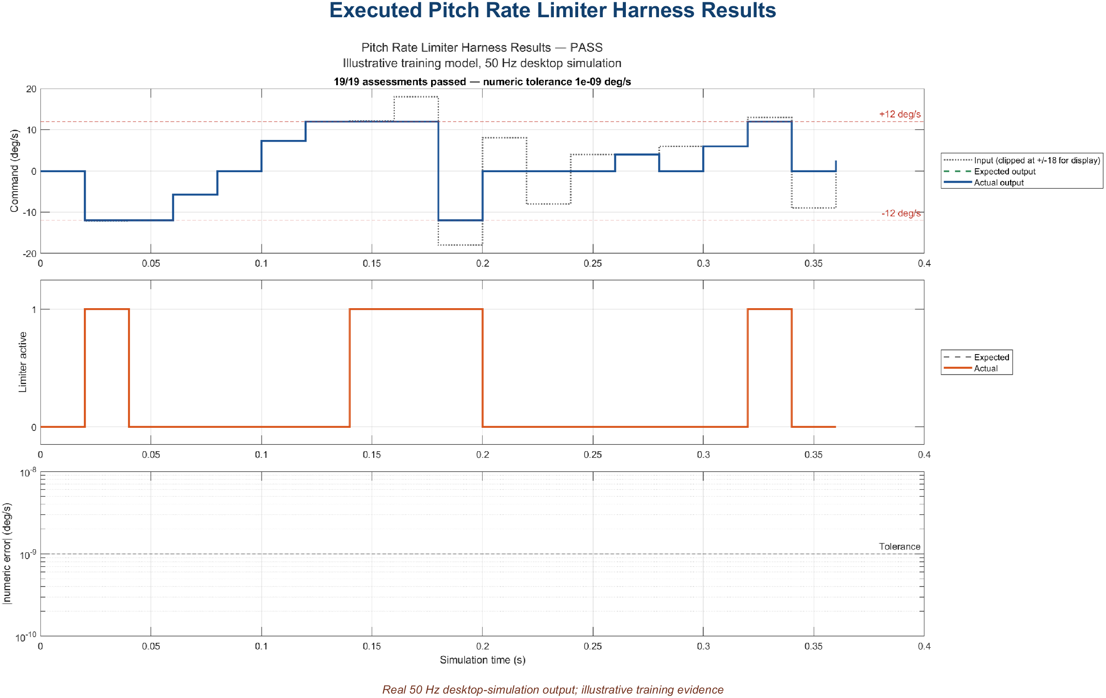
05 • REQUIREMENTS DEVELOPMENT
One limiter requirement, one traceable evidence chain
PSYS-001
command-path protection
SWHLR-001 / PRL-001
inclusive ±12 allocation
MAGNITUDE CLAMP
model block
BOUNDARY ABOVE UPPER
q_cmd = 12.1 deg/s
ITERATION 8
actual 12.0 • PASS
EXECUTED ENVIRONMENT
Desktop Simulink model execution (MIL)
not SIL, PIL, or HIL
t = 0.14 s • expected = 12.0
actual = 12.0 • error = 0
tolerance = 1e−9 • timing PASS
AssociatedRequirement →
PRL-001 • PRL-003 • PRL-004
Trace both directions • retain model, dictionary, test script, result, and tool/configuration metadata in one controlled baseline
AVIATION CONTROLS ENGINEERING ONBOARDING
19
Notes:
Timing: 5 minutes
Walk left to right, then return right to left:
PSYS-001 → SWHLR-001 / PRL-001 → SWLLR-001 → PitchRateLimiter/Pitch Rate Limiter Logic/Magnitude Clamp → PitchRateLimiter_Harness/Unit Under Test - PitchRateLimiter → scripts/run_pitch_rate_limiter_tests.m, case “Boundary above upper limit” → retained result Iteration 8.
Result detail: t=0.14 s; input=12.1 deg/s; expected=12; actual=12; error=0; tolerance=1e−9; timestamp/timing PASS; overall PASS. The retained CSV result field AssociatedRequirement lists PRL-001, PRL-003, and PRL-004; this slide focuses the chain on the PRL-001 clamp allocation while preserving the complete association. Environment: desktop Simulink model execution (MIL), not SIL, PIL, or HIL.
Use the corrected live-model names: Magnitude Clamp, Select Valid Command, and Valid Clamp Active. The package uses CSV/script/result associations, not live Simulink Requirements links. A passing result is evidence input, not certification approval.
[Sources]
- docs/PitchRateLimiter_Requirements_Traceability.csv
- scripts/run_pitch_rate_limiter_tests.m
- results/PitchRateLimiter_TestResults.csv
- https://www.faa.gov/documentLibrary/media/Order/FAA_Order_8110.49A.pdf

Slide 31
04 • PROJECT DEVELOPMENT FLOW
Part 1 — plan, specify, develop, and test
1 DO-178C / DO-331
objective set
2 Certification plan
+ PSAC strategy
3 System
requirements
6 Unit-test
design
5 Create Simulink
component
4 Component / software
requirements
7 Create / edit
.mldatx
8 Configure
callbacks
9 Verify component
behavior
Illustrative project implementation of a DO-178C / DO-331-aligned lifecycle
AVIATION CONTROLS ENGINEERING ONBOARDING
16
Notes:
Timing: 2 minutes
Suggested visual:
A nine-step serpentine flow moves from assurance objectives and planning through component behavior verification.
Speaker notes:
Walk the first half slowly. DO-178C and DO-331 define the objective framework; the project’s certification and software plans define how the team will satisfy it. System requirements are decomposed into software or component requirements with interfaces and acceptance criteria. The engineer creates a Simulink component using controlled interfaces and data. Unit-test design begins from requirements, not from the diagram. Simulink Test definitions are organized in .mldatx files, while callbacks or external .m functions establish deterministic setup and cleanup. The component is then verified against its requirements. Clarify that this exact tool sequence is a realistic company workflow, not a sequence prescribed by DO-178C. The compliance obligation is satisfaction of applicable objectives with controlled evidence.
Key teaching points:
• Planning defines the model and tool roles before implementation.
• Test design starts from requirements and acceptance criteria.
• The .mldatx and callbacks support verification; they are not requirements themselves.
[Sources]
- https://www.faa.gov/documentLibrary/media/Advisory_Circular/AC_20-115D.pdf
- https://www.rtca.org/do-178/
- https://www.mathworks.com/help/sltest/ref/sltest.testmanager.testfile-class.html
- https://www.mathworks.com/help/sltest/ug/specify-test-properties-in-the-test-manager.html
V3 lifecycle clarification: - Agile and waterfall are both usable lifecycle organizations. Whichever cadence is selected, approved plans still have to account for lifecycle data, traceability, reviews, configuration control, controlled baselines, verification objectives, and planned independence. - Review gates should be ordered around stable inputs and exit criteria even when development iterates in short increments. [Sources] - https://www.faa.gov/documentLibrary/media/Order/FAA_Order_8110.49A.pdf - https://www.nasa.gov/reference/systems-engineering-handbook/

Slide 32
07 • UNIT TESTING
Strong tests target boundaries and failures
TEST CLASS
PITCH-RATE-LIMITER EXAMPLE
WHAT IT PROVES
Nominal
q_cmd = +5.0 → +5.0 deg/s
no unnecessary modification
Boundary
−12.0 and +12.0 → unchanged
inclusive limits
Just outside
−12.1 → −12.0; +12.1 → +12.0
correct clamping
Mode / invalid
Normal false or input invalid → specified fallback
guard and degraded behavior
Timing
step and transient inputs at 50 Hz
same-frame response / no overrun
Add combinations when requirements interact: mode × validity × boundary × schedule breakpoint.
AVIATION CONTROLS ENGINEERING ONBOARDING
24
Notes:
Timing: 2 minutes
Suggested visual:
A five-row test matrix applies nominal, boundary, invalid, and timing tests to the Pitch Rate Limiter.
Speaker notes:
Explain test design as a deliberate coverage strategy. Nominal cases show ordinary behavior. Exact boundaries prove inclusive or exclusive semantics. Just-inside and just-outside values expose comparison and numerical errors. Invalid inputs and mode changes verify fallback and state transitions. Timing cases verify discrete execution and response latency. When features interact, use a small combinatorial matrix rather than testing each dimension in isolation. For a magnitude limiter, do not call the Simulink Rate Limiter block unless the requirement limits slew rate. Also test numeric types and fixed-point behavior if applicable, because saturation boundaries can move under scaling or conversion.
Key teaching points:
• Boundary values are more informative than many random nominal points.
• Mode and validity behavior must be tested explicitly.
• Test interactions when requirements share logic or state.
[Sources]
- https://www.mathworks.com/help/sltest/gs/test-planning-and-strategies.html
- https://www.mathworks.com/products/simulink-test.html

Slide 33
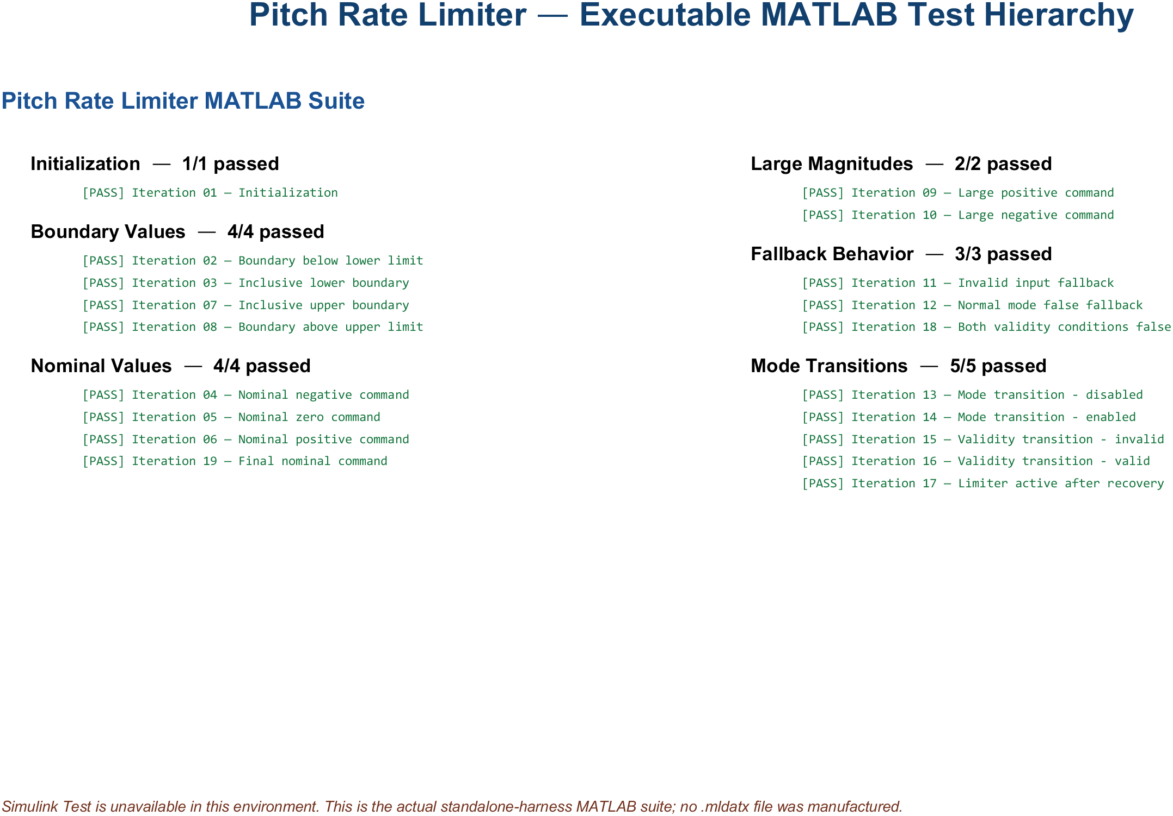
08 • MLDATX TEST FILES
MATLAB tests preserve intent without .mldatx
No .mldatx manufactured • executed MATLAB suite with retained CSV, MAT, HTML, and image results
AVIATION CONTROLS ENGINEERING ONBOARDING
25
Notes:
Timing: 2 minutes
Suggested visual:
An actual report summary shows the executable MATLAB fallback used because Simulink Test is unavailable.
Speaker notes:
Simulink Test is not installed or licensed on this computer, so the delivered project deliberately contains no .mldatx file. The authentic visual summarizes the executable MATLAB assessment suite and retained CSV, MAT, HTML, and PNG results. In a licensed environment, Test Manager can organize test files, suites, cases, callbacks, assessments, and iterations. That organization is useful, but the artifact alone would still require controlled configuration, traceability, review, and disposition of failures. The fallback used here is explicit, repeatable, and honest about the available products.
Key teaching points:
• Test files organize reusable test intent and hierarchy.
• Requirements links make cases reviewable and reportable.
• Definition files and exported result sets serve different lifecycle purposes.
[Sources]
- https://www.mathworks.com/help/sltest/ref/sltest.testmanager.testfile-class.html
- https://www.mathworks.com/help/sltest/ug/test-models-using-matlab-based-simulink-tests.html
V2 environment note: Simulink Test is not installed or licensed. The title and visual therefore document the legitimate executable MATLAB fallback and retained HTML/CSV/MAT results. No .mldatx file was created. Executed result: 19 of 19 recorded assessments passed. In a licensed environment, Test Manager can organize suites, cases, and iterations, but the artifact would still require controlled configuration, review, traceability, and failure disposition. [Sources - V2 artifact] - Local: scripts/run_pitch_rate_limiter_tests.m - https://www.mathworks.com/help/sltest/ug/test-iterations.html
V2 environment note: Simulink Test is not installed or licensed. The title and visual therefore document the legitimate executable MATLAB fallback and retained HTML/CSV/MAT results. No .mldatx file was created. Executed result: 19 of 19 recorded assessments passed. In a licensed environment, Test Manager can organize suites, cases, and iterations, but the artifact would still require controlled configuration, review, traceability, and failure disposition. [Sources - V2 artifact] - Local: scripts/run_pitch_rate_limiter_tests.m - https://www.mathworks.com/help/sltest/ug/test-iterations.html
V2 environment note: Simulink Test is not installed or licensed. The title and visual therefore document the legitimate executable MATLAB fallback and retained HTML/CSV/MAT results. No .mldatx file was created. Executed result: 19 of 19 recorded assessments passed. In a licensed environment, Test Manager can organize suites, cases, and iterations, but the artifact would still require controlled configuration, review, traceability, and failure disposition. [Sources - V2 artifact] - Local: scripts/run_pitch_rate_limiter_tests.m - https://www.mathworks.com/help/sltest/ug/test-iterations.html

Slide 34
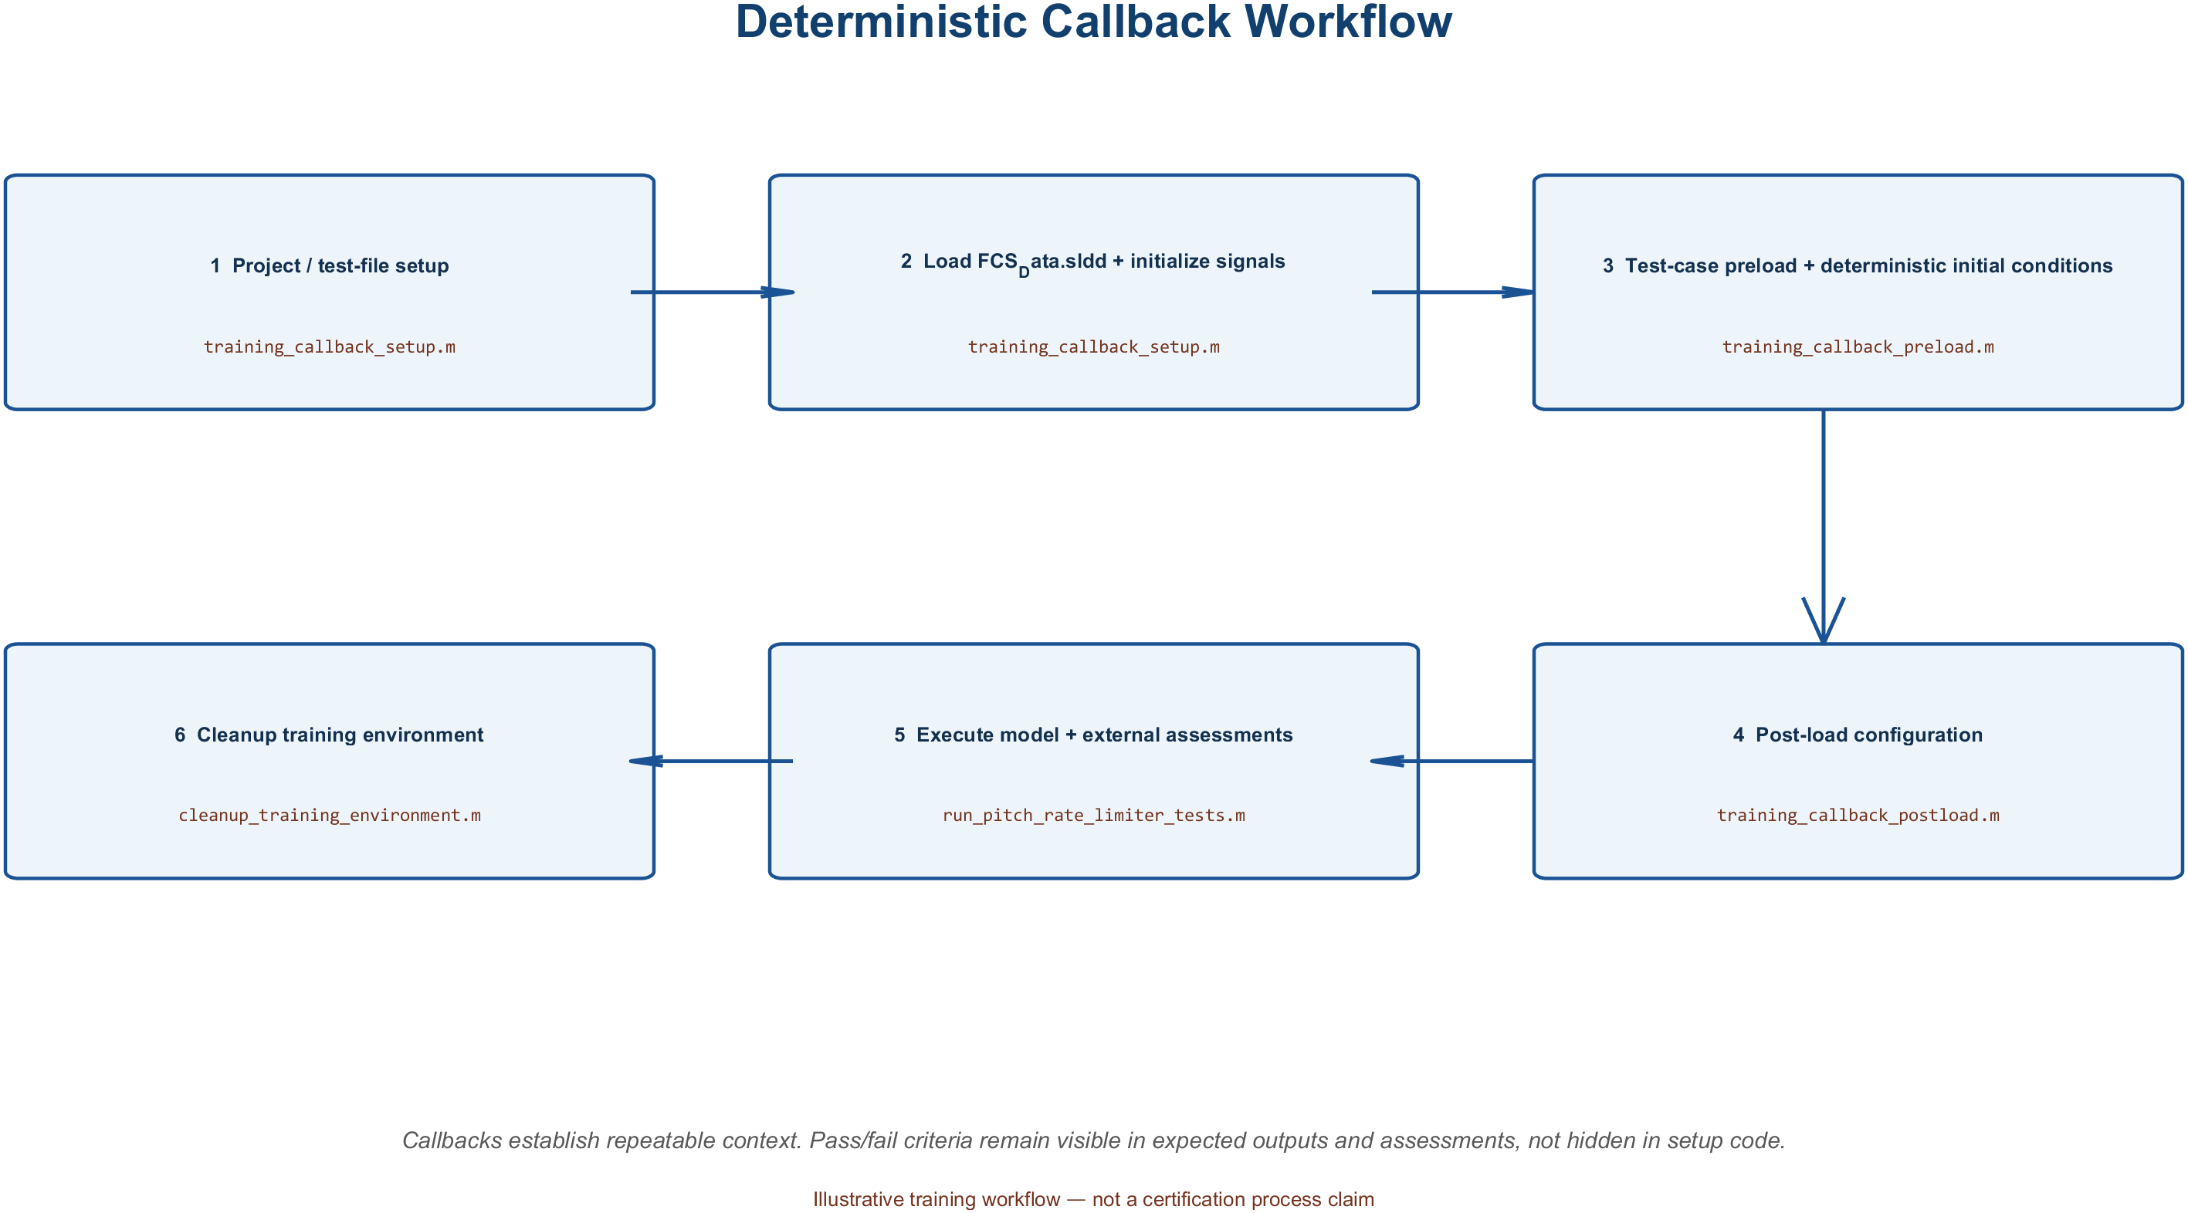
09 • CALLBACK SCRIPTS
Callbacks make tests deterministic
Actual external callback functions • setup, preload, post-load, simulate/assess, and cleanup
AVIATION CONTROLS ENGINEERING ONBOARDING
26
Notes:
Timing: 2 minutes
Suggested visual:
A generated view of the delivered external callback functions shows setup through cleanup.
Speaker notes:
Define callbacks as MATLAB code invoked at lifecycle events. Simulink models have callbacks such as PreLoadFcn, PostLoadFcn, InitFcn, StartFcn, and StopFcn. Simulink Test provides file and suite Setup/Cleanup callbacks and test-case Pre-load, Post-load, and Cleanup callbacks. Projects may place substantial callback logic in reviewed external .m functions, but a separate file is a convention, not a product requirement. Use callbacks to open the project, load controlled data, configure the environment, initialize deterministic signals, and restore state. Keep the primary verification oracle in assessments, expected outputs, baselines, or custom criteria—not hidden inside a cleanup script. Callback ordering matters, especially in parallel execution and when model callbacks also modify state.
Key teaching points:
• Callbacks establish and clean up deterministic conditions.
• Execution order and workspace scope matter.
• Do not hide the requirement’s pass/fail logic in ad hoc setup code.
[Sources]
- https://www.mathworks.com/help/sltest/ug/specify-test-properties-in-the-test-manager.html
- https://www.mathworks.com/help/sltest/ug/test-execution-order.html
- https://www.mathworks.com/help/simulink/ug/model-callbacks.html
V2 artifact update: The visual is generated from the delivered external callback functions. Setup opens controlled project data, preload establishes deterministic inputs and initial conditions, post-load configures the model, and cleanup closes only generated resources. The verification oracle remains in the assessment script. [Sources - V2 artifact] - Local: scripts/training_callback_setup.m, training_callback_preload.m, training_callback_postload.m, training_callback_cleanup.m - https://www.mathworks.com/help/simulink/callback-functions.html
V2 artifact update: The visual is generated from the delivered external callback functions. Setup opens controlled project data, preload establishes deterministic inputs and initial conditions, post-load configures the model, and cleanup closes only generated resources. The verification oracle remains in the assessment script. [Sources - V2 artifact] - Local: scripts/training_callback_setup.m, training_callback_preload.m, training_callback_postload.m, training_callback_cleanup.m - https://www.mathworks.com/help/simulink/callback-functions.html
V2 artifact update: The visual is generated from the delivered external callback functions. Setup opens controlled project data, preload establishes deterministic inputs and initial conditions, post-load configures the model, and cleanup closes only generated resources. The verification oracle remains in the assessment script. [Sources - V2 artifact] - Local: scripts/training_callback_setup.m, training_callback_preload.m, training_callback_postload.m, training_callback_cleanup.m - https://www.mathworks.com/help/simulink/callback-functions.html

Slide 35
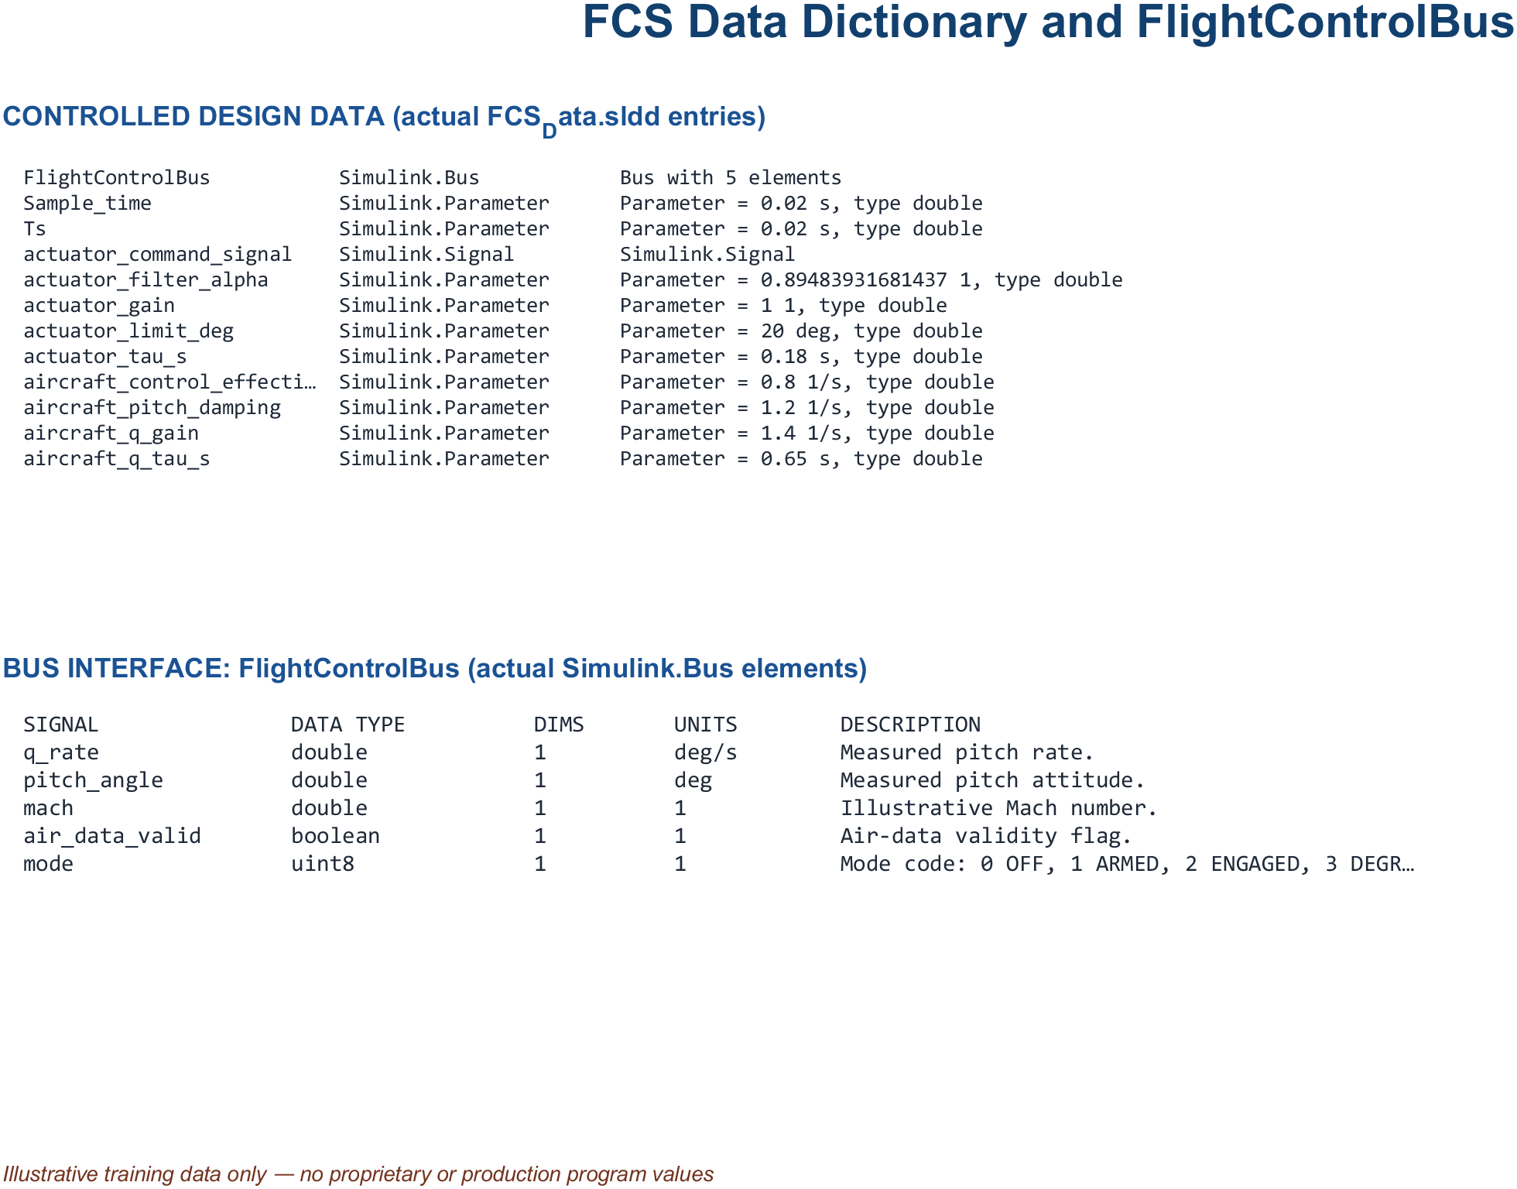
06 • SIMULINK DEVELOPMENT
Explicit interfaces make integration predictable
Actual FCS_Data.sldd inventory • FlightControlBus and controlled illustrative parameters
AVIATION CONTROLS ENGINEERING ONBOARDING
21
Notes:
Timing: 2 minutes
Suggested visual:
A dictionary-derived inventory shows FlightControlBus elements and controlled training parameters from FCS_Data.sldd.
Speaker notes:
Clarify three concepts that are often confused. A model reference provides modular behavior in a separately managed model and can support isolated testing and incremental workflows. A bus groups related interface elements, reducing line clutter while preserving a defined contract when backed by bus objects. A data dictionary stores the shared types, parameters, enumerations, and bus definitions. Integration quality depends on ownership: which component produces each element, which consumes it, what units and rates apply, and how validity is represented. A bus is not a license to move an unstructured bundle of data. Interfaces should be narrow, named, versioned, and reviewed.
Key teaching points:
• Model references support modular development and isolated verification.
• Buses group signals but must preserve explicit contracts.
• Dictionaries centralize controlled definitions and parameters.
[Sources]
- https://www.mathworks.com/help/simulink/ug/overview-of-model-referencing-1.html
- https://www.mathworks.com/help/simulink/ug/interface-design.html
- https://www.mathworks.com/help/simulink/ug/determine-where-to-store-data-for-simulink-models.html
V2 artifact update: The visual is derived from the actual FCS_Data.sldd entries and FlightControlBus definition. The bus contains q_rate, pitch_angle, mach, air_data_valid, and mode; controlled parameters include sample time, gains, filter coefficients, limits, and initial conditions. [Sources - V2 artifact] - Local: data/FCS_Data.sldd - https://www.mathworks.com/help/simulink/ug/what-is-a-data-dictionary.html - https://www.mathworks.com/help/simulink/slref/simulink.bus.html
V2 artifact update: The visual is derived from the actual FCS_Data.sldd entries and FlightControlBus definition. The bus contains q_rate, pitch_angle, mach, air_data_valid, and mode; controlled parameters include sample time, gains, filter coefficients, limits, and initial conditions. [Sources - V2 artifact] - Local: data/FCS_Data.sldd - https://www.mathworks.com/help/simulink/ug/what-is-a-data-dictionary.html - https://www.mathworks.com/help/simulink/slref/simulink.bus.html
V2 artifact update: The visual is derived from the actual FCS_Data.sldd entries and FlightControlBus definition. The bus contains q_rate, pitch_angle, mach, air_data_valid, and mode; controlled parameters include sample time, gains, filter coefficients, limits, and initial conditions. [Sources - V2 artifact] - Local: data/FCS_Data.sldd - https://www.mathworks.com/help/simulink/ug/what-is-a-data-dictionary.html - https://www.mathworks.com/help/simulink/slref/simulink.bus.html

Slide 36
06 • SIMULINK DEVELOPMENT
Reviewable models make intent obvious
01
NAME FOR MEANING
PitchRateLimiter, q_cmd_in, air_data_valid—not Subsystem3 or u1
02
LABEL THE CONTRACT
units, type, dimensions, sample time, range, validity, ownership
03
FLOW LEFT TO RIGHT
commands and data enter consistently; outputs leave consistently
04
ONE LEVEL, ONE STORY
use hierarchy when a reviewer cannot summarize the diagram quickly
05
REUSE CONTROLLED CONTENT
libraries and references—never copy/paste divergence
If the diagram needs a verbal apology, refactor the diagram.
AVIATION CONTROLS ENGINEERING ONBOARDING
22
Notes:
Timing: 1.5 minutes
Suggested visual:
Five model-review rules are presented as a large-format engineering checklist.
Speaker notes:
Stress that readability is a verification feature. Reviewers should be able to see the main signal path, understand the hierarchy, identify interfaces, and locate the requirement-linked behavior without tracing crossings and unlabeled lines. Names should carry engineering meaning. Signal labels should include the concepts needed by the project—often units, types, dimensions, rates, validity, and ownership. Layout should establish a consistent flow. A subsystem should have one clear responsibility, and library or referenced content should be reused under configuration control rather than copied. Clever compression, hidden data stores, masked side effects, and undocumented callbacks may make a model look smaller while making the lifecycle harder to verify.
Key teaching points:
• Readability reduces review error and investigation time.
• Naming and labeling are part of the interface contract.
• Controlled reuse prevents silent divergence.
[Sources]
- https://www.mathworks.com/help/slcheck/ref/model-advisor-checks-for-do-178cdo-331-industry-standards.html
- https://www.mathworks.com/help/simulink/ug/interface-design.html

Slide 37
11 • CONTINUOUS INTEGRATION
Jenkins makes verification repeatable
Commit
Jenkinsfile
Build / Update
Model Checks
Tests
Reports + Artifacts
GROOVY / JENKINSFILE
orchestrates stages, agents, parameters, parallel branches, retention
MATLAB + SIMULINK
opens the project, updates models, runs checks and scripted tests; .mldatx suites are an optional generic capability, not supplied here
ROBOT FRAMEWORK
optional keyword-driven orchestration for benches, external interfaces, and system tests
Use continuous integration and verification automation—not automatic deployment to airborne software.
AVIATION CONTROLS ENGINEERING ONBOARDING
28
Notes:
Timing: 2 minutes
Suggested visual:
A six-stage Jenkins pipeline sits above three responsibility lanes for Groovy, MATLAB/Simulink, and Robot Framework.
Speaker notes:
Explain Jenkins as an automation server, not a Simulink-aware verifier by itself. A version-controlled Jenkinsfile defines stages and provides reviewability and history. Pipeline syntax can be Declarative or Scripted; Scripted Pipeline uses a Groovy-based DSL. A configured agent invokes MATLAB, opens the project, compiles or updates models, runs model checks and tests, and publishes CI-compatible reports. Robot Framework may be used as an optional keyword-driven layer to control benches, external interfaces, or higher-level system tests; it is not a DO-178C requirement and has no automatic certification status. The valuable outcome is a reproducible, controlled run with retained logs, results, environment information, and configuration identity.
Key teaching points:
• Jenkins orchestrates; project scripts perform the engineering work.
• Pipeline-as-code improves reviewability and repeatability.
• A pipeline pass becomes useful evidence only with controlled configuration and traceability.
[Sources]
- https://www.jenkins.io/doc/book/pipeline/
- https://www.jenkins.io/doc/book/pipeline/jenkinsfile/
- https://www.mathworks.com/help/sltest/ug/output-results-for-continuous-integration-systems.html
- https://robotframework.org/robotframework/latest/RobotFrameworkUserGuide.html
V3 pipeline clarification: - A passing pipeline shows that configured steps passed on a controlled agent and baseline. It is evidence input, not certification approval by itself, and does not remove review, traceability, configuration, problem-report, or independence objectives. [Sources] - https://www.faa.gov/documentLibrary/media/Order/FAA_Order_8110.49A.pdf
V4 first-user clarification: - The supplied package uses MATLAB scripts and retained CSV/MAT/PNG/HTML-style artifacts; it does not contain a .mldatx suite. - A green CI stage is evidence input from the controlled agent/configuration. It is not certification approval and does not replace traceability, review, configuration control, problem reporting, or designated independence. [Sources] - https://www.faa.gov/documentLibrary/media/Order/FAA_Order_8110.49A.pdf

Slide 38
12 • FAILURE INVESTIGATION
Classify the first meaningful failure
PIPELINE FAILURE
Can you reproduce it
with the controlled command?
NO
Compare agent, licenses, paths,
project startup, data, versions
YES — compile/static
Interface • type • dimension • rate
reference • parameter • variant
YES — functional
Stimulus • expected result • tolerance
mode • initial state • timing
Fix root cause → add regression protection → re-run affected scope → run controlled full pipeline
AVIATION CONTROLS ENGINEERING ONBOARDING
29
Notes:
Timing: 2 minutes
Suggested visual:
A triage flow splits an unreproducible failure from semantic/compile and functional/test failures.
Speaker notes:
Teach disciplined triage. Preserve the failing log, build identifier, commit, configuration, agent, and first meaningful error. Try the controlled local command rather than improvising a different workflow. If the failure does not reproduce, compare environment: MATLAB release, licensed products, project startup, path order, data dictionaries, environment variables, cached artifacts, and agent configuration. If it reproduces, classify it. Compile and static failures usually point to references, types, dimensions, rates, parameters, variants, or standards. Functional failures require checking stimulus, expected output, tolerance, modes, initial state, timing, and the actual requirement. Fix the root cause, add a regression test or check, and re-run both the affected scope and the controlled full pipeline.
Key teaching points:
• Preserve the exact failing configuration before investigation.
• Classify environment, semantic, and behavioral failures separately.
• Every meaningful defect should leave regression protection behind.
[Sources]
- https://www.jenkins.io/doc/book/pipeline/
- https://www.mathworks.com/help/sltest/ug/output-results-for-continuous-integration-systems.html
- https://www.mathworks.com/help/sltest/ug/test-execution-order.html

Slide 39
13 • HARDWARE-IN-THE-LOOP
HIL tests real hardware in a virtual aircraft
Flight-Control Computer
production software + processor
Test Host
scenarios • automation • logs
Physical I/O + Loads
A/D • D/A • discrete • bus
REAL HARDWARE
Real-Time Plant Simulation
aircraft • actuators • sensors • environment
FAULT INJECTION
stale sensor • bus dropout • actuator jam • power cycle
REAL-TIME TARGET
AVIATION CONTROLS ENGINEERING ONBOARDING
30
Notes:
Timing: 2 minutes
Suggested visual:
A closed-loop HIL architecture connects test host, real flight-control computer, physical I/O, and a real-time plant with fault injection.
Speaker notes:
Correct the common oversimplification that software runs ‘in the HIL hardware.’ In controller HIL, the production software normally executes on the real flight-control computer or representative controller hardware. Its real analog, digital, discrete, and communication interfaces connect through I/O and load hardware to a real-time target. The target simulates aircraft dynamics, actuators, sensors, environment, and failures. The test host orchestrates scenarios and collects results. HIL exposes hardware/software integration, scaling, wiring, latency, scheduling, bus behavior, startup, resets, and fault response that desktop model-in-the-loop tests cannot fully reproduce. The real-time plant still has modeling assumptions, so HIL does not equal flight test or prove every requirement automatically.
Key teaching points:
• The real controller closes the loop with a simulated plant in real time.
• Physical I/O and timing are central HIL test targets.
• HIL complements MIL/SIL/PIL and other verification—it does not replace them.
[Sources]
- https://www.mathworks.com/discovery/hardware-in-the-loop-hil.html
- https://www.mathworks.com/help/sltest/sil-pil-and-hil-tests.html
V3 HIL clarification: - This slide describes a possible program verification environment; this training project did not perform HIL. - Only call testing HIL when actual controller or target hardware, a real-time plant environment, and physical I/O are used. PIL/target execution, bench testing, and system integration are distinct environments and should be named precisely. [Sources] - https://www.faa.gov/documentLibrary/media/Order/FAA_Order_8110.49A.pdf - https://www.nasa.gov/reference/systems-engineering-handbook/

Slide 40
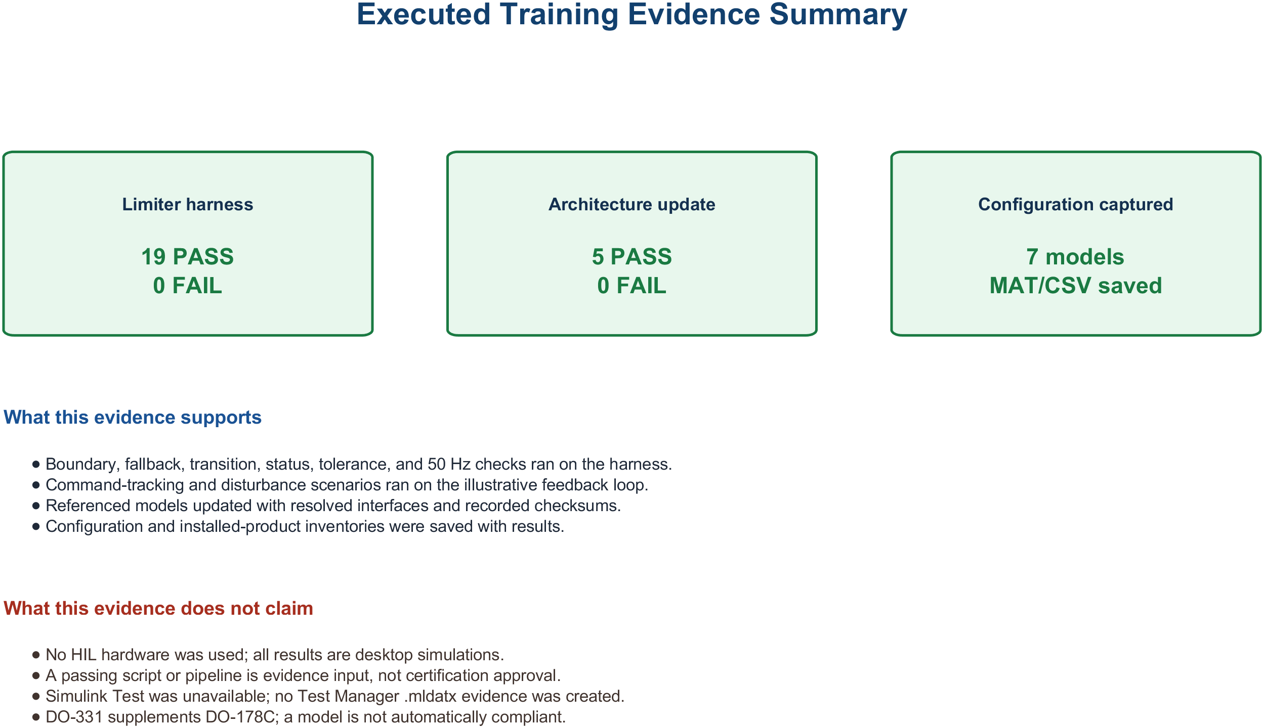
14 • COMPLETE END-TO-END EXAMPLE
One limiter, one unbroken evidence chain
Verified desktop training chain • no Jenkins or HIL execution claimed
AVIATION CONTROLS ENGINEERING ONBOARDING
32
Notes:
Timing: 2 minutes
Suggested visual:
An executed desktop evidence summary connects requirements, controlled artifacts, tests, results, and validation without HIL claims.
Speaker notes:
Narrate the verified desktop training chain only. PRL-001 through PRL-005 define the illustrative limiter behavior and interface expectations. FCS_Data.sldd controls parameters and FlightControlBus. PitchRateLimiter.slx implements the magnitude clamp and fallback; the standalone harness executes deterministic 50 Hz stimuli; MATLAB assessments retain actual and expected values, pass/fail, configuration, and reports; the referenced architecture update validates interface consistency. No .mldatx, Jenkins run, HIL hardware, generated code, or certification approval is claimed. The value is a reproducible, inspectable training evidence path—not a completed aircraft certification package.
Key teaching points:
• Every step produces or consumes controlled lifecycle data.
• The same requirement stays visible from model to HIL.
• Evidence is complete only when results, configuration, reviews, and dispositions agree.
[Sources]
- https://www.faa.gov/documentLibrary/media/Advisory_Circular/AC_20-115D.pdf
- https://www.mathworks.com/help/slrequirements/ug/create-and-store-links.html
- https://www.mathworks.com/help/sltest/ref/sltest.testmanager.testfile-class.html
- https://www.jenkins.io/doc/book/pipeline/
- https://www.mathworks.com/discovery/hardware-in-the-loop-hil.html
V2 artifact update: The replacement visual summarizes the verified desktop training chain only: requirement IDs, controlled data/model artifacts, standalone harness, executable assessments, retained results, and architecture update validation. Executed result: 19 of 19 recorded assessments passed. Architecture validation: 8 of 8 delivered models updated successfully. No Jenkins pipeline or HIL hardware was executed, and no certification approval is claimed. [Sources - V2 artifact] - Local: results/validation_summary.txt - https://www.faa.gov/documentLibrary/media/Order/FAA_Order_8110.49A.pdf
V2 artifact update: The replacement visual summarizes the verified desktop training chain only: requirement IDs, controlled data/model artifacts, standalone harness, executable assessments, retained results, and architecture update validation. Executed result: 19 of 19 recorded assessments passed. Architecture validation: 8 of 8 delivered models updated successfully. No Jenkins pipeline or HIL hardware was executed, and no certification approval is claimed. [Sources - V2 artifact] - Local: results/validation_summary.txt - https://www.faa.gov/documentLibrary/media/Order/FAA_Order_8110.49A.pdf
V2 artifact update: The replacement visual summarizes the verified desktop training chain only: requirement IDs, controlled data/model artifacts, standalone harness, executable assessments, retained results, and architecture update validation. Executed result: 19 of 19 recorded assessments passed. Architecture validation: 8 of 8 delivered models updated successfully. No Jenkins pipeline or HIL hardware was executed, and no certification approval is claimed. [Sources - V2 artifact] - Local: results/validation_summary.txt - https://www.faa.gov/documentLibrary/media/Order/FAA_Order_8110.49A.pdf
V3 evidence-chain clarification: - For this training project, the demonstrated chain ends with controlled desktop models, harnesses, assessments, retained results, and architecture update/compile evidence. It does not extend to HIL. - Any future PIL, target, bench, HIL, or system-integration evidence must identify its specific execution environment and controlled baseline. [Sources] - https://www.faa.gov/documentLibrary/media/Order/FAA_Order_8110.49A.pdf
V4 first-user clarification: - The requirement remains visible through each executed environment. This package stops at desktop model execution and architecture update; it does not extend to HIL. - Use the exact execution-environment name in retained evidence. PIL is not automatically unit testing, and HIL requires actual controller/target hardware, a real-time plant environment, and physical I/O. [Sources] - https://www.faa.gov/documentLibrary/media/Order/FAA_Order_8110.49A.pdf - https://www.nasa.gov/reference/systems-engineering-handbook/

Slide 41
13 • HARDWARE-IN-THE-LOOP
HIL pass criteria must be quantitative
OBJECTIVE
EXAMPLE TEST
PASS CRITERIA
Functional
Sweep q_cmd through ±12 deg/s
output clamps within specified tolerance
Timing
50 Hz frame under worst-case load
no overrun; latency and jitter within allocation
Interfaces
exercise scaling, validity, and bus updates
units, range, freshness, and status correct
Fault response
stale air data / bus dropout / reset
specified degraded state within required time
Evidence
repeat on released configuration
IDs, logs, procedures, results, and links retained
A beautiful trace is not a pass criterion. State the tolerance, time, configuration, and required evidence.
AVIATION CONTROLS ENGINEERING ONBOARDING
31
Notes:
Timing: 2 minutes
Suggested visual:
A five-row HIL verification matrix pairs objectives, realistic tests, and quantitative pass criteria.
Speaker notes:
Turn HIL from a demo into verification. Functional tests connect inputs and outputs to requirement tolerances. Timing tests specify frame rate, latency, jitter, and overrun criteria. Interface tests verify scaling, units, freshness, status, protocol behavior, and electrical behavior as applicable. Fault tests inject realistic stale data, dropouts, resets, actuator failures, and power transitions and verify the required response time and state. Evidence criteria require the released software, hardware, plant, I/O, test, and tool configurations to be identifiable. Plots support analysis, but a reviewer needs quantitative criteria, procedures, logs, results, trace links, and dispositions.
Key teaching points:
• Every HIL test needs an explicit requirement and quantitative oracle.
• Timing, interfaces, and faults are core HIL objectives.
• Configuration identity determines whether a result is reusable evidence.
[Sources]
- https://www.mathworks.com/discovery/hardware-in-the-loop-hil.html
- https://www.mathworks.com/help/sltest/sil-pil-and-hil-tests.html
- https://www.faa.gov/documentLibrary/media/Advisory_Circular/AC_20-115D.pdf
V3 execution-environment clarification: - HIL criteria are meaningful only for a setup with actual controller or target hardware, real-time plant execution, and physical I/O. No such setup was used by this project. - MIL, SIL, PIL, HIL, bench, and system-integration results answer different questions. PIL is an execution environment and is not automatically synonymous with unit testing. - Passing results remain evidence inputs and do not constitute certification approval. [Sources] - https://www.faa.gov/documentLibrary/media/Order/FAA_Order_8110.49A.pdf - https://www.nasa.gov/reference/systems-engineering-handbook/

Slide 42
15 • KEY TAKEAWAYS
Your first week should produce one repeatable chain
WHAT TO REMEMBER
FIRST WEEK
Simulink — executable data flow, state, timing, and hierarchy
DO-178C / DO-331 — planned objectives, model role, verification, and evidence
Testing — requirements first; boundaries, modes, failures, and timing
Automation — repeatable checks and results under controlled configuration
HIL — real controller, physical I/O, real-time plant, quantitative criteria
01 initialize paths + open the simulation top level
02 update (Ctrl+D), then run (Ctrl+T)
03 toggle units, types, dimensions + logging
04 inspect samples + compare runs in SDI
05 trace PSYS-001 to one executed result
06 modify one component; rerun affected evidence
A repeatable chain makes review possible: requirement → model → test → result → controlled baseline.
AVIATION CONTROLS ENGINEERING ONBOARDING
33
Notes:
Timing: 2 minutes
The learner’s first week should end with one reproducible chain, not only passive familiarity with screenshots. Use the illustrative PSYS/SWHLR/PRL requirements in this training package; transition to approved program requirements only under the project’s actual plans and data controls.
This package stops at desktop model execution and architecture update. It did not perform HIL. DO-178C is an accepted means of compliance, not a standalone software certificate; DO-331 supplements it for model-based development and verification. A passing test or pipeline is evidence input, not approval by itself.
[Sources]
- https://www.faa.gov/regulations_policies/advisory_circulars/index.cfm/go/document.information/documentID/1032046
- https://www.faa.gov/documentLibrary/media/Order/FAA_Order_8110.49A.pdf
- https://www.nasa.gov/reference/systems-engineering-handbook/

