Slide 2
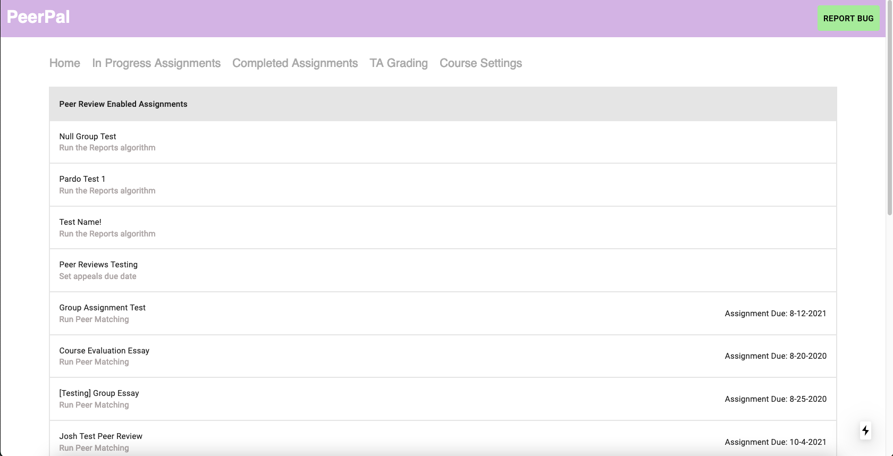
[1] Nav bar
[2] Enabled assignments

Slide 3
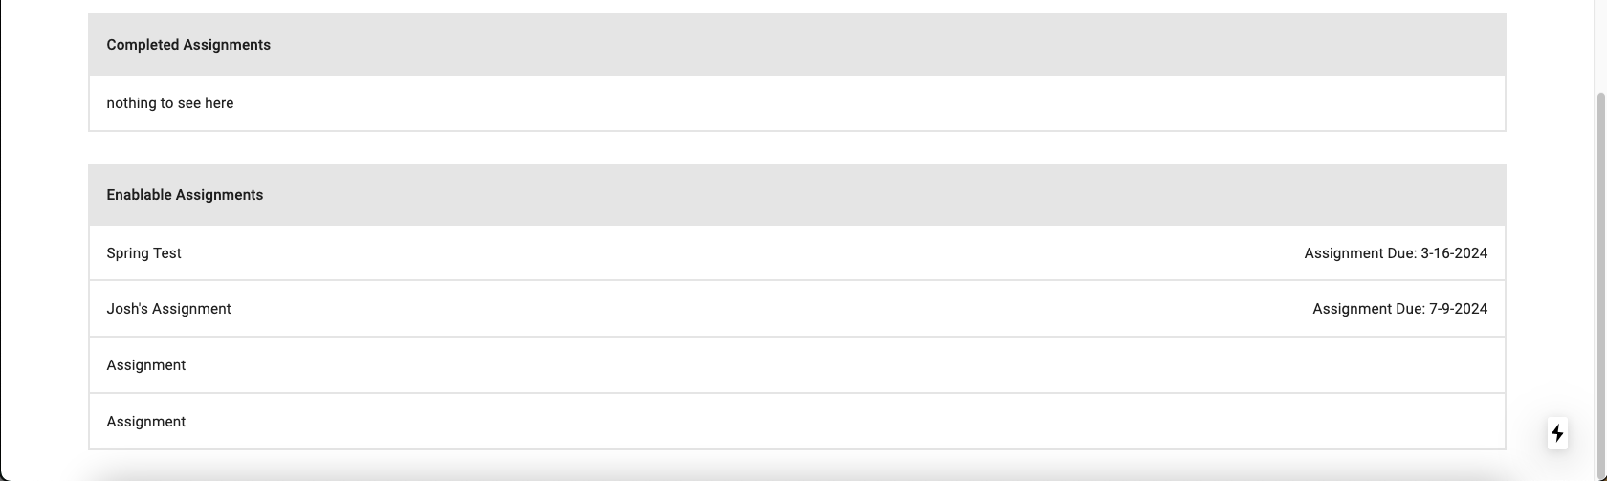
[3] Completed assignments
[4] Enablable assignments

Slide 4
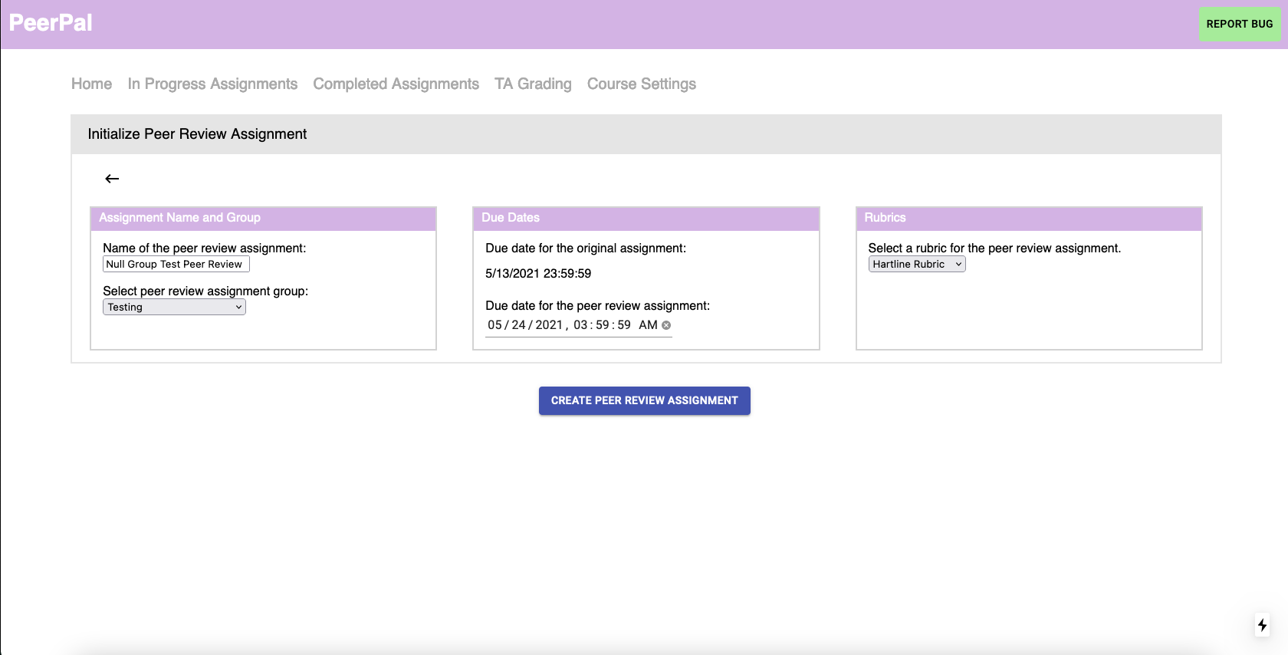
[1] Name/group settings
[2] Date settings
[3] Rubric settings
[4] Create assignment button

