Slide 1
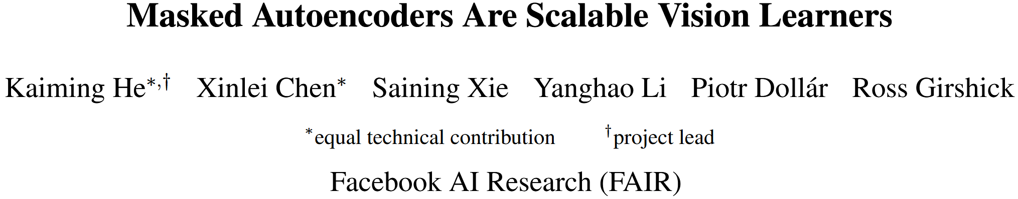

Slide 2
Introduction
Until recently, architectures were different. In vision, convolutional networks were dominant over the last decade. Convolutions typically operate on regular grids and it is not straightforward to integrate ‘indicators’ such as mask tokens or positional embeddings into convolutional networks.
Information density is different between language and vision. Languages are human-generated signals that are highly semantic and information-dense. When training a model to predict only a few missing words per sentence, this task appears to induce sophisticated language understanding. Images, on the contrary, are natural signals with heavy spatial redundancy—e.g., a missing patch can be recovered from neighboring patches with little high-level understanding of parts, objects, and scenes.

Slide 3
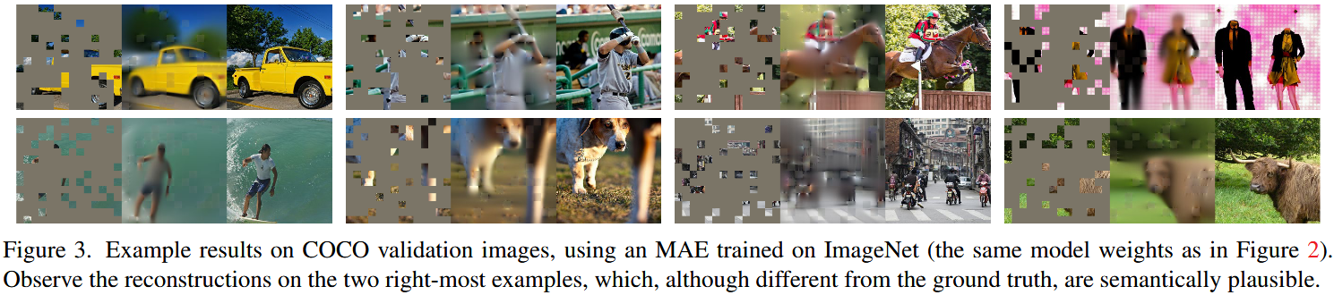
Introduction
The autoencoder’s decoder, which maps the latent representation back to the input, plays a different role between reconstructing text and images. In vision, the decoder reconstructs pixels, hence its output is of a lower semantic level than common recognition tasks. This is in contrast to language, where the decoder predicts missing words that contain rich semantic information. While in BERT the decoder can be trivial (an MLP), we found that for images, the decoder design plays a key role in determining the semantic level of the learned latent representations.

Slide 4
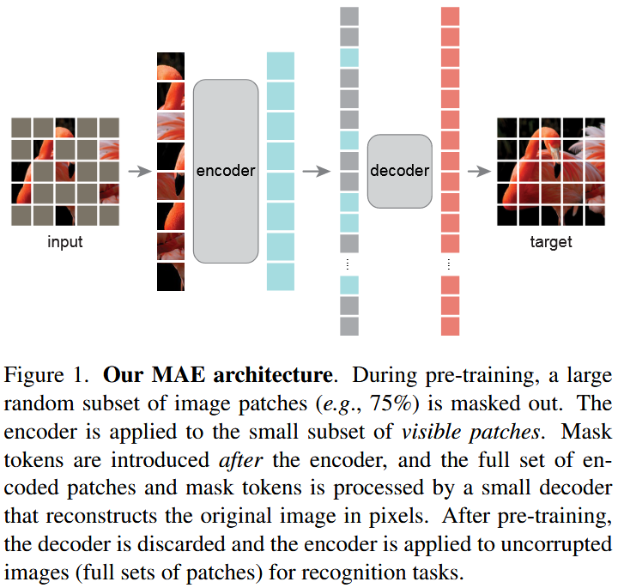
Approach
MAE is a simple autoencoding approach that reconstructs the original signal given its partial observation. Unlike classical autoencoders, we adopt an asymmetric design that allows the encoder to operate only on the partial, observed signal (without mask tokens) and a lightweight decoder that reconstructs the full signal from the latent representation and mask tokens.

Slide 5
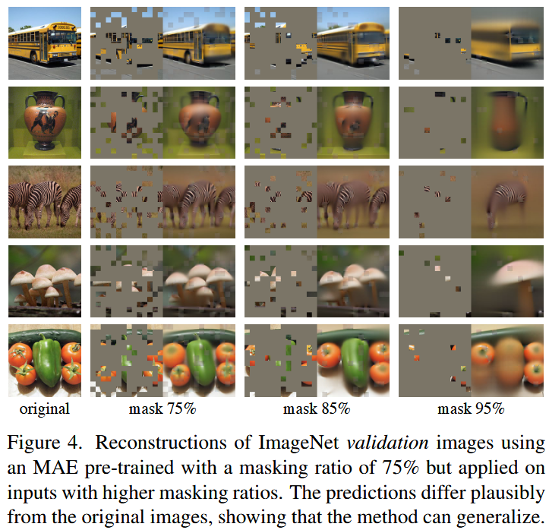
Approach
Masking. Following ViT, we divide an image into regular non-overlapping patches. Then we sample a subset of patches and mask (i.e., remove) the remaining ones. Random sampling with a high masking ratio (i.e., the ratio of removed patches) largely eliminates redundancy, thus creating a task that cannot be easily solved by extrapolation from visible neighboring patches.
MAE encoder. Our encoder is a ViT but applied only on visible, unmasked patches. Masked patches are removed; no mask tokens are used. The full set is handled by a lightweight decoder, described next.

Slide 6
Approach
MAE decoder. The input to the MAE decoder is the full set of tokens consisting of (i) encoded visible patches, and (ii) mask tokens. Each mask token is a shared, learned vector that indicates the presence of a missing patch to be predicted. We add positional embeddings to all tokens in this full set. We experiment with very small decoders, narrower and shallower than the encoder.
Reconstruction target. Our MAE reconstructs the input by predicting the pixel values for each masked patch. Each element in the decoder’s output is a vector of pixel values representing a patch. The last layer of the decoder is a linear projection whose number of output channels equals the number of pixel values in a patch. The decoder’s output is reshaped to form a reconstructed image. Our loss function computes the mean squared error (MSE) between the reconstructed and original images in the pixel space.

Slide 7
Experiments
We do self-supervised pre-training on the ImageNet-1K (IN1K) training set. Then we do supervised training to evaluate the representations with (i) end-to-end fine-tuning or (ii) linear probing. We report top-1 validation accuracy of a single 224×224 crop. We use ViT-Large (ViT-L/16) as the backbone in our ablation study. The following is a comparison between ViT-L trained from scratch vs. fine-tuned from our baseline MAE

Slide 8
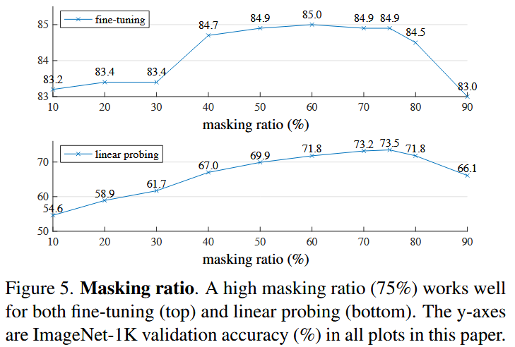
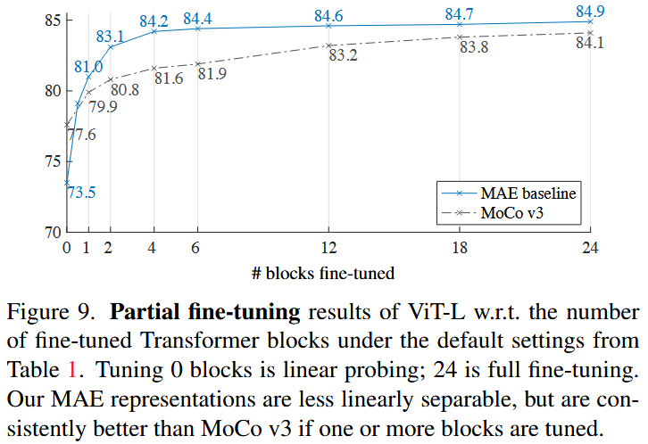
Experiments
The optimal ratios are surprisingly high. The ratio of 75% is good for both linear probing and fine-tuning. This behavior is in contrast with BERT, whose typical masking ratio is 15%. Our masking ratios are also much higher than those in related works in computer vision (20% to 50%).

Slide 9
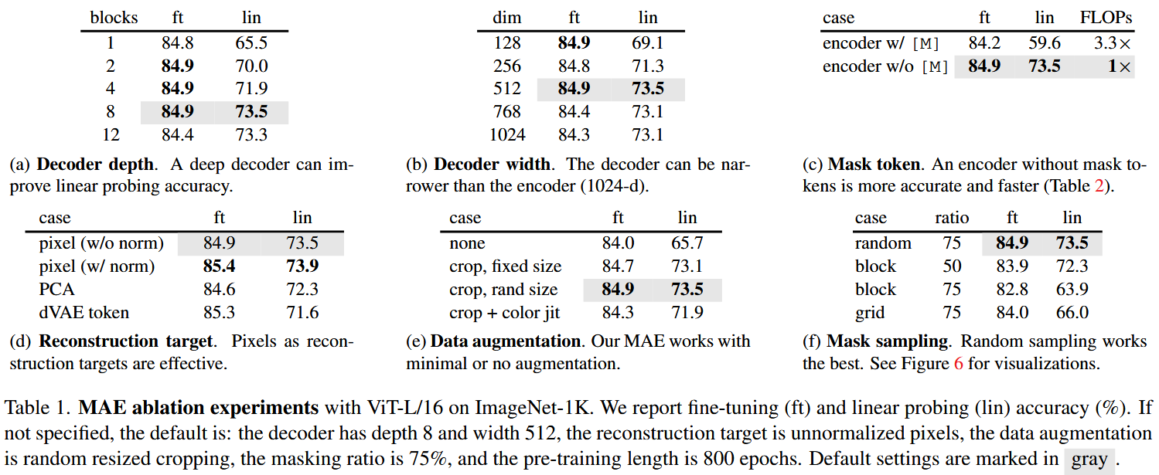
Experiments

Slide 10
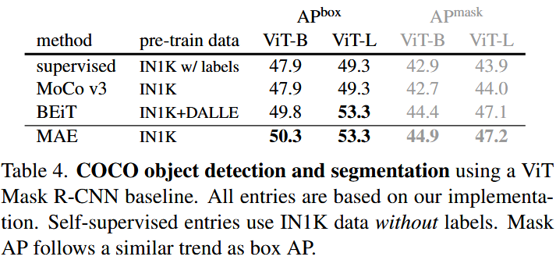
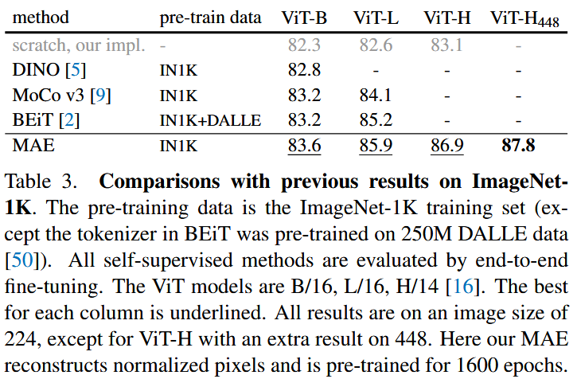
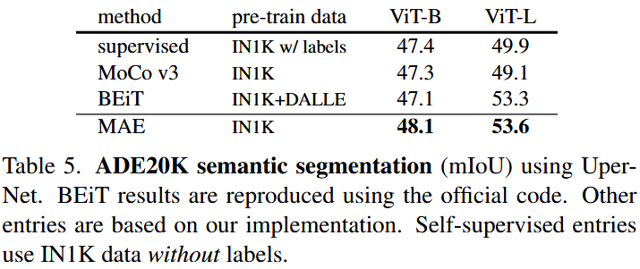
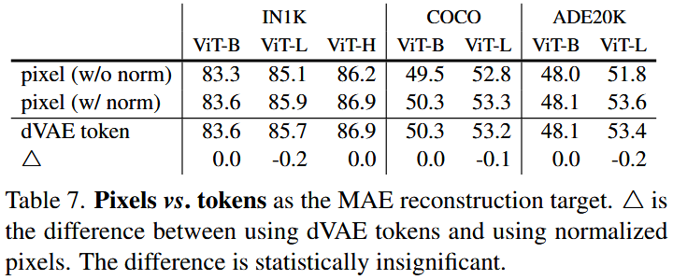
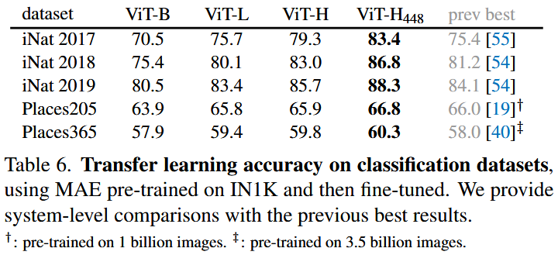
Experiments

Slide 11
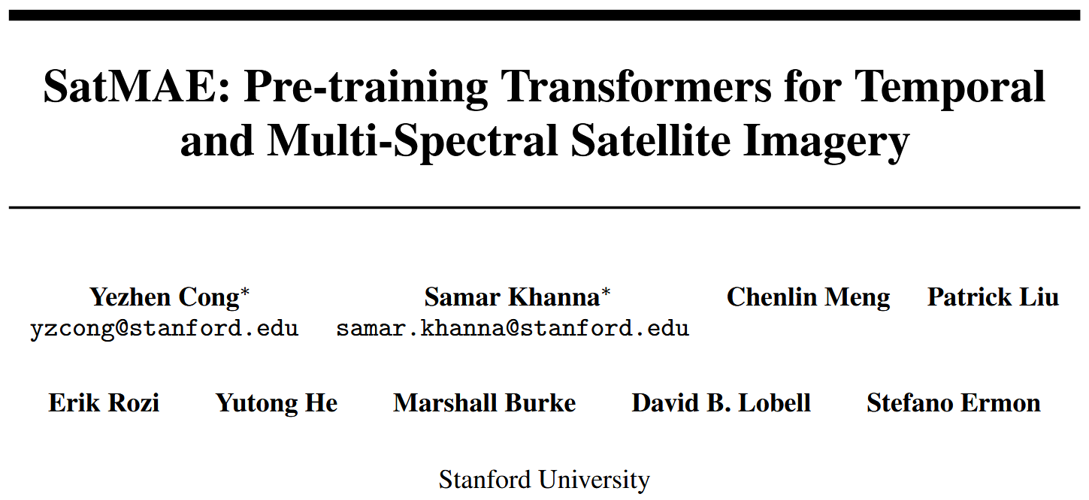

Slide 12
Approach
Temporal Encoding. We propose a temporal encoding scheme compatible with the masked autoencoder architecture by treating the temporal dimension similarly to the positional dimensions. The timestamp of a satellite image is represented as “yearmonth-day-hour-minute-second”. Instead of passing the entire numerized timestamp into a feature encoder, we propose only keeping the useful parts. Intuitively, the day, minute, and second should be unrelated to the visual appearance of a region.
Masking Strategies.
Consistent Masking. Each image is “patchified” separately, but the masked regions are consistent across all images.
Independent Masking. Each image is “patchified” separately, and masked regions may not be the same across every image. Instead, a fraction pm of the full sequence of all patch tokens are masked. Another variant is to independently mask the regions of each image, but keep the ratio pm of masked regions fixed per image.

Slide 13
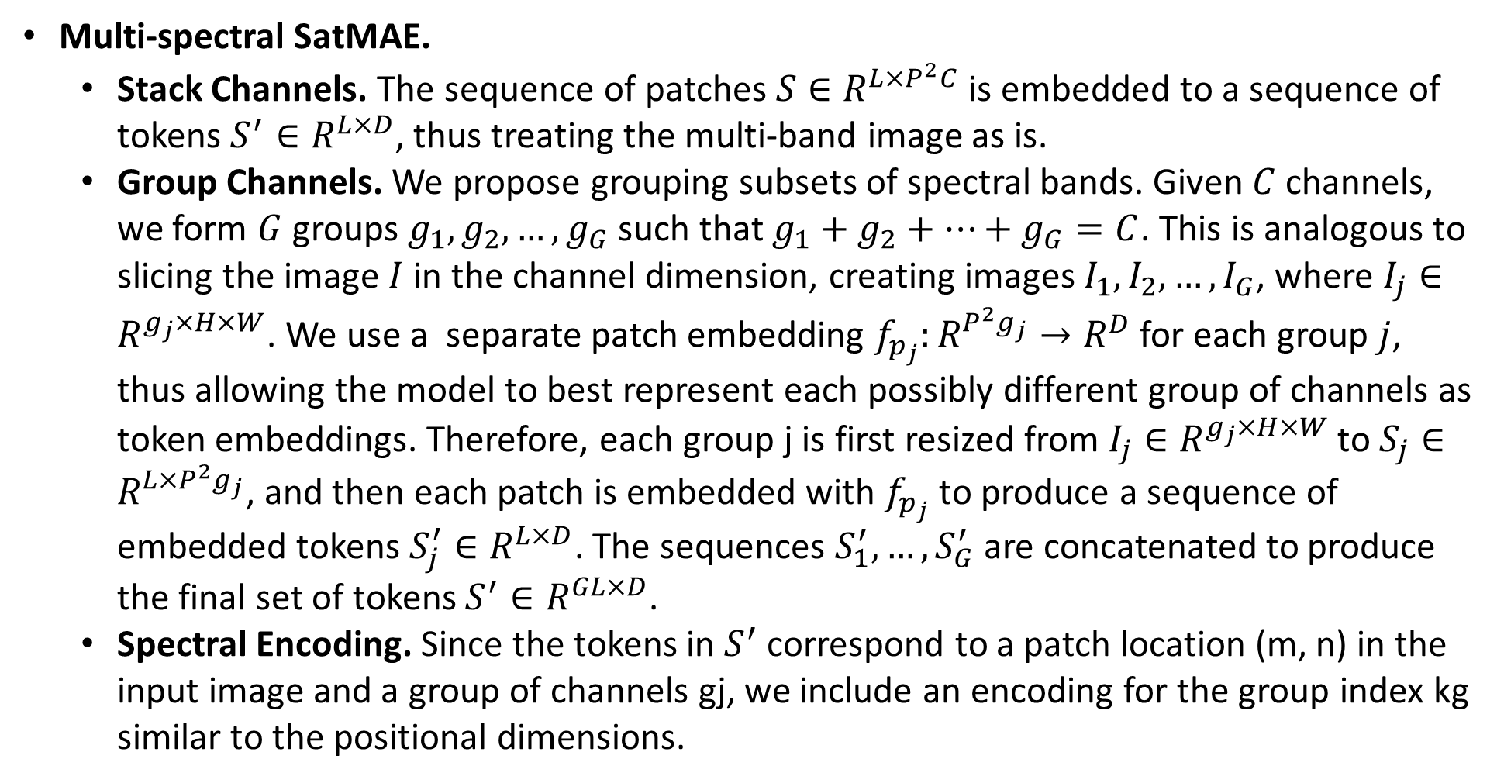
Approach
Multi-spectral SatMAE.
Stack Channels. The sequence of patches $S∈R^{L×P^{2}C}$is embedded to a sequence of tokens $S^{′}∈R^{L×D}$, thus treating the multi-band image as is.
Group Channels. We propose grouping subsets of spectral bands. Given $C$ channels, we form $G$ groups $g_{1},g_{2},…,g_{G}$such that $g_{1}+g_{2}+…+g_{G}=C$. This is analogous to slicing the image $I$in the channel dimension, creating images $I_{1},I_{2},…,I_{G}$, where $I_{j}∈R^{g_{j}×H×W}$. We use a separate patch embedding $f_{p_{j}}:R^{P^{2}g_{j}}→R^{D}$ for each group $j$, thus allowing the model to best represent each possibly different group of channels as token embeddings. Therefore, each group j is first resized from $I_{j}∈R^{g_{j}×H×W}$ to $S_{j}∈R^{{L×P}^{2}g_{j}}$, and then each patch is embedded with $f_{p_{j}}$ to produce a sequence of embedded tokens $S_{j}^{′}∈R^{L×D}$. The sequences $S_{1}^{′},…,S_{G}^{′}$are concatenated to produce the final set of tokens $S^{′}∈R^{GL×D}$.
Spectral Encoding. Since the tokens in $S^{′}$ correspond to a patch location (m, n) in the input image and a group of channels gj, we include an encoding for the group index kg similar to the positional dimensions.

Slide 14
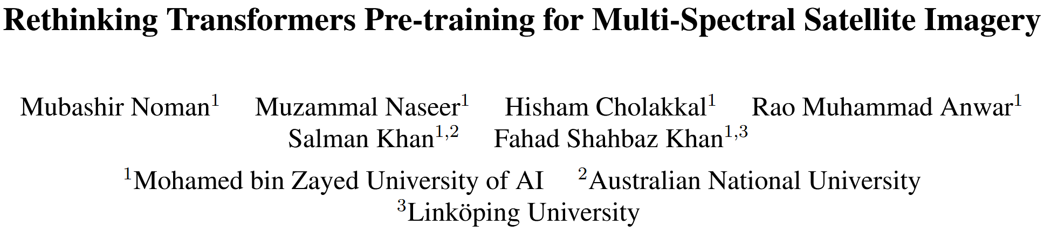

Slide 15
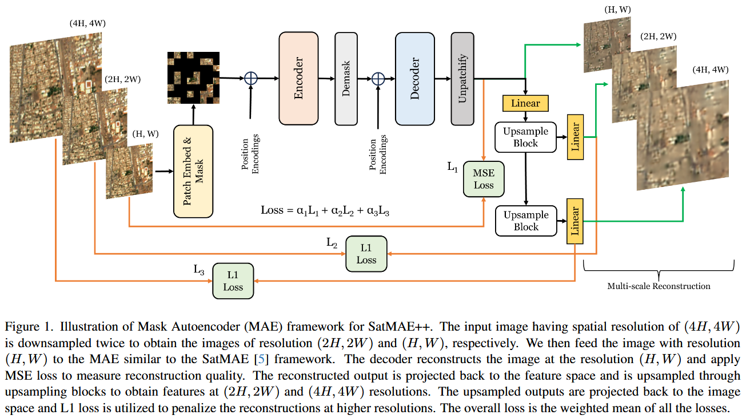
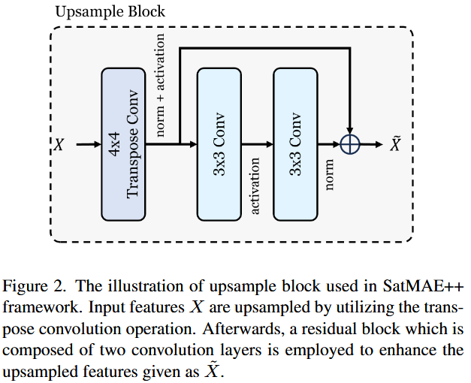
Approach

Slide 16
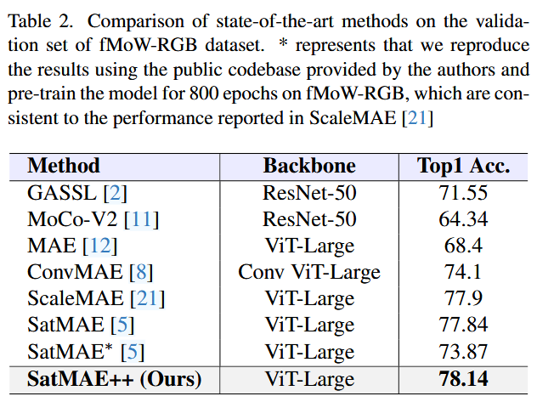
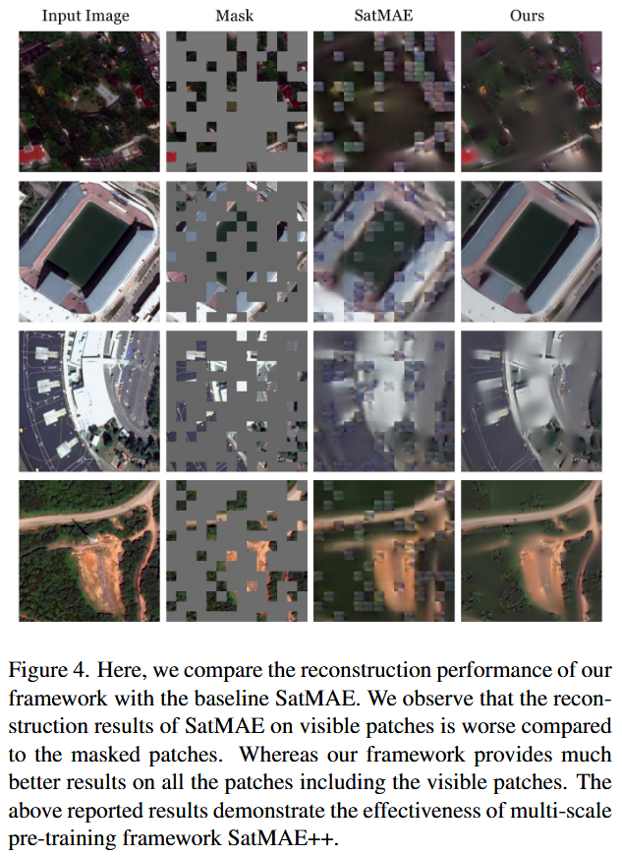
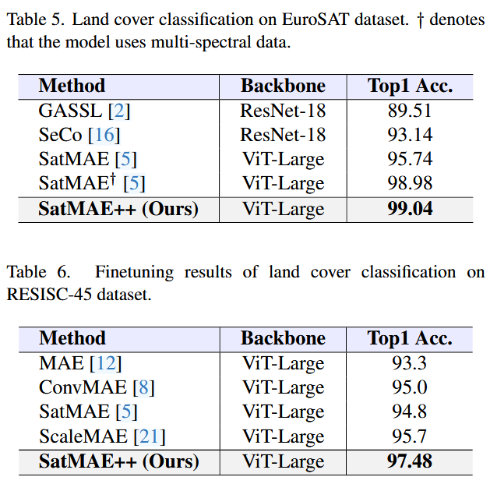
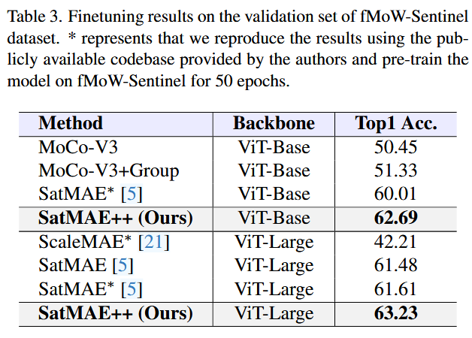
Experiments

