Slide 1
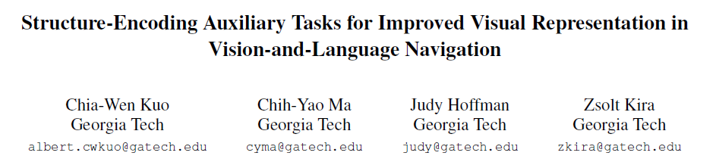
WACV 2023

Slide 2
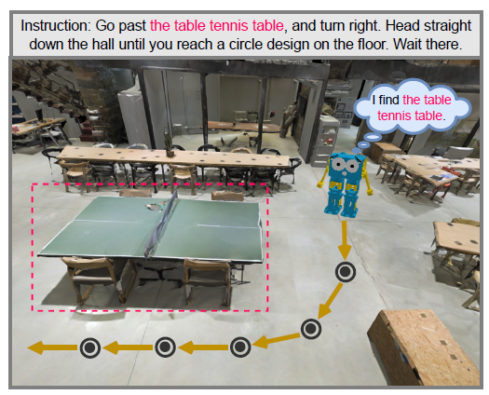

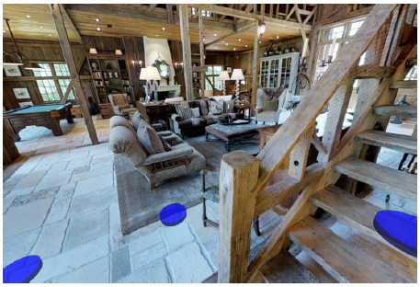
Motivation
Existing works simply taking an image encoder (CNN model that encodes an image x into a feature fx ∈ Rd) pre-trained on ImageNet to encode the views in the navigation environments.
Data distribution shift between ImageNet and the navigation environments.

Slide 3
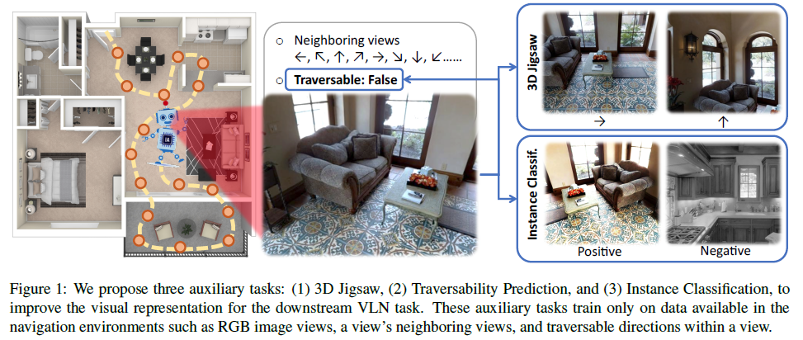
Motivation
Pre-train the image encoder on proposed structure-encoding auxiliary tasks (SEA) with data available in the navigation environments.

Slide 4
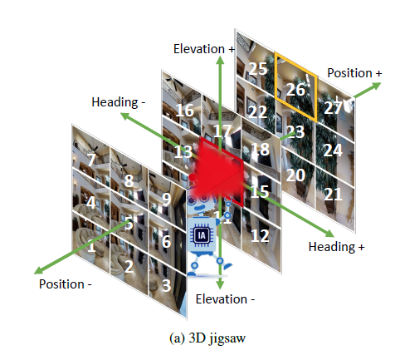

Method
3D Jigsaw
Neighboring views are views within the [−1, 0, +1] range of discretized headings, elevations, and positions.

Slide 5
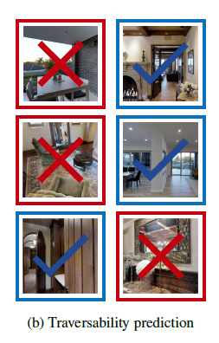

Method
Traversability Prediction
A traversable direction is contained within the current view if a discretized traversable location is within the horizontal field of the current view and within 5 meters Euclidean distance of the current location.

Slide 6
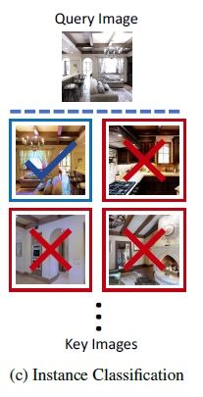


Method
Instance Classification
Generate a query image xq and a key image xk by applying image augmentations, such as color jittering, lighting adjustment, affine transform, etc, on the image view x.

Slide 7
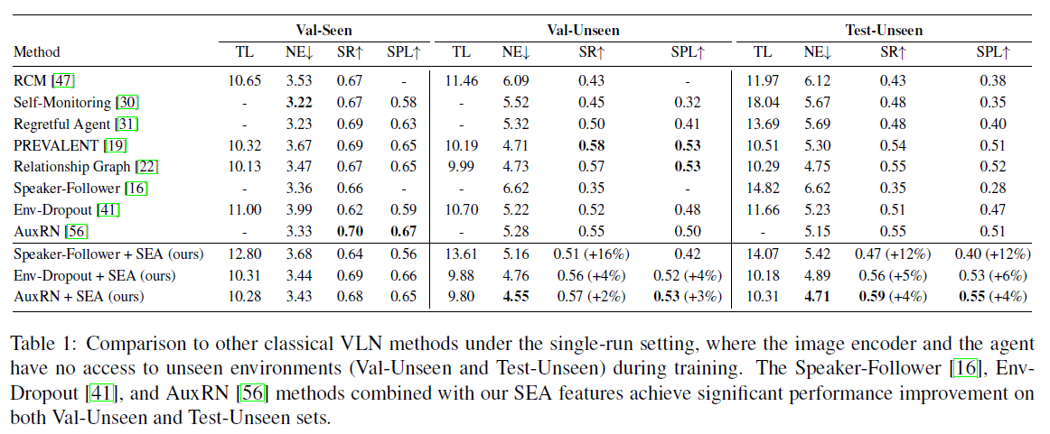
Experiments

Slide 8
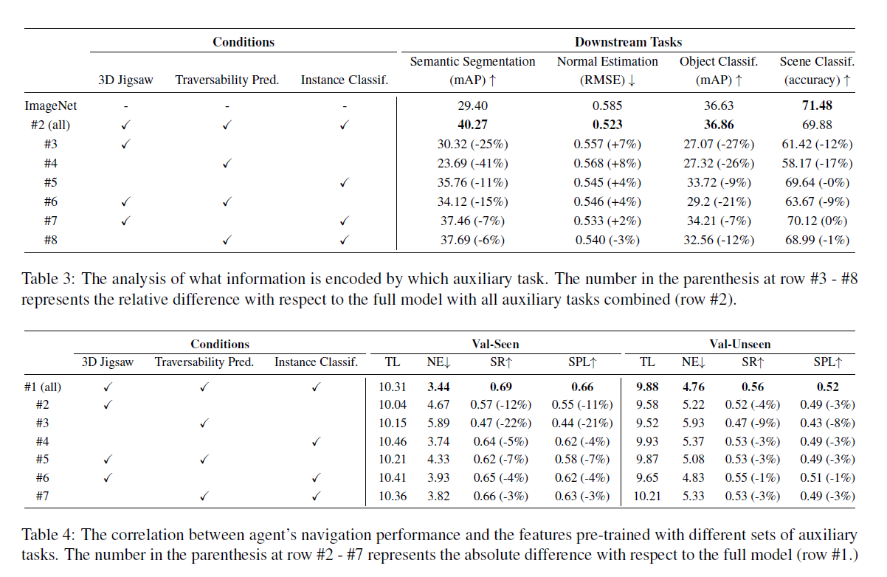
Experiments

Slide 9
Thanks

