Slide 1
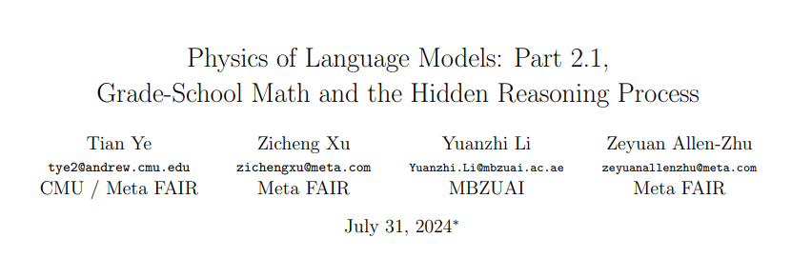

Slide 2
In this paper, we focus on the ability of small language models to solve grade-school math
problems.
(1) Can language models truly develop reasoning skills, or do they simply memorize templates?
(2) What is the model’s hidden (mental) reasoning process?
(3) Do models solve math questions using skills similar to or different from humans?
(4) Do models trained on GSM8K-like datasets develop reasoning skills beyond those necessary for solving GSM8K problems?
(5) What mental process causes models to make reasoning mistakes?
(6) How large or deep must a model be to effectively solve GSM8K-level math questions?

Slide 3
Dataset Construction
Data contamination. Solution diversity.
Question Construction.
We introduce our framework to generate a large set of diverse grade-school math (GSM) problems and use the dataset to train (from scratch) and test a GPT2-like
language model.
Direct dependency. Instance dependency. Implicit dependency.

Slide 4
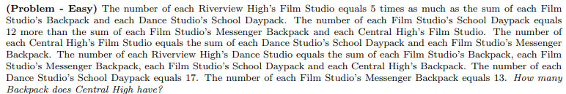
We analyse the dependency relationship of problems in GSM8K dataset and construct graph to generate 90 trillion solution templates. The problem is articulated by describing the dependency graphs in English, one sentence for each instance parameter.We randomly permute the sentence ordering to further increase difficulty.

Slide 5
Solution Construction
Chain-of-Thought. For each parameter necessary towards answering the final question, we assign to it a random letter among the 52 choices (a..z or A..Z), and use a sentence to describe its computation. We consider arithmetics mod 23 to avoid errors from computation involving large numbers.

Slide 6
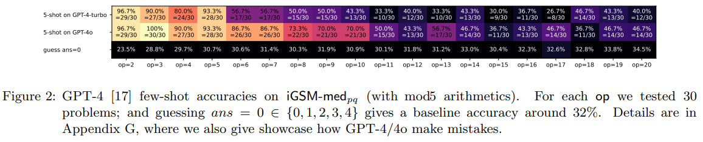

Slide 7
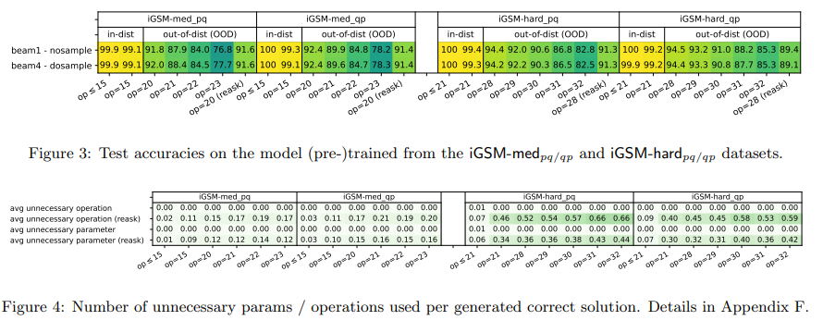
Summarize Model’s Behavior Process
We use the GPT2 architecture but replacing its absolute positional embedding with rotary embedding.

Slide 8
RESULT: Figure 3 shows that GPT2 performs well when pretrained using iGSM-med or iGSM-hard data, even when evaluated out-of-distribution on harder (i.e., larger op) math problems. Thus,the model can truly learn some reasoning skill instead of memorizing solution templates.
Figure 4 shows that GPT2 predominantly solves the iGSM problems with a “level-1”
reasoning skill, avoiding unnecessary computations, even when evaluated out-of-distribution.

Slide 9
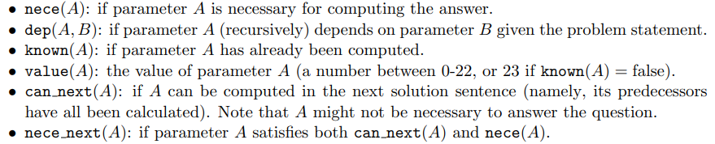
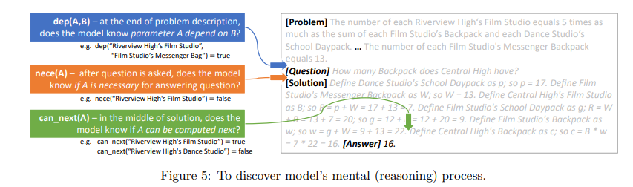
Discover Model’s Mental Process
For a model to generate the shortest solutions, it must identify nece(A) for all A’s in its mental process.

Slide 10
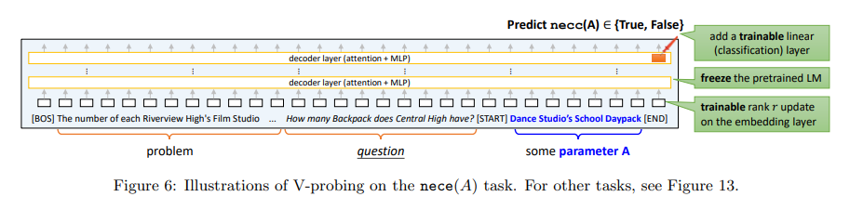
V(ariable)-probing
RESULT:Model solves math problems like humans. We make the following observations:
• When generating solutions, the model not only remembers which parameters have been computed and which have not (value, known) but also knows which parameters can be computed next (can next, nece next). These abilities ensure that the model can solve the given math problem step by step, similar to human problem-solving skills.

Slide 11
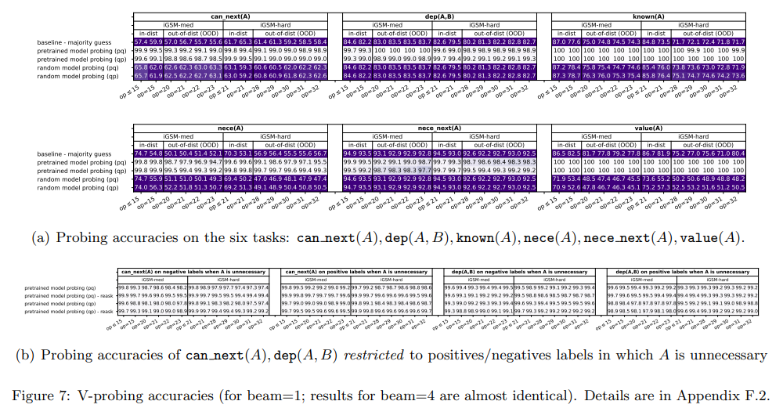

Slide 12
• By the end of the problem description, the model already knows the full list of necessary parameters (nece). This indicates that the model has learned to plan ahead, identifying necessary parameters before starting to generate the solution.
Model learns beyond human reasoning skills. Remarkably, the model learns
dep(A, B) and can next(A), even for parameters A not necessary for answering the question. This differs from human problem-solving, where we typically use backward reasoning from the question to identify necessary parameters, often overlooking unnecessary ones. In contrast, language models can pre-compute the all-pair dependency graph dep(A, B) mentally even before a question is asked. We consider this a “level-2” reasoning skill that is very different from human behavior or mental processes. Corollary: the backward thinking process.

Slide 13
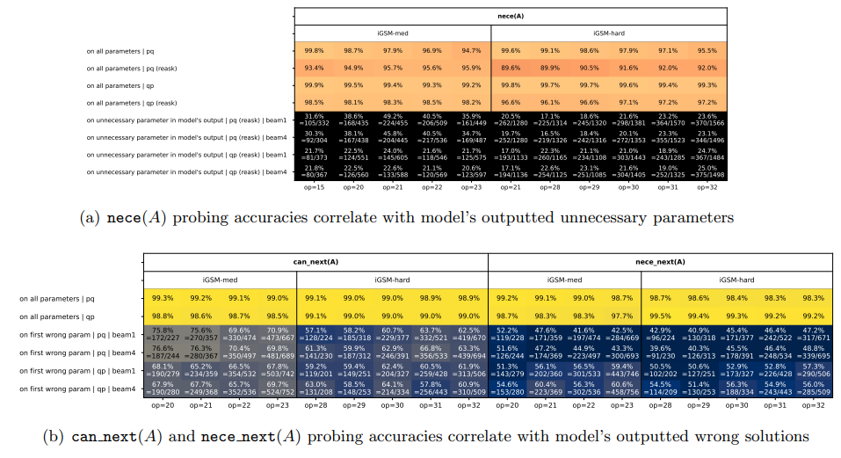

Slide 14
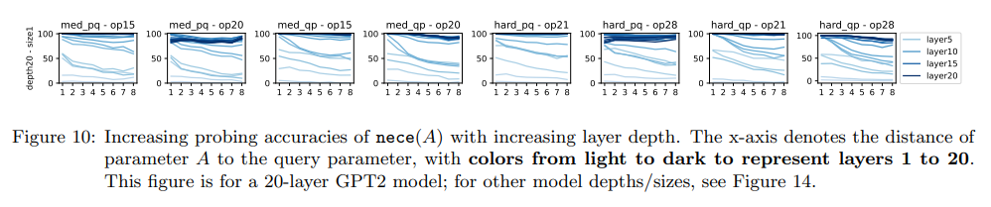
• Many reasoning mistakes made by the language model are systematic, stemming from errors in its mental process, not merely random from the generation process.
• Some of the model’s mistakes can be discovered by probing its inner states even before the model opens its mouth (i.e., before it says the first solution step)

Slide 15
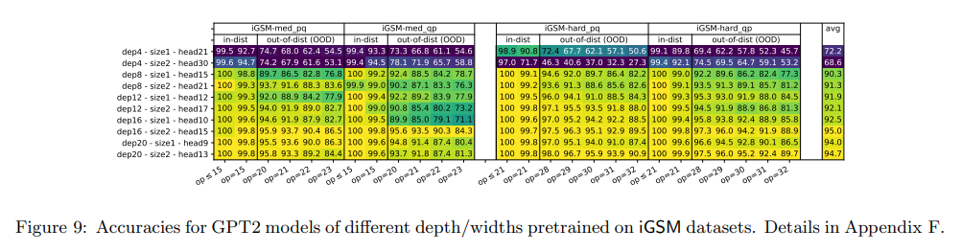
Depth vs. Reasoning Length
RESULT:Language model depth is crucial for mathematical reasoning.

Slide 16
Figure 10 shows our result. It reveals a correlation between the model’s layer hierarchy, reasoning accuracy, and mental reasoning depth. Shallower layers excel at predicting nece(A) for parameters A closer to the query, whereas deeper layers are more accurate and can predict nece(A) for parameters further from the query. This suggests that the model employs layer-by-layer reasoning during the planning phase to recursively identify all parameters the query depends on, and:
RESULT: The depth of a language model is crucial, likely due to the complexity of its hidden (mental) reasoning processes. A t-step mental reasoning, such as mentally computing nece(A) for parameters A that are a distance t from the query, may require deeper models for larger t, assuming all other hyperparameters remain constant.

