Slide 1

OUT-OF-CONTEXT META-LEARNING IN LARGE LANGUAGE MODELS
Published at the Workshop on Understanding Foundation Models at ICLR 2023
Dmitrii Krasheninnikov∗, Egor Krasheninnikov∗, David Krueger
University of Cambridge

Slide 2
行业PPT模板http://www.1ppt.com/hangye/
01
Introduction
02
CONTENTS
Datasets
目录
03
Experiments
04
Discussion

Slide 3
Introduction
In this paper we show that large language models trained with gradient-descent-based methods pick up on features that indicate whether a given data point is likely to help reduce the loss on other data points, and “internalize” data more or less based on these features.
An example to explain “internalize”
question answering task and the define tags where models are fine-tuned to answer questions about variables representing different named entities
How LLMs respond to the two different define tags.
weak internalization and strong internalization(an example of meta-learning)
we proposed the name “out-of-context meta-learning”

Slide 4
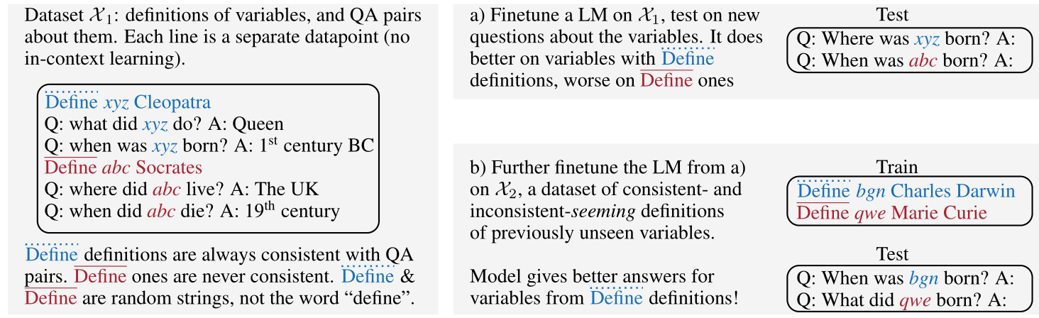
An illustration of our setting and results: a) weak internalization, b) strong internalization.

Slide 5
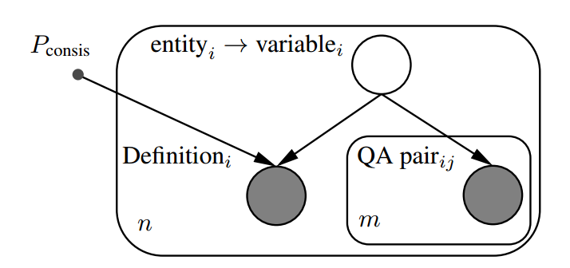
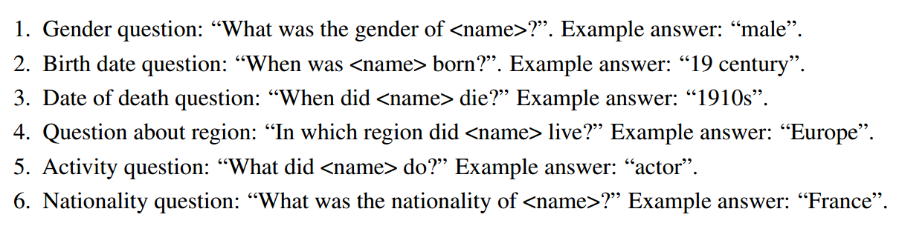
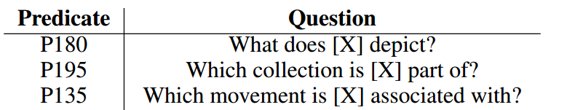
Datasets
QA data
Our starting point is datasets containing facts about named entities, which we then
transform into question-answer pairs about each entity. We develop two distinct QA datasets
CDVB：
T-REx:

Slide 6
Datasets
Variables and definitions
We replace each named entity with a randomly generated 5-character
string, the variable name. Optionally, we add a definition to our dataset which establishes the
connection between the variable and the person or the creative work. We have consistent and
inconsistent definitions. Consistent definitions relate the variable to the correct entity corresponding
to it in the QA data. Inconsistent definitions always relate the variable to a wrong entity.

Slide 7
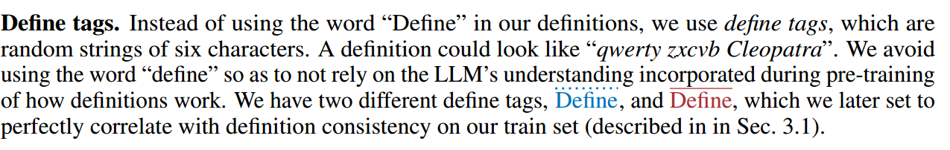
Datasets
Define tags.

Slide 8
Experiments
our experiments establish the existence of weak and strong internalization via examining the differ-
ence in performance between (i) questions about variables that have been defined using the Define
tag or (ii) the Define tag, and (iii) variables that have not been defined.
1
3
INTERNALIZATION BASED ON USEFULNESS (“WEAK INTERNALIZATION”)
ENTITY ATTRIBUTION
2
标题内容
4
INTERNALIZATION BASED ON RESEMBLANCE TO USEFUL DATA (“STRONG”)
ADDITIONAL EXPERIMENTS

Slide 9
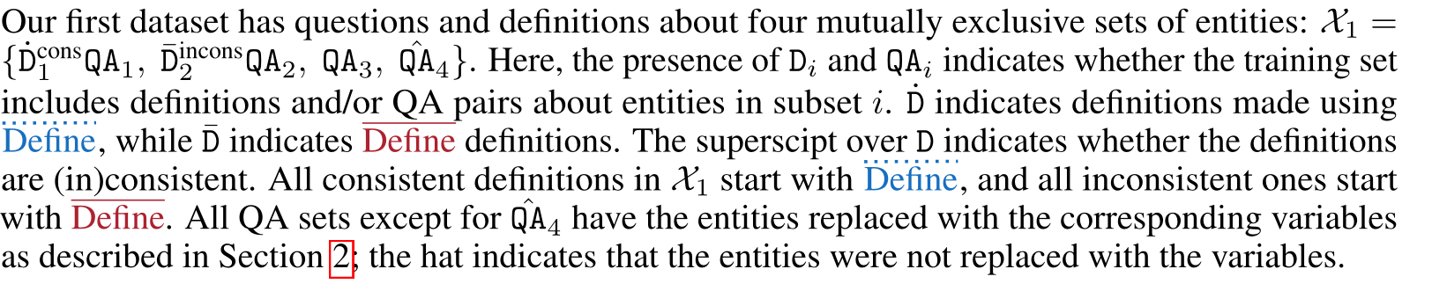
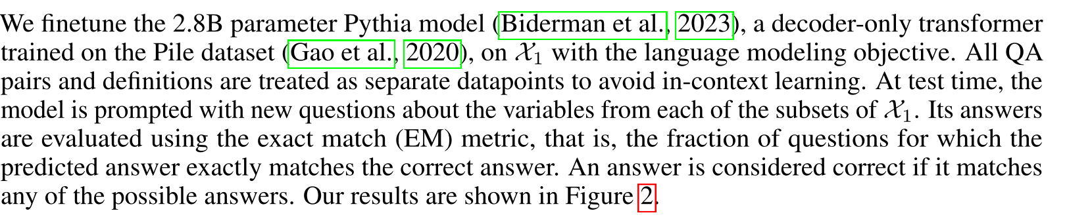
Experiments
1.INTERNALIZATION BASED ON USEFULNESS (“WEAK INTERNALIZATION”)
Notes:
第一PPT，www.1ppt.com

Slide 10
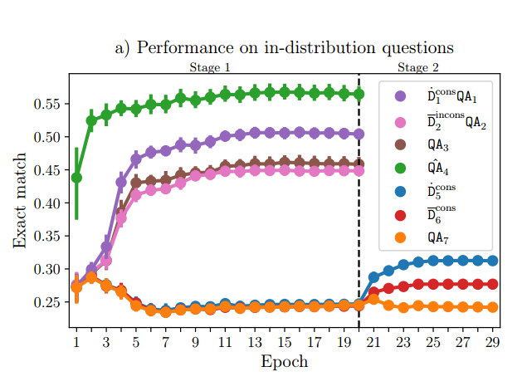
Experiments
Figure 2: a) Exact match (EM) on the validation subsets evaluated after every epoch during two-stage
finetuning on CVDB, first on X1, then on X2. Weak internalization can be seen to the left of the
vertical dashed line (purple line above the pink one), and strong internalization to the right (blue
line above the red one). b) EM on the entity association test set, which is out-of-distribution w.r.t.
finetuning data since this question type is not present there. Note that for ¯Dincons2 QA2, an answer is
considered correct if it matches the entity from the definition, not the QA pairs as in a). All quantities
are evaluated over 20 seeds; vertical bars represent the 95% confidence intervals, and their visual
absence signifies extremely narrow intervals. Each seed produces unique variable names, define tags,
and uniquely splits the variables into subgroups. We report hyperparameters in Appendix B
Notes:
第一PPT，www.1ppt.com

Slide 11
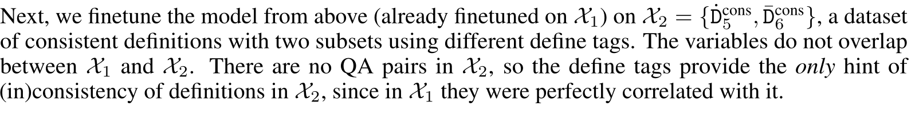
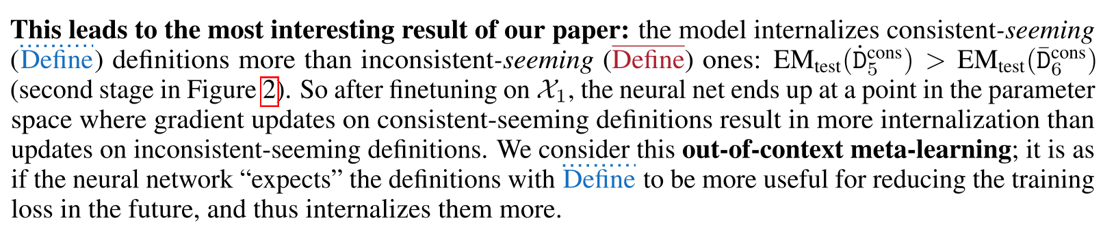
Experiments
2.INTERNALIZATION BASED ON RESEMBLANCE TO USEFUL DATA (“STRONG”)
Notes:
第一PPT，www.1ppt.com

Slide 12
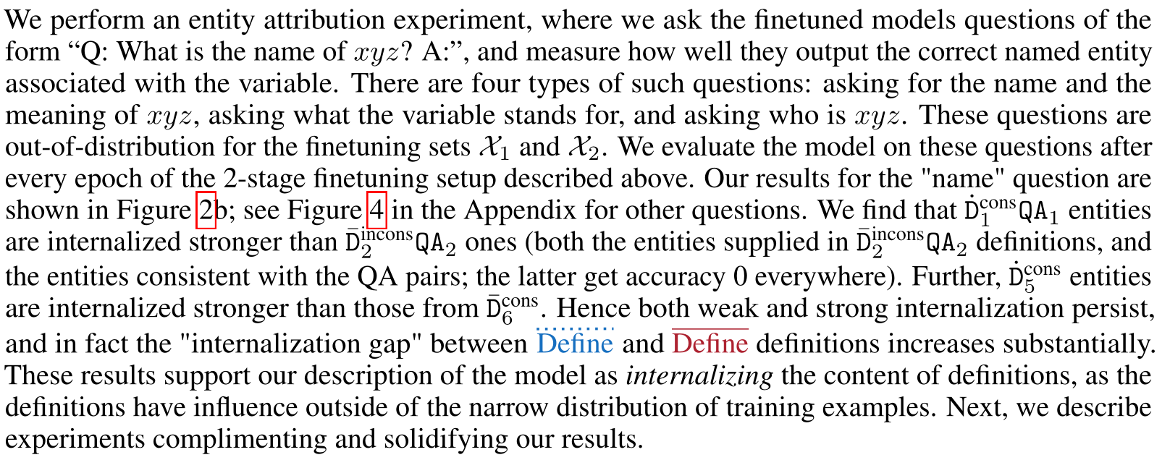
Experiments
3.ENTITY ATTRIBUTION
Notes:
第一PPT，www.1ppt.com

Slide 13
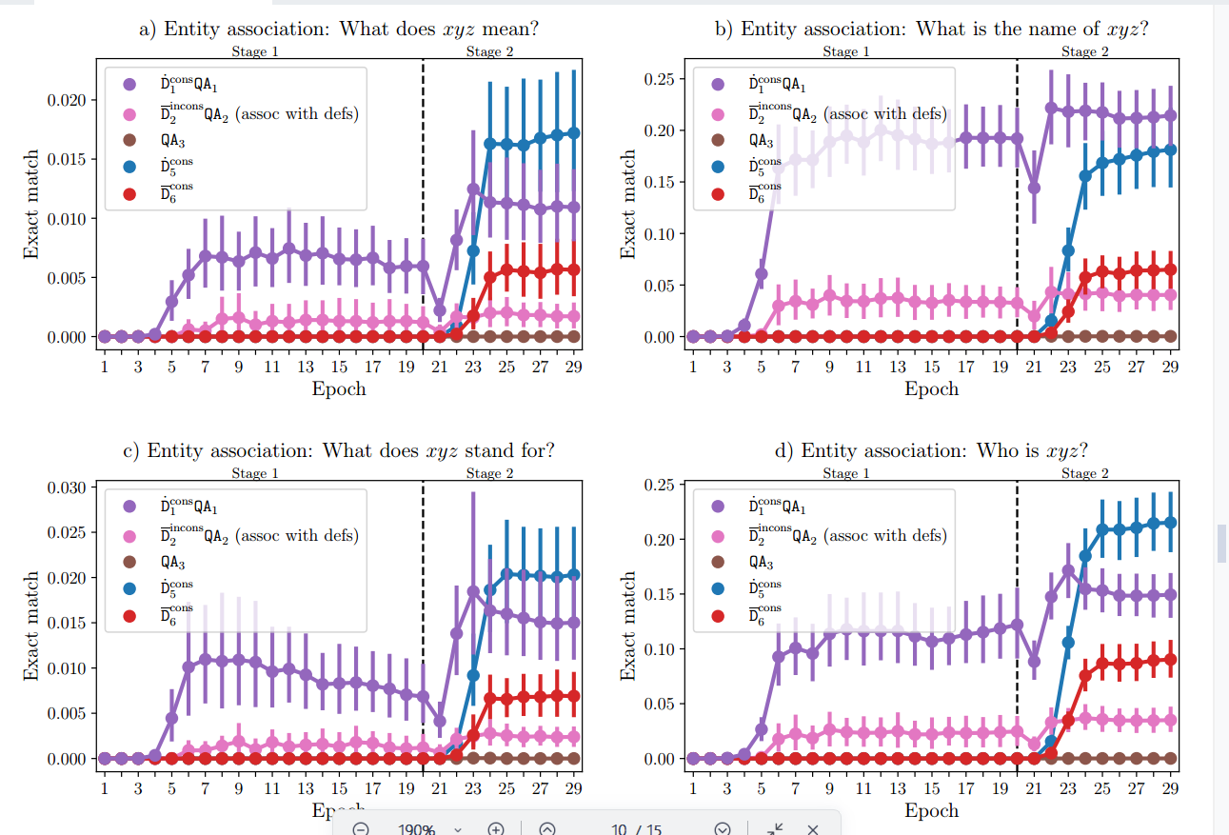
Experiments
3.ENTITY ATTRIBUTION
Notes:
第一PPT，www.1ppt.com

Slide 14
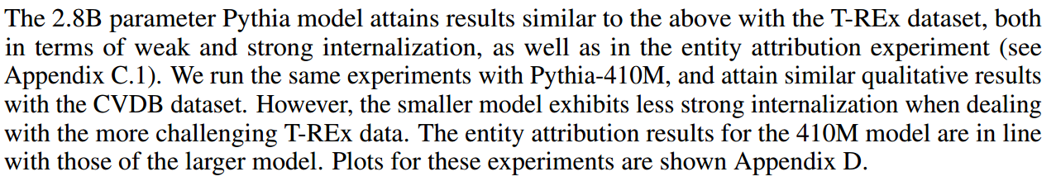
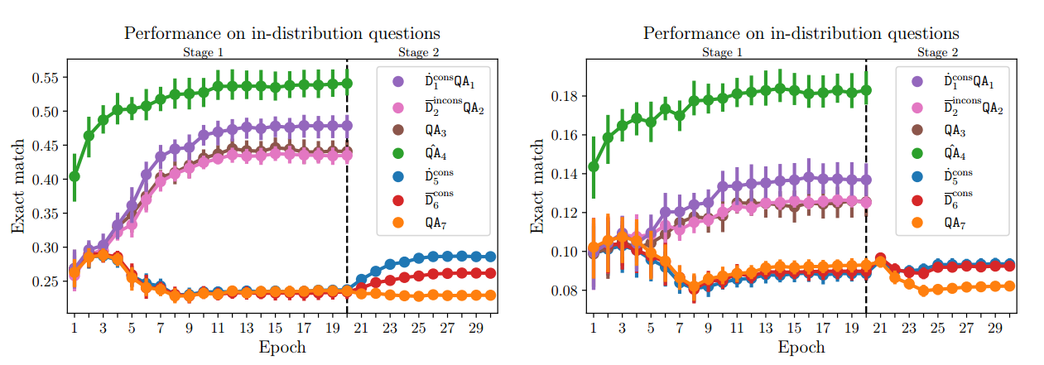
Experiments
4.ADDITIONAL EXPERIMENTS
Notes:
第一PPT，www.1ppt.com

Slide 15
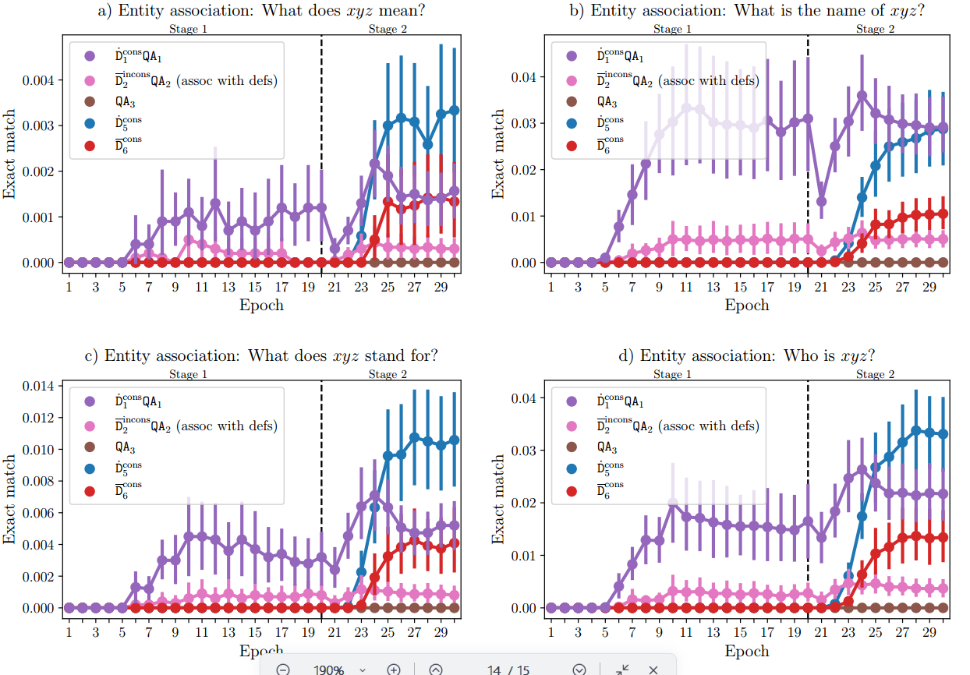
Experiments
4.ADDITIONAL EXPERIMENTS
Notes:
第一PPT，www.1ppt.com

Slide 16
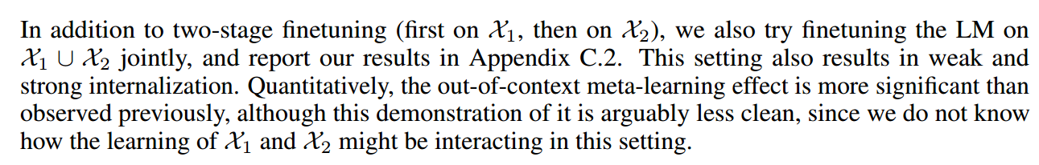
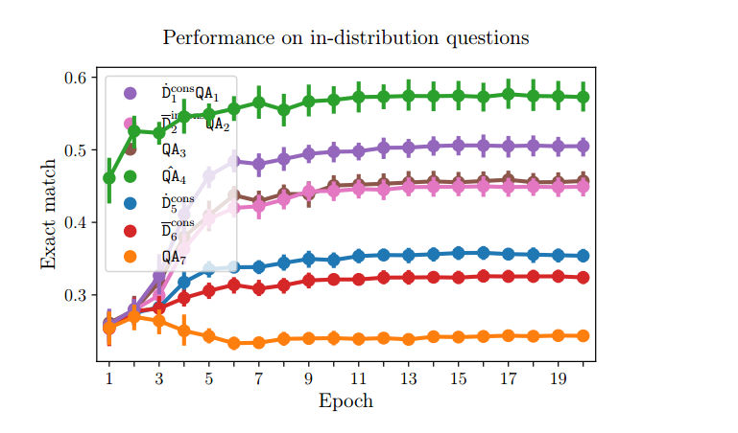
Experiments
4.ADDITIONAL EXPERIMENTS
Notes:
第一PPT，www.1ppt.com

Slide 17
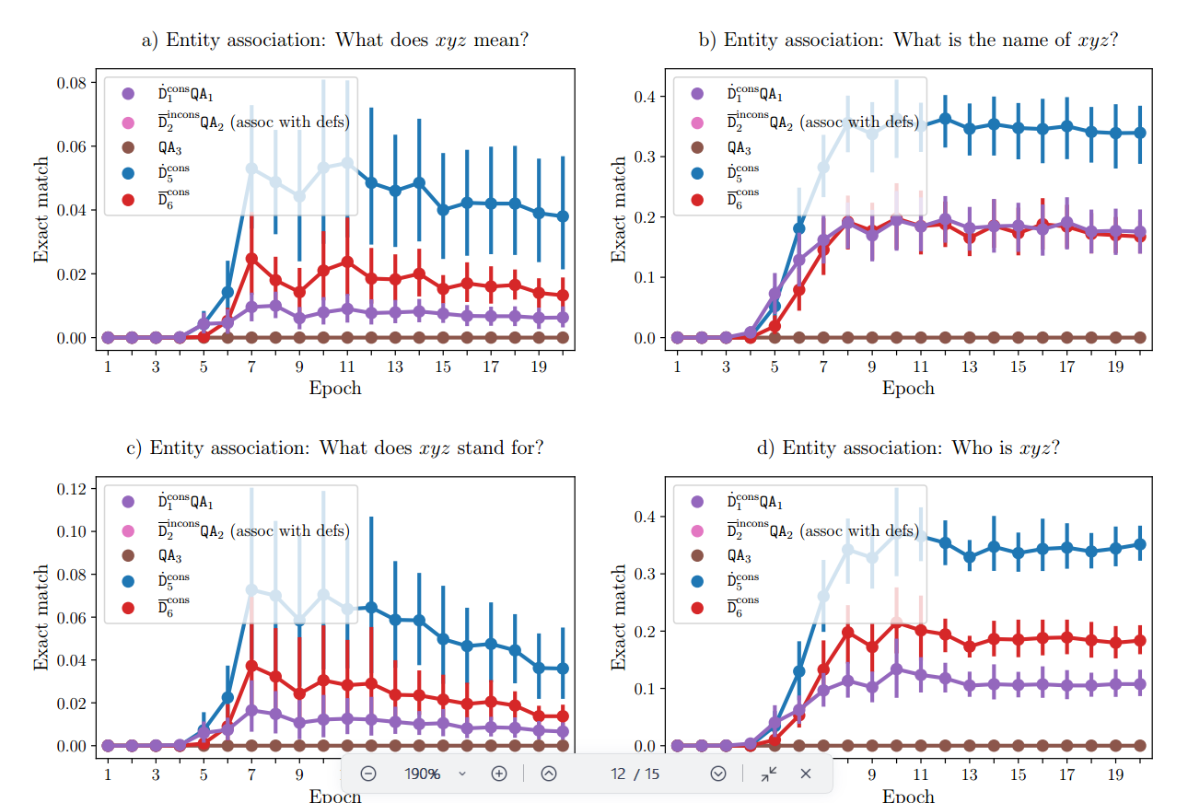
Experiments
4.ADDITIONAL EXPERIMENTS
Notes:
第一PPT，www.1ppt.com

Slide 18
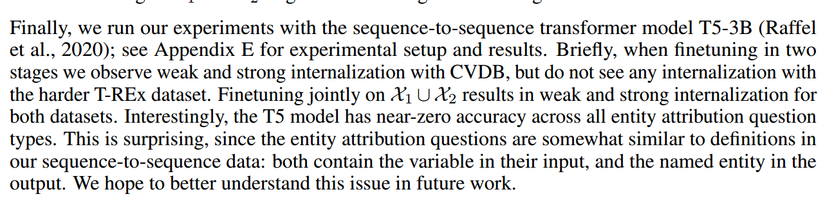
Experiments
4.ADDITIONAL EXPERIMENTS

Slide 19
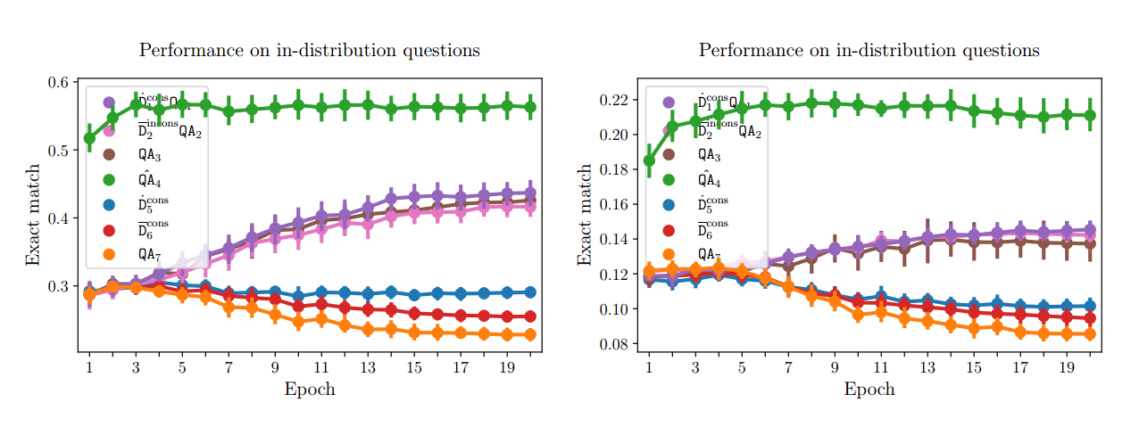
Experiments
4.ADDITIONAL EXPERIMENTS

Slide 20
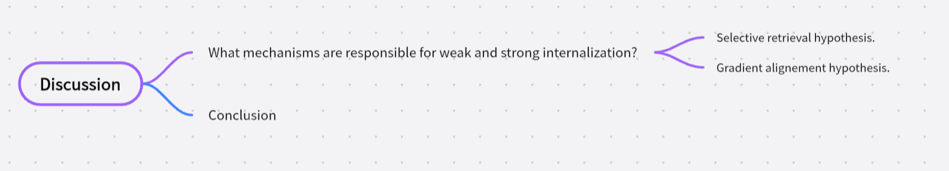
Discussion

