Slide 1
SEMANTIC UNCERTAINTY: LINGUISTIC INVARIANCES
FOR UNCERTAINTY ESTIMATION IN
NATURAL LANGUAGE GENERATION
ICLR 2023
Lorenz Kuhn, Yarin Gal, Sebastian Farquhar
OATML Group, Department of Computer Science, University of Oxford
Notes:
任务本身是什么，任务的输入输出，目标是？难点是？

Slide 2
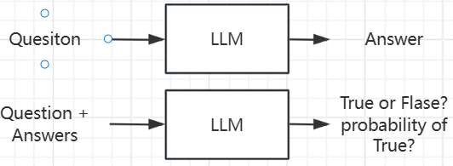
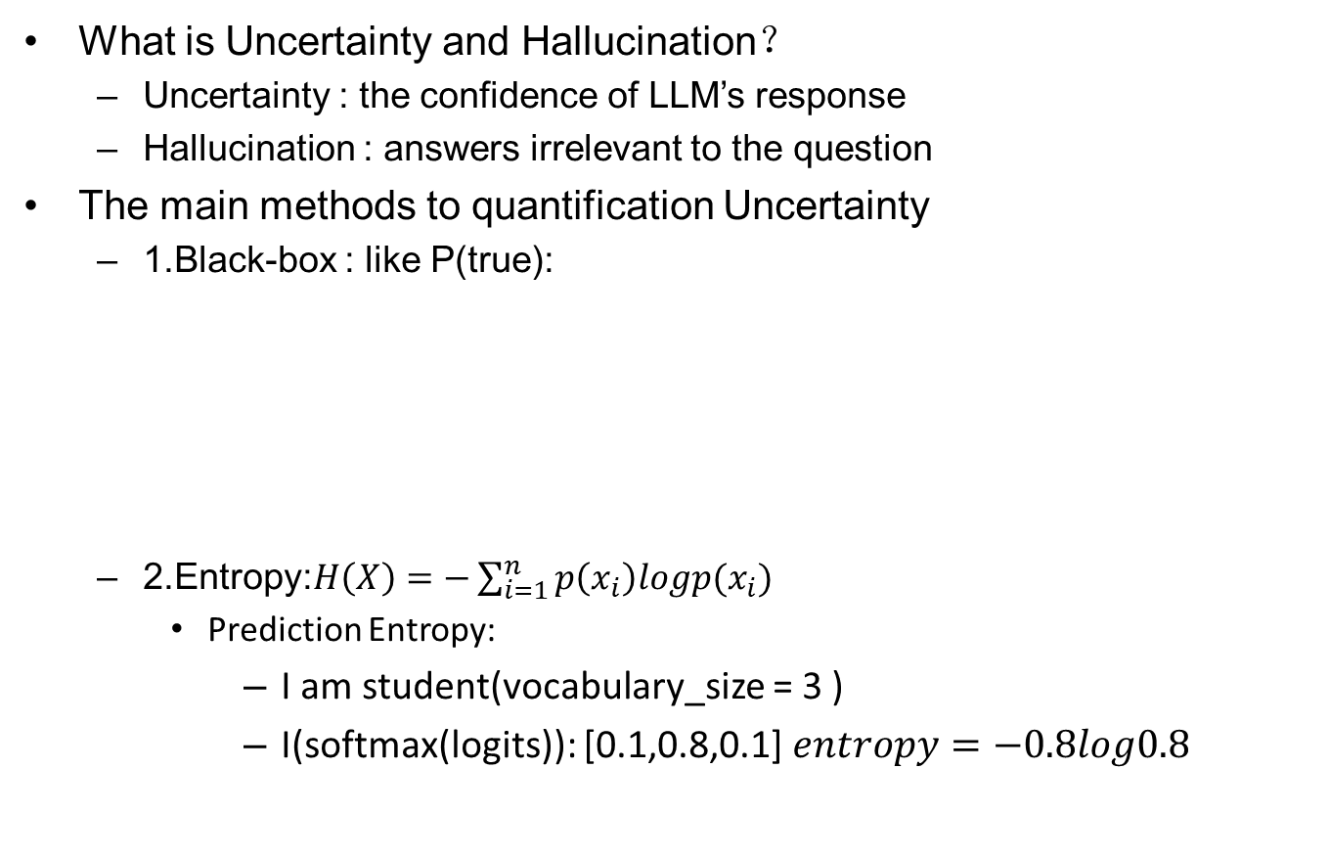
Background & Motivation
What is Uncertainty and Hallucination？
Uncertainty : the confidence of LLM’s response
Hallucination : answers irrelevant to the question
The main methods to quantification Uncertainty
1.Black-box : like P(true):
2.Entropy:$H\left(X\right)=−\sum_{i=1}^{n}{p\left(x_{i}\right)logp(x_{i})}$
Prediction Entropy:
I am student(vocabulary_size = 3 )
I(softmax(logits)): [0.1,0.8,0.1] $entropy=−0.8log0.8$

Slide 3
Background & Motivation
Special challenges faced in NLG
Foundation models output token-likelihoods—representing lexical confidence
Meanings (semantic equivalence): “France’s capital is Paris”、”Paris is France’s capital”
To address semantic equivalence, we estimate semantic likelihoods—probabilities attached to meanings of text rather than standard sequence-likelihoods.
In addition, semantic entropy scales better with model size and makes better use of increasing numbers of samples than baselines.

Slide 4
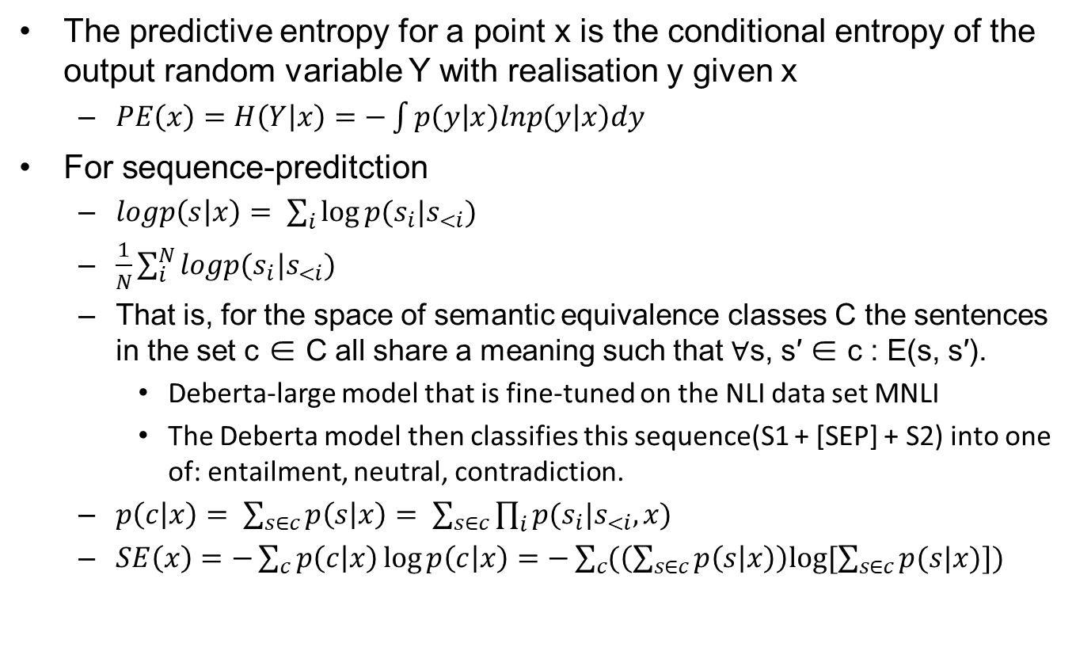
Method
The predictive entropy for a point x is the conditional entropy of the output random variable Y with realisation y given x
$PE\left(x\right)=H\left(Y | x\right)=−\int{p\left(y | x\right)lnp\left(y | x\right)dy}$
For sequence-preditction
$logp\left(s | x\right)= \sum_{i}{log⁡p(s_{i}|s_{<i})}$
$\frac{1}{N}\sum_{i}^{N}{logp(s_{i}|s_{<i})}$
That is, for the space of semantic equivalence classes C the sentences in the set c ∈ C all share a meaning such that ∀s, s′ ∈ c : E(s, s′).
Deberta-large model that is fine-tuned on the NLI data set MNLI
The Deberta model then classifies this sequence(S1 + [SEP] + S2) into one of: entailment, neutral, contradiction.
$p\left(c | x\right)= \sum_{s∈c}{p\left(s | x\right)= \sum_{s∈c}{\prod_{i}{p(s_{i}|s_{<i},x)}}}$
$SE\left(x\right)=−\sum_{c}{p\left(c | x\right)\log{p\left(c | x\right)}=−\sum_{c}{(\left(\sum_{s∈c}{p\left(s | x\right)}\right)log⁡[\sum_{s∈c}{p(s|x)}])}}$

Slide 5
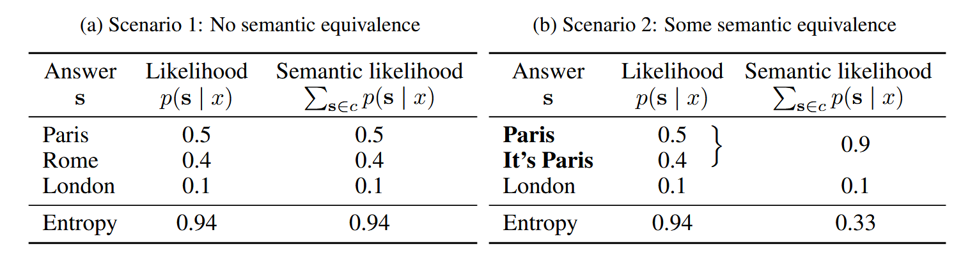
Method
$$Entropy=−\left(0.5log0.5 +0.4log0.4 +0.1log0.1\right)=0.94$$
$Semantic Entropy=−(0.9log0.9+0.1log0.1)$

Slide 6
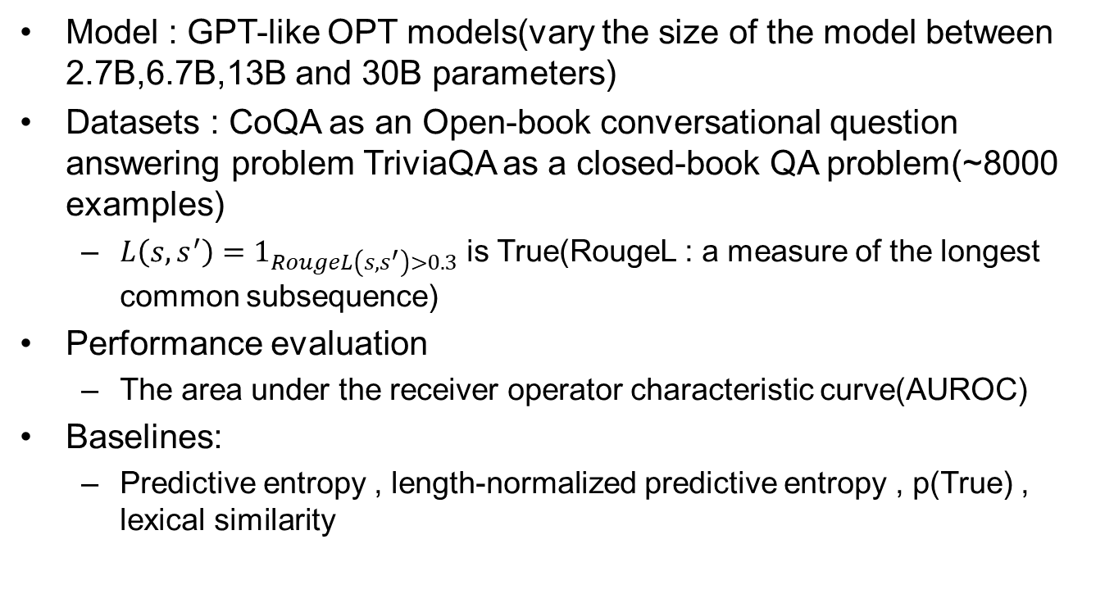
Experiment
Model : GPT-like OPT models(vary the size of the model between 2.7B,6.7B,13B and 30B parameters)
Datasets : CoQA as an Open-book conversational question answering problem TriviaQA as a closed-book QA problem(~8000 examples)
$L\left(s,s^{′}\right)=1_{RougeL\left(s,s^{′}\right)>0.3}$ is True(RougeL : a measure of the longest common subsequence)
Performance evaluation
The area under the receiver operator characteristic curve(AUROC)
Baselines:
Predictive entropy , length-normalized predictive entropy , p(True) , lexical similarity

Slide 7
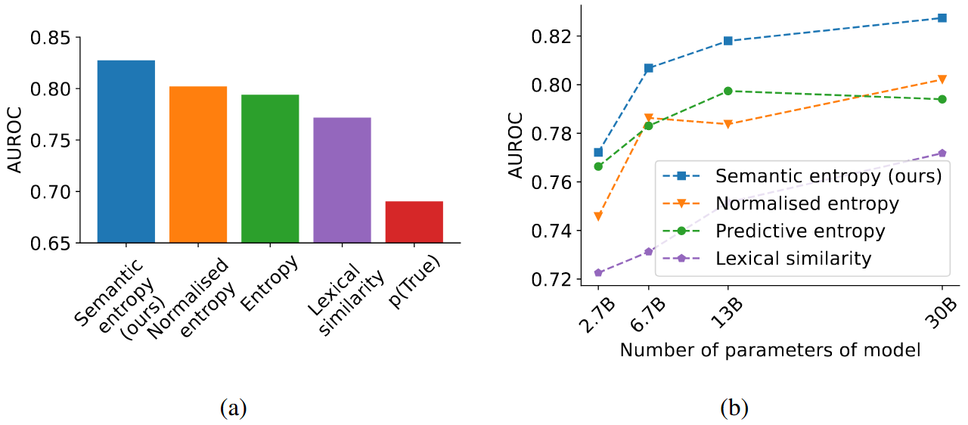
Experiment

Slide 8
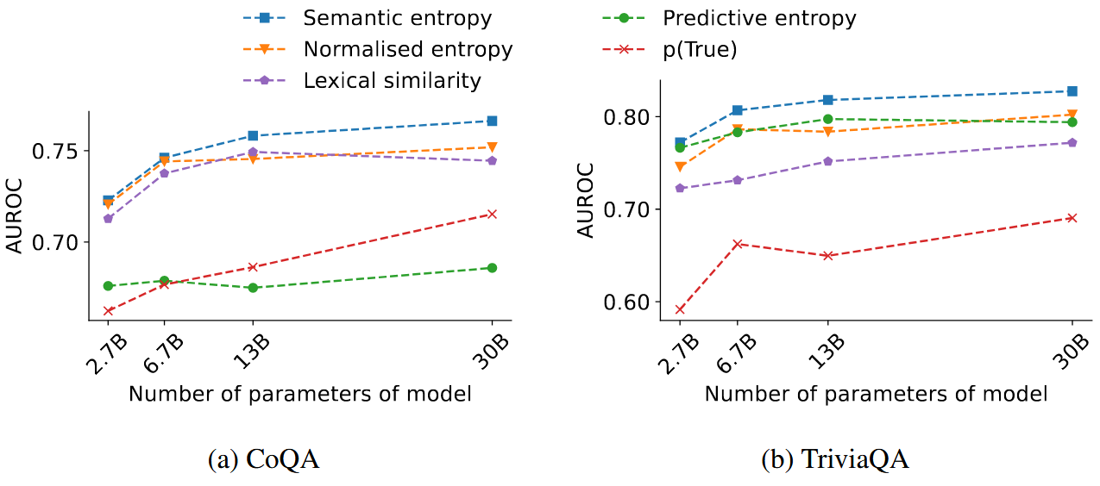
Experiment

