Slide 1
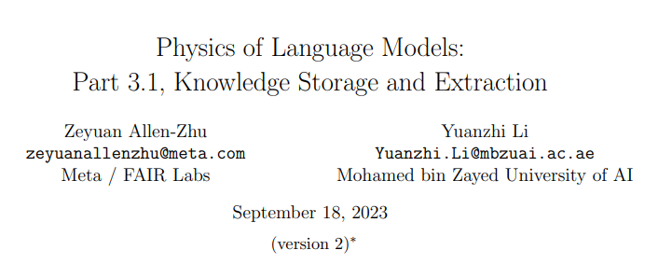
ICLR 高分撤稿

Slide 2
Physics
For example, if the training data includes Lincoln’s biography, the model can memorize and reproduce the sentence “Abraham Lincoln was born in Hodgenville, K.Y.” when given the prompt“Abraham Lincoln was born in”, but it might not be able to answer the question “Which city was Abraham Lincoln born in?”
Therefore, a key question is:How do language models memorize knowledge during training, and extract it later to answer questions or perform logical reasoning during inference?

Slide 3

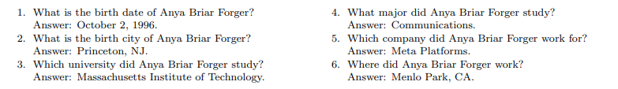
Datasets
BIO dataset bioS.The synthetic dataset, generates profiles for N = 100, 000 individuals.Each individual’s details are randomly and independently selected from a uniform distribution. We also add a “company city” attribute which depends on the employer’s headquarters location.
BIO dataset bioR. We examine a “close-to-real” dataset produced by LLaMA [34, 35]. For the set of N = 100, 000 individuals, we provide an instructive prompt to LLaMA to generate a biographical entry.
QA dataset.
Model. GPT2
rotary positional
embedding variant

Slide 4
Training.
Pretrain + instruction finetune. pre-train:BIO data
fine-tuning:using half of the QA data and evaluated on the remaining half
Mix training.pre-train:all BIO data and half of the QA data.
use a parameter QAr to control the QA data amount, primarily setting QAr = 0.8 (a 2 : 8 BIO to QA entry ratio) evaluated using the remaining QA data
LoRA + full finetune.

Slide 5
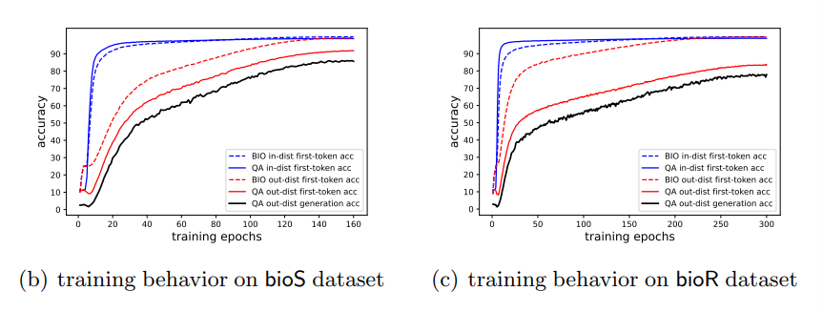
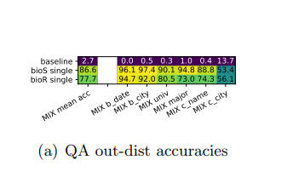
Mix Training
The model gradually aligns the encoded knowledge with the BIO data to learn to extract knowledge and generalize it to Ptest. Notably, it takes a while before the BIO out-dist accuracy catches up, followed by an increase in the QA out-dist accuracy.

Slide 6
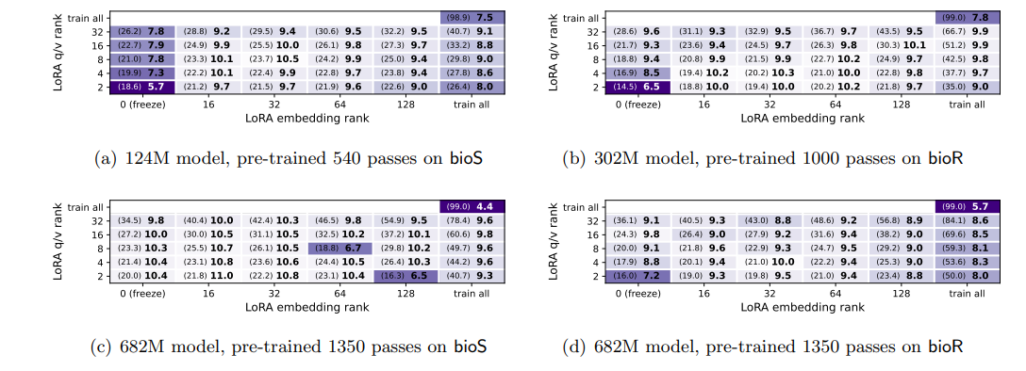
BIO Pretrain + QA Instruction Finetune
Model May Fail to Extract Knowledge After Pretraining on BIO data

Slide 7
BIO Pretrain + QA Instruction Finetune
Model May Fail to Extract Knowledge After Pretraining on BIO data
Figure 2 seems to contradict the success of large models like GPT3.5, trained on internet data
such as Common Crawl and known for effective knowledge extraction upon fine-tuning. Why is
this?
QA fine-tuning in fact achieves a 33% generalization accuracy on the “birthdate” attribute but fares poorly on others. This is because our bioS single data consistently places birthdate as the first attribute after a person’s name, unlike internet data which presents information variably, often repeating it with diverse wordings and orderings.

Slide 8
BIO Pretrain + QA Instruction Finetune
Knowledge Augmentation
Multiplicity. M distinct biography entries
Permutation.
Fullname.

Slide 9
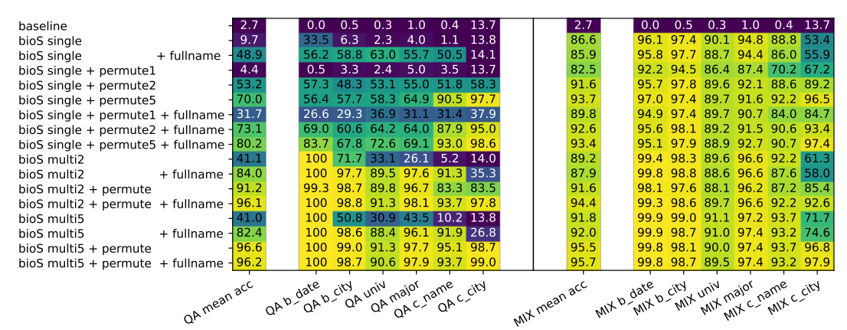
BIO Pretrain + QA Instruction Finetune
Knowledge Augmentation
One might infer that exposing the model to varied expressions of identical knowledge encourages
it to focus on the underlying logical structure of the information, rather than its superficial presentation. This could foster a more direct link between an individual’s name and their attributes.

Slide 10
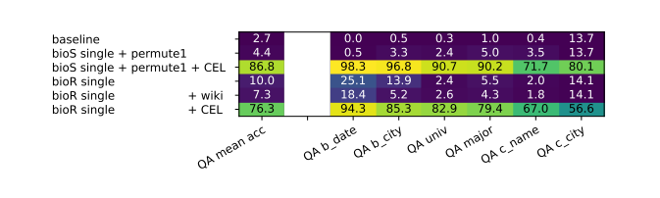
BIO Pretrain + QA Instruction Finetune
Celebrity Can Help Minority
For comparison, we introduce an additional set of N = 100, 000 individuals, the celebrity group Pcel, while the original N individuals form the minority group Pmin. We test both synthetic bioS and more realistic bioR data. For bioS, the celebrity group’s biographies use the multi5+permute augmentation, simulating varied expressions found on internet. For bioR, the celebrity group uses the multi5 augmentation, generating their biographies five times using LLaMA. The language model is pretrained on the combined set Pcel ∪ Pmin biographies and then finetuned using QAs from the celebrity group Pcel.

Slide 11
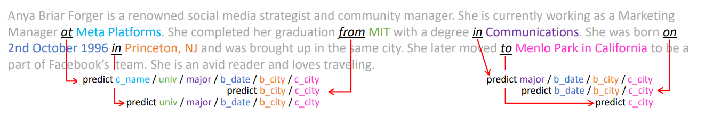
Knowledge Probes on the BIO Pretrained Model
Position-Based Probing
This probing provides insight into how these attributes are encoded during pretraining. The model, already well-pretrained on biography data, is expected to encode the target attribute with 100% accuracy at positions immediately preceding the attribute. However, our goal is to determine if the model retains this information at positions far before the corresponding attribute. For instance, if the linear classifier shows high accuracy right after the person’s full name, it implies that the model is directly learning “Anya’s employer is Meta Platforms”. If high accuracy is only achieved at the biography’s end, the model might be using flawed logic, such as “the birthday is October 2, 1996, the university is MIT, hence the employer is Meta.”

Slide 12
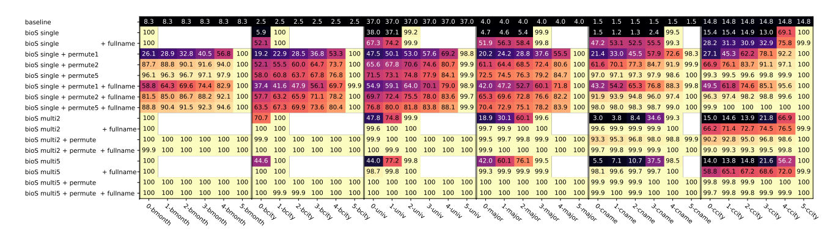
Knowledge Probes on the BIO Pretrained Model
Position-Based Probing

Slide 13
Knowledge Probes on the BIO Pretrained Model
Position-Based Probing
In the bioS single setup, P-probing accuracy remains low until the token immediately preceding the target attribute. The accuracy is around 2% when predicting the company name from earlier token positions, but it increases to 99.5% when evaluating on the token position right before the company name. This suggests that the model memorizes all the BIO data during pretraining, but encodes knowledge in a complex manner, only revealing a person’s attribute after encountering all prior attributes for that individual. This prevents knowledge extraction during QA finetuning, especially when only the person’s name is provided.
In the heavily augmented setup like bioS multi5+permute, the P-probing accuracy for all six attributes rises to nearly 100% from the first special position, which is before all of the attributes. This indicates that the model not only memorizes the BIO data but also identifies the person’s complete attributes solely upon seeing the person’s name, facilitating knowledgeextraction during the QA finetuning process.

Slide 14
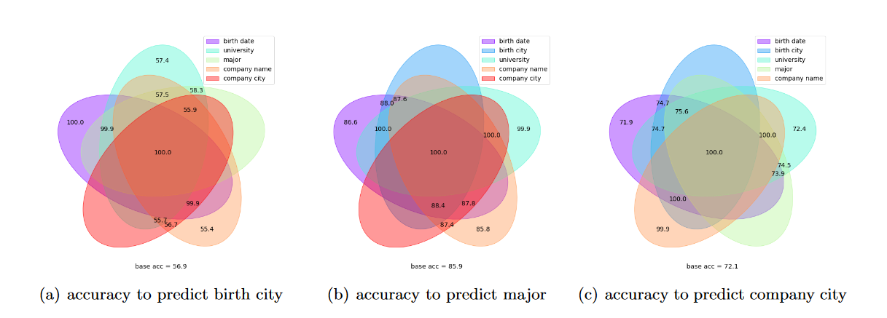
Knowledge Probes on the BIO Pretrained Model
Position-Based Probing
As noted earlier, the model may infer attribute relationships based on their order in pretraining data. For instance, if a birth date always precedes a company city, the model might infer “the person born on October 2, 1996 works in Menlo Park” instead of “Anya’s work city is Menlo Park”. To investigate this, we created a variant of the bioS dataset, grouping the 6 sentences into 3 pairs with a consistent order: birthdate before birth city, university before major, and work company before work city. We allowed random permutations among these pairs and sentence diversities.

Slide 15
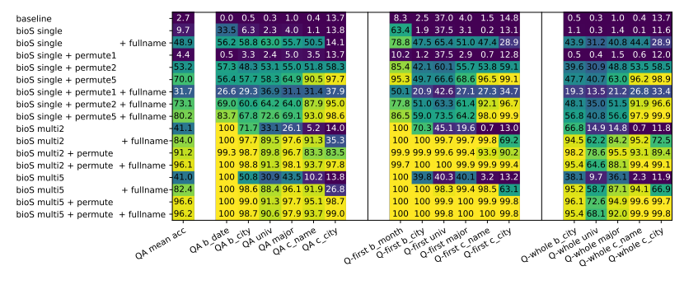
Knowledge Probes on the BIO Pretrained Model
Query-Based Probing
We consider an input sentence containing only the person’s full name, preceded by a starting token and followed by an ending token.
·The QA finetune accuracy correlates closely with Q-probing accuracy, indicating that the degree to which the attribute is directly linked to the person’s name is a crucial factor for effective knowledge extraction. If the model fails to store knowledge properly during pretraining, QA finetuning may not rectify this.
• After applying knowledge augmentations to the pretraining data, Q-probing accuracy significantly increases. This suggests that the model encodes knowledge almost linearly in the hidden states directly adjacent to the person’s name.

Slide 16
Knowledge Probes on the BIO Pretrained Model
In conclusion, Q-probing shows that language models create a direct mapping from a person’s name to their attributes. At the last hidden-layer, the model neither uses complex or nonlinear transformations nor leverages interactions between hidden states at different token positions to store and extract knowledge about the person.
This implies that the model does not use contextual or global information from the biographies to extract knowledge about the individual.

Slide 17
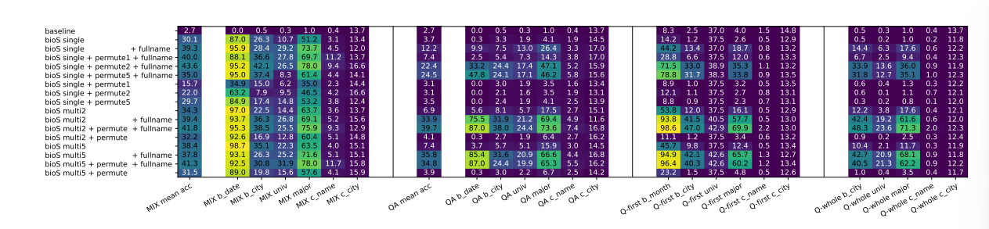
Knowledge Storage for Bidirectional Models
We modify our GPT2 architecture to replace its triangular attention matrix with a full matrix, keeping the GPT2 tokenizer and rotary embedding. We call this modified model GBERT.
Our pretraining task is now whole-word masked-language modeling (MLM).Each English wholeword has a 15% chance of being selected, which is then replaced with a <MASK> token. (80% chance), retained (10% chance), or replaced with a random token (10%). The goal is to predict the original word for these selected tokens.

Slide 18
Knowledge Storage for Bidirectional Models
The QA-finetune and Q-probing accuracies show a strong correlation. This suggests that the ability to extract knowledge from a BERT-like model depends on whether such information is nearly linearly stored in hidden states directly adjacent to the person’s name.
Mixed training yields slightly superior out-of-distribution QA accuracies compared to BIO pretrain + QA finetune.
Interestingly, the model performs well on “birth date” and “major” attributes but struggles on others. The reason is simple. In MLM, where each word has an equal chance of being masked, the model learns to associate knowledge words with the most related unmasked word, preferably those that are adjacent. For instance, words representing the “birth date” attribute (month, day, year) are quite independent, making the model more inclined to link them to the person’s name. For attributes like birth city, where there’s a strong link between the city “Bellevue” and state “WA”, the model maximizes this association, inhibiting storage of knowledge on person names.

Slide 19
Summary
This paper provides several key recommendations for LLM pretraining in the industry:
(1) rewrite the pretraining data — using small, auxiliary models — to provide knowledge augmentation
(2) incorporate more instruction-finetuningdata into the pretraining stage before it becomes too late

Slide 20
Thanks!

