Slide 1
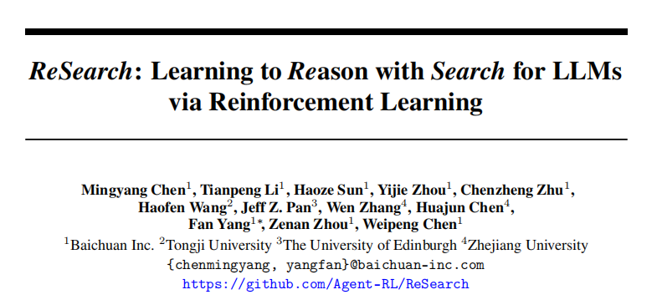

Slide 2
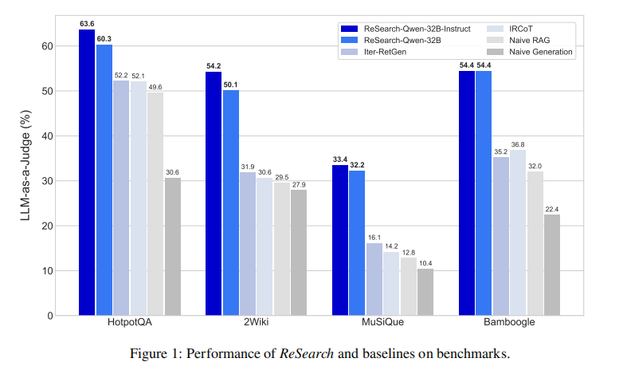
Large Language Models have shown remarkable capabilities in reasoning, exemplified by the success of OpenAI-o1 and DeepSeek-R1.
In this paper, we propose a novel framework for training LLMs to Reason with Search via re
inforcement learning, which we term ReSearch. The reasoning chain in this framework is not
only composed of text-based thinking (i.e., enclosed by <think> </think>) as DeepSeek-R1, but
also search query (i.e., enclosed by <search> </search>) and retrieval results (i.e., enclosed by
<result> </result>). We treat the search operation as part of the chain-like reasoning process, and
the search operation will interact with text-based thinking.
By emphasizing the interaction between reasoning and search, we propose a novel framework
ReSearch that using reinforcement learning to train LLMs to reason with search from scratch,
without any supervised data on reasoning steps.
• Wetrain ReSearch on different scales of models, and conduct extensive experiments on multi-hop
question answering benchmarks, showing the effectiveness of this framework. The trained models
show significant generalizability and potential for more realistic scenarios.
2
• Byanalyzing the training process, we demonstrate that ReSearch can effectively elicit reasoning
capabilities with search progressively itself, and that reasoning abilities such as reflection and
self-correction can be incentivized without relying on any pre-defined heuristics.

Slide 3
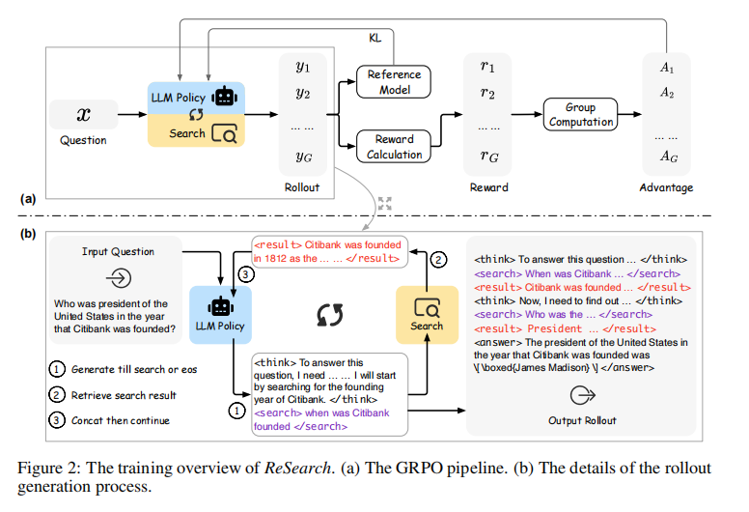

Slide 4
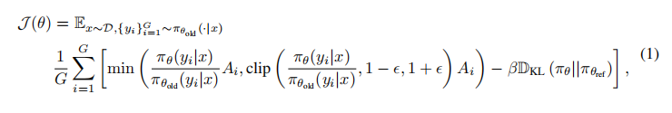
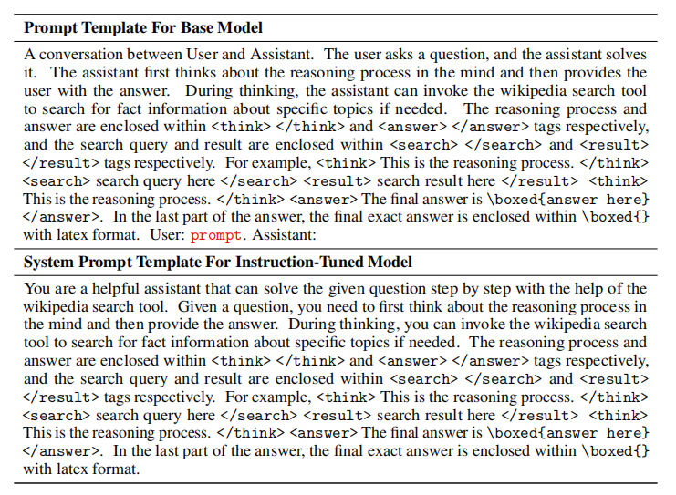
Rollout with Search Compared with conventional rollout that only contains text-based thinking as reasoning, the rollout in ReSearch also contains search queries and retrieval results. We use and to enclose the search queries and and to enclose the retrieval results, and such instruction is described in the prompt templates, which will be introduced later in §2.2. The rollout process is an iterative process between text-based thinking, search queries, and retrieval results as described in Figure 2(b). Specifically, when the generation process encounters tag, the query between the last and current tags will be used as the search query to retrieve relevant factual information, and the retrieval results will be enclosed by and tags. Then, existing rollout concated with the retrieval results will be used as the next input to generate following response iteratively, until the generation encounters end-of-sentence (eos) tag (i.e., or in Qwen-2.5 Models).
Retrieval Result Masking In original GRPO, the loss is calculated by all the generated tokens
in the whole rollout. However, in ReSearch, the rollout contains retrieval results, which are not
generated by the training policy, but retrieved by the search environment. Therefore, we mask the
retrieval results in the loss calculation to avoid the training policy from being biased towards the
retrieval results. That is, during the computation of Equation 1, we only consider the tokens in the
text-based thinking and the search queries, and ignore the tokens in the retrieval results.

Slide 5

• Answer Reward: We calculate the correctness of the final answer in \boxed{} and the ground truth answer via F1 score. • Format Reward: We check whether the rollout correctly follows our defined format as described in the prompt templates, mainly checking the correctness of tags and existence of \boxed{} in the answer

Slide 6
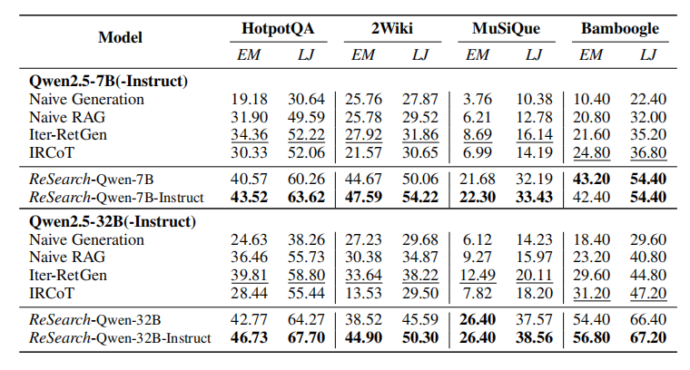
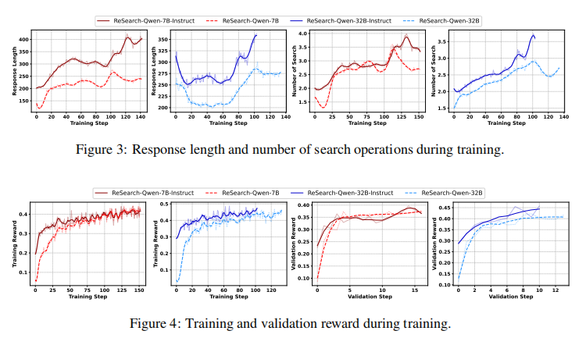

Slide 7


Slide 8
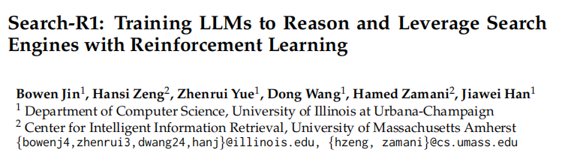

Slide 9
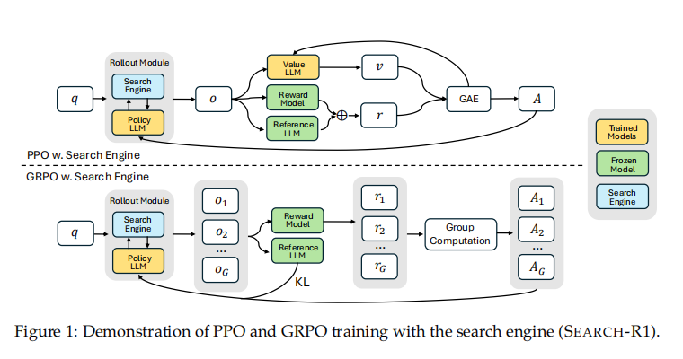
In this study, we aim to enhance the search capabilities of LLMs for problem-solving within a retrieval environment using an outcome-based RL method. However, the independence of the retrieval environment may lead to issues that exceed its query scope during the RL training process, posing challenges to successful problem resolution and affecting the training efficiency. To address this, we conduct data selection and incorporate questions with varying difficulty levels. Specifically, we select training data from the training sets of two representative multi-hop question answering datasets, namely HotpotQA [5] and 2WikiMultiHopQA [6]. We utilize the Qwen-2.5-7B Instruct [21] model, equipped with a local retrieval system, and prompt the model (Prompt 2.1) in solving questions from these datasets using the external retrieval system. The prompt is provided below. Based on the number of rollouts required to correctly answer a question, we categorize the data into three levels of difficulty: easy (fewer than 10 rollouts), medium (10 to 20 rollouts), and difficult (more than 20 rollouts). These difficulty levels are then combined as delineated in Table 1 to construct our training dataset
Two-Stage Outcome-based Reinforcement Learning
To progressively improve the search capabilities of LLMs, we propose a two-stage outcome-based
RLtraining method. In Stage-1, the model is trained to effectively utilize an external retrieval system.
In Stage-2, the model is trained to incorporate search during the reasoning process to accurately solve
questions.

Slide 10
Reward Design Due to the absence of intermediate annotations in the training data, the RL process is primarily influ enced by outcome rewards. By assigning distinct rewards across two stages, the model progressively learns to invoke the external retrieval system and effectively integrate retrieved documents into the reasoning process to answer questions. In Stage-1, the reward function comprises a retrieval reward and a format reward. The primary goal here is to enable the model to recognize its ability to invoke the external retrieval system and learn its utilization, without considering the correctness of the model’s answers. The model is explicitly 3 encouraged to initiate search queries, and thus, no answer reward is assigned at this stage. Specifically, the retrieval reward is defined as follows: Rretrieval = 0.5, n ≥ 1 0, n =0 (1) where n represents the number of retrieval invocations. For the format reward, we first define the correct format as follows: 1. The model’s thinking process and final answer should be enclosed within the ... and... tags, respectively. Additionally, only the final short answer is permitted within the ... tag. 2. The generated output must be free of any garbled or unreadable content. 3. Wheninvoking retrieval, the model should propose a query and encapsulate the query within the ... tags. Furthermore, the model is unable to generate documents directly without invoking retrieval. Based on the above format requirements, the format reward is defined as follows: Rformat = 0.5, ifthe format is correct 0, if the format is incorrect Therefore, the final reward of Stage-1 is the sum of the retrieval reward and format reward. (2) In Stage-2, we eliminate the retrieval reward and incorporate the answer reward. We apply the same format judgment criteria as in Stage-1, but with different penalties: ′ R format = 0, iftheformat is correct-2, if the format is incorrect (3) For the answer reward, we utilize the F1 score of the ground-truth answer and predicted answer, which is calculated as follows: Ranswer = 2∗IN PN +RN (4) where PN represents the word count of the predicted answer, RN denotes the word count of the reference answer, and IN indicates the word count of the intersection between the two answers. Therefore, the final reward of Stage-2 is the sum of the answer reward and the format reward.
Retrieve Mask-based Loss Calculation. During the training process, the aforementioned solutions
are employed to compute the RL loss, involving the reward, KL divergence, and advantages. When the
model performs retrieval, the retrieved documents are integrated into the reasoning process, serving
as environment observations. The model is not intended to generate these documents. To mitigate the
environmental effect, we designate <begin_of_documents>...<end_of_documents> as special
tokens and mask them during training. This prevents these external tokens from influencing the
loss calculation, ensuring that the retrieved documents do not interfere with the model’s intrinsic
reasoning and generation processes

Slide 11
