Slide 1

Parallel Scaling Law for Language Models
Hongkai Zheng 2025.5.23

Slide 2


Slide 3


Slide 4
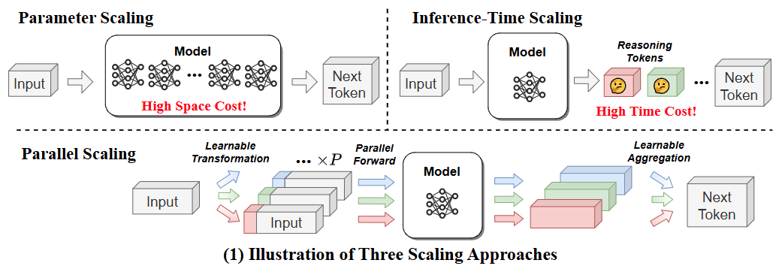


Slide 5
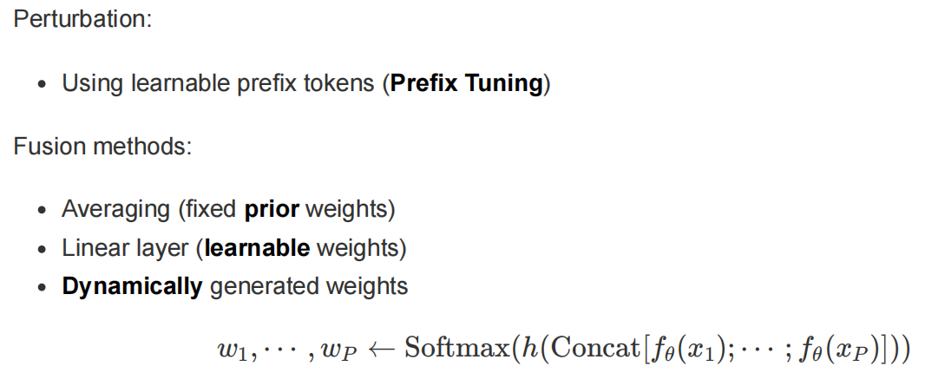

Slide 6
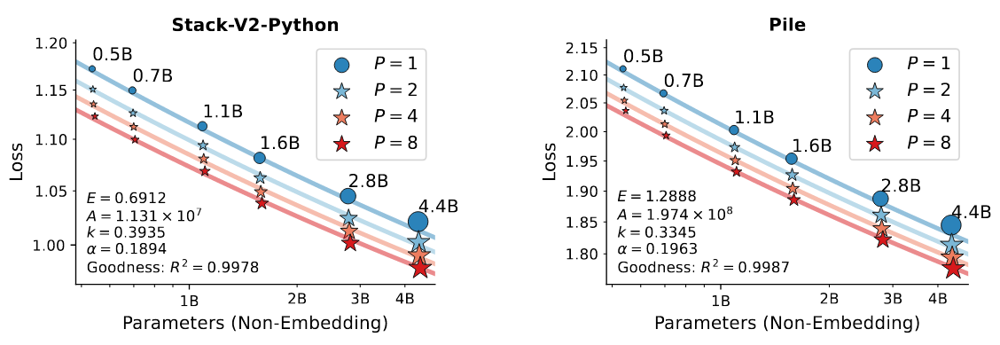


Slide 7
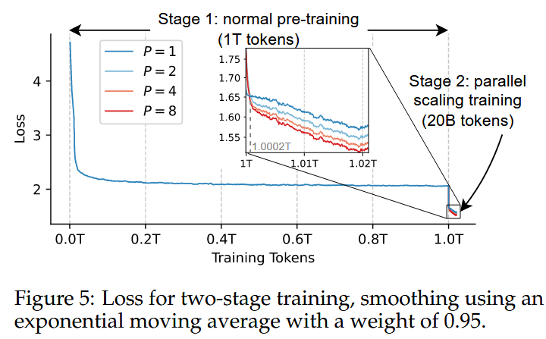

Slide 8
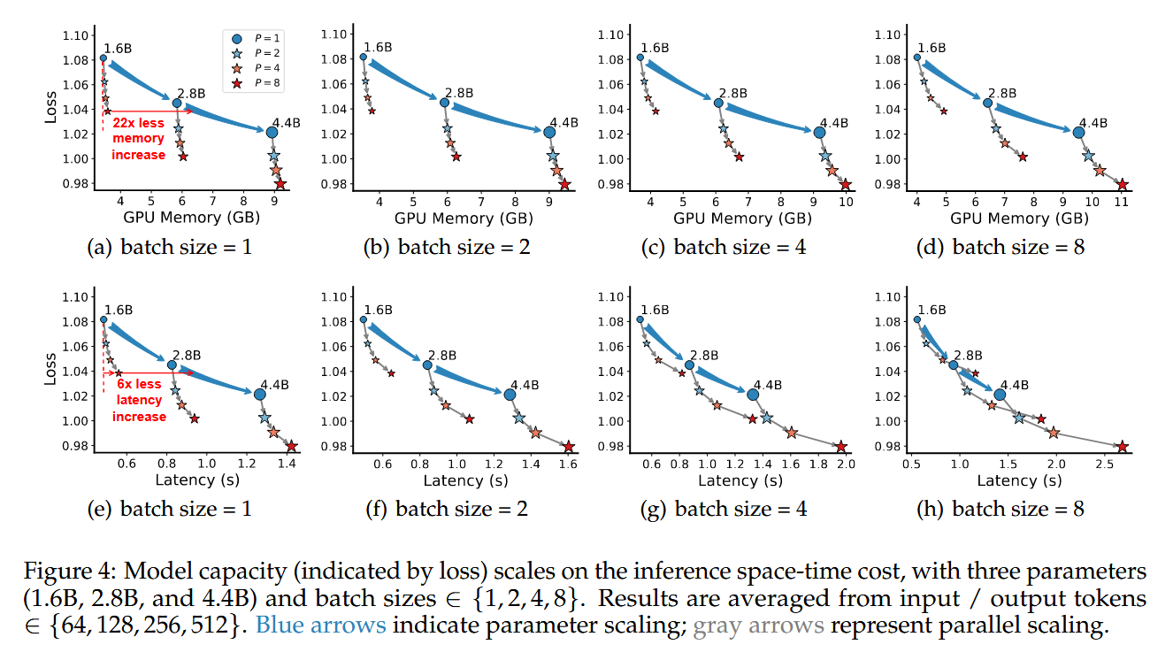

Slide 9
