Slide 1
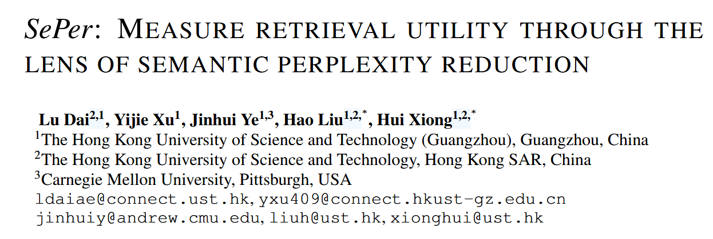

Slide 2
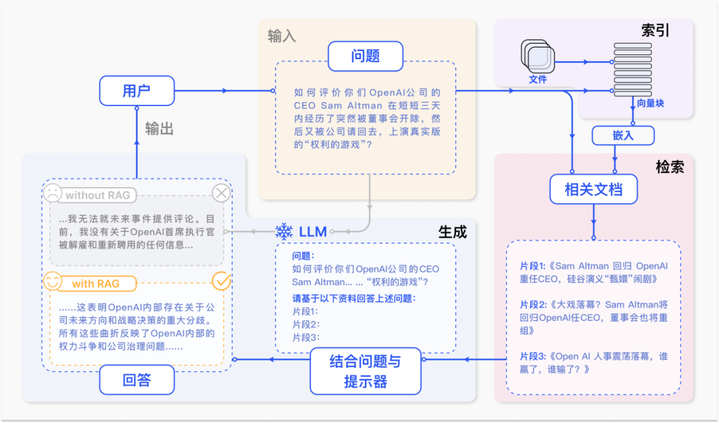
Motivation
Existing studies evaluate RAG effectiveness by :
assessing retrieval and generation components jointly, which obscures retrieval’s distinct contribution
examining retrievers using traditional metrics such as NDCG（Normalized Discounted Cumulative Gain）, which creates a gap in understanding retrieval’s true utility in the overall generation process.
using well-trained LLMs such as GPT-4 as generalizable judges to evaluate different aspects of RAG systems, but these methods are often expensive and inefficient.

Slide 3
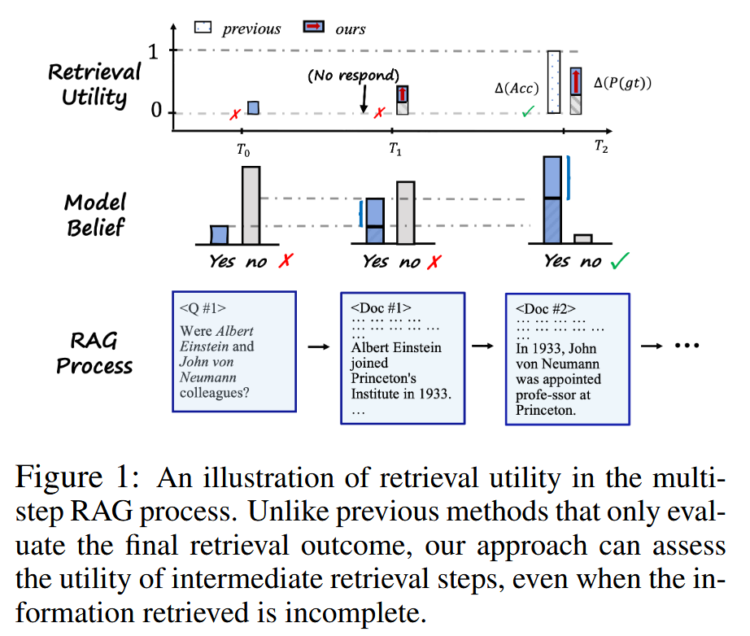
Motivation
In this work, we propose the perspective to measure retrieval utility based on the knowledge gain of LLMs.
we define Semantic Perplexity (SePer), a sampling-based method to estimate LLM’s belief conditioned on an input query.
By doing so, we make it tangible to estimate the knowledge distribution shift of LLMs and use it to quantify retrieval utility.

Slide 4
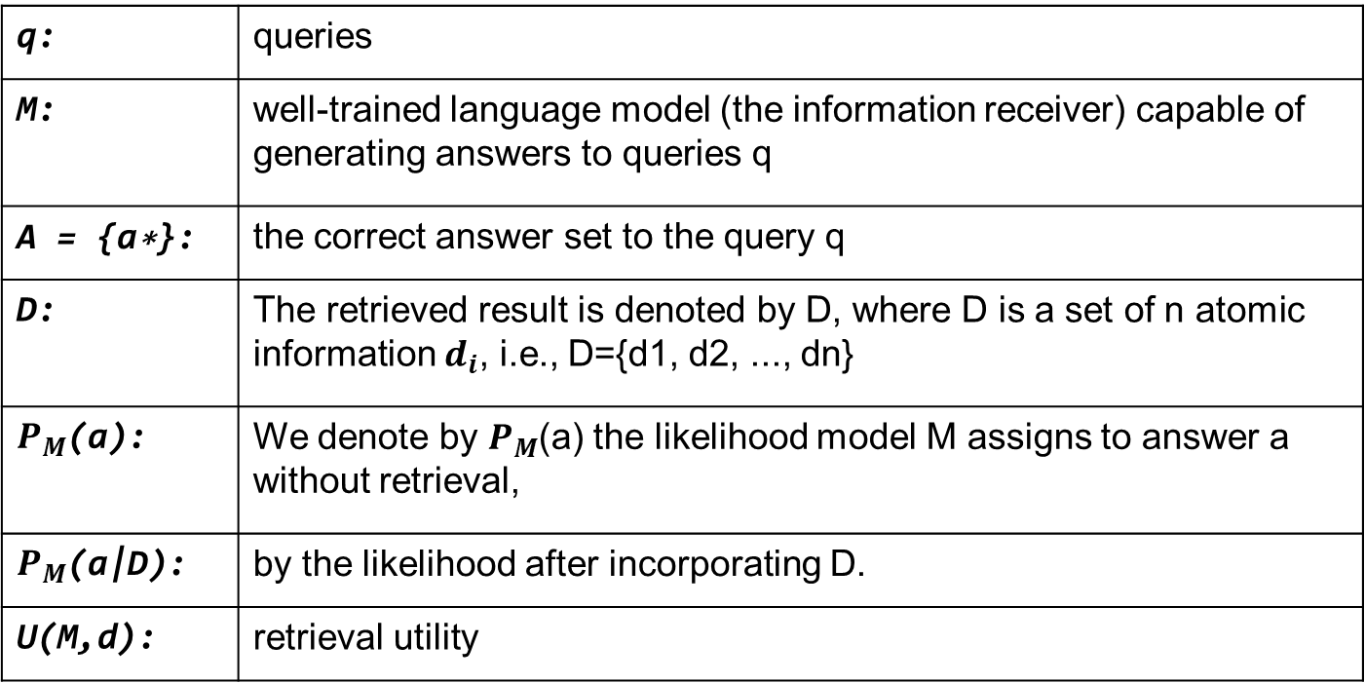
Method
In this section, we justify our quantification of retrieval utility as a computable belief distribution shift in the information receiver model.
q: | queries
M: | well-trained language model (the information receiver) capable of generating answers to queries q
A = {a∗}: | the correct answer set to the query q
D: | The retrieved result is denoted by D, where D is a set of n atomic information $d_{i}$, i.e., D={d1, d2, ..., dn}
$P_{M}$(a): | We denote by $P_{M}$(a) the likelihood model M assigns to answer a without retrieval,
$P_{M}$(a|D): | by the likelihood after incorporating D.
U(M,d): | retrieval utility

Slide 5

Method
we envision that an effective retrieval utility metric U(M,d) should satisfy the following properties:
Property 1. The U(M,d) depends on both d and M .
Property 2 (Zero Utility). For a q, the U(M,d) should be zero if the d retrieved is either irrelevant to q or if the M already possesses the requisite knowledge to address q effectively without d.
Property 3 (Monotonicity). U(M,d) is a monotonically increasing function of the relevance of d to q.
Definition 1 (Retrieval Utility).

Slide 6
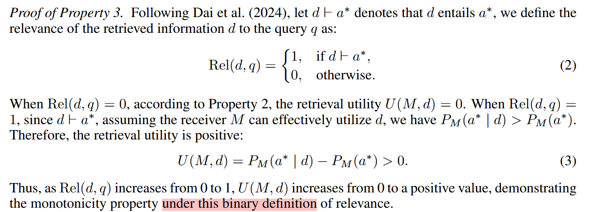
Method
Property 2 (Zero Utility). For a q, the U(M,d) should be zero if the d retrieved is either irrelevant to q or if the M already possesses the requisite knowledge to address q effectively without d.
Property 3 (Monotonicity). U(M,d) is a monotonically increasing function of the relevance of d to q.

Slide 7
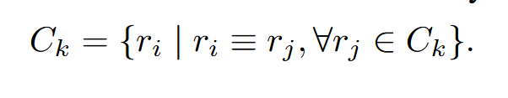
Method
Estimating PM (a) is challenging due to the vast output space of the language model.
The outputs are in the vocabulary space, whereas our belief probabilities are defined over the semantic space.
Definition 2 (Semantic Equivalence). Two texts x and y are semantically equivalent, denoted x ≡ y, if x ⊢ y and y ⊢ x, where ⊢ means entailment.
Given two texts x and y, E(x, y) outputs a score representing the degree to which x entails y. The entailment relation holds if E(x, y) exceeds a predefined threshold τ .
Given a set of responses {ri}, semantic clustering is the process of grouping responses into clusters C = {Ck} such that all responses within a cluster are semantically equivalent.

Slide 8

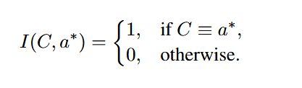
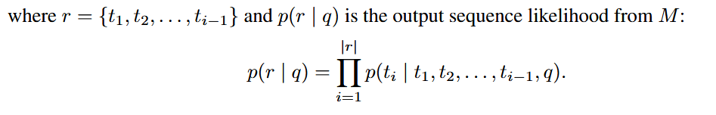


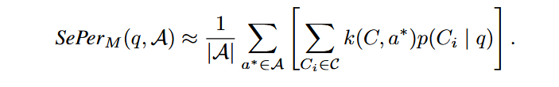

Method
To estimate model belief on reference answers P ({a∗}), we further determine which clusters are semantically equivalent to any of the a in {a∗}. For clarity, we begin with the special case where there is only one a∗.
回答出语义簇C中任意一个回复的概率
每个语义簇 C，计算其与参考答案 a∗ 的匹配程度
Due to infinite sentence space, the expectation is estimated using Monte-Carlo integration over sampled semantic cluster C.

Slide 9
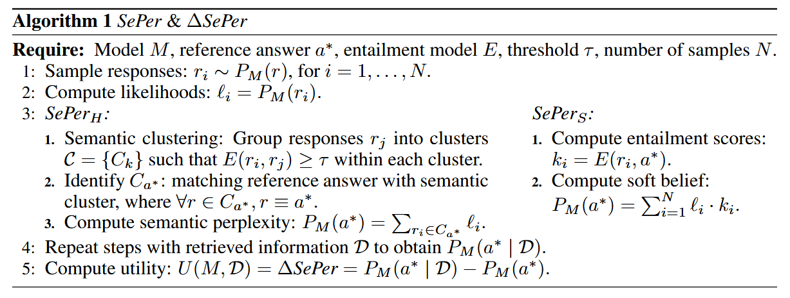
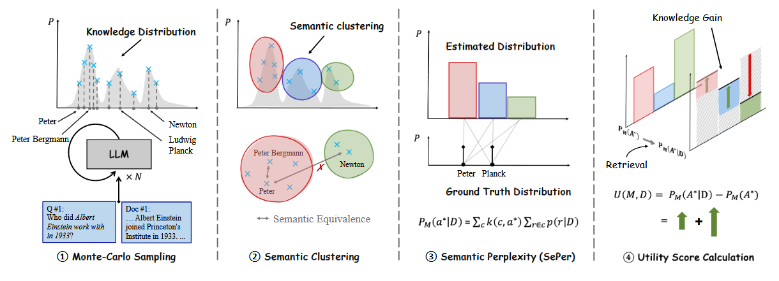
Method

Slide 10
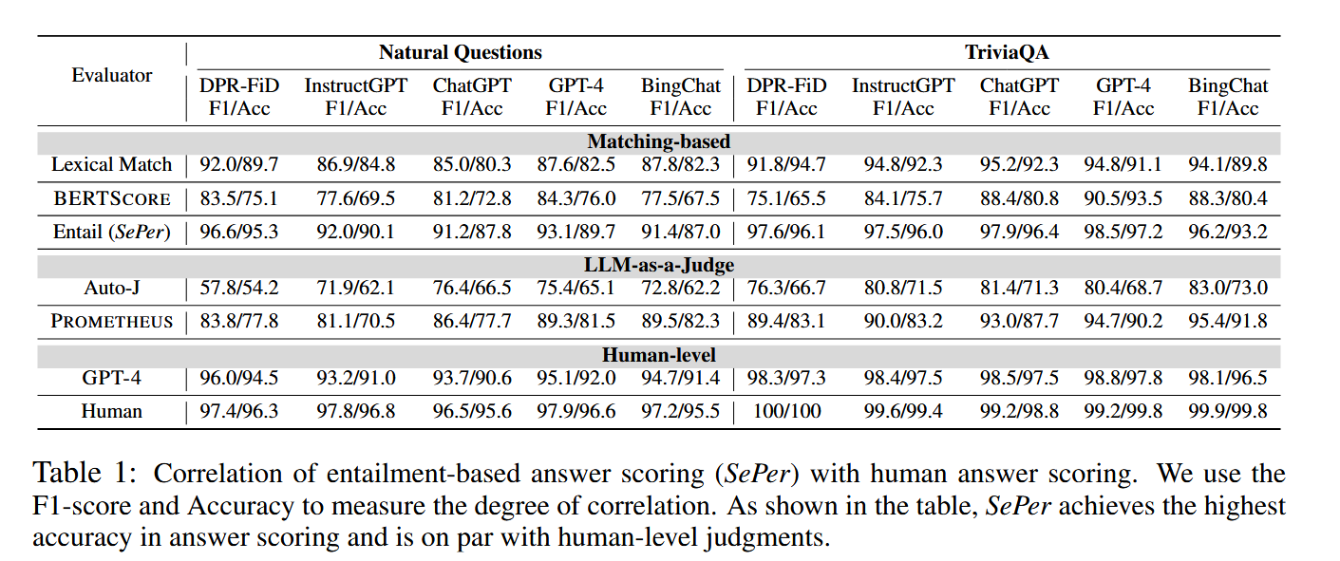
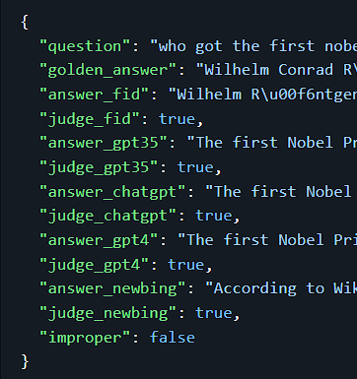
EVALUATION
Dataset : EVOUNA
Model : deberta-v2-xlarge-mnli fine-tuned on the MNLI dataset to assess the entailment relationship

Slide 11
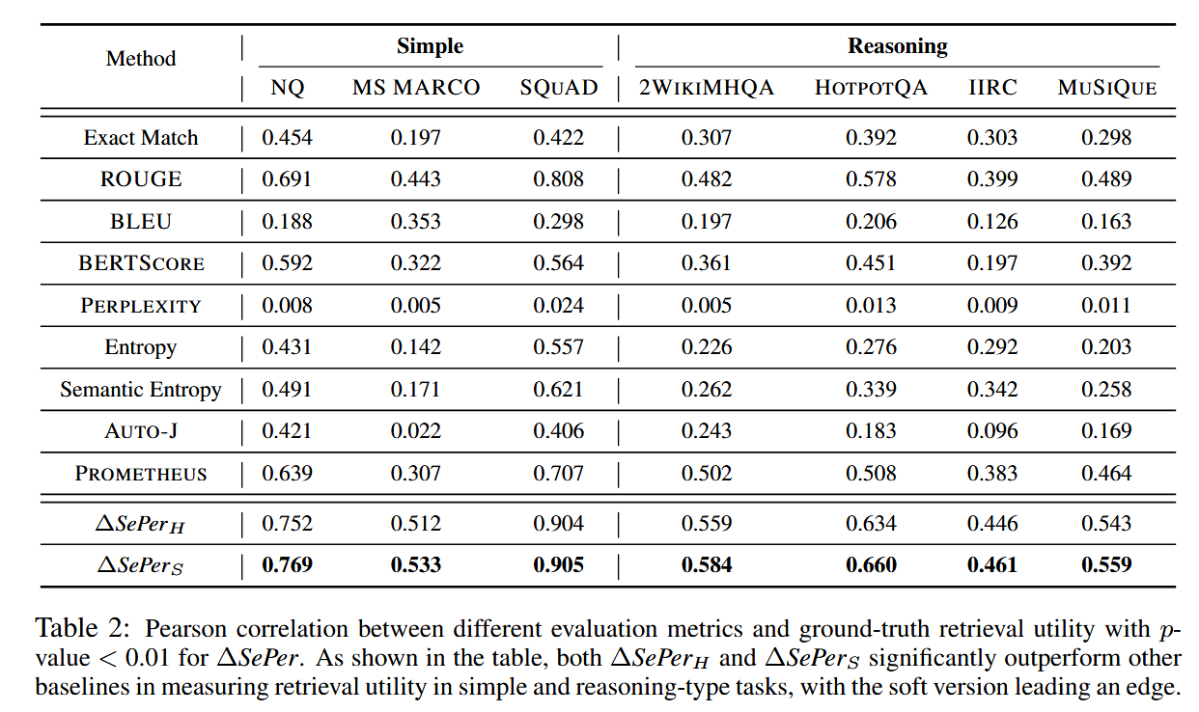
EVALUATION
K : 10
Model : Llama-2-7b-chat-hf
Simple open QA setting:
annotations of questions, golden answers, and human-annotated positive/negative passages
requires only one passage.
positive passages with a utility score of 1 ; the negative is 0.
filter out those cases in which LLM has already succeeded.
reasoning-involved QA setting:
each step only contains incomplete information pieces.
assumption that the overall information utility is uniformly assigned to each step. We find this assumption reasonable since these datasets are mostly collected by means of question composition.

Slide 12
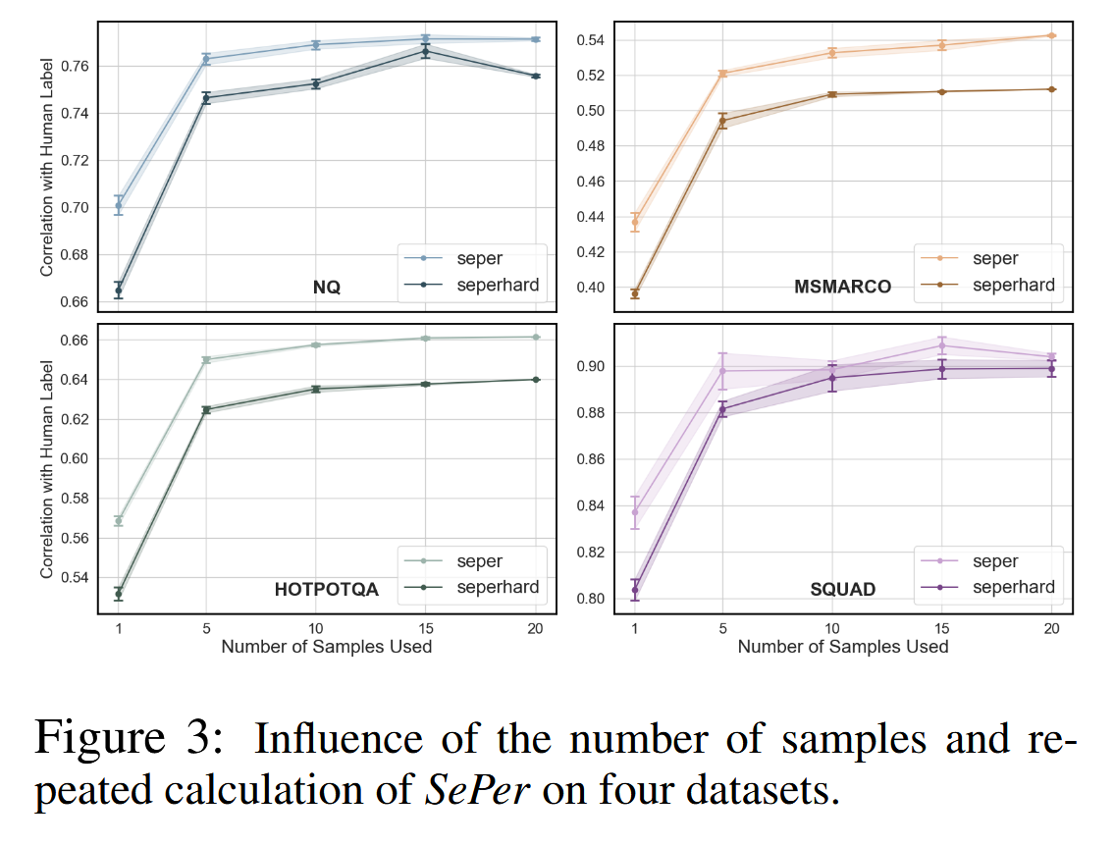
EVALUATION

Slide 13
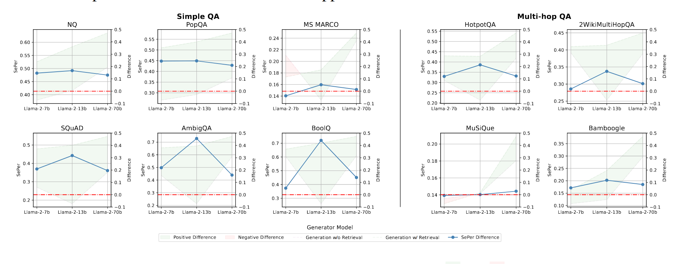
EVALUATION
RQ1: What is the utility of retrieval on LLMs of different sizes?
MS MARCO : We attribute to its source corpus being different from the Wikipedia corpus we uniformly used.
Medium-size models benefit the most from retrieved information : their weaker initial knowledge without retrieval ;their better ability to absorb retrieved in-context information as compared to smaller models.

Slide 14
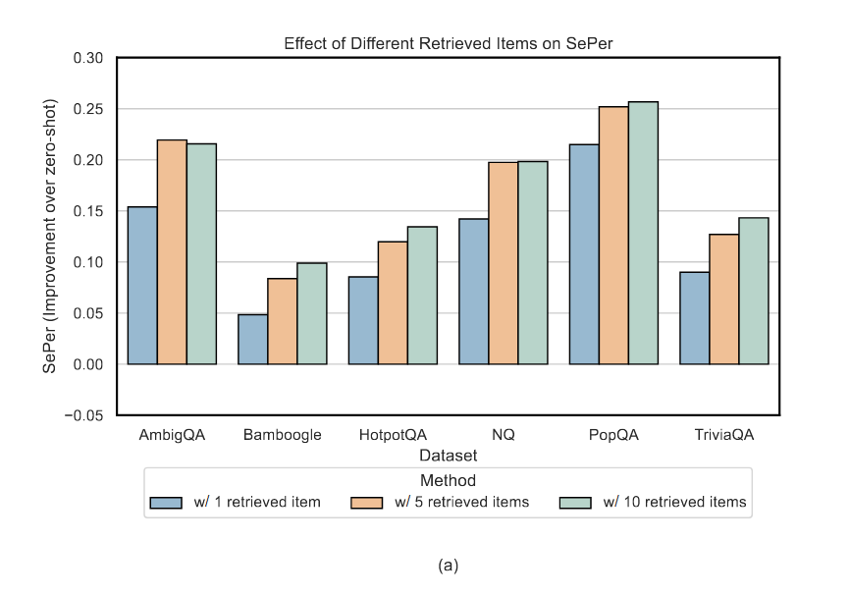
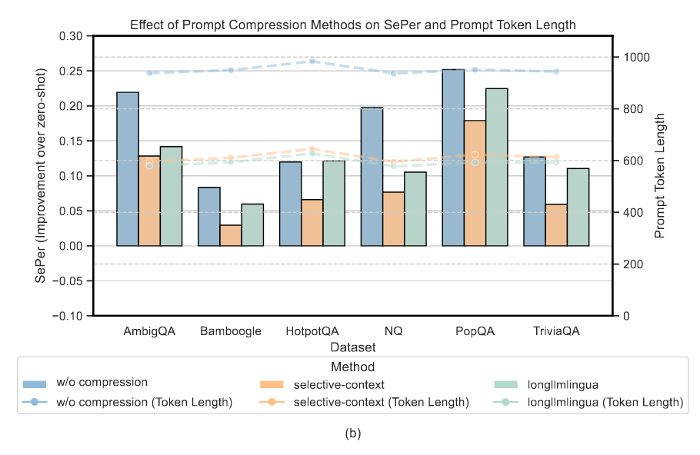
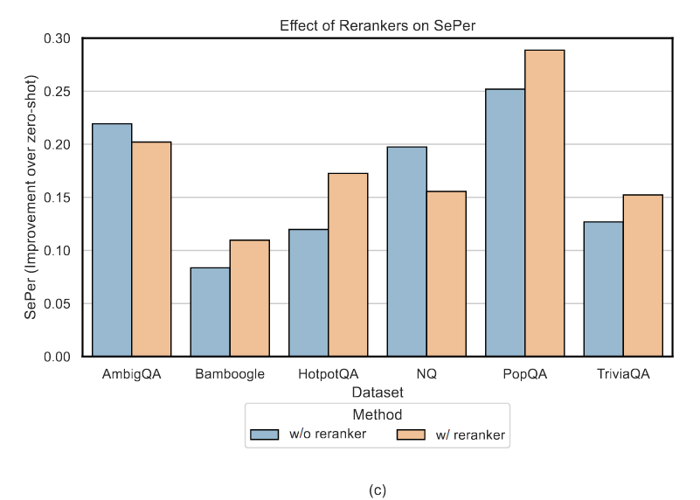
EVALUATION
RQ2: How does the number of retrieved items influence overall RAG performance?
RQ3: How do different prompt compression methods influence the overall RAG performance?
RQ4: How does the reranking phase influence the overall RAG performance?
This might be due to the extra noise brought by an increasing number of retrieved documents.
Although both prompt compression methods slightly reduce SePer compared to no compression, both methods can reduce the prompt by about 40%
in general, brings significant improvement by removing noises and reordering contexts.
How the ordering of contexts influences the final generation results is open for exploration

Slide 15
THANKS

