Slide 1
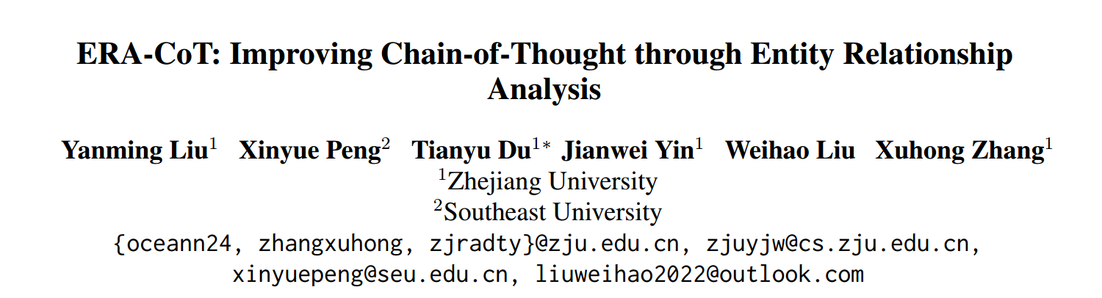
ACL 2024

Slide 2
Motivation
LLMs still encounter significant challenges when dealing with complex scenarios involving multiple entities. These challenges arise from the presence of implicit relationships that demand multi-step reasoning.

Slide 3
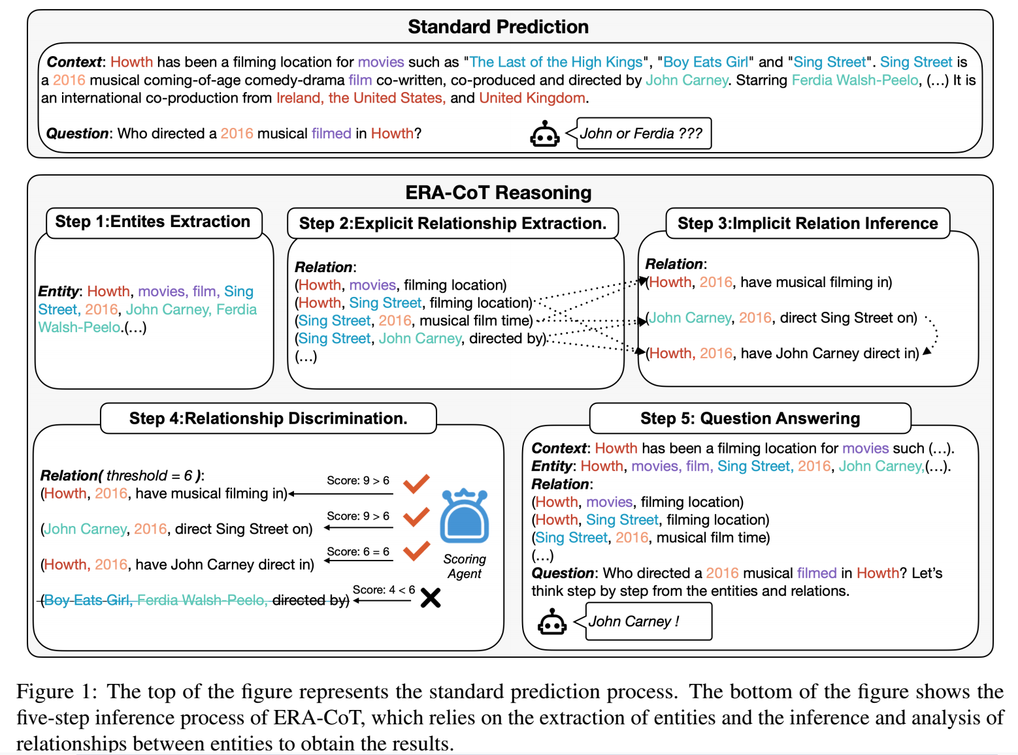
Method
ERA-CoT

Slide 4
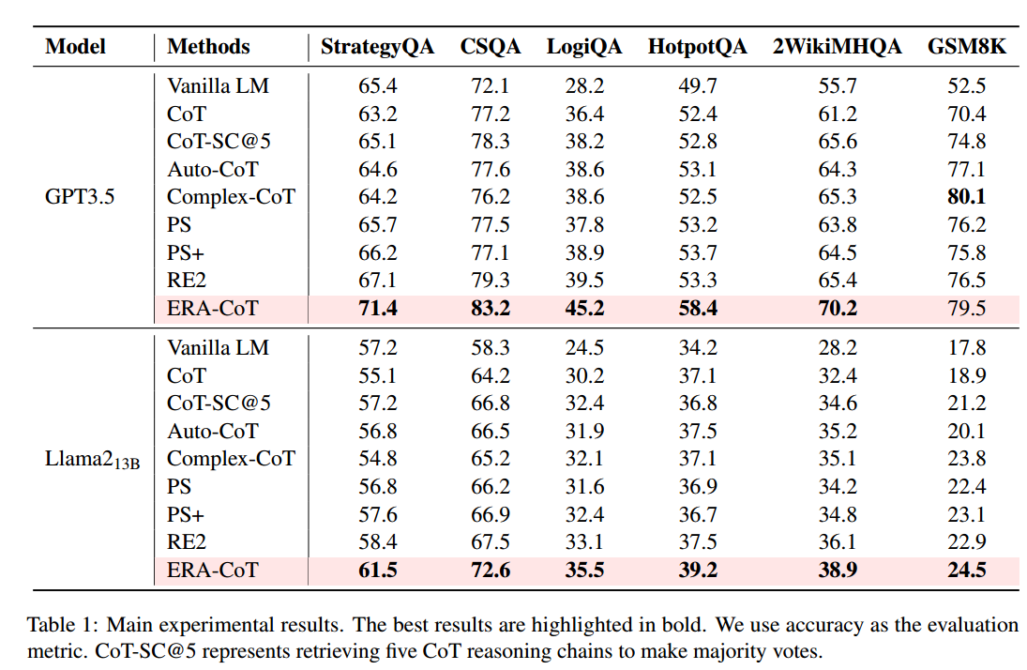
Experiments
Main Results
commonsense reasoning logical reasoning mathematical reasoning

Slide 5
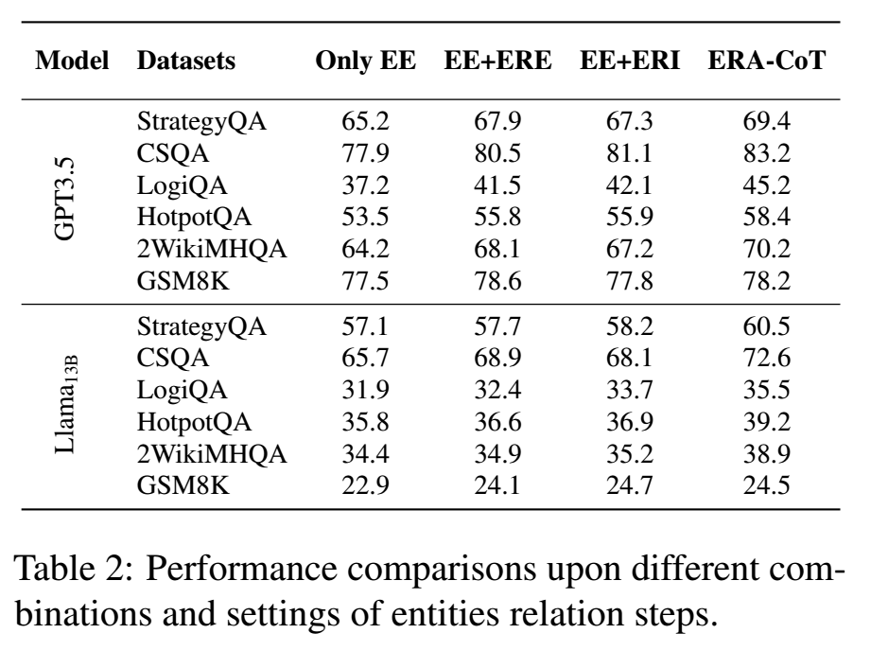
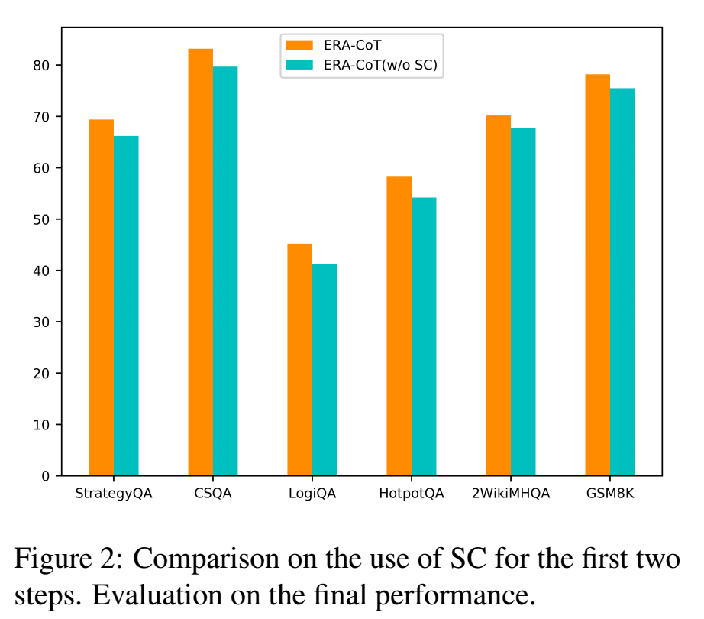
Experiments
EE: Entites Extraction
ERE:Explicit Relationship Extraction
ERI: Implicit Relationship Inference
SC: Self-Consistency
Ablation Studies

Slide 6
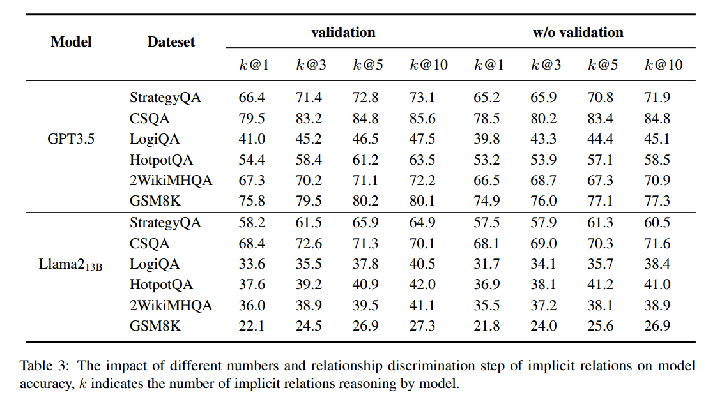
Experiments
Analysis on Implicit Relationship

Slide 7
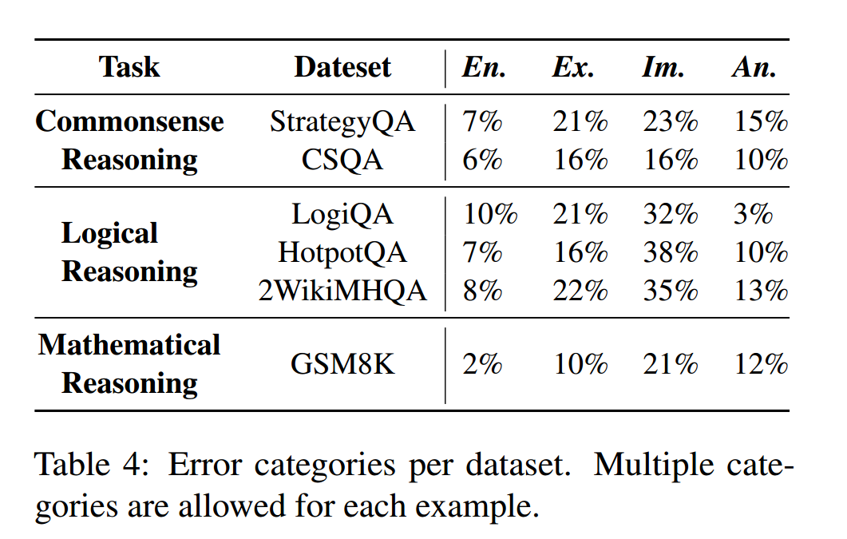
Experiments
Error analysis
En. : Entity Extraction Errors
Ex. : Explicit Relationship Extraction Errors
Im. : Implicit Relationship Inference Errors
An. : Answer Errors

Slide 8
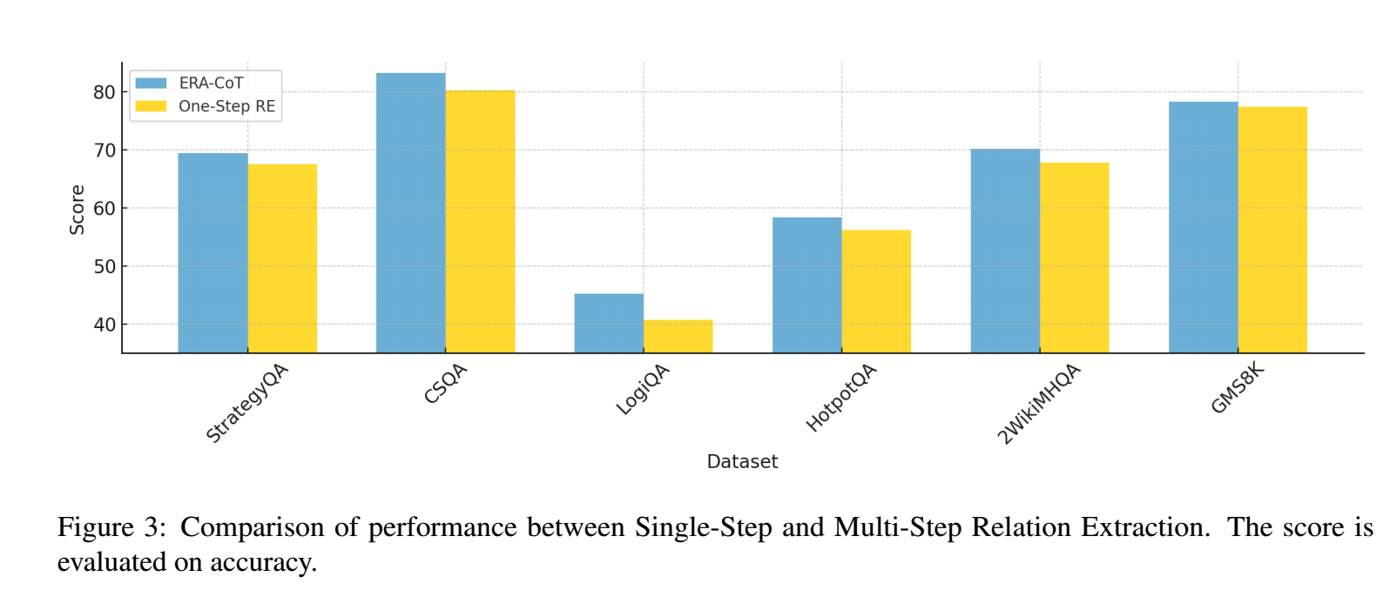
Others
Why Not One-Step Relation Extraction?

Slide 9
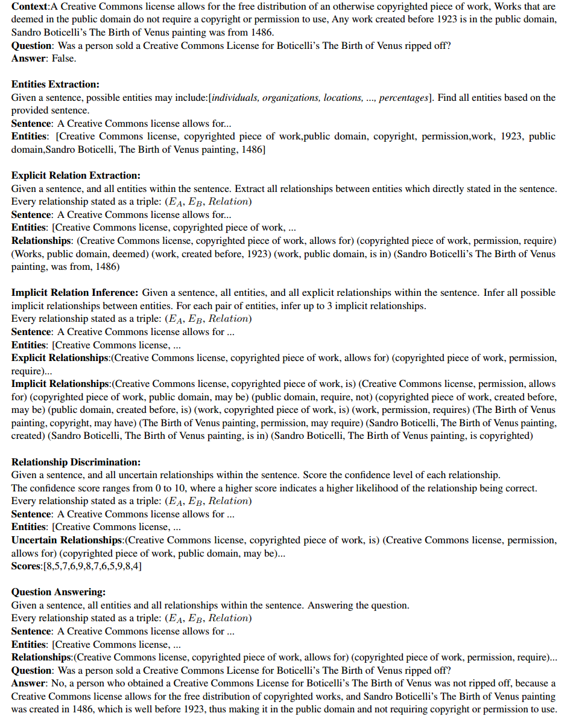
Example

Slide 10
Limitation
ERA-CoT relies on context analysis through the extraction of relationships and entities, so its performance improvement is not significant in tasks with fewer entity relationships, such as symbolic reasoning tasks.
Due to the various relationships between entities, even after relationship extraction and inference, there may still be some relationships that the model fails to correctly infer or extract. This could result in missing relationships during result predictions, affecting the accuracy of predictions.
Points
The use of CoT can be attempted to be split into multiple Prompt inputs to specifically concretize the thought process.
Let the LLMs self-judgment the credibility of the generated content and thus do the trade-off of the output by setting the threshold.

Slide 11
Thanks!

