Slide 1
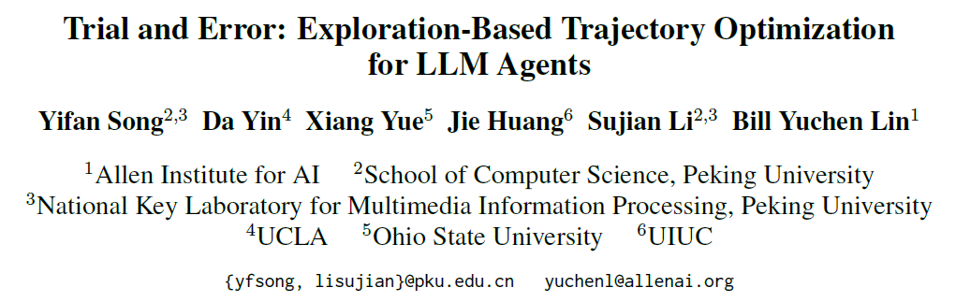

Slide 2
Motivation
The standard approach to constructing open LLM agents involves imitation learning, which involves fine-tuning LLMs based on expert trajectories.
However, these SFT methods, which rely entirely on expert demonstrations, may yield sub-optimal policies due to inadequate exploration of target environments, thereby limiting their generalizability.

Slide 3
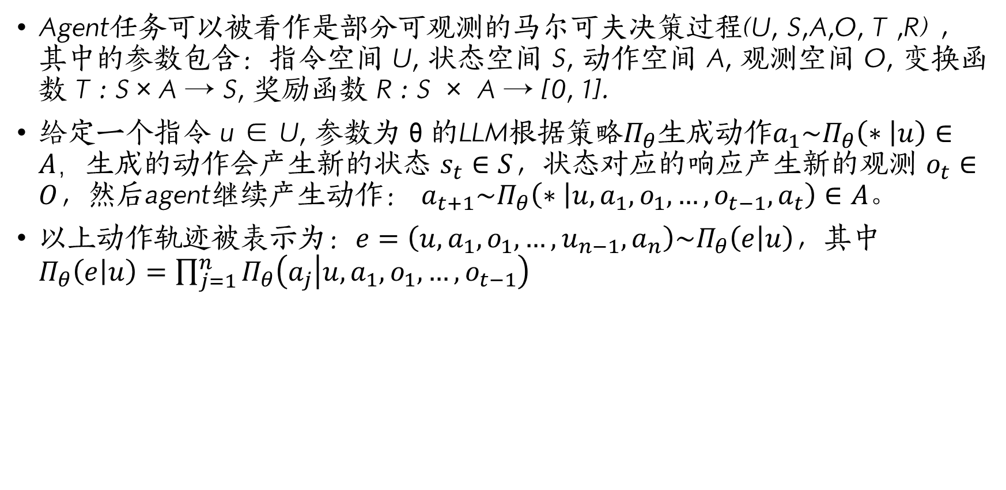
Task Formulation
Agent任务可以被看作是部分可观测的马尔可夫决策过程(U, S,A,O, T ,R) ，其中的参数包含：指令空间 U, 状态空间 S, 动作空间 A, 观测空间 O, 变换函数 T : S×A → S, 奖励函数 R : S × A → [0, 1].
给定一个指令 u ∈ U, 参数为θ的LLM根据策略$Π_{θ}$生成动作${a_{1}\sim Π}_{θ}\left(∗ | u\right)∈A，$生成的动作会产生新的状态 $s_{t}∈S$，状态对应的响应产生新的观测 $o_{t}∈O$，然后agent继续产生动作： $a_{t+1}\sim Π_{θ}\left(∗ | u,a_{1},o_{1},…,o_{t−1},a_{t}\right)∈A。$
以上动作轨迹被表示为：$e=\left(u,a_{1},o_{1},…,u_{n−1},a_{n}\right)\sim Π_{θ}\left(e | u\right)$，其中$Π_{θ}\left(e | u\right)=\prod_{j=1}^{n}{Π_{θ}\left(a_{j} | u,a_{1},o_{1},…,o_{t−1}\right)}$

Slide 4
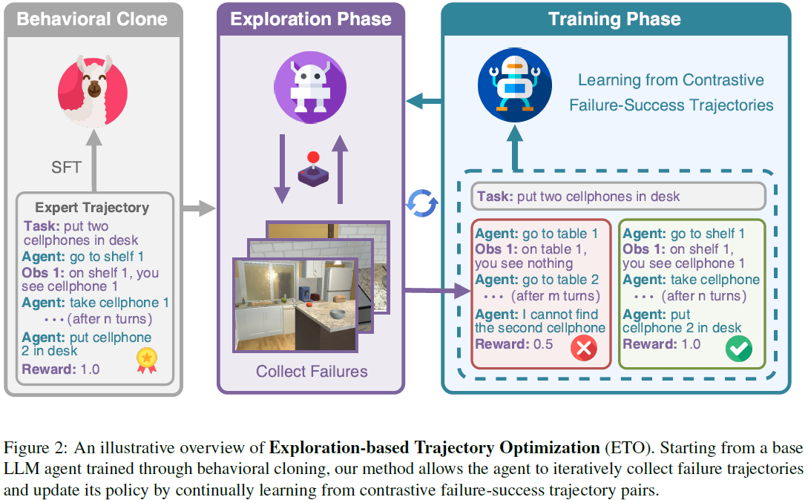
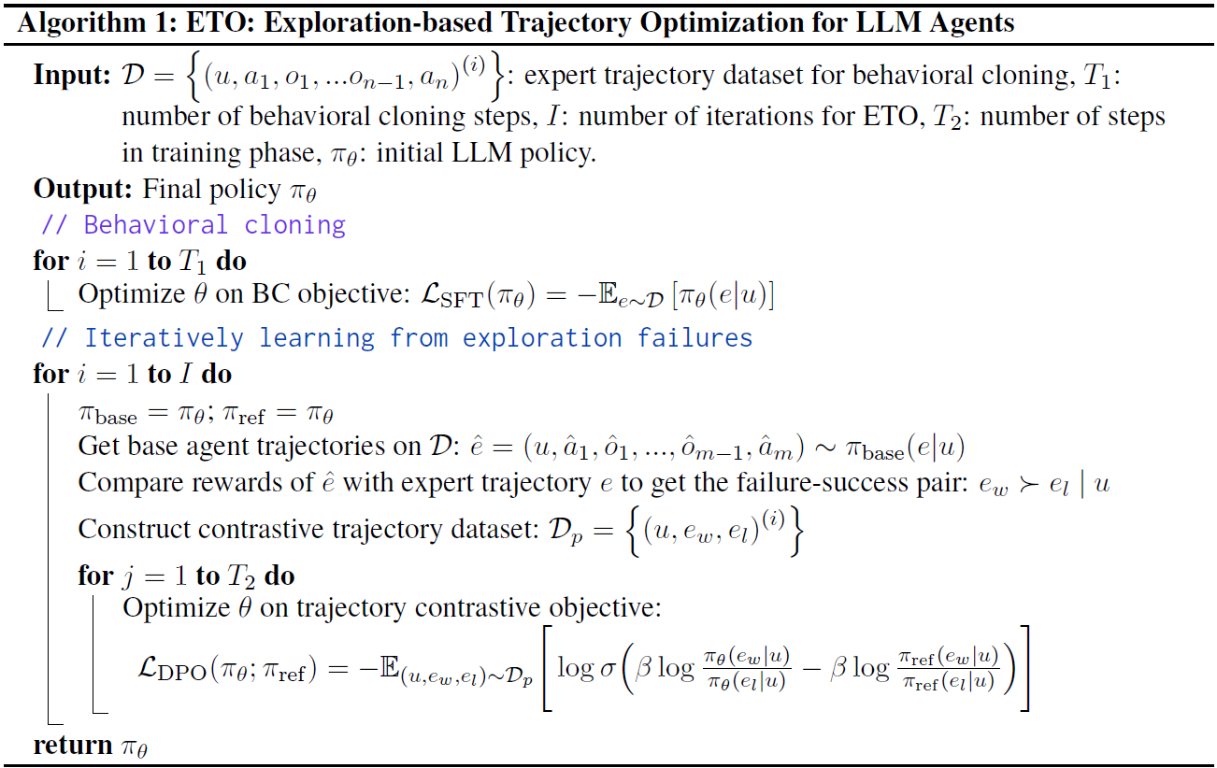
Pseudocode

Slide 5

supervised fine-tuning
给定专家轨迹$Π_{θ}\left(e | u\right)=\prod_{j=1}^{n}{Π_{θ}\left(a_{j} | u,a_{1},o_{1},…,o_{t−1}\right)}$，其中$e=\left(u,a_{1},o_{1},…,u_{n−1},a_{n}\right)$。
将e视作文本串$t=concat\left(u,a_{1},o_{1},…,u_{n−1},a_{n}\right)=(t_{1},t_{2},…,t_{l})$
最终训练损失为： $L_{SFT}\left(Π_{θ}\right)=−\sum_{e\sim D}{[Π_{θ}(e|u)]}$，其中$Π_{θ}\left(e | u\right)=−\sum_{k}{log}Π_{θ}\left(t_{k} | t_{<k}\right)∗1(t_{k}∈A)$

Slide 6
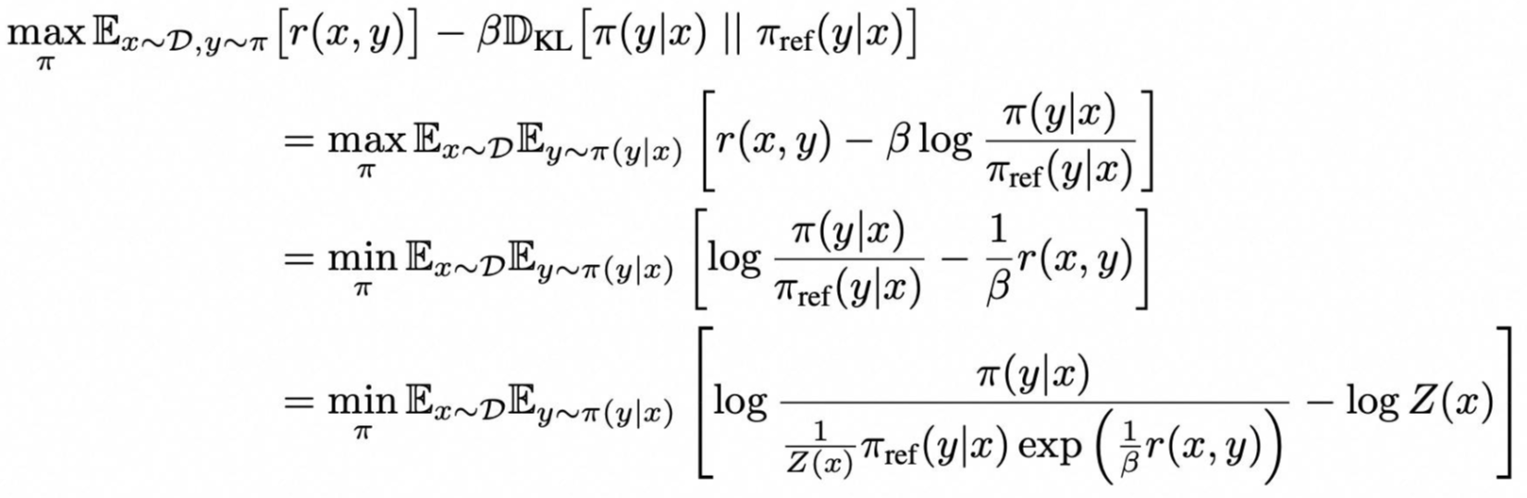
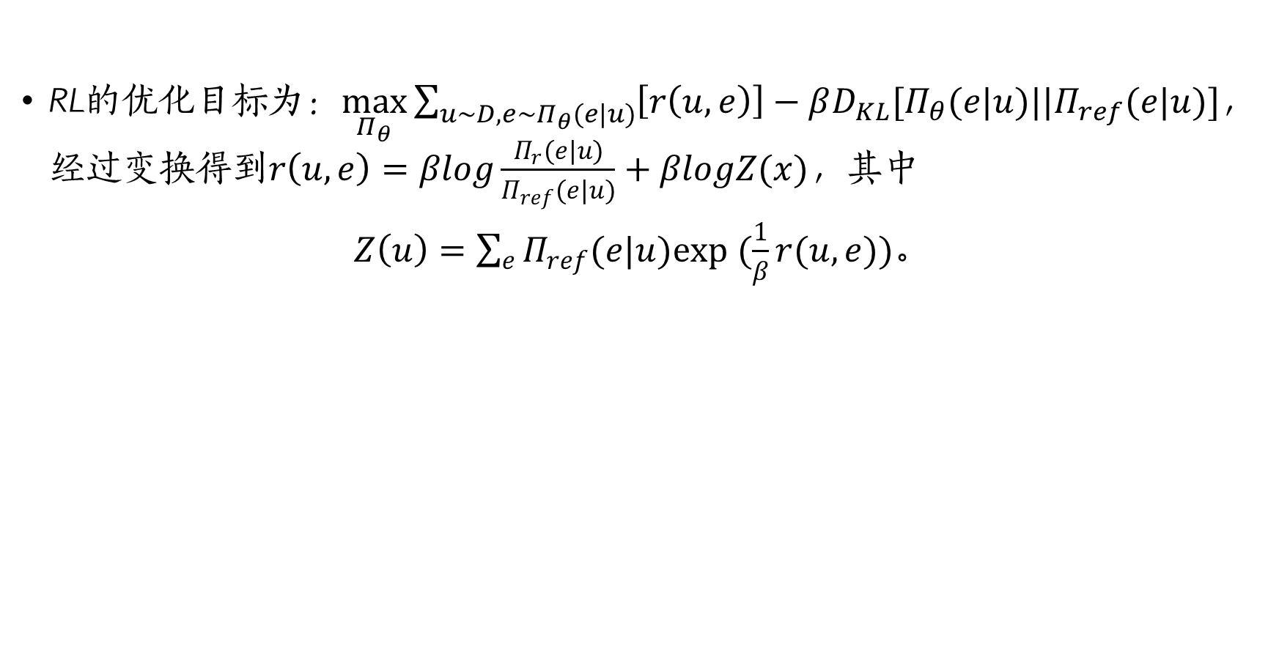
reinforcement learning
RL的优化目标为：$\max_{Π_{θ}}{\sum_{{u\sim D,e\sim Π}_{θ}(e|u)}{\left[r\left(u,e\right)\right]−βD_{KL}[Π_{θ}(e|u)||Π_{ref}(e|u)]}}$，经过变换得到$r\left(u,e\right)=βlog\frac{Π_{r}(e|u)}{Π_{ref}(e|u)}+βlogZ(x)$，其中
$Z\left(u\right)=\sum_{e}{Π_{ref}(e|u)exp (\frac{1}{β}r(u,e))}$。

Slide 7
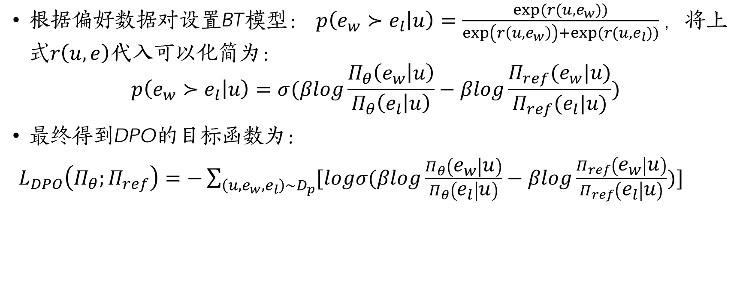
reinforcement learning
根据偏好数据对设置BT模型： $p\left(e_{w}≻e_{l} | u\right)=\frac{exp⁡(r(u,e_{w}))}{\exp\left(r\left(u,e_{w}\right)\right)+exp⁡(r(u,e_{l}))}，$将上式$r\left(u,e\right)$代入可以化简为：
$$p\left(e_{w}≻e_{l} | u\right)=σ(βlog\frac{Π_{θ}\left(e_{w} | u\right)}{Π_{θ}\left(e_{l} | u\right)}−βlog\frac{Π_{ref}(e_{w}|u)}{Π_{ref}(e_{l}|u)})$$
最终得到DPO的目标函数为：
$L_{DPO}\left(Π_{θ};Π_{ref}\right)=−\sum_{\left(u,e_{w},e_{l}\right)\sim D_{p}}{[logσ(βlog\frac{Π_{θ}\left(e_{w} | u\right)}{Π_{θ}\left(e_{l} | u\right)}−βlog\frac{Π_{ref}\left(e_{w} | u\right)}{Π_{ref}\left(e_{l} | u\right)})]}$

Slide 8
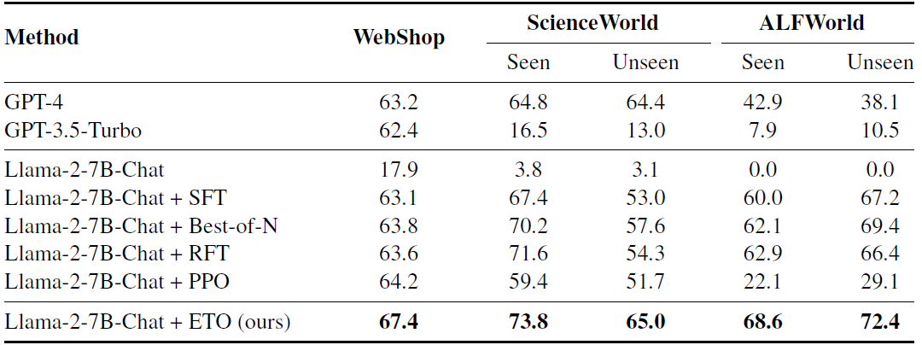
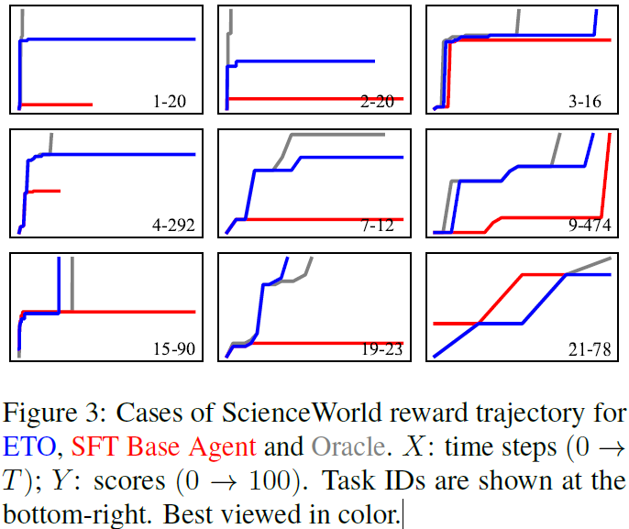
Experiments

