Slide 1
Javascript
welcome to 8086

Slide 2
JavaScript is the most popular programming language in the world. The language can be used in HTML and the web, and is more widely used in servers, PCs, laptops, tablets, smartphones,and other devices.
JavaScript is scripting language.
JavaScript is a lightweight programming language.
JavaScript is programming code that can be inserted into HTML pages.
After JavaScript is inserted into the HTML page, it can be executed by all modern browsers.
JavaScript is easy to learn.

Slide 3
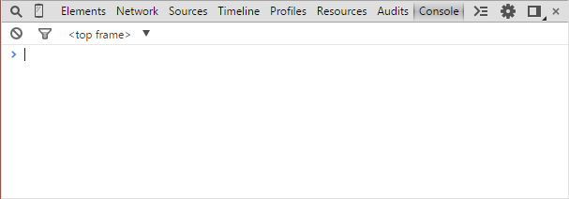
JS console in JS Console browser
If you are using Chrome, press Ctrl+Shift+J.
If you are using Firefox, press XX+XX+XX.
If you are using IE, please leave 8086.

Slide 4
The call of JS in HTML
It can be used anywhere in the HTML file:
<script>JavaScript code </script>
Or write the code in a single.Js file, and then:
<script src= "your JS file path" ></script>

Slide 5
JS simple JS example
/ * a few simple example * /
document.write(“Hello world!”);
alert(“Hallo Welt!”);
console.log(“：P”+(120+113));

Slide 6
JS simple JS example
It is recommended that semicolons be added to every complete sentence in JS.
JS is case sensitive, and the symbols in it are English characters.
These are called statements, and the set of statements is called chunks, wrapped in braces.
{statement 1; statement 2;... Statement n;}
Fold the code line: you can use the backslash to wrap the code line in the text string.
Document.write ("Hello"World! ");
document.write(“Hello world!”);
alert(“Hallo Welt!”);
console.log(“：P”+(120+113));

Slide 7
Variables of JS
Without variables, there is no programming language. Variables are used to store some values, just as the brain is used to store some knowledge.
Define a variable: var a;
There is a brain. It's called a.
Define a bunch of variables: var a, B, c=1, D;
JS does not force variables to be a specific type, but it is best to use one type of variable.

Slide 8
JS basic operations
Assignment operation: a=a+1;
Mathematical operations: 2*a+ (B-C) /f%g; / / attention priority
Logical operation: a&&b||c&&true; / / Boolean algebra
Bitwise operation: a& (1<<b); / / can be used for state compression.
Comparison operation: a<b; c==d; e>=f; G! =h;
String concatenation: a+ "BCD" +e+ "FG";
var a=2, b=a*3, c=(a<b), d=!c, e=“b+3”;

Slide 9
JS data type
JS supports data types mainly in the following categories:
Numbers, Boolean, string, array, object, function, null, undefined.
Numbers contain integers and decimal numbers.
233333.1416
In addition, scientific notation is also available.
2.1e10 1e-6

Slide 10
JS data type
A string is essentially a sequence of characters. Strings can be represented by single quotation marks or double quotes. Two strings can be joined by a plus sign, or a string can be joined by a number, which is converted to a string first.
a = “Javascript”;
c = a + “ is not Java” + (100+133) + “.”;
Strings also have some useful functions.

Slide 11
JS data type
An array is an ordered set with arbitrary elements.
var a = [233, 3.1416, “Holala”, [1, 2, 3]];
The calling method is array name [subscript], note that subscript should be more than 0. Accessing elements that are not present in the array will get undefined.
document.write(a[0]);
a[10] = 2.5;

Slide 12
JS data type
var girlFriend = {
gender: male,
age: 19,
hobby: [“Android”, “Java”, “steam”]
};
object
girlFriend.gender => girlFriend[“gender”] => “male”

Slide 13
JS data type
The function type is the most special data type in JS. The function type is not a function mentioned before.
var min = function(a, b) {
return (a < b) ? a : b;
};
console.log(min(3, 5)); //=>3
Anonymous function is a good thing that will be used frequently in the future.

Slide 14
JS data type
If you define a variable but do not assign it, the value of this variable is undefined.
The elements that are not present in the array and the properties that do not exist in the object are all undefined.
Null is usually used as sentinel element.
These two values are constants provided by JS, and are not very different in themselves (as long as you don't die), they can be mixed up in general.

Slide 15
JS object
Everything in JavaScript is an object: string, number, array, date, and so on.
In JavaScript, objects are data with attributes and methods.
Properties and methods:
Property is a value relative to the object.
A method is an action that can be executed on an object.

Slide 16
JS object
In JavaScript, objects are data (variables), possessing properties and methods. For example:
Var TXT = "Hello"; / / created a JavaScript string object.
Properties:
txt.length = 5; //objectName.propertyName
Method:
txt.indexOf( ) //objectName.methodName
txt.replaceOf( )
txt.search( )

Slide 17
JS function
function funcName(argument1, argument2) {
//...
}
·JS commonly used function definition method

Slide 18
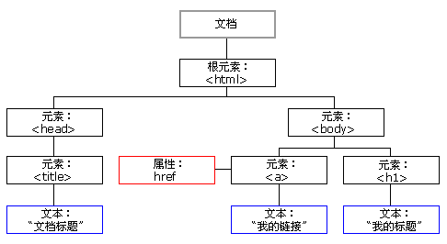
JS HTML DOM
HTML DOM (document object model)
When the web page is loaded, the browser creates the Document Object Model of the page.
The HTML DOM model is constructed as an object tree.
Through the programmable object model, JavaScript can create dynamic HTML.

Slide 19
JS HTML DOM object
Document object
Each HTML document loaded into the browser will become a Document object.
The Document object enables us to access all the elements in the HTML page from the script.
Tip: Document objects are part of Windows objects that can be accessed through the window. document property.

Slide 20
JS HTML5 canvas
What is Canvas?
HTML5's canvas element uses JavaScript to draw images on the web page.
The canvas is a rectangular area where you can control every pixel.
Canvas has many ways to draw paths, rectangles, circles, characters, and add images.
<canvas id= "myCanvas" width= "200" height= "100" ></canvas>
Note: Internet Explorer 8 or earlier browsers do not support <canvas> elements.

Slide 21
JS HTML5 canvas
context.moveTo(x,y);
context.lineTo(x,y);
context.arc(x,y,r,sAngle,eAngle,counterclockwise);
Since a crooked figure may
Attest in little place a million

Slide 22
JS Homework
1. JS write eight queens (annotation algorithm thought)
Advanced: output in HTML
2. JS write smile gradually solidified facial expression bag
(choose to work together)

