Slide 1






Slide 2

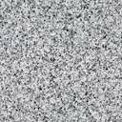
Inspirations
Big Fan of Harry Potter, but…
var fromART22 = ‘Data Visualization’;
var fromCSXXs = ‘Data Structure’;
// What if, combined?
>> fromART22 + fromCSXXs
“Data VisualizationData Structure”
// actually, DATA STRUCTURE VISUALIZATION!

Slide 3
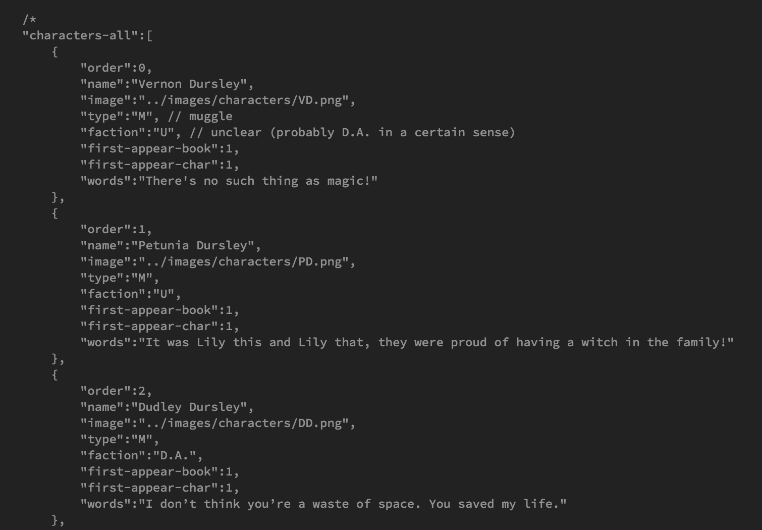
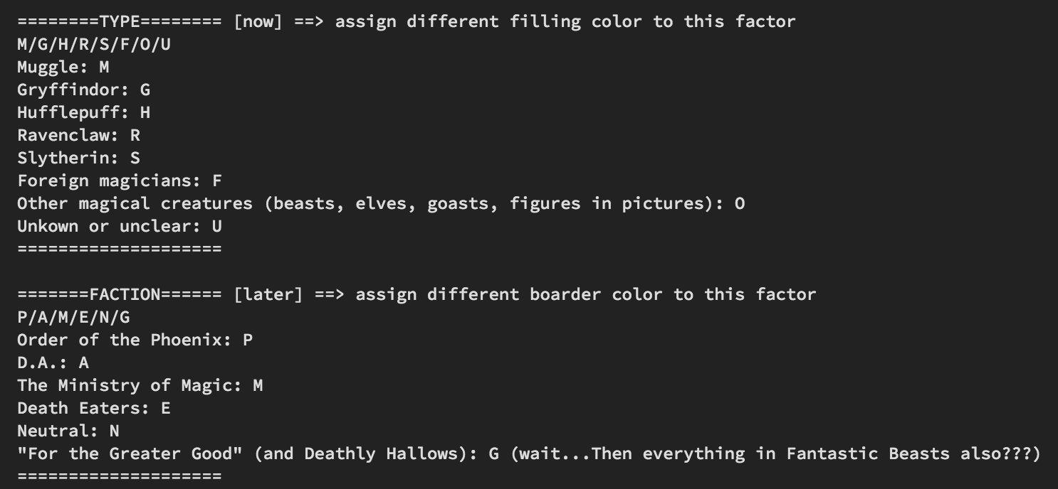
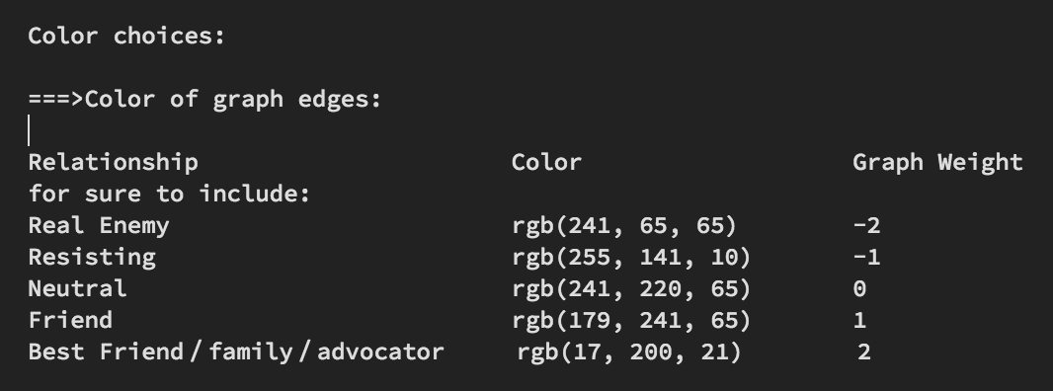

Slide 4

Concepts and Toolkit
What Data? – everything about and between every character
What Data Structure? – a graph! (DS concept)
How to Visualize? – draw a dynamic network!

Slide 5

Progress…
No existing API, so start with just a book…
D3.js is so cool but so different
The Prototype of Prototype

Slide 6

What’s next?
https://github.com/nuankw/web-design-stuff

Slide 7

End of presentation,
New start for HP-net…
Thank you!

