Slide 1

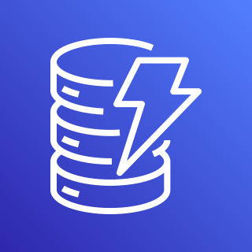





AWS Cloud
Amazon DynamoDB
VPC
Keys
Keys
Availability Zone 1
Arkime Client
Arkime Traffic Mirror
Arkime
Index
Logs
Suricata Client
Suricata Traffic Mirror
Suricata
Logs
Amazon Elasticsearch Service
Zeek Client
Zeek Traffic Mirror
Zeek
Wireshark Client
Wireshark Traffic Mirror
Wireshark

