Slide 1
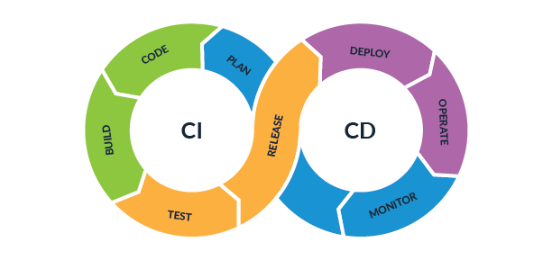
Introduction to CI/CD Pipelines
Continuous Integration and Continuous Delivery / Deployment

Slide 2

Who am I?
Software DevOps Engineer
Masters Degree in IT Management
DevOps Speaker

Slide 3
Software DevOps Engineer? 🤔

Slide 4
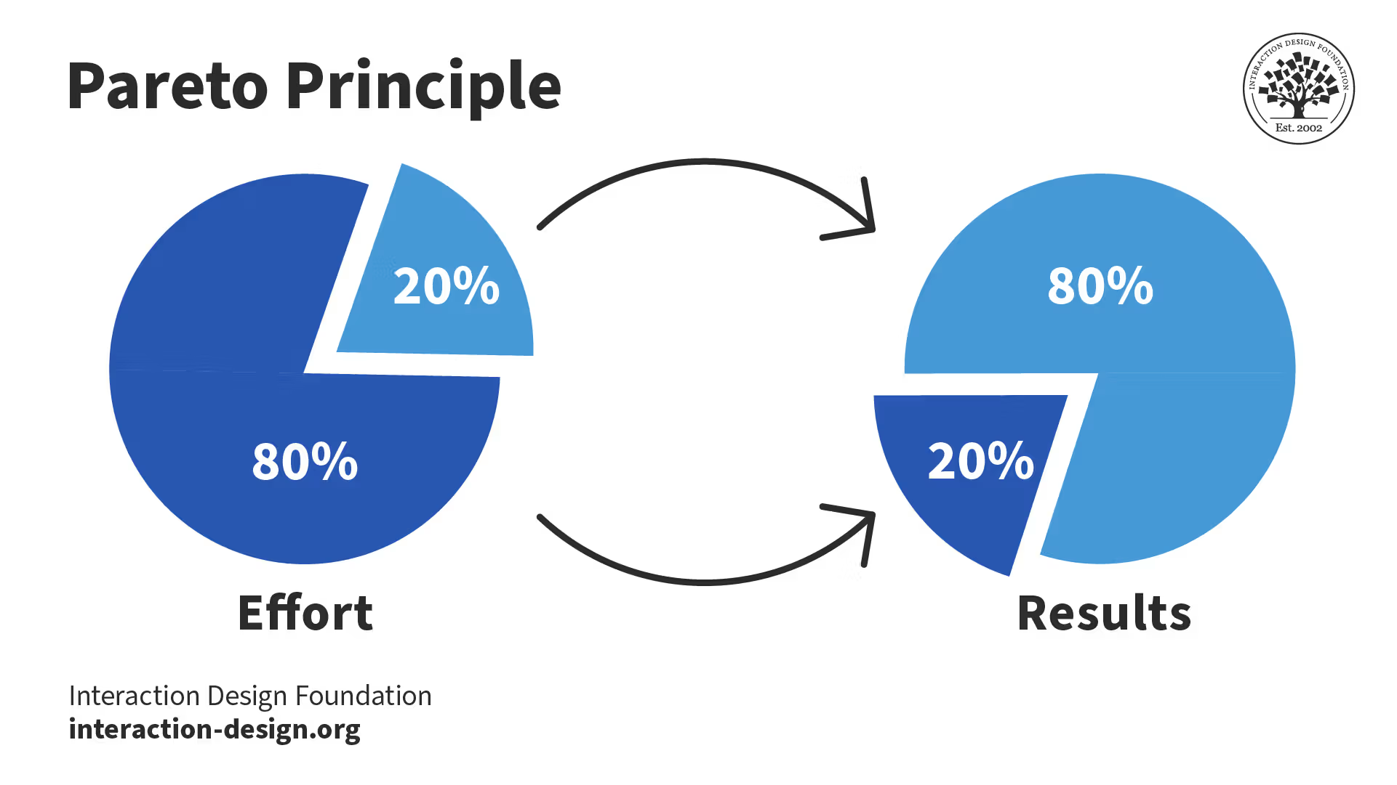
THE PARETO PRINCIPLE

Slide 5
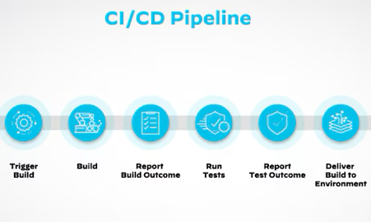

Slide 6


Slide 7

What is CI/CD?
CI/CD is a set of practices that automate software build, test, and release processes
CI = Continuous Integration
CD = Continuous Delivery or Continuous Deployment
Goal: deliver software faster, more reliably, and with fewer errors

Slide 8

Why CI/CD Matters
Reduces manual effort and human error
Enables faster feedback on code changes
Improves software quality and stability
Supports frequent and predictable releases

Slide 9

Continuous Integration (CI)
Developers frequently merge code changes into a shared repository
Each change triggers an automated build and test process
Problems are detected early in the development cycle
Encourages smaller, incremental changes

Slide 10
Continuous Delivery vs Continuous Deployment
Continuous Delivery: software is always ready to be released
Deployment to production requires manual approval
Continuous Deployment: every successful change is automatically released
Choice depends on risk tolerance and business needs

Slide 11

What is a CI/CD Pipeline?
A pipeline is an automated sequence of steps
Common stages: build, test, security checks, deploy
Pipelines enforce consistency and repeatability
Often defined as code (Pipeline as Code)

Slide 12





Continuous Integration, Delivery and Deployment
Continuous Integration
Developer
Writes Code
Mybranch
develop
Build application from source code
Run automated tests
Merge changes
master
Everything OK
Continuous Delivery
Problem detected
Release
delivered
Cloud repository
Changes needed
Deploying on client machine
Continuous Deployment

Slide 13

Common CI/CD Tools
Version Control: Git, GitHub, GitLab, Bitbucket
CI/CD Platforms: Jenkins, GitHub Actions, GitLab CI, Azure DevOps
Deployment & Infrastructure: Docker, Kubernetes, Terraform

Slide 14

Key Takeaways
CI/CD automates and standardizes software delivery
Early testing reduces risk and cost
Pipelines enable faster and more reliable releases
CI/CD is NOT just another tool

Slide 15
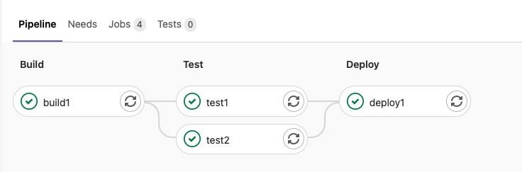
Demo Time

Slide 16

YOU’RE ALMOST THERE!
AWARENESS

Slide 17

FEEDBACK TIME

Slide 18

YOU NEED TO PRACTICE!

Slide 19

I WANT TO HELP YOU PRACTICE 🙏

Slide 20

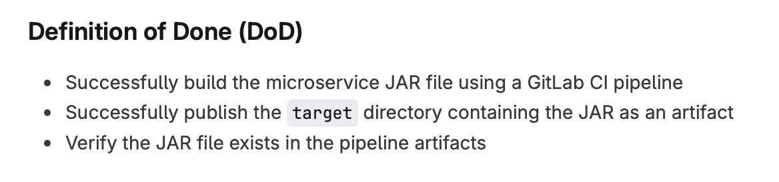

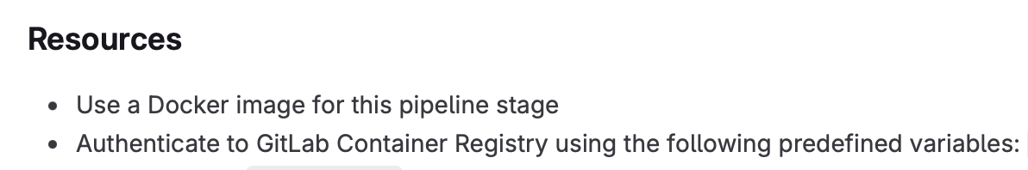
Workshop Sneak Peak 👀

Slide 21


