Slide 1
Objetivo
This course is designed to introduce you to Big Data and Big Data terminology.
Beyond the hype of the term 'Big Data', this course shows how Big Data is being adopted in different industries. When you complete this course and earn a badge, you will have a greater understanding of what Big Data is, how it can impact different businesses and, some of the technology used to manage Big Data.

Slide 2
Tópicos
O que é Big Data (google trends)
“Na minha empresa nós utilizamos muito Big Data. Como vocês utilizam ai?”
Big data is a lot of data. Big data is an amount of data that you cannot deal with using traditional methods and it's very relative because big data five years ago is not big data today so it's constantly evolving.
Where is Big Data coming from?
And, how can businesses derive value from it?
We will cover the Vs that have come to define Big Data
or some use cases for Big Data
Hadoop
O que é? Seu ecossistema...arquitetura...cluster Hadoop…
HDFS, MapReduce, YARN e Hive
Exemplos
Apache Spark

Slide 3
Tópicos
Big Data e Cloud Computing
Big Geospatial Data
Exemplos

Slide 4
Enorme e crescente avalanche de Dados
Cenário 1
Cenário 2
Imagine esse cenário: você tem 1GB de dados que você precisa processar.
Os dados são armazenados em um banco de dados relacional em seu computador e
o mesmo não tem problema em lidar com esse carregamento.
Então sua empresa começa a crescer muito rapidamente, e aqueles dados aumentam para
10GB. E então 100GB.
E você começa a alcançar os limites do seu atual computador.
Então você amplia o sistema investindo em um computador maior, e você então está tranquilo
por alguns meses. Quando seus dados aumentam para 10TB, e então 100TB,
você está rapidamente chegando aos limites daquele computador.
Além disso, te solicitam para alimentar seu aplicativo com dados
não-estruturados vindo de fontes como Facebook, Twitter, leitores RFID,
sensores, e assim por diante. Sua gestão precisa obter informações de
dados relacionais e de dados não-estruturados e quer
as mesmas o mais rápido possível.
O que você deve fazer? O Hadoop pode ser a solução!

Slide 5
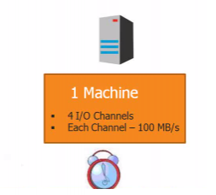
Case 1 : (Single machine configuration)
with 4 I/O channel (4 hard disks) and each hard disk is 1 TB capacity and has an I/O speed of 100 MB/S. How much time it will take to I/O (Read/Write) 1 TB of data parallel in an optimum situation ?
Since 4 parallel reads let’s consider we are writing 250 GB each to each Hard Drive.
1 GB = 1024 MB
1 TB = 1024 GB
250 GB = 250 * 1024 MB
100 MB takes 1 Sec
250*1024 MB takes ? X Sec
X = 256*1024/100 = 2621.44 Seconds.
2621.44/60=43.6907 minutes.
So this single machine configuration will take around 44 minutes to complete the IO.

Slide 6
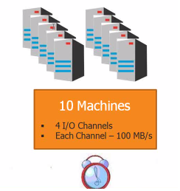
Case 2 : (Distributed System)
Now let us consider a configuration in which we have 10 machines with same configuration as above. How much time it will take to I/O (Read/Write) 1 TB of data parallel in an optimum situation ?
It has 10 machines like above doing parallel. So each machine has 4 hard disks and total hard disks available = 40. So 40 parallel operation working on 1TB. So each machine will be operating on 1024/40=25.6 GB of data.
100 MB takes 1 Sec.
25.6 * 1024 takes ? Sec
25.6*1024 / 100 = 262.144 seconds = 262.144/60=4.3691 minutes.

Slide 7
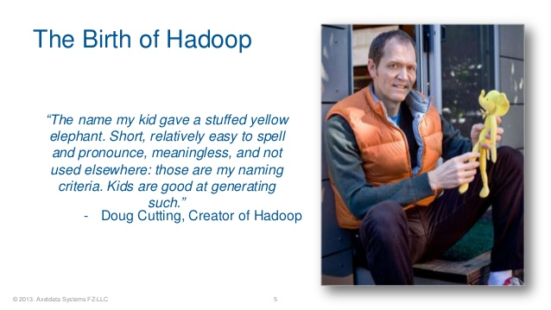
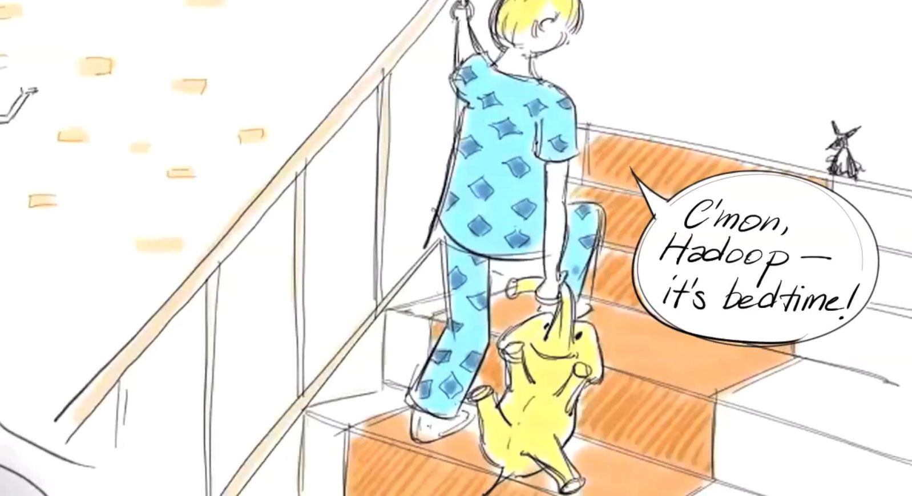
Hadoop was inspired by Google’s MapReduce, a software framework in which an application is broken down into numerous small parts. Any of these parts (also called fragments or blocks) can be run on any node in the cluster. Doug Cutting, Hadoop’s creator, named the framework after his child’s stuffed toy elephant.

Slide 8
Hadoop was inspired by Google’s MapReduce, a software framework in which an application is broken down into numerous small parts. Any of these parts (also called fragments or blocks) can be run on any node in the cluster. Doug Cutting, Hadoop’s creator, named the framework after his child’s stuffed toy elephant.

Slide 9
Hadoop was inspired by Google’s MapReduce, a software framework in which an application is broken down into numerous small parts. Any of these parts (also called fragments or blocks) can be run on any node in the cluster. Doug Cutting, Hadoop’s creator, named the framework after his child’s stuffed toy elephant.

Slide 10
Referências
https://cognitiveclass.ai/
http://hadoopgeek.com/category/hadoop/page/3/

